Slide 1
Cutting Data Fabric and Data Mesh to Measure
30 March 2022
Data Warehousing and BI Summit 2022

Slide 2
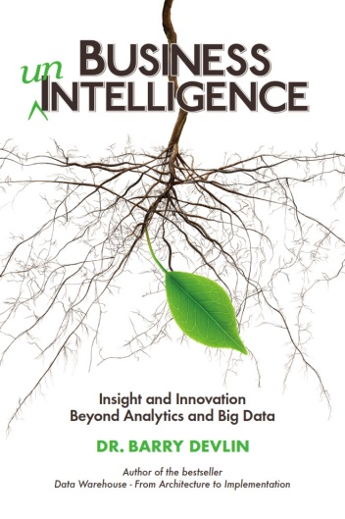
Dr. Barry Devlin
Founder and Principal
9sight Consulting, www.9sight.com
Dr. Barry Devlin is a founder of the data warehousing industry and among the foremost authorities worldwide on business intelligence (BI) and beyond. He is a widely respected consultant, lecturer and author of the seminal “Data Warehouse—from Architecture to Implementation”. His second book, “Business unIntelligence—Insight and Innovation Beyond Analytics and Big Data” (bit.ly/BunI-TP2) was published in October 2013.
Barry has 30+ years of experience in the IT industry, previously with IBM, as an architect, consultant, manager and software evangelist.
As founder and principal of 9sight Consulting (www.9sight.com), Barry provides strategic consulting and thought-leadership to buyers and vendors of BI solutions. He is continuously developing new architectural models for all aspects of decision-making and action-taking support, including new thinking on the use and consequences of artificial intelligence.
Based in Cornwall, UK, Barry’s knowledge and expertise are in demand both locally and internationally.
Email: barry@9sight.com
Twitter: @BarryDevlin
I=X1-01-A
C=2021-06-18

Slide 3
What are data fabric and data mesh?
Data Fabric
A distributed Data Management platform whose objective is to combine various types of data storage, access, preparation, analytics, and security tools in a fully compliant manner to support seamless Data Management.
Dataversity 2021
Data Mesh
A domain-driven analytical data architecture where data is treated as a product and owned by teams that most intimately know and consume the data, applying the principles of modern software engineering and the learnings from building robust, internet-scale solutions to unlock the true potential of enterprise data.
ThoughtWorks, 2020
But what exactly do they mean?
I=M1-01-A
C=2021-11-01

Slide 4
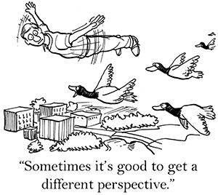
A soupçon of architecture as a basis for comparison
Digital Systems Information Architecture (DISA)

Slide 5
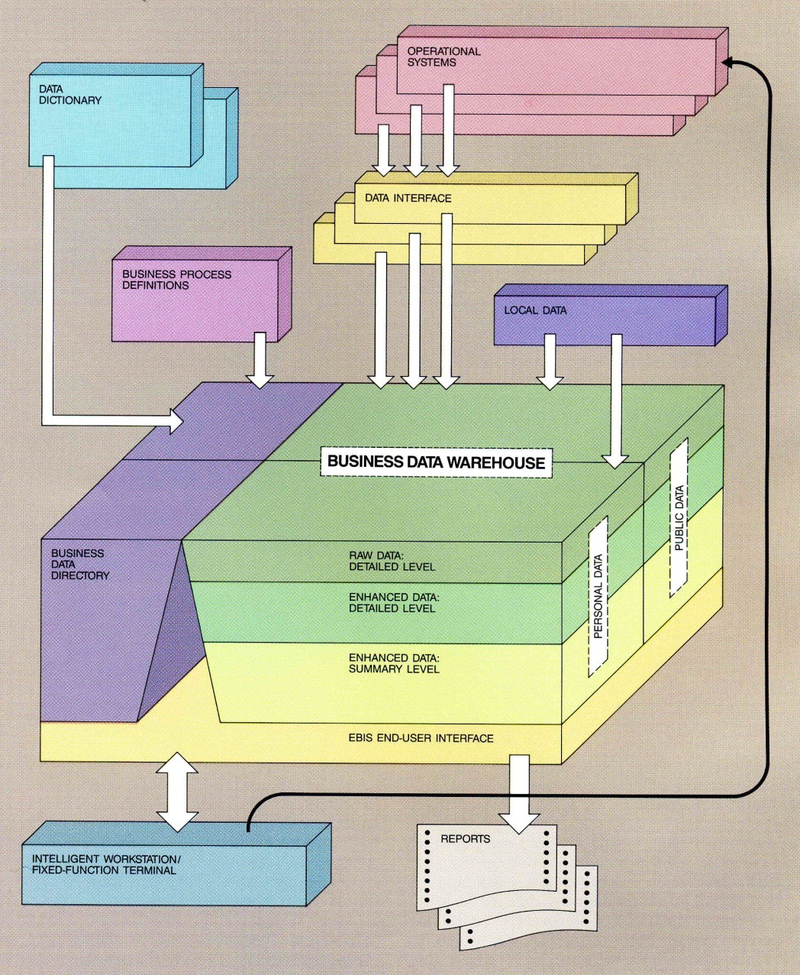
Data architecture since the mid-’80s
“An architecture for a business and information system”, Devlin & Murphy, IBM Systems Journal, (1988) bit.ly/EBIS88A
Design point (1986): internally sourced data
Separate operational systems layer to run the business processes
Data warehouse for business decision making
“Subject-oriented, integrated, time-variant, non-volatile data”
Popularised by Inmon, 1992-’95
Two layers within the Data Warehouse
EDW – Reconciled data: 3NF → Data Vault
Data marts – Users’ needs: often star schema
Characteristics
Vertical and horizontal segmentation
Hard data only
Unidirectional data flow
Separate metadata
Dive deeper: B. Devlin, “Data Warehouse – from Architecture to Implementation”, (1997)
Data marts
Metadata
Data warehouse
Enterprise data warehouse
Operational systems
I=B1-02-D
C=2021-11-10

Slide 6
Data and information domains of the Digital Information Systems Architecture (DISA)
Process-mediated data (PMD)
Operational & informational data
Via data entry and cleansing
Machine-generated data (MGD)
Machine and sensor output, Internet of Things
Human-sourced information (HSI)
Subjectively interpreted personal experiences
From Tweets to Videos
Context-setting information (CSI)
Metadata and more
AI-generated “information” (AGI)
Lacking human understanding, poorly defined, and a Gartner 2022 top strategic technology trend!
Human-sourced information
AI-generated “information” (emergent)
Context-setting information
Process- mediated data
Machine-generated data
I=D1-05-A
C=2022-02-18

Slide 7
Introducing Information pillars
Single architecture for all types of data/information
Mix/match technology as needed
Relational, NoSQL, Hadoop, etc.
CSI (metadata+) included
Data flows as fast as needed and reconciled when necessary
Only strictly necessary storage and transformations
CSI → pillars rather than silos
External data may only be accessed
(Contrast layered architecture)
From sources to stores
Events – discrete MGD data points
Measures – on-going MGD
Messages – HSI
Transactions – created from events, measures and messages
Machine-generated data
(MGD)
Process-mediated data
(PMD)
Human-sourced information
(HSI)
Context-setting information
(CSI)
Transactions
Measures
Events
Messages
I=D2-01-C
C=2022-02-18
Notes:
I=D1-07-E
The answer to the problems of the old DW architecture is to move from layers to pillars. There exists three information pillars in the REAL logical architecture. The pillars are fed in parallel, rather than sequentially.
The central, process-oriented data pillar contains traditional operational and core informational data, fed from legally binding transactions (both OLTP and contractual). It is centrally placed because it contains core business information, including traditional operational data and informational EDW and data marts in a single logical component.
Machine-generated data and human-sourced information are placed as pillars on either side. The leftmost pillar focuses on real-time and well-structured data, while the one on the right emphasizes the less-structured and, at times, less timely information.
In this architecture, context-setting information (aka metadata) is explicitly included as a part of the information resource and spans the three pillars. While these pillars are independent, their content is also coordinated and made consistent, as far as necessary based on the core information in the process-mediated pillar, the context-sensitive information stored in all three pillars and the assimilation function shown in the centre.
From an implementation point of view, these three pillars require relatively differentiated types of storage and processing. While the actual platforms required may change as technology evolves, the distinctly different characteristics of the domains suggest that there will be three (or perhaps more) different optimal performance points on the spectrum of available technology at any time.

Slide 8
The logical (REAL) architecture implements IDEAL concepts
Processes to create, maintain and use business information
Realistic, Extensible, Actionable, Labile
Instantiation: Tools by which raw sources are represented as information instances
File access, ETL, DWA, change capture, streaming…
Assimilation: Creation of reconciled & consistent information sets and CSI prior to business use
ETL, ELT and data virtualization
Reification: Consistent, cross-pillar information access in real-time via overarching model
Data virtualization
Utilization: direct or application use of data/info
Choreography: manage processes
Organization: administer the entire environment
Used mainly by IT
Utilization
Reification
Machine-generated data
Process-mediated data
Human-sourced information
Choreography
Organization
Assimilation
Context-setting information
Transactions
Instantiation
I=B6-02-C
C=2022-02-18
Measures
Events
Messages
Notes:
Was=F3-03-A

Slide 9
Data warehouse and data lake today
Data Warehouse – manage ongoing business, based on operations
Clean, correct, reconciled, perhaps delayed
Governance is vital, architected approach
Reification
Data Lake – predict / influence the future, from digital activities
Flexible, innovative, often near real-time
Limited data management
Data Warehouse
Choreography
Together: Logical Data Warehouse
Data
Lake
Assimilation
Challenges
Operational / informational overlap
Complex data and model flows
Data links or extensive copies
Integration
Predictive / prescriptive analytics demands integration of all systems
Design & maintenance is complex & inflexible
Context-setting information
PMD
MGD
Transactions
HSI
Instantiation
Measures
Events
Messages
I=D5-06-A
C=2021-11-03

Slide 10
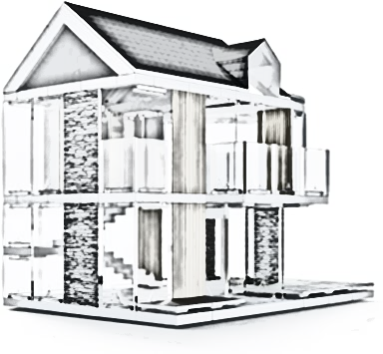
Meaningful definitions & architected pictures
Data Fabric and Data Mesh

Slide 11
Data fabric – as described by proponents
Gartner – Design concept:
Integrated layer (fabric) of data and connecting processes
Continuous analytics over existing, discoverable, and inferenced metadata
Supporting design, deployment & utilization of integrated & reusable data across all environments, incl. hybrid and multi-cloud platforms
Leverages both human and machine capabilities to access data in place or support its consolidation where appropriate
No. 3 in Gartner Top 10 Data & Analytic Trends 2021
Not truly “new”
Described (in part) since 2013 by Forrester and others
Layers?
See gtnr.it/3gOo7zk
I=M3-02-A
C=2022-02-18

Slide 12
REAL data fabric pattern – (simply) an evolution of Logical DW?
Retain and access all current sources and copies of data as required
Operational systems and external data sources
Data warehouse and data lake
Data virtualisation to access all data
Automated, integrated information preparation
Strong focus on context-setting information
Central to data management / governance
Key to widespread self-service usage
Pervasive – business, technical, operational
Actively maintained and used
Reification
Data Warehouse
Choreography
Assimilation
Context-setting information
Challenge: requires significant new / improved technologies, e.g.
Choreographed workflows
Semantic knowledge graphs
Active metadata management
Embedded machine learning
PMD
MGD
Transactions
HSI
Instantiation
Measures
Events
Messages
I=M3-13-A
C=2021-11-30

Slide 13
So, do you need a data fabric?
Number of data warehouses and marts
Number of data lake instances
Other data sources (e.g. operational systems) your users access
Number of information preparation processes
Rate of change in information preparation processes / marts
The higher your score the more you need a data fabric, in order to:
Limit maintenance costs for data models and information preparation through automation
Empower businesspeople to find and easily use the right information
I=M3-15-A
C=2021-11-30

Slide 14
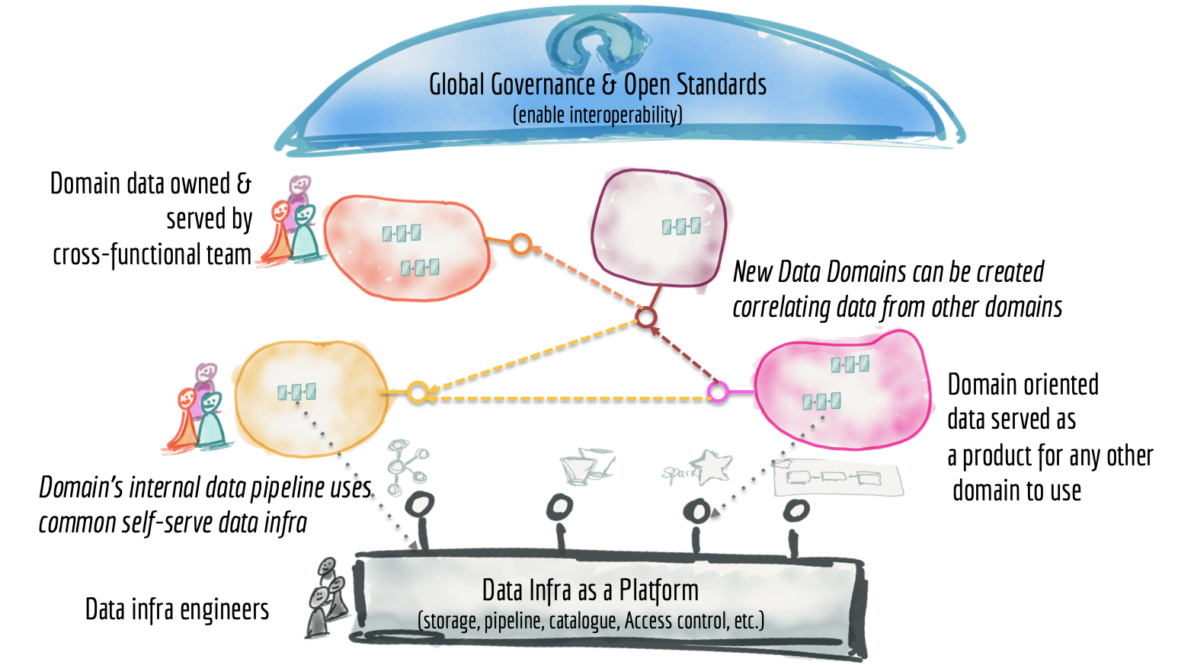
Data mesh – as described by proponents (1)
Drivers
Unlock analytical data at scale – autonomy and democratisation
Address common failure modes of centralized data lakes & warehouses
“Embrace the reality of [the] ever-present, ubiquitous, and distributed nature of data”
Strong focus on organisational concepts and concerns
New governance approach
Local vs central control
Principles
Learn from DDD, microservices & DevOps from modern software engineering
Domain-oriented decentralized data ownership and architecture
Data as a product
Self-serve data infrastructure as a platform
Federated computational governance
See: thght.works/3q5QbSR
Image: Zhamak Dehghani, 2019, bit.ly/3dtLrl3
I=M2-32-A
C=2021-11-02
Notes:
https://www.thoughtworks.com/radar/techniques/data-mesh

Slide 15
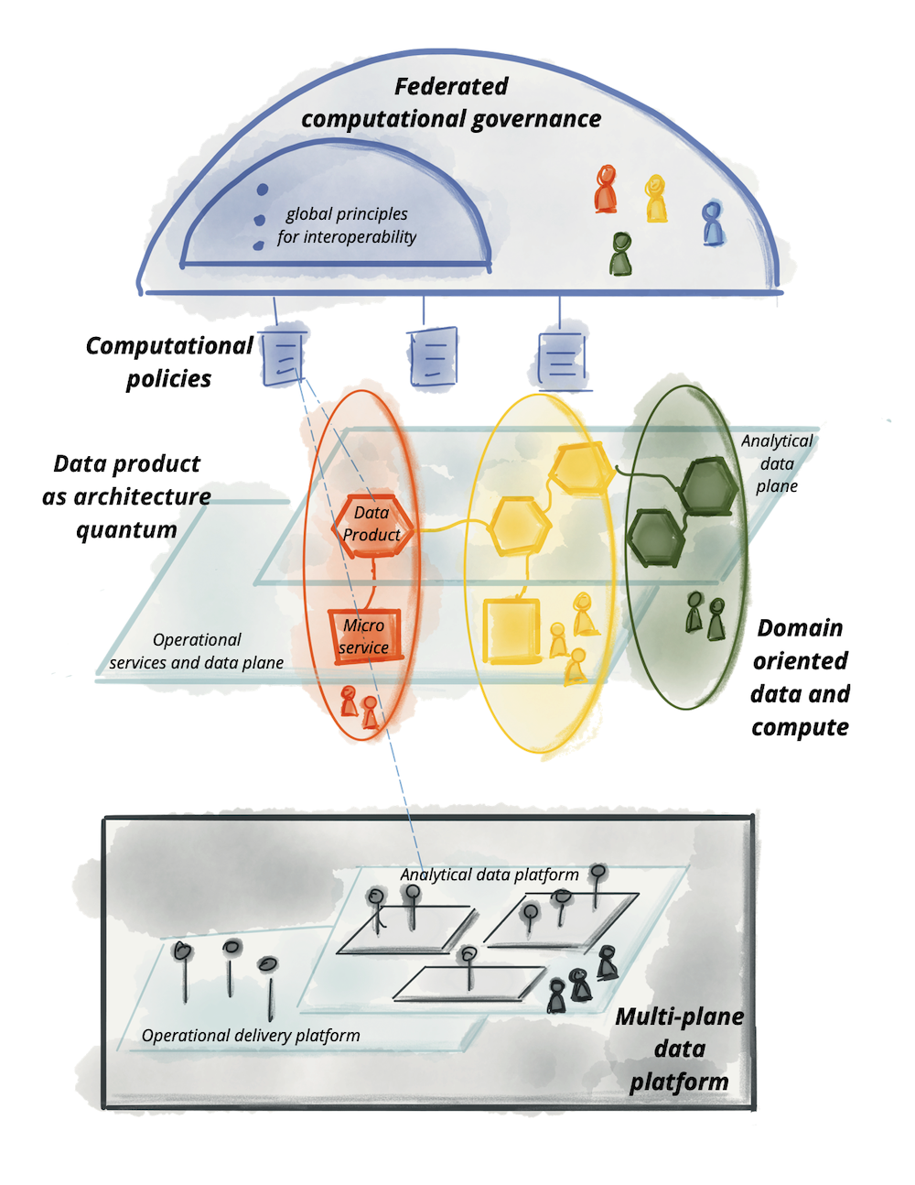
Data mesh – as described by proponents (2)
Technical / architectural concepts
Data product quantum [microservices thinking]: Code + Data & Metadata + Infrastructure
Multi-plane data platform, including:
Data infrastructure provisioning plane
Data product developer experience plane
Data mesh supervision plane
Computational policies embedded in the mesh
Federation / virtualization of data
Pull data on demand
Conceptual complexity
Dehghani tweet, 13 August 2021
“There are no warehouses in a mesh. There are autonomous data product quantums that provide multimodal access to domain data for analytical workloads - connected together in a graph - each both transforming and serving/controlling immutable bitemporal data.”
I=M2-33-A
C=2021-11-02
Image: Zhamak Dehghani, 2020, bit.ly/2S7i4xd
Notes:
https://www.thoughtworks.com/radar/techniques/data-mesh

Slide 16
Data mesh: Service oriented architecture for data?
Dispenses with centralised copies of data as far as possible
(Although some data mesh approaches keep data warehouse / lake constructs)
Instantiation & assimilation in data products – multiple instances across enterprise
Choreography and reification are key
Microservices structure make data products (DPs) available for “pull” usage
Requires pervasive / active CSI
Central to data management / governance
Key to microservices
Reification
DP1
Choreography
Assimilation
Context-setting information
Challenge: requires extensive changes to design thinking and new technologies, e.g.
Micro-services operational view
Reconciliation across domains (silos?)
Gaps in open-source and commercial tooling
DP2
PMD
MGD
Transactions
HSI
Instantiation
Measures
Events
Messages
I=M2-29-A
C=2021-11-30

Slide 17
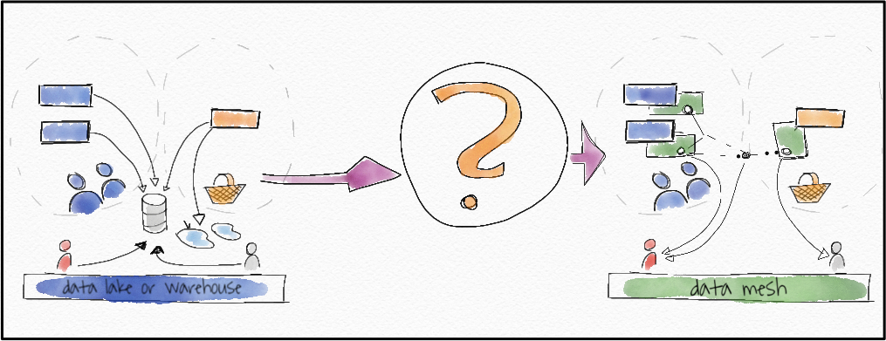
So, do you need a data mesh?
Quantity of data sources
Size of your data team
Number of data domains
Data engineering bottlenecks
How frequently is the data engineering team a bottleneck to the implementation of new data products on a scale of 1 to 10?
Data governance
How much of a priority is data governance for your organization on a scale of 1 to 10?
The higher your score the more you need a data mesh!
>30 = data mesh sweet spot
See “What is a Data Mesh — and How Not to Mesh it Up”, Moses, July 2020 , bit.ly/2ZJ4h3B
Image: Sven Balnojan, 2019, bit.ly/3GFIivg
I=M2-31-A
C=2021-11-30

Slide 18
Are you really ready to build a data fabric or mesh?
Data Fabric
Data Mesh
How far toward Logical Data Warehouse (LDW) are you?
Is your data lake a data swamp or a start toward an LDW?
A good LDW is already the foundation of Data Fabric
How good is your metadata / context-setting information (CSI)?
CSI foundation is vital for Data Fabric
Data Fabric → integration automation
How good are you in microservices, agile dev., and domain-driven design approaches?
How willing is your data team to adopt and adapt these approaches?
Data Mesh demands very different organisation and governance
How important is consolidated / reconciled data to your reporting / analytics?
Enterprise DW / Vault not formally included
Data Mesh → significant redesign for agility
I=M1-02-A
C=2021-11-08

Slide 19
Conclusions
Understanding data fabric and mesh needs common base
Digital Information Systems Architecture (DISA)
Allows comparison between them
Enables migration planning from warehouse or lake
Data fabric is an evolution of Logical Data Warehouse
Automation and augmentation via active CSI (metadata)
Knowledge graph for CSI
Data mesh applies domain-driven design to data
Requires large shift in organisation and methods
Driven by governance thoughts – eliminate centralisation
Microservices approach in technology

Slide 20
Thank you Questions?

