Slide 1
Data and analytics as a line of business
Donald Farmer
Principal
TreeHive Strategy
www.treehivestrategy.com
@donaldtreehive

Slide 2
Data as an asset

Slide 3
Data as an asset
All software companies are data companies
All data companies should be analytic companies
All analytic companies need a roadmap to advanced analytics

Slide 4
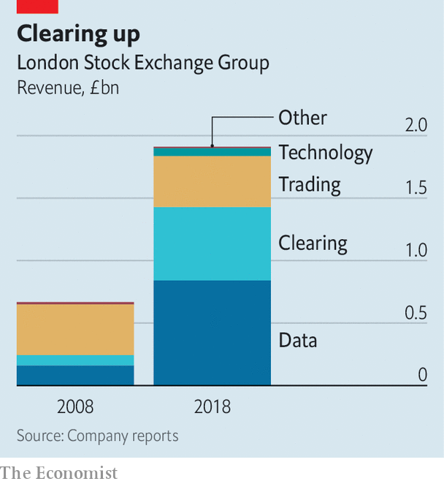
Data is a line of business
For the modern enterprise, data is a new line-of-business.
Sometimes deriving even more value than the core business. The LSE now makes 2x more revenue from Data than from Trading.
The business of data can also drive enhanced or more efficient services (Clearing in this case) which can further multiply the value of the core business.

Slide 5
A path to value from data
Enhance Current Business
Added Value New Business
High Value New Business

Slide 6
A path to value from data
Enhance Current Business
Integrate and augment line-of-business reports and dashboards
Integrate external data for broader insights
Usage data
Augmented analytics: exceptions, smart inputs etc.
Added Value New Business
Packaged data as listings, reference data, APIs
Integration with external apps and services such as collaboration, geospatial etc.
Adaptive, usage-driven applications
High Value New Business
Insights as a service, ie: benchmarking
Prediction and recommendation
Automation and intelligence

Slide 7
Evaluating data for the path to value
Volume
Depth
Representation
Quality
Usability
How much data do you have? Sufficient for useful analytic or data services?
Is the data rich enough in attributes? Does it need to be enriched or enhanced?
Is the data diverse enough to fully represent your use cases?
Is the data sufficiently complete, accurate, timely and consistent?
Is the data accessible to the right users, while being correctly governed? Is it usable with appropriate tools for your use cases?

Slide 8
Evaluating analytic opportunities

Slide 9
Three quick wins with predictive analytics
Time series analysis
Next month’s costs, inventory, with upper and lower limits.
Cluster analysis
Identify outliers and anomalies
Association analysis
Customers who did X also did Y? Make a suggestion.

Slide 10
Focus on Decisions
Operational
Start Here!
n
Tactical
Strategic
Aggregation and Augmentation

Slide 11
Focus on decisions
Clarify the user
Who is making the decision?
How will they measure success?
Clarify the data
What inputs do they need?
How quickly does data arrive?
How quickly can the system usefully respond?

Slide 12
Gameplans not roadmaps

Slide 13
Intelligence and Autonomy
Prediction and Patterns
Exploration and Discovery
Reporting and Visualization
Ad-Hoc
Tactical
Strategic
Cultural

Slide 14
Intelligence and Autonomy
Prediction and Patterns
Complexity of development
Exploration and Discovery
Diversity of tools
Reporting and Visualization
Diversity of data
Ad-Hoc
Tactical
Strategic
Cultural

Slide 15
A Sample Vendor Gameplan
Autonomous Workflow
Intelligence and Autonomy
Smart Action
Smart Assistant / Classifier
Prediction and Patterns
Correlations Dashboard
Quality Analytics Application
Exploration and Discovery
Operational Dashboard
Executive Dashboard
Quality KPI Dashboard
Reporting and Visualization
Ad-Hoc
Tactical
Strategic
Cultural

Slide 16
A Sample Vendor Gameplan
Intelligence and Autonomy
Always Audit Ready
Smart Action
Risk Assessment
Smart Assistant / Classifier
Prediction and Patterns
Quality Analytics Application
Exploration and Discovery
Operational Dashboard
Executive Dashboard
Reporting and Visualization
Ad-Hoc
Tactical
Strategic
Cultural

Slide 17
The data supply chain

Slide 19
Desktop sources
Customization
Collaboration
Export to Excel
Data Supply Chain
Sources
Integration
Storage
Analysis
Visualization
Reports / Dashboards

Slide 20
Some case studies

Slide 22
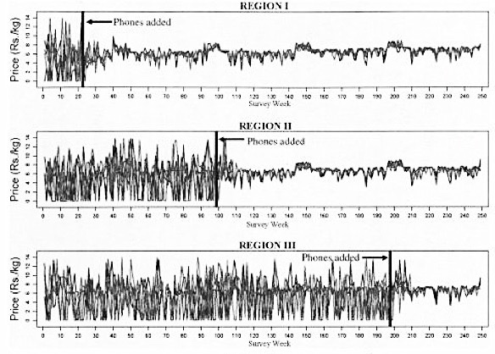

Slide 23
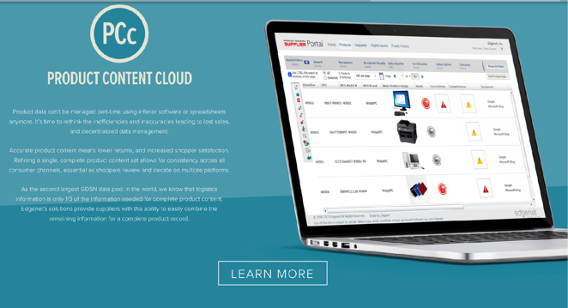
Integration and Augmentation

Slide 24
External Data Integration

Slide 25
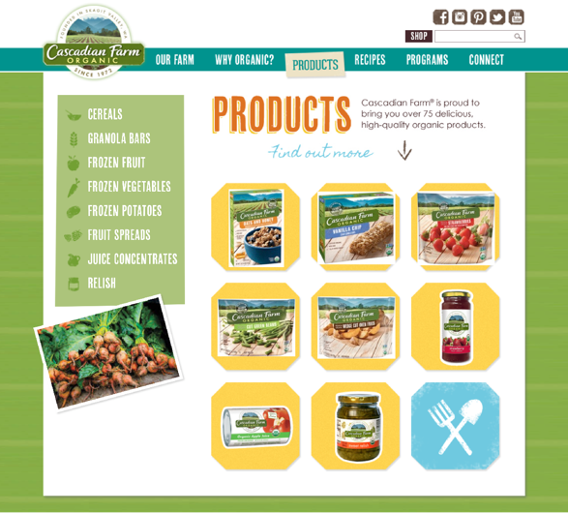
Social Data Integration

Slide 26
Predictive Analytics

Slide 27
Analyzing Usage Data

Slide 28
The Analytic Experience

Slide 29
Orientation
Glimpsing
Examining
Acquiring

Slide 30
Orientation
Glimpsing
Examining
Acquiring

Slide 31
Orientation
Glimpsing
Examining
Acquiring

Slide 34
Orientation
Glimpsing
Examining
Acquiring

Slide 35
Orientation
Glimpsing
Examining
Acquiring

Slide 38
Orientation
Glimpsing
Examining
Acquiring

Slide 39
A path to value from data
Enhance Current Business
Integrate and augment line-of-business reports and dashboards
Integrate external data for broader insights
Usage data
Augmented analytics: exceptions, smart inputs etc.
Added Value New Business
Packaged data as listings, reference data, APIs
Integration with external apps and services such as collaboration, geospatial etc.
Adaptive, usage-driven applications
High Value New Business
Insights as a service, ie: benchmarking
Prediction and recommendation
Automation and intelligence

Slide 40
Data and analytics as a line of business
Donald Farmer
Principal
TreeHive Strategy
www.treehivestrategy.com
@donaldtreehive

