Slide 1
Clariteq Method for Business Process Change –
Delivering real change in Agile timeframes
Alec Sharp
Consultant
Clariteq Systems Consulting Ltd.
West Vancouver, BC, Canada asharp@clariteq.com www.clariteq.com
© 2023 V1.3
www.clariteq.com

Slide 2
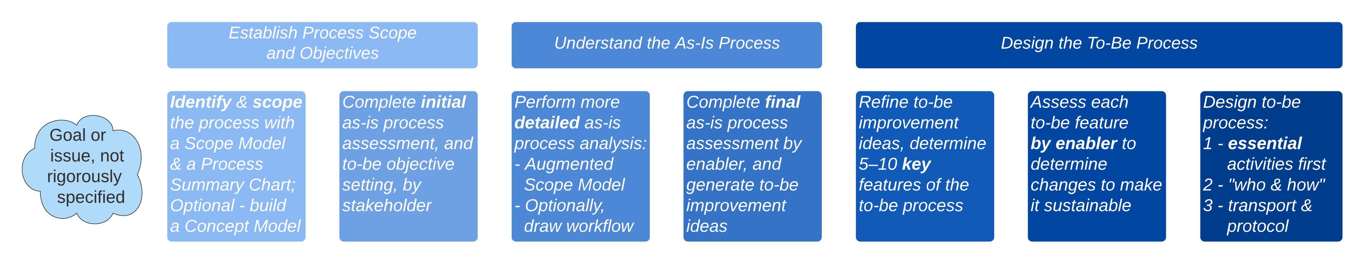
Our three-phase methodology – proven, practical, & agile
1
2
3
Customer
Performers
Owner
others…
Process
IT
M&M
HR
P&R
Fac. or…
Re-think!
Select key
to-be Features
Develop as-is models:
  Augmented Scope Model –
  add ~5 – 7 more detailed
  Activities for each main Activity
  (Optional) as-is Workflow Models –
  only enough detail to understand process behaviour
Conduct enabler-based assessment and identify potential improvements
Assess each key
Feature by enabler
…
...
...
…
...
...
...
...
…
...
...
…
…
...
...
...
...
…
...
...
Identify and sequence
essential activities
Develop to-be
Workflow Models
depicting the future
who and how
…on to requirements
definition and implementation
ID processes & draw Process Landscape (Optional – only if you have a large scope)
ID Trigger, Results, main Activities, Cases (TRAC) & draw Process Scope Model – focus on what, no reference to who or how
ID involved functions & mechanisms (who and how) & draw Process Summary Chart
Conduct stakeholder-based assessment

Slide 3
Our methodology – three responses to three common difficulties
Big picture first
Don’t start here!
Flow first, detail later
1 – Premature diagnosis
of the situation
Don’t start with a problem statement!
There will be some goal or issue, but don’t formalise it yet.
And remember… it may not be a “process” issue.
Why not?
My hardest assignments
2 – Failure to identify true end-to-end processes
Rigorous techniques to identify real business processes –
a Process Scope Model and a Process Summary Chart
make scope and context visible.
.
3 – A rapid descent into unhelpful detail
Clarify the big picture, then take a controlled descent
with well-defined levels of detail.

Slide 4
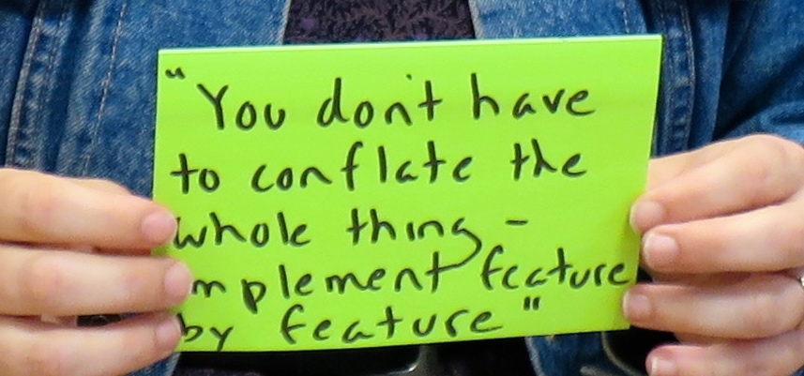
Our methodology – two points highlighted by clients
Start with what
Inclusive assessment
Based on reality
Awareness of all factors
Addresses our goals
We can do it!
Feature-based approach
Builds support
for change
Not a “big bang” –
an effective, implementable, sustainable business process
"We like the way support for change is built in throughout your approach, not bolted on at the end."
Feature-based approach makes it Agile / iterative.
And fast! – up-front work avoids endless rehashing later

Slide 5

Every phase contributes to the goal – don't skip any!
Discover the real process and participants
Complete holistic as-is assessment & generate to-be ideas
Design to-be process flow
Ensure features are implementable
with no unforeseen consequences
Identify issues for all stakeholders
Understand activities and flow
Determine key process features

Slide 6
Remember – "It's a process!"
Transparency and involvement are core principles –Brad Wheeler – “You can’t skip the therapy” and
"We are legitimizing what comes next."
You can’t start here with “best practices”
Making the new process sustainable:
Alignment of all enablers, especially Motivation & Measurement,
Human Resources & Organisation, and Policies & Rules
Visibility of the process – the whole process, right down to job aids
Training in the new process for current and new staff
Time for each feature of the new process to take hold before more change –
continuous change should mean regular but not constant change

Slide 7
Phase 1 summary – Discover processes, “frame” the target process
– 2 –
Understand the
“as-is” process
– 3 –
Characterise and
design the
“to-be” process
– 1 –
Identify, scope, and assess the target process
Phase 1 – Identify processes & “frame” the target process (scope, issues, goals)
Identify a set
of related processes
Select target process and define “what”
(essential scope)
Define
as-is process “who and how”
Determine
why process must change – “Case for Action”
Specify to-be process goals – “Process Goals” and Differentiator
Specify to-be process performance metrics
ID common terms
Select core nouns (things)
ID activities acting on things
Link activities into processes
Draw Process Landscape
What – TRAC:
Triggering
event
Final Results
by stakeholder
~5 +/- 2 main Activities
Cases / variations
Draw Process Scope Model
Who – Functions / Organisations / each Actor
(optionally main responsibilities)
How – supporting Mechanisms
Draw Process Summary Chart
Stakeholder issues and concerns
Business context (changes in the environment)
Consequences of inaction
Record
Case for Action
Establish subjective goals
by stakeholder
Establish objective (measurable) goals
Clarify differentiator
Record Process Goals
Determine basic measures
Craft process metrics:
  strategically aligned
  outcome-based
  customer-focused.

Slide 8
Phase 2 summary – Model and understand the as-is process
– 1 –
Identify, scope,
and assess the target process
– 3 –
Characterise and
design the
“to-be” process
– 2 –
Understand the
“as-is” process
Phase 2 – Model and understand the as-is process, and impact of all enablers
Organise and initiate a modelling session
Augment Process Scope Model with more detailed steps
Optional:
Develop handoff-level
as-is Swimlane Diagram
Validate completeness using “the five questions” for each step
Model other cases of the same process
Develop
service-level Swimlane Diagram, if necessary
Workers, managers,
external stakeholders
Review Process Landscape, Process Scope Model, and Process Summary Chart
Review ground rules
Identify ~5 – 7 essential steps per main Activity
Determine
“who and how” for each key step
Add supporting activities (e.g., transport, review, inform) as necessary
From trigger,
trace one flow to result – “flow first, detail later”
Three questions:
1 - “Who next?”
2 - “How?”
3 - “Who really?”
Add details –
names, labels, alternate flows
1) “How does it
get there?”
- system?
- external process?
2) “Good name?”
3) “All inbound flows shown?”
4) “All actors / systems shown?”
5) “All outbound flows shown?”
Use initial diagram (case) as starting point.
If unwieldy, it's normal to create a separate diagram
Develop service level diagrams (one per case)
Document procedures etc. as needed (not usually done)
Optional, if you choose to develop as-is Swimlane Diagrams (Workflow Models.)

Slide 9
Phase 3 summary – Define to-be process characteristics and design
– 1 –
Identify, scope, and assess the target process
– 2 –
Understand the
“as-is” process
– 3 –
Characterise and
design the
“to-be” process
Phase 3 – Assess as-is process, develop to-be characteristics, design to-be
Conduct final assessment of as-is and generate ideas for the to-be
Decide on overall
approach
Conduct a challenge session to
generate more to-be ideas
Select
5-10 key features for
the to-be
Assess each feature by enabler
(to avoid unanticipated consequences)
Design
to-be
process
Collect first impressions
and ideas
Identify
leverage points and ideas
Assess process (and optionally each step) by enabler, and record ideas
Abandon
Outsource
Leave as-is
Improve or redesign
Totally new design
Optional
State
underlying assumption in each step
Overstate! and challenge
Record alternative ideas, or keep statement
Team and management review
Select 5 – 10 key ideas that:
- meet goals
- are significant
- are feasible
These are the to-be features
Describe what must be done, one enabler at a time,
to make the feature work
Result:
Characterised To-Be Process, Process Requirements
Identify essential activities (what), then who & how
Link activities by dependency and adjust
Draw initial Swimlane Diagram
Add non-essential activities
Annotate!

Slide 10
Three phases – summary
Phase 1
Identify, scope, and assess the target process
Phase 2
Understand the as-is process
Phase 3
Characterise and design the to-be process
Identify related processes
  identify and link activities
  1:1 links are in same process
  draw Process Landscape
Use TRAC to clarify target process' scope
  Triggering event
  Result for each stakeholder
  ~5+/- 2 main Activities
  Cases (main variations)
  draw Process Scope Model
Clarify as-is process elements
  functional areas
  actors and responsibilities
  systems and mechanisms
  draw Process Summary Chart
Assess as-is process
by stakeholder (initial assessment)
  also specify context and
  consequences of inaction
Specify to-be process goals
  subjective and objective
Specify performance metrics
  customer-focused outcomes,
  not internal task efficiency
Organise and initiate session
  staff and management plus external stakeholders
  review scope, issues, goals
  review ground rules
Build Augmented Scope Model
  Identify main steps by Activity
  Identify who & how per step
Build as-is swimlane diagram
  Optional
  one case and path at a time
  Three questions:
  “Who next?,” “How does it get there?,” “Who really gets it?”
Check each step - 5 questions
  Verify all flows in and out
  Confirm active, accurate name
  Confirm all actors / systems
Model other process cases
  create new diagram, or use original case as a starting point
Add additional levels of detail
  only if necessary
Assess as-is process
by enabler (final assessment)
  using as-is models as a guide
  record ideas for to-be
Decide on approach
(abandon, outsource, leave as-is, improve or redesign)
Conduct challenge session
  challenge hidden assumptions
  record ideas for to-be
Eliminate infeasible ideas
(cost, legal, resources, impact, …)
Select 5 – 10 key ideas –
these are the to-be “features”
Assess each feature by enabler
  helps us avoid unanticipated consequences
  builds Process Requirements
Identify & sequence essential activities
Lay out to-be workflow
  handoff then service
  only then add non-essential steps
Notes:
Phase 4) will move into specific requirements and development for IT and other enablers
Phase 5) Implementation

Slide 11
I hope this helps!
Alec Sharp, West Vancouver, BC, Canada
If you have questions or comments…
don't be shy, get in touch!
e: asharp@clariteq.com
t: @alecsharp
ig: @alecsharp01
m: +1 604 418-3352
Notes:
Bio:
Alec Sharp, a senior consultant with Clariteq Systems Consulting, has deep expertise in a rare combination of fields – process modelling, analysis, and redesign; business analysis and requirements specification; and business-oriented data modelling. Increasingly, his work involves facilitation and organisational change. His 40 years of hands-on consulting experience, practical approaches, and global reputation in model-driven methods have made him a sought-after resource in locations as diverse as Ireland, Illinois, and India.
He is also a popular conference speaker, mixing content and insight with irreverence and humour. Among his many top-rated presentations are “Crossing the Chasm - From Process Model to IT Requirements,” “Getting Traction for Process – What the Experts Forget,” “The Multi-Skilled Influencer – Becoming a T-Shaped Professional,” “Integrating Change Into Your Business Process Approach – Timing is Everything,” and “Days not Weeks or Months – Process Change in Agile Timeframes.” His 90-minute briefing “Five Things You Need To Know About Business Processes” has been delivered to senior executives at major organisations around the globe.
Alec literally wrote the book on business process modelling, “Workflow Modelling: Tools for Process Improvement and Application Development.” Popular with process improvement specialists, business analysts, consultants, and business professionals, it is consistently a top-selling title on business process modelling, analysis, and design, and is widely used as an MBA textbook. He was awarded DAMA's Professional Achievement Award, a global award given to one professional a year for contributions to the Data Management profession.
Alec's popular workshops “Working With Business Processes,” “Advanced Business Process Techniques,” “Business-Oriented Data Modelling,” “Business-Oriented Data Modelling MasterClass,” and “Requirements Modelling” are conducted on four or five continents each year (pre-COVID!), at many of the world's best-known organisations. His classes are practical, energetic, and fun, consistently earning “excellent” ratings.
Contact Alec – asharp@clariteq.com

