Slide 1
“A Data Strategy For Becoming Data Driven”
Workshop
Van der Valk Hotel, Utrecht
Thursday 12 October 2023
Nigel Turner
Principal Consultant EMEA
Global Data Strategy
1
1

Slide 2
WORKSHOP
AGENDA
Data Strategy: Definition & Rationale
Data Strategy: Where to Begin?
The Four Step Data Strategy Approach:
  Step 1 – Business Goals & Objectives Aligned to Data
  Step 2 – Current State Capability Assessment
  Step 3 – Proposed / Required Future State
  Step 4 – Developing the Data Strategy Roadmap
Implementing the Roadmap: the Need for Data Governance
The Critical Importance of Change Management
Key Messages and Conclusions
2

Slide 3


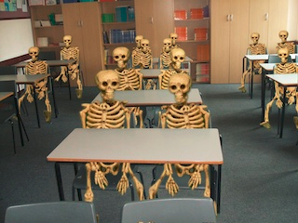
Aim for an Interactive Session
Everyone to do a quick introduction:
Name, Role, Organisation, Data Strategy Interest

Slide 4


What we’ll be doing…
HANDS ON – A CHANCE TO PRACTISE
This Photo by Unknown Author is licensed under CC BY-SA

Slide 5

Building a Data Strategy
Rationale & Definitions

Slide 6
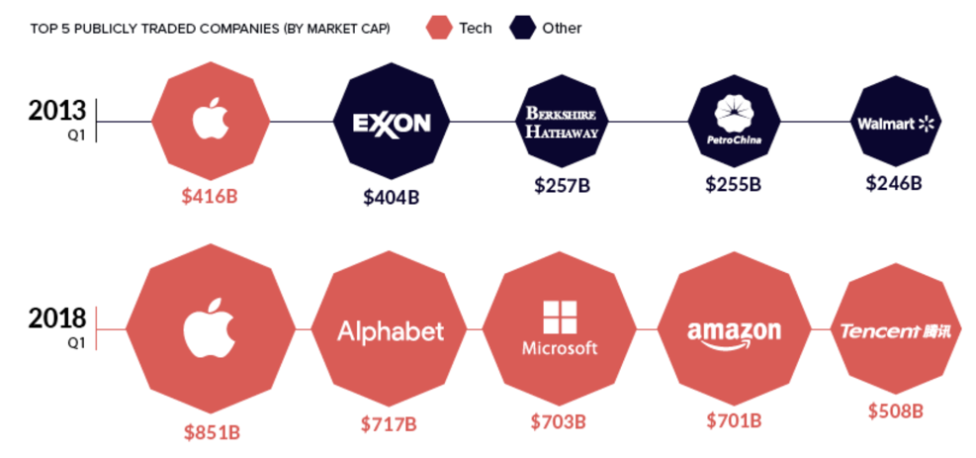

Data is Driving the Future of the Global Economy
“For most of the history of business, the world’s leading companies have been industrially-focused…
…But today’s business reality is very different. We live in a world of bytes – and for the first time technology and commerce have collided in a way that makes data far more valuable than physical, tangible objects.
The best place to see this is in how the market values businesses.” ¹
Product Focus
Data Focus
¹ Oct 15, 2018, World Economic Forum, “These are the 8 major forces shaping the future of the global economy”
The World Economic Forum sees today’s economy as driven by Data, not Goods & Services

Slide 7




Gartner’s View – the data driven, digital business
To manage its people, a digital company needs a HR Strategy to steer recruitment, skills & people retention
To manage its IT, needs an IT Strategy to ensure its technology investment supports its business aspirations
To manage its processes, needs a Process Strategy to drive the design, deployment & management of its automated and manual processes
To manage its data, needs a Data Strategy to develop & improve its data assets to underpin its People, Process & Technology strategies

Slide 8



Business Optimisation vs. Business Transformation
Digital Transformation is transforming business
Business Optimisation
Becoming a Data-Driven Company
Improving Efficiency
  Reduce Redundancy
  Eliminate Manual Effort
Growing Revenue
  Improved Marketing Campaigns
  Data-driven Product Development
Etc.
Business Transformation
Becoming a Data Company
New Business Models
  Data is the product
  Monetisation of information
Digital Transformation
  New Business Models
  Data is the Business
Etc.
How do we do what we do better?
How do we do something
different?

Slide 9

DISCUSSION
What problems or opportunities are changing or driving an increased focus on data in your organisation / industry?
9

Slide 10

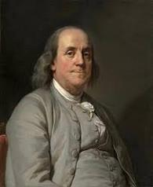
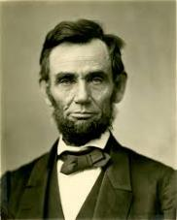

Why the need for a Data Strategy?
“If you don’t know where you are going, you’ll end up someplace else.”
YOGI BERRA,
US BASEBALL PLAYER
“By failing to prepare, you are preparing to fail.”
BENJAMIN FRANKLIN,
US FOUNDING FATHER
“Give me six hours to chop down a tree and I will spend the first four sharpening the axe”
ABRAHAM LINCOLN,
US PRESIDENT
“Strategy is a fancy word for coming up with a long term plan and putting it into action”
ELLIE PIDOT,
VP STRATEGY, MEDTREONIC

Slide 11




Further good reasons for a Data Strategy – data volumes
2.5 QUINTILLION
GRAINS OF SAND
ON EARTH
7.5 QUINTILLION
BYTES OF NEW DATA CREATED EVERY DAY
90% OF ALL DATA HAS BEEN
CREATED IN THE LAST 2 YEARS
AVERAGE BUSINESS DATA
VOLUMES DOUBLE EVERY
1.2 YEARS

Slide 12
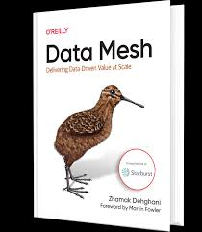
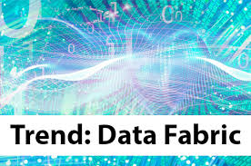
Further good reasons for a Data Strategy – complexity and divergence
Notes:
Decentralisation
Data created, stored and processed on a wider variety of systems, platforms & devices
Much of this data is in sources which fall outside core enterprise systems & platforms
Increasingly, much of the data is created outside internal IT platforms – Open Data, Social Media data et al
More organisational data held outside company boundaries on external Cloud based platforms
Democratisation
Data-driven digitisation requires more data democracy
Data must be more accessible to all people who need it, when they need it
Self-service becomes the predominant model – users want to acquire, manipulate & use data, and do it for themselves
Devolution
The IT Department no longer has monopoly control of data creation and storage
It can no longer dictate all technology and must accept some degree of chaos

Slide 13
Top 10
The Importance of Data Strategy in the UK:
Recent DAMA UK Members’ Survey
Data Management
Priorities 2023
KEY:
2023
2022
Source:
DAMA UK Members Survey
June 2023
13

Slide 14

Overview of the Data Strategy Approach :
Key Questions
ANALYSE CURRENT STATE
DESIGN FUTURE STATE
What are the organisation’s current business goals and objectives?
“The future starts today, not tomorrow”
What does the business aspire to do in the future that it does not / cannot do today?
What are the current data strengths and what weaknesses prevent or impede its ability to deliver its goals?
What new data capabilities would it need to support this?
Pope John Paul II
14
14

Slide 15
Where to begin? Developing a Data Strategy
Business Goals & Strategy
STRATEGY DEVELOPMENT
ITERATION & EVOLUTION
STEP 1
Identify Business Goals & Objectives Aligned to Data
Current State Assessment
STEP 2
Understand Current Data Maturity & Environment
Proposed Future State
Propose Future State Capabilities, Processes &
Organisational Structure
STEP 3
Implementation Roadmap
STEP 4
Prioritise Efforts & Identify “Quick Wins”
15

Slide 16
Basic definitions
Business & Data Strategies
A BUSINESS STRATEGY is a medium to long term business plan which details the aims & objectives of a business and how it means to achieve them
A DATA STRATEGY is a medium to long term plan for the improvement, management & exploitation of data across a business, and how it is to be achieved

Slide 17

The traditional relationship between Business & Data Strategy
Sets requirements for
Business Strategy
Business Strategy
Data Strategy

Slide 18
The digital, data driven enterprise – equal partners
Informs & Guides
Business Strategy
Data Strategy
Business Strategy
Informs & Guides
“Only 30% of organisations have a data strategy that is aligned with their business strategy”
McKinsey Survey, quoted in “Does Your Data & Analytics Strategy Have These 10 Crucial Elements”, Ganes Kesari, Forbes,
31 May 2022

Slide 19

The role of the data professional in the data driven business
In the current environment of data driven business, data professionals have an opportunity to have a seat at the table:
  Finding new opportunities to leverage data for business benefit
  Creating efficiencies & business process optimisation
  Integrating data from disparate sources for new business insights
  Supporting organisational change

Slide 20



What a data strategy is NOT
… or 8 certain ways to make sure it fails
Encompass all corporate data & information
Owned and actioned by the IT Department
Led and developed exclusively by middle managers
A technology shopping list
Long term, with no immediate benefits
Set in stone and never changed
A general strategy, reused from elsewhere
A set of noble principles & aspirations

Slide 21
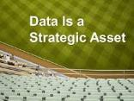

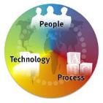



What a data strategy IS
… or 8 certain ways to ensure it succeeds
Closely focused on the key data that the organisation depends on
Actively owned by senior business executives
Unique to the specific organisation
Holistic, encompassing People, Process & Technology
Developed & maintained collaboratively across business & IT
An action roadmap, with milestones & deliverables
Include ‘ quick wins’ but keep sight of the longer term goals
Evolutionary & dynamic, adapting to the changing needs of the organisation

Slide 22

Building a Data Strategy
Where to begin?

Slide 23
Where to begin? Developing a Data Strategy
Business Goals & Strategy
STRATEGY DEVELOPMENT
STEP 1
Identify Business Goals & Objectives Aligned to Data
ITERATION & EVOLUTION
Current State Assessment
STEP 2
Understand Current Maturity & Environment
Proposed Future State
STEP 3
Propose Future State Capabilities, Processes &
Organisational Structure
Implementation Roadmap
STEP 4
Prioritise Efforts & Identify “Quick Wins”

Slide 24
Building a Data Strategy STEP 1
Identify Business Goals & Objectives Aligned to Data

Slide 25


Capturing business goals and drivers - research
Look at company websites & documents (external and internal) to highlight:
  Current Mission & Vision
  Strategic business aims and goals
  Current challenges – external and internal
Consider how these depend on data and its effective management
  For example, a business goal to ‘Increase our revenues from our top 10% revenue generating customers’
  Data questions:
    Can we identify our top 10% revenue generating customers?
    What data issues may stop us doing that (data quality, data duplication, missing data etc.)
    What are the implications if we can’t?
25

Slide 26
Capturing & analysing data problems & opportunities
Identify the primary data stakeholders (Include both Business & IT)
Set up 1-1 interviews, group interviews or workshops to highlight:
  How are you currently using or managing data in your role?
  What’s working well?
  What needs to be improved and why?
  What future data needs do you have and what opportunities can be taken with better (use of) data?
  What are the current costs / lost opportunities of current data shortcomings? (Quantify in financial terms if possible)
  What is your One Wish for data?
It’s important to speak to a wide range of roles across the organisation:
  Senior Executives
  Management roles (Business & IT)
  Front line roles (Business & IT)
26

Slide 27
Stakeholder Analysis
Stakeholders are key to the success or failure of your data strategy. Like data assets, they should be analysed and managed.
  They are the “Who” in the Zachman Framework
A number of tools and techniques exist to help manage stakeholders
  Stakeholder matrix: Listing of key stakeholders with their roles, contact information, location, etc.
  Interest/Influence matrix: Rank stakeholders by level of interest vs. amount of influence they hold.
  Interest matrix: Identify key interest areas and map their importance to each stakeholders or stakeholder group.
  Interview schedule & key questions: Plan the interview schedule to respect stakeholders’ time. Identify key questions ahead of the meeting.
  Preferred communication styles: Identify the styles of communication preferred by stakeholders & their communication styles (email, face to face meeting, coffee, introvert/extrovert, etc.)
  Communication Plan: Develop a phased communication plan including feedback, reporting, metrics, etc.

Slide 28
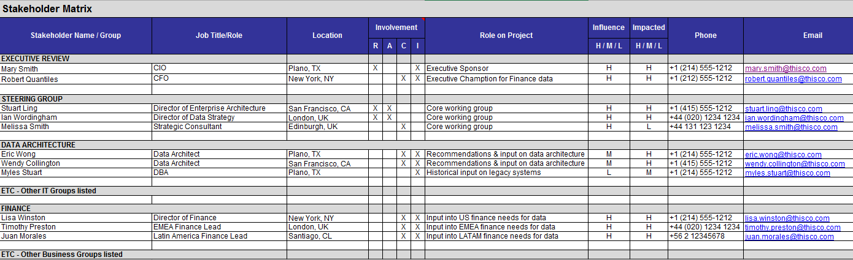
Example Stakeholder Matrix
RACI *:
R: Responsible
A: Accountable
C: Consulted
I: Informed

Slide 29
Data Issues & Opportunities Log: Suggested Template from Interviews
Unique ID | Interview No. | Short Name | Description | Impact of the Problem | Raised By

Slide 30
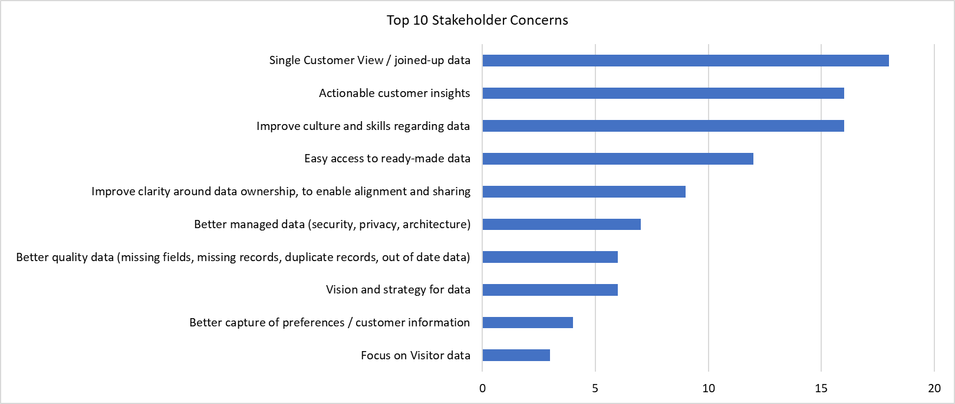

Example: What is your One Wish related to data?
Top Themes: All Stakeholders
Top 10 Themes
Number of Interviewees Raising Theme
AnyCo faces some challenges due to its operating model of multiple businesses, and this came through strongly in the themes such as “Single Customer View / joined-up data” and “Improve clarity around data ownership, to enable alignment and sharing”
Total stakeholders interviewed = 63
See Appendix for list of Stakeholders, and details on Departmental findings

Slide 31
Issue Matrix
An Issue Matrix lists:
  Key Themes & Issues around data
  Which teams are interested in each issue / theme
Creates a “heat map” of priorities
Key Issues & Themes | Leadership | Sales | Finance | Marketing | Support | R&D | HR | Legal | Compliance
Improved Customer Information | X | X | X | X | X | X | X | X | X
No Cross-Domain Integration view (Sales, Marketing, Support, etc.) | X | X | X | X | X | X | X | X | X
Inconsistent Definitions of Key Business Terms | X | X | X | X | X |  |  | X | X
Inconsistent Summarisation/Timing (e.g. Monthly view) | X | X | X
External data integration needed |  |  |  | X | X
Faster Time-to-Market for New Applications | X | X |  | X |  | X
Lack of standards creating quality issues & rework |  |  |  |  | X | X
Siloes of information slow development across teams | X | X |  | X | X | X | X
Increase Efficiency & Reduce Costs
System Redundancy | X | X | X | X | X | X
Staff spend extra hours looking for information | X | X | X | X | X | X | X | X | X
Rework needed due to incorrect definitions |  |  | X |  | X | X
Etc.

Slide 32

Legal Rider
This case study is based upon a purely fictional hotel business
Any resemblances to real hotel chains are unintentional and purely coincidental
This Photo by Unknown Author is licensed under CC BY-ND
32
This Photo by Unknown Author is licensed under CC BY-ND

Slide 33

Case Study:
Global Destinations & Spas (GDS) Hotel Chain
The Global Destinations & Spas (GDS) Hotel Group is a hotel, casino, spa and nightclub chain.
The hotel has grown rapidly through aggressive acquisition and now has 30,500 employees.
Although the GDS Group has remained profitable, increasing competition from other chains & new accommodation services (e.g. Airbnb), and the rapid rise of online gambling, have been gradually eroding its profit margins over the last five years.
There is a low level of confidence in the accuracy of financial reports and the CFO is nervous about the financial and regulatory implications of this.
A new CEO was appointed six months ago. Her brief is to increase the profitability of the Group and assure its future.
ACTIVITY: Read the case study and then consider who would be the key stakeholders
This Photo by Unknown Author is licensed under CC BY-SA
Legal Disclaimer: This case study is based upon a purely fictional hotel business. Any resemblances to real hotel chains are unintentional and purely coincidental .

Slide 34

Activity – Stakeholders
Who are the Key Stakeholders for the Hotel Chain?
For the key business initiatives you identified, who are the key stakeholders you need to speak with?
Include at least:
1 or more high-level managers or executives
1 or more operational staff members from “the field”
1 or more potential external stakeholders
Key Stakeholders by Role/Title
1.
2.
3.
4.
5.
6.
7.
8.
9.
10.
Notes:
Photo from Microsoft stock images

Slide 35
Building a Data Strategy STEP 2
Understand Current Data Maturity & Environment

Slide 36
Maturity baseline – plotting your data strategy
THE DATA DRIVEN DIGITAL ENTERPRISE
TO BE
DATA STRATEGY & ROADMAP
CURRENT MATURITY / READINESS FOR BEING DATA DRIVEN
AS IS

Slide 37

Discussion: “Offence” vs. “Defence”
Which style of data management fits your organisation?
Offence
Defence
Focused on Creating Opportunity
  Improving Profitability
  Increasing Revenue
  Improving Customer Satisfaction
  Competitive Advantage
Focused on Reducing Risk
  Compliance & Regulation
  Avoiding Audits or Fines
  Fraud Detection
  Security & Privacy
Discussion: On which end of the spectrum is your organisation?

Slide 38
Discussion: “Offence” vs. “Defence”
Which style of data management would fit the Hotel Group?
Offence
Defence
Focused on Creating Opportunity
  Improving Profitability
  Increasing Revenue
  Improving Customer Satisfaction
  Competitive Advantage
Focused on Reducing Risk
  Compliance & Regulation
  Avoiding Audits or Fines
  Fraud Detection
  Security & Privacy
Discussion: On which end of the spectrum is the Hotel Group?

Slide 39




Motivation Model: What is it?
Artful Art Supplies
ArtfulArt
One page diagram, used to clarify and communicate the rationale for, and the main priorities of a Data Strategy
Corporate Mission
Corporate Vision
To provide a full service online retail experience for art supplies and craft products.
To be the respected source of art products worldwide, creating an online community of art enthusiasts.
External Drivers
Internal Drivers
C
Top half highlights the business need for better data and new data
Digital Self-Service
Increasing Regulation Pressures
Targeted Marketing
360 View of Customer
Cost Minimisation
Online Community & Social Media
Customer Demand for Instant Provision
Brand Reputation
Community Building
Revenue Growth
Goals & Objectives
Bottom half summarises the primary focus, goals and objectives of the Data Strategy
C
C
C
Accountability
Quality
Culture
Create a Data Governance Framework
Define clear roles & responsibilities for both business & IT staff
Publish a corporate information policy
Document data standards
Train all staff in data accountability
Define measures & KPIs for key data items
Report & monitor on data quality improvements
Develop repeatable processes for data quality improvement
Implement data quality checks as BAU business activities
Ensure that all roles understand their contribution to data quality
Promote business benefits of better data quality
Engage in innovative ways to leverage data for strategic advantage
Create data-centric communities of interest
Consider how the Drivers depend on data and effective data management and highlight current weaknesses raised in interviews etc.
Motivation Model overall can be the basis of a 2 minute ‘elevator pitch’ – see later
39

Slide 40
Motivation Model: How to Develop It
Artful Art Supplies
ArtfulArt
Mission & Vision can be identified from business strategies, annual reports etc.
Corporate Mission
Corporate Vision
To provide a full service online retail experience for art supplies and craft products.
To be the respected source of art products worldwide, creating an online community of art enthusiasts.
Internal & External Drivers are the forces which are driving the need for change, including better data management. Can be derived from stakeholder interviews and documents e.g. Annual Report
External Drivers
Internal Drivers
C
Digital Self-Service
Increasing Regulation Pressures
Targeted Marketing
360 View of Customer
Cost Minimisation
Online Community & Social Media
Customer Demand for Instant Provision
Brand Reputation
Community Building
Revenue Growth
External Drivers are the forces which are in the environment of the organisation and so cannot be directly controlled
Goals & Objectives
C
C
C
Internal Drivers are the forces which are within the control of the organisation and reflect business challenges & initiatives
Accountability
Quality
Culture
Create a Data Governance Framework
Define clear roles & responsibilities for both business & IT staff
Publish a corporate information policy
Document data standards
Train all staff in data accountability
Define measures & KPIs for key data items
Report & monitor on data quality improvements
Develop repeatable processes for data quality improvement
Implement data quality checks as BAU business activities
Ensure that all roles understand their contribution to data quality
Promote business benefits of better data quality
Engage in innovative ways to leverage data for strategic advantage
Create data-centric communities of interest
Top half of model (Business needs) can be completed after the end of the Vision stage of the framework
Bottom half of the model (Data Strategy goals) can be completed after Current & Future State analysis is complete (see later)

Slide 41


Real (Anonymised) Motivation Model
ACME MISSION
To champion better work and working lives by improving practices in people and organisation development, for the benefit of individuals, businesses and society
ACME VISION
To define and represent the international benchmark for excellence in people and organisation management and development
External Drivers
Internal Drivers
Hub for Professional Connections
Digitisation of Products & Services
Create a Collaborative Ecosystem
Brand & Reputation
Coherent Customer View: Individual & B2B
Enhance Customer Insight
Increase Customer Satisfaction / NPS
Create & Leverage Partnerships
Customer & Company Experience
Relevant & Timely Communication
Regulatory & Legal Compliance
Competitive Landscape
Faster Time to Market
Exploit Intellectual Property
Increase Surplus
Efficiency & Cost Minimisation
C
C
C
C
C
Strategy
Accountability
Architecture
Innovation
Culture
Develop a Data Strategy aligned with Business Strategy
Identify high priority data issues and problems
Review and join up ongoing data improvement initiatives
Ensure focus & resources align with business priorities
Make the case for investment in data and supporting IT
Define clear roles & responsibilities for both business & IT staff
Set up cross-business governance to lead and implement change
Make data fit for purpose through better data quality
Manage master data to enable a coherent customer view
Develop an Architecture for the business of today and tomorrow
Define & document supporting data models
Develop and implement an IT Strategy to support the Data Strategy
Manage architecture as a key business / IT function
Gain greater insight on the ACME market & ecosystem
Better use and exploit data to gain new insights through BI & analytics
Use data to drive & develop new products & services
Share data with partners and others to enhance knowledge
Communicate the goals and achievements of the Data Strategy to all
Enhance digital skills of staff by organic development and recruitment
Train all staff in data management best practices
Encourage active participation in data improvement

Slide 42
Business Motivation for Global Destinations & Spas
Revisit the Hotel Case Study:
What is the Group’s stated Mission & Vision?
What are the top Internal & External Drivers? (Try to find at least 5 of each)
  See next slides for templates
  (see also workbook)
This Photo by Unknown Author is licensed under CC BY-SA

Slide 43
Activity – Business Motivation & Drivers
HOTEL GROUP MISSION:
HOTEL GROUP VISION:
EXTERNAL DRIVERS
________________________________
________________________________
________________________________
________________________________
________________________________
INTERNAL DRIVERS
________________________________
________________________________
________________________________
________________________________
________________________________

Slide 44
Data Management is an Evolution
Business
Value
Tactical
Management
Project-Level Management
Enterprise Management
Strategic Management
Transformational Management
Little or no Formal Governance
Manual efforts in place
Reactionary approach to data issues
Project-level Governance Leads
Architecture developed for specific projects & tools
Single Enterprise Lead
Business-driven priorities
Aligned Architecture
Chief Data Officer
Dedicated data organisation or committee
Data tightly integrated with business operations
Business strategy aligned with data strategy
Transformational
Strategic
Enterprise
Project-level
Tactical Approach
Maturity
Level 1: Performed
Data is not seen as a strategic asset. Created for tactical documentation needs only
Level 2: Managed
Data is seen as a requirement for the implementation of individual projects
Level 3: Defined
Data is seen as an enterprise asset that can be reused across the organisation
Level 4: Measured
Data is seen as critical to business performance and as an asset that helps create and grow business value
Level 5: Optimised
Data is seen as mission-critical for business performance, and a source for competitive advantage in a dynamic and competitive marketplace
44
* From Global Data Strategy’s Maturity Assessment Methodology, adapted from CMMI, DMBOK, and industry experience with Global Fortune 100 Companies

Slide 45
Performing a Current & Future State Assessment
Strategy
Data Governance & Collaboration
Master Data Management
Data Warehousing
Business Intelligence
Data Analytics
Data Quality
Data Architecture & Modelling
Data Asset Planning & Inventory
Data Compliance & Security
Data integration
Metadata Management
Suggested
Data Management
Maturity
Assessment
Capabilities
45

Slide 46
Performing a Current & Future State Assessment: Capabilities
DATA MANAGEMENT CAPABILITY | EXAMPLE TOPICS ANALYSED
Data Strategy | Alignment of data to business strategy; budgets & resources; communication
Data Governance | Accountability; stewardship; data issue management; critical data identification
Master Data Management | Master & reference data storage & processing; matching rules; hierarchies; CDEs
Data Warehousing | DW capability; performance & scalability; documentation; design methodologies
Business Intelligence | Provision of user reports; tooling; self-service; semantic layer; visualisation
Data Analytics | Operational v predictive; use of data science, AI/ML; social media; geographic data
Data Quality | Measurement & KPIs; root cause analysis; tooling; enrichment; data entry validation
Data Architecture & Modelling | Models; data standards; process / data mapping; system architecture; documentation
Data Asset Planning & Inventory | Location & documentation of data assets; data lifecycle management; data retention
Data Compliance & Security | Legal & regulatory compliance processes; privacy tagging; access & security controls
Data Integration | Batch v real time capability; APIs ; common business logic; platforms & tools
Metadata Management | Business data glossary, dictionaries & catalogs; data lineage; maintenance processes

Slide 47
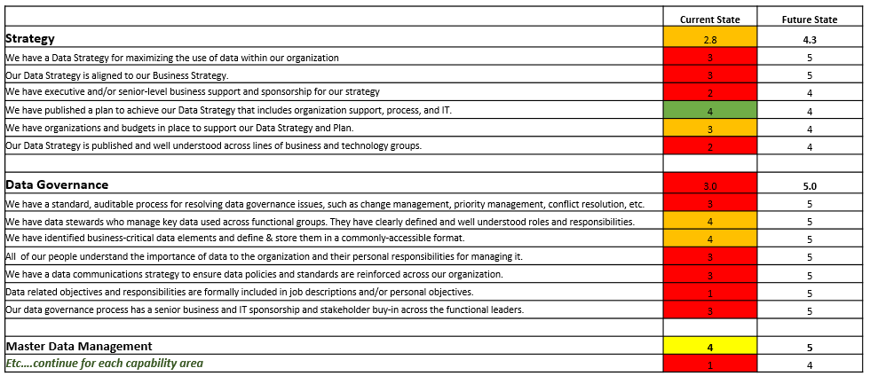
Data Management Maturity Assessment
Defining “As Is” and “To Be” maturity levels
Detailed Questionnaire for Each Capability Area
“Heat Map” of Problem Areas
Summary of Strengths, Weakness & Target Maturity

Slide 48
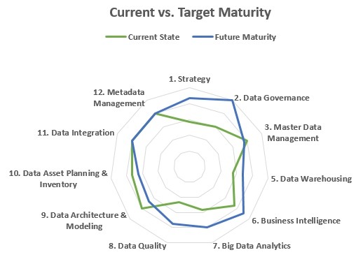
Visualising Current vs. Target Maturity
Determine Relative Strengths
It’s important to take a realistic look at your organisation’s current state maturity
  Where you are
  Where you want to be
Metadata Management meets Target Maturity
Significant Gap in Data Governance
We’re “overdoing it” for Data Architecture

Slide 49
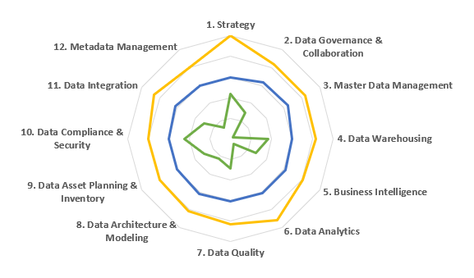

STEP 2 into STEP 3: Maturity Assessment –
Key Recommendations
Although XXX is currently engaged in efforts to modernise its external database platforms, a more comprehensive data strategy needs to be developed to align data mgmt capabilities for both internal and external applications. Sponsorship for the data strategy should be actively championed and visible at the highest level of senior leadership.
A formal Data Governance organisation has not yet been established. While the Data Solutions team and Data Governance Officer in particular have been critical in developing the initial framework of policies to date, the programme is challenged by lack of business involvement. The next step for XXX is to focus on building out and operationalising DG practices.
In general, there is an overall lack of data labelling and documentation. A POC with Data Catalog is underway within the Azure environment around the claims data assets but is still in the early stages of discovery.
XXX has invested the capabilities in the MS Azure stack to start addressing system performance issues. However, current platforms and applications remain siloed, with limited ability to integrate data from these sources.
Master Data is not formally managed at XXX and key data domains (e.g. customer, product, employee) should be identified as a future priority. At present, master data is duplicated in inconsistent ways across several data sources. This causes inefficiencies and the need for significant manual matching of data.
An external audit of XXX’s Information Security policies and practices has produced a 2021 Information Security roadmap, which is being executed to improve capabilities around internal/external technology assets and data access
XXX has migrated the existing DW repository to an Azure environment which includes a suite of products that support increased capacity for storage, data transformation, and reporting. Subsequent focus in this space should be on integrating and conforming data in an optimised data warehouse design.
Data assets cataloguing and classification exists at XXX, within the scope of meeting data protection and regulatory compliance around personal data. Performing a more comprehensive inventory of XXX's assets and definition of key domains and their lifecycles needs to be prioritised as critical activity for XXX.
PowerBI is currently being used as XXX’s enterprise reporting tool and is increasingly replacing MS Excel reports. Future outputs in this area should also ensure enterprise-wide metrics and data sourcing consistency
Data Quality practices have largely been done in an ad hoc, reactive & manually intensive way. XXX has recently acquired a data profiling tool and this can accelerate development of formal business rules and target KPIs / quality thresholds with wider business engagement.
XXX has access to an extensive amount of data held in its externally hosted databases around managed services which is only likely to increase with shifts in both technological and legislative advances within the industry. The organisation needs to be positioned with regards to its analytical and real time capabilities once a solid foundation in supporting data mgmt domains has been established.
There is a lack of any overall Data Architecture, with primary and secondary data sources not clearly identified and documented. Conceptual data models exists on a limited set processes, making it difficult for XXX to identify its key data objects and attributes and where these are physically held and mastered.
Maturity Assessment Detail
49

Slide 50
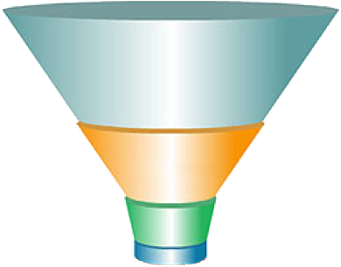
Critical Data Element (CDE) Identification – One Way
High priority data items and attributes
e.g. Launch a New Product – Marketing Campaigns require better customer information
Identify Key Business Drivers
Filter Data Elements Aligned with Business Drivers
Targeted Projects in the Data Strategy to Deliver Short-Term Results
Customer
Product
Focus Strategy Efforts on Key Data
Region
Partner
Vendor

Slide 51
CDE Identification – Another Way
Audience
Purpose
Business Stakeholders
Data Architects
Organisation & Scoping of main business domain areas
Enterprise
Subject Areas
Business Stakeholders
Data Architects
Communication & Definition of Business Concepts & Rules
Conceptual
Business Concepts
Data Architects
Business Analysts
Clarification & Detail of Business Rules & Data Structures
Logical
Data Entities
DBAs
Developers
Physical
Technical Implementation on a Physical Database
Physical Tables

Slide 52
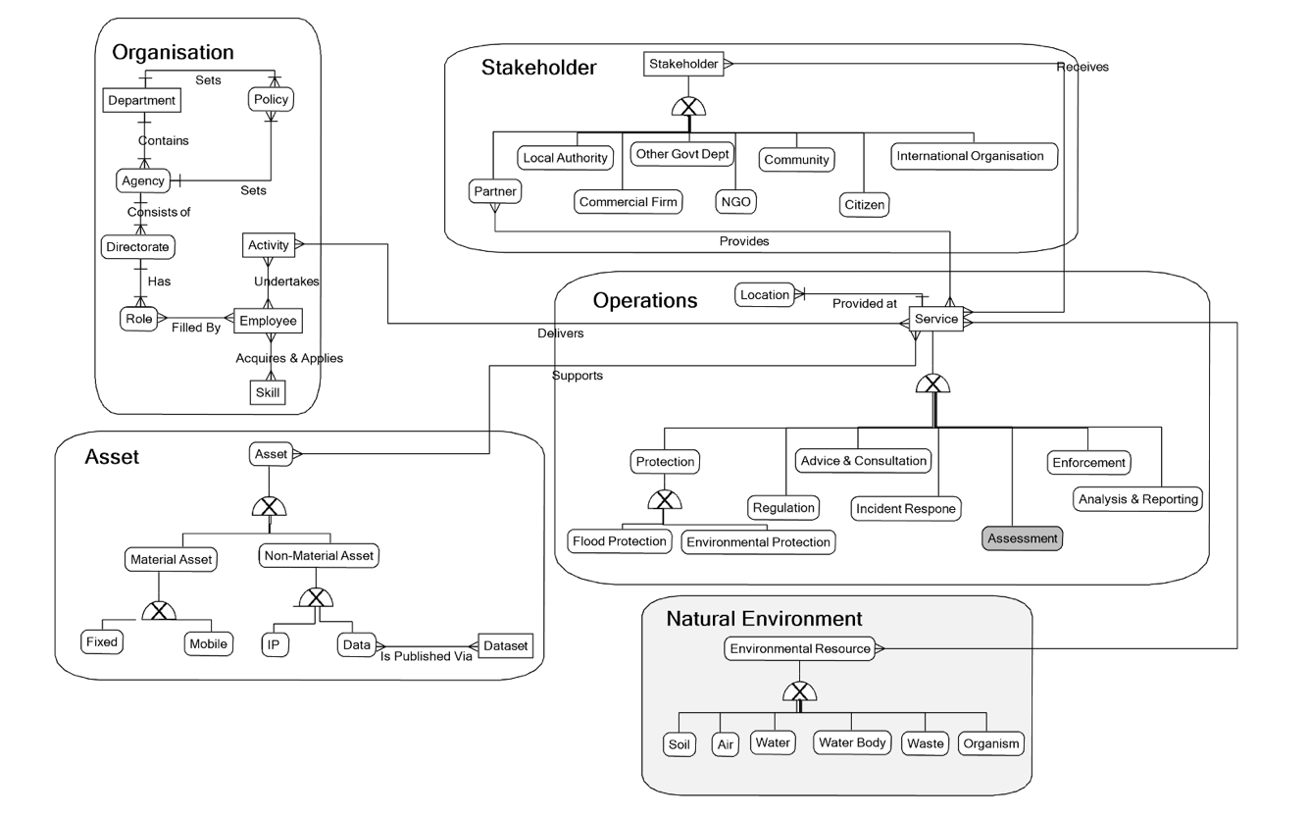
Actual Business / Conceptual Data Model

Slide 53
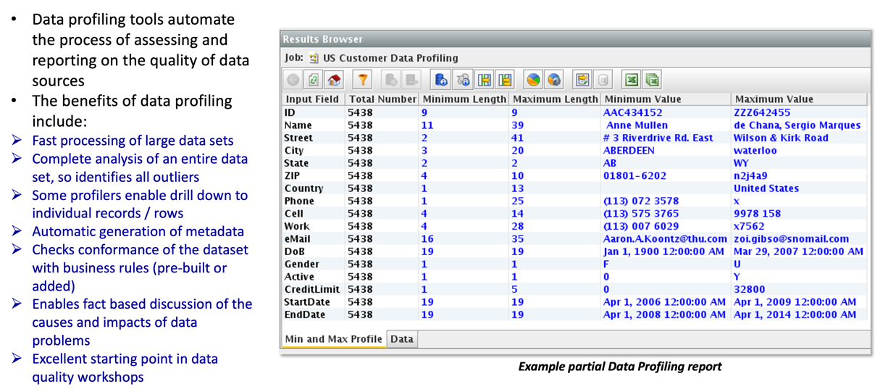
Baseline Key Data Sources
Data quality will arise as a key problem in Step 1 – guaranteed!
To quantify the scope and scale of data quality problems consider data profiling key data sources
This will:
  Provide real, concrete evidence for existing data problems
  Help identify and quantify the state of critical data elements (CDEs)
  Help to build the business case for action
DATA PROFILING TOOLS

Slide 54
Key Data Identification: Create a Business Glossary
The importance of definitions
Definitions are as important as the data elements themselves
Many data-related problems and issues are caused by unclear or ill-defined terms
What do you mean by “customer”?
How are we defining a “household”?
We’re calculating “total sales” differently in each region!
What’s the difference between an “ingredient” and a “raw material”?
Sales is using a different “monthly calendar” than Finance.
What’s a “PEG ratio”?
“API” as in “Application Programming Interface?” or “American Petroleum Institute”?
What’s an “equity derivative”?

Slide 55
Data Source Inventory
Document key data sources across the organisation… as well as who is using them (i.e. key departments & stakeholders)
Data models & other architecture tools can help document the technical structures & metadata
Data Sources | Leadership | Sales | Finance | Marketing | Support | R&D | HR | Legal | Compliance
Relational Databases
MySQL |  |  |  | X
Oracle |  | X | X | X | X | X | X | X | X
SQL Server |  | X | X
Sybase |  |  | X
Etc.
BI Tools
Tableau |  | X |  |  | X | X | X | X | X
Qlik | X |  | X | X
Etc.
Open Data
Data.gov – agricultural data | X |  |  | X |  | X
Etc.

Slide 56



















Example Current State Data Architecture
Manual Entry
Sales Orders via EDI / ftp
CRM
Careline
Retail POS Data
3rd Party Outsourcing
.csv flat file export
Media Graphics
MS Access
MUSA
UK
EEM
Sales & Purchase Orders
System 21 ERP
MSC Supply Chain
Media Vault Content Mgt
Cognos BI Reports
MLE Demand Planning
Cognos TM1 OLAP Cubes
Marketing Campaigns
PIF Product Information
Commercial Finance
MS SQL Azure
IBM Planning Analytics Excel Plugin
Cognos BI OLAP Cubes
Product Hierarchy
Email registrations from web
GRO eCommerce
Marketing Analytics
GRO eCommerce
Budget
Forecast
AUS Sales Spreadsheet
Regional
Data Marts

Slide 57
Current Data Architecture – problems
Manual Entry
No clearly-defined data stewardship roles
Sales Orders via EDI / ftp
Product Master Data not Kept in sync
CRM
Customer Service Data not Integrated with Enterprise Data
Flat file exports from ERP not aligned to a common data model standard
Manual/batch export not automated via API or other methods
Careline
Retail POS Data
Inconsistent Product Master Data causes issues with partner warehousing, freight, fines, etc.
3rd Party Outsourcing
.csv flat file export
Media Graphics
MS Access
US
UK
EMEA
Product Media not easily integrated with internal master data or external partner sites
Sales & Purchase Orders
System 21 ERP
MSC Supply Chain
Media Vault Content Mgt
Common, consistent metrics & KPIs across functions needed
Manual Product Master Data causes errors and wasted resource effort
Cognos BI Reports
MLE Demand Planning
Cognos TM1 OLAP Cubes
Marketing Campaigns
PIF Product Information
OLAP-only access limited flexibility. Full Data Warehouse needed
Commercial Finance
Consumer data from website limited, and not integrated with other sources
MS SQL Azure
IBM Planning Analytics Excel Plugin
Cognos BI OLAP Cubes
Product Hierarchy
Email registrations from web
Difficulty integrating new product hierarchies & SKUs for acquisition
GRO eCommerce
“Shadow IT” – many SAAS products not integrated with central architecture
Marketing Analytics
GRO eCommerce
Marketing Analytics not Integrated with Enterprise Data
Budget
Forecast
AUS Sales Spreadsheet
Regional
Data Marts

Slide 58
Building a Data Strategy STEP 3
Propose Future State Capabilities, Processes & Organisational Structure

Slide 59
Maturity baseline – plotting your data strategy
THE DATA DRIVEN DIGITAL ENTERPRISE
TO BE
DATA STRATEGY & ROADMAP
CURRENT MATURITY / READINESS FOR BEING DATA DRIVEN
AS IS

Slide 60

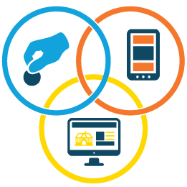







Example Future State Architecture
Branding & graphics
Customer Relationship (CRM) managers relationships and interactions with consumers and prospects.
eCommerce Platform builds Digital Storefront to sell products to customers digitally.
Product Information Management (PIM) ensures provides trusted product content for unified commerce.
Transactions
Product
Consumer
Enterprise Resource Planning (ERP) provides operational end-to-end processes, such as finance, HR, distribution, manufacturing, service and the supply chain.
Consumer
Product
Transactions
Location
Employee
SQL Server
Supplier
Business Intelligence (BI) tool provides the ability to visualise data via structure reports and graphs.
Supplier
Consumer
Consumer
Region
Product
Supplier
Consumer
Location
Employee
Sales
Customer
Category
Customer
Product
Product
Data Warehouse stores data extracted from transaction systems, operational datastores and external sources for summarised reporting and easy “slice and dice” analysis.
Product
Consumer
Etc.
Consumer
MDM Hub stores a Single, Consistent View of Customer, Product, Supplier, etc. to publish across all enterprise systems
Enhanced Customer Support through text mining & voice analytics and potential for automated chat bots.
SQL Azure
Social Media Platforms provide insight into customer sentiment and advocacy.
Advanced Analytics uses sophisticated techniques and tools to discover deeper insights, make predictions, or generate recommendations.
Data Lake stores structured & unstructured data in raw format for advanced analytics & insights.
60

Slide 61
Future State Architecture: Benefits
eCommerce Platform provides direct to consumer purchase with related data insights
PIM ensures consistent product branding & content to eCommerce & Partner platforms, based on Product Master Data
Branding & graphics
Customer Relationship (CRM) managers relationships and interactions with consumers and prospects.
eCommerce Platform builds Digital Storefront to sell products to customers digitally.
Product Information Management (PIM) ensures provides trusted product content for unified commerce.
Consumer Data integrated through MDM to support Marketing campaigns & analytics activities
Transactions
Self Service Analysis Capabilities
Product
Consumer
Enterprise Resource Planning (ERP) provides operational end-to-end processes, such as finance, HR, distribution, manufacturing, service and the supply chain.
Consumer
Product
Business-friendly documentation of data structures & definitions
Location
Employee
SQL Server
Transactions
Master Data Hub serves consistent data for key business data areas (Product, Consumer, etc.)
Supplier
Business Intelligence (BI) tool provides the ability to visualise data via structure reports and graphs.
Supplier
Consumer
Consumer
Region
Product
Supplier
Consumer
Location
Employee
Sales
Customer
Category
Common data models & design across MDM, DW, and data exchange formats provide a consistent, business-focused view of enterprise data
Product
Customer
Product
Flexible, Customisable Data Warehouse for Enterprise Data
Data Warehouse stores data extracted from transaction systems, operational datastores and external sources for summarized reporting and easy “slice and dice” analysis.
Product
Consumer
Etc.
Consumer
MDM Hub stores a Single, Consistent View of Customer, Product, Supplier, etc. to publish across all enterprise systems
Enhanced Customer Support through text mining & voice analytics and potential for automated chat bots.
Data Lake provides common source for unstructured data to provide analytics insights on consumer sentiment and other key areas
SQL Azure
Social Media Platforms provide insight into customer sentiment and advocacy.
Advanced Analytics uses sophisticated techniques and tools to discover deeper insights, make predictions, or generate recommendations.
Data Lake stores structured & unstructured data in raw format for advanced analytics & insights.
61

Slide 62
HOTEL GROUP CASE STUDY ACTIVITY
Perform a high-level enterprise Data Management maturity assessment of the Hotel Group
Use the Data Management Capability topics to help your assessment
Highlight a score for each capability between 1 & 5 where:
  1 is lowest capability (Current or Desired)
  5 is highest capability (Current or Desired)
Provide a brief reason for your scores
Use the Assessing Maturity template and the Data Management Capability topics in the workbook to complete the activity
62
This Photo by Unknown Author is licensed under CC BY-SA

Slide 63
Activity – Assessing Maturity
Data Maturity Capability | Current State Score | Desired Future State Score (within 3 years) | Reason
Data Strategy
Data Governance & Collaboration
Master Data Management
Data Warehousing
Business Intelligence
Data Analytics
Data Quality
Data Architecture & Modelling
Data Asset Planning & Inventory
Data Compliance & Security
Data Integration
Metadata Management
Rating Scale for Current State Score & Desired Future State Score:
1 = Lowest
5 = Highest

Slide 64
Performing a Current & Future State Assessment: Capabilities
DATA MANAGEMENT CAPABILITY | EXAMPLE TOPICS ANALYSED
Data Strategy | Alignment of data to business strategy; budgets & resources; communication
Data Governance | Accountability; stewardship; data issue management; critical data identification
Master Data Management | Master & reference data storage & processing; matching rules; hierarchies; CDEs
Data Warehousing | DW capability; performance & scalability; documentation; design methodologies
Business Intelligence | Provision of user reports; tooling; self-service; semantic layer; visualisation
Data Analytics | Operational v predictive; use of data science, AI/ML; social media; geographic data
Data Quality | Measurement & KPIs; root cause analysis; tooling; enrichment; data entry validation
Data Architecture & Modelling | Models; data standards; process / data mapping; system architecture; documentation
Data Asset Planning & Inventory | Location & documentation of data assets; data lifecycle management; data retention
Data Compliance & Security | Legal & regulatory compliance processes; privacy tagging; access & security controls
Data Integration | Batch v real time capability; APIs ; common business logic; platforms & tools
Metadata Management | Business data glossary, dictionaries & catalogs; data lineage; maintenance processes

Slide 65


Building the Business Case
Making the Case for Change
Make the Right Business Case to the Right Audience
  Know your audience – do they want a spreadsheet, quick PowerPoint, 100 page document, water cooler conversation?
  Understand what detail is needed, i.e. don’t “overkill” – sometimes simple is better
  Focus on high-priority business needs
  Define key business metrics for success aligned with data mgt deliverables
Plan to start small, with a plan to build to a longer-term goal
Lay out the current status quo including
  Successes to date
  Challenges with current structures & processes
Include Metrics & Anecdotes where possible
  Cost savings or revenue gains
  Data quality improvements
  Compliance & regulatory issues
  Any real-world anecdotes that can be shared (e.g. We underreported sales last year due to data quality issues)
VS

Slide 66

Find Advocates Across the Organisation
It’s key to find champions for your data strategy effort across the business
  Both “business” and “IT”
  From senior level executives as champions to field staff as supporters
In making the case for funding or buy-in, it’s helpful to have someone else tell your story
  Can marketing advocate the case for change to improve campaigns?
  … Or sales discuss the potential increases in revenue?
  …. Or Engineering point out the increases in efficiency and quality?
While we may want to take the “credit” for the data strategy, it is often most successful when other people have embraced it as their own

Slide 67




Making the Business Case
While Business Cases and ROI Calculations can be complex, they generally fall into 4 categories:
Decreasing Costs
Increasing Revenue
Reducing Risk
Protecting Reputation
Wasted Labor costs due to manual efforts
(Data cleansing, manual integration, etc.)
Inefficient business processes for data management
(Product Master Data process)
Data quality cost avoidance
(Wasted mailings sent to wrong address)
Price Optimisation through Analytics
Improved Marketing Campaigns through Quality Customer Data
Data-Driven Recommendation Engines to enhance the sales cycle.
Better Grant writing through data-driven needs analysis
Industry regulations
(GDPR, HIPAA, BCBS 239, Spice,
HIPAA, etc.)
Product Traceability
(Food lineage from farm/catch)
Litigation due to Data Breach
Health and Safety Audit
Customer Satisfaction
Brand Trust
Social Media Voice of Consumer
Loyalty & ‘Stickiness’

Slide 68
Activity: Making the Business Case
What are some key areas that can drive ROI for the hotel?
List some of the ROI drivers for the hotel chain in each of the areas below:
Decreasing Costs
Increasing Revenue
Reducing Risk
Protecting Reputation
1.
2.
3.
4.
5.
1.
2.
3.
4.
5.
1.
2.
3.
4.
5.
1.
2.
3.
4.
5.
Notes:
Photo from Microsoft stock images

Slide 69
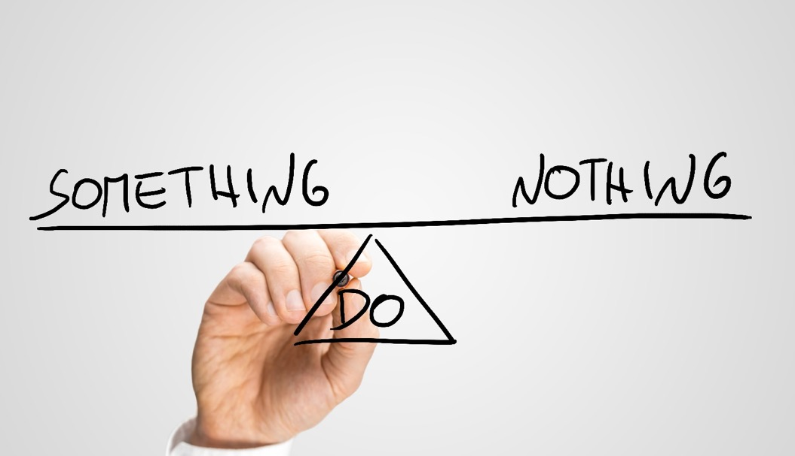
Include the Risk of Doing Nothing
There is significant cost and risk in the status quo
Doing nothing often has a higher cost than investing in data management.
Make sure to include the “do nothing” option in your analysis.

Slide 70
An outline for a documented Data Strategy
Typical Data Strategy ‘headings’ – document and / or presentation
Executive Summary – Headlines
Business Context
  Current business drivers, strategy & goals (Motivation Model)
  The overall dependence on data
Key Data Focus – What is our key data?
Current Problems with Key Data
  What are the main issues – quality, accountability, accessibility, security, etc.
  Potential benefits of improvement
  Unrealised / future data opportunities
  Implications of the ‘Do Nothing’ option
Overall Approach – Key Objectives of the Data Strategy
  Business priorities
  Consequent data priorities
Roadmap:
  0-3 Months
  3 – 6 Months
  6 – 12 Months
  12 – 24 Months
Tracking Benefits and Progress – KPIs and Success Measures

Slide 71
Building a Data Strategy STEP 4
Developing the Data Strategy Roadmap:
Prioritise Efforts & Identify Quick Wins

Slide 72

Setting Priorities & Activities
WHY?
Ensure clear focus & priority to manage limited time
Important to make an early impact to gain credibility
Need to gain support of Data Champion & Steering Group (see later)
Build confidence & experience in principles & approaches
WHAT?
Look for ‘quick wins’
Data Quality improvement projects often a good source of quick wins as benefits easier to quantify
Create a use case for promoting the value of the Strategy
Build a foundation for longer term success
HOW?
Prioritise Issues List & agree priorities with the Data Champion
Sell the data vision to the Steering Group
Specify any support (financial and / or resources) required
Create & lead a team to deliver the Data Strategy
WHEN?
Don’t spend too long doing analysis and reflection
Start a pilot / PoC project as the top priority
Use the pilot / PoC to introduce Strategy principles & practices
Apply to further pilots / POCs
72

Slide 73
Setting Priorities: Priority Grid
Priorities based on Benefits vs. Level of Difficulty can often be easily determined via a workshop activity using a Priority Grid.
High Benefits – Low Difficulty
High Benefits – High Difficulty
Customer MDM
Business Process Change
Address Validation
Benefits
Low Benefits – Low Difficulty
Low Benefits – High Difficulty
Manual Cleanup
Legacy Migration
Level of Difficulty
Notes:
73

Slide 74

Who: Return to the Stakeholder Matrix
When building the Roadmap, it’s important to consider the
Key Stakeholders who will see benefits
  Document the departments, roles, etc. that will be affected
  Consider the WIIFM factor (What’s in it for me)?

Slide 75

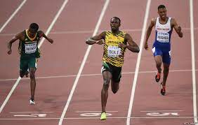


Look for “Quick Win” Projects
Quick Win Project: A “Quick Win” Project is a project that shows early value while at the same time building towards a long term goal. A successful “quick win”:
  Aligns with business objectives and solves a high-value business problem or
  Creates a proof of concept for a high-value business opportunity
  Sets a solid foundation for future efforts
  Acts as a “light bulb moment” for key stakeholders to understand the value of data-centric activities
75

Slide 76


A “Quick Win” is Not a “Quick Fix”
A Quick Win is not a sloppy, “quick fix” that will not scale for future use
A Quick Win is well-planned first step to build a strong foundation for future efforts
NO
YES

Slide 77
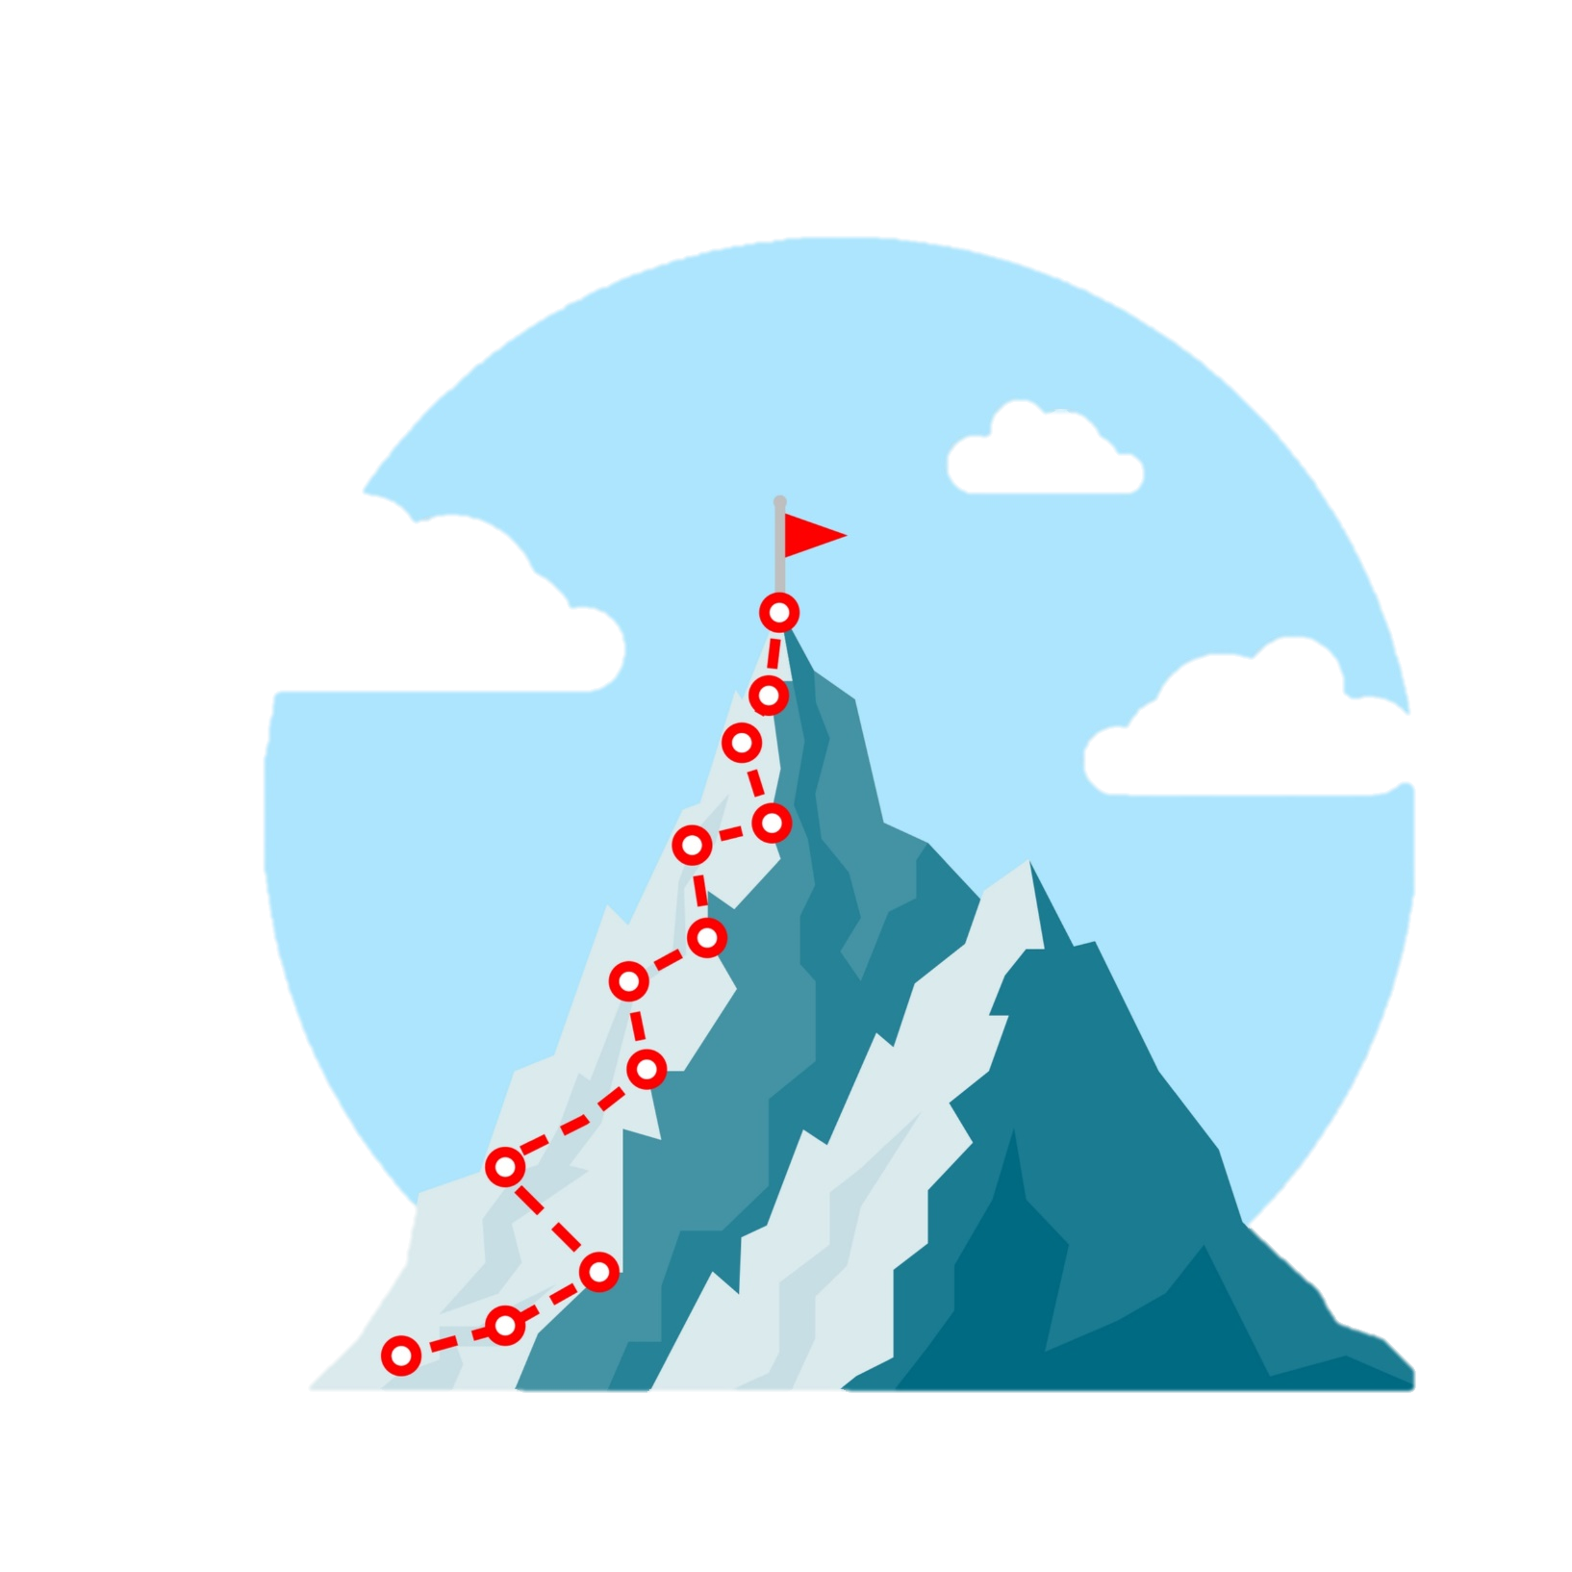


Quick Wins Should Build Towards the Journey
As part of the Roadmap Planning
  Show how each Quick Win fits as a step towards the goal
  Plan the timing and coordination accordingly
Tie these steps into the larger Story and Vision

Slide 78
HOTEL GROUP CASE STUDY ACTIVITY
Use the Boston Grid to identify at least 5 potential top priority activities which should be included in a Data Strategy for the Hotel Group
Try to ensure that you identify at least 2 quick win projects
78
This Photo by Unknown Author is licensed under CC BY-SA

Slide 79
Activity: Defining Priorities
Pick 5 potential top priority activities for the Hotel Chain and place them in the appropriate area of the matrix
Activity
High Benefits – Low Difficulty
High Benefits – High Difficulty
Benefits
Low Benefits – Low Difficulty
Low Benefits – High Difficulty
Level of Difficulty
Notes:
79

Slide 80

A Roadmap is Not a Laundry List
A common error is to create a roadmap that reads like a “Laundry List” of activities
  Create “themes” for each stage that tie into the vision
  Call-out “quick wins” and value for each activity
  Consider the WIIFM – what do key stakeholders care about?

Slide 81
Define Themes and Evolution
Tell the “Story” of the Journey by defining an overarching theme for each year
Year 3:
Innovation & Market Leadership
Year 2:
Growth & Efficiency
Year 1:
Foundation & Trust

Slide 82
Define Themes and Evolution
Build the roadmap around the themes
Year 3:
Innovation & Market Leadership
Year 2:
Growth & Efficiency
Fully integrate data catalog into operational environment
Complete customer & product MDM hubs
Operationalise data analytics and data science capabilities
Expand data warehouse to accommodate new reporting requirements
Create comprehensive self-serve reporting environment
Year 1:
Foundation & Trust
Acquire Data Catalog & populate with CDEs
Start MDM hub for product & customer data
Create reporting semantic layer
Deliver priority data quality improvement projects
Run analytics and data science pilot projects etc.
Create Data Governance Framework & organisation
Produce business cases for Yr 1 workstreams
Baseline CDE data quality & establish KPIs
Run data quality pilot projects etc.
etc.
DATA STRATEGY ROADMAP TIMELINE

Slide 83
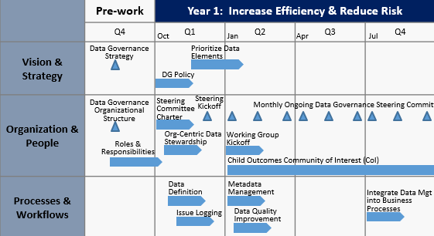
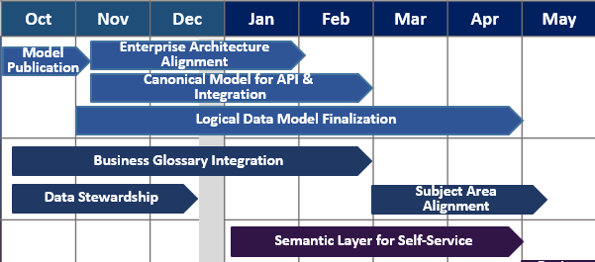
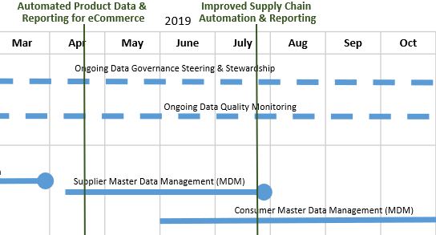
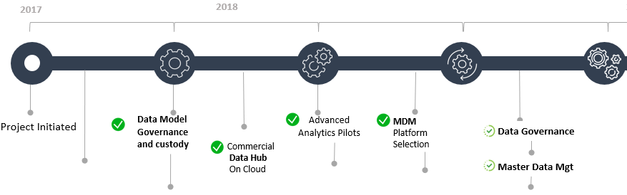
How to Visualise the Roadmap
The way the roadmap is visualised is highly subjective based on the audience.
Understand your stakeholders & the level of detail and style they prefer. You may have several versions for different audiences.

Slide 84
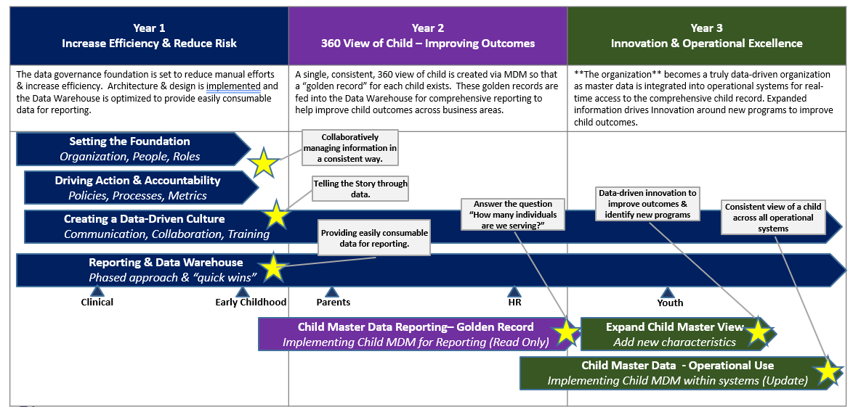
Create Themes for the Roadmap
Tell the story of the evolution Year over Year
  Showing a 3 year trajectory with a theme/aspiration for each year
  High-level activities shown in a Gantt – like chart
  “Quick wins” highlighted with narration”

Slide 85

Align with Other Roadmaps
When building the Data Strategy, it’s important to align with other key Roadmaps being developed.
  Can the Data Strategy provide benefits that support these Roadmaps?
  Will there be any conflicting resources?
  Are there marketing events or communications you can align with and leverage the momentum?
Data Strategy

Slide 86
HOTEL GROUP CASE STUDY ACTIVITY
From the Data Maturity assessment carried out earlier:
  Identify 3-5 potential Roadmap themes and give each a 1or 2 word title
  List 2-3 key objectives for each of the themes / objectives. The objectives should relate to potential data strategy work packages or projects
86
This Photo by Unknown Author is licensed under CC BY-SA

Slide 87
Activity: Roadmap Themes and Goals
Theme 1 | Theme 2 | Theme 3 | Theme 4 | Theme 5
Objectives | Objectives | Objectives | Objectives | Objectives
1. | 1. | 1. | 1. | 1.
2. | 2. | 2. | 2. | 2.
3. | 3. | 3. | 3. | 3.

Slide 88
Delivering the Roadmap
The Need for Data Governance

Slide 89
Data Governance – A Simple Definition
Business Led Continuous Process
Data is a business asset so must be owned by the business
Data Governance must be an ongoing activity - it’s not a project
Improve Data
Data Governance must demonstrate business improvement through better data
Monitoring data without an improvement agenda is pointless
Benefit
The benefits of Data Governance must be real and measurable
All stakeholders (Business, IT, Customers, Suppliers, Regulators etc.) should recognise the benefits it brings to them
Data Governance is a business led continuous process to improve data for the benefit of all data stakeholders
89

Slide 90

Data Governance: The Bridge Between Business & IT
DATA
GOVERNANCE
TECHNICAL
DATA TEAMS
BUSINESS
FUNCTIONS
90

Slide 91
Data Strategy and Data Governance – mutual allies
Data Strategy
Sets overall direction & priorities for
Data Governance
Provides means to deliver & enforce
Most successful Data Strategies depend on Data Governance as the primary mechanism to deliver it

Slide 92
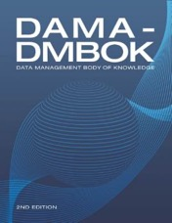
Data Governance – Relationships with Other Data Disciplines
DISCIPLINE | EXAMPLE RELATIONSHIPS
Data Quality | Data Quality requires Data Governance to drive & sustain improvement so it becomes BaU
Data Architecture | Designs the structural framework for the management of data across platforms & systems
Data Modelling & Design | Identifies business definitions, entities & attributes to focus Data Governance activities
Data Storage & Operations | Lack of business accountability for data can impact Data Storage & Operations efficiency & reliability
Data Security | Lack of business accountability makes data less secure & more open to fraud
Data Integration & Interoperability | Depends on defined & consistent data formats & content
Documents & Content | Good Data Governance practices support Documents & Content, e.g. content ownership, version control, tagging, taxonomies
Reference & Master Data | Manages widely shared, business critical data, ensuring single truth data. Governance of the data is critical for success.
Data Warehousing & Business Intelligence | Data Governance is the foundation of effective DW&BI (e.g. business definitions for KPIs etc.). Also garbage in, garbage out is as true as ever.
Metadata | Metadata provides context & meaning to data and so supports effective Data Governance
11 DATA DISCIPLINES
Data Architecture
Data Quality
Data Modelling & Design
Metadata
Data Governance
Data Storage & Operations
Data Warehousing & Business Intelligence
Data Security
Reference & Master Data
Data
Integration & Interoperability
Documents &
Content
DAMA DMBOK – Version 2 2017

Slide 93







Data Governance Roles
Executive Sponsor
Business Data Owner
Business Data Steward
Technical Data Steward
Promotes Data Driven Culture
Champions Best Practices
Advocate with ELT and Board
Escalation Point for Key Issues
Represents the data needs for a particular functional area
Defines key KPIs & data elements
Defines key business rules
Sets Data Quality Metrics & Thresholds
Responsible for the day-to-day management and quality of data
Subject Matter Expert (SME) for a given business domain
Aligns with the Data Owner to support business rules and to align with key KPIs
Digital/IT expert for a given business unit
Subject matter expert for a given system and its usage
Aligns with Business Data Stewards to ensure technical needs are met
Data Strategy and / or Governance Lead*
Acts as a cross-functional lead for the data governance effort, working with both business and IT roles
Chair of the Data Governance Steering Committee
Data Architect*
Oversees the holistic data architecture for the organisation, including data models, data standards, data integration, etc.
Works with both business and technical stakeholders to ensure that systems implementations align with key business rules & needs
Data Security Lead*
Ensures that the organisation adheres to the adequate security standards to support industry regulations and best practices
Works with the Data Governance Lead and Data Architecture to ensure that data implementations support business needs in a secure way.
* Typically a full-time role

Slide 94

How might you determine who Data Owners and Data Stewards should be?
DISCUSSION
This Photo by Unknown Author is licensed under CC BY-NC-ND

Slide 95


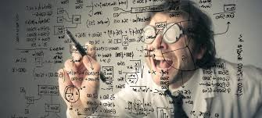

How to Find Potential Data Owners & Data Stewards
De Facto (Maybe Unrecognised) Owners & Stewards
People Who Feel the Pain of Poor Data
Data Domain Experts / Geeks
(The ‘Go To’ person)
Enthusiasts Seeking a New Challenge

Slide 96

Example Strategy / Governance Organisation
Executive Leadership Team
Executive Level
Executive support
Data advocacy
Vital to have ELT level sponsor and champion
Executive Sponsor
Dept. Head 1
CIO
Dept. Head 2
Dept. Head 3
Dept. Head 4
Dept. Head 5
Dept. Head 6
Strategic Level
Data Strategy & Governance Steering Group
Owns and enacts the Data Strategy
Sets strategic direction for Strategy & Data Governance
Owns the Roadmap
Identification of working groups as needed
Funding within budgeted amounts for data quality & governance
Identification of data stewards for key data areas
Arbiter in the case of conflicting needs, definitions, or priorities around cross-functional use of data.
Updates & Escalation
Data Strategy Lead
IT
Representative
Data Owner 1
Data Owner 2
Data Owner 3
Data Owner 4
Data Owner 5
Data Owner 6
Invited Data Stewards
Other SMEs (e.g. DPO, HR, Legal)
Data Strategy / Governance Working Groups
Tactical Level
Creation & Direction
Data Steward
Business Data Stakeholders
Technical Data Stakeholders
Other SMEs e.g. DPO, HR
Create Data Improvement Plans for Data Domains
Propose and progress data improvement initiatives
Report progress to Data Governance Steering Group
Escalate cross-domain issues and barriers to DG Steering Group
Updates & Escalation
Leadership
Management & Progression
Data Owners & Data Stewards by Data Domain (e.g. Property, Customer, Finance etc.)
Data Plans & Activities
Key
Lead Role
Technical Role
Business Role

Slide 97
Business & IT Roles in Data Strategy
BUSINESS ROLES | IT ROLES | JOINT ROLES
Establish a clear and communicable Business Strategy | Understand the Business Strategy & its potential technology implications and requirements | Formulate & execute the Data Strategy
Prioritise key data areas and problems | Evaluate, select & procure appropriate data technologies to support the Data Strategy | Ensure both business & IT senior management play an active role to ensure its success
Owns the Strategy through the establishment of Data Governance principles & practices | Understand and introduce Data Management industry best practices and methodologies | Exercise rapid and effective change control
Estimate, measure & realise potential and actual benefits delivered by the Data Strategy | Be aware of technology innovations and propose how these can be introduced to enhance the Data Strategy, e.g. Big Data, Cloud, Internet of Things, AI etc. | Monitor Data Strategy deliverables and instigate corrective action as required
Enact the business process and behavioural changes required to implement the Data Strategy | Proactively propose how future technologies might improve and enrich the Business Strategy | Ensure constant cross-business & IT collaboration to ensure continued alignment of Business & Data Strategies

Slide 98
Data Strategy Development – Potential Deliverables & Useful Tools
POTENTIAL DELIVERABLES
Data Strategy Slide Deck + 2 /10 min. pitches
Motivation Model
Stakeholder Matrix
Data Issues & Opportunities Log / Matrix
Business / Conceptual Data Model
Outline Business Case
Maturity Assessment Report Summary
Roadmap (1-3 Year Horizon)
Data Strategy Steering Group Charter
Data Strategy Working Group Charter
Application Landscape Diagram (Current)
Application Landscape Diagram (Future)
Business Glossary
Communications Plan
USEFUL TOOLS
PowerPoint / Visio
Data Modelling Toolset (e.g. ERwin, ERStudio)
Data profiling tool to baseline data quality in current source systems

Slide 99
Selling the Data Strategy
The Critical Importance of Change Management

Slide 100

‘ Culture eats strategy for breakfast.’
Peter Drucker,
Management
Strategist & Consultant
100

Slide 101
Tell the Story – Explain Vision and the Journey to Get There
Storytelling and vision-building is a key part to any strategy.
  Build a sense of excitement
  Provide a vision for what the future will look like
  Show the journey and the effort required
  Explain the steps to achieve the journey
  Clarify everyone’s role in the journey – where do they fit, and what skills do they need?

Slide 102






Organisational Change Happens at Three Levels
An organisational move to a future state requires individuals to reach their own future state
“how do we successfully achieve large scale transformation”?
“who are the impacted groups and how do we support them”?
Data Governance directly impacts the culture of an organisation
“In what ways are my current responsibilities affected”?
Organisation
Affect culture changes in the enterprise by embedding Change Management into every Data Strategy initiative
Project
Increase outcomes and ROI by integrating activities into the project plan that help prepare, manage, and reinforce change and results in adoption and usage
Individual
Enable people’s success by supporting them through the dimensions of change
“The achievements of an organisation are the results of the combined effort of each individual”.
Vince Lombardi
102
Reference PROSCI for methodology content
Notes:
Trying to illustrate the complexity of culture change

Slide 103
Methods for Managing the Change Impact of Data Strategy & Data Governance
1. Stakeholder Assessment
Identify, evaluate, and properly support people who can exert influence or pressure on your change, are responsible for creating your change, choose to use or not use the results of your change, & benefit from the work of your change
Key Success Enabler For:
Overall Adoption and ROI
2. Communication Planning
Aim to build awareness, interact with stakeholders, solicit feedback, elicit transparency, and publicly celebrate success as appropriate
Key Success Enabler For:
Awareness & Reinforcement
3. Knowledge & Coaching Plans
Develop a competency skill set in impacted stakeholders by providing tools, vocabulary, and best practices and other training they can utilise effectively in their roles and ensure their ability to be able to adopt changes appropriately
Key Success Enabler For:
Knowledge & Coaching
4. Resistance Management
Directly addresses barriers to successful adoption of change and increases the overall effectiveness of change management
Key Success Enabler For:
Interest & Excitement
Notes:
2. Manage the Change

Slide 104
Stakeholder Assessment Example
Evaluate by using your stakeholder matrix and categorise into impacted groups
Rate each group in each Change Phase from 1-5 (1 = least favorable 5 = most favorable)
The output score for each group allows the Change Mgt Team to prioritise the plans that are needed for each stakeholder group
104

Slide 105

The importance of culture change & communication
Remember that a Data Strategy is transformational and so must impact and involve all in the organisation who touch data
This includes Data Creators & Data Consumers in addition to formal roles such as Data Owners, Stewards etc.
Communication is critical as:
  Data Strategy is a collaborative activity
  It requires alignment of business and IT
  All people in the organisation are required to change behaviours to support new ways of working
Develop a clear communications plan and disseminate to all
Develop case studies / use cases of successes
Use existing internal events, newsletters, web sites etc.
Create a ‘home’ for Data Strategy materials (web site etc.)
105

Slide 106

Garnering Excitement - Engage Marketing & Branding
It’s beneficial to engage with your internal Marketing organisation and/or an external agency
Include a number of activities and materials in your communication and marketing plan. Here are a few ideas:
Video Testimonial from users/stakeholders
Executive sponsor video
Lunch and learn sessions
Roadshows
Training sessions
Newsletters
Website for data initiative
Data initiative slogan
“Swag” – t-shirts, stickers, mugs, etc.
Posters
Badges and awards
AVOID DATA JARGON:
USE BUSINESS LANGUAGE!

Slide 107



Selling & Communicating Your Data Strategy
  2 minute ‘Elevator Pitch’
    This should simply state what a Data Strategy is, why your organisation needs it, how are you going to deliver it, and what the expected benefits will be.
    It’s best memorised and replayed whenever you need it. This is useful when asked what your job is and what you are trying to achieve.
    It is also valuable when you are part of a Data Strategy core team to ensure all members of the team relay the same basic messages.
  10 minute ‘Taster Pitch’
    Create a PowerPoint deck to expand on the above which can be delivered by you and others when you get an opportunity to talk to a senior manager or if you can get an invite to scheduled team meetings held across the organisation.
    Try to use pictures to illustrate your key points – again these are more impactful than text lists and remember to include some of the stories you’ve collected. Use the ones most relevant to the audience of any particular pitch.
  30 minute ‘Full Pitch’
    Expand on the Taster Pitch above to provide a more in depth overview of your Data Strategy & roadmap.
    This can be used to brief key potential stakeholders and to convince people to become data owners and data stewards.
107

Slide 108


Discussion – Thinking of the Hotel Chain…
What do you think is the biggest resistance to change that a Data Strategy would face?
What would be the main excitement / opportunity drivers?

Slide 109
Discussion – Thinking of Your Organisation…
What do you think is the biggest resistance to change that a Data Strategy would face?
What would be the main excitement / opportunity drivers?

Slide 110
Summary
Use Cases & Key Messages & Conclusions

Slide 111
Summary: key steps to creating a Data Strategy
10 steps to success / key lessons learned
THE ESSENTIAL COMPONENTS OF A SUCCESSFUL DATA STRATEGY
Secure Senior Executive Support
Define Vision, Drivers & Motivations
Identify & Interview Stakeholders
Build the Business Case
    Elicit feedback from key stakeholders – listen & communicate
    Outline key benefits of data strategy & risks of not doing so
    Identify a Data Champion among senior leadership
    Define a business-driven vision for the strategy & Roadmap
Identify Business-Critical Data
Assess Data Maturity
Map Business Priorities to Data Capabilities
Create Change Organisation
    Focus on the data that has the highest impact on the business
    Assess the data maturity of the organisation across all aspects of data management
    Create a realistic “heat map” aligning business goals with data management capabilities
    Define an organisational structure to oversee and deliver the Data Strategy
    Implement change management to build support and engagement
Deliver “Quick” Wins
Communicate
    Short, iterative, business-driven projects deliver short-term value, building towards long-term gains
    Build a communications plan from initial feedback phase through all phases of implementation
Notes:
111

Slide 112
Summary: A Laser Focus on the Core Priorities
Business Needs & Drivers
Critical Data Elements
Data Management Capabilities
Current Data Problems
The core
of an effective and successful Data Strategy & Roadmap

Slide 113

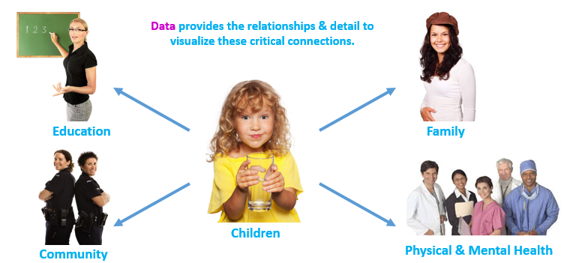

Case Study: Starfish Family Services
Using Data to Improve the Lives of Children
A local Head Start Program was looking to improve the lives of children & families through data, through a holistic, integrated view of the individual:
  Physical Health
  Mental Health
  Education
  Family Support
  Community Support
  Etc.
Global Data Strategy performed a Data Maturity Assessment & Strategy in 2017
  Evangelising to CEO
  Holistic view of Data Landscape
  Interviewing staff
  Maturity Assessment
  Alignment w/ Business Drivers
  Etc.
Resulting in a 5 Year Grant over $1M to better leverage data to help children
  Data Governance
  Data Warehousing
  Reporting & Analytics
  Master Data Management (MDM)

Slide 114

Building the foundations of a Data-Driven Business
through a Data Strategy
A lesson from Ancient Greece
For Data Strategy success,
anchor Digital Innovation with Foundational Excellence
And remember, like the Parthenon, building a Data Strategy is part art and part science
DIGITAL INNOVATION
Big Data
Analytics
Internet of Things
Artificial Intelligence
FOUNDATIONAL EXCELLENCE
Data Governance
Data Architecture
Data Quality
Master Data Management
114

Slide 115

Final Words
Contact Information
Email: nigel.turner@globaldatastrategy.com
Twitter: @NigelTurner8
Website: www.globaldatastrategy.com
Linkedin: uk.linkedin.com/in/nigelturnerdataman
“Great things are not done by impulse, but by a series of small things brought together.
And great things are not something accidental, but must certainly be willed.”
Vincent van Gogh
Good luck with your Data Strategy and hope our paths cross again!

