Slide 1
“A Data Strategy For Becoming Data Driven” Workshop Workbook Utrecht Thursday 12 October 2023 Nigel Turner Principal Consultant EMEA Global Data Strategy
1
1

Slide 2
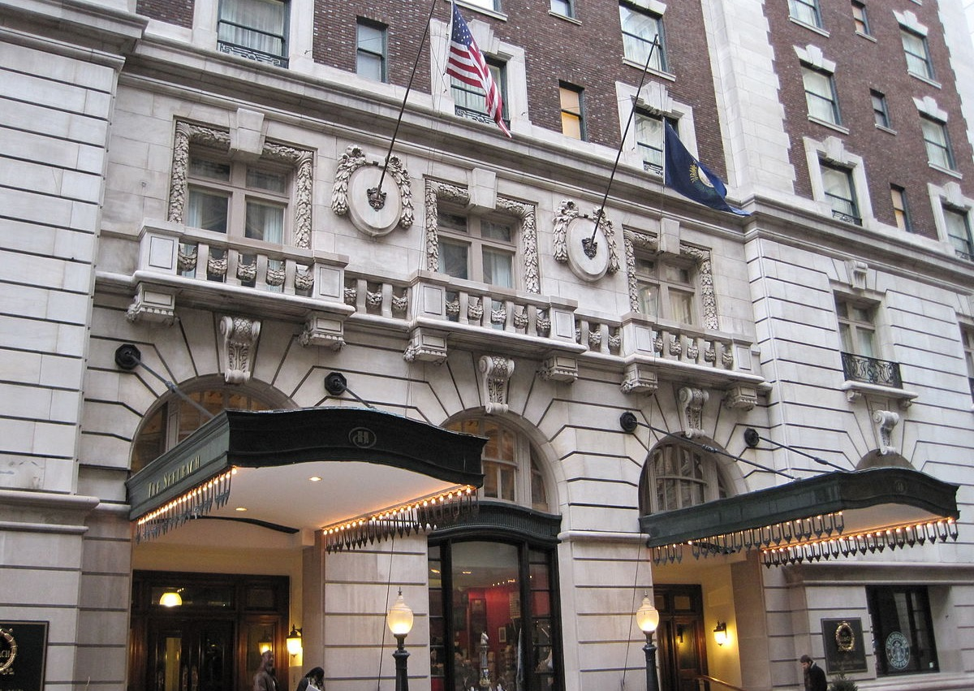
Case Study:
Global Destinations & Spas (GDS) Hotel Chain
The Global Destinations & Spas (GDS) Hotel Group is a hotel, casino, spa and nightclub chain.
The hotel has grown rapidly through aggressive acquisition and now has 30,500 employees.
Although the GDS Group has remained profitable, increasing competition from other chains & new accommodation services (e.g. Airbnb), and the rapid rise of online gambling, have been gradually eroding its profit margins over the last five years.
There is a low level of confidence in the accuracy of financial reports and the CFO is nervous about the financial and regulatory implications of this.
A new CEO was appointed six months ago. Her brief is to increase the profitability of the Group and assure its future.
ACTIVITY: Read the case study and then consider who would be the key stakeholders
This Photo by Unknown Author is licensed under CC BY-SA
Legal Disclaimer: This case study is based upon a purely fictional hotel business. Any resemblances to real hotel chains are unintentional and purely coincidental .

Slide 3
Activity – Stakeholders
Who are the Key Stakeholders for the Hotel Chain?
Who are the key stakeholders you need to engage with?
Include at least:
1 or more high-level managers or executives
1 or more operational staff members from “the field”
Any potential external stakeholders?
Key Stakeholders by Role/Title
1.
2.
3.
4.
5.
6.
7.
8.
9.
10.
Notes:
Photo from Microsoft stock images

Slide 4
Business Motivation for Global Destinations & Spas
Revisit the Hotel Case Study:
What is the Group’s stated Mission & Vision?
What are the top Internal & External Drivers? (Try to find at least 5 of each)
See next slides for templates
(see also workbook)
This Photo by Unknown Author is licensed under CC BY-SA

Slide 5
Activity – Business Motivation & Drivers
HOTEL GROUP MISSION:
HOTEL GROUP VISION:
EXTERNAL DRIVERS
________________________________
________________________________
________________________________
________________________________
________________________________
INTERNAL DRIVERS
________________________________
________________________________
________________________________
________________________________
________________________________

Slide 6
HOTEL GROUP CASE STUDY ACTIVITY
Perform a high-level enterprise Data Management maturity assessment of the Hotel Group
Use the Data Management Capability topics to help your assessment
Highlight a score for each capability between 1 & 5 where:
1 is lowest capability (Current or Desired)
5 is highest capability (Current or Desired)
Provide a brief reason for your scores
Use the Assessing Maturity template and the Data Management Capability topics in the workbook to complete the activity
6
This Photo by Unknown Author is licensed under CC BY-SA

Slide 7
Activity – Assessing Maturity
Data Maturity Capability | Current State Score | Desired Future State Score (within 3 years) | Reason
Data Strategy
Data Governance & Collaboration
Master Data Management
Data Warehousing
Business Intelligence
Data Analytics
Data Quality
Data Architecture & Modelling
Data Asset Planning & Inventory
Data Compliance & Security
Data Integration
Metadata Management
Rating Scale for Current State Score & Desired Future State Score:
1 = Lowest
5 = Highest

Slide 8
Performing a Current & Future State Assessment: Capabilities
DATA MANAGEMENT CAPABILITY | EXAMPLE TOPICS ANALYSED
Data Strategy | Alignment of data to business strategy; budgets & resources; communication
Data Governance | Accountability; stewardship; data issue management; critical data identification
Master Data Management | Master & reference data storage & processing; matching rules; hierarchies; CDEs
Data Warehousing | DW capability; performance & scalability; documentation; design methodologies
Business Intelligence | Provision of user reports; tooling; self-service; semantic layer; visualisation
Data Analytics | Operational v predictive; use of data science, AI/ML; social media; geographic data
Data Quality | Measurement & KPIs; root cause analysis; tooling; enrichment; data entry validation
Data Architecture & Modelling | Models; data standards; process / data mapping; system architecture; documentation
Data Asset Planning & Inventory | Location & documentation of data assets; data lifecycle management; data retention
Data Compliance & Security | Legal & regulatory compliance processes; privacy tagging; access & security controls
Data Integration | Batch v real time capability; APIs ; common business logic; platforms & tools
Metadata Management | Business data glossary, dictionaries & catalogs; data lineage; maintenance processes

Slide 9
Activity: Making the Business Case
What are some key areas that can drive ROI for the hotel?
List some of the ROI drivers for the hotel chain in each of the areas below:
Decreasing Costs
Increasing Revenue
Reducing Risk
Protecting Reputation
1.
2.
3.
4.
5.
1.
2.
3.
4.
5.
1.
2.
3.
4.
5.
1.
2.
3.
4.
5.
Notes:
Photo from Microsoft stock images

Slide 10
HOTEL GROUP CASE STUDY ACTIVITY
Use the Boston Grid to identify at least 5 potential top priority activities which should be included in a Data Strategy for the Hotel Group
Try to ensure that you identify at least 2 quick win projects
10
This Photo by Unknown Author is licensed under CC BY-SA

Slide 11
Activity: Defining Priorities
Pick 5 top priority activities for the Hotel Chain an place them in the appropriate area of the matrix
Activity
High Benefits – Low Difficulty
High Benefits – High Difficulty
Benefits
Low Benefits – Low Difficulty
Low Benefits – High Difficulty
Level of Difficulty
Notes:
11

Slide 12
HOTEL GROUP CASE STUDY ACTIVITY
From the Data Maturity assessment carried out earlier:
Identify 3-5 potential Roadmap themes and give each a short title
List 2-3 key objectives for each of the themes / goals. The objectives should relate to potential Data Strategy projects.
12
This Photo by Unknown Author is licensed under CC BY-SA

Slide 13
Activity: Roadmap Themes and Objectives
Theme 1 | Theme 2 | Theme 3 | Theme 4 | Theme 5
Objectives | Objectives | Objectives | Objectives | Objectives
1. | 1. | 1. | 1. | 1.
2. | 2. | 2. | 2. | 2.
3. | 3. | 3. | 3. | 3.

