Slide 1
Tackling Data Quality Problems: As Simple As A2E Adept Events Training Nigel Turner Principal Consultant EMEA, Global Data Strategy Tuesday 5 December 2023
1

Slide 2
COURSE LEARNING objectives
Understand what ‘fit for purpose’ data is, and is not
Describe the dimensions of data quality
Know the main causes of poor data quality
Highlight the impact of poor data quality on individuals and organisations
Understand the relationship between data quality and other data management disciplines, with particular emphasis on data governance
Highlight the shortcomings of traditional ways of tackling poor data quality and the importance of a holistic approach, involving people, process and technology
Learn the five steps of the A2E methodology and how to apply it to identify, prioritise and address data quality problems
Specify and apply the main activities and deliverables of each of the five steps
Be able to understand and develop business rules to baseline data quality and to set improvement thresholds
Be aware of software tools that can help to support and automate the A2E approach
2

Slide 3
Course Logistics
Start at 9:00 and end at 13:00
There will be three 10-minute breaks during the course
Note that you will receive today’s slides as a PDF after the course
This is an interactive course so please contribute to the discussions and activities
Please also complete course evaluation forms after the end of the course

Slide 4
Course Agenda (Indicative)
SESSION | TITLE | START TIME | END TIME
1 | Scene Setting & Introductions | 9:00 | 9:20
2 | Data Quality: The Basics | 9:20 | 10:00
 | Break | 10:00 | 10:10
3 | Holistic Approaches to Data Quality Improvement | 10:10 | 10:20
4 | The A2E Approach: ASSESS | 10:20 | 11:00
 | Break | 11:00 | 11:10
5 | The A2E Approach: BASELINE | 11:10 | 11:40
6 | The A2E Approach: CONVERGE | 11:40 | 12:00
 | Break | 12:00 | 12:10
7 | The A2E Approach: DEVELOP | 12:10 | 12:35
8 | The A2E Approach: EVALUATE | 12:35 | 12:45
9 | The Future of Data Quality | 12:45 | 12:50
10 | Summary & Conclusions | 12:50 | 13:00

Slide 5
Please briefly introduce yourself by sharing:
Your name, job role and organisation
Your experience of data management / data quality
What do you want / expect to get out of this course?
Introductions
5

Slide 6
Who Am I?
35 years’ experience in IT & Business Strategy; 27 years in Data Management
2015 to present: Principal Information Management Consultant EMEA, Global Data Strategy. Worked with private and public sector clients in the UK and Europe, North America and the Middle East. Currently acting Chief Data Officer at a global financial company.
2010 to 2015: IT & Data Consultant at Trillium Software, IPL and FromHereOn (Enterprise Architects)
1981 to 2010: Worked for British Telecommunications (BT) as graduate entrant, programmer, business analyst, project manager, programme manager, unit head, director. Ultimately ran a £15 million revenue Information Management & CRM practice.
1997 to 2005: While at BT, led an Information Quality improvement programme that delivered recorded benefits of over £650m and was praised by Gartner, Forrester and others
Former Vice Chair of the Data Management Association of the UK (DAMA UK) and still a DAMA UK Committee Member
Born and still live in Wales in the United Kingdom
Follow on Twitter - @NigelTurner8
Follow on LinkedIn - https://www.linkedin.com/in/nigelturnerdataman/

Slide 7
What is Data Quality?
How do you know if Data Quality meets user and business needs?
DISCUSSION
7
This Photo by Unknown Author is licensed under CC BY-NC-ND

Slide 8
Data Quality – A Simple Definition
Demonstrably: Implies that data quality & improvement can be measured, and business impact demonstrated
Fit for Purpose: Data quality must meet the needs of the organisation and its stakeholders
Data that is demonstrably fit for purpose

Slide 9
Work through the following examples:
What do you think are desirable and achievable levels of data quality ‘fitness for purpose’ in each?
Answer as a percentage from 0% to 100%
ACTIVITY
9
This Photo by Unknown Author is licensed under CC BY-NC-ND

Slide 10
Use Cases 1 & 2: ‘Fit for Purpose’
USE CASE 1
You are a marketeer within a consumer products business. Your company is about to launch a new product. You choose initially to target this product at your existing customer base.
To do this you decide to send an email to every customer on your marketing database. However, some customers may have moved without informing you, and you know you have duplicate records on the database. What should your data quality target be and why?
ANSWER | % | REASON:
USE CASE 2
You are a student records manager in a College of Further Education. Your job is to ensure that marks obtained by students on courses run by your college are recorded in a central database. You strive to enter records accurately but know that as you put marks manually into the database occasionally you enter a wrong score. In any case the lecturers who provide you with the marks themselves make mistakes. Eventually you know that someone will notice any errors (often the student) and the marks can be corrected.
ANSWER | % | REASON:

Slide 11
‘Fit for Purpose’ Data
‘Fit for purpose’ implies that 100% data quality is not always required or necessary
What is ‘fit for purpose’ depends on the specific needs of the organisation
When assessing what ‘fit for purpose’ means in any particular use case, it is important to understand the specific business context and use of the data
When data is used for several different purposes, the definition of ‘fit for purpose’ will vary from user to user
Where this happens, ‘fit for purpose’ data ideally needs to meet the needs of all its users; where not possible or practicable a compromise should be sought
Global Data Strategy, Ltd. 2023

Slide 12
DISCUSSION
What might go wrong if data is not fit for purpose?
12
This Photo by Unknown Author is licensed under CC BY-NC-ND

Slide 13
Data Quality
Horror Stories
Quiz
ACTIVITY
13

Slide 14
Data Quality Horrors Quiz – Question 1
In April 2021 a report highlighted that “a serious incident” had occurred at Birmingham airport, UK in July 2020. Three planes took off that day, but the total weight of each of these planes was underestimated by an average of 1,200kg per flight. As weight is key in determining the take off speed this error could have caused a potential catastrophe.
This problem was the result of:
Pilot error as the pilots misread the weight calculations provided
The system which calculated the weights had inbuilt business rules that assumed every passenger with the prefix ‘Miss’ was a child
The weight information provided was wrongly labelled in Pounds (lb) rather than Kilograms (kg)
The weight of the passenger luggage in the hold had been omitted from the calculations

Slide 15
Data Quality Horrors Quiz – Question 2
In a wide ranging survey in 2017, The Harvard Business Review asked 75 executives across 75 different organisations to extract 100 records from core systems in their companies to analyse if the records contained data quality errors.
The results of the survey showed that the percentage of the 100 records which contained one or more critical data quality errors was:
17%
47%
77%
97%

Slide 16
Horror Story 2: Evidence of Failure
Source:
Only 3% of Companies’ Data Meets Basic Quality Standards
Tadhg Nagle, Thomas C. Redman & David Sammon
Harvard Business Review
September 11 2017

Slide 17
DISCUSSION
How does this compare with your own organisation?
Would you say it was better, the same or worse?
17
This Photo by Unknown Author is licensed under CC BY-NC-ND

Slide 18
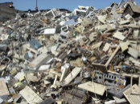
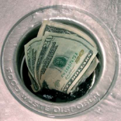
The Industry Impact of Poor Data – The Evidence
On average, half of all organisations believe
at least 26% of their data is inaccurate
(Source: BARC 2019)
On average, poor data quality costs companies between 15-25% of revenue
(Source: MIT Sloan 2017)
Most organisations believe at least 30% of their customer data is inaccurate; 49% do not trust the data in their ERP or CRM systems
(Source: Experian 2019)
Companies lose on average $13 million a year because of poor data
(Source: Gartner 2021)

Slide 19
Law & Regulation: a reminder
GDPR 2018: the Six Key Principles
Data should be:
Processed lawfully, fairly and in a transparent manner…
Collected for specified, explicit and legitimate purposes and not processed further in a manner that is incompatible with those purposes…
Adequate, relevant and limited to what is necessary…
Accurate, and where necessary, kept up to date…personal data that are inaccurate… are erased and rectified without delay
Kept in a form which permits identification of data subjects for no longer than is necessary…
Processed in a manner that ensures appropriate security…
Source: Quant Marketing

Slide 20
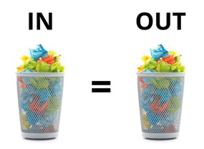
Data Quality – why it matters
Data quality is a foundational data discipline
Without ‘fit for purpose’ data quality all other data management disciplines (e.g. BI, MDM, Analytics etc.) can never deliver their promised benefits
Poor data quality in organisations:
Increases costs
Leads to operational inefficiencies and lower productivity
Reduces revenues and profits
Increases risk – poor decision making, breaching legislative / regulatory requirements etc.
Damages organisational brand and reputation
Alienates customers and deters potential customers
GARBAGE IN, GARBAGE OUT ………………………………………………………

Slide 21
Data Quality – relationships with other data disciplines
DISCIPLINE | EXAMPLE RELATIONSHIPS
Data Governance | DQ requires DG to drive & sustain improvement
Data Architecture | DA designs the structural framework for the management of DQ
Data Modelling & Design | DA&M identifies business definitions, entities & attributes to focus DQ improvements
Data Storage & Operations | Poor DQ impacts DS&O efficiency & reliability
Data Security | Poor DQ makes data less secure & more open to fraud
Data Integration & Interoperability | DI&O depends on defined & consistent data formats & content
Documents & Content | Good DQ practices support D&C, e.g. version control, tagging, taxonomies et al
Reference & Master Data | R&MD manages widely shared, business critical data, ensuring single truth, high quality data
Data Warehousing & Business Intelligence | DQ is the foundation of effective DW&BI (e.g. business definitions for KPIs etc.). Also garbage in, garbage out is as true as ever.
Meta-data | MD provides context & meaning to data and so enhances DQ
11 DATA DISCIPLINES
Data Architecture
Data Quality
Data Modelling & Design
Metadata
Data Governance
Data Storage & Operations
Data Warehousing & Business Intelligence
Data Security
Reference & Master Data
Data Integration & Interoperability
Documents &
Content
DAMA DMBOK – Version 2 2017

Slide 22
The Causes of Poor Data Quality

Slide 23
DISCUSSION
Thinking about your own organisation, why is your data quality not always ‘fit for purpose’?
23
This Photo by Unknown Author is licensed under CC BY-NC-ND

Slide 24
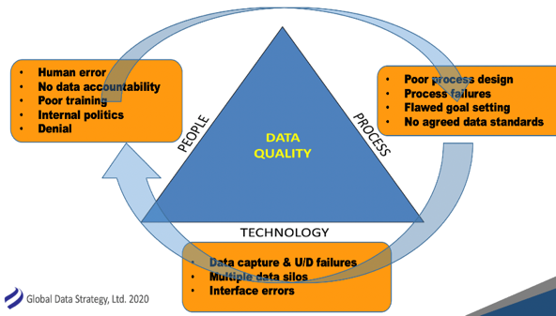
Why Does Poor Data Persist? (1)
The data world has become more complex & diffuse
(Volume, Variety, Velocity)
The world constantly changes, and data models the world
Poor data is a business problem, not an IT problem, so holistic solutions required
People will make mistakes with data (e.g. data entry, data amendment etc.)
24

Slide 25
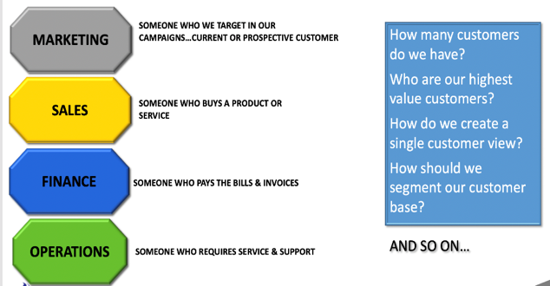
Why Does Poor Data Persist? (2)
Data flows horizontally, but organisational silos hinder collaboration
Absence or conflict of data definitions
Data problems often emerge far away from the cause
Lack of accountability for improving data
Lack of context & metadata can cause misunderstandings and confusion
“If we are all supposed to be responsible, no one is responsible and nothing changes”
(Quote from senior GDS client – Professional Services Organisation 2019)
25

Slide 26
DISCUSSION
How do these data quality challenges identified in a recent survey compare with yours?
26
This Photo by Unknown Author is licensed under CC BY-NC-ND

Slide 27
Primary Data Quality Challenges
Headline Findings:
Data quality challenges remain holistic, embracing people, process and technology issues
Business challenges include culture change, skills, training, senior management buy in etc.
Technical challenges include scaling, handling new data types, and managing data quality across multiple platforms and sources
Challenges embrace all stages of the data lifecycle, from data creation to data usage and publication
Source: 2022 State of Data Quality, TDWI, James Kobielus
Available for download at https://globaldatastrategy.com/resources/white-papers/
27

Slide 28
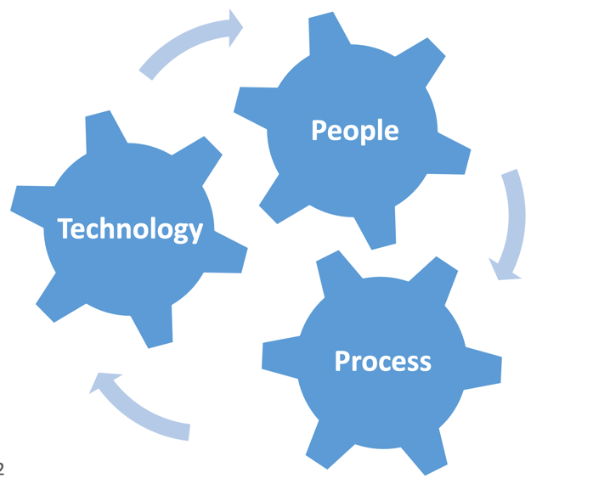
A Better Way:
Holistic Approaches to Data Quality Improvement

Slide 29
Data Quality – it’s not about IF you do it but about HOW you do it
OPTION 1: FIGHT FIRES (REACTIVE)
OPTION 2: PREVENT FIRES (PROACTIVE)

Slide 30
Traditional Approaches to Data Quality
Highlight a business or IT problem where Data Quality is suspected or known to be a prime cause of the problem
Inspect data sources and highlight data deficiencies, omissions and duplication
Develop data standards and common data definitions
Build business rules to enforce and police data standards
Automate data cleanse and enhancement projects, using the business rules defined
Embed the standards & rules into both batch and real-time environments to keep the data clean
Produce Data Quality KPIs and measures to monitor ongoing quality and track trends
This approach still has value for specific data quality problems but
is REACTIVE rather than PROACTIVE… a more rigorous approach is required
to tackle and resolve organisation wide data quality problems

Slide 31
Tackling Data Quality: the Holistic A2E approach
Assess
Baseline
Converge
Develop
Evaluate
Step | Purpose
Assess Business Usage | Understand what data exists and how it is used within the organisation
Baseline Data Sources | Baseline the current quality of the data and assess how well it is meeting business needs
Converge on Business Critical Areas | Focus priorities to optimise early business benefits and set ‘fit for purpose’ quality targets to guide improvement activities
Develop Improvements | Design & deploy improvement initiatives (encompassing people, process, and technology) and measure the impact against targets
Evaluate Benefits & ROI | Regularly measure the data and continue to improve it so that it continues to meet current and future business needs
CYCLE OF CONTINUOUS DATA QUALITY
IMPROVEMENT

Slide 32
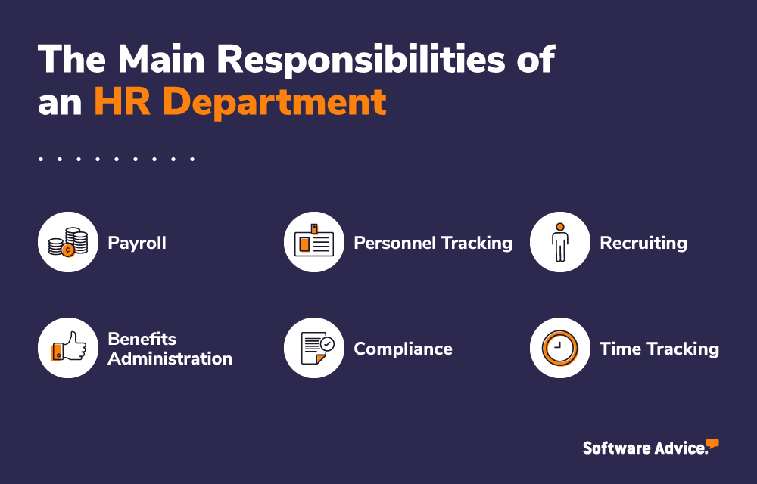
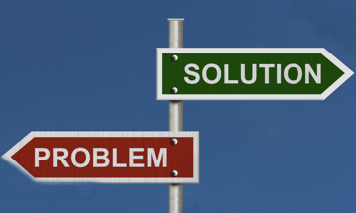
The A2E Approach: Where To Use It
TOP DOWN
ORGANISATION
FUNCTION / PROCESS
DEPARTMENT
DATA DOMAIN
BOTTOM UP
SPECIFIC DATA QUALITY ISSUE

Slide 33
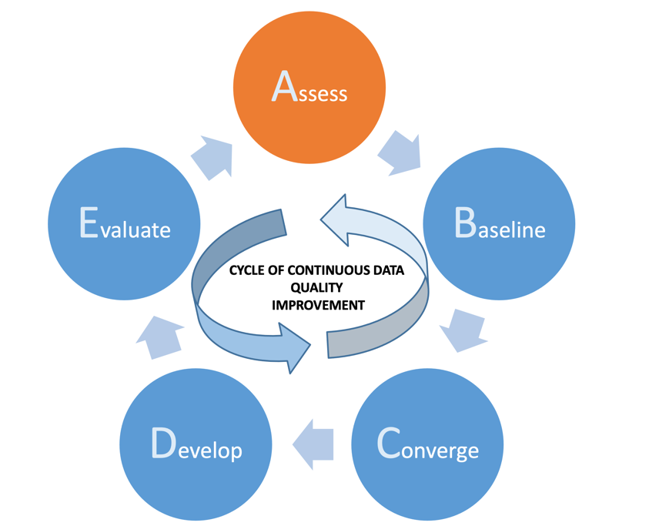
The A2E Approach:
Step 1 – Assess

Slide 34
A2E Step 1: Assess
ASSESS THE BUSINESS LANDSCAPE
POTENTIAL OUTPUTS & TOOLS
Understand the business and its primary goals & objectives
Analyse what data the business:
Relies on today
Will need to support its future aspirations
Identify the primary data stakeholders:
Business
IT
External parties (e.g. customers, suppliers, partners)
Work with them to evaluate current data ‘fitness for purpose’ and establish:
Where / how it is captured, stored and processed
What’s working well
What needs to be improved
The potential benefits of better data quality
Create a Data Quality Issues (& Opportunities) Log
Highlight:
Most important business critical data domains
Business impact
Main data creators and consumers
Accountability for the data
Current problems and issues with the data
Opportunities & potential benefits
Outputs may include:
RACI Stakeholder Matrix
Rich Picture highlighting real-world issues
Data Quality Issues Log
Business Data Model / Conceptual Data Model
Business Process Model
ROI analysis

Slide 35
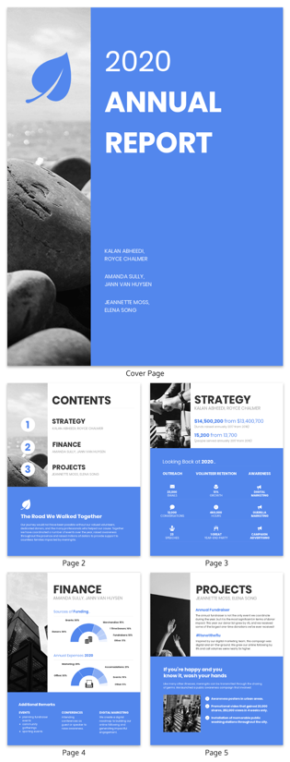
How to capture business goals and drivers (1) – Business
Look at organisation / company websites & documents (external and internal, e.g. Annual Reports) to highlight:
Current Mission & Vision
Strategic business aims and goals
Current challenges – external and internal
Consider how these depend on data and its effective management
For example, a business goal to ‘Increase our revenues from our top 10% revenue generating customers’
Data questions:
Can we identify our top 10% revenue generating customers?
What data issues may stop us doing that (data quality, data duplication, missing data etc.)
What are the business implications if we can’t?

Slide 36
How to capture business goals and drivers (2) – Data
Identify the primary data stakeholders (Include both Business & IT)
Set up 1-1 interviews, group interviews or workshops to highlight:
How are you currently using or managing data in your role?
What’s working well?
What needs to be improved and why?
What future data needs do you have and what opportunities can be taken with better (use of) data?
What are the current costs / lost opportunities of current data shortcomings? (Quantify in financial terms if possible)
What is your One Wish for data?
It’s important to speak to a wide range of roles across the organisation:
Senior Executives
Management roles (Business & IT)
Front line roles (Business & IT)

Slide 37
Example Stakeholder Matrix
RACI *:
R: Responsible
A: Accountable
C: Consulted
I: Informed

Slide 38
Data Issues & Opportunities Log: Suggested Template
ID | Short Name | Brief Description | Impact of the Problem / Potential Opportunity (Business & IT) | Raised By
1 | Customer Data Duplication | Both in the CRM platform and the Customer Data Warehouse there are known customer record duplications, mainly caused by marketing and sales people not being able or willing to search for an existing customer record. One estimate is that up to 25% of CRM customer records are duplicates. Data Warehouse duplication unknown. | Multiple marketing communications sent to the same customer, causing brand damage Inability to evaluate total customer lifetime revenue value Impossible to derive a single view of a customer Risks contravening GDPR if customer submits Data Subject Access Request (DSAR) and all data not returned Resolving this problem would accelerate MDM ambitions and enable better targeted 1-1 customer marketing | Bob Mills (Marketing Manager) Anna Ford (CRM Technical Architect) George May (Senior Sales Rep)
2
3
38

Slide 39
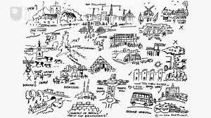
Data Quality Complexity & Value of Rich Pictures
Data Quality is a ‘messy’ and complex issue:
Problems often poorly understood (e.g. data flows and lineage)
Lack of information & hard facts (e.g. measures)
Large numbers of people involved with differing perspectives (e.g. data producers, data consumers, senior executives, customers, suppliers)
Problem ownership unclear (e.g. problem origins and impacts)
Rich Pictures have great value:
Ideal starting point for complex (messy) organisational problems like data quality
Holistic, embracing people, process & technology
Highlight interconnectedness of problems
Best initially created in a workshop (whiteboard and coloured pens ideal!) - encourage participants to contribute
Primary use is to derive ‘problem themes’ to enable focus on key issues

Slide 40
The following Rich Picture is of a hotel chain and its data problems
What are the main Data Quality themes that you can identify from the diagram?
DISCUSSION
40
This Photo by Unknown Author is licensed under CC BY-NC-ND

Slide 41
Our details again?!
RICH PICTURE OF DATA QUALITY PROBLEMS AT ACME HOTEL & CASINO GROUP
Help! I can’t improve data on my own
Our details again?!
6 CASINOS
10 NIGHTCLUBS
OUTMODED IT
Our details again?!
CEO (NEW)
COST
REDUCTION
CIO
GROWTH
We know our data stinks
BUSINESS & IT MEETINGS
1 HOTEL =
1 DATABASE
60 HOTELS
DUPLICATE
CUSTOMERS
Data? It’s not my problem
Poor data? Blame the CIO
STOCK PRICE
LOYALTY
SCHEME
POOR DATA
QUALITY
Stubs? Who cares? We don’t.
SHAREHOLDERS
BUSINESS
Valet Parking: Stubs not submitted loss £2.5M pa
CMO
Untrusted financial results
41% of all supplies are Emergency Supplies; cost £21.7m
CFO
COO
£315k lost on returned magazines
406 email addresses for Mickey Mouse in CRM
ACME TRAVEL
MAGAZINE
Finance data rework & delay

Slide 42
Our details again?!
RICH PICTURE OF DATA QUALITY PROBLEMS AT ACME HOTEL & CASINO GROUP
Help! I can’t improve data on my own
Potential need for IT investment
PROBLEM THEMES
Our details again?!
Uncontrolled customer data duplication
6 CASINOS
10 NIGHTCLUBS
OUTMODED IT
Our details again?!
CEO (NEW)
COST
REDUCTION
CIO
GROWTH
Lack of business accountability for data
We know our data stinks
BUSINESS & IT MEETINGS
1 HOTEL =
1 DATABASE
60 HOTELS
No single customer view
Data? It’s not my problem
Poor data? Blame the CIO
DUPLICATE
CUSTOMERS
STOCK PRICE
LOYALTY
SCHEME
POOR DATA
QUALITY
Cultural issues about data capture
Stubs? Who cares? We don’t.
SHAREHOLDERS
BUSINESS
Valet Parking: Stubs not submitted loss £2.5M pa
Financial data trust and rework
CMO
Poor marketing data quality
Supply management problems
Untrusted financial results
41% of all supplies are Emergency Supplies; cost £21.7m
CFO
COO
£315k lost on returned magazines
406 email addresses for Mickey Mouse in CRM
ACME TRAVEL
MAGAZINE
Finance data rework & delay
Notes:
No single view of customer
Uncontrolled customer data duplication
Cultural problems around valuing and using data (e.g. valet parking)
Lack of business accountability for data
Problems with both procurement and financial reporting; data probably an underlying cause
Potential need for new IT investment

Slide 43
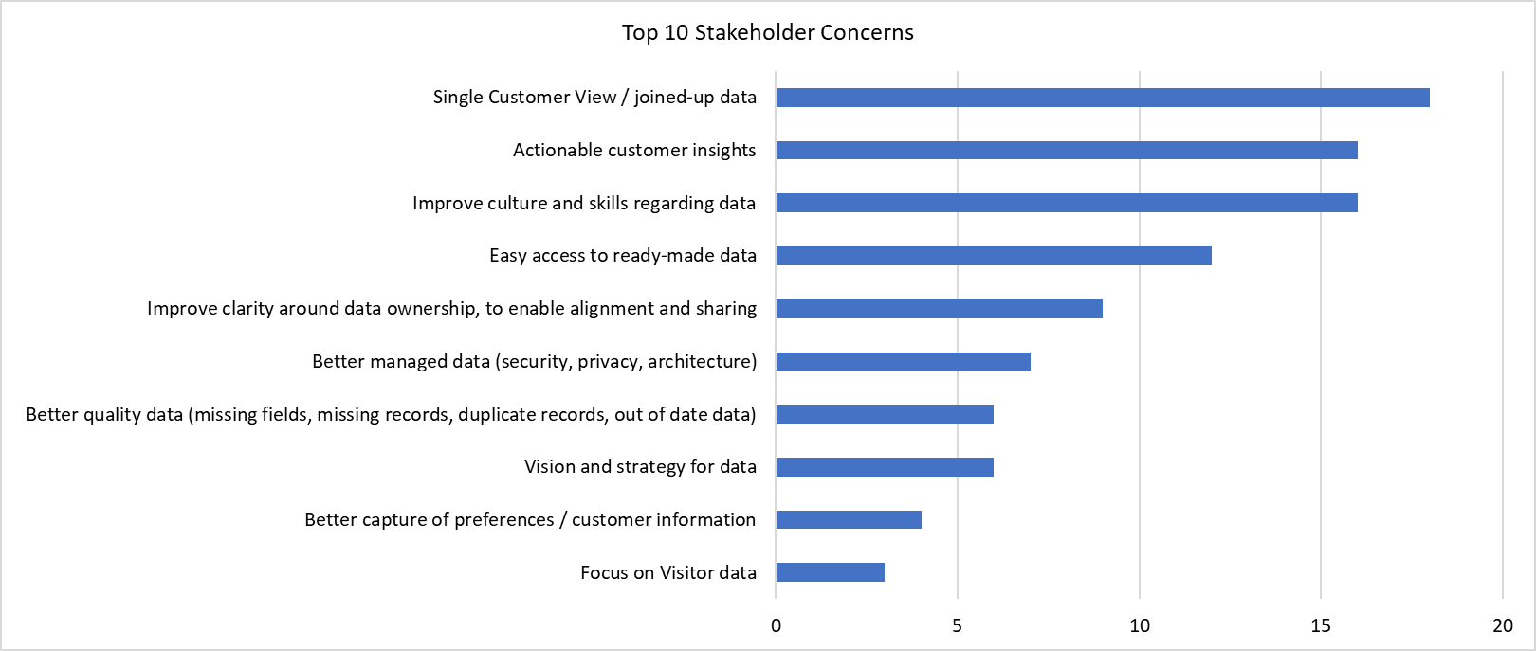
Example: What is your One Wish related to data? Top Themes: All Stakeholders
Top 10 Themes
Number of Interviewees Raising Theme
AnyCo faces some challenges due to its operating model of multiple businesses, and this came through strongly in the themes such as “Single Customer View / joined-up data” and “Improve clarity around data ownership, to enable alignment and sharing”
Total stakeholders interviewed = 63
See Appendix for list of Stakeholders, and details on Departmental findings

Slide 44
Data Quality: Real Example Motivation Model
Motivation for Customer Data Domain Improvement
XX - Current Customer Data Importance
External Drivers
highlight changes in the external environment that need to be addressed
Internal Drivers highlight internal functional or company initiatives
To support and enable excellent personalised customer relationships
XX – Future Data Vision
To enable all future service provision via online customer interaction
External Drivers
Internal Drivers
C
Increased Competition
Digital Transformation
Rise of Online Sales Channels
Fostering Community Engagement
Supporting Whole Family Care
Telling our Story through Data & Metrics
Revenue & Market Share Growth
Direct To Consumer (DTC)
Digital Transformation
Consumer Advocacy
Compliance and Regulation
Social Media & Online Community
Efficiency & Process Automation
Risk Reduction
Mergers & Acquisitions
High Level Goals
Specify main goals of DQ Roadmap
(NB: Headings can be varied)
Customer Data Improvement – High Level Goals
C
C
C
C
Governance
Data Quality
Innovation
Business Insight
Personal responsibility for data
Cross-functional collaboration
Aligned projects to deliver enhanced customer data management foundation
Single version of the truth
Automate data entry & checking
Ensure that key data is fit for business purposes
New perspectives into the business and the market
Understand customers & their needs
Feedback into new product & service development
Data-driven, fact-based decision making
Data available to all who need it
Real time operational & predictive analytics capability

Slide 45
What are the main External and Internal drivers for better Data Quality in your organisation?
Try to list 5 External and 5 Internal drivers
ACTIVITY
45
This Photo by Unknown Author is licensed under CC BY-NC-ND

Slide 46
Your Organisation – Business Motivation & Drivers for Better Data Quality
Suggest 5 internal and external drivers
EXTERNAL DRIVERS
________________________________
________________________________
________________________________
________________________________
________________________________
INTERNAL DRIVERS
________________________________
________________________________
________________________________
________________________________
________________________________
46

Slide 47
“Offence” vs. “Defence”
What are your main reasons for improving Data Quality in your organisation?
Offence
Defence
Focused on Creating Opportunity
Improving Profitability
Increasing Revenue
Improving Customer Satisfaction
Gaining Competitive Advantage
Focused on Reducing Risk
Ensuring Compliance & Regulation
Avoiding Audits or Fines
Fraud Detection
Security & Privacy
Discussion: On which end of the spectrum is your organisation?
47

Slide 48
Making the Case for Action
While Business Cases and ROI Calculations can be complex, they generally fall into 4 categories:
Decreasing Costs
Increasing Revenue
Reducing Risk
Protecting Reputation
Wasted labour costs due to manual efforts (Data cleansing, finding data, manual integration, etc.)
Inefficient business processes for data management (Product Master Data process)
Data quality cost avoidance (Wasted mailings sent to wrong addresses)
Price optimisation through Analytics
Improved marketing campaigns through quality customer data
Data-driven recommendation engines to enhance the sales cycle
Better grant applications through data-driven needs analysis
Industry regulations (GDPR, HIPAA, BCBS 239, Spice, HIPAA, etc.)
Product traceability (Food lineage from farm/catch)
Litigation due to data breaches
Health and safety audits
Customer satisfaction
Brand trust
Social media voice of consumer
Loyalty & ‘stickiness’

Slide 49
Include the Risk of Doing Nothing
There is significant cost and risk in the status quo
Doing nothing often has a higher cost than investing in data quality
Make sure to include the “do nothing” option in your analysis

Slide 50
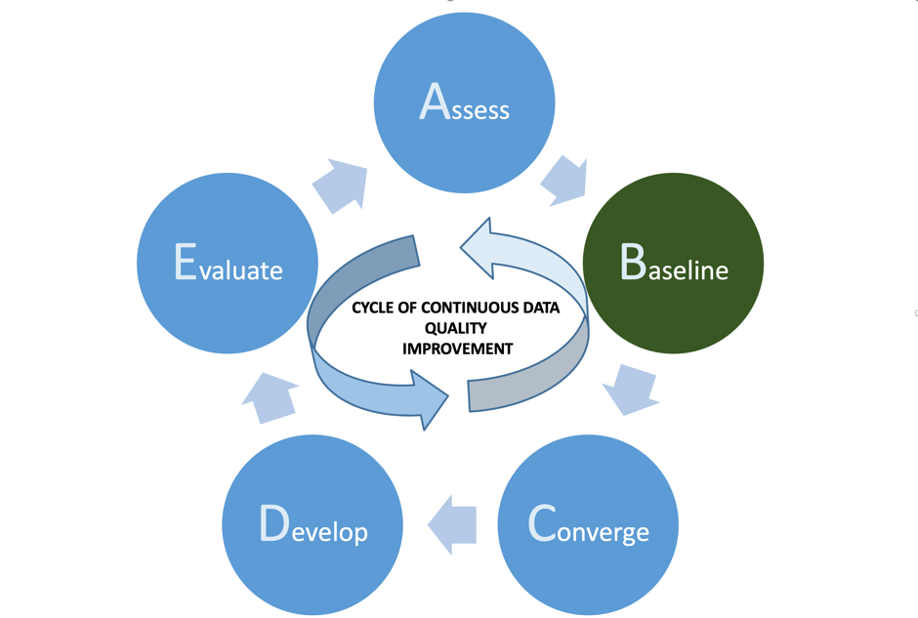
The A2E Approach:
Step 2 – Baseline

Slide 51
A2E Step 2: Baseline
BASELINE CRITICAL DATA SOURCES
POTENTIAL OUTPUTS & TOOLS
Gives a quantitative view of key data quality problems
Measure the baseline quality of key data sources to quantify the issues
To do this:
Select the key data sources and data domains identified in the Step 1 Assessment
Profile the data (ideally use a data profiling tool) and focus on key objects and attributes
Assess the data according to the 7 Dimensions of Data Quality – see later
Present the results to relevant stakeholders - gain consensus on the business impact of the problems found
Expand and refine the Data Quality issues log
Data Quality Report(s)
Data Profiling outputs – derived metadata
Updated Issues Log, with quantification of financial costs and other business impacts

Slide 52
From this extract of a real HR data source, list all the real or suspected data quality problems you can identify
Hint: There are at least 13 problems
ACTIVITY
52
This Photo by Unknown Author is licensed under CC BY-NC-ND

Slide 53
ACTIVITY – Extract of HR data source
EMPLOYEE NO | SURNAME | FIRST NAME | GENDER | DATE OF BIRTH | ROLE CODE
802540 | Smith | Brian | Female | 31/01/56 | PM16
YN4176B | Gregg |  | Male | 07/09/80 | 9999
811609 | Patel | Priya | XXXX | 25/12/78 | AL60
22298 | Bothroyd | Bridget | Female | 28/08/09 | TBD
802540 | Smith | Bryan | Male | 31/01/56 | PM10
855265 | Hayes | Leslie | Female | 00/00/00 | AL76
 | Taylor | Kevin | Unknown | 12/30/69 | US18
Note: Records extracted and anonymised from an actual HR database

Slide 54
ACTIVITY – Extract of actual HR data source
EMPLOYEE NO | SURNAME | FIRST NAME | GENDER | DATE OF BIRTH | ROLE CODE
802540 | Smith | Brian | Female | 31/01/56 | PM16
YN4176B | Gregg |  | Male | 07/09/80 | 9999
811609 | Patel | Priya | XXXX | 25/12/78 | AL60
22298 | Bothroyd | Bridget | Female | 28/08/09 | TBD
802540 | Smith | Bryan | Male | 31/01/56 | PM10
855265 | Hayes | Leslie | Female | 00/00/00 | AL76
 | Taylor | Kevin | Unknown | 12/30/69 | US18
Key:
Potential
Data Quality
Problem
Potential
Duplicate
Record
ANSWER: Total number of potential Data Quality problems is 13 or 19, depending on whether Smith is a duplicate record
54

Slide 55
Quantifying Data Problems: The Value of Data Profiling Tools
Data profiling tools automate the process of assessing and reporting on the quality of data sources
The benefits of data profiling include:
Fast processing of large data sets
Complete analysis of an entire data set, so identifies all outliers
Some profilers enable drill down to individual records / rows
Automatic generation of metadata
Checks conformance of the dataset with business rules (pre-built or added)
Enables fact based discussion of the causes and impacts of data problems
Excellent starting point in data quality workshops
Example partial Data Profiling report
55

Slide 56
The Importance of Business Review & Validation
Data profiling findings should be reviewed by appropriate business & IT stakeholders
If formal Data Governance in place, this should ideally led by the Data Stewards responsible for the specific data areas (see later)
Aim to reach consensus on what the business impact is
Ways of doing this:
Workshops and / or meetings (virtual or F2F)
By workflows, seeking views on the potential problem areas
For priority areas, agree Business Rules which should be in place to baseline current data quality and measure data quality improvement (covered later)

Slide 57
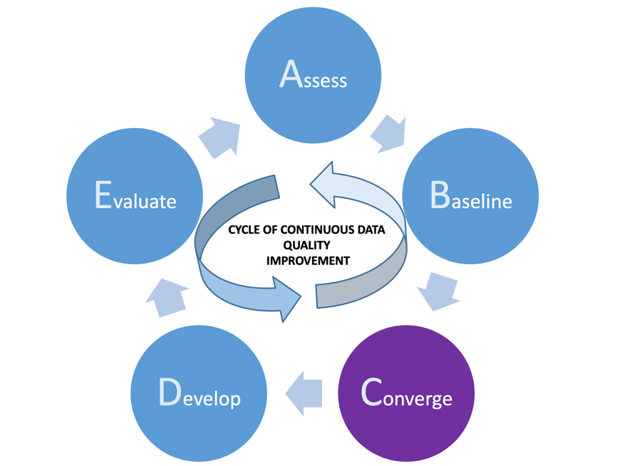
The A2E Approach:
Step 3 – Converge

Slide 58
A2E Step 3: Converge
PRIORITISE & FOCUS ON SPECIFIC
ISSUES & OPPORTUNTIES
POTENTIAL OUTPUTS & TOOLS
Determine initial data quality improvement projects; focus in on two things:
Potential pilot / proof of concept data quality improvement project(s)
Data quality improvement projects with the largest net benefits
Note: these are often NOT the same thing; in the early stages of a DQ initiative it’s important to establish credibility and prove the potential benefits of wider adoption via a PoC
Work with stakeholders to identify priorities from the Data Quality Issues log
Prioritise projects (e.g. Priority Grid)
Run pilots / proofs of concept
Identify and run initial DQ improvement projects
Prioritised Data Quality Issues Log
Priority Grid
Agreed pilot project(s)
Agreed potential DQ projects
Business cases
KEY MESSAGE:
Focus & Purpose: the Pareto Principle
80% of business benefit can often be delivered through improving the quality of 20% of the data – concentrate on the 20% that really matters (good candidates are often shared master data, reference data etc.)

Slide 59
Setting Priorities & Activities
WHY?
Ensure clear focus & priority to manage limited time
Important to make an early impact to gain credibility
Need to gain support of Data Champions & Steering Group
Build confidence & experience in DQ principles & approaches
WHAT?
Look for ‘quick wins’
Data Quality improvement projects often a good source of quick wins as benefits easier to quantify
Create a use case for promoting the value of the role
Build a foundation for longer term success
HOW?
Prioritise Issues List & agree priorities with the data stakeholders
Specify any support (financial and / or resources) required
Create & lead a team to deliver the improvements
WHEN?
Don’t spend too long doing analysis and reflection
Start a pilot / PoC DQ project as the top priority
Use the pilot / PoC to introduce DQ principles & practices
Apply to further pilots / PoCs
59

Slide 60
Key Data Identification (1)
Focus on high priority data items and attributes
e.g. Launch a New Service – Marketing Campaigns require better customer information
Identify Key Business Drivers
Filter Data Elements Aligned with Business Drivers
Targeted Projects in to Deliver Priority Improvements
Customer
Name
Customer Address
Focus Improvement Efforts on Key Data
Customer email Address
Date of Birth
UK Region Code
60

Slide 61
Key Data Identification (2)
Focus on key Data Architecture entities and attributes
Governance/ SME Lead
Purpose
Communication & Definition of Business Terms & Rules
Senior Business Owners
Conceptual
Business Concepts
Business Operations & IT People
Logical
Clarification & Detail of Business Rules & Data Structures
Data Entities
Business SMEs & IT Specialists
Physical
Technical Implementation on a Physical Database
Physical Tables

Slide 62
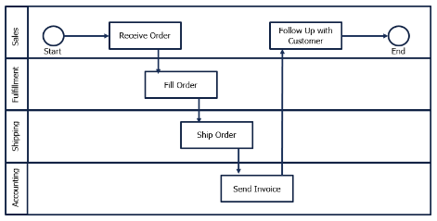
Key Data Identification (3)
Analyse use of data in critical Business Processes
Modelling key business processes to the data that is Created, Updated, or Deleted (CRUD) is important in understanding data usage and helps to establish priority actions
Business Process Model
CRUD Matrix
 | SALES | FULFILMENT | SHIPPING | ACCOUNTING
Receive Customer Order | C | R,U | R,U | U
Process Customer Order | C,R,U | R,U | R,U | U
Fill Order | R,U | C | R,U | R
Send Invoice | R,U |  | R,U | C
C - Create
R – Read
U – Update
D – Delete
62

Slide 63
Seek Out “Quick Win” Projects
Quick Win Project: A “Quick Win” Project is a project that shows early value while at the same time building towards a long term goal. A successful “quick win”:
Aligns with business objectives and solves a high-value business problem or
Creates a proof of concept for a high-value business opportunity
Sets a solid foundation for future efforts
Acts as a “light bulb moment” for key stakeholders to understand the value of improving Data Quality
63

Slide 64
Setting Priorities: Priority Grid
Priorities based on Benefits vs. Level of Difficulty can often be easily determined via a workshop activity using a Priority Grid.
High Benefits – Low Difficulty
PRIORITY
1
High Benefits – High Difficulty
PRIORITY
2
Customer MDM
Business Process Change
Address Validation
BENEFITS
Low Benefits – Low Difficulty
PRIORITY
3
Low Benefits – High Difficulty
PRIORITY
4
Manual Cleanup
Legacy Migration
LEVEL OF DIFFICULTY
Notes:
64

Slide 65
Data Issues & Opportunities Log: Suggested Template
ID | Short Name | Brief Description | Impact of the Problem / Potential Opportunity (Business & IT) | Raised By | Boston Grid Priority Score (*) 1 – High Benefits / Low Difficulty 2 – High Benefits / High Difficulty 3 – Low Benefits / Low Difficulty 4 – Low Benefits / High Difficulty
1 | Customer Data Duplication | Both in the CRM platform and the Customer Data Warehouse there are known customer record duplications, mainly caused by marketing and sales people not being able or willing to search for an existing customer record. One estimate is that up to 25% of CRM customer records are duplicates. Data Warehouse duplication unknown. | Multiple marketing communications sent to the same customer, causing brand damage Inability to evaluate total customer lifetime revenue value Impossible to derive a single view of a customer Risks contravening GDPR if customer submits Data Subject Access Request (DSAR) and all data not returned Resolving this problem would accelerate MDM ambitions and enable better targeted 1-1 customer marketing | Bob Mills (Marketing Manager) Anna Ford (CRM Technical Architect) George May (Senior Sales Rep) | 2 (Though conducting an initial data cleanse of the CRM platform may be a 1 – further investigation required)
2
3
65

Slide 66
Have you already identified any potential ‘quick win’ Data Quality projects in your organisation?
Could you identify potential ’quick wins’ that you could progress on your return?
ACTIVITY
66
This Photo by Unknown Author is licensed under CC BY-NC-ND

Slide 67
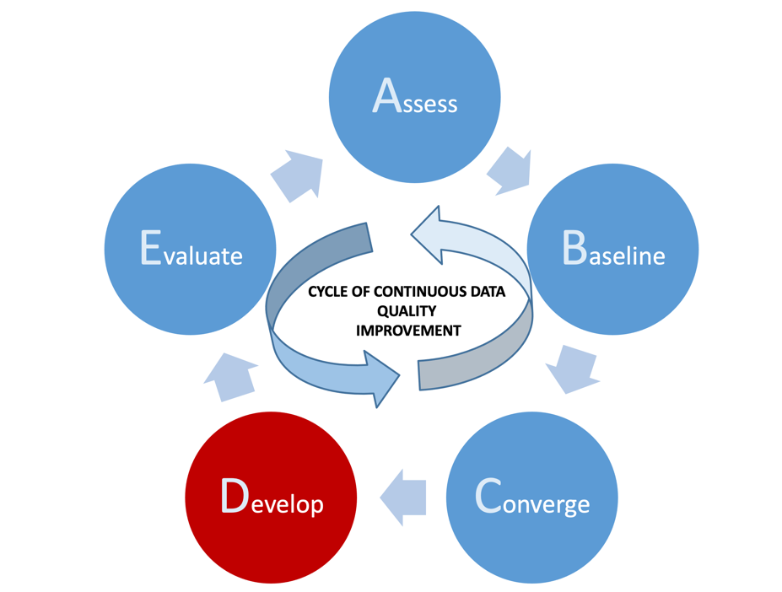
The A2E Approach:
Step 4 – Develop

Slide 68
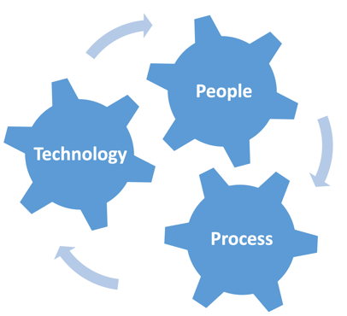
A2E Step 4: Develop
DESIGN & IMPLEMENT IMPROVEMENTS
POTENTIAL OUTPUTS & TOOLS
Create data quality improvement team to include:
Business stakeholders (Data producers, consumers and others, e.g. process owners)
IT stakeholders – SMEs, DBAs etc.
Other specialists as required (e.g. Data Protection Officer if Personal Data involved)
Note: It is important to align with Data Governance Initiatives & Roles (e.g. Data Owners, Data Stewards)
Re-analyse current problems
Perform root cause analysis
Design and implement improvements
Design and implement changes
Identify Business Rules & set data quality KPIs
Measure improvements against KPIs
Revisit the business case to log benefits
Identify future improvements
Produce case study
Root Cause Analysis diagrams
Updated business cases & case study
Data Quality KPIs and thresholds based on the 7 Data Quality Dimensions and identified Business Rules
Data Improvement Plans

Slide 69
Creating Data Quality Working Groups: Getting Wider Engagement & Collaboration
De Facto (Maybe Unrecognised) Data Owners / Stewards etc.
People Who Feel the Pain of Poor Data
Data Domain Experts / Geeks
(The ‘Go To’ person)
Enthusiasts Seeking a New Challenge

Slide 70
Multiple Cause Diagrams (Root Cause Analysis) – Example
Legacy IT &
Underinvestment
Lack of Data
Entry Training
Lack of Data
Literacy
Poor Data
Entry
Duplicate
Customer
Records
Inadequate Data
Entry Validation
TIPS FOR MCDs
Start with the end effect to be explained and put in the centre of the diagram
Work backwards from the end effect
Stop when you have identified 10-15 causes / effects
Inconsistent
Data Definitions
Poor Customer
Data Quality
Poorly
Defined &
Documented
Business Processes
Missing or
Obsolete
Business Rules
Undefined
Process & Data
Ownership
No Business
Accountability
for Data Standards
Poor Requirements
& Change
Management
70

Slide 71
Multiple Cause Diagrams (Root Cause Analysis) – Value
Legacy IT &
Underinvestment
Lack of Data
Entry Training
Lack of Data
Literacy
Poor Data
Entry
Duplicate
Customer
Records
Inadequate Data
Entry Validation
USES OF MCDs
Demonstrates multi-causality of problems & effects
Gives holistic analysis (PPT)
Highlights Root Causes to suggest potential sequencing of activities
Useful technique for gaining consensus on problems & potential actions
Inconsistent
Data Definitions
Poor Customer
Data Quality
Poorly
Defined &
Documented
Business Processes
Missing or
Obsolete
Business Rules
Undefined
Process & Data
Ownership
No Business
Accountability
for Data
Key: GREEN – End problem to be explained
RED – Root causes
Poor Requirements
& Change
Management
71

Slide 72
The Importance of KPIs
“You Can’t Manage What You Can’t Measure”
Most businesses set strategic goals they desire to achieve and measure these goals against Key Performance Indicators (KPIs).
These KPIs provide a concrete, objective way to measure progress towards these goals
To use Finance as a comparison, they have a number of KPIs they use to manage financial assets
Revenue Projections
Budget Goals & Limits
Expense Ration, etc.
We need to do the same with data assets
% complete
% accuracy
Timeliness
RoI
Cost Savings
001011
72

Slide 73
Baselining & Setting KPIs: the 7 Dimensions of Data Quality
You cannot measure DQ per se: you need to measure each dimension and roll up into an overall DQ measure
Completeness
Accuracy
Uniqueness
Validity
Consistency
Accessibility
Timeliness
Is all the required data present?
(e.g. date of birth in a DoB field)
Is the data available to users when they need it and is it sufficiently timely to meet their needs?
(e.g. invoices sent in last 24 hours available on the data warehouse by 9am the next day)
Does the data reflect the real world?
(e.g. current customer address)
THE SEVEN DIMENSIONS OF DATA QUALITY
Key:
Do the users who need to use the data have access to it?
(e.g. Finance team and invoice data held in data warehouse)
In a data source, is the entry unique or are there unintended duplicate records?
(e.g. same client organisation spelled several different ways in multiple CRM records)
CONTENT
DIMENSIONS
Does the data conform to a specified or expected format and / or business rule?
(e.g. date of birth as DD/MM/YYYY; age between 18 and 120 years)
CONTEXT
DIMENSIONS
Where data is held in different sources, are the sources consistent?
(e.g. current customer address)
73

Slide 74
Data Improvement: The Importance of Business Rules
In a data context, business rules are used to define and enforce the standards that data must conform to
Therefore have a key role in assessing, baselining and improving data quality
Are used to specify data design, e.g. drop down lists, data input validation etc.
A simple typology of Business Rules as applied to data is:
Format business rules – specify the format standards data should comply with
Content business rules – specify the allowable content of records or fields
”A Business Rule is a criterion used to guide day-to-day business activity, shape operational business judgments, or make operational business decisions.”
Ronald Ross, quoted in
architectureandgovernance.com
74

Slide 75
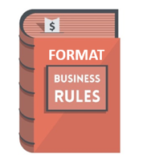
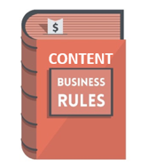
Example Data Related Business Rules
FORMAT RULES
A UK National Insurance Number must be in the format: aa nn nn nn a
An employee must have a unique Employee ID in the format: aa nnnn
Date of birth should be in North American format of MM/DD/YYYY
A full US zip code must be in the format nnnnn-nnnn
Internet router identifier must be in the format Aaa_Nan_Naa
CONTENT RULES
Every Sales Representative must be assigned to one and only one Sales Region
A valid email address must be entered by a customer to enable a customer’s order to be accepted
Gender codes must have the valid value of Male, Female or Unknown
A supplier must have at least one associated geographical address
Product Price should be Product Unit Cost + 25%
75
75

Slide 76
How Do You Identify Business Rules?
Business rules can be discovered or derived from:
Data models (Business / Logical / Physical)
Business documentation (e.g. Process Descriptions, User Instructions)
IT Documentation (e.g. requirements specifications, system manuals)
Source code (e.g. If ‘A Then B’ statements)
Master and / or Reference Data Sources (e.g. currency codes, product master data)
Documented metadata (e.g. Business Glossaries, Data Dictionaries, Metadata Repositories)
Data profiling outputs
Talking to key stakeholders:
Data owners and data stewards (if in place)
Data producers and consumers
Other business and IT subject matter experts
VITAL IMPORTANCE OF STAKEHOLDER ENGAGEMENT:
Business rules are frequently implicit (i.e. locked in people’s heads) and not formally documented
Where business rules are documented, documentation is often out of date and not updated in line with system changes

Slide 77
Referring back to the HR data source sample earlier, specify:
3 Format Business Rules
3 Content Business Rules
that can be used to create and enforce ‘fit for purpose’ data improvement on this data source
ACTIVITY
77
This Photo by Unknown Author is licensed under CC BY-NC-ND

Slide 78
ACTIVITY – Extract of actual HR data source
EMPLOYEE NO | SURNAME | FIRST NAME | GENDER | DATE OF BIRTH | ROLE CODE
802540 | Smith | Brian | Female | 31/01/56 | PM16
YN4176B | Gregg |  | Male | 07/09/80 | 9999
811609 | Patel | Priya | XXXX | 25/12/78 | AL60
22298 | Bothroyd | Bridget | Female | 28/08/09 | TBD
802540 | Smith | Bryan | Male | 31/01/56 | PM10
855265 | Hayes | Leslie | Female | 00/00/00 | AL76
 | Taylor | Kevin | Unknown | 12/30/69 | US18
Key:
Potential
Data Quality
Problem
Potential
Duplicate
Record
78

Slide 79
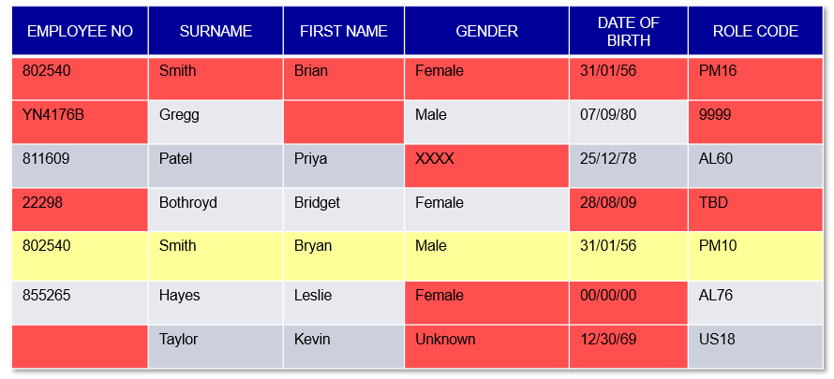
Using Business Rules to steer and enforce Data Quality standards
Example potential format business rules | Example potential content business rules
Employee No. must be in format nnnnnn. Blank Employee Numbers are only allowed if new starter is awaiting Emp. No. allocation | Employee No. should be unique. Only one Employee No. should be allocated to any individual employee
First Name must not be blank | Gender should align with First Name derived from Common Names Reference file
Date of Birth must be in format nn/nn/nn | Allowable Genders are FEMALE, MALE, SELF-DETERMINED or UNKNOWN
Role code must be in format AAnn | Date of Birth must be expressed as DD/MM/YY and in the range 01/01/1940 to 12/12/2006

Slide 80
Deploying Business Rules - Approaches
Data Entry Guidelines, Business Glossary & Training
Master & Reference Data Management
Application Code
(e.g. data input validation)
Data Quality Tool:
DQ Business Rules Engine

Slide 81
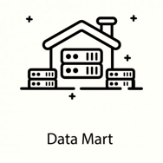
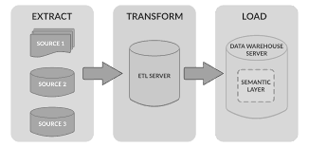
Step 3: Automating Data Quality Business Rules via a DQ Rules Engine
DATA
INPUT
DATA QUALITY
RULES ENGINE
Real Time Data Validation
Real Time & Batch Validation
Real Time & Batch Validation
Batch Validation
Batch Validation
Batch
Validation
REPORTING
LAYER
SOURCE
SYSTEMS
STAGING / ETL
LAYER
DATA
WAREHOUSE
DATA
MARTS
81

Slide 82
Use of Tools & Technology in Data Quality Management
Headline Findings:
Tools and technologies are increasingly being acquired and used to support data quality management
Strong focus on Data Preparation & Transformation reinforce finding that analytics and intelligence are key drivers for better data quality management
Although only 16% currently have an enterprise wide data catalog, 45% intend implementing one within the next 12 months
Tools enable:
Profiling
Monitoring
Parsing
Standardising
Matching
Merging
Cleansing
Correcting
Enhancing
Management of data quality rules
Data quality workflows
Data quality reporting
Source: 2022 State of Data Quality, TDWI, James Kobielus
Available for download at https://globaldatastrategy.com/resources/white-papers/
82

Slide 83
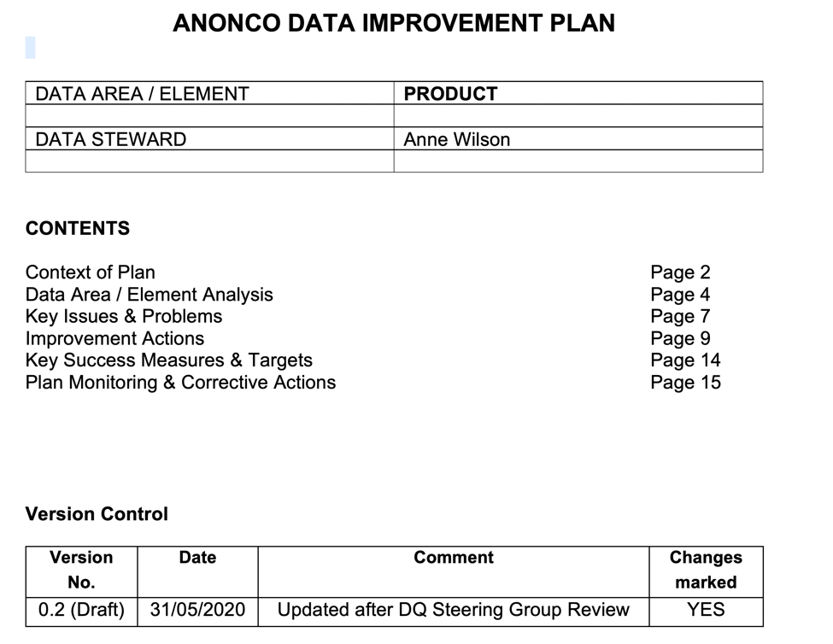
Data Improvement Plan
A Data Improvement Plan is a formal plan to specify and manage improvements to a specified data domain and / or data problem area
The benefits of a Data Improvement Plan are that it:
Sets out goals and expectations for data improvement
Acts as a focal point for all data improvement activities
Prioritises improvement activities
Can be used to track improvements and communicate successes
Can evolve to align with the changing needs of the business
Data domain DIPs can be rolled up to form the core of a company wide Data Quality Improvement Program

Slide 84
Align your Data Quality Roadmap with other relevant Roadmaps
When managing your Data Quality Roadmap, it’s important to engage and align with other Roadmaps being developed
Will the existing Data Quality Roadmap deliver benefits that support the development of other Roadmaps? For example:
Billing Re-platforming project
CRM system deployment
New product launch
Regulatory change
Do you need to adapt your Data Quality Roadmaps to better support other Roadmaps?
Are there existing communications you can leverage to promote your Data Quality Roadmap?
Billing Re-platform
CRM Deployment
New Product Launch
Regulatory Change
Data Quality Roadmap
84

Slide 85
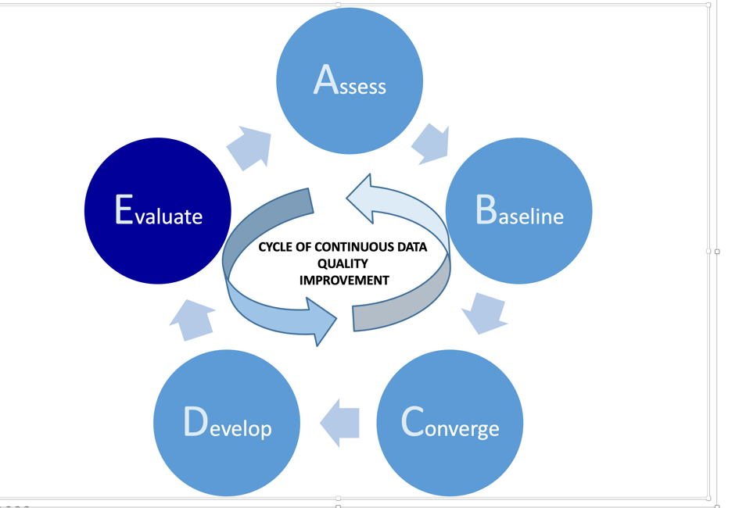
The A2E Approach:
Step 5 – Evaluate

Slide 86
A2E Step 5: Evaluate
EVALUATE & SUSTAIN GAINS
POTENTIAL OUTPUTS & TOOLS
Embed Data Quality improvement as a business as usual activity
Evolve Data Quality improvement teams into wider Data Governance structure:
Track Data Quality improvements via Data Quality Dashboards
Monitor financial and business benefits over time
Evangelising benefits – part of your job is marketing!
Evolving & incremental Data Improvement Plans
Formal Data Governance Roles in place for targeted data areas
Regular Data Quality Dashboard updates and analysis
Business Process Change
Continued RoI and financial benefits
Communication Plan and Organisational Change Efforts
Notes:
Appoint Data Owners and Data Stewards
Maintain Data Improvement Plans as living artefacts
Look for continual data improvement

Slide 87
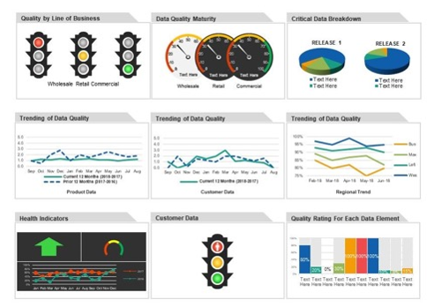
Monitor & Report Business Rule Adherence
When Business Rules are implemented can be used to:
Check continued adherence of existing data
Enforce the rules on new data to prevent new problems
Best monitored via Data Quality Dashboards
Provide regular reports on adherence of data to Business Rules
Set KPIs to drive continuous data improvement
Identify data quality trends
Highlight areas where corrective action required
Indicate where / if Business Rules may need to be amended to meet changing business needs
When reporting always try to relate data quality to business outcomes
Address the ‘so what’ objection
Puts a financial or other benefit on continued data quality improvement
Data Quality Dashboard

Slide 88
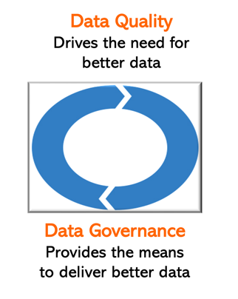
Data Governance & Data Quality: the synergies
Data Quality improvement is a primary reason why many organisations implement data governance:
Realise that Data Quality is a business problem and not an IT problem
Recognise that Data Quality improvement cannot be sustained without business leadership
Have learnt that Data Quality is NOT a synonym for data cleanse; data cleanse is a repeated cost of failure and usually does not remove the root causes of poor Data Quality
Data is volatile and so Data Quality has to be a perpetual business as usual activity enabled through data governance
Better Data Quality is usually a very effective way of demonstrating the value of Data Governance:
Enhanced Data Quality can deliver ‘quick wins’
The benefits of reducing the ‘costs of failure’ caused by poor Data Quality can be significant & measurable
A sound Data Quality foundation enhances the value & success of other data management investments (e.g. Business Intelligence, Data Science, Analytics, CRM et al)
88

Slide 89
Typical Key Data Governance Roles
Executive Sponsor
Data Owner
Business Data Steward
Technical Data Steward
Promotes Data Driven Culture
Champions Best Practices
Advocate with ELT and Board
Escalation Point for Key Issues
Represents the data needs for a particular functional area
Defines key KPIs & data elements
Defines key business rules
Sanctions Data Quality Metrics & Thresholds
Responsible for the day-to-day management and quality of data
Subject Matter Expert (SME) for a given business domain
Aligns with the Lead Data Steward to support business rules and to align with key KPIs
Digital/IT expert for a given business unit
Subject matter expert for a given system and its usage
Aligns with Business Data Stewards to ensure technical needs are met
Data Governance Lead*
Acts as a cross-functional lead for the data governance effort, working with both business and IT roles
Chair of the Data Governance Steering Committee
Data Architect*
Oversees the holistic data architecture for the organisation, including data models, data standards, data integration, etc.
Works with both business and technical stakeholders to ensure that systems implementations align with key business rules & needs
Data Security Lead*
Ensures that the organisation adheres to the adequate security standards to support industry regulations and best practices
Works with the Data Governance Lead and Data Architecture to ensure that data implementations support business needs in a secure way.
* Typically a full-time role
89
89

Slide 90
The A2E Approach: Summary Benefits
Views Data Quality as a holistic problem requiring holistic solutions:
People, Process, Technology
Supports incremental and continuous data quality improvement
A reusable methodology that can be applied at multiple organisational levels:
Organisation
Function (e.g. Finance, Order Fulfilment etc.)
Department (e.g. Sales, Marketing, HR etc.)
Data Domain (e.g. Customer, Product, Billing)
Specific Data Quality Issue (e.g. missing contact data in CRM platform)
Identifies focus and priority:
Identifies ‘quick wins’ to accelerate momentum
Ensures resources are targeted at highest priority problems

Slide 91
Data Quality: The Future

Slide 92
Data Quality Remains a Growing Priority
Data Priorities in Place for 2021
Data Quality is #6
Future Data Priorities in 2022-2023
Data Quality is #4
From the 2020 DATAVERSITY survey on “Trends in Data Management”, by Donna Burbank & Michelle Knight
Available for download at: https://globaldatastrategy.com/resources/white-papers/
92

Slide 93
Evolution of Data Quality since 2000… Evolving Approaches
BATCH |  | REAL TIME / ONLINE
REACTIVE |  | PROACTIVE
IT DRIVEN |  | BUSINESS DRIVEN
PLATFORM SPECIFIC |  | ENTERPRISE WIDE
DATA CLEANSE |  | DATA RE-ENGINEERING
MANUAL |  | AUTOMATED
OPERATIONAL FOCUS |  | REPORTING / ANALYTICS FOCUS
IN-PLATFORM DATA QUALITY |  | DATA QUALITY AS A SERVICE
SILOED FOCUS |  | PART OF HOLISTIC DM CHANGE
2000
2022
TIMELINE

Slide 94
The Future of Data Quality
New approaches for data quality in digital organisations
Increased focus on real time data validation and improvement at the point of data creation, ingestion or use:
Automated digitised processes and self-service will fail if the data is not fit for purpose
Data validation and improvement must be done in real time on large data volumes & varieties
‘After the fact’ data cleanse and improvement is now too late
Opportunity to exploit IoT and AI to develop self-checking data quality capabilities through machine learning to:
Automate and validate data entry
Identify duplicate records
Detect data anomalies
Fill data gaps
Match data
Business users need more control over the creation & management of business rules
They need the ability to create business rules dynamically when preparing data
The paradigm where business rules are created and held centrally by IT is obsolete
End user self-service data quality functionality is essential:
Data preparation & formatting
Data parsing & cleansing
Data enhancement & enrichment

Slide 95
Summary & Conclusions

Slide 96
COURSE LEARNING objectives
Understand what ‘fit for purpose’ data is, and is not
Describe the dimensions of data quality
Know the main causes of poor data quality
Highlight the impact of poor data quality on individuals and organisations
Understand the relationship between data quality and other data management disciplines, with particular emphasis on data governance
Highlight the shortcomings of traditional ways of tackling poor data quality and the importance of a holistic approach, involving people, process and technology
Learn the five steps of the A2E methodology and how to apply it to identify, prioritise and address data quality problems
Specify and apply the main activities and deliverables of each of the five steps
Be able to understand and develop business rules to baseline data quality and to set improvement thresholds
Be aware of software tools that can help to support and automate the A2E approach
96

Slide 97
How well do you feel the course has met its stated objectives?
How well have your personal objectives been met?
DISCUSSION
97
This Photo by Unknown Author is licensed under CC BY-NC-ND

Slide 98
Summary & Conclusions
Data quality is complex because businesses and organisations are complex
Addressing data quality issues requires a holistic approach combining people, process, and technology change
Data governance is needed to sustain data quality improvement – it orchestrates the people, processes and organisational structures required to improve data quality
Build quantifiable Data Improvement Plans to show demonstrable RoI and implement a culture of continuous data quality improvement
It’s vital to deliver frequent incremental improvements to maintain business interest and backing
Data quality is a multi-dimensional issue for organisations so tackle it through multi-dimensional approaches such as A to E

Slide 99
Contact Info
Email: nigel.turner@globaldatastrategy.com
Twitter: @NigelTurner8
Website: www.globaldatastrategy.com
LinkedIn: uk.linkedin.com/in/nigelturnerdataman

Slide 100
Final Thoughts
“It is not in the stars to hold our destiny but in ourselves”
William Shakespeare (Julius Caesar)
“The harder I practise,
the luckier I get.”
(Gary Player, Golfer)
AND PLEASE COMPLETE THE FEEDBACK FORM…
THANK YOU!
Good luck in your Data Quality journey and hope our paths cross again…

