Slide 1

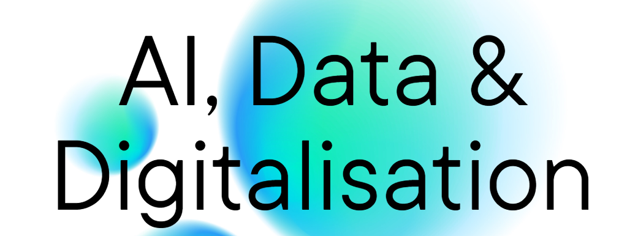
Erasmus Data Collaboratory – House of AI
Mixed Source Analytics
DWBISummit- March 27, 2024

Slide 2

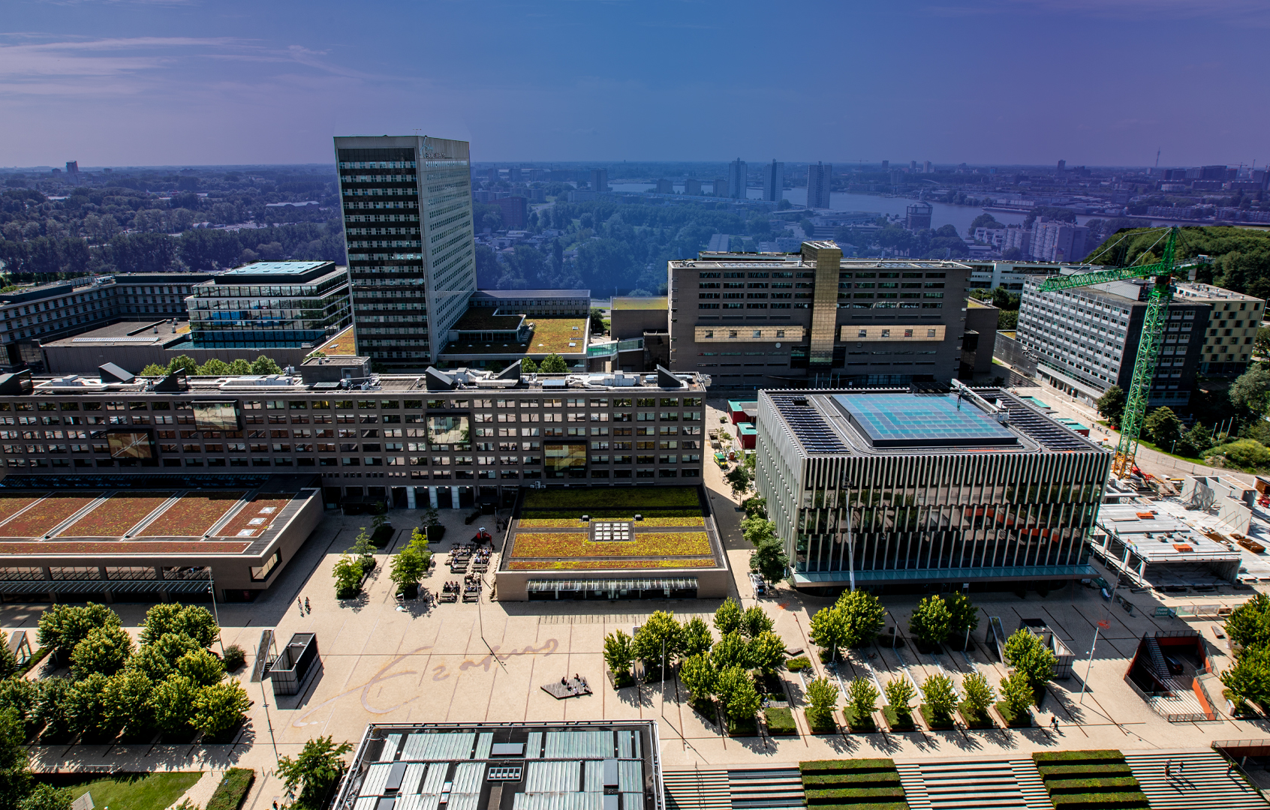


Erasmus Centre for Data Analytics
Flagship centre for
cross-disciplinary insight on
Artificial Intelligence ,Data, Digitalization and
Immersive Technologies
at the Erasmus University Rotterdam.
2
Notes:
otherwise known as the hub for excellent research on AI, data, and digitalization .

Slide 3



ECDA as supporting hub
Funding
Strategic EUR innovation programmes on Digitalization, AI & immersive tech
Transdisciplinary interfaculty initiatives
Erasmus Data Collaboratory
House of AI
Strategic research programmes on Digitalization, AI & immersive tech
Convergence AIDD
Labs & Initiatives
AI-PACT
SSH
influence of digitalization on work, prosperity and entrepre-neurship
(under discussion)
AI-MAPS
Smart
Campus
AI @ EUR
Energy Transition programme
……………….
Supported Programs
ALGOSOC
Offering
Facilitate Research & Innovation programs
Facilitate Hands on Education / (re)skilling
Share Thought Leadership XPs
Community Building
Connect & Inspire
Activate & Empower Partner organizations
ECDA
AI & Data Competency / Marketing & Communications / Programs & Events / Business Development
Competencies
Notes:
Version Long:
Our first and most important guiding principle is our hands-on approach in making talent more data competent by teaching them everything there is to know about the power of data, how to turn that into valuable information, learn from that and become competent, and how to use that competence to make wiser decisions.
We skill and re-skill them in understanding how to come from data to wisdom and we let them experience the context of the use of data in their work and learning environment by trying and applying.
This way we combine education and research with hands-on experience in data analytics, turning talent into the future digital leaders for a sustainable future.

Slide 4


Boardroom & event
space
Project & meeting spaces
Ofices ECDA
EDSC
AI PhD
study
space
immersive
tech
space
AIDD
Convergence
centres
&
AIDD
trans
disciplinary programs
Visuals / Art
EDSC/
Data lab
Open
space
Notes:
Version 1:
Expert practices that use our Erasmus Data Collaboratory, a space we established where our stakeholders can collaborate on data-related challenges. With the support of the various tech partners that donate their technology, the Collaboratory will exploit a so-called ‘Data Sandbox’ The sandbox may be used for activities that vary from general experimenting with data to building a proof of concept. It supports data-sharing in a safe and secure environment.

Slide 5

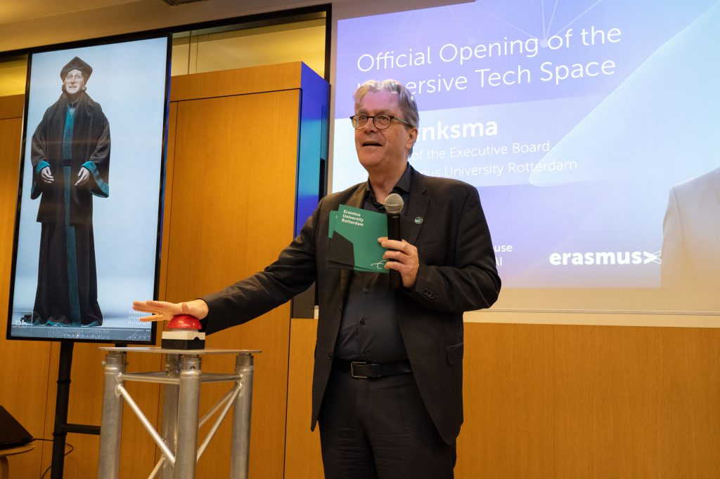



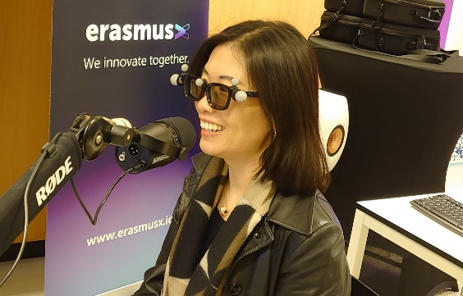
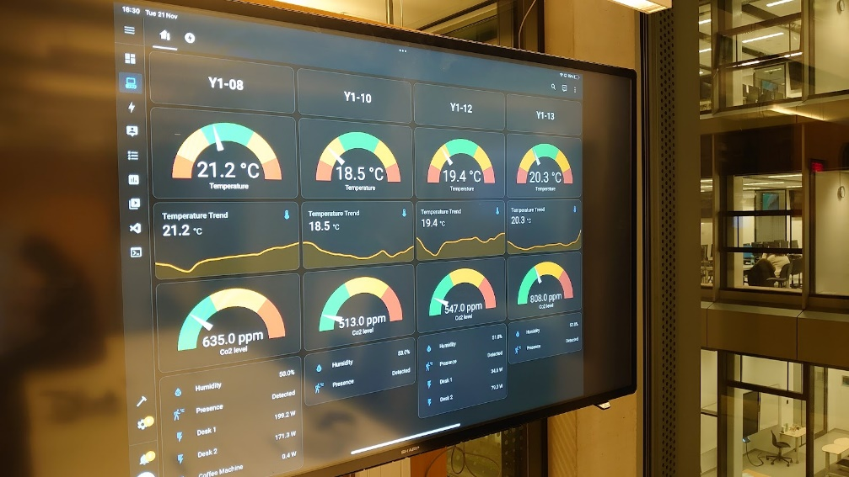
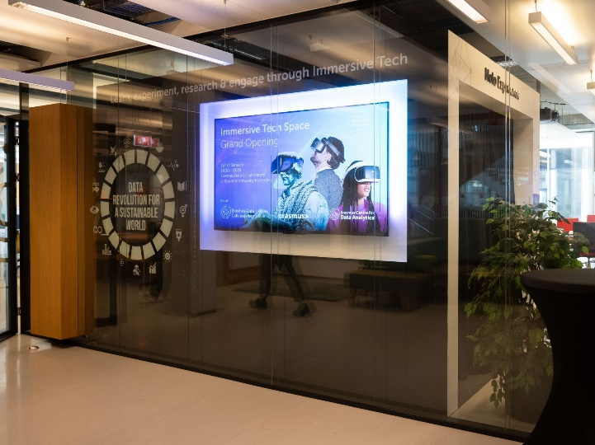
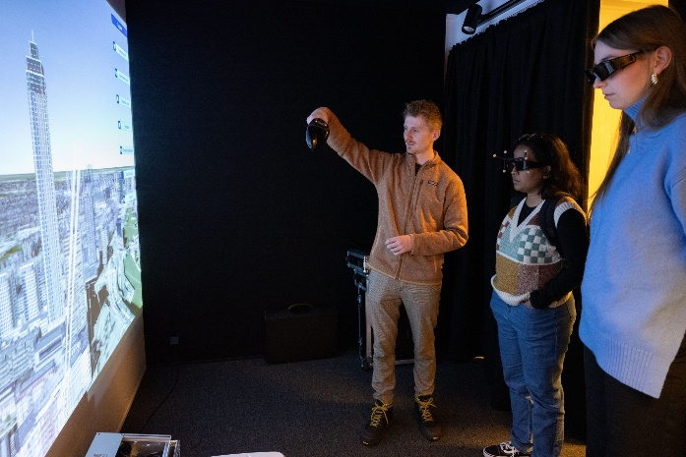
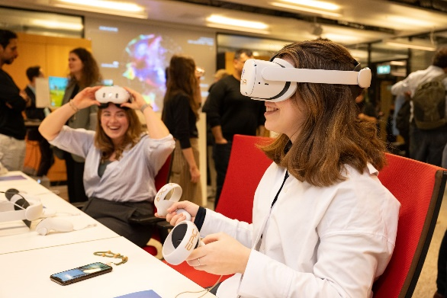
Visualization room
Immersive Tech Space
Generative AI
Notes:
Version 1:
Expert practices that use our Erasmus Data Collaboratory, a space we established where our stakeholders can collaborate on data-related challenges. With the support of the various tech partners that donate their technology, the Collaboratory will exploit a so-called ‘Data Sandbox’ The sandbox may be used for activities that vary from general experimenting with data to building a proof of concept. It supports data-sharing in a safe and secure environment.

Slide 6

“…support innovative data intensive projects with both internal and external parties at EUR ”
If your project contains one or more of the following characteristics, please reach out to us:
  Innovative in nature
  Has a major data, AI or Immersive Technology component;
  Involves collaboration with External Parties with active exchange of data/expertise;
  Needs additional resources such as compute or engineering support.

Slide 7
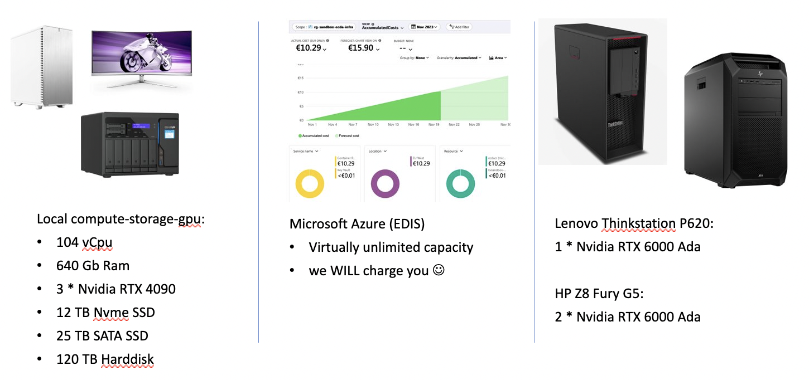
Services for qualified research projects
Access to external network (for data & funding)
Access to internal resources (for skills & knowledge)
Qualified data engineering support staff
Safe and secure online collaboration environment
Local compute & GPU (€0, limited)
Access to cloud compute (€-€€€)

Slide 8


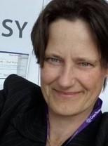


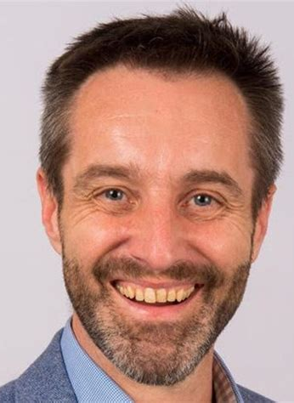
Meet the Team!
Data Team
Immersive Tech Team
Platform & Apps
Infrastructure

Slide 9

EDC Data Sandbox
Core Principles
1. Never compromise on security
2. No to Personal Data (unless…)
3. Data is a strategic asset
4. Don't reinvent the wheel
6. Embrace change
7. Stay independent
8. Don’t (try to) boil the ocean
9. Maximize Utilization
10. Minimize Carbon Footprint
5 Everything should be reusable

Slide 10
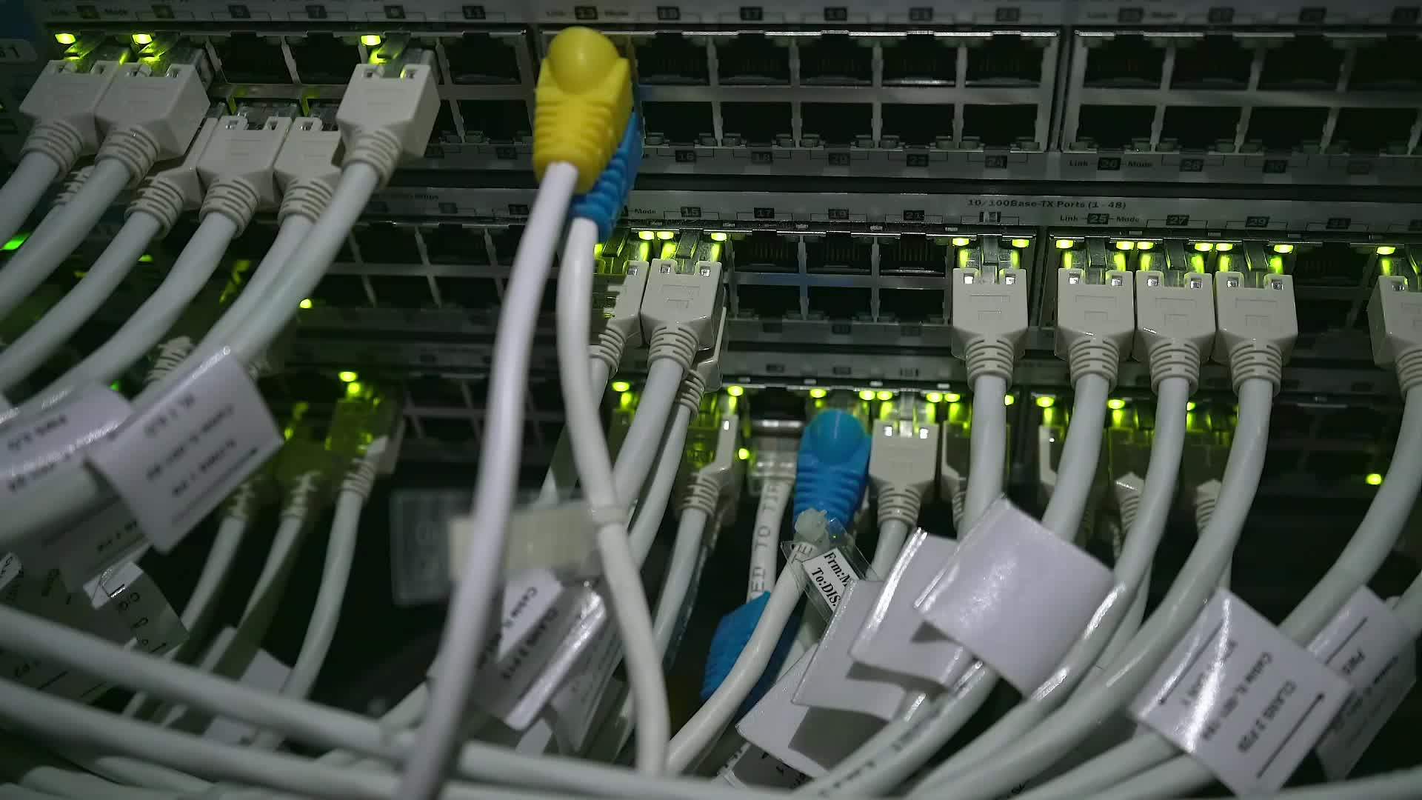









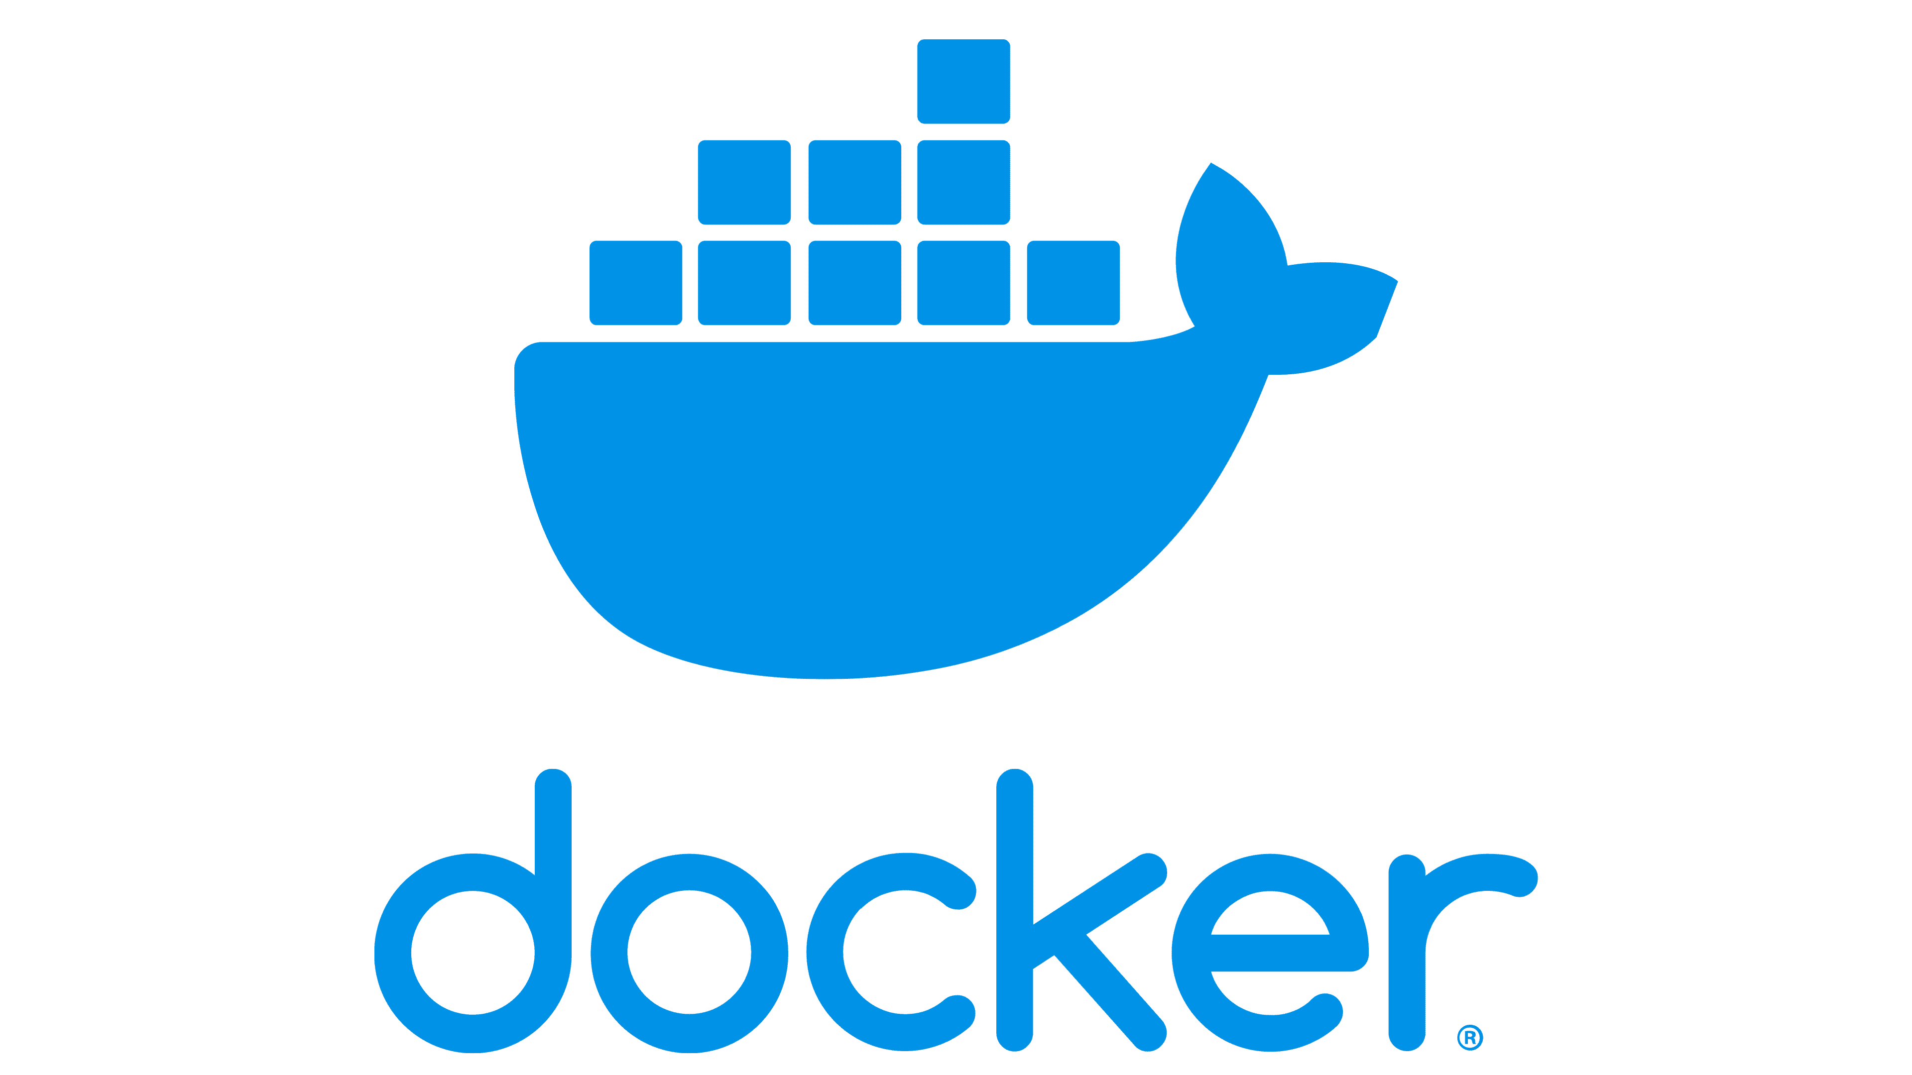



EDC Sandbox: powered by Open Source
Ollama

Slide 11

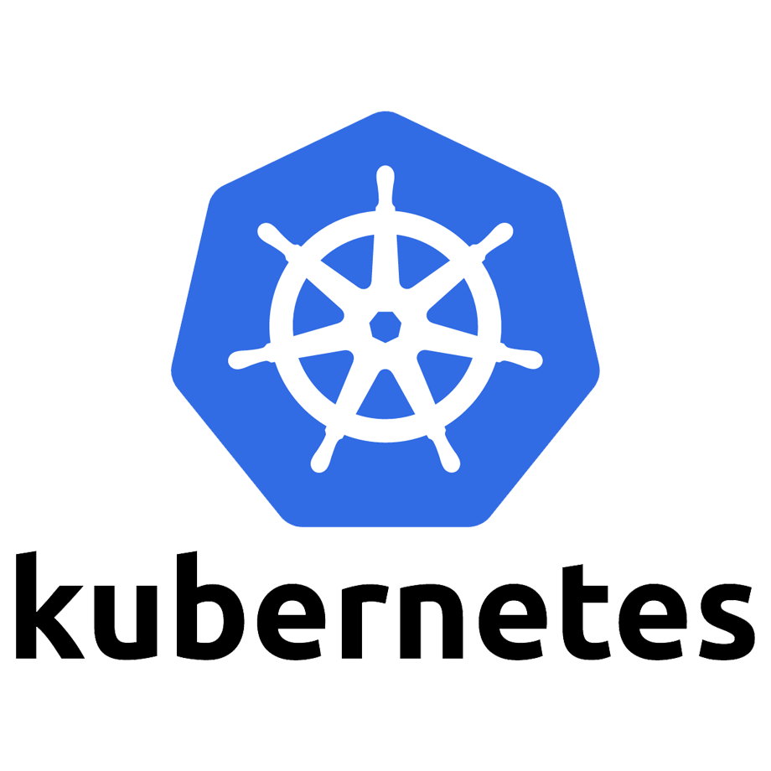
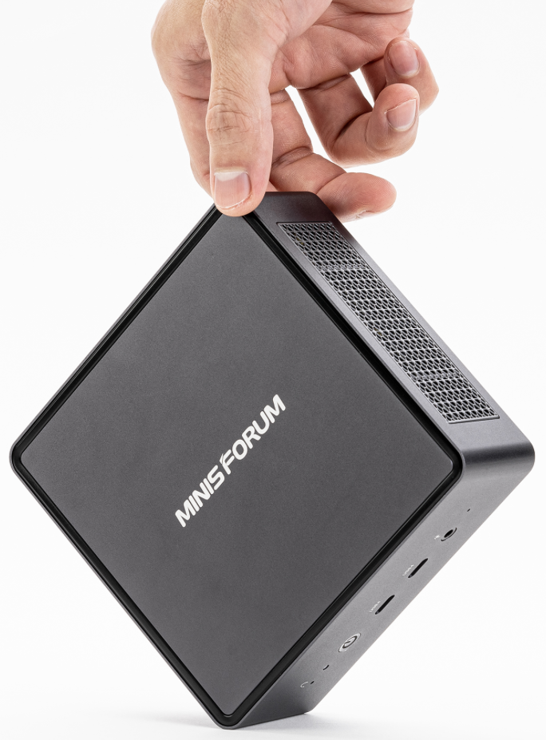

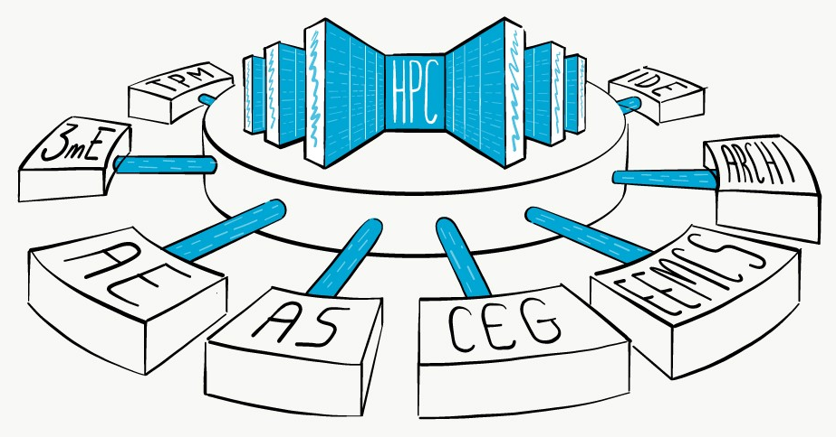

High Level Architecture
Identity & Access Management
Services & Applications

Slide 12







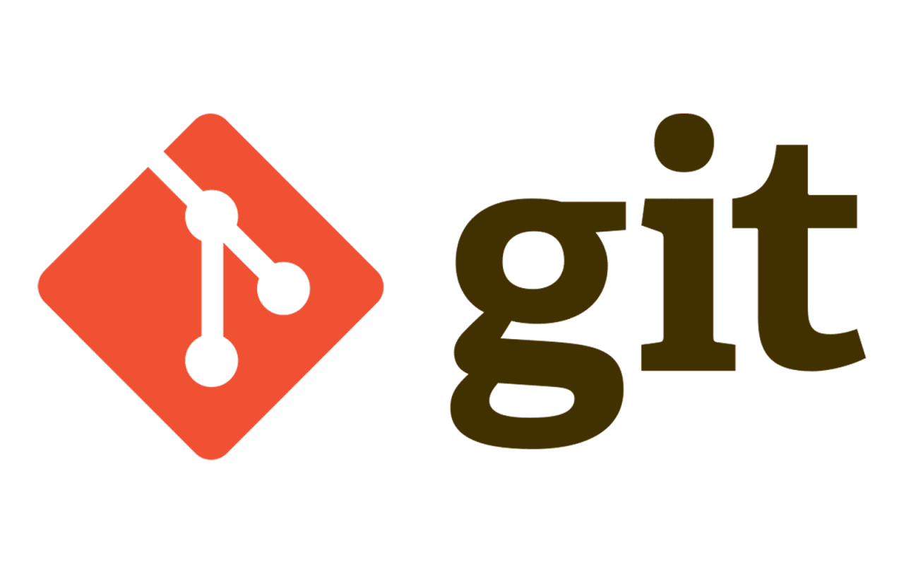













Erasmus Data Collaboratory Sandbox Tech
MetaData Catalog / Search / Marketplace
Other platforms & sandboxes
Data Hub
(batch/streaming)
Full-Code
(Python, R, Scala, etc)
ECDA Knowlegde Repository
No-Code / Low-Code
Code
Data
Algorithms
&
Solutions
(Containers)
Open Sources
Data Exploration
Data Visualization
Model Development
Company Sources
Model Management
Data Pipelines, Orchestration & Governance
Identity & Access Management (IAM)

Slide 13
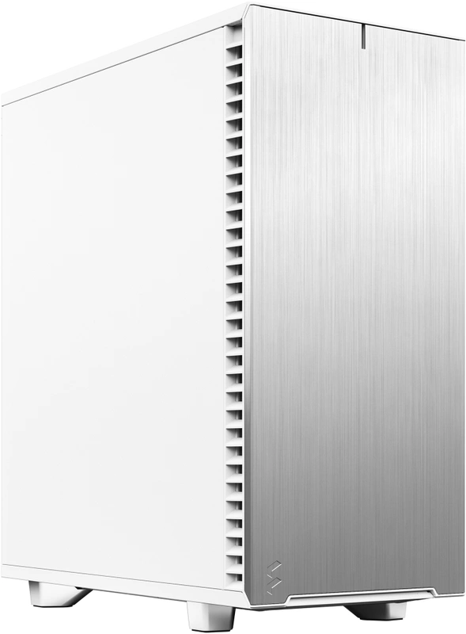
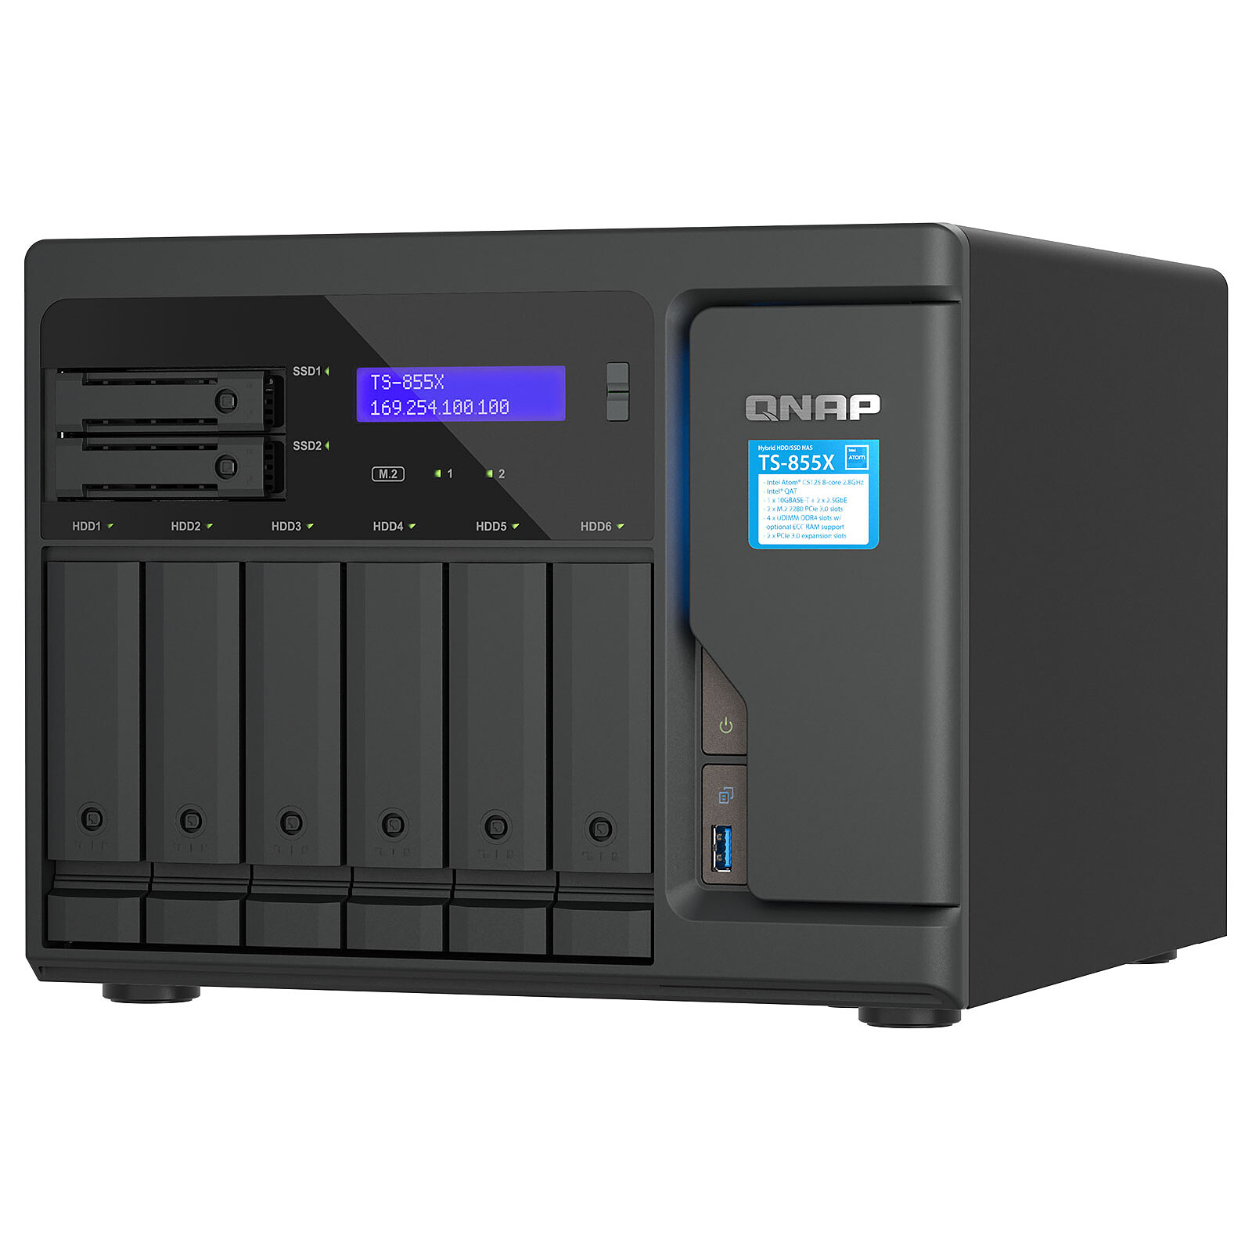

Sandbox = Hybrid ‘Cloud’
Monthly Cost on Azure would be
> € 8.500, excl. GPU’s!
6 * MinisForum UM 790 Pro
16 vCpu, 64 GB Ram
internal GPU
2*2TB Nvme SSD
10 Gbit interconnects
4 * GPU Workstation
32 vCpu, 192 GB Ram
nVidia RTX 4090
2*1TB + 2*2TB Nvme SSD
25 Gbit interconnects
Backup/ shared storage
8 core cpu, 64 GB Ram
2*2TB Nvme SSD, 2*1.8TB SSD
6 * 20 TB Sata
10 Gbit interconnect
EDC – House of AI LeafCloud
EDC - House of AI Local Infrastructure
EDC - House of AI EDIS-Azure
EDC - House of AI Surf Research Cloud
Total compute capacity
112 cores/224 vCpu
1.15 TB Ram
Total storage capacity (raw/net)
50 / 34 TB Nvme SSD
120 / 60 TB Sata
Total compute/storage capacity
Virtually unlimited

Slide 14
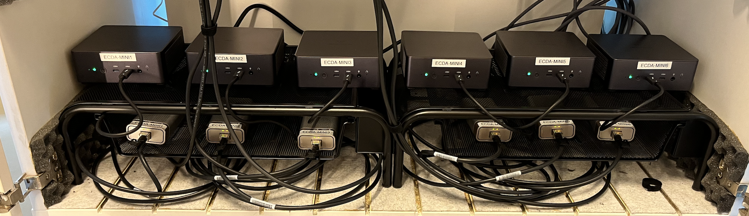
The EDC Compute Cabinet ☺
Fast
Affordable
Reliable
Energy Efficient
✅
✅
✅
✅

Slide 15


Public Cloud vs On Prem
“You’re crazy if you don’t start in the cloud; you’re crazy if you stay on it”
Source: The Cost of Cloud, a Trillion Dollar Paradox

Slide 16
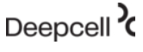


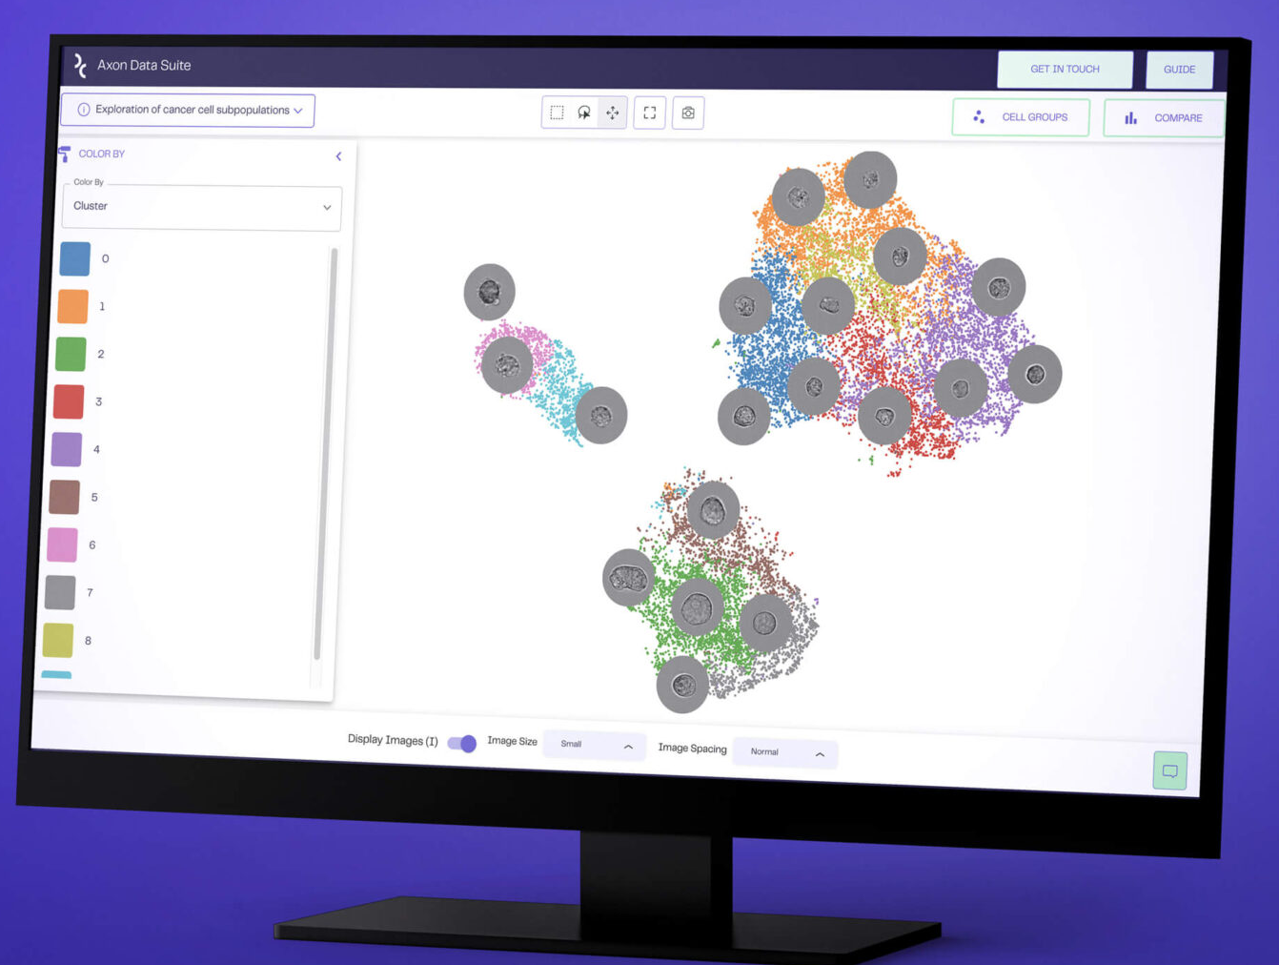





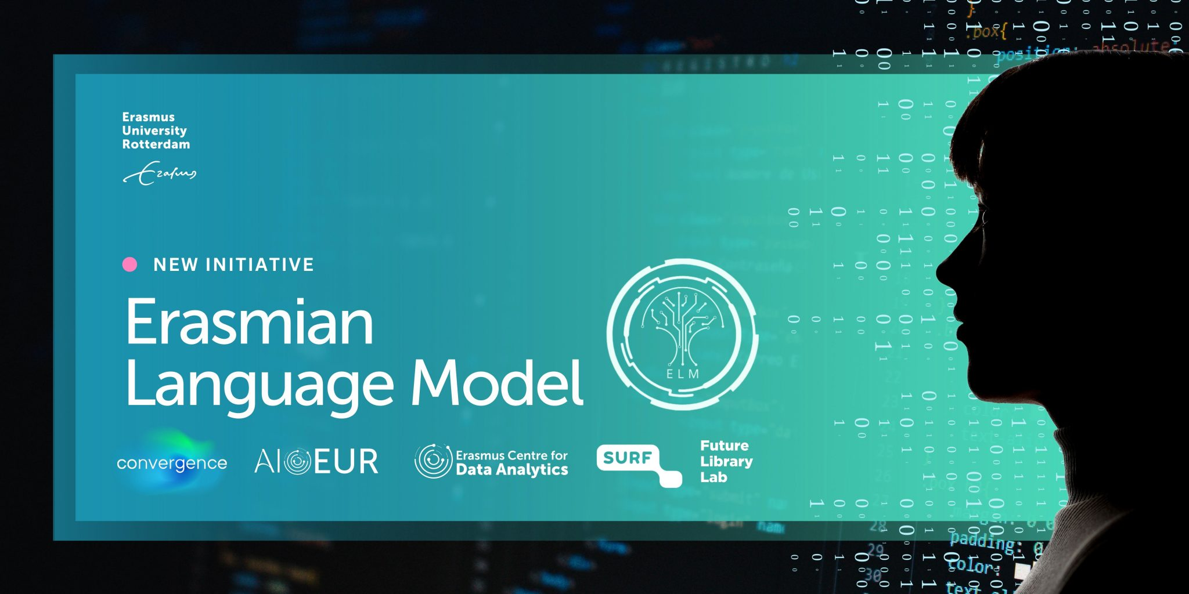


Sandbox Experiments / Projects
MetaData Catalog / Search / Marketplace
Other platforms & sandboxes
Data Hub
(batch/streaming)
Coding options
(Python, R, Scala, etc)
ECDA Knowlegde Repository
No-Code / Low-Code
Code
Data
Algorithms
&
Solutions
(Containers)
Open Sources
Data Exploration
Data Visualization
Model Development
Company Sources
Model Management
Data Pipelines, Orchestration & Governance
chat.ecda.ai
Identity & Access Management (IAM)
Ollama
16

Slide 17
Data Engineering @ Erasmus Data Collaboratory

Slide 18
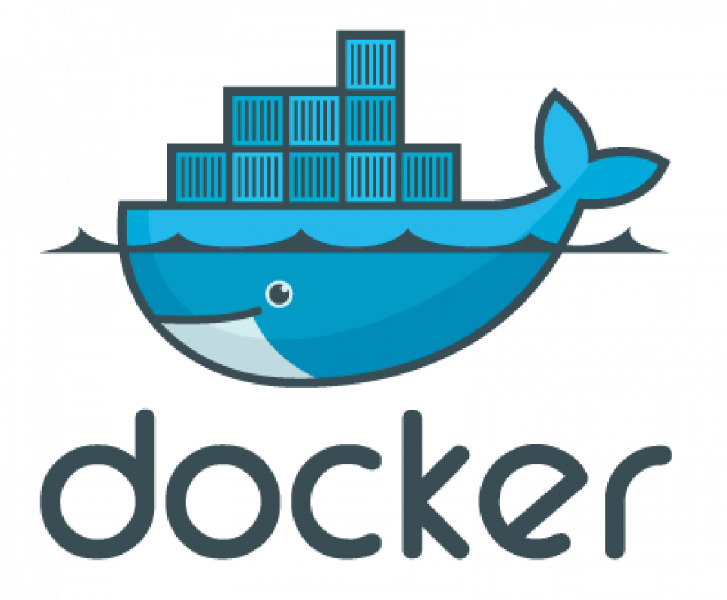




Tools of the Trade

Slide 19
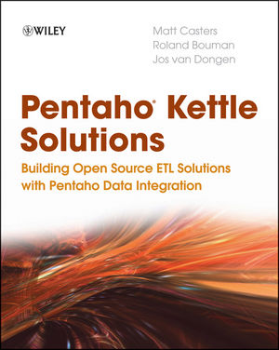
Apache
A.k.a. Kettle a.k.a. Pentaho Data Integration
Kettle founded by Matt Casters early 2000’s
2005: Open Sourced & ‘acquired’ by Pentaho
2015: Pentaho acquired by Hitachi
2019: Forked by community
2020: Apache Incubator project
2022: Apache Top Level project (Jan 18)
https://hop.apache.org

Slide 20



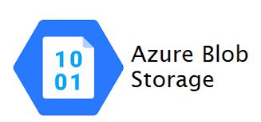








Sources
Sinks
DBMS Access
ETL
Sensors
JWT
Data Sources
ETL
JWT

Slide 21

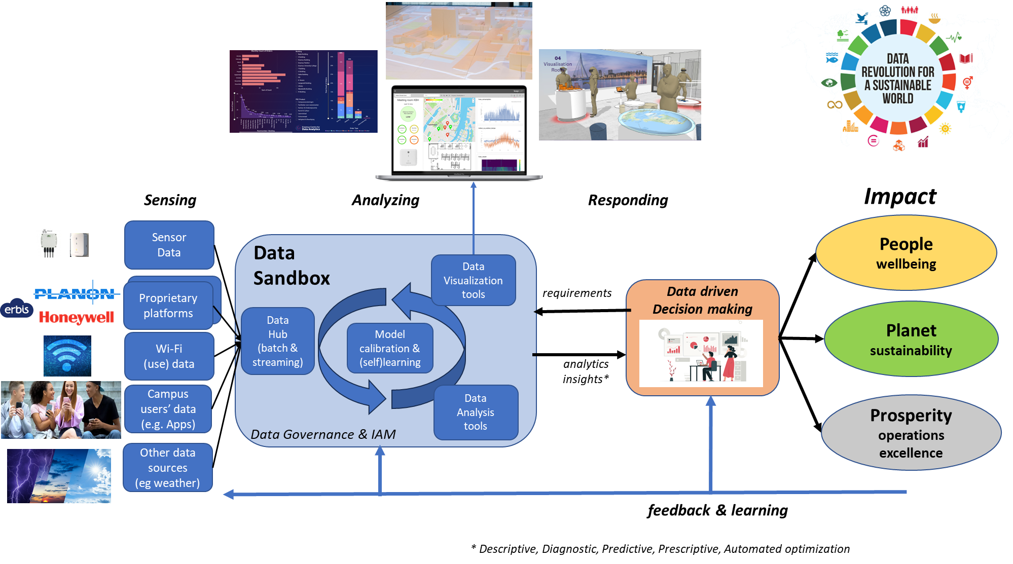
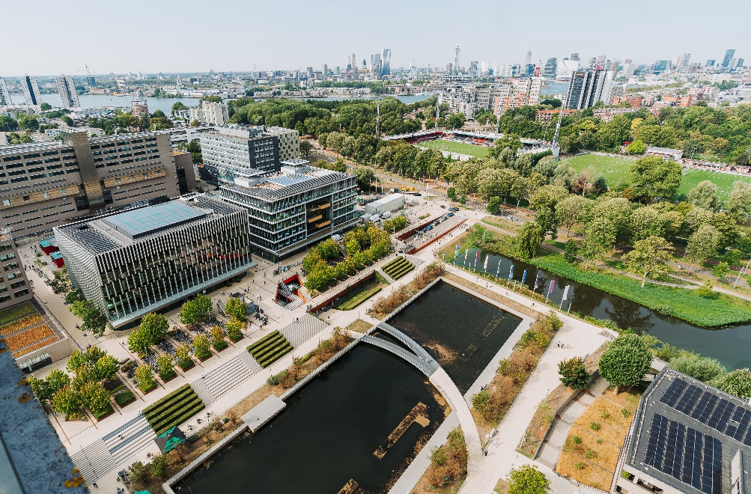
Erasmus Centre for
Data Analytics (ECDA)
Erasmus Digitalisation & Information Services (EDIS)
Real Estate & Facilities (RE&F)
Notes:
Version Long:
Our first and most important guiding principle is our hands-on approach in making talent more data competent by teaching them everything there is to know about the power of data, how to turn that into valuable information, learn from that and become competent, and how to use that competence to make wiser decisions.
We skill and re-skill them in understanding how to come from data to wisdom and we let them experience the context of the use of data in their work and learning environment by trying and applying.
This way we combine education and research with hands-on experience in data analytics, turning talent into the future digital leaders for a sustainable future.

Slide 22

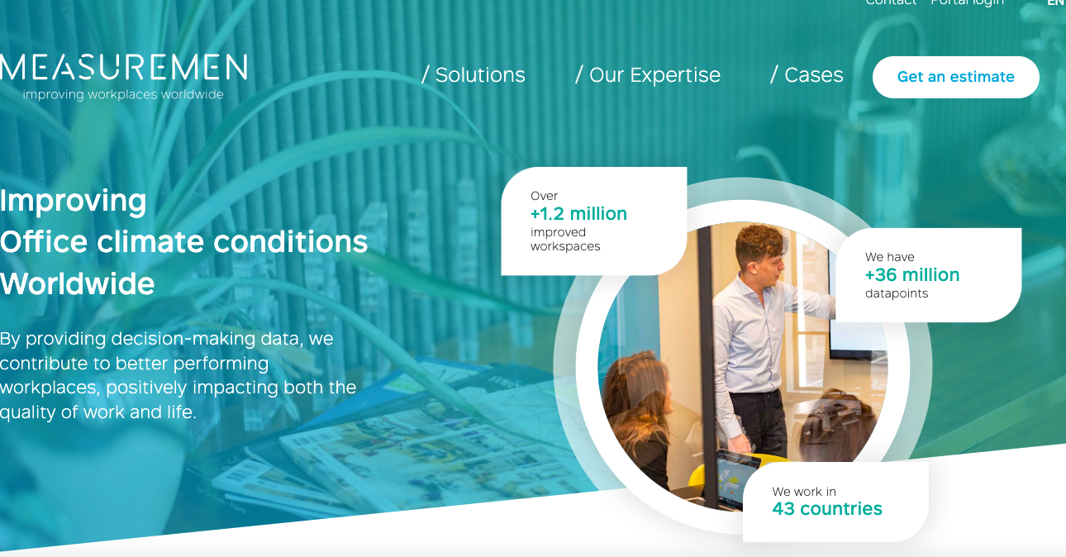
Sensor data
From API System of the Measurement
ETL
JWT

Slide 23
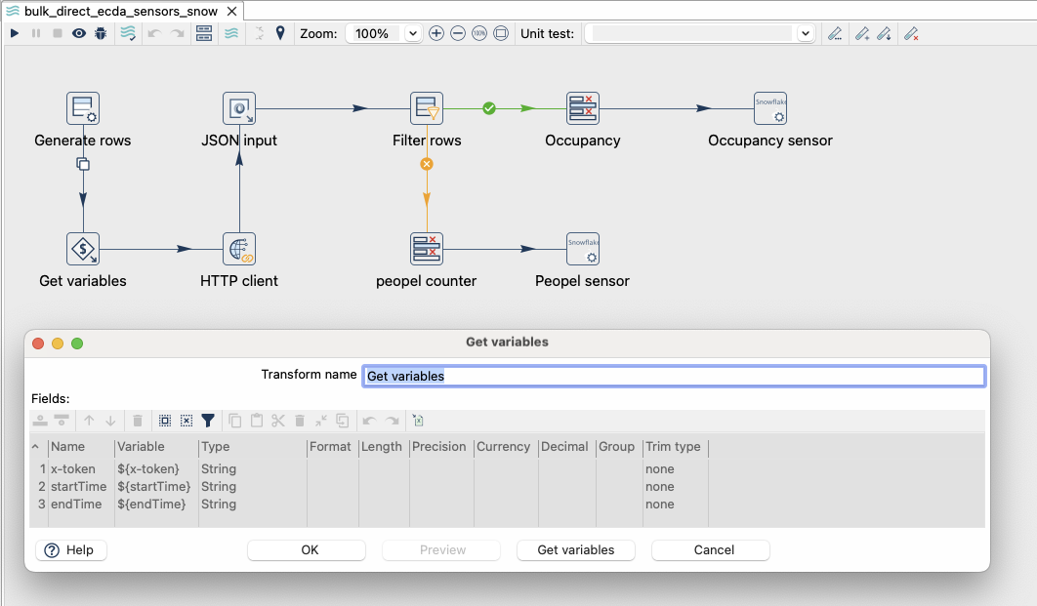
In Apache HOP, the data is extracted from API Swagger (Measurement Company) and transferred to CrateDB

Slide 24
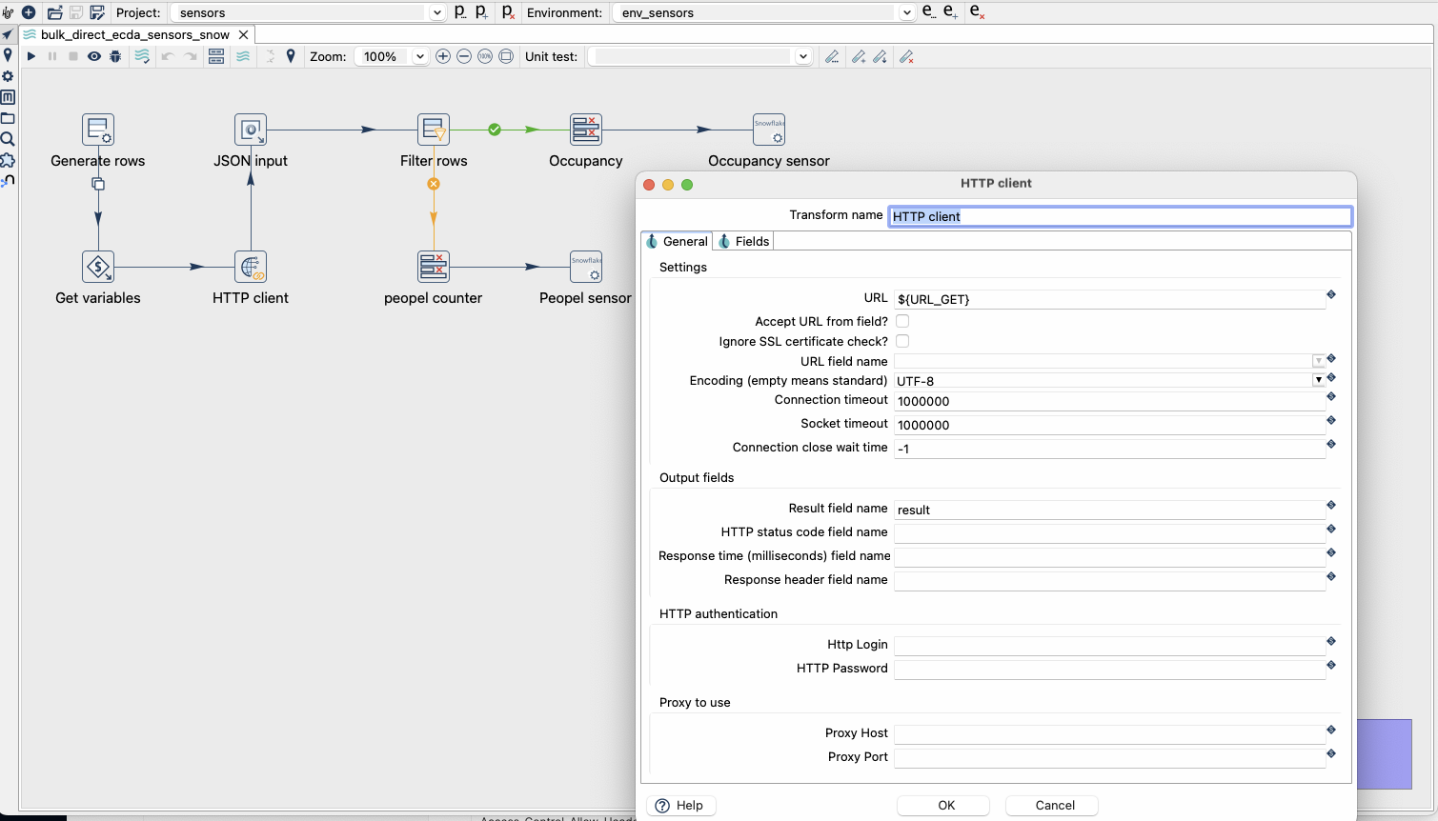

Slide 25
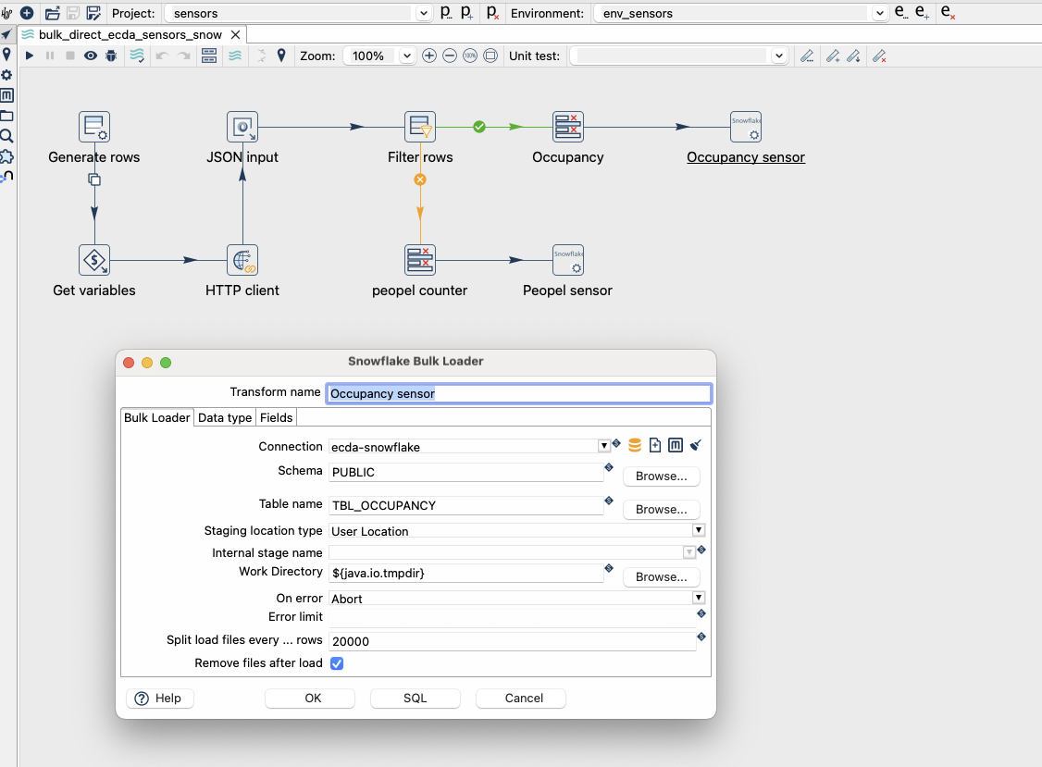

Slide 26
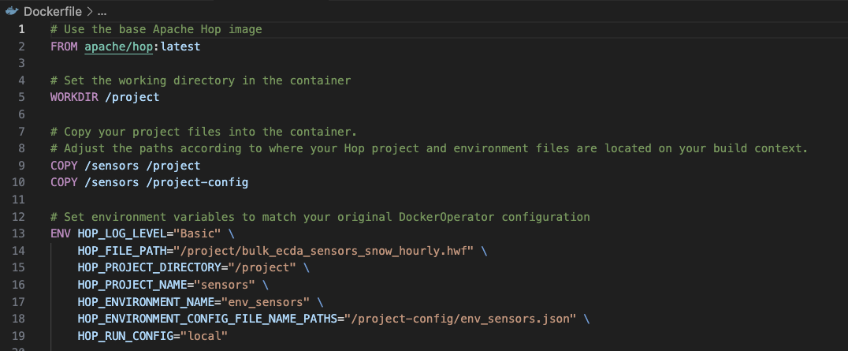

Slide 27
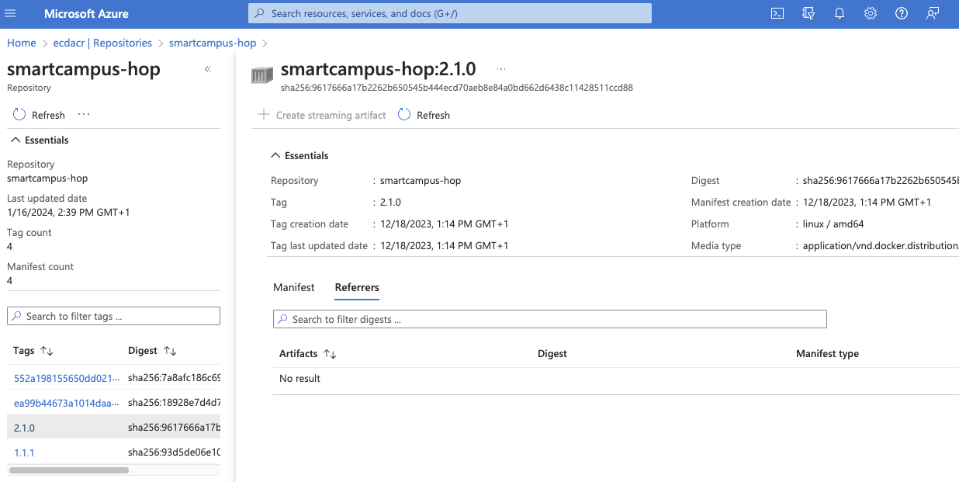
Az login
Docker build -t ecdacr.azurecr.io/smartcampus-hop:2.1.0
Docker push ecdacr.azurecr.io/smartcampus-hop:2.1.0

Slide 28
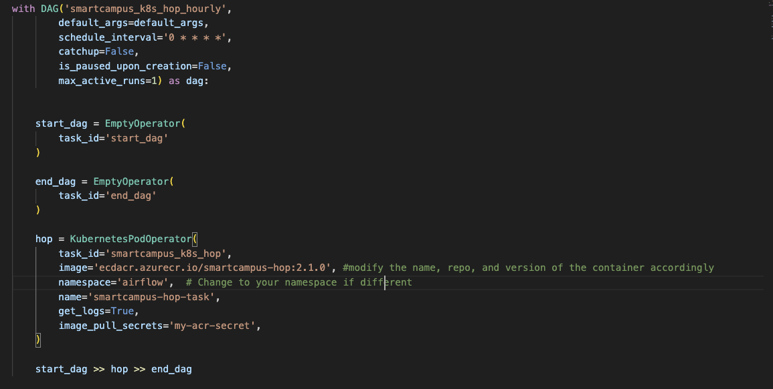

Slide 29
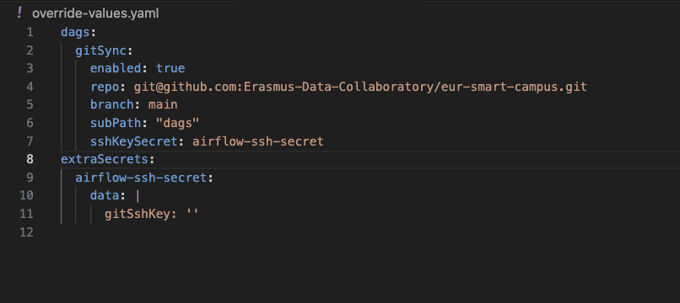

Slide 30
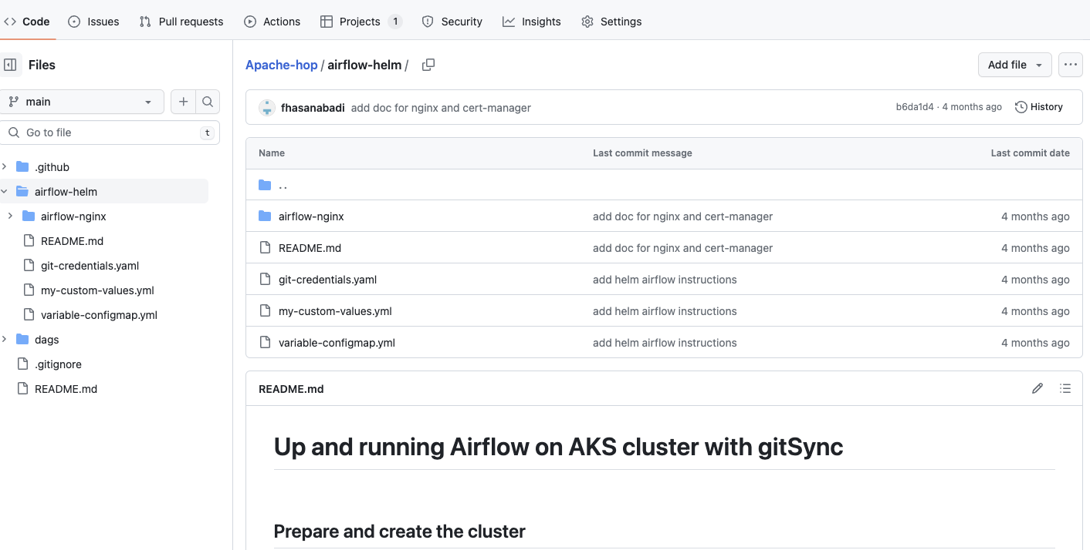
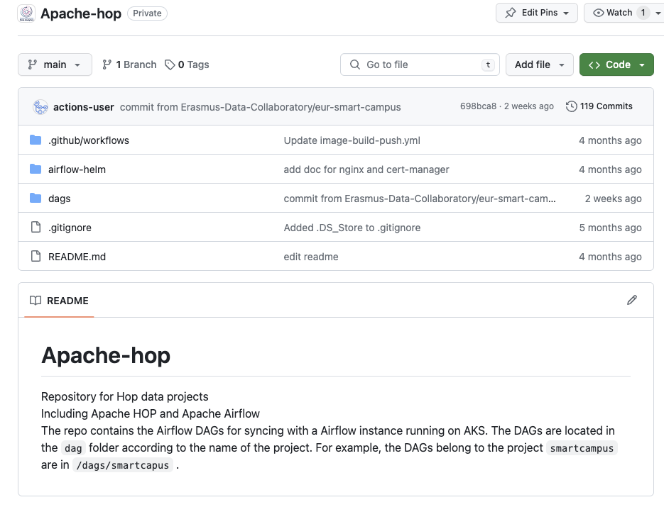

Slide 31
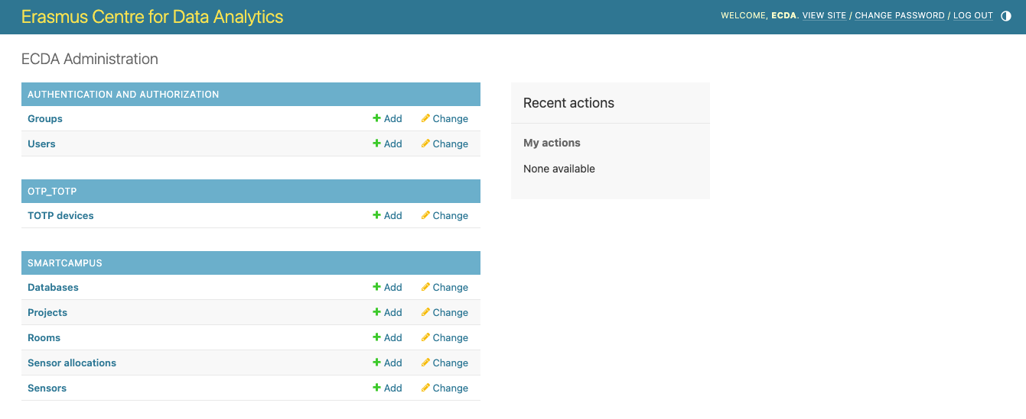
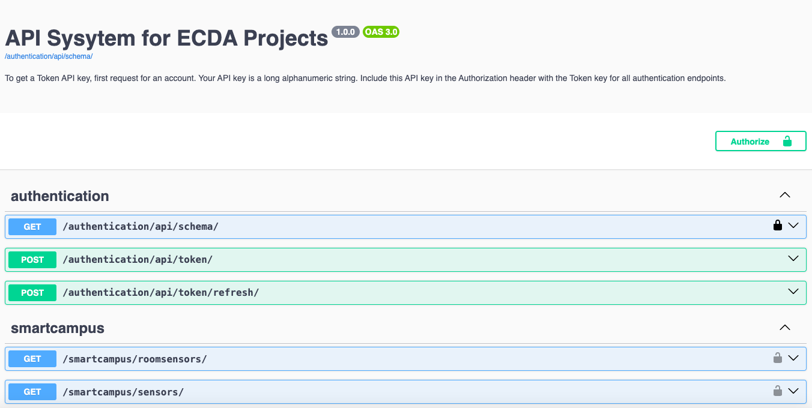
ADMIN
USERS

Slide 32
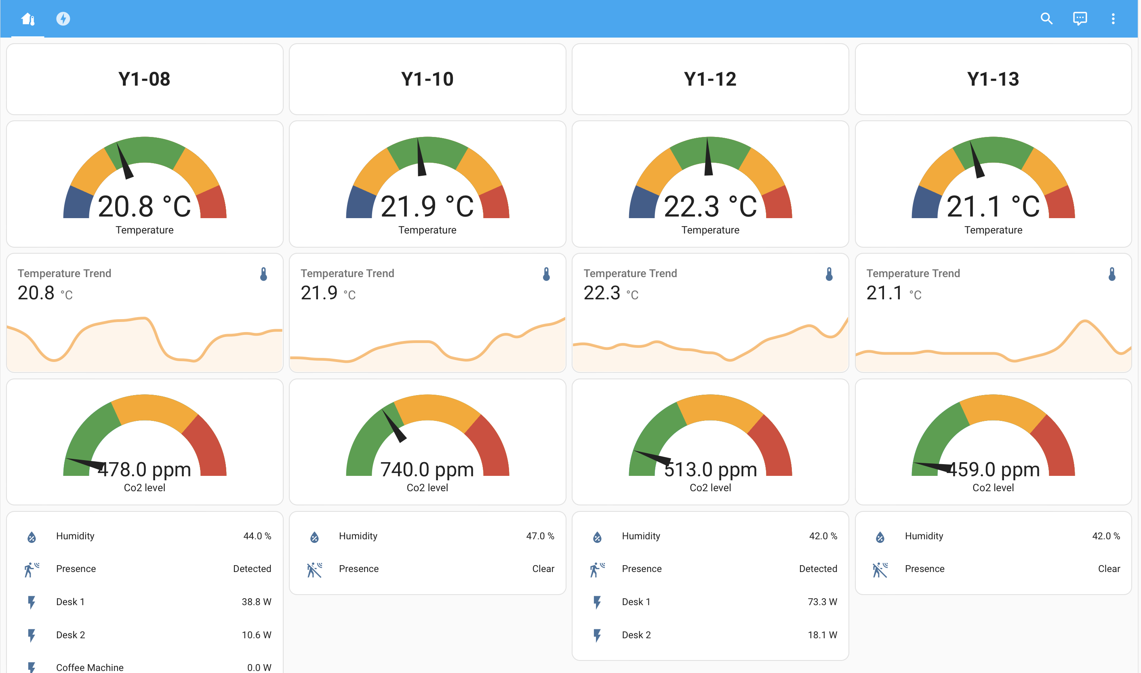

Slide 33

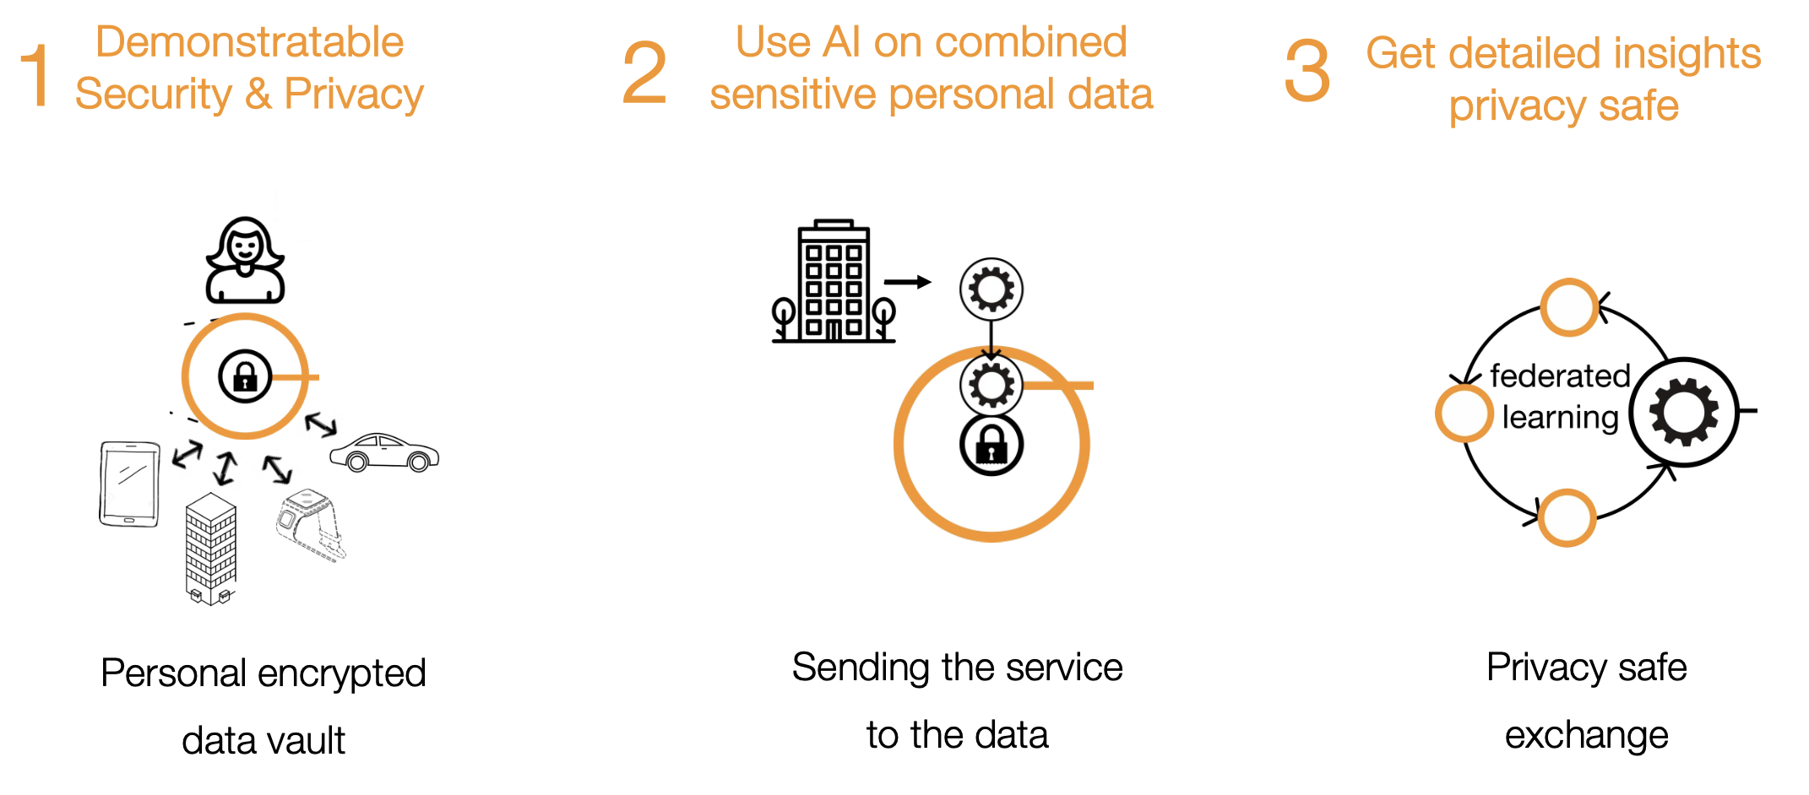
New Pilot:

Slide 34
Questions?

