Slide 1
Knowledge Graphs
Panos Alexopoulos
Data & AI Professional
http://www.panosalexopoulos.com
p.alexopoulos@gmail.com
@PAlexop
Pragmatic Approach and Best Practices

Slide 2
About me
Working since 2006 as an ontologist and semantic technologies researcher and practitioner.
Working since 2016 as Head of Ontology at Textkernel, developing and delivering a large cross-lingual Knowledge Graph in the HR and Recruitment domain
Published in 2020 a field guide for semantic data modeling.

Slide 4
Seminar Goals & Learning
Outcomes
CONTEXT
METHODOLOGY
TECHNIQUES
Understand what a knowledge graph is and how it can benefit your data applications
Learn what steps are involved in knowledge graph development and how to kick off your own project
Get an overview of techniques and technologies for the main development stages and tasks

Slide 5
Know where you are getting into

Slide 6
Knowledge Graphs are interconnected entities under shared semantics
Not something really new but rather a rebranding of terms like semantic networks, knowledge bases, ontologies, linked data
If you have been designing database schemas, taxonomies, ontologies or other types of structured data, you already know a lot about knowledge graphs.
What you may have missed is the shared semantics aspect!

Slide 7
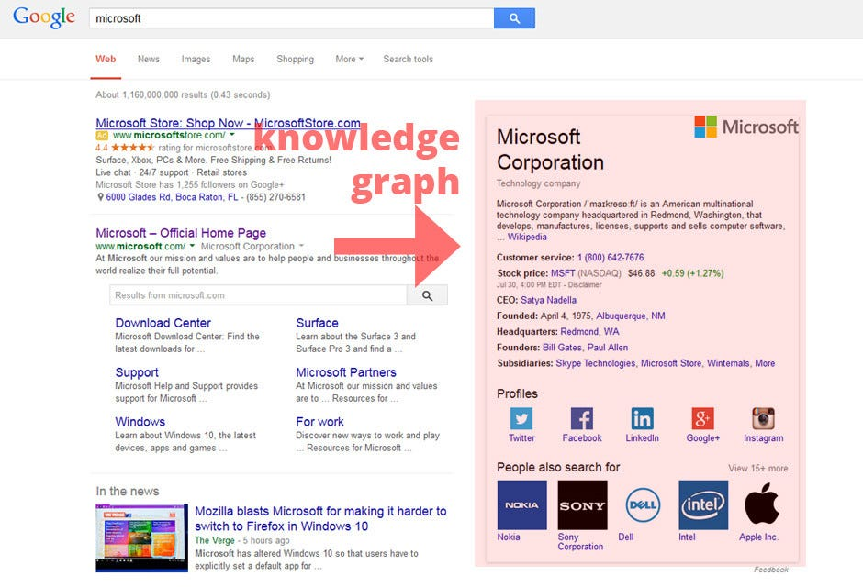
Example: Google Knowledge Graph

Slide 8
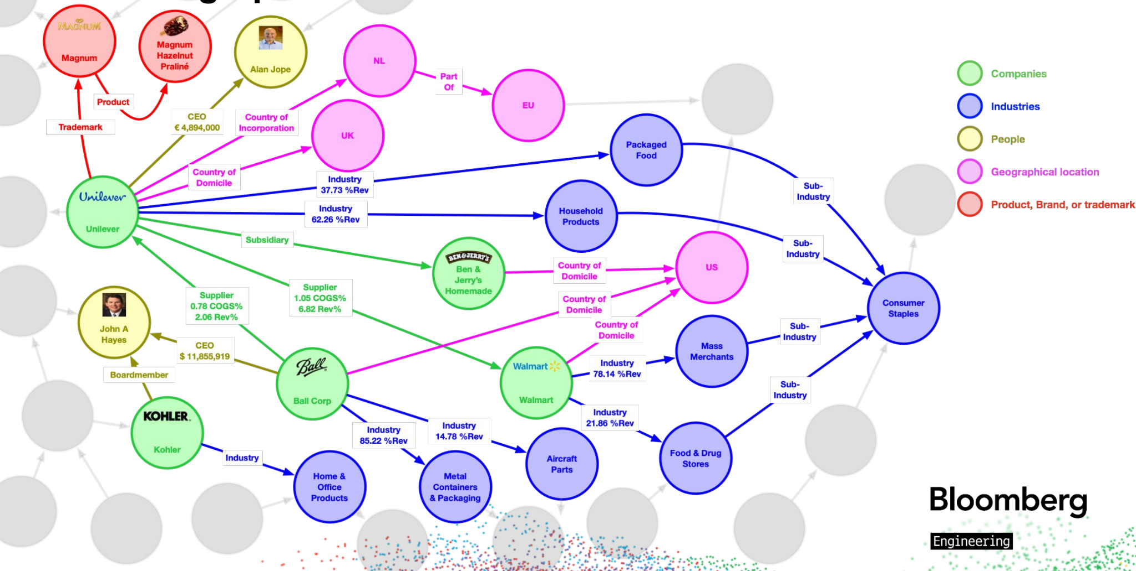
Example: Bloomberg Knowledge Graph

Slide 9
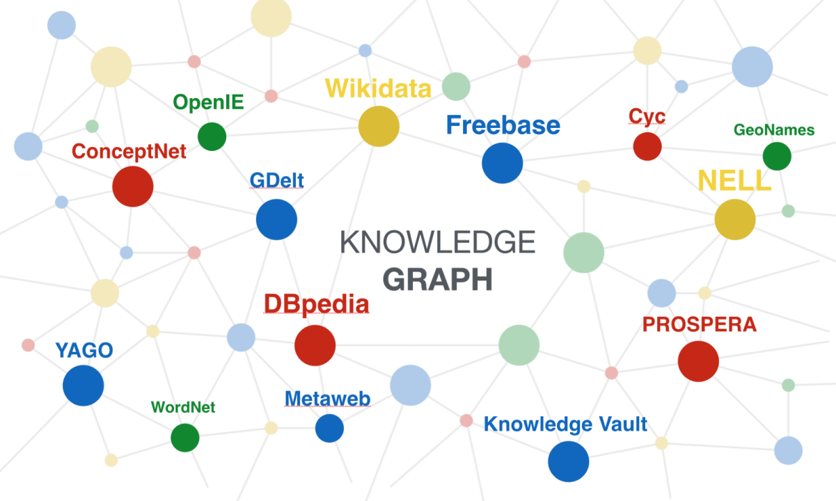
Public Knowledge Graphs

Slide 10
Important (but non-defining) dimensions of Semantic Data Models
REPRESENTATION & TECHNOLOGY STACK
SIZE AND
CONNECTIVITY
RDF, Property Graphs, JSON-LD, NoSQL, ...
Small, medium, large, densely connected, sparsely connected, ...
EXACT NATURE OF ELEMENTS
Concrete entities, abstract entities, “real-world” entities, hierarchical relations, entity attributes, relation attributes, associative relations, constraints, axioms, rules, ...
SCOPE
PURPOSE
Single domain, multiple domains, single context, multiple context
Data Analytics, Data Integration, Semantic search, Question answering, Reasoning

Slide 11
Crucial dimensions of Knowledge Graphs
MEANING ACCURACY
MEANING EXPLICITNESS
MEANING AGREEMENT
How correct/accurate is the meaning of each entity, relation or other element for all people and systems that use the graph.
How clear and unambiguous is the meaning of each entity, relation or other element for all people and systems that use the graph.
How commonly acceptable is the meaning of each entity, relation or other element among the people and systems that use the graph.

Slide 12
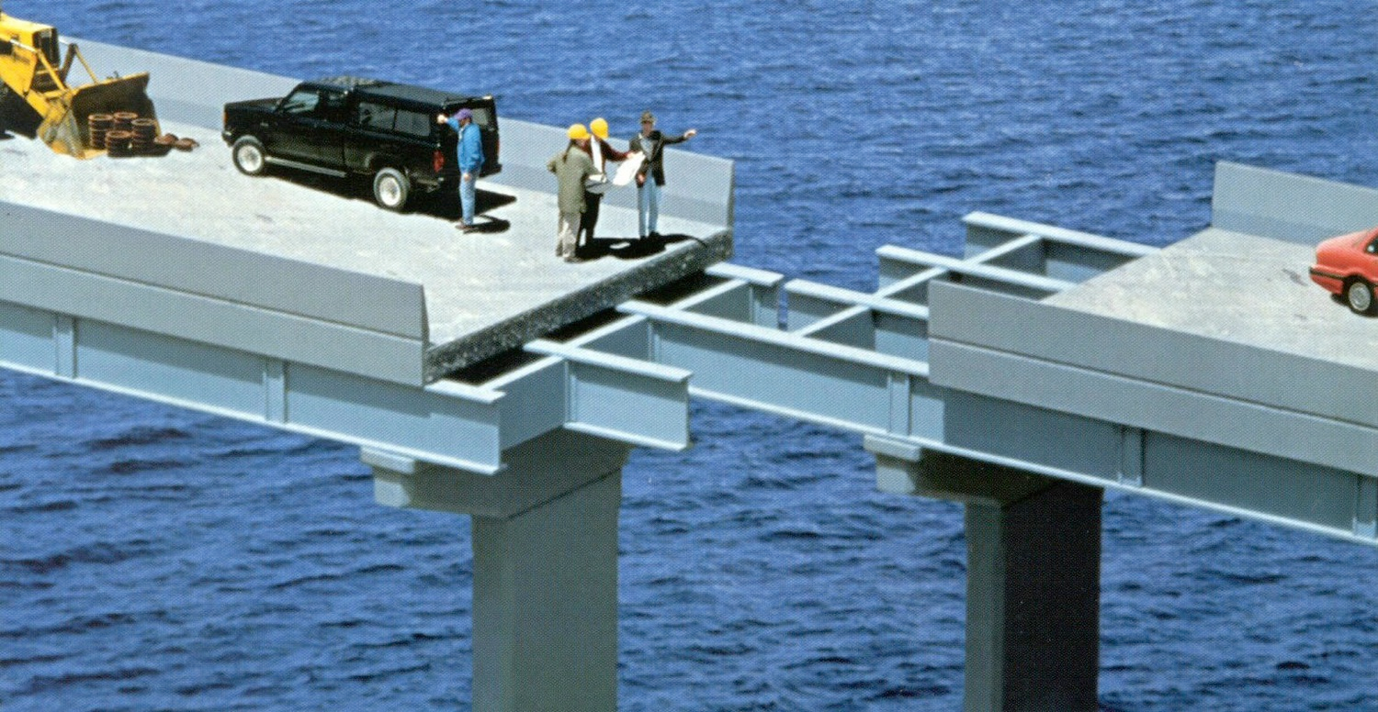
Semantic gap

Slide 13
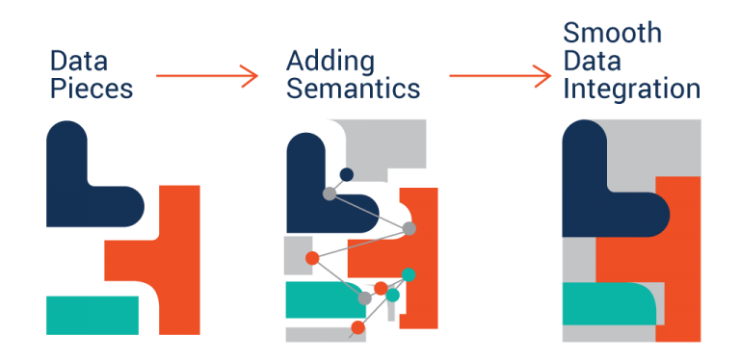
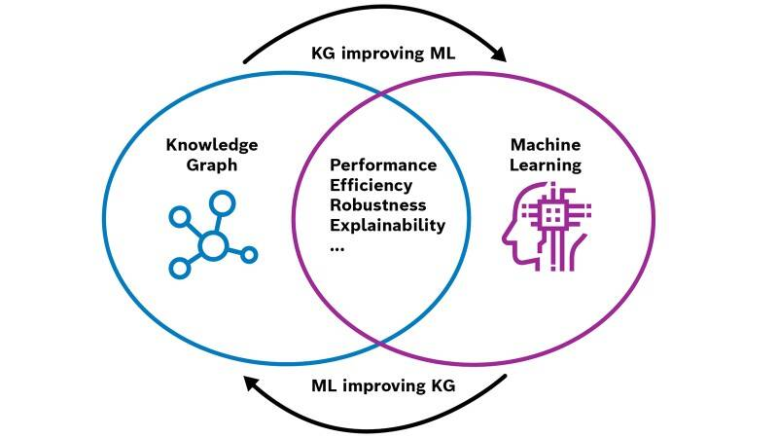
Three High-Level Uses of Knowledge Graphs
Complementing and Enhancing Machine Learning Applications
Integrating Data in a Semantic Way
Data Analytics
and Science

Slide 14
How Bloomberg uses their Knowledge Graph

Slide 15
How Bloomberg uses their Knowledge Graph

Slide 16
A knowledge graph project is almost never a one-off, purely technical, engineering project
The graphs we build require a continuous effort to keep them relevant and useful.
We have to take into account business, strategic, and organizational aspects.

Slide 17
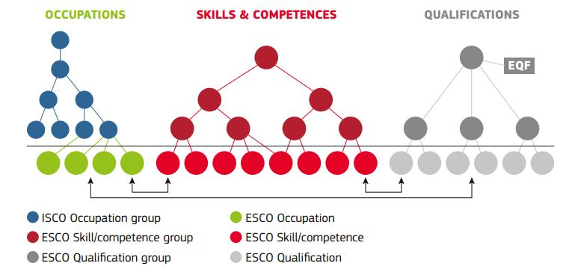
A tale of two graphs
EU’s ESCO knowledge graph:
Released September 2017
12K Skill and 3K Profession interrelated concepts in 27 languages
Built completely manually by experts in 6 years and cost ~15 million Euros
To be updated once a year by a maintenance committee
DBPedia knowledge graph
First release in 2007
Currently >17M entities in 127 languages
Automatically extracted from Wikipedia infoboxes
Live version and monthly releases

Slide 18
An Execution Framework for Knowledge Graph Initiatives
1. SET-UP
THE STAGE
3. GIVE IT SHAPE & SUBSTANCE
5. MAKE IT
USEFUL
What are we building, why are we building it, how are we building it, who is building it, who cares?
Modeling the schema(s), building data population pipelines
Making it available to people, applications, processes and tasks
2. DECIDE WHAT
TO BUILD
4. ENSURE IT’S
GOOD
6. MAKE IT
LAST
Investigating the status quo, finding pain points, eliciting requirements, scoping and prioritizing
Defining quality dimensions and metrics, building quality measurement and monitoring mechanisms
Establishing continuous improvement and change management mechanisms and processes

Slide 19
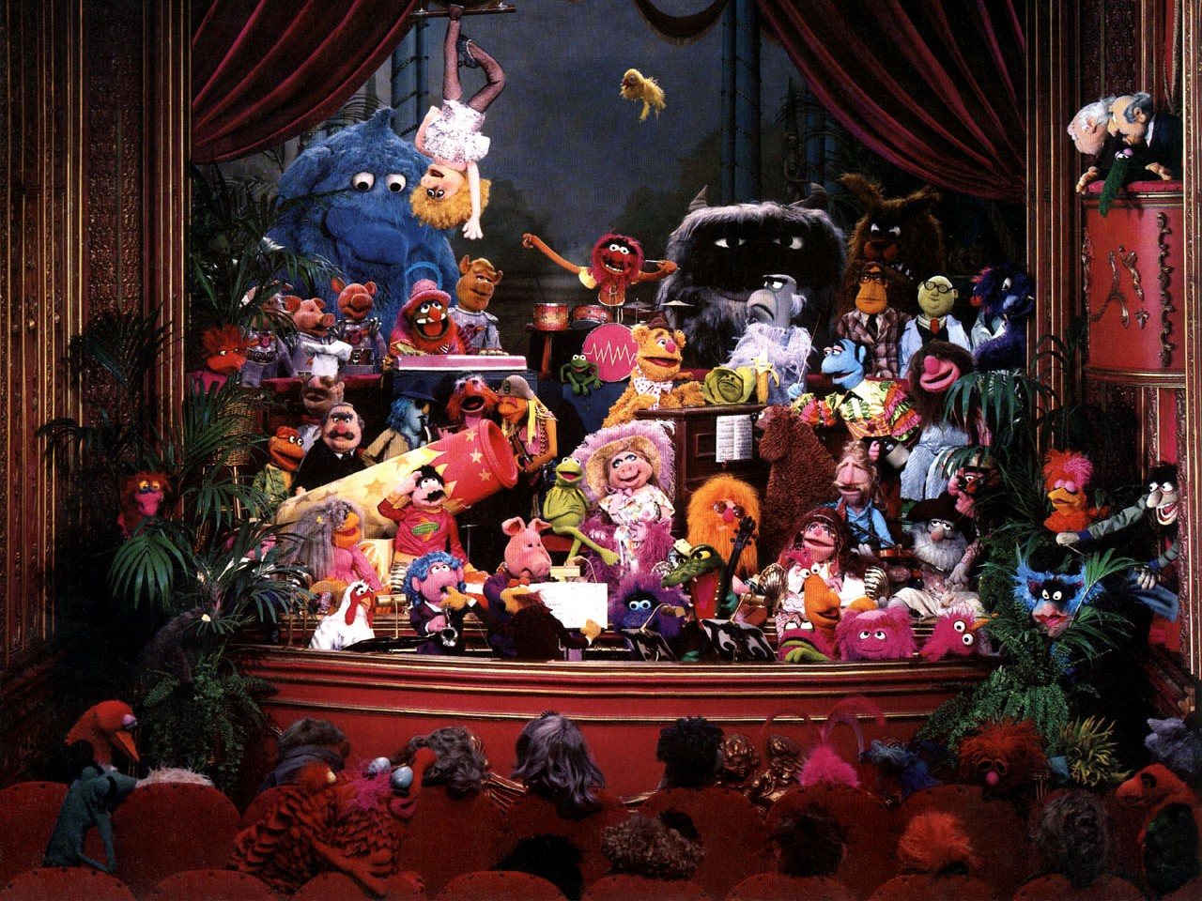
Set up the
stage

Slide 20
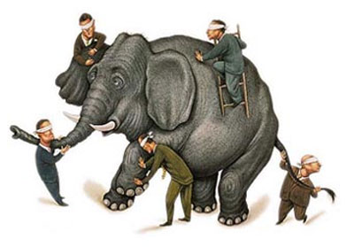
What are we building?
There will many perspectives and biases on what a Knowledge Graph is:
Linguists and NLP people will think of Wordnet and linguistic databases
Semantic Web people will think of RDF and Linked Data
Data people will think of just another database or data warehouse

Slide 21
What are we building?
Don’t get overly obsessed or argue about the definition
Show rather than tell
Create and support narratives that make sense to each stakeholder.
Highlight the fact that we are not just building the graph but also the supporting technology and processes.

Slide 22
Why are we building it?
What business/technical goals is the organization trying to achieve?
Imitate the others?
Enhance current products/processes? If so, which?
Lay the foundations for new products/processes? If so, which?
Integrate dispersed data and improve their governance?
You need concrete, measurable and prioritized goals

Slide 23
How are we building it?
Overall Philosophy/Methodology/Lifecycle/Strategy
E.g. centralized or distributed graph modeling and management?
E.g. mainly manual or mainly automatic population?
Approaches/Methodologies/Techniques for each lifecycle stage
A good opportunity to align expectations and prevent misunderstandings

Slide 24
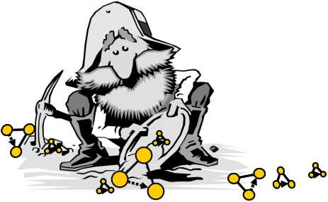
How we build the Textkernel Graph
Data-Driven Graph Population
Human-in-the-loop
Scope & Structure based on Customer Needs
Concepts to include
Domains to cover
Tasks to support
Technology constraints
New Entity Discovery
Synonym Detection
Taxonomy Induction
Relation Extraction
Entity Mapping and Alignment
Data Generation
Knowledge Validation
Quality Assessment

Slide 25
Who is building it?
Highly dependent on the “How”
Expertise and experience you might need in your team:
Conceptual/Semantic Modeling
NLP / Machine Learning / Knowledge Extraction
Data Management / Engineering
Full Stack Development
Domain knowledge
You will need to decide what expertise to “buy” and what to “build”.

Slide 26
Who is building it?
Roles and dependencies:
Who has the KG ownership (and accountability)?
Who defines the roadmap and takes strategic decisions?
Which products/systems and teams/people contribute?
Which products/systems and teams/people are affected?

Slide 27
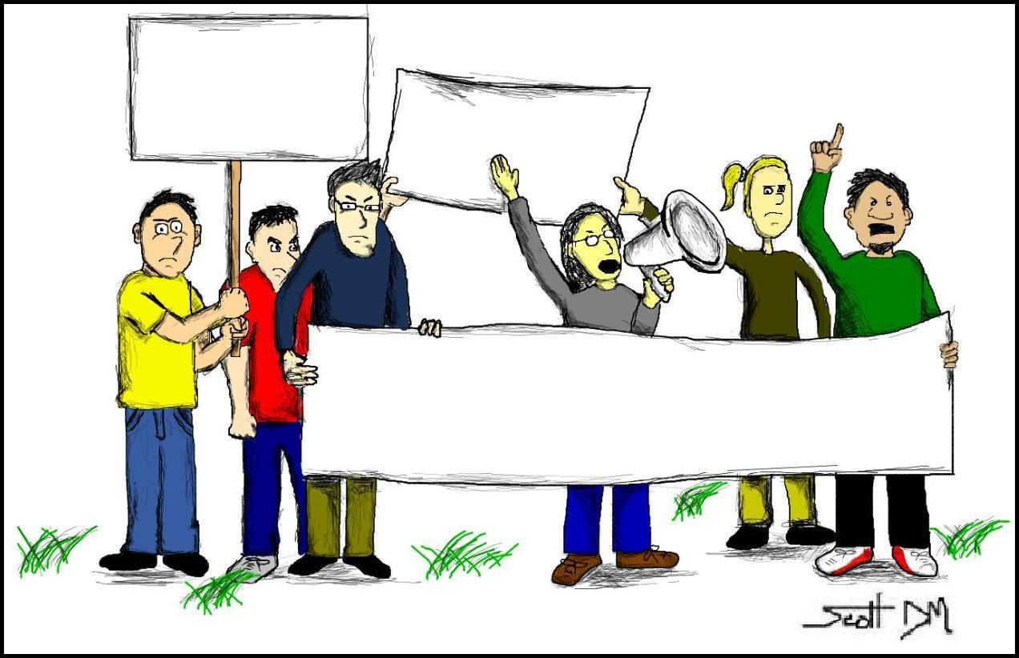
Who cares?
Those who will (have to) use the KG
They set the requirements and are the ultimate quality judges
They might have to change their systems and practices
Those who will (have to) contribute to the development and maintenance of the KG
They will need to share their data and knowledge
They will need to learn new techniques and follow new processes.
Those who put the money and expect a return on their investment

Slide 28
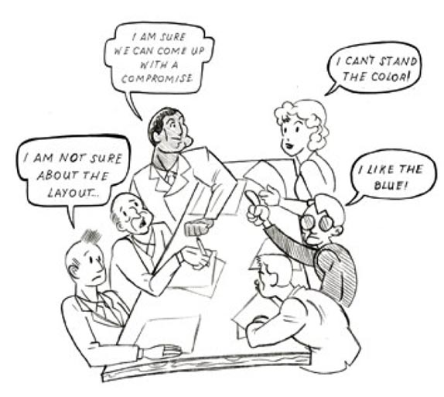
Decide what
to build

Slide 29
Building the wrong thing
When I joined Textkernel I was all too eager to start building the knowledge graph
Within my first month I had the main KG requirements and a schema.
Within 6 months I had KG version 1
But when I went to integrate the KG into Textkernel’s products, both the integration and the performance improvement proved to be extremely difficult and took much more time than initially estimated.

Slide 30
What did I do wrong?
INCORRECT KNOWLEDGE
HARMFUL KNOWLEDGE
UNNECESSARY KNOWLEDGE
E.g. Implemented a stricter version of synonymy than needed
E.g. I added way more lexicalization to the model’s entities than the parsing system could effectively disambiguate
E.g. I added a relation to the model representing the typical skills a particular profession requires in the job market, yet none of our products at that moment could make productive use of this relation.

Slide 31
What did I do wrong?
Did not push
for clarity
Did not anticipate conflicting requirements
E.g. People would
tell me that their application needed synonyms, but what they really meant and
wanted were semantically related terms for search expansion purposes.
People and teams would give me biased and single-sided requirements, often not realizing conflicts and trade-offs with other applications.
Did not consider the KG applications from the beginning
Ignored legacy and history
Instead of trying to
understand how certain flaws of existing models came to be, I just dismissed these models and went on to
define new ones from scratch.
I focused solely on the domains and data the graph had to cover, leaving the application aspects as an afterthought.

Slide 32
Investigate the status quo
What products/systems exist, being developed, or are expected to be developed that use/need structured knowledge?
What knowledge exactly they use/need?
Where do these systems currently get their knowledge from?
Is there a central “knowledge department” or each product works on its own?
What are the methods, processes, tools supporting knowledge generation, delivery and maintenance?
How is knowledge shared? Are there any knowledge silos?

Slide 33
Identify knowledge pains
What are the “knowledge pains” of each product/system?
E.g., not enough coverage of a particular domain
E.g., missing particular entity types or relations
E.g., inadequate knowledge synchronization with other systems.
How consensual are these pains?
How important/urgent are these pains?

Slide 34
Knowledge capabilities, needs and gaps
Your investigation should uncover the knowledge gap between what your knowledge-based applications need and what they already have.
A good way to express that gap is Competency Questions, i.e. questions users would want get from the knowledge graph.

Slide 35
Competency Questions
Questions expressed in natural language that the graph should be able to provide answers to.
Enable stakeholders to tell us what elements they want/need the model to have without having expertise in semantic data modeling.

Slide 36
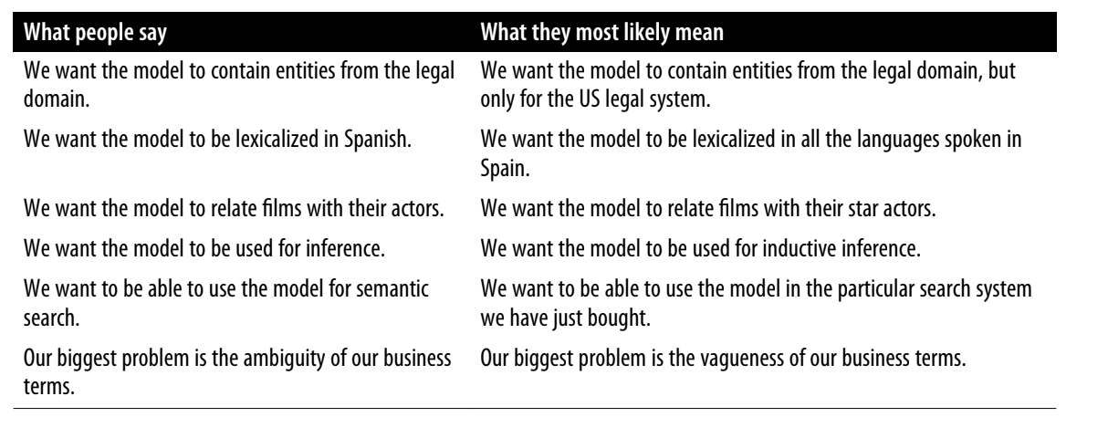
Expressed vs Desired Requirements
Learn to guess what people mean

Slide 37
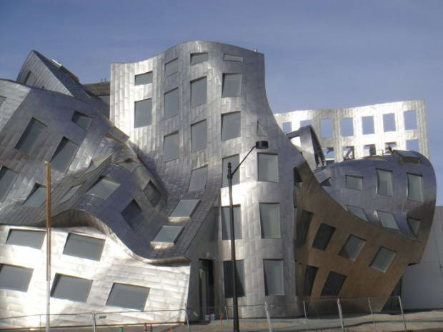
Give it a
shape

Slide 38
Knowledge
Graph
Elements

Slide 39
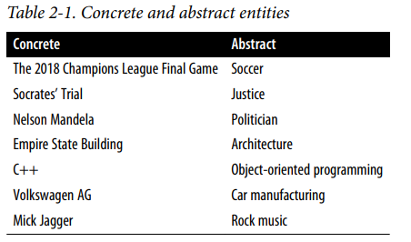
Entities and Concepts
Without being too philosophical, an entity is something that may exist concretely or abstractly, outside or within our mind.
Abstract entities are also called concepts and are typically more difficult to model than concrete ones.

Slide 40
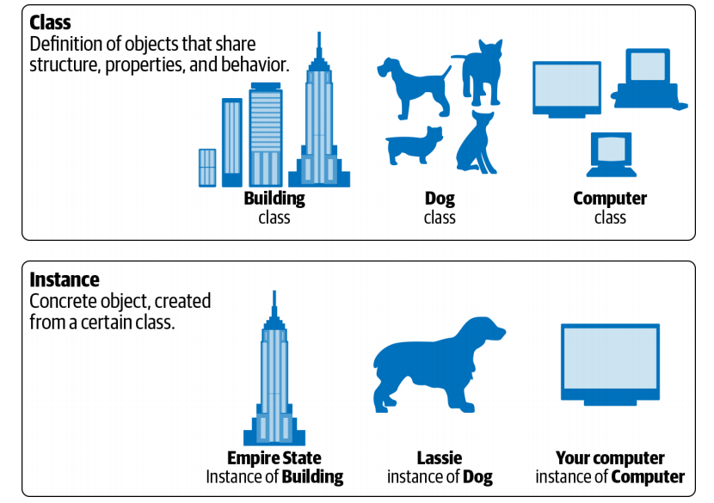
Classes and Individuals
Classes are abstract entities that represent kinds of things in the world that may serve as semantic types of other entities, concrete or abstract.
The entities that belong to a class are also known as instances or individuals.
Notes:
Show here in Protege how classes and individuals are defined

Slide 41
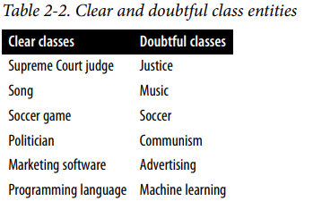
The Concept=Class Fallacy
In ontology literature, the term “concept” is used interchangeably with the term “class”.
This is only partially correct; a concept can indeed play the role of a class if its definition implies a set of entities that instantiate it, but this is not always the case.
The only criterion that matters when determining if an abstract entity can be a class is whether there are other entities that can be instances of it.

Slide 42
Entities that can be both classes and individuals
There are several entities that can be legitimately modeled as both a class and an individual.
For example, the entity Secretary can be modeled as a class, representing the set of all individual persons that work as secretaries.
It can also be modeled as an individual belonging to the class Occupation.
Certain knowledge representation languages do not allow an entity to be both a class and an individual.

Slide 43
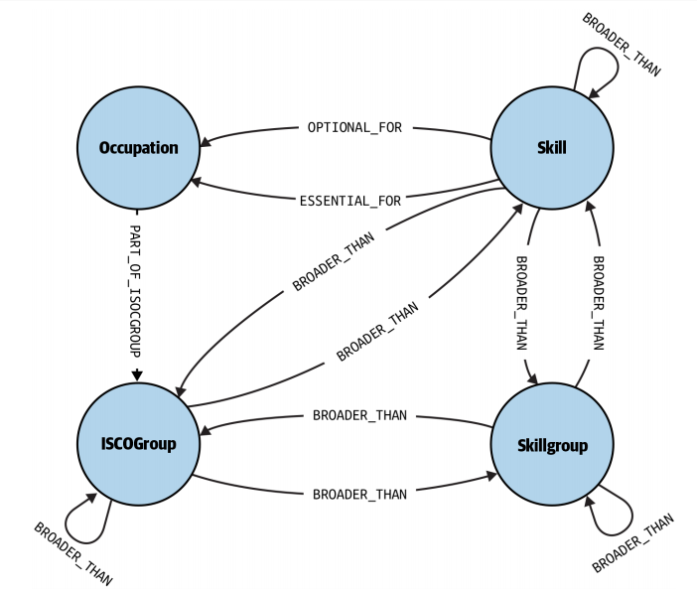
Relations
A relation expresses a particular way that two or more entities can be related to one another

Slide 44
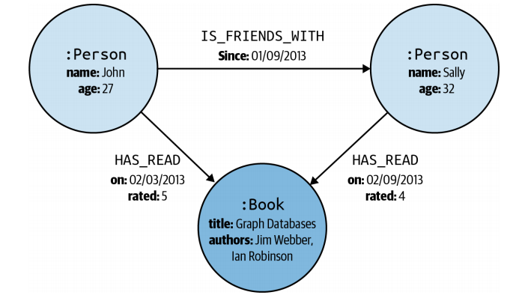
Attributes
An entity attribute is used to represent a characteristic of an entity that we cannot (or choose not to) represent as a relation with another entity, and instead we use literal values.
A relation attribute is used to represent a characteristic of the relation between two or more entities.
The conceptual distinction between a relation and an attribute is not always clear and ends up being a matter of representation choice.

Slide 45
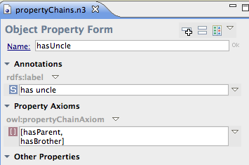
Complex Axioms and Rules
Complex elements that allow the modeling of more elaborate data semantics and enable reasoning
E.g., we can define that a person A is the uncle of person B if he is the brother of some A’s parent.

Slide 46
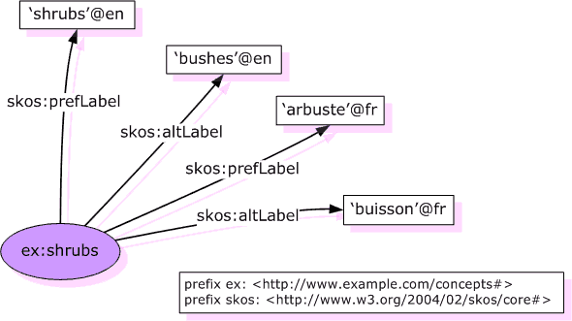
Lexicalization
Lexicalization links a model element (entity, relation, attribute, etc.) to one or more terms that can be used to express it in natural language.
These terms are basically either synonyms or lexical variants to each other.
These terms should be seen as “meaningless” strings that obtain a meaning only via their relations to classes, entities and concepts.

Slide 47
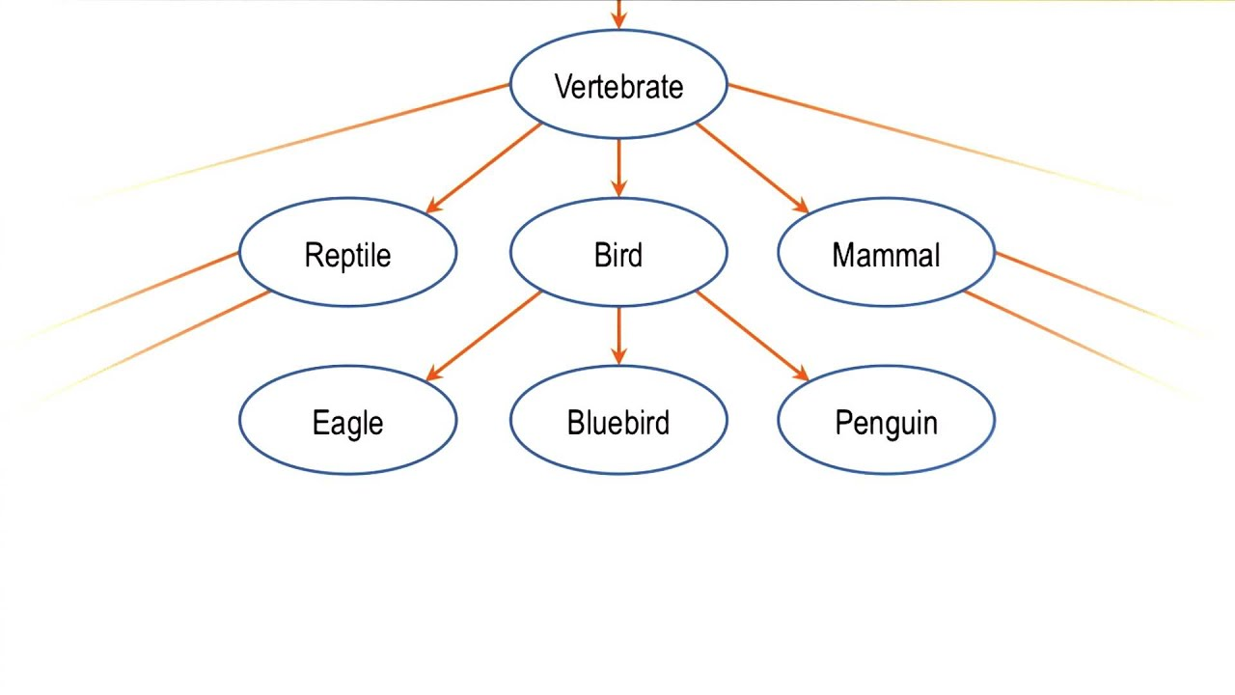
Meaning Inclusion
A meaning inclusion relation between two modeling elements indicates that the meaning of the one is included in the meaning of the other.

Slide 48
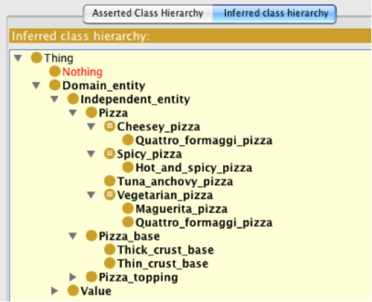
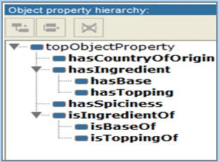
Class/relation subsumption
When meaning inclusion is applied to classes, it is called class subsumption or sub‐classing and has the following logical implication:
If class A is a subclass of class B then all entities that instantiate A are also instances of B.
Similarly, if the meaning inclusion is about relations, then it has the logical implication that if relation A is subsumed by relation B then all entities related via A are also related via B

Slide 49
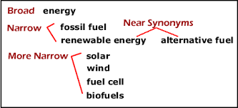
Broader/Narrower Relation
A broader/narrower relation between entities indicates that one is in some way more general (broader) than the other (narrower).
This relation covers three different relation types:
Meaning inclusion
Part-whole
Instantiation
Therefore, a subclass hierarchy is not equivalent to a broader/narrower hierarchy!

Slide 50
Documentation Elements
Elements that aim at human-understandability, like natural language definitions, provenance information, or scope notes.

Slide 51
Modeling
the KG
Schema

Slide 52
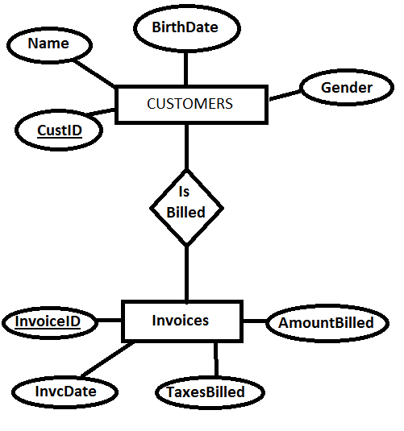
What we need to define
CLASSES (ENTITY TYPES)
RELATIONS
What are the core types of entities we want our Knowledge Graph to contain
What relations will connect these entities
ATTRIBUTES
(PROPERTIES)
CONSTRAINTS AND
RULES
What attributes will these entities and relations have
What constraints and rules will govern these entities and relations

Slide 53
Defining a class
DETERMINE INSTANTIATION CRITERIA
DETERMINE
IDENTITY
CRITERIA
What characteristics and criteria does an entity need to satisfy in order to belong to the class.
What characteristics and criteria make any two entities of the class distinct

Slide 54
Defining a relation
DETERMINE DOMAIN AND RANGE CLASSES
DETERMINE INSTANTIATION CRITERIA
What types of entities does the relation relate and in what direction.
What characteristics and criteria do two or more entities need to satisfy in order to be related through this relation.

Slide 55
Naming
Things

Slide 56
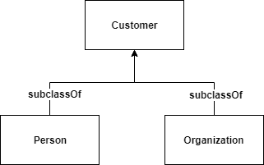
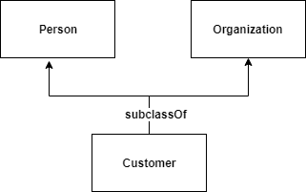
Which model is correct?

Slide 57
Well, none!

Slide 58
What’s the problem?

Slide 59
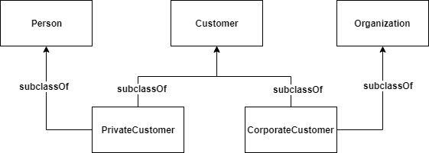
Better model

Slide 60
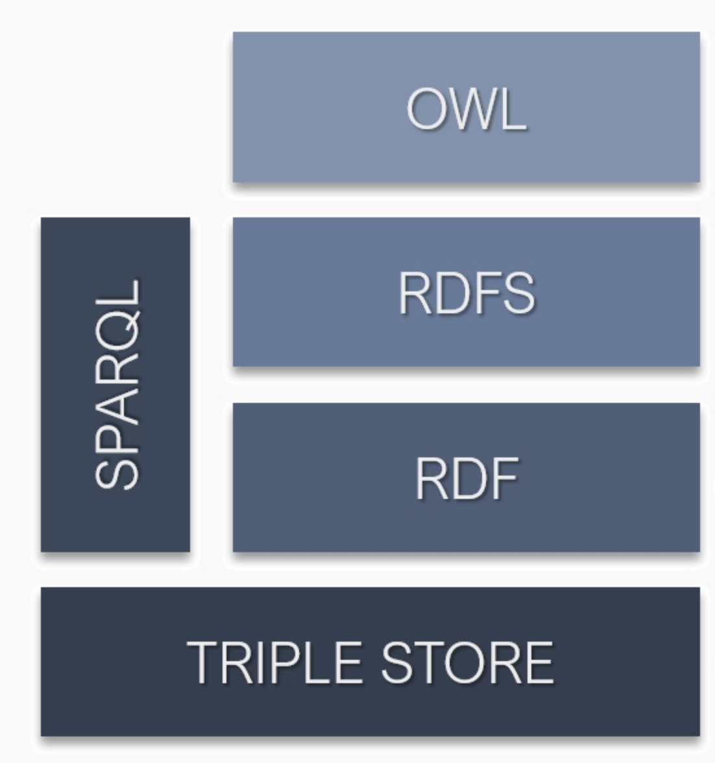
Working with Semantic Web Languages

Slide 61
RDF (Resource Description Framework)
Models data as triples

Slide 62
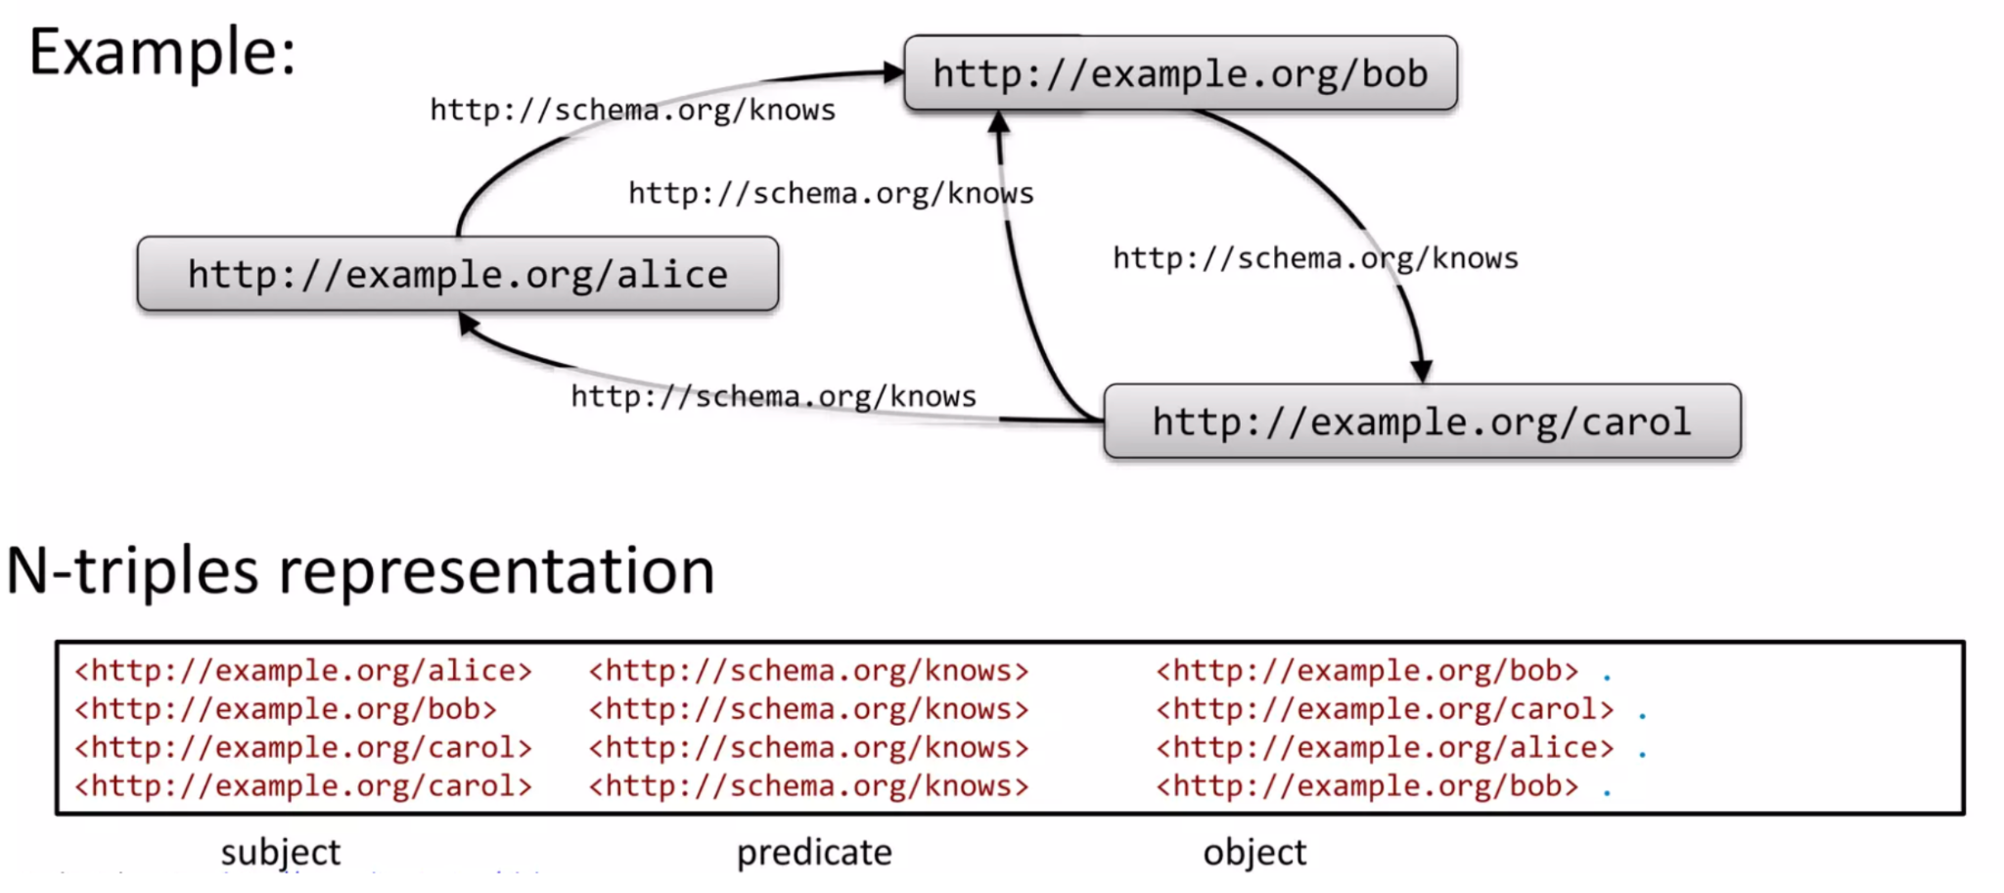
RDF (Resource Description Framework)
Multiple triples form a directed graph

Slide 63
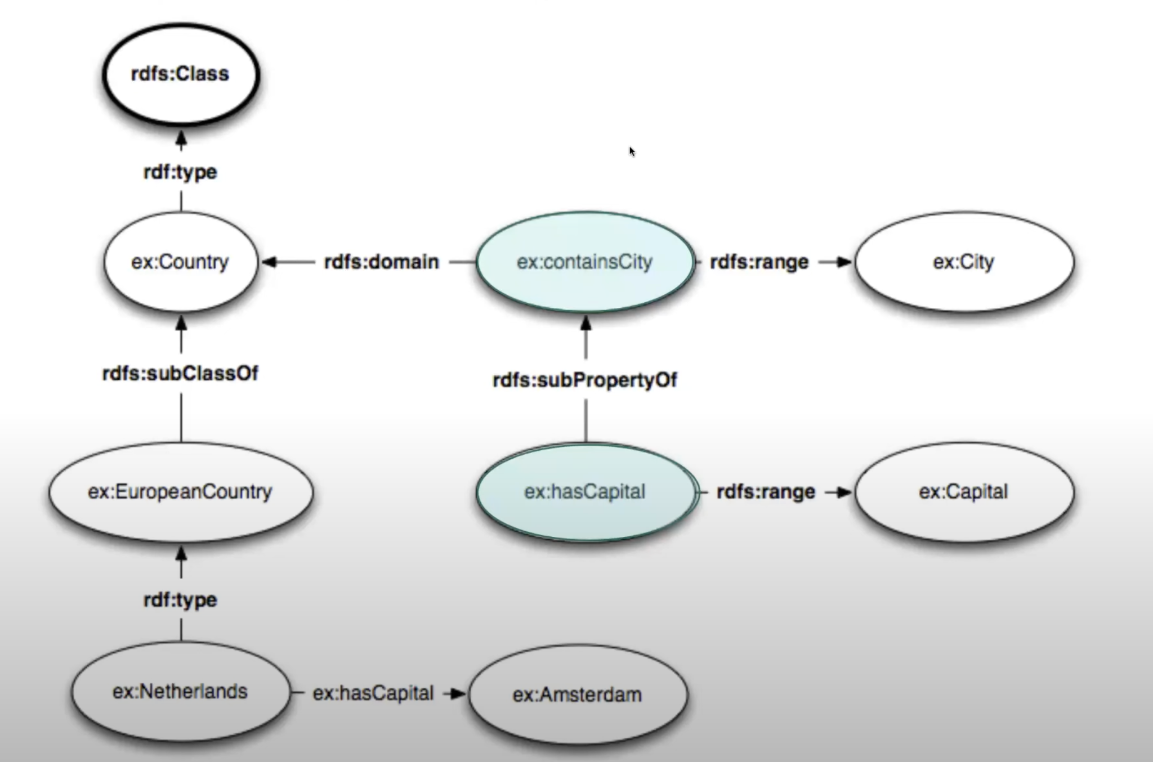
RDF Schema
Defines a vocabulary for “reserved” entities and relations

Slide 64
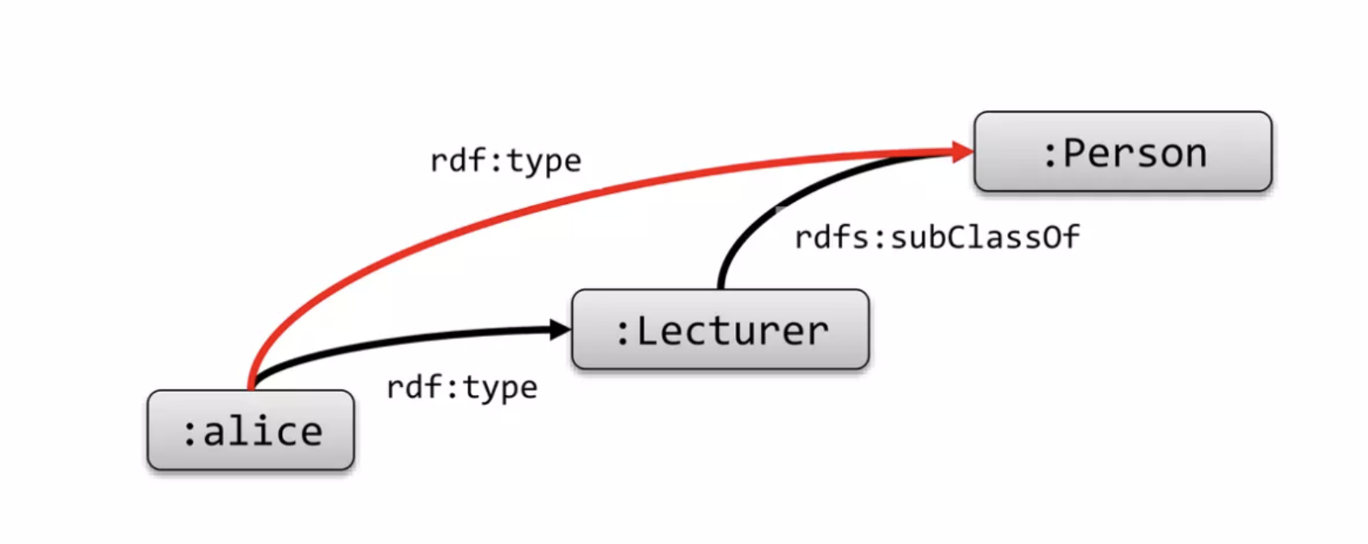
RDF Schema
Enables deductive inference via built-in rules

Slide 65
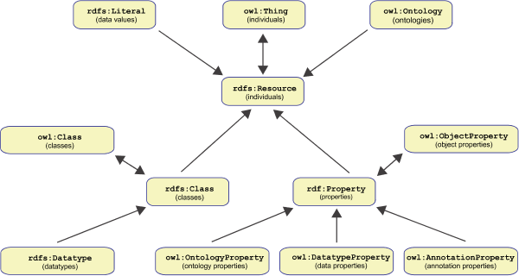
OWL (Web Ontology Language)
Adds additional “reserved” vocabulary for describing relations, attributes and classes

Slide 66
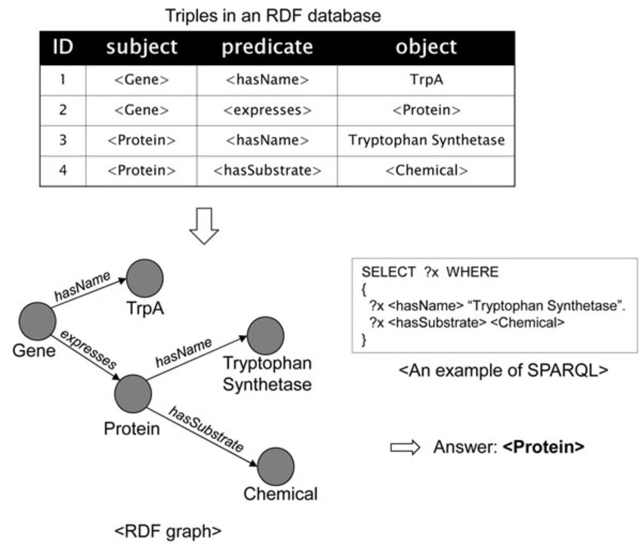
SPARQL
Query language for RDF, RDF(S) and OWL

Slide 67
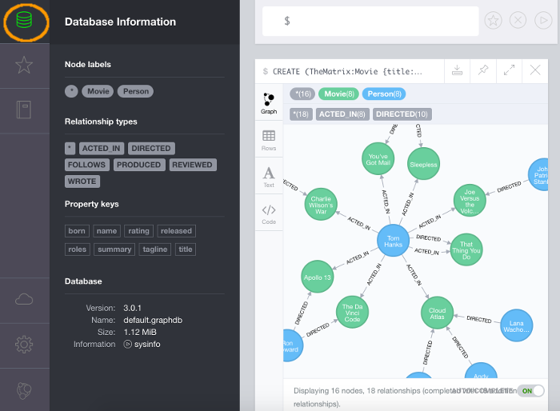
Working with Neo4j

Slide 68
What is Neo4j
A scalable and flexible graph database management system
Designed to handle complex and interconnected data relationships
Utilizes a property graph model to represent, store and query data.
Offers a range of built-in graph algorithms, such as PageRank and shortest path, for advanced data analysis.

Slide 69
The Labeled Property Graph Model
Nodes (Vertices)
The main data elements from which a graph is constructed
Tom Hanks
Cloud Atlas

Slide 70
The Labeled Property Graph Model
Nodes (Vertices)
The main data elements from which a graph is constructed
Relations (Edges)
Directed links between two nodes
Tom Hanks
Cloud Atlas
ACTED_IN

Slide 71
The Labeled Property Graph Model
Nodes (Vertices)
The main data elements from which a graph is constructed
Relations (Edges)
Directed links between two nodes
Labels
Typically used to denote the node category
Cannot be related to other labels, nor have properties
:Person
:Movie
ACTED_IN

Slide 72
The Labeled Property Graph Model
Nodes (Vertices)
The main data elements from which a graph is constructed
Relations (Edges)
Directed links between two nodes
Labels
Typically used to denote the node category
Cannot be related to other labels, nor have properties
Properties
Represent characteristics of nodes and relations
Tom Hanks
Cloud Atlas
ACTED_IN
roles: Zachry
born: 1956
release: 2012

Slide 73
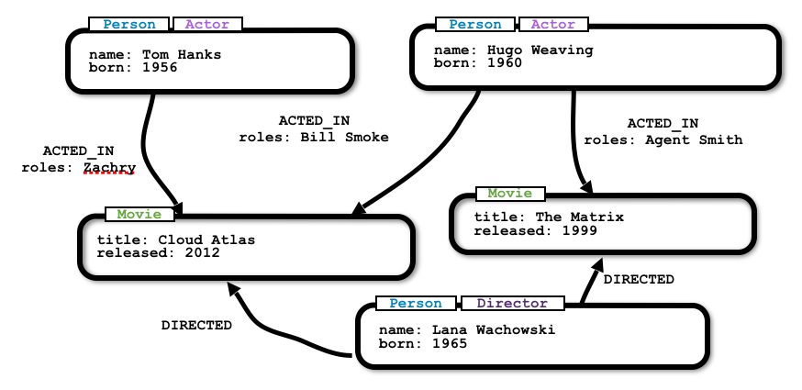
Putting it all together

Slide 74
The Cypher Query Language
//Match all nodes
MATCH (n)
RETURN n;
//Match all nodes with a Person label
MATCH (n:Person)
RETURN n;
//Match all nodes with a Person label and property name is "Tom Hanks"
MATCH (n:Person {name: "Tom Hanks"})
RETURN n;
//Return all nodes with a Person label, born between 1950 and 1999
MATCH (n:Person)
WHERE n.born > 1950 AND n.born < 1999
RETURN n;

Slide 75
Whatever language you use, read very well the intended semantics of its elements!

Slide 77
Give it
substance

Slide 78
Performing KG Population
SELECT AND ANALYZE DATA
SOURCES
EXTRACT, MAP,
AND
IMPORT DATA
Determine what data sources to use to populate the Knowledge Graph, and analyze their characteristics and quality
Pipelines and rules for extracting data from the sources, mapping them to the Knowledge Graph Schema, and importing them into the Graph

Slide 79
Typical Data Sources
Knowledge graphs, ontologies, taxonomies
Databases
Files (json, csv, xml, …)
Text

Slide 80
What we need to know for each data source
Type/Format
Availability
Schema & Content
Documentation and understanding so as to ensure semantic compatibility!
Schema & Content Dynamics
Quality

Slide 81
Mining Knowledge Graphs from Text

Slide 82
Knowledge graph mining can be defined as the task of acquiring and incorporating terms, entities, relations, and other elements from data in a knowledge graph, with limited human effort
The goal is not to understand everything that is going on in the source data but to get from them the elements we need!

Slide 83
Mining Tasks
Extracting
Entities
Extracting
Relations
Extracting Axioms and Rules
Extracting terms that denote entities and concepts of some particular type, such as persons, organizations, locations, or other.
Extracting relations
that hold between different entities such as synonymy,
meaning inclusion, semantic relatedness, etc.
Extracting complex
axioms and rules that can be used for reasoning purposes.

Slide 84
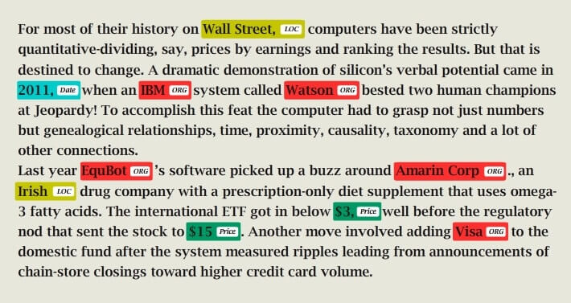
Entity Recognition
Typical task: Locate and classify entities mentioned in unstructured text into pre-defined entity categories
In knowledge graph mining: Given a set of entity types, get an appropriate text corpus and find all the distinct entities per type within it.

Slide 85
Relation Extraction and Classification
Typical task: Locate and classify relations between entities mentioned in unstructured text into pre-defined relation categories
In knowledge graph mining: Given a set of entities and a set of relations, get an appropriate corpus and find all the distinct pairs of entities that are related through these relations.

Slide 86
Some Mining Difficulty Factors
Complexity of target semantics
Specificity of target semantics
Availability of appropriate data
E.g. It is easier to find salient terms in a text than identifying
their entity types.
E.g. It is easier to identify semantically similar entities than
identifying ones that are synonyms.
Looking for synonyms or hyponyms of an entity is easier in an encyclopedic text than in a news article.

Slide 87
Knowledge Mining Tools

Slide 88
There are many entity extraction APIs and services, though for a limited set of entity types
There are much fewer relation extraction systems, especially for core relations like synonymy and meaning inclusion

Slide 89
Mining Approaches
HAND-BUILT PATTERNS AND RULES
TRANSFER
LEARNING
SEMI-SUPERVISED MACHINE LEARNING
Extraction patterns and rules are defined by humans
Extraction patterns and rules are learned from models trained for another task
Extraction patterns and rules are learned from few labeled a lot of unlabeled data.
SUPERVISED MACHINE LEARNING
DISTANT
SUPERVISION
SELF-SUPERVISED MACHINE LEARNING
Extraction patterns and rules are learned from human-labeled examples
Extraction patterns and rules are learned from machine-labeled data
Extraction patterns and rules are learned from unlabeled data.

Slide 90
Implementing a Knowledge Mining Pipeline
1. DEFINE THE
MINING TASK
3. SELECT APPROPRIATE INPUT DATA
5. EVALUATE THE MINING PIPELINE
What information exactly we want to extract and what are its exact semantics
Pick the data that are most likely to contain the desired knowledge and semantics
Measure how accurate, complete and time-efficient is the mining process
2. CREATE A GROUND TRUTH
4. DEVELOP THE MINING PIPELINE
6. APPLY AND EVOLVE
Investigating the status quo, finding pain points, eliciting requirements, scoping and prioritizing
Implement and orchestrate the most appropriate tools and methods for the task, possible including humans in the loop
Start using the pipeline and
continuously improve it

Slide 91
Questions to ask before you “buy” a knowledge mining tool
SUPPORTED
TASKS
SEMANTICS &
QUALITY
KNOWN
WEAKNESSES
What extraction tasks and semantics does the tool support exactly?
Does the tool deliver the semantics and the quality it promises?
Does the tool have any systematic errors or biases?
EFFECTIVENESS RANGE AND CONDITIONS
INGREDIENTS AND RECIPES
TROUBLESHOOTING AND IMPROVEMENT
What effectiveness range can I expect from the tool, and under what conditions?
What are the ingredients and recipe(s) I need in order to use the tool?
How can I troubleshoot/optimize the tool’s performance?

Slide 92
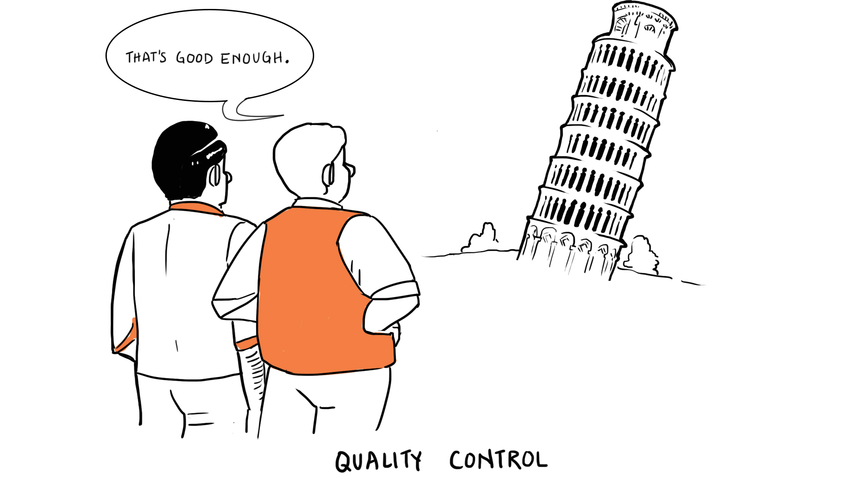
Ensure it’s
good

Slide 93
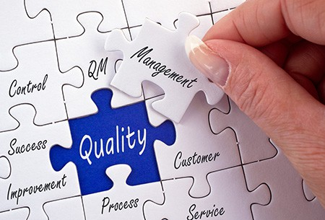
Quality Dimensions & Problem Causes

Slide 94
Semantic Accuracy
The degree to which the semantic assertions of a knowledge graph are accepted to be true

Slide 95
Discussion point
How would you measure the semantic accuracy of the following knowledge?

Slide 96
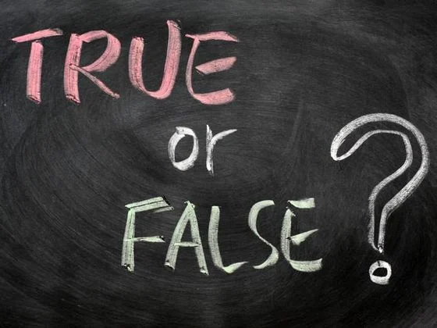
Why a KG may be inaccurate
Inaccuracy of the data sources from which the graph has been populated.
Inaccuracy of the population methods and pipelines
Misunderstanding of modeling elements’ semantics and intended usage
Lack of domain knowledge and expertise
Biases
Vagueness

Slide 97
Completeness
The degree to which elements that should be contained in the knowledge graph are indeed there

Slide 98
Discussion point
How would you measure the completeness of the following knowledge?

Slide 99
Why a KG may be incomplete
Large domain size and high conceptual complexity
Non-availability of automatic mining tooling
Lack of appropriate data sources from
High degree of vagueness
High domain volatility and dynamics

Slide 100
Consistency
The degree to which a knowledge graph is free of logical or semantic contradictions

Slide 101
Why a KG may be inconsistent
Absence or nonenforcement of appropriate constraints and consistency rules
Too lazy or too busy to create such constraints.
The modeling framework we employ does not inherently support them.
Their enforcement is computationally too complex.

Slide 102
Conciseness
The degree to which the knowledge graph does not contain redundant elements

Slide 103
Why a KG may be inconcise
Uncoordinated modeling from multiple parties with inadequate governance
Optimizing for different applications at the same time
Temporary elements or hacks that haven’t been removed
Legacy elements that haven’t been removed

Slide 104
Relevancy
The degree to which the knowledge graph’s structure and content are useful and important for a given task or application

Slide 105
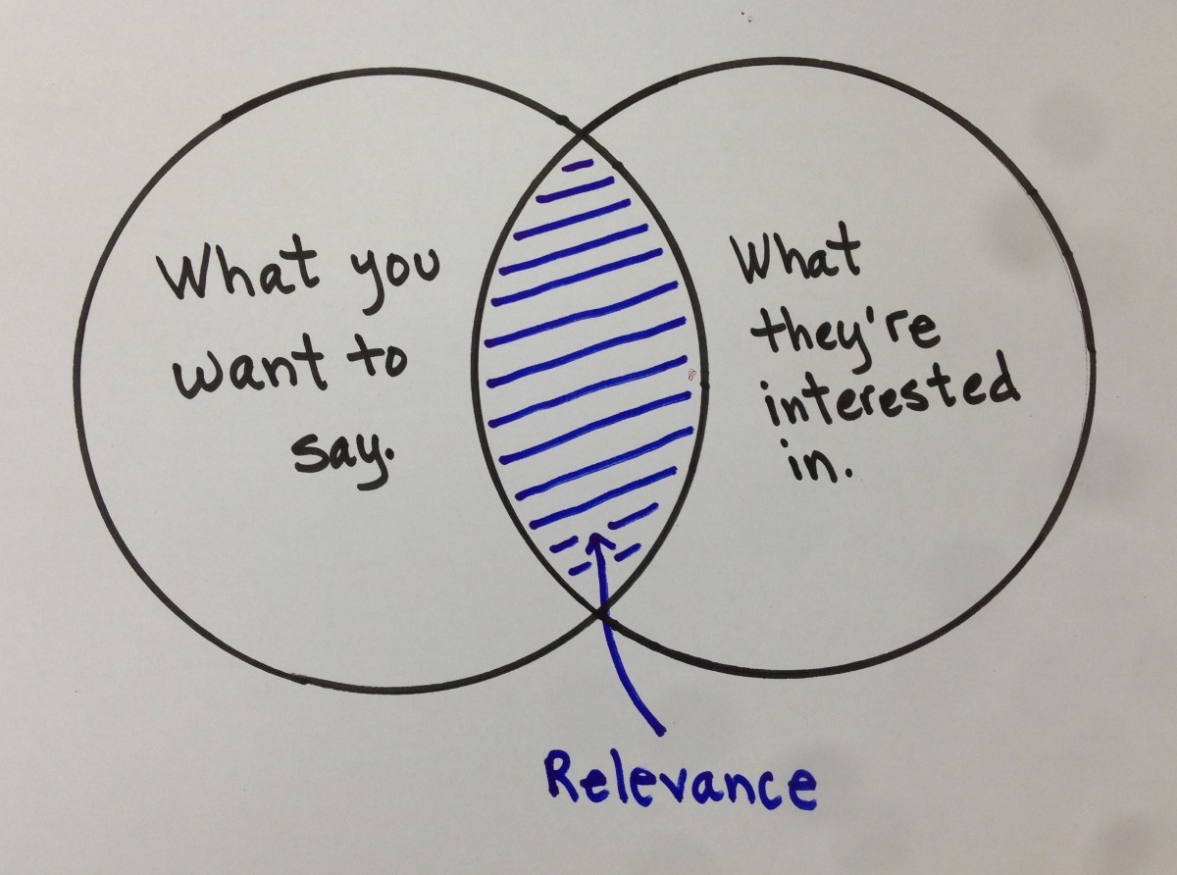
Why a KG may be irrelevant
It contains relevant information about the domain but misses information that is critical for the task
It contains relevant information about the task but in a way that is technically incompatible or not easily accessible.
It has been developed without having considered the application’s requirements.

Slide 106
Understandability
The ease with which human consumers can understand and utilize the knowledge graph’s elements, without misunderstanding or doubting their meaning

Slide 107
Why a KG may be difficult to understand
Bad or inadequate descriptions.
Ambiguous or inaccurate element names
Obscure axioms
Lack of human-readable definitions
Undocumented biases and assumptions

Slide 108
Trustworthiness
The perception and confidence in the quality of the knowledge graph by its users

Slide 109
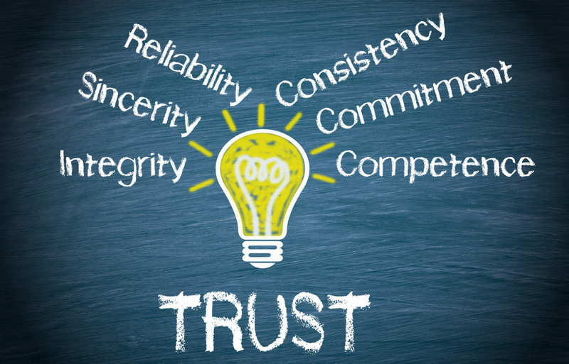
Why a KG may be untrustworthy
Lack of endorsement or adoption by different communities and industries
Non-availability and content of formal evaluations and experience reports
Lack of provenance information
Reasons to believe that the model contains biases and reflects the own interests of its creators.

Slide 110
Discussion point
What biases might this knowledge have?

Slide 111
Implementing KG Quality
Step 1: Select quality dimensions
Step 3: Define and implement quality signals
What dimensions are of interest and how important are they?
Determine signals and heuristics that could proactively detect quality problems
Step 5: Operationalize
Determine who is going to be monitoring the quality and how should they act
Step 2: Define and implement
quality metrics
Step 4: Define diagnostic and fixing actions
Determine what you want to measure per dimension, how to measure it, when to measure it, and how should the measurement results be interpreted
Define and implement error diagnosis and fixing guidelines and/or methods

Slide 112
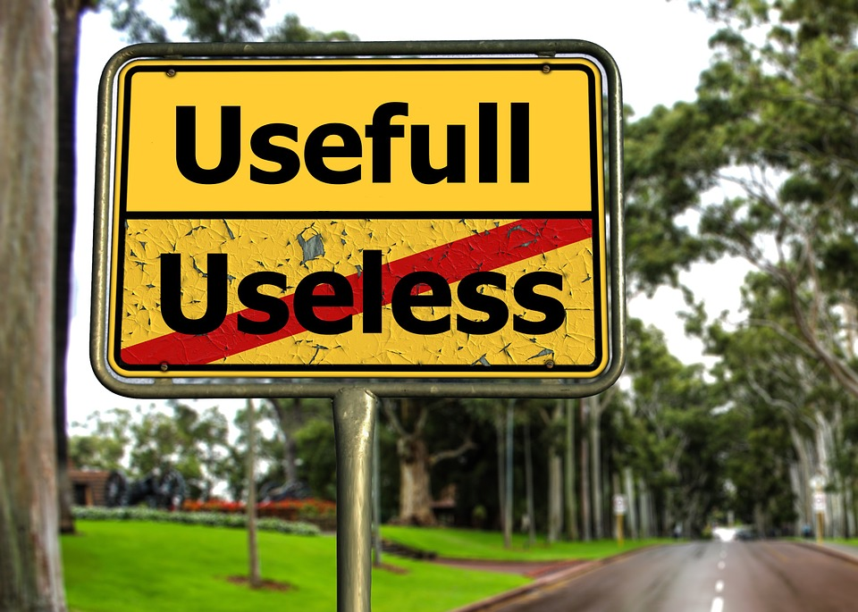
Make it
useful

Slide 113
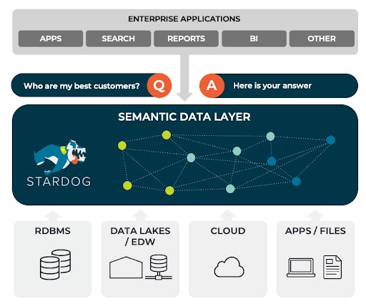
Semantic Data Layer

Slide 114
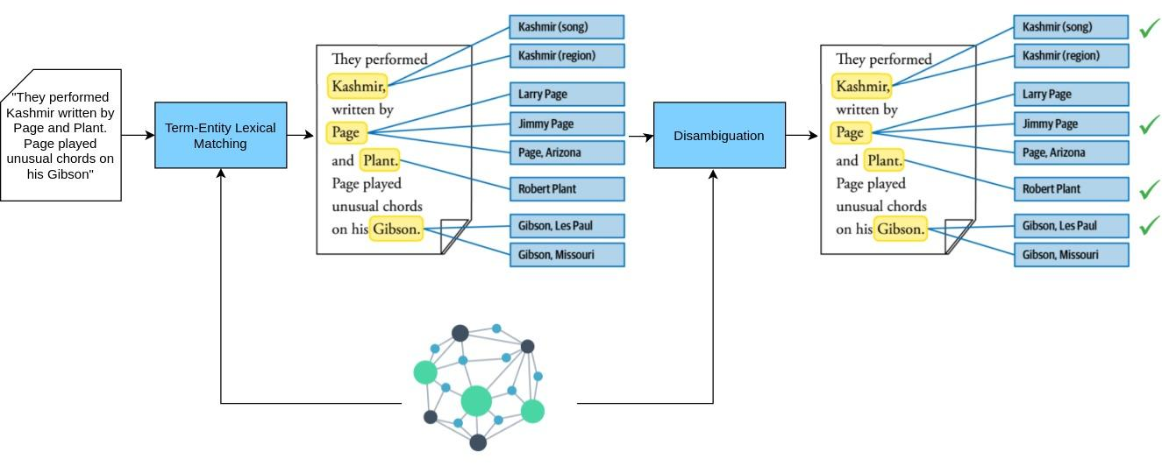
Entity Linking and Disambiguation

Slide 115
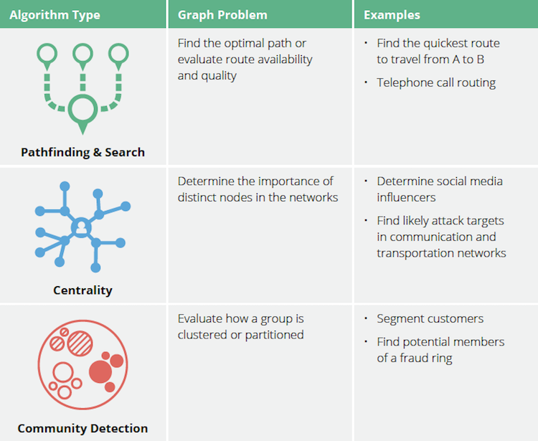
Graph Analytics Algorithms

Slide 116
Knowledge Graphs enhancing Large Language Models
PRE-TRAINING AND FINE-TUNING
QUERYING AND INFERENCING
EXPLANATION AND INTERPRETATION
Using a KG as training data for an LLM
Using a KG to contextualize the input of an LLM and provide better responses
Using a KG to explain the responses and behaviour of an LLM

Slide 117
Grounding LLMs with Knowledge Graphs

Slide 118
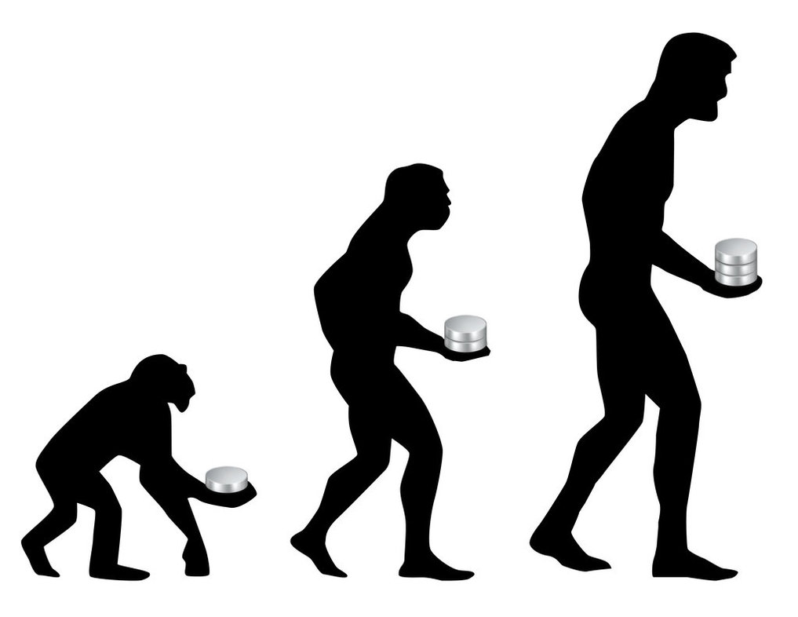
Make it
last

Slide 119
Knowledge Graph Evolution Strategy
When to improve:
Reactive v.s. Proactive
Release frequency
What to improve:
Breadth v.s. Depth
Precision v.s. Recall
Knowledge v.s. Methods v.s. Infrastructure

Slide 120
Knowledge Graph Evolution Strategy
How to decide/prioritize:
Democracy v.s. Aristocracy v.s. Dictatorship
User-driven v.s. Data-driven v.s. Expert-driven
How to customize:
“One graph to rule them all” v.s. customized versions

Slide 121
Semantic drift
The phenomenon where a term or concept meaning and usage change over time, often in such a way that its new meaning is radically different than the initial one.
Typically occurs due to linguistic, psychological, and sociocultural forces

Slide 122
Why care about semantic drift?
Knowledge Graphs are dynamic artifacts that need to evolve over time if they are to maintain and improve their quality and usefulness.
As users of KGs, we need to ensure that the entities’ meanings are in sync with the ones in the data and applications we currently apply the models to.
E.g., the concept of “Customer” 10 years ago might be different than the current one.
As creators and maintainers of KGs, we need to know which entities change meaning and at what pace.

Slide 123
Knowledge Graph Governance
ARGUMENTS FOR CENTRALIZATION
ARGUMENTS FOR DECENTRALIZATION
Semantic modeling requires technical and domain expertise that only few people can reliably provide.
With too many opinions, it’s hard to steer the KG toward achieving specific goals.
Without large-scale collaboration, it’s pretty hard or too expensive for a KG to evolve fast enough.
Without diverse opinions and perspectives, a KG will definitely contain biases.

Slide 124
Factors to consider when designing your governance model
The automation degree of the KG’s development and quality control
Its modularity and complexity
Its (required) breadth, diversity, and vagueness of your model
Your quality priorities
The expected impact of the potential changes

Slide 126
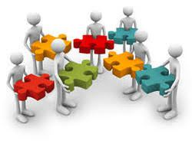
Take Aways
A Knowledge Graph is not just an engineering project
LLMs can be decent knowledge miners
LLMs are unreliable knowledge providers
Use them for things you can easily check or for which you don’t need high accuracy
Use them in conjunction with other knowledge sources
They have learned modeling languages but they don’t really understand their semantics
Use with caution
There can still be hallucination problems
They can become much better if they are fine-tuned and adapted for special tasks

Slide 127
Upcoming 2-Day Online Course on Knowledge Graphs

Slide 128
Thank you!
E-mail: p.alexopoulos@gmail.com
Web: http://www.panosalexopoulos.com
Twitter: @PAlexop

