Slide 1


Data Architecture Evolution – The Impact on Analytics Data Platforms
Mike Ferguson
CEO, Intelligent Business Strategies
Adept Events Data Warehousing & BI Summit
Utrecht, March 2024
@mikeferguson1

Slide 2
About Intelligent Business Strategies
A UK-based independent IT analyst and consulting firm founded 1992 specialising in data management and analytics
Mike Ferguson is an independent IT Industry Analyst and consultant, Conference Chairman of Big Data LDN and a member of the EDM Council CDMC Executive Advisory Board
Three main lines of business in the areas of Data Management, BI / ML / AI Analytics and Intelligent Business
Research
  Market research
    4th Industrial Revolution Survey
  D&A product research
    Data Catalogs
    Data Governance
    Data Fabric
    Data Science Workbenches
    Data Marketplaces
    Analytical Databases
Education
Modern Data Architecture
How to Govern Data Across a Distributed Data Estate
Practical Guidelines for Implementing a Data Mesh
Building a Competitive Data Strategy for a Data Driven Enterprise
Data Catalogs
Data Warehouse Modernisation
Data Warehouse Migration to the Cloud
Embedded Analytics, Intelligent Apps & AI Automation
Public classes (anyone)
On-site classes (single client)
  Customers, vendors, systems integrators
On-line (public & on-site classes)
Consulting
Customer consulting services
  D&A Strategy, Data Architecture
  D&A Technology selection
  D&A Reviews, Data Governance
  Project implementation advisory
Vendor advisory services
  Product strategy
  Product positioning & go to market
  Marketing support
    Speaking at vendor events
    White papers
    Webinars
Venture Capitalists
  Due-diligence, Asset advisory
www.intelligentbusiness.biz

Slide 3
Copyright © 1992-2024 Intelligent Business Strategies Limited. All rights reserved.
All materials pertaining to this presentation are the intellectual property and copyright of Intelligent Business Strategies Ltd and cannot be reproduced or distributed in any form without prior written permission from Intelligent Business Strategies Ltd. In addition, they must not be used by any party for hire and/or to compete against Intelligent Business Strategies Ltd

Slide 4
Topics
The demand for data and AI
The need for a data foundation to underpin data and AI initiatives
The emergence of data mesh and data products
The challenge of a distributed data estate
Data fabric and how can they help build data products
Data architecture options for building data products
The impact of open table formats and query language extensions on architecture modernisation
Conclusions

Slide 5
Topics – Where Are We?
The demand for data and AI
The need for a data foundation to underpin data and AI initiatives
The emergence of data mesh and data products
The challenge of a distributed data estate
Data fabric and how can they help build data products
Data architecture options for building data products
The impact of open table formats and query language extensions on architecture modernisation
Conclusions

Slide 6
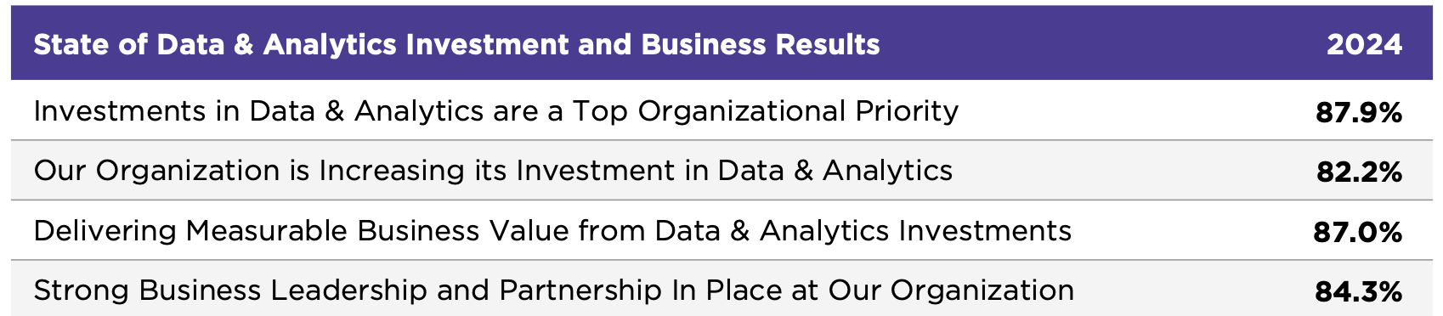
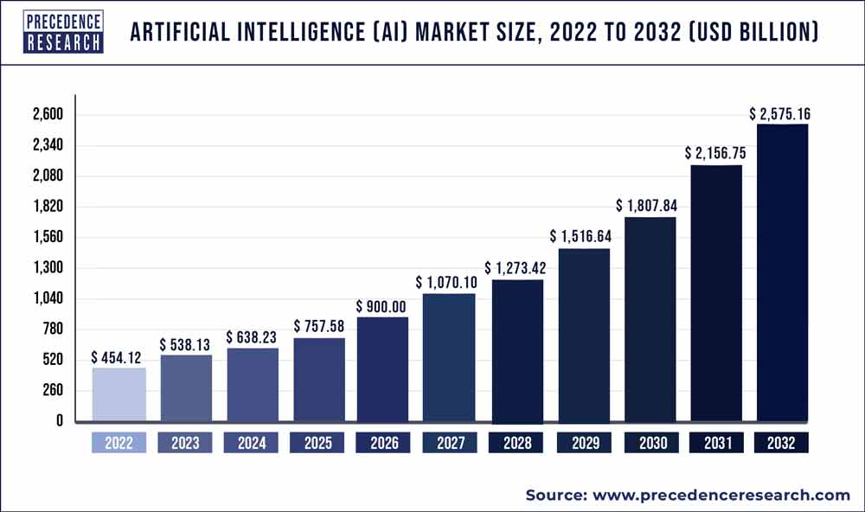
Demand Is Increasing For Data And AI
Source: Data And AI Leadership Executive Survey 2024 – New Vantage Partners (A Wavestone Company)

Slide 7
Executive Expectations Of Data And AI Are Huge But Maximum Return On Investment Will Not Happen Unless There Is A Solid Foundation Of High-Quality, Reusable Data
The
Data and AI Driven
Enterprise
Disruption
Transformation
DATA
& AI
Competitive
Advantage
Speed & Agility
High Quality & Governed Data Foundation

Slide 8



Many Companies Do Not Have A Data Foundation
– They Have Multiple Siloed Analytical Systems With Data Redundancy
GraphDB
Cloud Lakehouse
DW
Bronze tables
(Raw data)
Silver tables
Gold tables
Feature store tables
mart
DW
mart
DW / data mart tables
mart
mart
Hadoop
cluster
Hadoop
cluster
Lakehouse
Data Lake (cloud storage)
DW
Data Lake (cloud storage)
Data Lake (cloud storage)
mart
mart

Slide 9


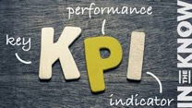


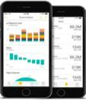
Data Products Have Become The Building Blocks To Incrementally Create A Data Foundation
Data Products
Analytical Products Created Using Data Products
Orders
Products
Invoke via API
Customers
Payments
pipeline
Ready made
Data Products
Virtual
Data Products
Data product pipeline
as-a-service
BI Reports & Spreadsheets
Dashboards / Stories / Conversations
∑∫(x)
Key performance indicators
Analytical ML models
(as-a-service)
Decision services
(e.g. recommendations, alerts, problem predictors, opportunity predictors)
Action Services
(e.g. alerts, transactions,
task automations)
Plans
AI- Driven Automated Tasks
AI-Driven intelligent Processes
Analytic apps

Slide 10
Foundation Data Products Are Critical In Any Business
– There Are Different Levels Of Data Products
Top 20 customers in furniture
Customer Orders over £300
Customer
Orders
Furniture Products
Products
Insight Data Products
Integrated / or filtered Data Products
Foundational Data Products Are Reusable and Semantically Linked
All data products must have an ID
Critical to building a data foundation

Slide 11

Steps To Creating For Data Products
– From Data Concept Model To Data Marketplace
Identify the data concepts, properties and relationships and construct a data concept model
The data concepts become the ‘skeleton data entities’ in the common vocabulary
Each data concept and its attributes should be defined in the business glossary as a data entity with a data owner
Use the catalog to discover the data for each data entity in underlying data stores across the data landscape
Design DataOps component-based pipelines to create the data products with common vocabulary data names
Publish all data products in a data marketplace
Data Concept Model Example
Data catalog
Customer
Product
Biz glossary
Order

Slide 12






A Data Foundation Includes Reusable ‘Business Ready’ Data Products That Are Semantically Linked, Built Once And Reused Everywhere For Different Analytical Workloads
Deeper integration is happening between DWs and data lakes that can also reduce data redundancy
clickstream
clicks
Data Products
web logs
Cloud storage
Online behaviour analysis
clicks
pipeline
Quotes &
Purchase
Quotes
Quotes
NoSQL
Agreements
agreements
Customer sentiment analysis
Customer segmentation analysis
CRM
Customers
Customers
pipeline
Cloud storage
Lakehouse
ERP
Premium payments
Premium payments
Products
Products
Graph DB
Marketing
Campaigns
Campaigns
pipeline
Fraud analysis
Claims
Claims
Claims
DW
Claims and payments,
Marketing analysis
Interactions
pipeline
Interactions
mart
social
Data sources
DataOps integration pipelines
Internal Data Marketplace
Analytical systems

Slide 13
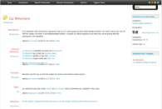
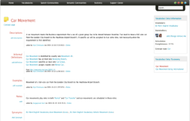

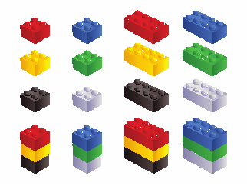
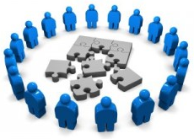

Companies Should Create Semantically Linked Data Products – Why Do This?
Customer
Product
Orders
Business Glossary
e.g., Orders should reuse the keys of other data products such as Customer and Product
Data Modelling
Data catalog
GLOBAL IDENTIFIERS allows quick assembly of ‘component’ data products for different analytical use cases
Data Producer Pipelines
data products
Analytical use case
consume, assemble & use to meet analytical needs
DW & marts
Assemble data products
Data consumers
Like Lego bricks
GraphDB

Slide 14
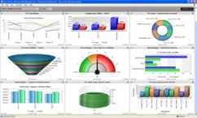



Shortening Time-To-Value - Assembling Analytical Data Models Using Semantically Linked Data Products For Use In Self-Service Analytics
BI Tool
BI Tool
Data Science
SQL
SQL
Python
Aggregate sales by product
Data Aggregation
Features for ML model development
Customers
Time
Common business
terms for data products, tables and views
Data marts
Products
Sales
Channels
Customers
Products
Sales
Channels
Time
Shipments
Returns
Dist Centres
Data products
Data marketplace
Foundational Data Products

Slide 15
Topics – Where Are We?
The demand for data and AI
The need for a data foundation to underpin data and AI initiatives
The emergence of data mesh and data products
The challenge of a distributed data estate
Data Fabric and how can they help build data products
Data architecture options for building data products
The impact of open table formats and query language extensions on architecture modernisation
Conclusions

Slide 16





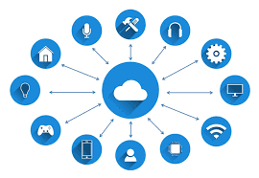







Challenges When Creating A Data Foundation - Many Companies Today Have Data Housed In Multiple Data Stores Across A Hybrid, Multi-Cloud Distributed Data Estate
SaaS Applications
Cloud Based Applications
On-Premises Systems
Edge Devices
OLTP systems
Analytical Systems
Analytical Systems
Files
OLTP Systems
Content
Files
Content
Multiple clouds
IoT data

Slide 17


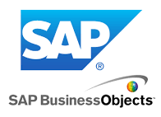



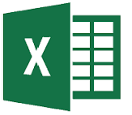



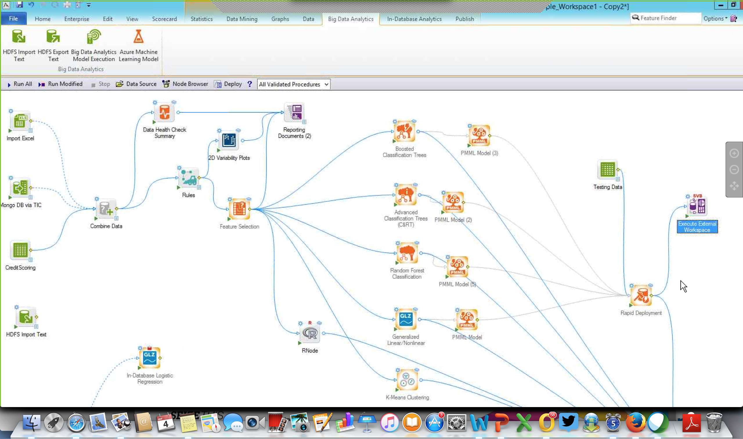











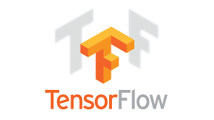
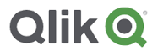



Also, Many Analytical Projects Have Been Running As Silos - Inconsistent Development Approaches, Fractured Skills, Limited Re-Use, Maintenance Challenge, Cost…
Business Intelligence
Data Science
HR
Marketing
HR
Marketing
Data mining tool
Finance DW
Finance
DW
DW
Sales
Finance
Sales
Sales & mktng DW
SaaS Applications
Cloud Based Applications
On-Premises Systems
Edge Devices
OLTP systems
Analytical Systems
Analytical Systems
Files
OLTP Systems
Content
Files
Content
Procure-ment
Manufacturing & inventory DW
Multiple clouds
IoT data
Service
Procure-ment
DW
Service
Operations
Distribution
Operations
Distribution
Data Science workbench with TensorFlow

Slide 18
Challenges – History Has Told Us That Decentralised Citizen Data Engineering With Best Of Breed Self-Service Data Prep Tools Runs A Risk Of Leading To Chaos
HR
Marketing
Self-service data prep
Self-service data prep
Finance
Sales
Self-service data prep
Self-service data prep
SaaS Applications
Cloud Based Applications
On-Premises Systems
Edge Devices
OLTP systems
Analytical Systems
Analytical Systems
Files
OLTP Systems
Content
Files
Content
Multiple clouds
IoT data
Procure-ment
Self-service data prep
Service
Self-service data prep
Self-service data prep
Self-service data prep
Operations
Distribution
Different colours indicate different best of breed self-service data prep tools

Slide 19
We Are Now In A New Era - Companies Are Beginning To Put Data And AI First
AI-Automation
Intelligent Apps
Chatbots
Data Products
Co-Pilot
Analytical Products
Data + AI Foundation
Employee Experience
Process Optimisation
Customer Experience
Marketing Content Generation
Code Generation
Personalisation
Active Data and AI Governance

Slide 20

The Challenge Of Data Complexity – How Do You Build A Data Foundation Providing Timely, High Quality, Compliant Data Products On A Highly Distributed Data Estate?
HR
Risk
Marketing
BI, ML, AI & Decision Services (Alerts, Recommendations & Auto Actions)
Finance
Data-Driven
Intelligent Business
Sales
Timely, High Quality, Compliant Data Foundation (data products)
Procurement
Service
Operations
Distribution
SaaS Applications
Cloud Based Applications
On-Premises Systems
Edge Devices
OLTP systems
Analytical Systems
Analytical Systems
Files
OLTP Systems
Content
Files
Content
Multiple clouds
IoT data
Data is spread across a hybrid distributed data landscape and stored in files, Relational DBMSs, NoSQL DBMSs, Cloud storage, Hadoop systems, SaaS applications and Content stores

Slide 21
The Challenge Of Data Complexity – How Do You Build A Data And AI Foundation Providing Timely, High Quality, Compliant Data And Analytical Products
HR
Risk
Marketing
BI, ML, AI & Decision Services (Alerts, Recommendations & Auto Actions)
Finance
Data-Driven
Intelligent Business
Sales
Timely, High Quality, Compliant Data Foundation (data products)
Procurement
Service
Operations
Distribution
Integrated Data and Analytics Software Platform & A Modern Data Architecture
SaaS Applications
Cloud Based Applications
On-Premises Systems
Edge Devices
OLTP systems
Analytical Systems
Analytical Systems
Files
OLTP Systems
Content
Files
Content
Multiple clouds
IoT data
Data is spread across a hybrid distributed data landscape and stored in files, Relational DBMSs, NoSQL DBMSs, Cloud storage, Hadoop systems, SaaS applications and Content stores

Slide 22
Trends – Companies Want A Common Data And Analytics Software Platform With Integrated Tools And Shared Metadata To Accelerate Development
Build data products, analytical products and AI-driven applications faster with end-to-end governance
Single Vendor Data Fabric
The Modern Data Stack
Vs
One platform with integrated services and shared metadata
  Manage, build and deploy data and analytical products
  Govern data and AI models across the enterprise
  Bundled data catalog or 3rd party catalog integration
Some vendors also bundle integrated BI / ML and AI tooling
Attractive because of no standard to share metadata between tools
A D&A stack made up of complementary best-of-breed tools from multiple vendors who have partnered
Pre-built integrations across the stack
Formed to compete against single vendor data fabric
Several variations of the modern data stack have appeared on the market, confusing prospective buyers who are unsure on what tools are integrated

Slide 23

Creating Reusable Data Products Is An Approach Fast Gaining Momentum As A Way of Incrementally Building Up A Secure And Compliant Data Foundation
team
team
team
team
team
High Quality, Compliant Data Products
Data Fabric
Data catalog
SaaS Applications
Cloud Based Applications
On-Premises Systems
Edge Devices
Automatic data discovery, classification & data quality profiling
OLTP systems
Analytical Systems
Analytical Systems
Files
OLTP Systems
Content
Files
Content
Multiple clouds
IoT data

Slide 24
Topics – Where Are We?
The demand for data and AI
The need for a data foundation to underpin data and AI initiatives
The emergence of data mesh and data products
The challenge of a distributed data estate
Data Fabric and how can they help build data products
Data architecture options for building data products
The impact of open table formats and query language extensions on architecture modernisation
Conclusions

Slide 25
Multiple Architecture Options Have Emerged For Decentralised Creation Of Data Products?
Multiple approaches to creating data products
One storage account, multiple zones on cloud storage
Multiple zoned storage accounts on a single cloud
Multiple zoned storage accounts on multiple clouds
One or multiple zoned lakehouses (one per domain)
Create data products in a data warehouse staging tables
Leave data where it is and produce virtual data products using data virtualisation / federated queries
Create data products using Kafka topics
DataOps data integration pipelines
Internal Data Marketplace
Data Products
clicks
clicks
Quotes
Quotes
Agreements
agreements
Customers
Customers
Premium payments
Premium payments
Products
Products
Campaigns
Campaigns
Claims
Claims
Interactions
Interactions
Data products need to be semantically linked
(by using enterprise wide primary and foreign keys)

Slide 26







Modern Data Architecture – In 2022 Multiple Competing Data Architecture Patterns Emerged As Options To Create A Data Foundation – Zoned Cloud Data Lake
Characteristics
  Custom architecture
  Vendor agnostic
  Requires organised storage and governance
    using data fabric software and a data catalog
Issues
  No ACID properties on data lake files so data could be inconsistent if updated by multiple engines
  No schema governance or change control
  Data modelling often ignored by data scientists
  Data redundancy can proliferate if ungoverned
  Can deteriorate if storage is ungoverned and data products are not well defined
Organised Zoned Cloud Data Lake & Multiple Analytical Systems
Data science
MDM
NoSQL graph DB
EDW
R
U
C
Cust
Prod
Supplier
D
Data Fabric
Data Lake (cloud storage)
Trusted Data Products
Data Fabric
SaaS Applications
Cloud Based Applications
On-Premises Systems
Edge Devices
OLTP systems
Analytical Systems
Analytical Systems
Files
OLTP Systems
Content
Files
Content
Multiple clouds
IoT data
Custom built

Slide 27

Implementing Data Products and Data Mesh On A Single Cloud
– Each Domain Uses Its Own Cloud Storage Account To Build Data Products
Business Domain 1
Business Domain 2
team
catalog
team
Common Extensible Data Fabric Platform
Application
Pipeline development
Pipeline development
Application
DataOps pipeline
Savings
Credit card payments
DataOps pipeline
Mortgages
Current account
Ingest
process
persist
serve
Data Mesh
serve
persist
Ingest
process
Claims
Car loans
Customers
Premium payments
Cloud storage
Storage Account 1
Inter-actions
Products
Storage Account 2
Data product
Data product
Zone management
Zone management
Centralised management of domain-based storage accounts
from the Data Fabric platform is recommended

Slide 28

Ideally The Storage Account Used In Each Domain To Build Data Products Should Be Organised In A Standard Way And Managed From A Single Place
Business Domain 1
Business Domain 2
team
catalog
team
Data Fabric
Application
Pipeline development
Savings
Credit card payments
Pipeline development
Application
DataOps pipeline
Mortgages
Current account
DataOps pipeline
Claims
Data Mesh
Car loans
Ingest
process
persist
serve
serve
persist
Ingest
process
Customers
Premium payments
Cloud storage
Storage Account 1
Inter-actions
Products
Storage Account 2
Data product
Data product
This is like creating multiple lakes each with the same zone setup
landing zone
Curation zone
(in-progress)
Trusted zone (Data products)
Standard Storage Account setup

Slide 29
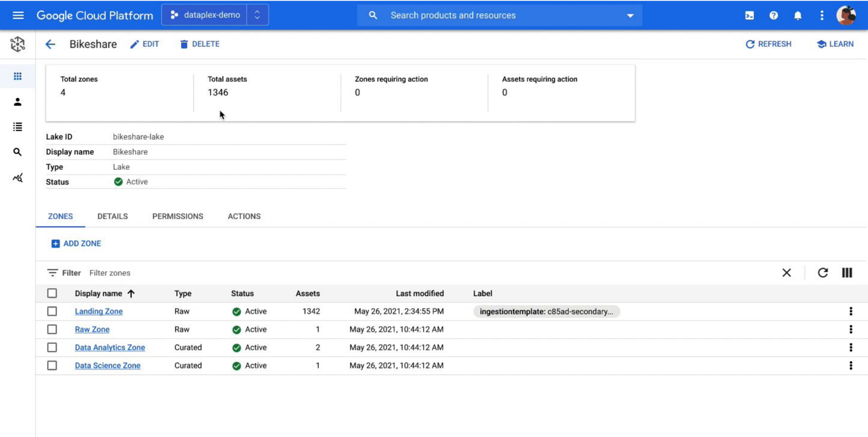
Storage Accounts Can Be Managed As Multiple Lakes With Zones In A Decentralised Environment Using Data Fabric Software – E.g. Google Dataplex
You can create a lake per business domain within your organisation and create data zones that map to data readiness and usage (landing zone, raw data zone, data products zone, data science zone, etc.)

Slide 30

Implementing A Data Mesh Across Multiple Clouds Should Also Be Possible
– Each Domain Uses Its Own Scalable Polyglot Storage Managed From Data Fabric
Business Domain 1
Business Domain 2
team
catalog
team
Common Extensible Data Fabric Platform
Application
Pipeline development
Pipeline development
Application
DataOps pipeline
Savings
Credit card payments
DataOps pipeline
Mortgages
Current account
Ingest
process
persist
serve
Data Mesh
serve
persist
Ingest
process
Claims
Car loans
Customers
Premium payments
Storage Account
Inter-actions
Products
Storage Account
Data product
Data product
Zone management
Zone management
Centralised management of domain-based storage accounts
from the Data Fabric platform is recommended

Slide 31
Modern Data Architecture – In 2022 Multiple Competing Data Architecture Patterns Emerged As Options To Create A Data Foundation – Lakehouse
Characteristics
  Centralised architecture governed by a data catalog
  Can also be a distributed architecture with multiple lakehouses
  Data is stored in open table format
  ACID properties guarantees consistency
  Data has to be ingested before processing
  Data engineering using platform specific software or 3rd party data fabric
Issues
  Could end up building silos on a single platform
  Exploratory storage Vs auditability
  Is data engineering done before BI and data science?
  Are BI tools accessing raw data or engineered data?
  Which data modelling design technique is used?
Vendor example:
  Databrick Lakehouse platform with Unity Catalog
Cloud Lakehouse
Bronze tables
(Raw data)
Silver tables
Gold tables
Customer pipeline
customer
Feature store tables
Product pipeline
product
pipeline
SaaS Applications
Cloud Based Applications
On-Premises Systems
Edge Devices
Orders pipeline
orders
Data Fabric
OLTP systems
Analytical Systems
Data Fabric
Analytical Systems
Files
OLTP Systems
DW / data mart tables
Files
Content
Data Fabric
Content
Shipments pipeline
shipments
Multiple clouds
IoT data
payments
Payments pipeline
pipeline
Lakehouse
Data Lake (cloud storage)

Slide 32




Distributed Options For Decentralised Data Product Development On A Lakehouse
– E.g., Multiple Domain-Oriented Lakehouses All On A Single Cloud
Business Domain Lakehouse
Business Domain Lakehouse
Data marketplace
Data marketplace
IoT
Bronze tables
(Raw source data)
Silver tables
Gold tables
IoT
Bronze tables
(Raw source data)
Silver tables
Gold tables
web logs
pipeline
data product
data scientists
pipeline
data product
data scientists
clickstream
web logs
pipeline
data product
Feature store tables
Data frames
/ SQL
Data Products
clickstream
pipeline
data product
Feature store tables
Data frames
/ SQL
NoSQL
pipeline
NoSQL
pipeline
Data Ingestion
pipeline
data product
consume
notebooks
Data Ingestion
pipeline
data product
consume
notebooks
XML,
JSON
web services
XML,
JSON
pipeline
data product
DW / data mart tables
Business analysts
Savings
Credit card payments
web services
pipeline
data product
DW / data mart tables
Business analysts
RDBMS
pipeline
data product
pipeline
SQL
RDBMS
pipeline
data product
pipeline
SQL
social
Business ready data products
BI tools
Mortgages
Current account
social
Business ready data products
BI tools
Cloud
Cloud
Files
Lakehouse
Files
Lakehouse
office docs
Data Lake (cloud storage)
Data marketplace
office docs
Data Lake (cloud storage)
Claims
Car loans
Business Domain Lakehouse
Business Domain Lakehouse
Customers
Premium payments
Data marketplace
Data marketplace
IoT
Bronze tables
(Raw source data)
Silver tables
Gold tables
IoT
Bronze tables
(Raw source data)
Silver tables
Gold tables
web logs
pipeline
data product
data scientists
Interactions
Products
web logs
pipeline
data product
data scientists
clickstream
pipeline
data product
Feature store tables
Data frames
/ SQL
clickstream
pipeline
data product
Feature store tables
Data frames
/ SQL
NoSQL
pipeline
NoSQL
pipeline
Data Ingestion
pipeline
data product
consume
notebooks
Data Ingestion
pipeline
data product
consume
notebooks
XML,
JSON
XML,
JSON
web services
pipeline
data product
DW / data mart tables
Business analysts
web services
pipeline
data product
DW / data mart tables
Business analysts
RDBMS
pipeline
data product
pipeline
SQL
RDBMS
pipeline
data product
pipeline
SQL
social
Business ready data products
BI tools
social
Business ready data products
BI tools
Cloud
Cloud
Files
Lakehouse
Files
Lakehouse
office docs
Data Lake (cloud storage)
office docs
Data Lake (cloud storage)

Slide 33
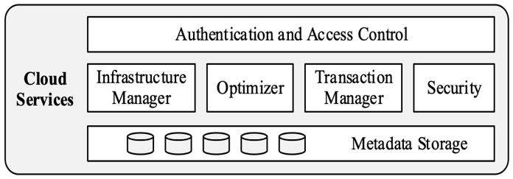
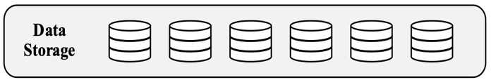
Modern Data Architecture – In 2022 Multiple Competing Data Architecture Patterns Emerged As Options To Create A Data Foundation – Data Cloud
Data Cloud
DW Clusters over Cloud Storage
Characteristics
  Centralised architecture governed by the DBMS
  Data typically ingested before processing
  Data stored in proprietary table formats
  Supports open table formats and federated query
  Storage separated from compute
  Workload separation via different compute clusters
  Data engineering using 3rd party data fabric
Issues
  Primarily used for data warehouse workloads
  Unstructured data mainly processed outside the DBMS
  SQL on everything requires invoking Deep Learning/AI
Vendor example:
  Snowflake Data Cloud
Compute Cluster
Compute Cluster
Compute Cluster
Compute Cluster
Data Fabric
Data Fabric
Cache
Cache
Cache
Cache
Cloud
Data Ingestion
SaaS Applications
Cloud Based Applications
On-Premises Systems
Edge Devices
OLTP systems
Analytical Systems
Analytical Systems
Files
OLTP Systems
Content
Files
Content
Multiple clouds
IoT data

Slide 34
Modern Data Architecture - In 2022 Multiple Competing Data Architecture Patterns Have Emerged As Options To Create A Data Foundation – SQL Data Mesh
Characteristics
  Centralised architecture
  Data typically ingested before data engineering
  Data stored in files e.g., Parquet, ORC
  Supports federated query beyond cloud storage
  Data engineering using data virtualisation
    Virtual data products
  Metadata specifications to process data are all in one place
Issues
  Ungoverned files in cloud storage could create a swamp
  SQL on everything - unstructured data is a challenge
  Data modelling can be overlooked
  What about data cleansing?
  Performance of file access on cloud storage
    Is there a parallel engine to compensate?
Vendor example:
  Starburst, Denodo (supports parallel engine)
SQL Data Mesh
- Federated Query Over a Data Lake
Consumption layer
Enterprise layer
Source layer
Data Lake (cloud storage)
Data Ingest
SaaS Applications
Cloud Based Applications
On-Premises Systems
Edge Devices
OLTP systems
Analytical Systems
Analytical Systems
Files
OLTP Systems
Content
Files
Content
Multiple clouds
IoT data

Slide 35
Modern Data Architecture - In 2022 Multiple Competing Data Architecture Patterns Have Emerged As Options To Create A Data Foundation – SQL Lakehouse
Characteristics
  Centralised architecture
  Data ingested before processing
  Open table format e.g. Apache Iceberg, Delta Lake
  ACID support - multiple engines can access and update
  Schema governance and data partitioning
  Federated query beyond the lakehouse
  Data engineering on ingest and using data virtualisation
    Virtual data products
  Metadata specifications all in one place
  Universal semantic layer
  Universal data access control
Issues
  Unstructured data is difficult to deal with
  Data modelling can be overlooked
  SQL engine performance for concurrent BI users
Vendor example:
  Dremio (Read/write only on Iceberg, read on Delta)
    Arctic catalog of Iceberg Tables
SQL Lakehouse
- Federated Query Over a Lakehouse
Consumption layer
Enterprise layer
Source layer
Lakehouse
Data Lake (cloud storage)
Data Ingest
SaaS Applications
Cloud Based Applications
On-Premises Systems
Edge Devices
OLTP systems
Analytical Systems
Analytical Systems
Files
OLTP Systems
Content
Files
Content
Multiple clouds
IoT data

Slide 36
Modern Data Architecture - In 2022 Multiple Competing Data Architecture Patterns Have Emerged As Options To Create A Data Foundation – Logical Data Fabric
Characteristics
  Leave data where it is
  Federated query architecture to multiple data sources including open table formats
  Data engineering using data virtualisation
    Query with pushdown and ML driven caching
    Parallel engine on cloud storage for performance
  Metadata specifications all in one place
  Virtual view materialisation and persistence to data warehouse or lakehouse
    Virtual and physical data products
  Universal semantic layer
  Universal data access control
Issues
  SQL on everything - unstructured data is a challenge
  Data cleansing
Vendor example:
  Denodo, Data Virtuality
Logical Data Fabric
Consumption layer
Enterprise layer
Source layer
SaaS Applications
Cloud Based Applications
On-Premises Systems
Edge Devices
OLTP systems
Analytical Systems
Analytical Systems
Files
OLTP Systems
Content
Files
Content
Multiple clouds
IoT data

Slide 37
Modern Data Architecture
– Multiple Competing Architectures Have Confused The Market
custom built zoned data lake feeding multiple analytical data stores
Organised Lakehouse
Data cloud
Data science
Bronze tables
Silver tables
Gold tables
Graph DB
EDW
R
pipeline
customer
Feature store tables
C
MDM
U
pipeline
product
pipeline
pipeline
orders
Centralised
Centralised
Data Fabric
Centralised
D
Data Fabric
DW / data mart tables
Compute Cluster
Compute Cluster
Compute Cluster
Compute Cluster
Data Fabric
pipeline
shipments
Data Lake (cloud storage)
pipeline
payments
pipeline
Data Fabric
Data Fabric
Cache
Cache
Cache
Cache
raw
in-progress
ready to go
Lakehouse
Cloud
Data Lake (cloud storage)
Which architecture?
Should it be centralised, distributed or federated?
Virtual data products
Virtual data products
Virtual data products
Centralised
Centralised
Federated
SaaS Applications
Cloud Based Applications
On-Premises Systems
Edge Devices
Lakehouse
OLTP systems
Analytical Systems
Data Lake (cloud storage)
Data Lake (cloud storage)
Analytical Systems
Files
OLTP Systems
Content
Files
Content
SQL Data Mesh
(virtual views on data in a data lake)
SQL Lakehouse
(virtual views on lakehouse open tables)
Multiple clouds
IoT data
Logical data fabric
(virtual views on everything)

Slide 38





A Popular Data Architecture Option That Emerged In 2022 Was Data Warehouse / Data Lake Integration With External Tables Pointing To Files In A Cloud Storage Data Lake
DBMS proprietary table format
Extended Data Warehouse DBMS
DBMS external table
External table
External table
Several vendors
External table
External table
Problems
No ACID properties
No Schema governance
Scalable concurrent user BI query performance on files in cloud storage
External table mappings & data pipelines
Centralised
Data Fabric
Data Lake (cloud storage)
Parquet files
Parquet files
Trusted Data Products
Data Fabric
SaaS Applications
Cloud Based Applications
On-Premises Systems
Edge Devices
OLTP systems
Analytical Systems
Analytical Systems
Files
OLTP Systems
Content
Files
Content
Multiple clouds
IoT data

Slide 39
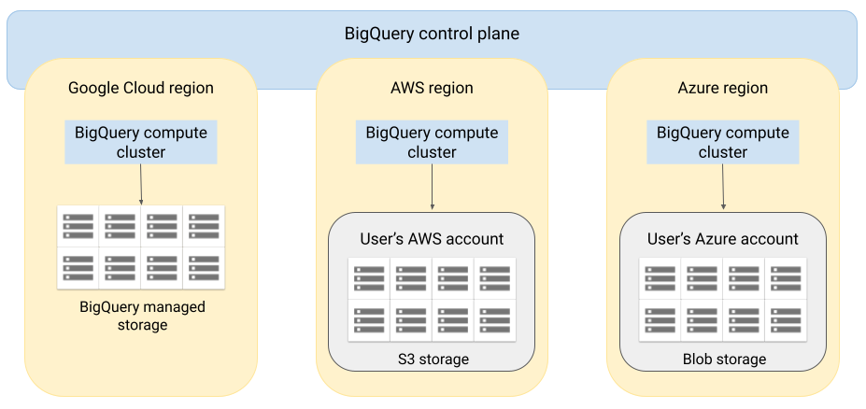
Some Vendors Went Further - Google BigQuery Architecture Allow Its Query Engine To Run On Other Clouds – BigQuery Omni
BigQuery's architecture separates compute from storage and so processing happens where the data is stored
Query results can be returned to Google Cloud over a secure connection
Image source: https://cloud.google.com/bigquery/docs/omni-introduction

Slide 40
Topics – Where Are We?
The demand for data and AI
The need for a data foundation to underpin data and AI initiatives
The emergence of data mesh and data products
The challenge of a distributed data estate
Data Fabric and how can they help build data products
Data architecture options for building data products
The impact of open table formats and query language extensions on architecture modernisation
Conclusions

Slide 41

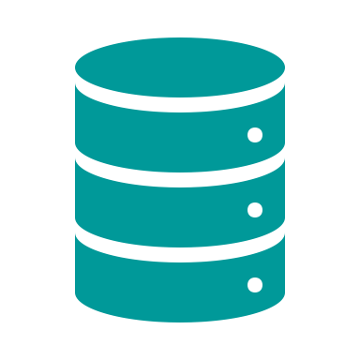




Data Architecture Evolution – Impact Of Data Lakehouse And Open Table Formats
Open table formats
  Apache Iceberg
  Apache Hudi
  Delta Lake
The lakehouse supports
  Open tables accessible and updatable by multiple engines
  Transaction integrity ACID properties for insert / update
  Schema enforcement and governance
  Schema evolution, version control and historical time travel
  Multiple query engines with SQL access to data in the data lake
  Streaming and batch unification on open tables
  Data in compressed columnar file format, e.g., Parquet, ORC
  Hidden data partitioning
  Integration with Spark for access via other languages e.g. Python
  Row level security
  Organised data lake with ELT processing
  ACID = Atomicity, Consistency, Durability and Isolation
  Ensures that data is current and transactionally consistent
Data engineering
BI Tools
Data Science
“Metadata & governance layer”
Open table format Lakehouse
Cloud storage (data lake)
Parquet, ORC, Avro files

Slide 42
Modern Data Architecture Continues To Change – Open Table Formats Means Multiple Query Engines Can Update And Access Open Tables, e.g., DW DBMS, Spark, Flink, etc.
DW DBMS
e.g. BigQuery
e.g. Presto
e.g.
DW DBMS
query engine
Select
Insert
Update
Delete
Multiple query engines
query engine
query engine
query engine
Single DBMS query engine
Select
Insert
Update
Delete
Versus
open table format
Apache Hudi
Apache Iceberg
Delta Lake
DBMS proprietary table format
Parquet file
columnar file format
e.g. ORC, Parquet
storage
DBMS proprietary columnar format
Google BigQuery example
CREATE EXTERNAL TABLE myexternal-table
WITH CONNECTION `myproject.us.myconnection`
OPTIONS (format = 'ICEBERG’,
uris = ["gs://mybucket/mydata/mytable/metadata/iceberg.metadata.json"])

Slide 43
Impact Of Open Table Formats
Enabling the integration of lakehouses and data warehouses as opposed to them being alternatives
ACID transaction with a transaction log supported which is critical for data consistency
  Offers access by multiple engines with full data integrity
Better performance of SQL queries
  Support for hidden data partitioning, data skipping etc.
Schema change on immutable files
Time travel for historical queries
  Transaction log in Delta Lake, Snapshots in Apache Iceberg
Enables data lakes to:
  Be used for more than just exploratory analysis
  Be governed, secured and managed
  Provide consistent data with data integrity in support of data science and DW/BI workloads
  Support training and retraining of ML models on consistent data

Slide 44
In 2023 Open Table Formats Have Gained Significant Momentum With Broad Adoption By DBMS Vendors
Open Table Format | Supported By
Apache Hudi | AWS Athena Onehouse OpenText Vertica
Apache Iceberg | AWS Athena Cloudera Dremio Flink Google IBM Oracle Presto Snowflake ….
Linux Foundation Delta Lake | Databricks Microsoft Fabric SAP DataSphere Teradata
DW DBMS
e.g. Oracle
e.g. Presto
e.g.
Multiple query engines
query engine
query engine
query engine
Select
Insert
Update
Delete
open table format
Apache Hudi
Apache Iceberg
Delta Lake
Parquet file
columnar file format
e.g. ORC, Parquet
Data Lake 3.0 Universal Format
  Read Delta tables in Delta, Hudi, & Iceberg formats
  Auto generates metadata for Apache Iceberg or Apache Hudi

Slide 45
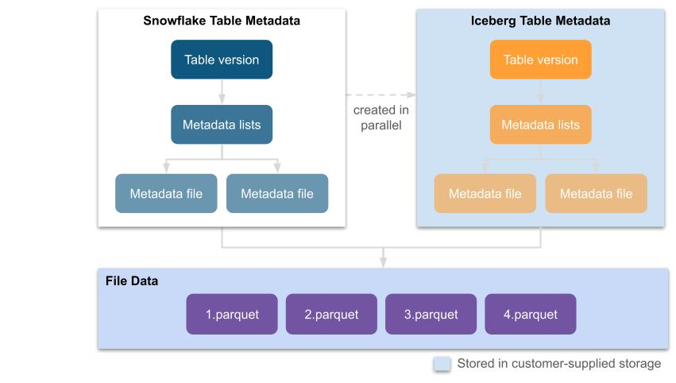
Apache Iceberg Table Support In Snowflake (Announced August 2022)
Image source: https://www.snowflake.com/blog/iceberg-tables-powering-open-standards-with-snowflake-innovations/
Iceberg tables work like Snowflake native tables with 3 key differences:
Table metadata is in Iceberg format
Data is stored in Parquet files
Both table metadata and data is stored in customer-supplied storage (customer managed)

Slide 46
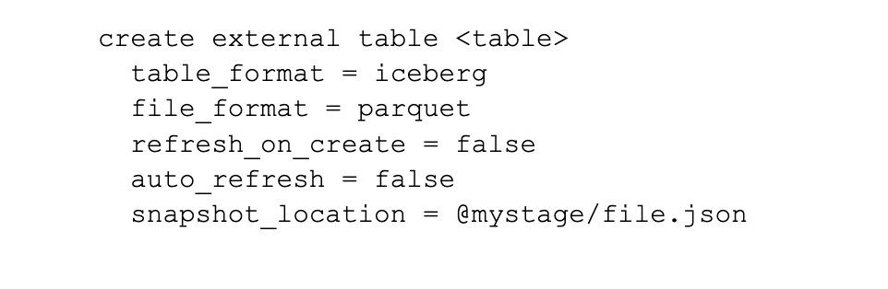
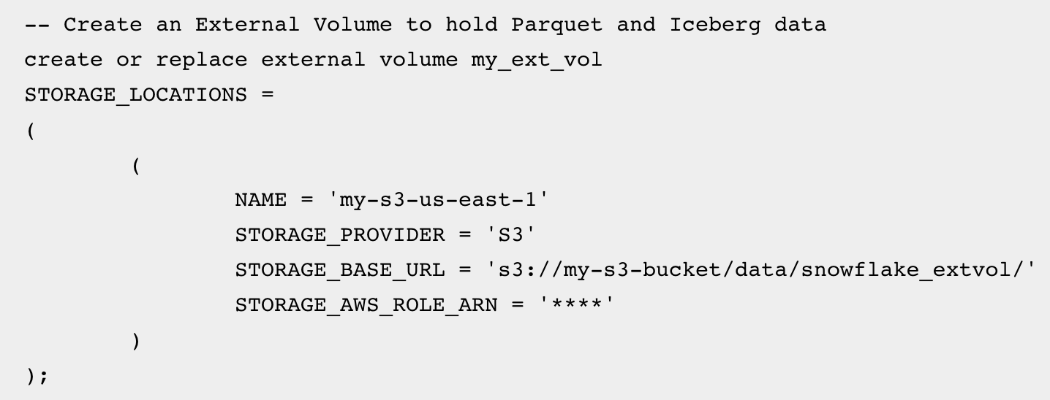
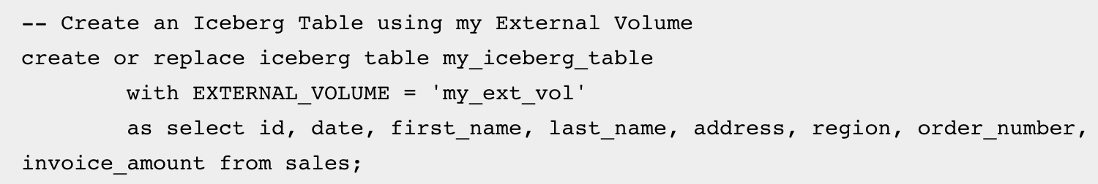
Using Iceberg Tables In Snowflake – Can Use External Tables Or Native Iceberg Tables
Table Type | Code Example
External Table
Native Iceberg table

Slide 47


A New Modern Data Architecture Option - Data Warehouse and Lakehouse Integration With Open Tables Used Directly in the Data Warehouse and By Other Engines
New Control Plane & Optimisation May Emerge to Handle Multiplel Engines
DBMS proprietary table format
Other engines can directly update and access open tables
Extended Data Warehouse DBMS
DBMS external table
Open table format
(Delta Lake, Iceberg, Hudi)
Flink
External table
External table
Native open table
Native open table
External table mappings, federated query & data pipelines
Federated Architecture
CSP 2
Data Fabric
CSP 1
CSP 3
Lakehouse
Lakehouse
Lakehouse
Cloud storage (data lake)
Trusted Data Products
Cloud storage (data lake)
Cloud storage (data lake)
E.g., Google BigQuery, Big Lake & Dataplex,
Microsoft Fabric and OneLake
Data Fabric
SaaS Applications
Cloud Based Applications
On-Premises Systems
Edge Devices
OLTP systems
Analytical Systems
Analytical Systems
Files
OLTP Systems
Content
Files
Content
Multiple clouds
IoT data

Slide 48










Data Virtualisation Can Be Used As Data Fabric To Build Virtual And Physical Data Products From Data In Multiple Sources Irrespective Of Data Architecture
BI Tools
Data Science
Power BI
Qlik
Tableau
ThoughSpot
SQL / JDBC
SQL, Python, R…
Federated Query / Logical Data Fabric
Simplified data access
Federated query
On-demand data integration
Can persist materialised views in DWs, marts & lakehouses
metadata
Virtual Data mart layer
Customers
Time
Claims
Products
Brokers
Virtual views & mappings
Common business terms for a common semantic layer
Virtual & physical Data products
(marketplace)
Customers
Products
Claims
Brokers
Time
Premiums
Quotes
Re-Investments
Data products
persist views
Federated query-based data integration
persist views to create physical data products
Data Warehouse
Open table format Lakehouse
Parquet, ORC files
Cloud storage (data lake)
ETL
INGEST
JSON
Data sources
JSON
Oracle
SQL Server
social
Files
office data
MongoDB
streaming
SaaS App

Slide 49
Open Table Formats - Critical Questions
Question | Answer
Can you swap query engines? | Not yet as not all are read/write plus some restrict write operations
Will SQL differences remain? | Yes
Will DBMS vendors try to prevent other engines accessing open table data by adding proprietary extensions? | I hope not! – so far so good Snowflake setting a precedent by not attempting to add their own proprietary micro-partitioning technique?
Will DBMS vendors keep their own metadata proprietary in addition to basic open table metadata? | Yes
Will metadata for open tables remain separate from metadata for proprietary tables | Yes, for now but pressure will emerge to create an industry standard to synchronise open table metadata into DBMS query engine catalogs
The battle of the query engines will become a more visible in the next 12-18 months
Open table formats will not be the differentiator because they will all be very similar by Q1 2025
It is the ecosystem of vendor and partner tools around the platform that be the differential
It is likely some vendors will roll out a single control plane to manage multiple engines

Slide 50
In-Database Machine Learning Has Been Available For Years But Now On Open Tables And Multiple Clouds - E.g., Google BigQuery ML Integrates With Google BigLake And Dataplex
A set of SQL extensions to build and deploy ML models using data stored in Google BigQuery
  Abstracts development of ML models into a simple SQL syntax
  Aimed at making ML more accessible to SQL developers
  Limited to Linear and Binary Logistic regression only
CREATE MODEL dataset.model_name OPTIONS(model_type=’linear_reg’, input_label_cols=[‘input_label’]) AS SELECT * FROM input_table;
Create a model
Train a model
SELECT * FROM ML.TRAINING_INFO(MODEL `my model`)
Evaluate a model
WITH eval_table AS ( SELECT *, label FROM `my dataset` )
SELECT * FROM ML.EVALUATE(MODEL `my model`, TABLE eval_table)
Execute model to get predictions
SELECT game_id, predicted_label
FROM ML.PREDICT(MODEL `my model`, table dataset_to_predict) ) AS predict
Source: https://www.linkedin.com/pulse/machine-learning-your-database-case-against-bigquery-ml-rodriguez/

Slide 51


Generative AI In The Database Can Access Open Tables Across Clouds – Google Duet AI In BigQuery, BigQuery ML Support For LLMs Used in SQL Queries Across BigLake
Duet AI in BigQuery enables you to:
Generate a SQL query
Complete a SQL query
Explain a SQL query
BI tools
Data Science
Remote model
Uses
Vertex AI
Classification
Sentiment Analysis
Entity extraction
Extractive Question Answering
Summarization
Re-writing text in a different style
Ad copy generation
Concept ideation
prompt
Google Big Query
(with BigQuery ML)
text-bison LLM
Run on TPUs
CREATE MODEL project_id.mydataset.mymodel
REMOTE WITH CONNECTION `myproject.us.test_connection`
OPTIONS(REMOTE_SERVICE_TYPE="CLOUD_AI_LARGE_LANGUAGE_MODEL_V1")
SELECT * FROM ML.GENERATE_TEXT( MODEL mydataset.llm_model TABLE mydataset.prompt_table,
STRUCT( 0.2 AS temperature, 75 AS max_output_tokens, 0.3 AS top_p, 15 AS top_k, TRUE AS flatten_json_output));
Provides prompt data from a table column that's named prompt
Returns a shorter generated text response
Returns a more probable generated text response
Flattens the JSON response into separate columns

Slide 52
Architecture Evolution – A New Opportunity To Combine Multiple Types of Analytics Across Multiple Clouds and On-Premises IF We Create and Share Data Products
Data engineering
BI Tools
Planning
Data Science
Other engines can directly update and access open tables
Extended Data Warehouse DBMS
DBMS proprietary table format
Flink
External table
Native open table
Native open table
External table
DBMS external table
Open table format
(Delta Lake, Iceberg, Hudi)
External table mappings, federated query & data pipelines
CSP 2
Data Fabric
CSP 1
CSP 3
Lakehouse
Lakehouse
Lakehouse
Trusted Data Products
Cloud storage (data lake)
Cloud storage (data lake)
Cloud storage (data lake)
E.g., Google BigQuery,Big Query Omi, Big Lake & Dataplex,
Microsoft Fabric and OneLake
Data Fabric
SaaS Applications
Cloud Based Applications
On-Premises Systems
Edge Devices
OLTP systems
Analytical Systems
Analytical Systems
Files
OLTP Systems
Content
Files
Content
Multiple clouds
IoT data

Slide 53
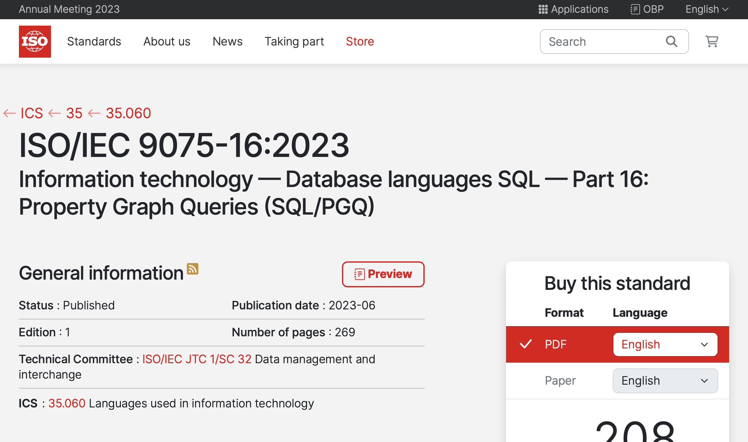
Data Architecture Evolution
– New Capabilities In SQL – ISO SQL/PGQ (June 2023)

Slide 54
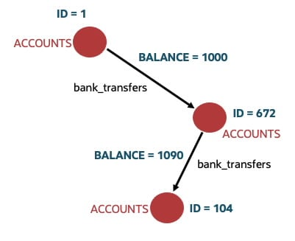
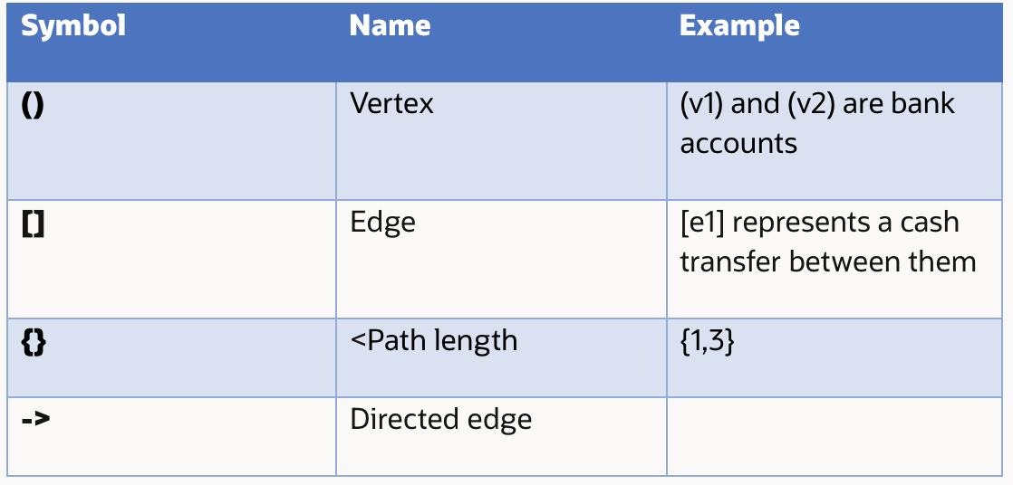
SQL/PGQ Is Already Available In Some Database Management Systems
– Oracle 23c Release (September 2023)
CREATE PROPERTY GRAPH bank_graph
VERTEX TABLES (
bank_accounts as ACCOUNTS
PROPERTIES(ID, BALANCE)
)
EDGE TABLES (
bank_transfers
SOURCE KEY (from_acc) REFERENCES ACCOUNTS(ID)
DESTINATION KEY (to_acc) REFERENCES ACCOUNTS(ID)
PROPERTIES (amount)
)
SELECT distinct(account_id)
FROM GRAPH_TABLE(bank_graph
MATCH (v1)-[is bank_transfers]->{3,5}(v1)
COLUMNS (v1.id as account_id)
);

Slide 55
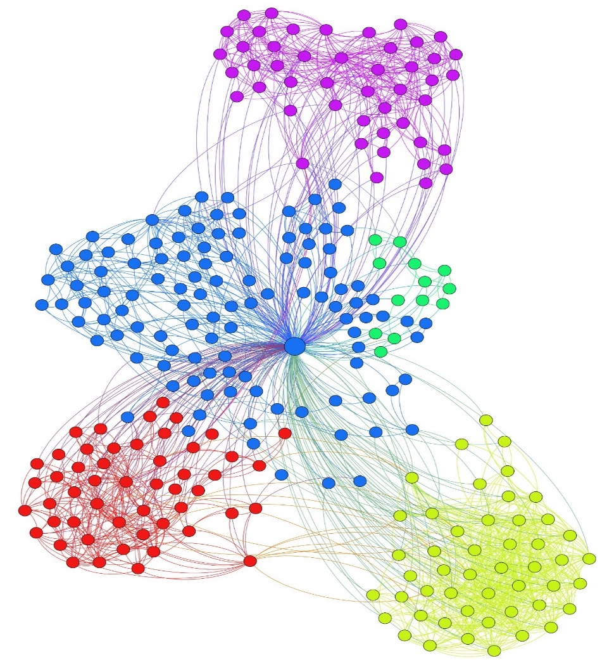
SQL/PGQ Opens Up Graph Analytics To Tools Generating SQL And Also To Developers
– E.g., Community Detection (also known as Graph Clustering)
Goal: Find group of vertices well-connected internally and poorly-connected externally
Applications
Community detection in social networks
Community detection in prospects, customer segments and across segments
Document clustering
Unsupervised learning
And many more…
Image Source: https://mattbaggott.wordpress.com/2012/06/18/visualization-of-clusters-of-friends-on-facebook/

Slide 56
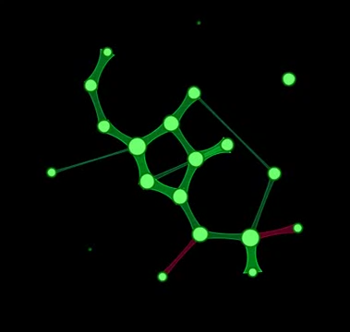
SQL/PGQ On Historical Data Enables Understanding Of Community Evolution Monitoring The Velocity Of Market Changes, Changes In Operations, e.g. Supply Chain, Distribution, Web Traffic
This is the rate that the graph dynamically changes over time
Changes to a graph are indicated by new nodes, deleted nodes, new edges…
See communities evolution over time
6 categories of evolving communities:
  Growth
  Contraction
  Merging
  Splitting
  Birth
  Death
Combine with ML and PREDICT community evolution
Could be hugely valuable in marketing, fraud pattern evolution, planning (resource usage)
What temporal interaction patterns are there?
How do these patterns help to identify communities?
e.g. Communities can grow and shrink

Slide 57
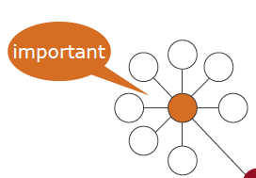
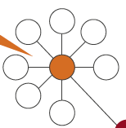
Sequencing Graph Analysis
– Find The Marketing Opportunity
Calculate the susceptibility of each member of the community to be influenced?
Community detection
“find the communities”
Centrality “find who are the influencers in the community”

Slide 58
SQL / PGQ And GQL Implications
Property graphs are much more widely adopted and easier to understand than RDF
  RDF is a steep learning curve and is gradually becoming legacy
SQL/PGQ is now part of the ISO/SQL standard as of June 2023
GQL (not the same as GraphQL for REST APIs) is a proposed standard graph query language for property graphs that will become a standard in early 2024
  A property schema for GQL will be delivered to ISO this year
  Being done by Linked Data Benchmark Council (LDBC - came out of EU FP7)
Graph Normal Form (GNF) or 6NF is likely to cause the merge of RDF with property graphs
Implications
Data catalogue vendors likely to favour SQL/PGQ and GQL over RDF by 2025
BI, Planning, Data Governance, Data Engineering tools can exploit graph analytics in data warehouse DBMSs, data mart DBMSs, and lakehouse SQL engines supporting SQL/PGQ
Graph analytics combined with machine learning and AI could be a game changer

Slide 59
Topics – Where Are We?
The demand for data and AI
The need for a data foundation to underpin data and AI initiatives
The emergence of data mesh and data products
The challenge of a distributed data estate
Data Fabric and how can they help build data products
Data architecture options for building data products
The impact of open table formats and query language extensions on architecture modernisation
Conclusions

Slide 60
Data Architecture Evolution - A New Opportunity to Combine Analytics
Reach data in open tables across multiple clouds via SQL and federated query in the DBMS
  Hybrid multi-cloud analytics
Live streaming data in open table formats and invoke ML models via SQL
  Stream directly into open tables and SQL PREDICT via SQL
  Real-time event driven decision intelligence, automation and dynamic planning
Analysis of structured, semi-structured and unstructured data in pipelines
  Process unstructured data using LLMs
  Generate content from structured data using LLMs
    e.g. marketing content, personalised plans
Invocation of ML models and LLMs from inside the database via SQL
Graph analytics via SQL/PGQ
Combine graph analytics and ML using SQL

Slide 61
Conclusions
The adoption of open table formats by analytical relational DBMS vendors is causing integration between data warehouse and lakehouse
Multiple workloads are converging on fewer copies of data
  Traditional BI
  Data science ML model development
  Streaming analytics
  Graph analysis
It is also possible to do this across data stored in multiple different cloud data stores
Multiple engines can be exploited to suit different analytical workloads on the same data
This opens up the opportunity to combine different types of analytics to create totally new insights for competitive advantage
  CPM using LLMs, ML and graph queries on open tables
  BI using LLMs, ML and graph queries on open tables

Slide 62






About Mike Ferguson
Mike Ferguson is Managing Director of Intelligent Business Strategies Limited. As an independent IT industry analyst and consultant, he specialises in BI / analytics and data management. With over 40 years of IT experience, Mike has consulted for dozens of companies on BI/Analytics, data strategy, technology selection, enterprise architecture, and data management. Mike is also conference chairman of Big Data LDN, the largest data and analytics conference in Europe and a member of the EDM Council CDMC Executive Advisory Board. He has spoken at events all over the world and written numerous articles. Formerly he was a principal and co-founder of Codd and Date – the inventors of the Relational Model that caused the birth of relational databases and SQL, Chief Architect at Teradata on the Teradata DBMS and European Managing Director of Database Associates. He teaches popular master classes in Data Strategy, Data Catalogs, Data Warehouse Modernisation, Practical Guidelines for Implementing a Data Mesh, Big Data Fundamentals, How to Govern Data Across a Distributed Data Landscape, Machine Learning and Advanced Analytics, and Embedded Analytics, Intelligent Apps and AI Automation
www.intelligentbusiness.biz
mferguson@intelligentbusiness.biz
@mikeferguson1
(+44) 1625 520700
Thank You!

Slide 63
Impact Of Open Table Formats – Major Growth In Lakehouse Product Examples
Product Example | Description
AWS Athena & Lake Formation | S3 governance tables support ACID properties Supports Apache Iceberg open tables
Cloudera CDP | All CDP services support Apache Iceberg open tables on ORC and Parquet files e.g., Cloudera Data Warehouse, Cloudera Data Engineering, Cloudera ML
Databricks Lakehouse Platform | Read and write to Delta Lake open tables on Parquet files, Delta Lake 3.0 supports Iceberg and Hudi
Dremio SQL Lakehouse | Dremio Sonar accessing Apache Iceberg tables on AWS S3 via Dremio Arctic catalog
Google BigLake | Supports Apache Iceberg tables and integrates with BigQuery, VertexAI, Spark, Hive, Trino and Presto
IBM watsonx.data Data Lakehouse | Based on Apache Iceberg open table format Hybrid cloud deployment - runs on IBM Cloud, AWS or self-managed on-premises Supports multiple engines – Db2 Warehouse, Netezza, Spark & Presto query engines Supports access to Db2 and Netezza data for lakehouse analytics
Hewlett Packard Enterprise (HPE) Ezmeral Data Fabric and Unified Analytics | Supports Apache Iceberg and Delta Lake open table formats
Microsoft OneLake | Supports Delta Lake open table format
Teradata VantageCloud Lake | Supports Teradata’s own and Delta Lake open table formats

Slide 64
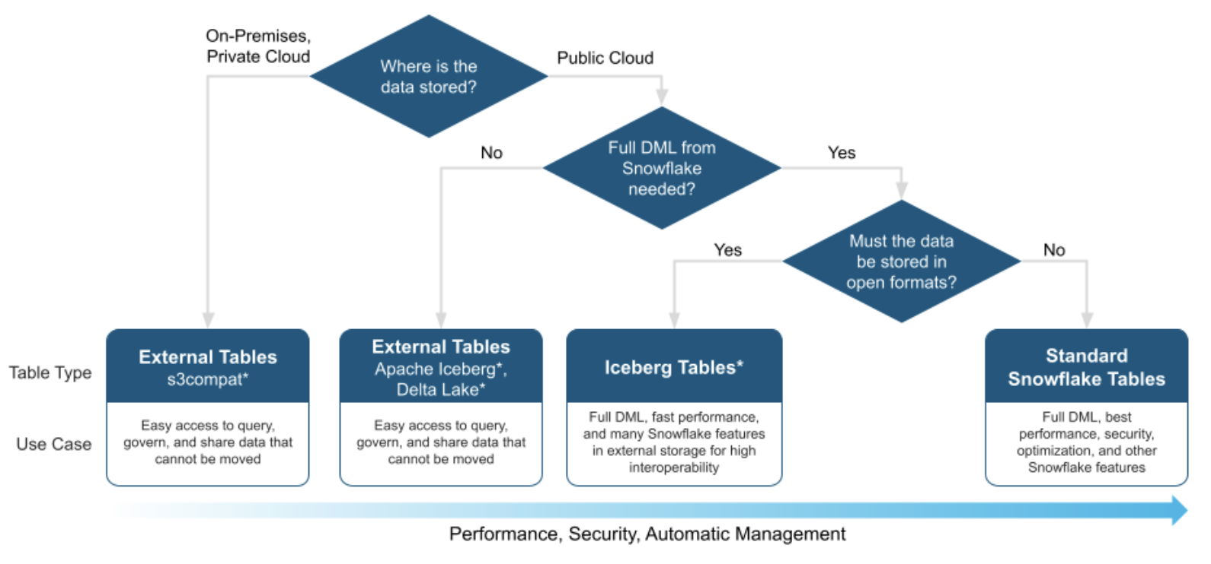
Snowflake Table Types For Analytical Workloads
Iceberg Tables use open table and file formats and store data in customer-supplied storage
Differences between Iceberg and Snowflake proprietary table formats:
Iceberg users have to manage their own cloud storage
Iceberg metadata is held separately from Snowflake tables
Snowflake materialised views cannot access Iceberg tables
Snowflake updates to Iceberg tables can’t be seen by other engines until metadata is synchronised (done via a command)
Image source: https://www.snowflake.com/blog/iceberg-tables-powering-open-standards-with-snowflake-innovations/

