Slide 1


Generative AI in Data Management and Analytics
– A New Era of Assistance, Productivity and Automation
Mike Ferguson
CEO, Intelligent Business Strategies
Adept Events Data Warehousing & BI Summit
Utrecht, March 2024
@mikeferguson1

Slide 2
Copyright © 1992-2024 Intelligent Business Strategies Limited. All rights reserved.
All materials pertaining to this presentation are the intellectual property and copyright of Intelligent Business Strategies Ltd and cannot be reproduced or distributed in any form without prior written permission from Intelligent Business Strategies Ltd. In addition, they must not be used by any party for hire and/or to compete against Intelligent Business Strategies Ltd

Slide 3



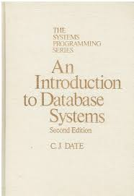
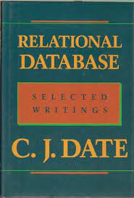
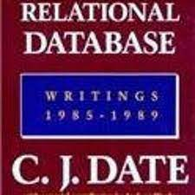

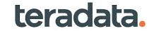

Who Is Mike Ferguson? – A Leading Analyst In Data Management & Analytics
Codd & Date
Edgar F Codd
Mike Ferguson
C J Date
Turing Award Winner
Relational Model
Chief Architect
All relational DBMSs
SQL Language
Data Normalisation
1st massively parallel relational DBMS
Founded 1992

Slide 4

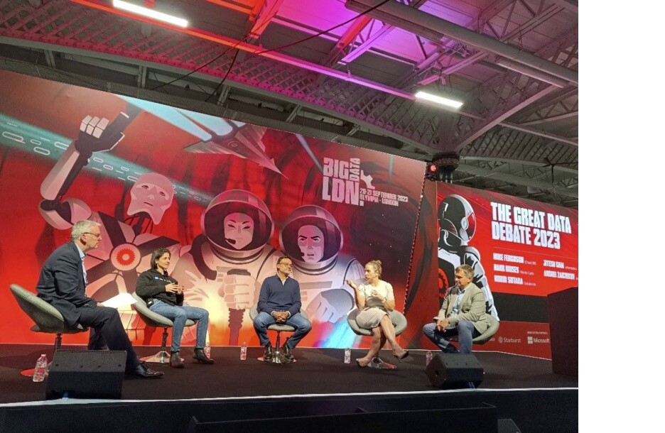
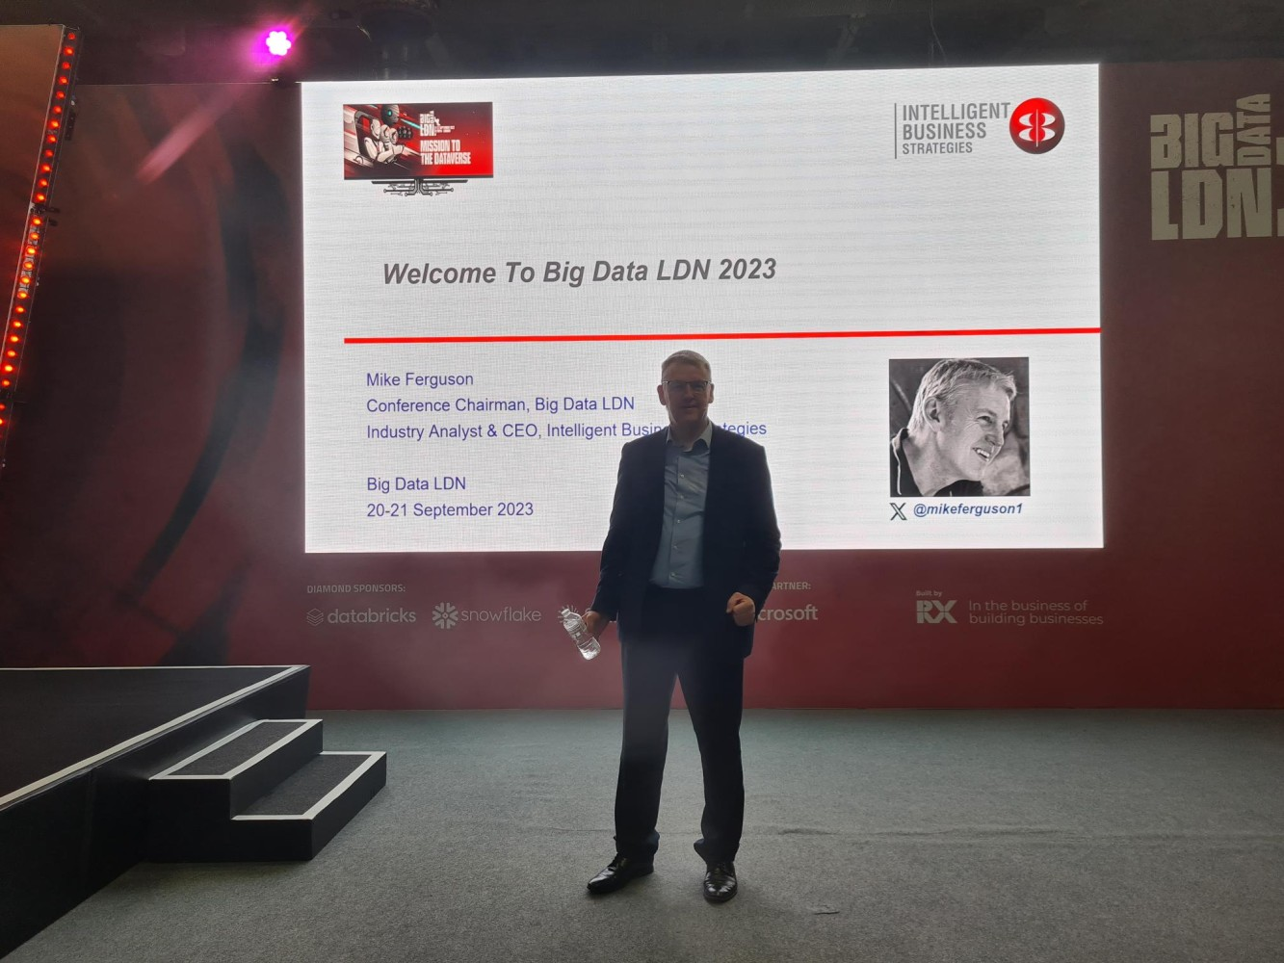
Mike Ferguson Is A Leading Industry Analyst / Consultant And Conference Chairman Of Big Data LDN - Leading The Industry In Data Management And Analytics
Big Data LDN is the largest data & analytics conference in Europe
  20000 delegates
  180 vendors
  15 theatres
  300+ speakers

Slide 5
About Intelligent Business Strategies
A UK-based independent IT analyst and consulting firm founded 1992 specialising in data management and analytics
Mike Ferguson is an independent IT Industry Analyst and consultant, Conference Chairman of Big Data LDN and a member of the EDM Council CDMC Executive Advisory Board
Three main lines of business in the areas of Data Management, BI / ML / AI Analytics and Intelligent Business
Research
  Market research
    4th Industrial Revolution Survey
  D&A product research
    Data Catalogs
    Data Governance
    Data Fabric
    Data Science Workbenches
    Analytical Databases
Education
How to Govern Data Across a Distributed Data Landscape
Practical Guidelines for Implementing a Data Mesh
Building a Competitive Data Strategy for a Data Driven Enterprise
Data Catalogs
Data Warehouse Modernisation
Data Warehouse Migration to the Cloud
Embedded Analytics, Intelligent Apps & AI Automation
Public classes (anyone)
On-site classes (single client)
  Customers, vendors, systems integrators
On-line (public & on-site classes)
Consulting
Customer consulting services
  D&A Strategy, Data Architecture
  D&A Technology selection
  D&A Reviews, Data Governance
  Project implementation advisory
Vendor advisory services
  Product strategy
  Product positioning & go to market
  Marketing support
    Speaking at vendor events
    White papers
    Webinars
Venture Capitalists
  Due-diligence, Asset advisory
www.intelligentbusiness.biz

Slide 6
Topics
What is generative AI?
What are the business benefits of generative AI?
How is generative AI being used in data management?
What does this mean for business going forward?
What should you do to get started?

Slide 7
Topics – Where Are We?
What is generative AI?
What are the business benefits of generative AI?
How is generative AI being used in data management?
What does this mean for business going forward?
What should you do to get started?

Slide 8

Top Ten Key Trends In Data Management And Analytics (D&A) In 2023
Generative AI – innovation in every area of business
Hybrid multi-cloud computing is now the norm
Architecture modernisation - integration of data warehouses, lakehouses, data lakes & streaming
Rationalisation towards a common data & analytics software stack for development & governance
  Do more with less, integration across tools, accelerated development and shared metadata
FinOps - CFOs demand visibility of the full cost of the D&A ecosystem with consumption-based pricing
Data governance remains very high priority with AI governance now also on the agenda
  More sources, distributed data complexity, data quality, security, privacy, usage, observability, sharing, retention
  Poor data culture and weak data governance are barriers to decentralised development
Increasing demand for lower and lower latency data
Democratisation and acceleration of data and analytics development
  E.g., Data Mesh, citizen data engineering, DataOps, autoML, MLOps, CI/CD, code Vs low code / no code
Compliant sharing and reuse of data and analytical products in data marketplaces / exchanges
Growth in intelligent applications, decision intelligence and AI-Automation

Slide 9
What Is Generative AI?
General use cases
  Text generation
  Virtual assistant – chat
  Conversational search
  Summarisation – text extraction
  Code generation
  Synthetic data generation
  Image generation and classification
  Video generation
Benefits
  Improve customer and employee experience
  Productivity, automation
  Ease of use, lower skills bar
  Democratisation of D&A development
What is Generative AI?
A subset of deep learning where multi-layer neural network models generate new content such as text, images, audio, video, code, and synthetic data in response to prompts based on what the models have learned from patterns in the content they were trained on

Slide 10
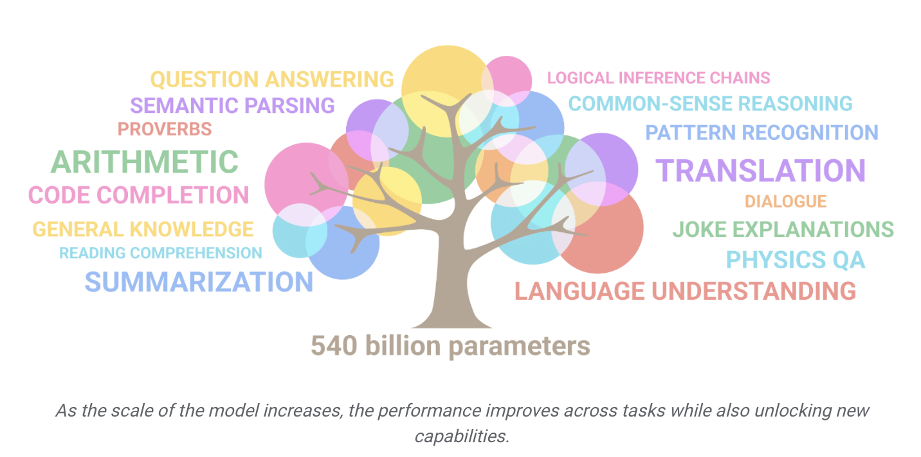
Generative AI – What Are Large Language Models (LLMs)?
Neural network models with billions of connections
Pre-trained using unsupervised learning on very large bodies of public content and code to:
  Predict the next token / word and generate it
  Append the token to content generated to date
Foundation LLM examples
Foundation LLMs can be fine-tuned for specific tasks
  Using supervised learning on smaller labelled data
repeat
Google Pathways Language Model (PaLM2)
Vendor | Foundation Models
Amazon | Titan & CodeWhisperer, Bloom
Databricks | Dolly
Google | Codey, LaMDA & PaLM2 Gemini is the chat interface to PaLM2
Open AI / Microsoft | Generative Pre-Trained Transformer (GPT4) ChatGPT is a chat interface to GPT
Image source: Google

Slide 11
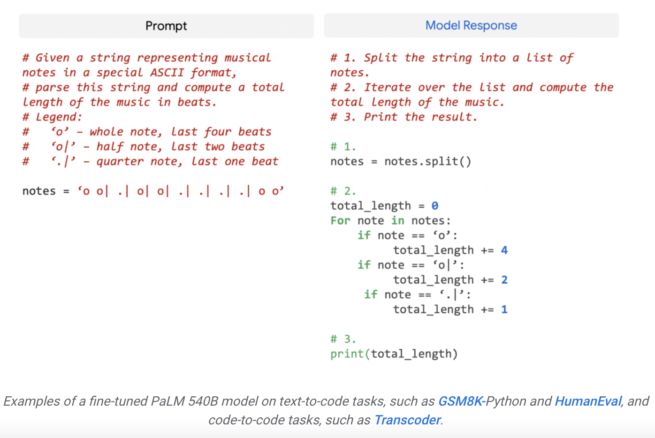
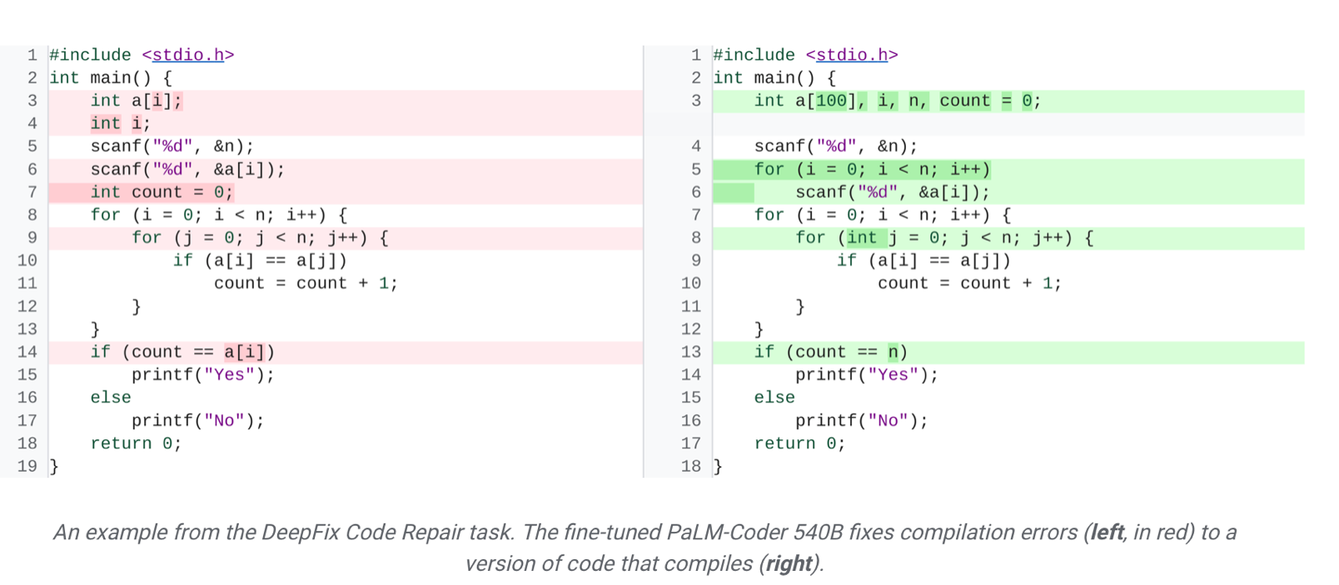
Generative AI Example – Code Generation Using LLMs, e.g., PaLM
Text-to-code
Automatically generate code from a prompt
Image source: Google
PaLM-Coder DeepFix Code Repair
(trained on Python)
Auto debug code so it compiles successfully
Image source: Google

Slide 12
Generative AI Concerns / Issues
Concern/Issue | More Detail
Hallucinations | LLM is unreliable because it can make up wrong answers when it doesn’t know, e.g., The wrong calculation or filter on a SQL statement The wrong transformation May be caused by a model not being given enough data, cab be reduced by fine tuning
LLMs are trained on very large bodies of public data | No domain knowledge No understanding of a company’s data No understanding of a company’s metadata, business terms, metrics No understanding of different user roles or business context
Governance for AI | Safe use - How to train LLMs on data that is safe to use? Compliance – use of regulated sensitive data may expose that data and/or violate privacy Prompt governance - Avoiding sensitive and commercially confidential data in prompts Keeping a prompt log
Infringement of IP and copyright | Reputation or legal implications
Ethics | Ensuring no bias, ensure use that will not cause harm to people or your business
Criminal / Social use | Deepfake, abuse (e.g., bad code), fraud, phishing…

Slide 13

How Does Generative AI Work?
Select the Foundation LLM you want to use e.g., Open AI GPT4
Use it as is OR fine tune it to create a customised LLM for your needs
  A combination of supervised learning and re-enforcement learning with human feedback
  A task which can be minutes to hours
Utilise the customised fine-tuned LLM by invoking it from within applications and tools
Fine tuning LLM using supervised learning
Foundation LLM
N
Tuned LLM
Training data
Eval-uate
Y
Deploy
e.g., Labeled prompts
Tool or Application
Prompt
GPT 4
Validate response & use
Respond
AI-generated content
(text, code, …)
Tuned LLM
Analytical data store

Slide 14
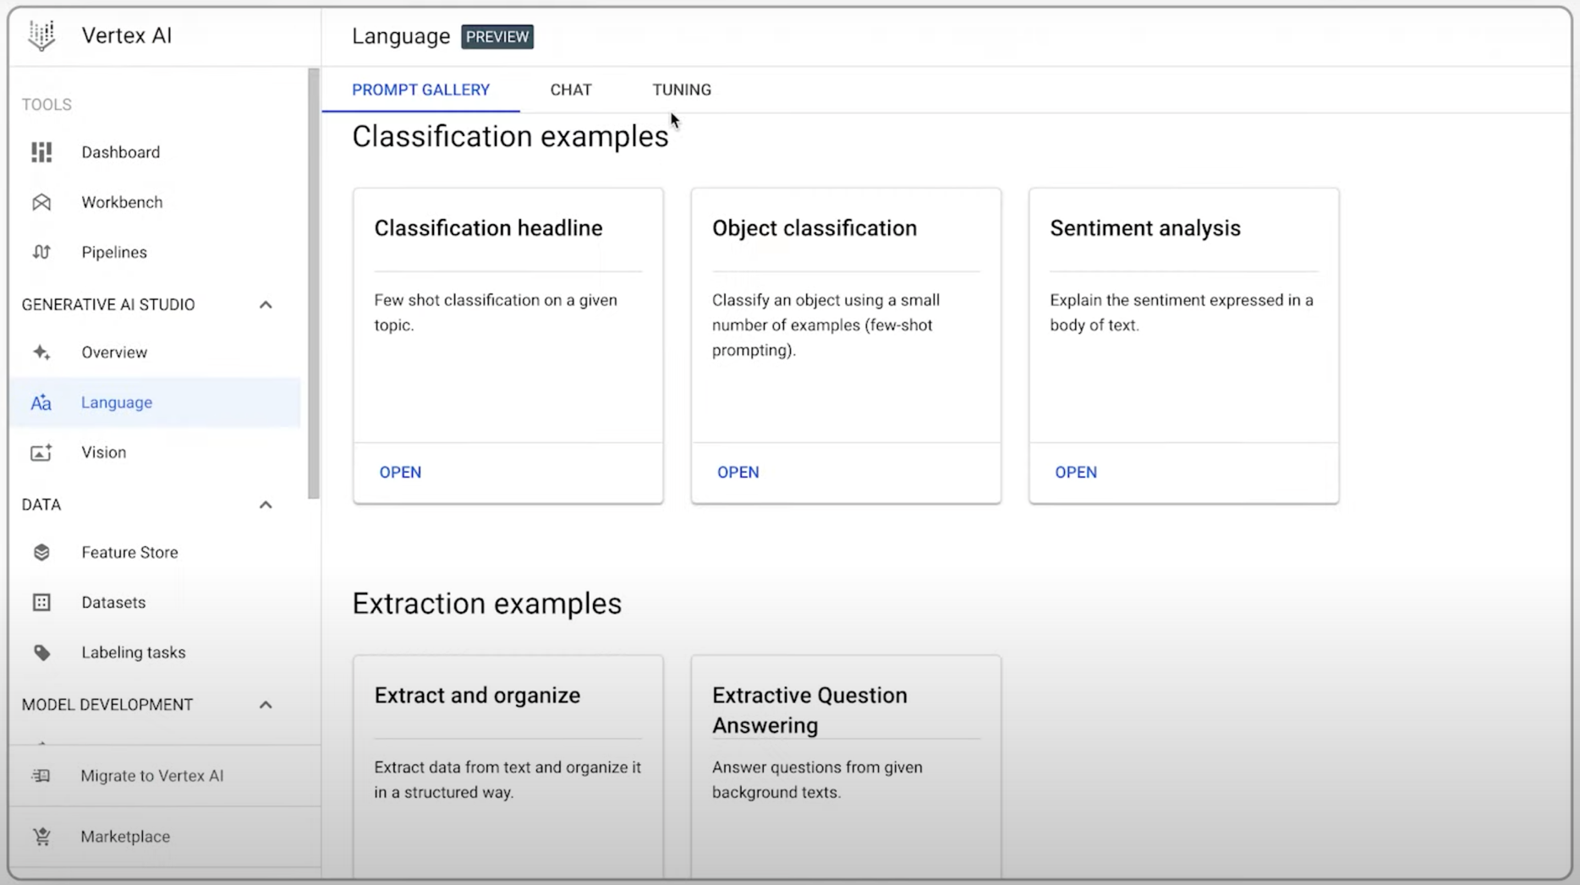
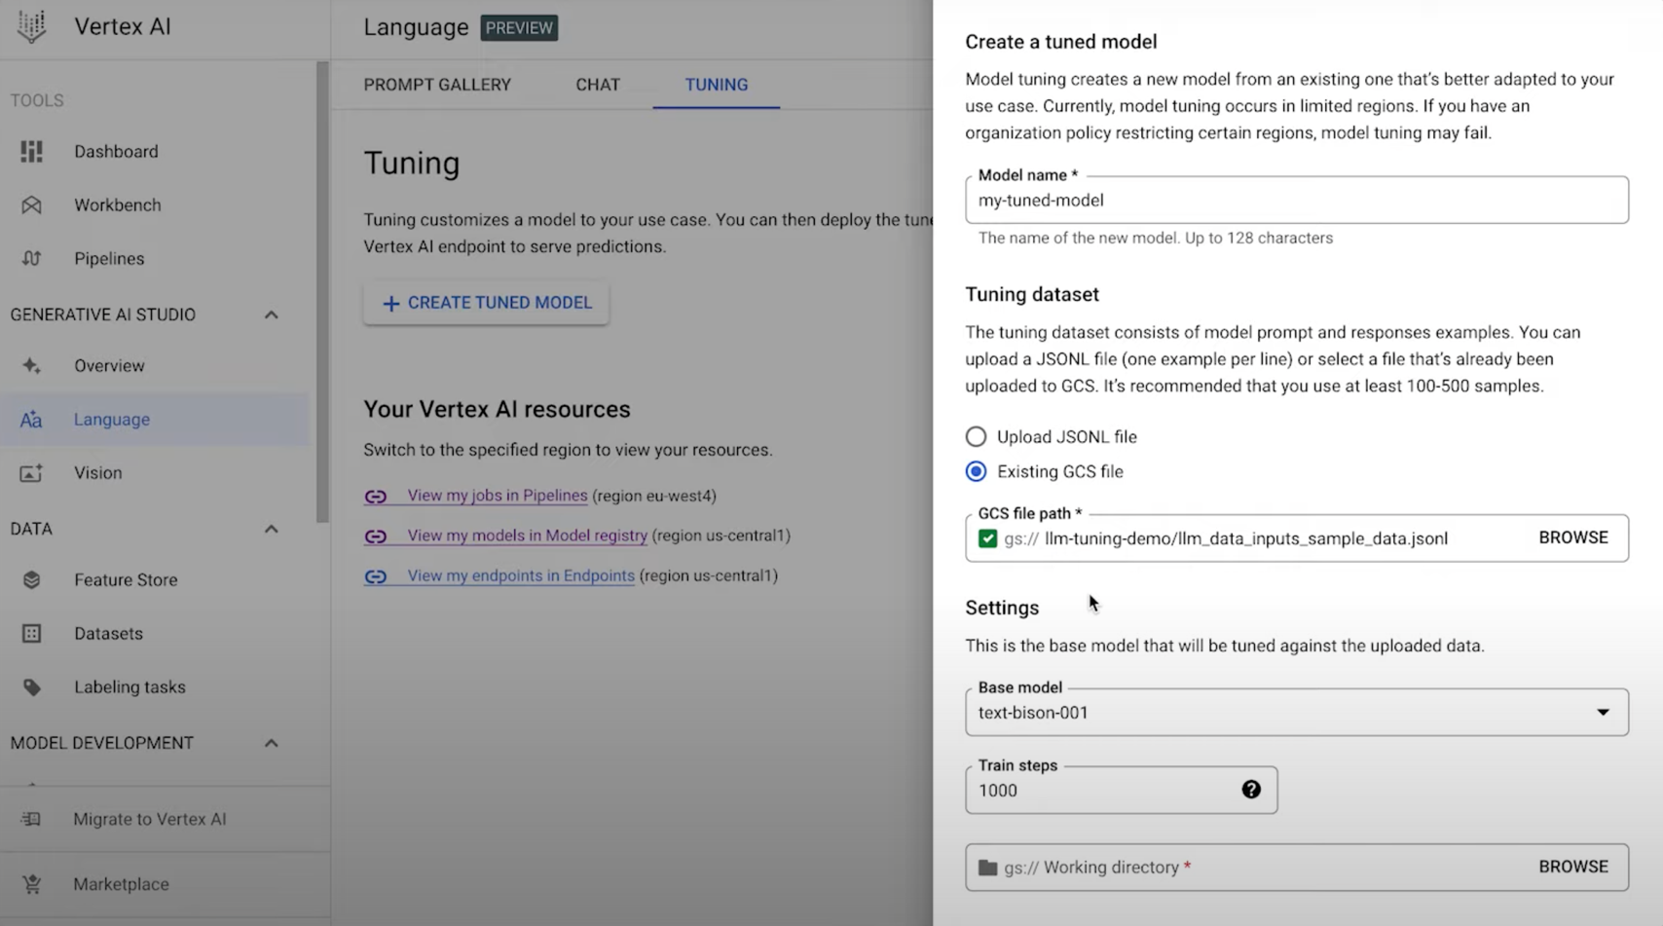
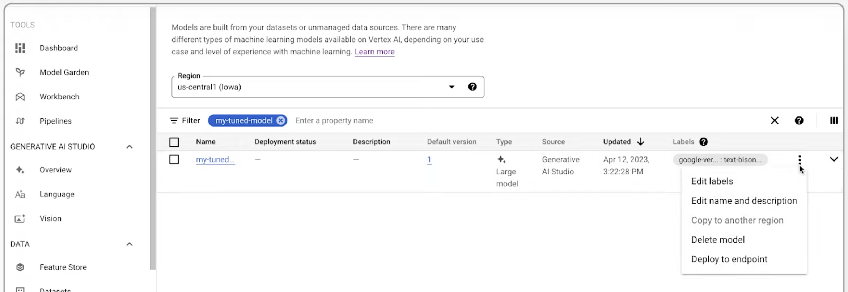
Tuning A LLM Can Be Done In A Data Science WorkBench
_ E.g., Fine Tuning A LLM In Google Vertex AI And Deploying It To An Endpoint
1
2
3

Slide 15

Supplementing And Training Open AI ChatGPT With Your Own Knowledge Base
– Creating Embeddings And Indexes
ChatGPT has been trained on general knowledge
  It has no or limited domain specific knowledge
  Hallucinations can occur – when a LLM makes up information
Internal or external sources
Embeddings
Split into chunks
vectors
vector database
What are embeddings?
  They supplement ChatGPT’s knowledge base
  Provide additional information from your own knowledge base that meets your needs
  Helps provide more relevant, reliable responses
  Help enable faster retrieval and similarity search
  Provides long-term memory for LLMs
Vector indexes
  Created on vector databases
  Enable faster search
Embedding ML model
An embedding is a vector of floating-point numbers
Text documents,
Web content,
CSV files
Trained LLM
Tool or Application
Prompt
Response
AI-generated content
(text, code, …)
S3 directory or files
Google BigQuery
Tool or catalog metadata
CSV files, Text documents
Internal or external sources
Split into chunks
GPT LLM
index
(SimpleVectorIndex)
JSON file
Reference article https://beebom.com/how-train-ai-chatbot-custom-knowledge-base-chatgpt-api/

Slide 16
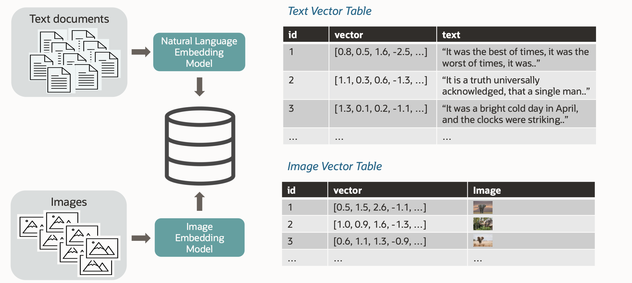
Generating Embeddings In A Vector Database
Creating embeddings addresses the hallucination problem associated with LLM responses
Vectors augment the prompt with enterprise-specific content to produce better responses
Image source and Copyright ©: Oracle - LRN1412 “Enabling Generative AI with AI Vector Search in Oracle Database”

Slide 17





LLM API Frameworks Are Also Now Available To Help Make Use Of LLMs In Tools And Applications
Several new frameworks have emerged to develop LLM powered Gen AI applications and tools
  E.g., Amazon Bedrock, Dust, LangChain, Steamship…
LangChain is a framework for developing applications and tools powered by LLMs
  LangChain is often used inside data management and BI tools
Customised LLM
Other service APIs
e.g., read data from a SQL
database or a dataframe,
transaction systems,
Email etc.
Tool or Application
Prompt
Response
AI-generated content
(text, code, …)
Agents
(actions)
Prompt text
Embedding model
Prompt as a vector
LangChain
Similarity search
Embeddings
(stored vectors)
Similar vectors to the prompt
(indexed
vector database)
Relevant information
(Vectorised text)
Notes:
You take the vectorised prompt, run K-means clustering on the vectors and the vectorised prompt, then K-nearest neighbour will find similar vectors to pass to the LLM

Slide 18

AI Development Using LLM API Frameworks - LangChain Is Used To Connect LLMs To Your Own Data And Also Use The LLM To Help You Take Actions
template = """\
You are a regional sales manager for a pharmaceutical company.
What are the total sales for {product} in {my_region} last {time_period}
"""
Data & Analytics Tool or Application
Customised LLM
Parameterised LLM inputs
Prompt templates
This kind of capability is now going inside
BI tools
Data science workbenches
Data modelling tools
Data integration tools
Data catalogs
Data governance tools
Databases
Data migration tools
Data virtualisation
Data fabric software
AI-driven applications
Chains
A sequence of calls to components, that can include other chains
LangChain
Other service APIs
(Invoke a transaction,
send an email etc.)
Similarity search
Agents
Embeddings
(Vector database)
You can have different prompt template libraries for different technical and business use cases
E.g. prompts for data engineering, data science, marketing insights, financial insights, sales insights, HR insights, …

Slide 19
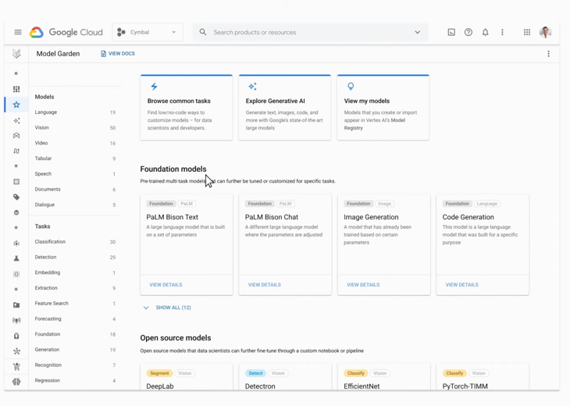
Development Tools Now Exist To Build Generative AI Applications
– E.g. Google Vertex AI Search And Conversation (formerly Generative AI App Builder)
Google Vertex AI Search and Vertex AI Conversation
  Brings together Google’s foundation AI models and search
  Includes a model garden of Google’s foundation and partner AI models
  Build apps without writing any code that make use of generative AI
  Transact during conversation with the bots you build
Gen Vertex AI Model Garden
Conversational AI using LLMs is likely to appear in ALL major applications in the enterprise
Foundation models can be tuned and tested in Vertex AI

Slide 20
Business Wants Generative AI And ML Models ‘Wired Into’ Every Application To Improve Productivity, Reduce Costs, And Shorten Time To Action For Better Profitability
Get employees to decide which tasks should use generative AI
Employees
Intelligent applications
Intelligent Application
Intelligent Application
Intelligent Application
HR
Marketing
Governed access to Generative AI LLMs and trained ML models as services across the business is critical to success
AI-Assistant
Productivity
Automation
Intelligent Application
Intelligent Application
Intelligent Application
Trained Generative AI
models
+ predictive / classification / and clustering
ML models
Intelligent Application
Finance
Sales
Suppliers
Partners
Customers
Procure-ment
Service
Generative AI does not replace other ML models in use in the enterprise
Intelligent Application
Intelligent Application
Intelligent Application
Use generative AI to improve ways of working that help yield better returns
Operations
Distribution
Intelligent Application
Intelligent Application
Intelligent Application
Intelligent Application
Things
Notes:
What about analytics? What’s happening there with respect to digital transformation?

Slide 21
Business Prompt Examples
– Getting Things Done With Generative AI In Customer Facing Business Functions
Marketing
Customer Service
Create a lead gen page for a webinar with a sign-up form
Create personalised emails to all customer likely to buy our new load product
Create tweets to promote our new product
Create a blog introducing our new product
What is the best reply for this customer?
Create personalised emails to all customers about our new loan product
Sales
Who are the top 10 contacts likely to buy the new product?
Recommend the best contact to go see next?
Write an informal introduction email
What insights are available on Acme Corporation?
Use generative AI to change customer and employee experiences and simplify complex tasks
AI powered voice and text conversations with customers
Build generative AI based personalised marketing into customer experiences
Help employees get things done quicker

Slide 22
Topics – Where Are We?
What is generative AI?
What are the business benefits of generative AI?
How is generative AI being used in data management?
How is generative AI being used in data science and BI
What does this mean for business going forward?
What should you do to get started?

Slide 23
Business Benefits Of Generative AI In Data Management And Analytics
Benefit | Examples
Improved productivity | AI-powered – conversational data search, assisted metadata curation
 | AI-automation of tasks – e.g., code generation
 | AI-automated actions e.g., governance actions
Natural language-based user interfaces | Make tools much easier to use
 | Broadens the use of tools to lesser skilled users
Guidance | AI-powered recommendations
Enriched answers | AI-powered natural language explanation of insights and their business impact
 | AI-powered natural language explanation of data, data pipelines and data products
Continuous learning | AI continues to learn as you use

Slide 24
Topics – Where Are We?
What is generative AI?
What are the business benefits of generative AI?
How is generative AI being used in data management?
What does this mean for business going forward?
What should you do to get started?

Slide 25
Mega Trends
– Generative AI Has Already Emerged In Data Management And Analytics Software
Data & Analytics Category | Example Data & AI Products Already Supporting Generative AI
Data Catalogs | Atlan
 | Collibra
 | Data.world
Data Integration | SnapLogic SnapGPT
 | Denodo
Data Governance | Informatica CLAIRE GPT (glossaries, policies, rules…) SodaGPT
Database Management Systems | ArangoDB
 | Google Duet AI in BigQuery and BigQueryML
 | Snowflake, Oracle
 | Neo4j, Kinetica
Master Data Management | ViaMedici PIM
Self-service analytics / BI | ThoughtSpot Sage
 | Tableau GPT & Einstein CoPilot
Data Science Workbench | Databricks LakehouseIQ & English API, LakehouseAI
Data Science Workbench | IBM Watsonx.ai
 | Google Vertex AI
Decision Intelligence | Aera

Slide 26







Generative AI Has Emerged In Almost Every Aspect Of Data Management
Data engineering
Data Modelling
Data Virtualisation
Generative AI
Data catalog
DBMS / Lakehouse
x
y
Customised LLMs
Business Glossary
Database
Migration
R
C
asset
U
Data Marketplace
prod
cust
Data Governance
D
MDM
Copyright © Intelligent Business Strategies 1992-2024

Slide 27
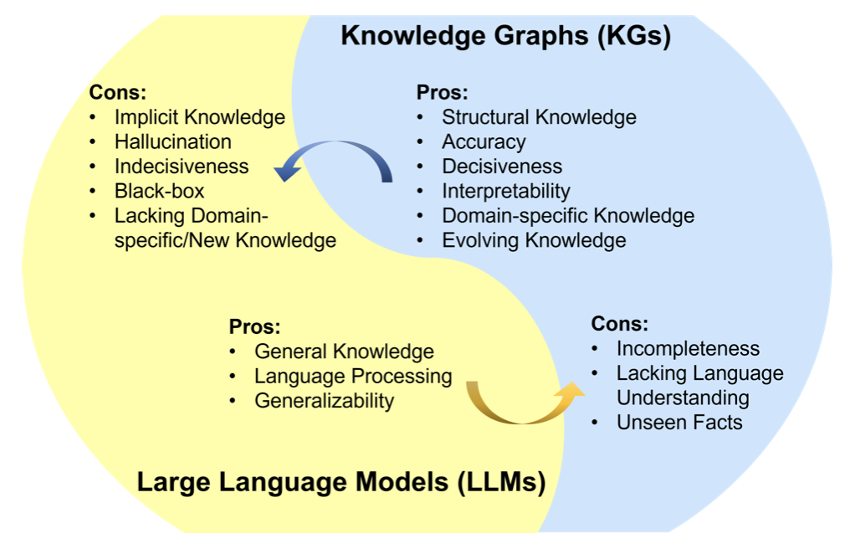
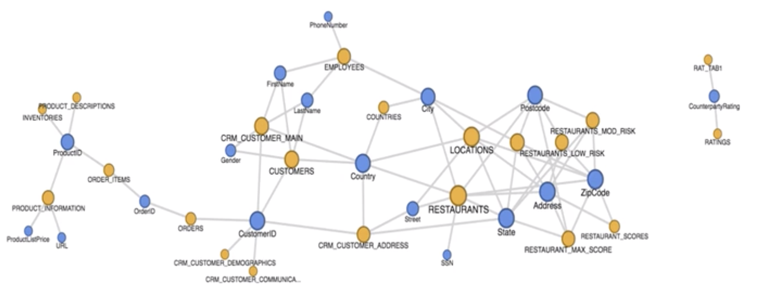
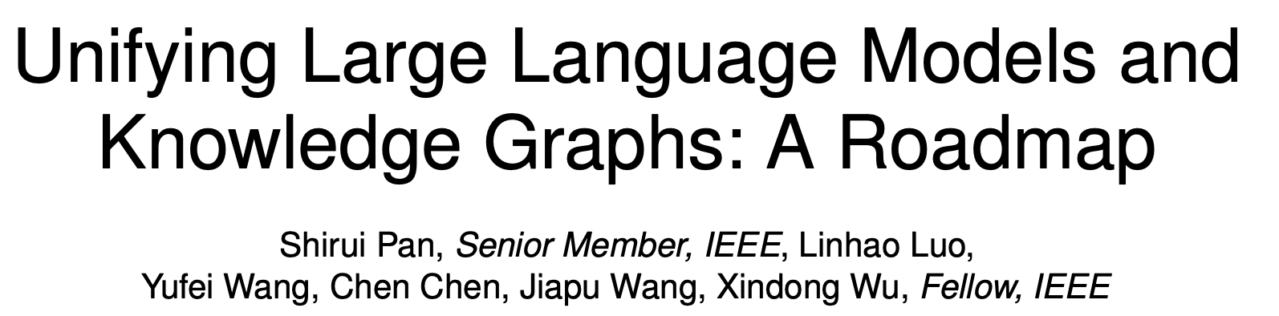
Generative AI In Data Catalogs
– The Promise Of Using Data Catalogs To Train LLMs
Data catalog
Training LLMs with your own knowledge graph
Metadata knowledge graph
Data catalog
Image source:
Data catalogs will provide much needed context to LLMs

Slide 28

Generative AI In Data Catalogs – What’s Possible?
Data catalog
Conversational data search
  Find data and other artefacts more rapidly
  Research question generation based on data collections
Automated metadata enrichment to accelerate curation
  Metadata infused prompts
  Automated AI generated metadata enrichment at scale during data discovery
  Auto-generation and recommendation of business terms, synonyms and term descriptions in the business glossary
  Auto generation and recommendation of editable data asset descriptions
  Provision auto-generated metadata into other tools via catalog APIs
  AI generated catalog update notifications
Automated query generation and summarisation
Automated synthetic sample data generation
Other tools
API
LLM
Data Catalog
metadata infused prompts
response
notify people of changes
GPT LLM indexed with data catalog metadata
Data catalog metadata
Data discovery & classification
Data sources

Slide 29




Using Generative AI To Simplifying The Data Catalog User Interface
– Conversational Data Search Using Natural Language And Voice To Find Data
Business user
(natural language query)
What data exists about….?
Voice UI
Data catalog
What table do I use….?
How is revenue defined?
Create a description for the Supplier table
LLM
Data Catalog UI
metadata infused prompts
response
LLM indexed with data catalog metadata and vector embeddings
Data
Catalog

Slide 30
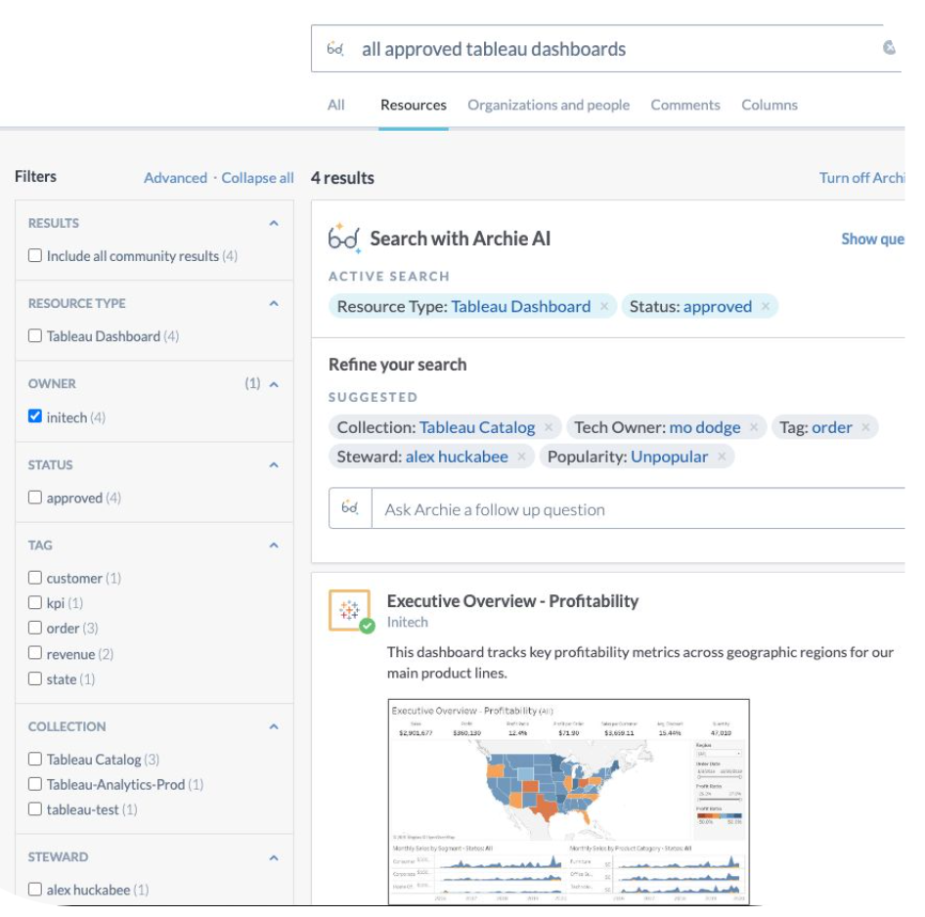
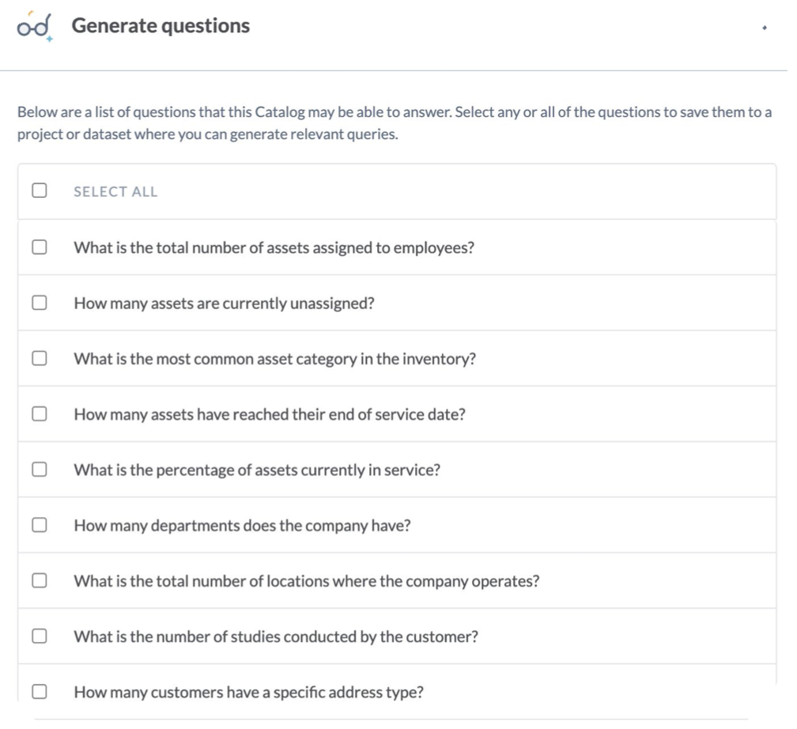
Prompt-Based Search And AI-Assisted Question Generation In Data Catalogs
– Product Example: Data.world
AI-Assisted Search
Automated AI-Assisted Question Generation
Source: data.world
data.world now has generative AI bots called Eureka bots

Slide 31
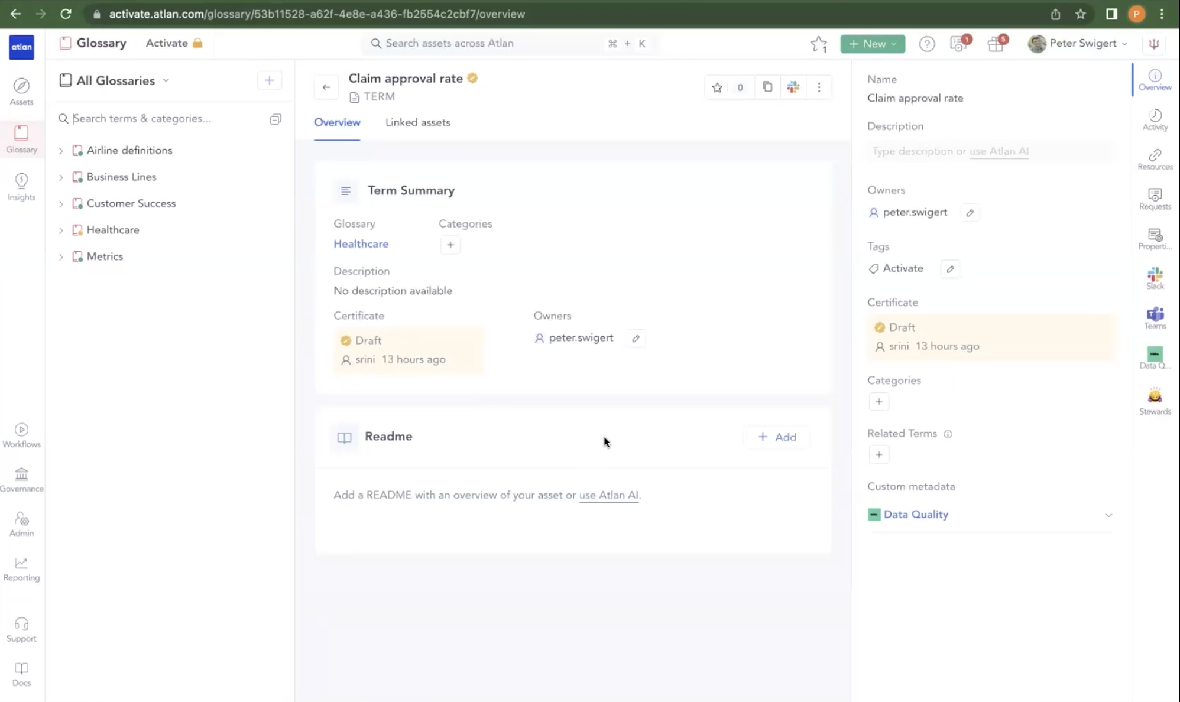
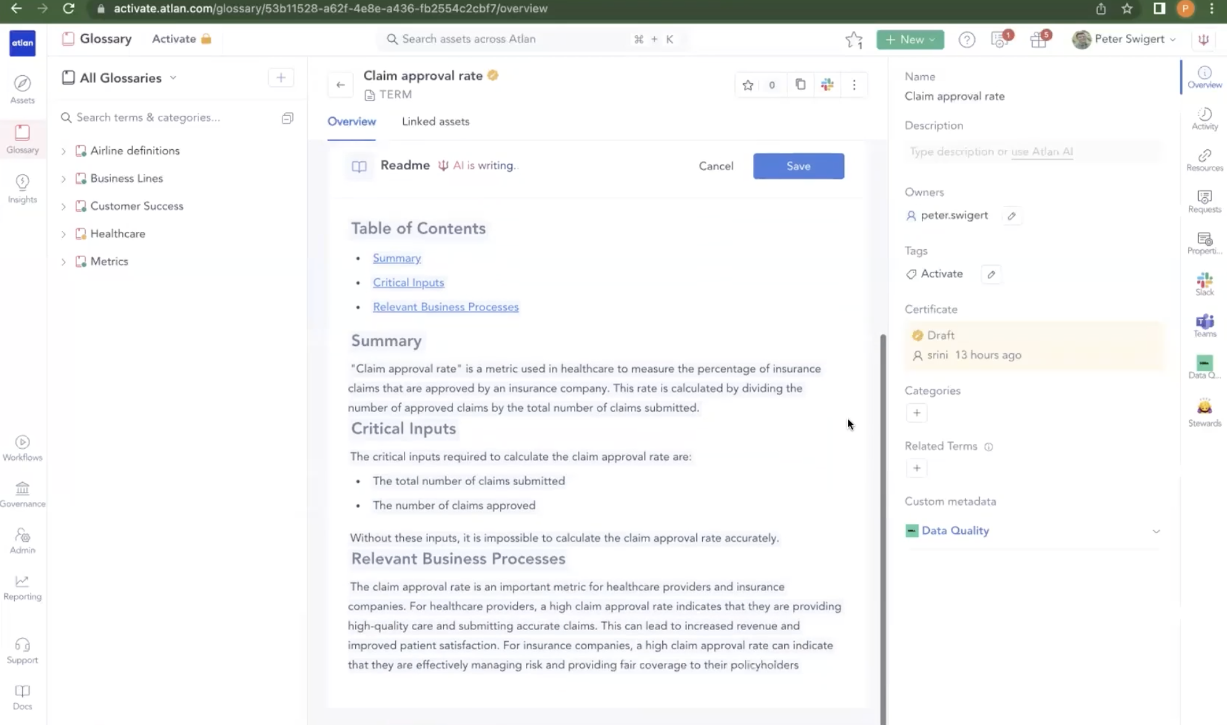
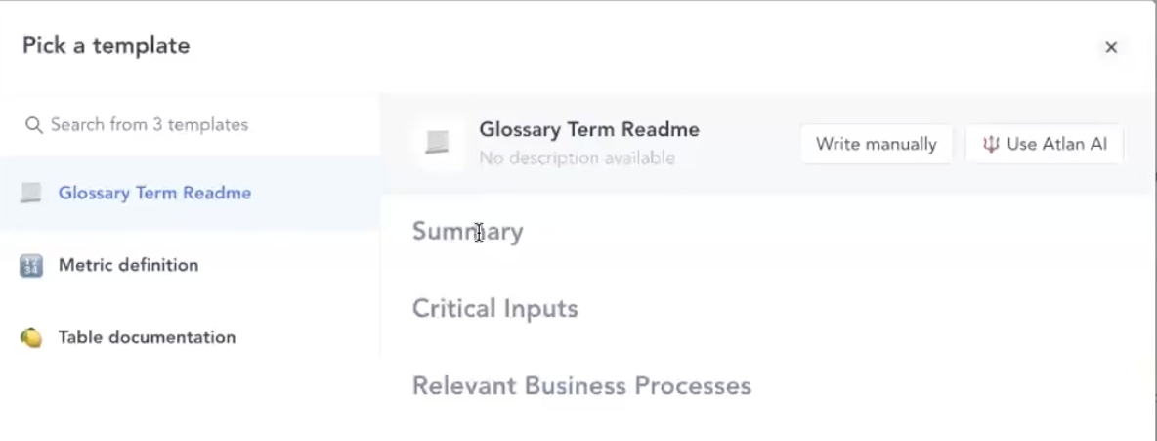
Using Generative AI For Data Catalog Metadata Enrichment
– Auto-Generation Of Business Term Descriptions In Atlan Business Glossary
Business Glossary
Data catalog
1
AI generate
3
2
Source: Atlan
Add a Readme, pick from a template and auto generate the Readme text using a generative LLM

Slide 32
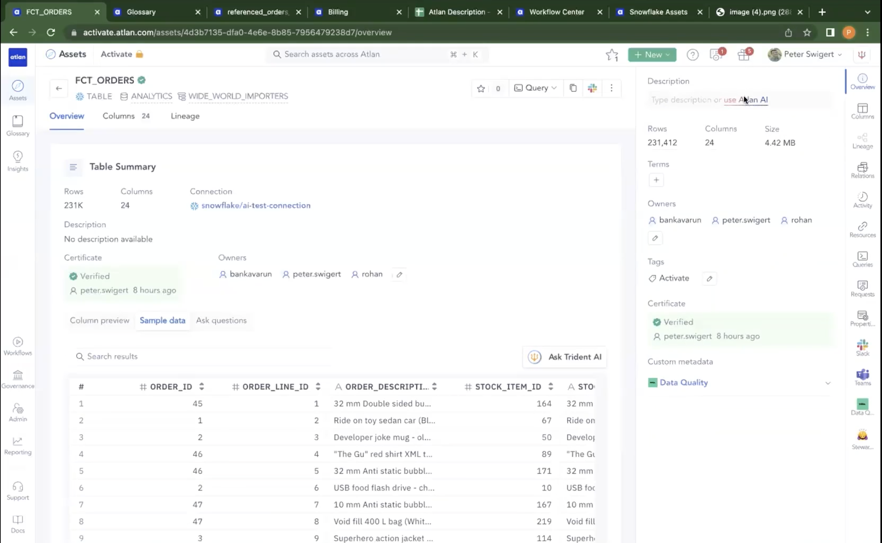
Generative AI In Data Catalogs
– Automated Metadata Enrichment Using Atlan AI To Generate A Description Of An Asset
FCT_ORDERS table currently has no description
Request Atlan AI to generate one
Data catalog
Source: Atlan

Slide 33
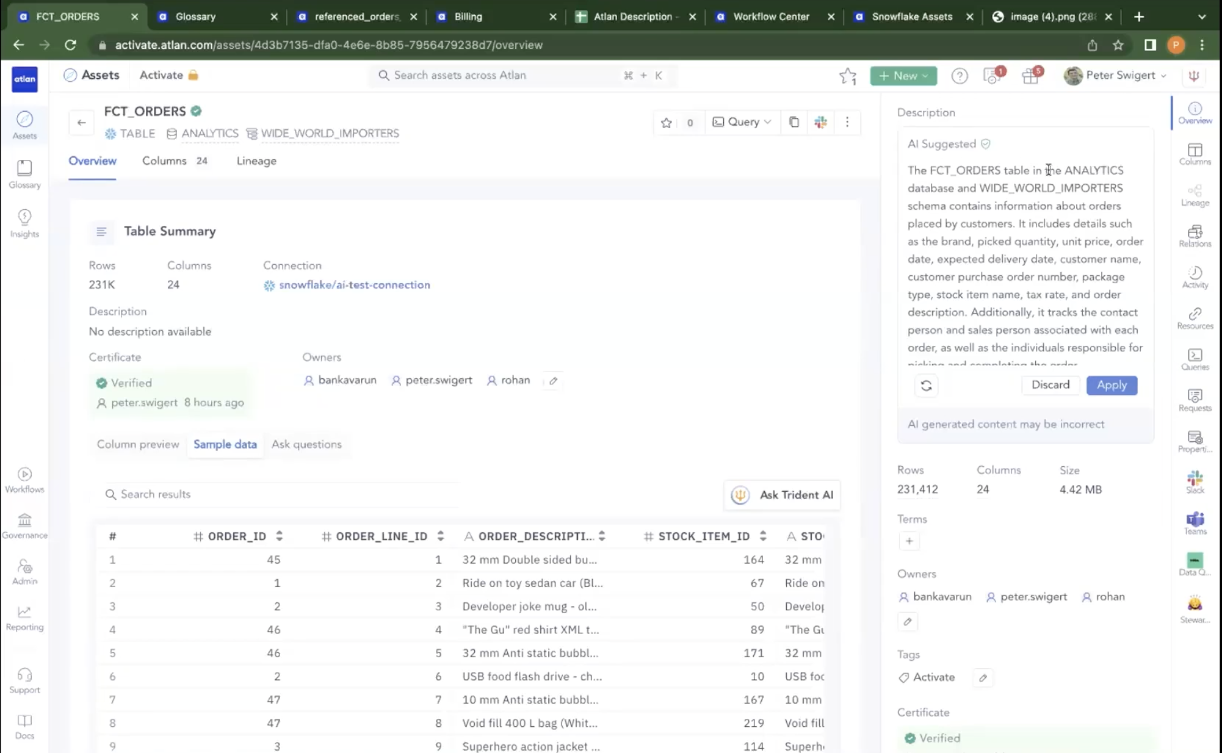
Atlan Generated Contextual Description
– E.g. The Description Includes The Database The Table Is In, The Schema
Data catalog
Generated description
User can accept this by clicking “Apply”
The user can also edit the description before accepting it
Source: Atlan

Slide 34
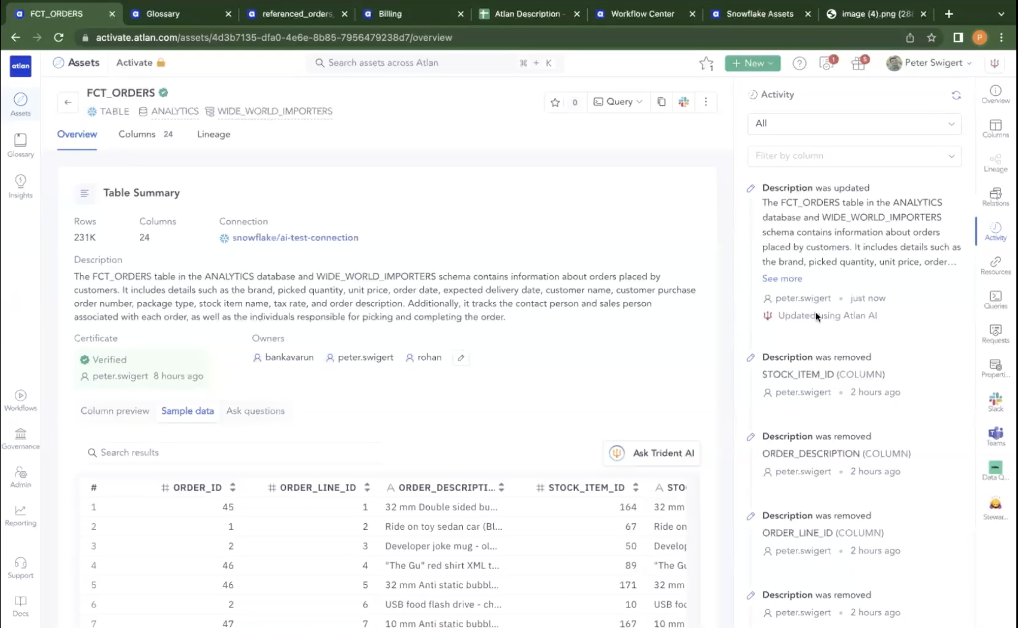
Atlan AI Activity Shows A Log Of The Changes Made By A User Using Atlan AI
Data catalog
‘Atlan keeps an activity’ log that shows the description was updated by a user using Atlan AI
Source: Atlan

Slide 35
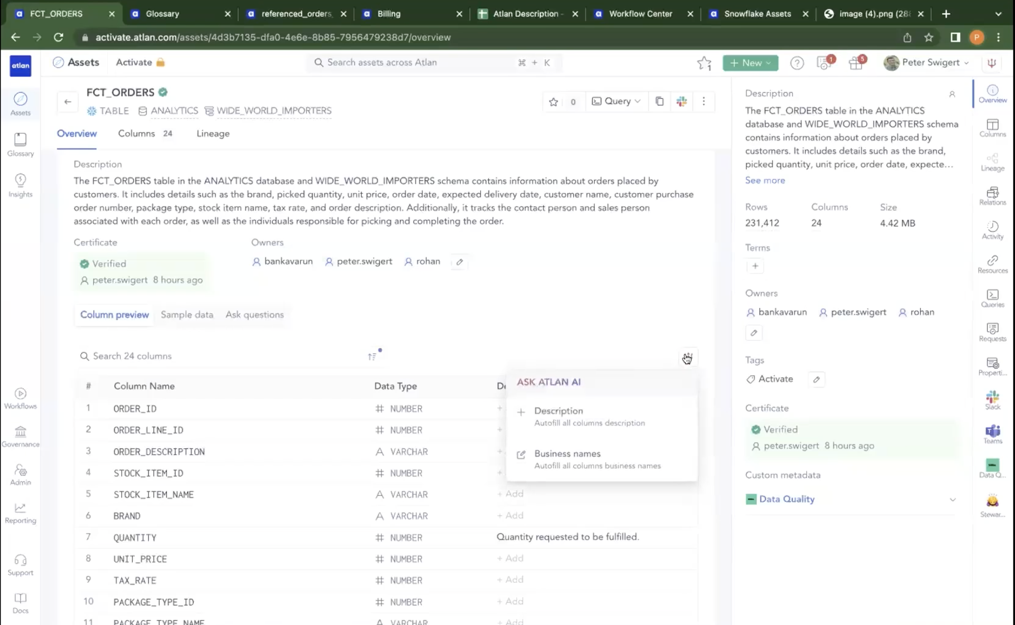
Generative AI And Data Catalogs - Automated Metadata Enrichment Using Atlan AI To Auto-Generate Column Descriptions And Business Data Names
Data catalog
Source: Atlan

Slide 36
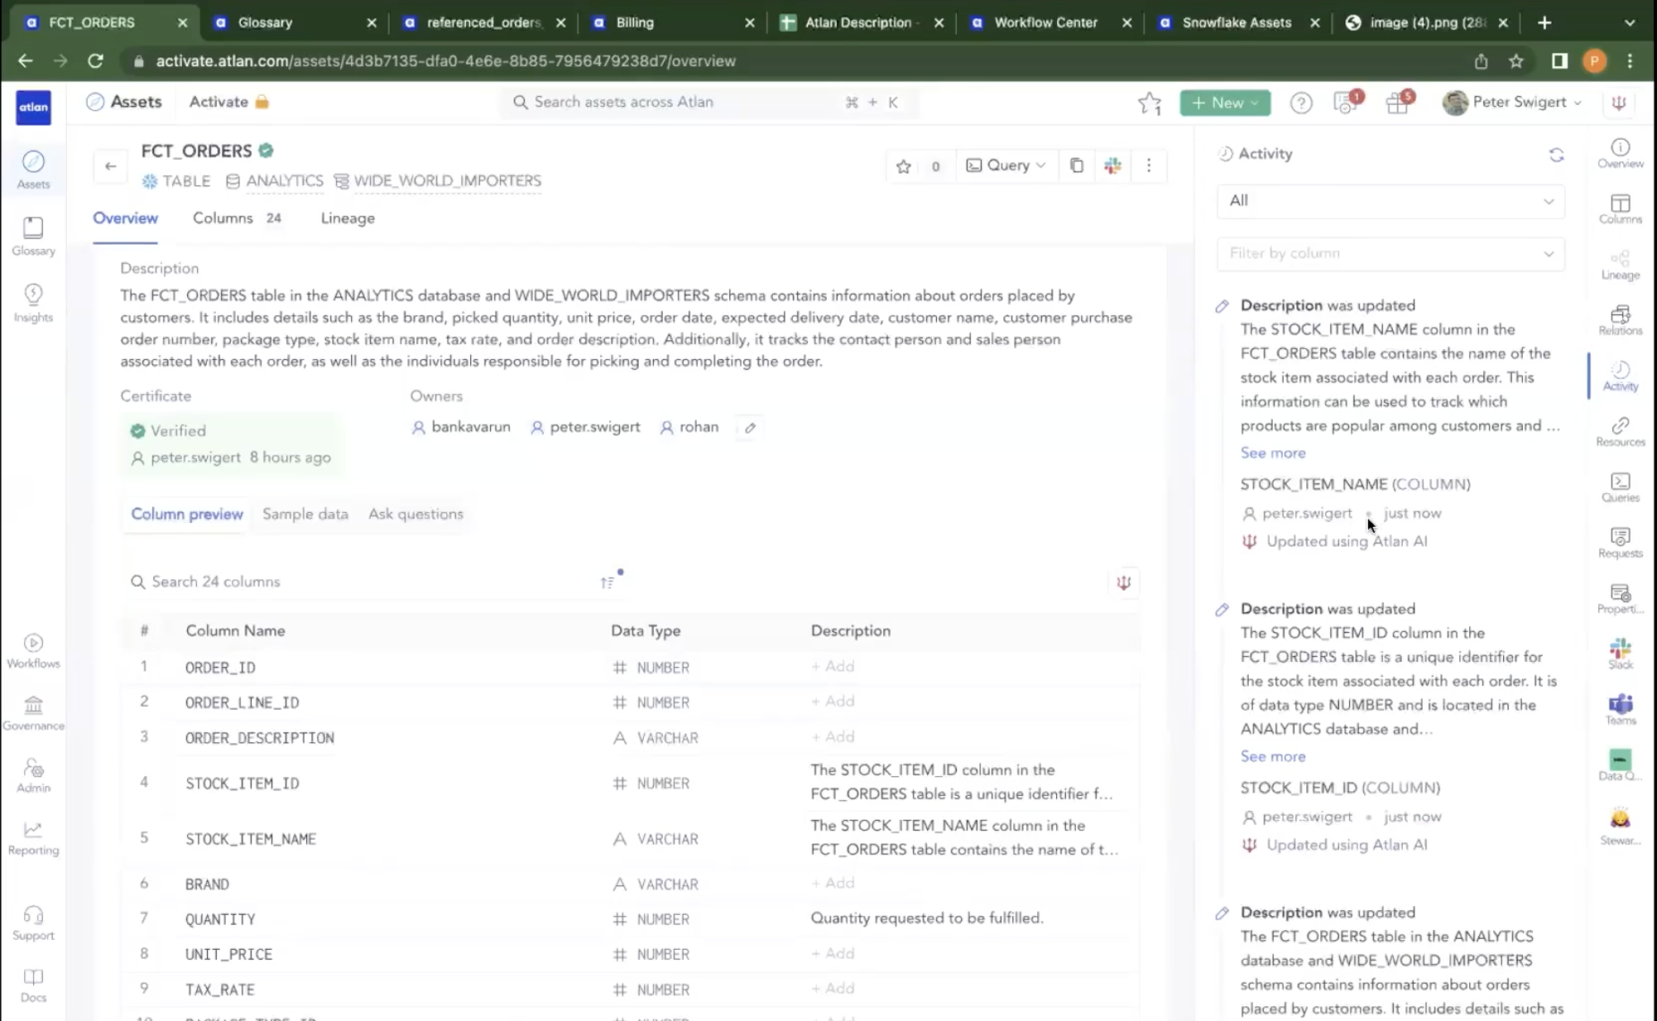
Atlan AI Activity Shows A Log Of The Column Description Changes Made By A User Using Atlan AI
Data catalog
Accepted AI-generated column descriptions are immediately visible
The activity log shows they were updated by a user using Atlan AI
Source: Atlan

Slide 37
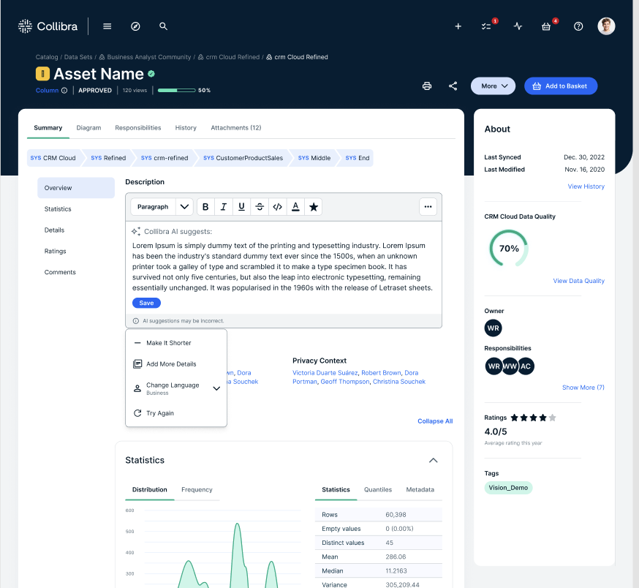
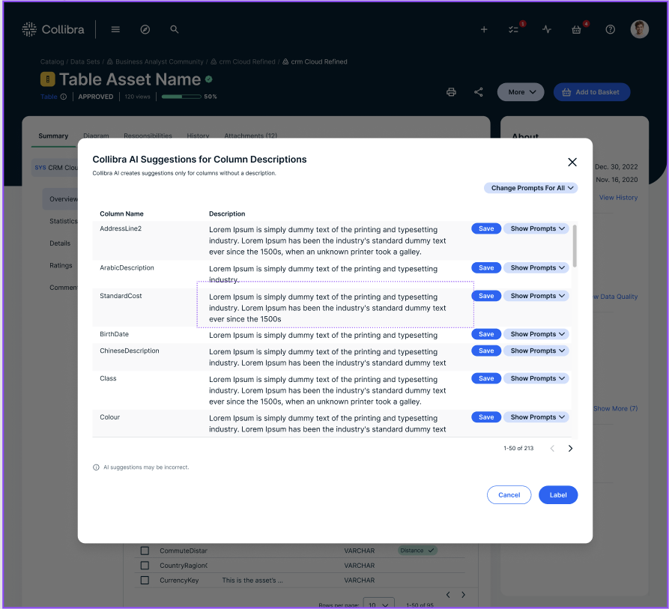
Generative AI In Data Catalogs - Automated Metadata Enrichment Using AI-Generated Column Descriptions In Collibra
Data catalog
Source: Collibra

Slide 38
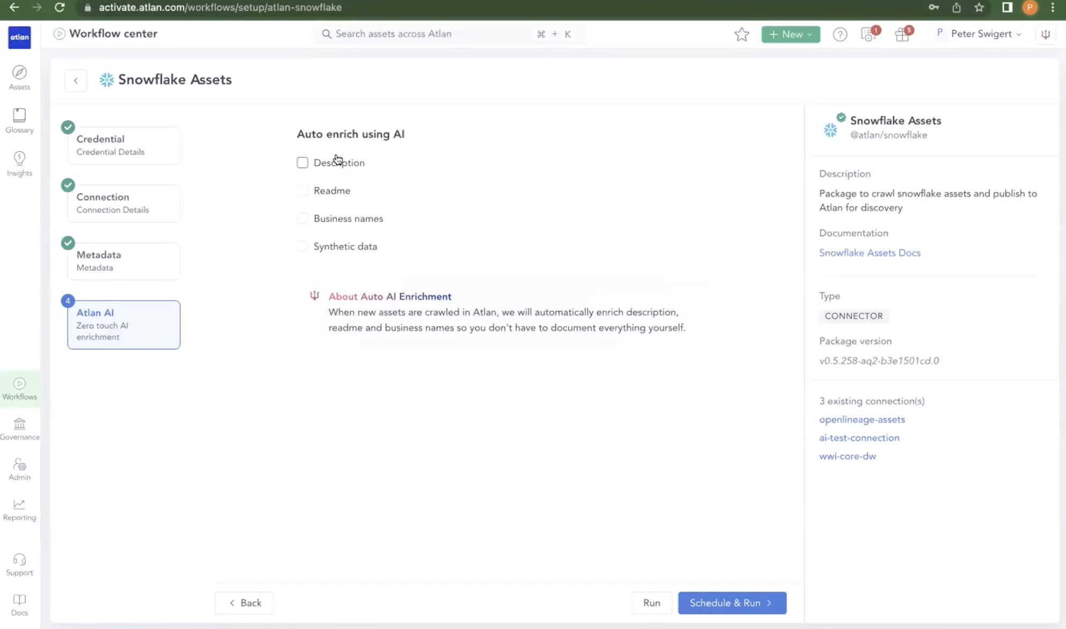
Generative AI In Data Catalogs – Automatic AI-Generated Metadata Enrichment At Scale During Source Data Discovery In Atlan
Data catalog
Select what metadata you want automatically generated
As Snowflake data assets are automatically discovered in Atlan, generative AI can be invoked to auto-enrich the metadata
Source: Atlan

Slide 39
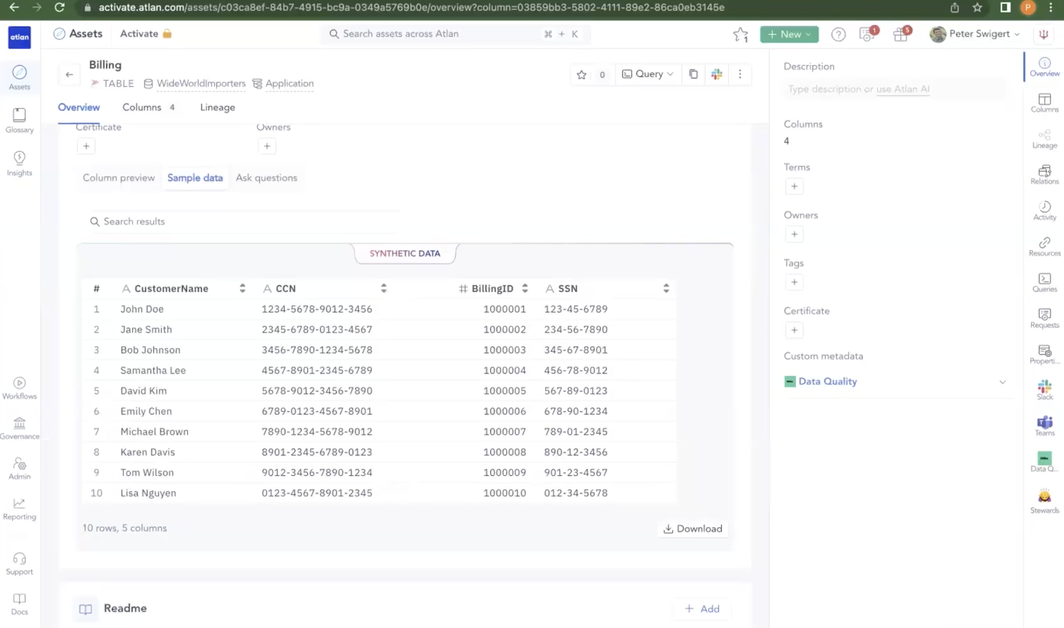
Synthetic Sample Data Generation In Atlan Data Catalog Using Generative AI
Data catalog
Source: Atlan

Slide 40
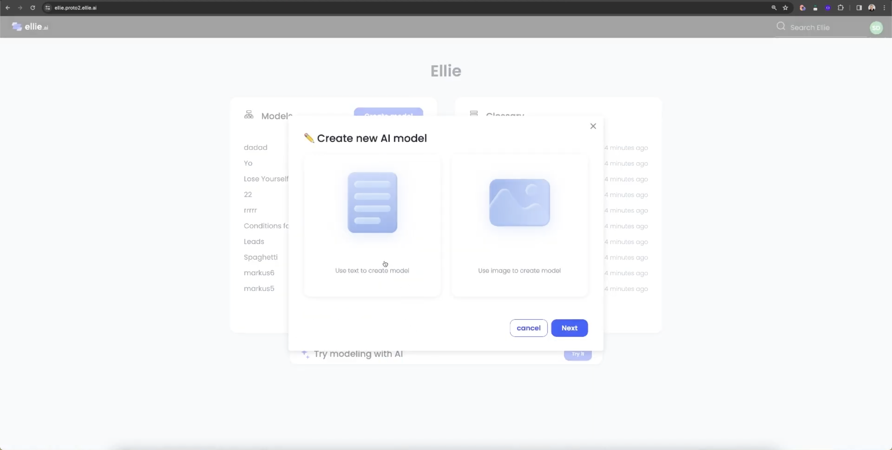
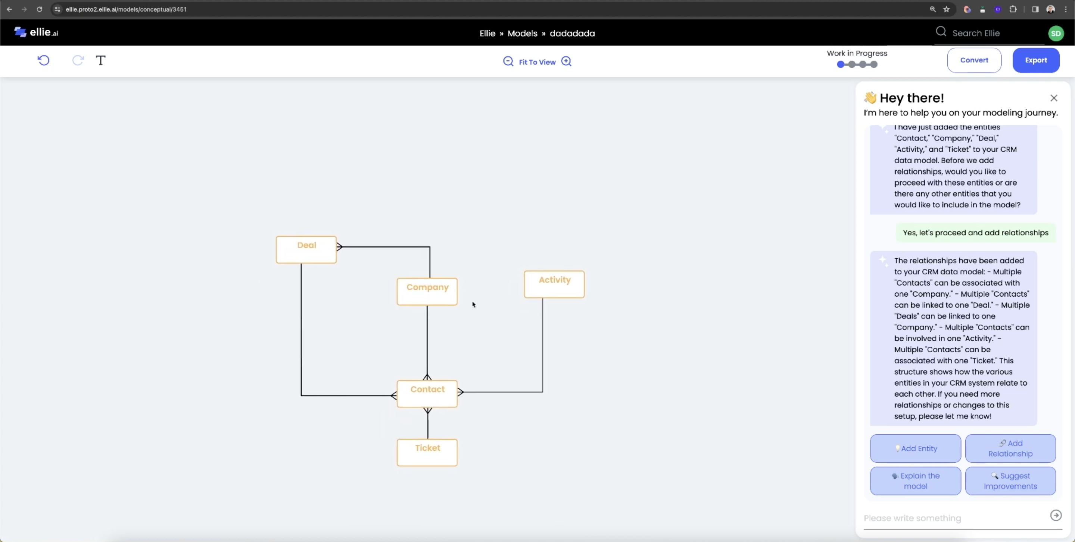
Generative AI And Data Modelling - Ellie.ai Is a Popular Data Modelling Tool That Can Use Generative AI to Help Build Data Models
Data Modelling
Use natural language prompt-based data modelling

Slide 41
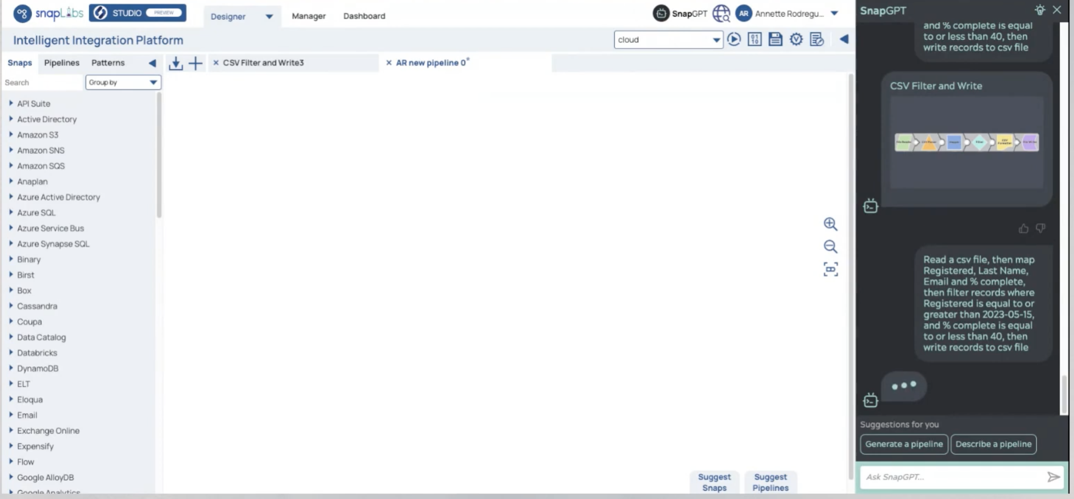
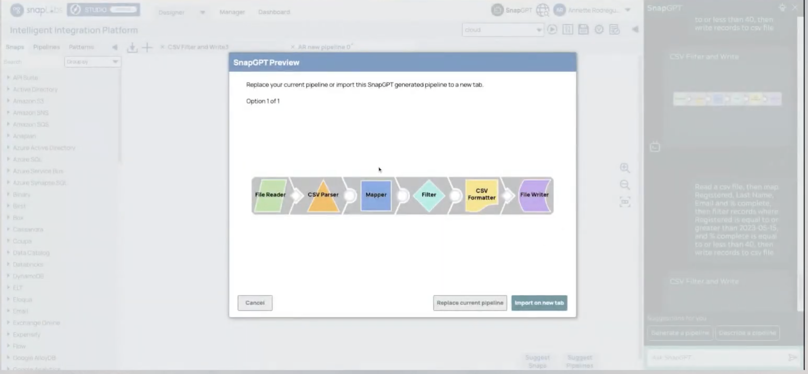
Generative AI In Data Engineering
– SnapLogic SnapGPT Prompt Based Data Engineering
Data engineering
Generated pipeline preview
Import the pipeline
Source: SnapLogic

Slide 42
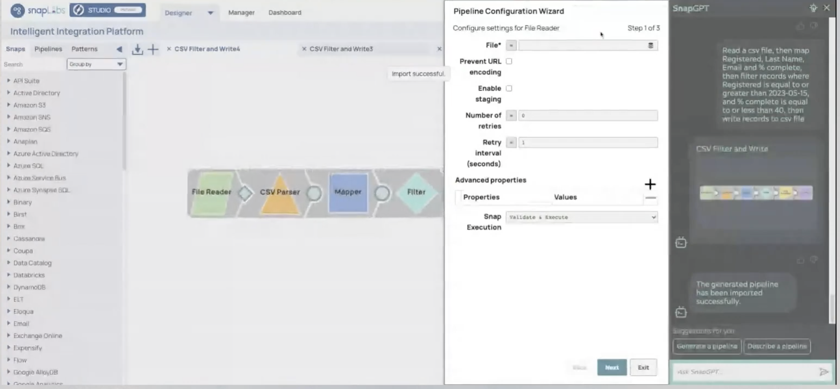
Generative AI Prompt Based Data Engineering
– SnapLogic SnapGPT Pipeline Configuration Wizard
Data engineering
Source: SnapLogic

Slide 43
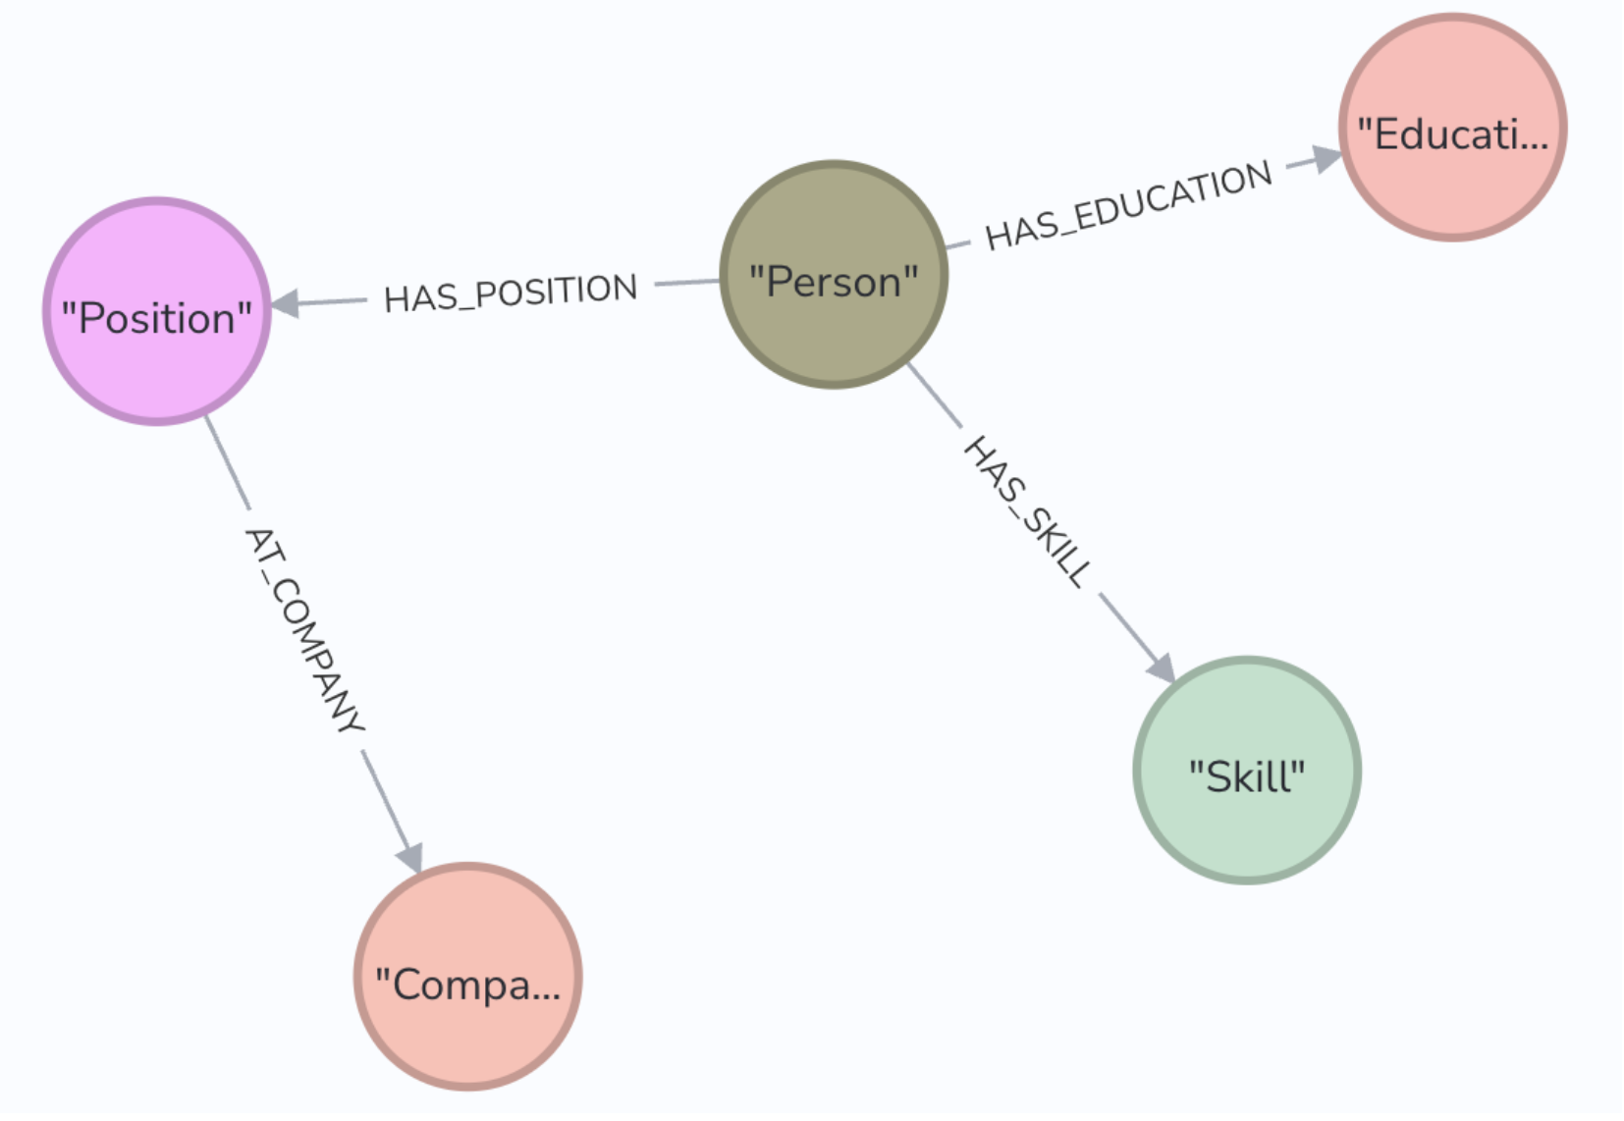
Prompt Based Data Engineering Example
– Parsing Text, Extracting Data And Populating A Graph Database Using Gen AI
Text documents
LLM
Code gen LLM
JSON
Parse documents and extract structured data from documents
Generate Cypher code to write the data into the database
e.g., CVs
Neo4J
Graph DB
Prompt to extract data from text for the Person node
person_prompt_tpl="""From the Resume text for a job aspirant below, extract Entities strictly as instructed below
First, look for the Person Entity type in the text and extract the needed information defined below: `id` property of each entity must be alphanumeric and must be unique among the entities. You will be referring this property to define the relationship between entities. NEVER create new entity types that aren't mentioned below. Document must be summarized and stored inside Person entity under `description` property
  Entity Types:
  label:'Person',id:string,role:string,description:string //Person Node
2. Description property should be a crisp text summary and MUST NOT be more than 100 characters
3. If you cannot find any information on the entities & relationships above, it is okay to return empty value. DO NOT create fictious data
4. Do NOT create duplicate entities
5. Restrict yourself to extract only Person information. No Position, Company, Education or Skill information should be focussed.
6. NEVER Impute missing values Example Output JSON: {"entities": [{"label":"Person","id":"person1","role":"Prompt Developer","description":"Prompt Developer with more than 30 years of LLM experience"}]}
Question: Now, extract the Person for the text below –
$ctext
Answer:
"""
Source: https://github.com/neo4j-partners/neo4j-generative-ai-google-cloud

Slide 44
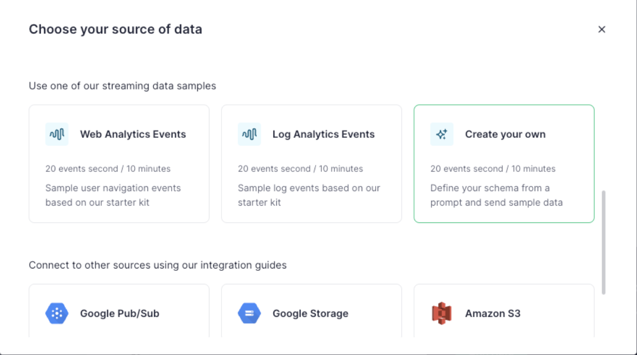

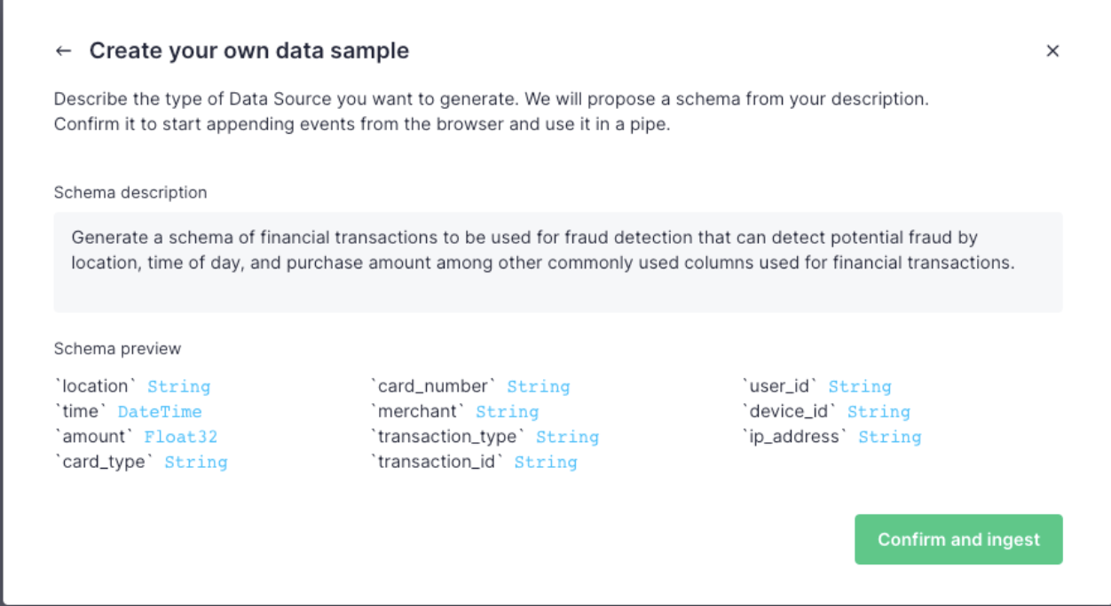
Generative AI In Data Engineering - Synthetic Data Generation Using LLMs e.g., Tinybird Mockingbird – Generate A Schema And Synthetic Streaming Test Data
Data engineering
Source: Tinybird
Prompt based test data schema generation
Source: Tinybird

Slide 45
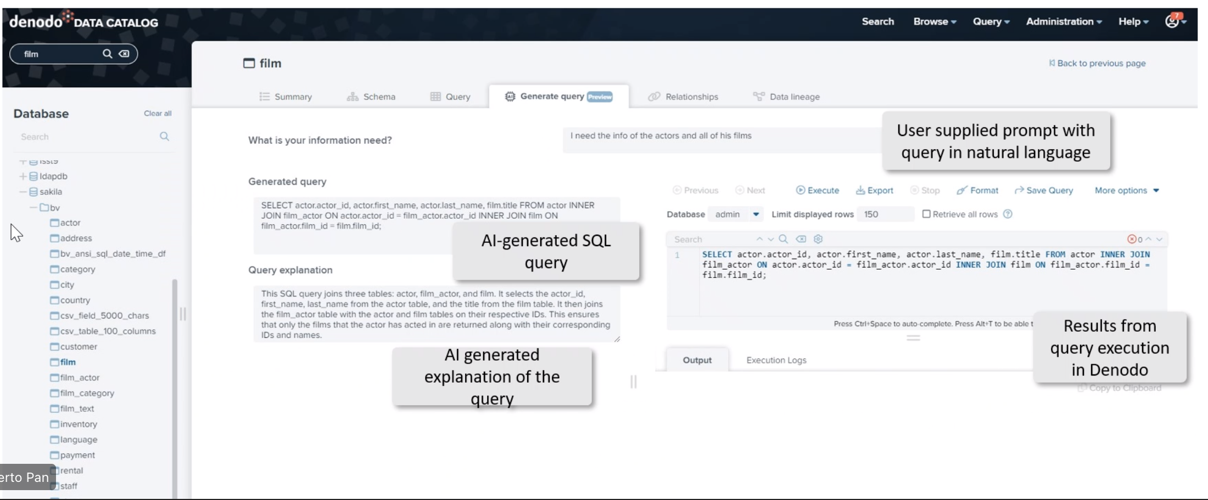


Generative AI In Data Virtualisation
– Product Example: Denodo NLP Queries And LLMs
Source: Denodo

Slide 46
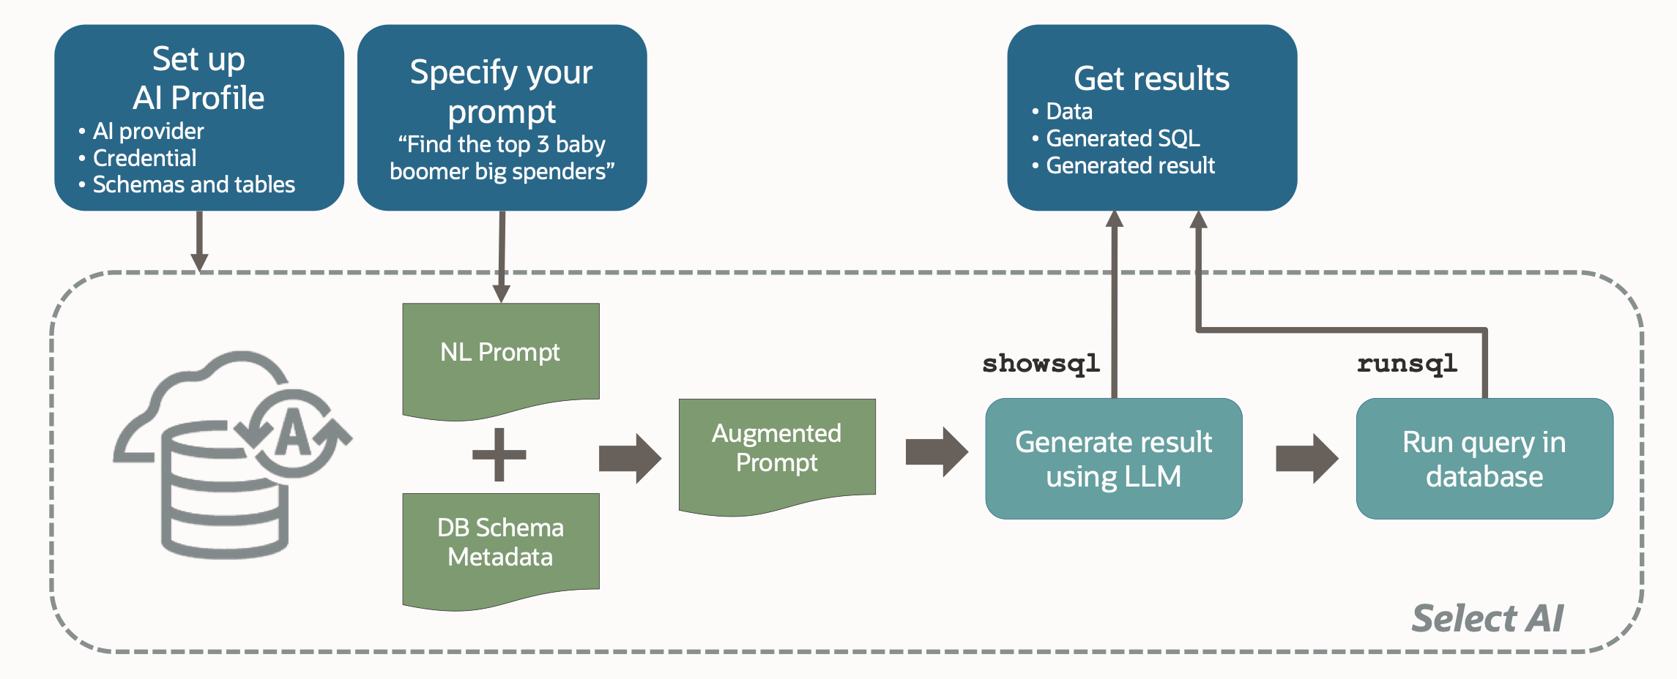
Generative AI In The Database
– SQL Generation Using LLMs In Oracle Autonomous Database
Enabled using the new DBMS_CLOUD_AI PL/SQL package
DBMS
New AI keyword
SELECT AI
What are our top 10 streamed movies that were released after 2018
Automated SQL query generation pipeline
Actions
runsql - return the SQL result set (default)
showsql – return the generated query
narrate – return a conversational result
chat - general AI chat
Image source and copyright © Oracle
Use generative AI models in combination with your database data
You can also combine relational and vector data in the same query

Slide 47
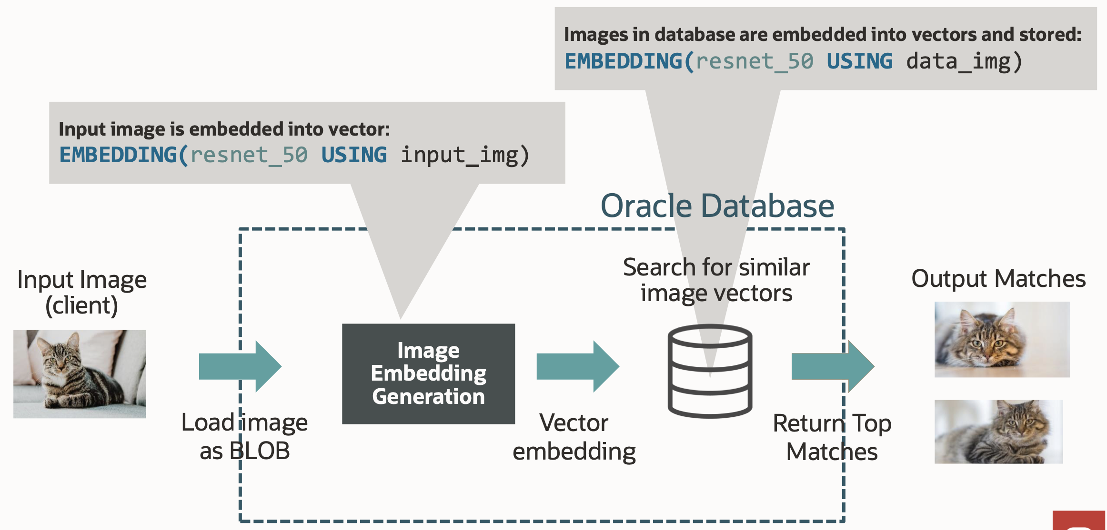
Generative AI In The Database – Oracle AI Vector Search
Native support for generating vectors – New SQL EMBEDDINGS Function
DBMS
Image source and Copyright © Oracle
You can also import Open Neural Network Exchange (ONNX) embeddings models into the DBMS from object storage

Slide 48
Generative AI In The Database
– Oracle Has Added A New VECTOR Datatype To Store Vectors Directly In The DBMS
New VECTOR datatype (with underlying BLOB storage for long-term extensibility)
  VECTOR (<optional # of dimensions>, <optional format for dimension values>)
Oracle 23c clients for Javascript and Python support VECTOR type, and so can insert Vectors directly
Vector DML Operations
  Insert ……. TO_VECTOR() converts a string representing an array of vector dimensions into VECTOR:
Several new vector functions are supported including Vector_Distance, Vector_Avg, Vector_Norm
  E.g., Get the Top-5 Nearest Vectors to a given query
DBMS
CREATE TABLE My_Images (id number, image BLOB, img_vec VECTOR(768, FLOAT32))
CREATE TABLE vec_tab(id number, dataVec VECTOR(3, ‘FLOAT32’))
INSERT into vec_tab values (1, TO_VECTOR(‘[1.1, 2.2, 3.3]’)
SELECT id from tab order by VECTOR_DISTANCE(data_vec, :queryVec) fetch first 5 rows only;

Slide 49



Generative AI In The Database – Google Duet AI In BigQuery AND
BigQuery ML Which Has Been Extended To Use LLMs In SQL Queries
DBMS
Duet AI in Big Query enables you to:
Generate a SQL query
Complete a SQL query
Explain a SQL query
BI tools
Data Science
Remote model
Uses
Vertex AI
Classification
Sentiment Analysis
Entity extraction
Extractive Question Answering
Summarization
Re-writing text in a different style
Ad copy generation
Concept ideation
prompt
Google Big Query
(with BigQuery ML)
text-bison LLM
Run on TPUs
CREATE MODEL project_id.mydataset.mymodel
REMOTE WITH CONNECTION `myproject.us.test_connection`
OPTIONS(REMOTE_SERVICE_TYPE="CLOUD_AI_LARGE_LANGUAGE_MODEL_V1")
SELECT * FROM ML.GENERATE_TEXT( MODEL mydataset.llm_model TABLE mydataset.prompt_table,
STRUCT( 0.2 AS temperature, 75 AS max_output_tokens, 0.3 AS top_p, 15 AS top_k, TRUE AS flatten_json_output));
Provides prompt data from a table column that's named prompt
Returns a shorter generated text response
Returns a more probable generated text response
Flattens the JSON response into separate columns

Slide 50
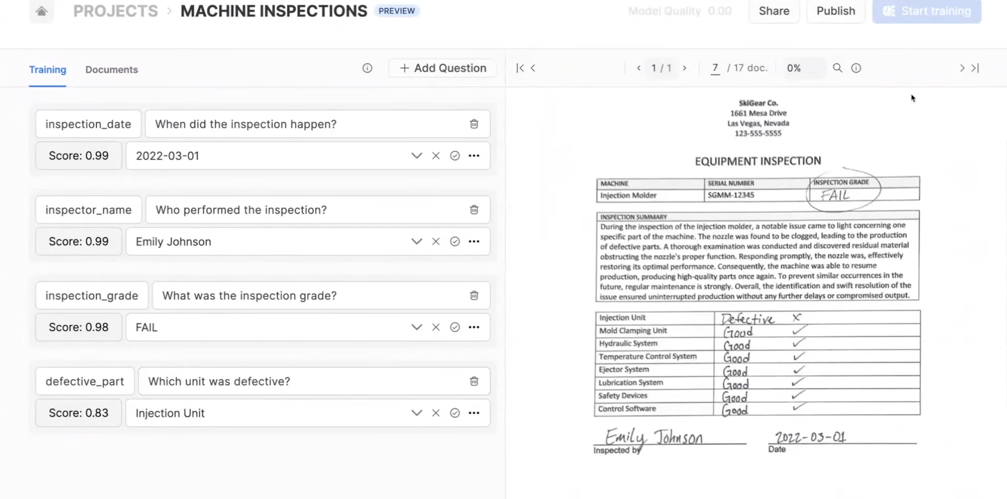
Generative AI In The Database – Use Natural Language Queries On Unstructured Documents Via Snowflake Document AI
DBMS
Source: Snowflake

Slide 51
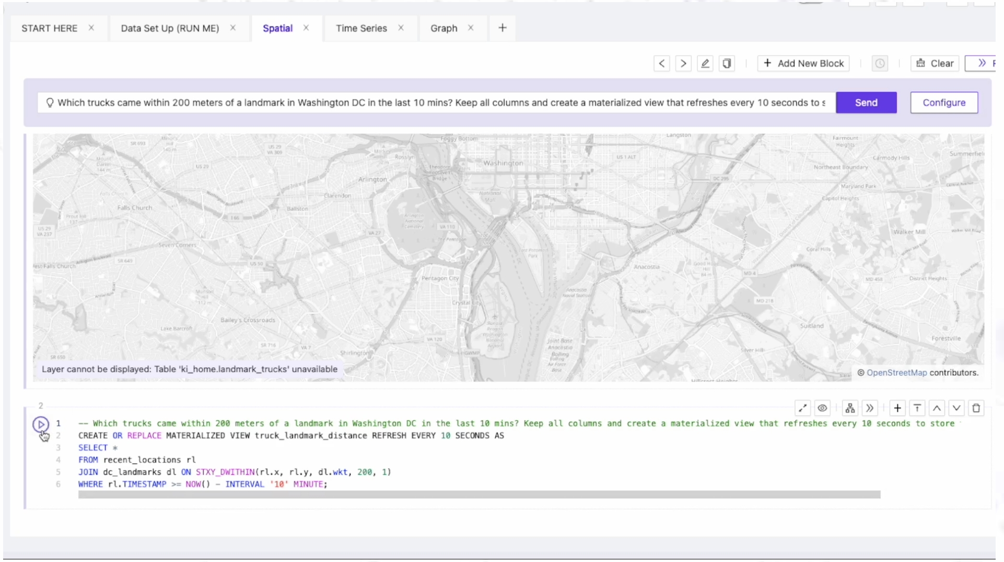
Generative AI In The DBMS – Natural Language Queries In Kinetica DBMS Become AI-Generated Geospatial SQL Queries
DBMS
Note that LLMs can run in Kinetica because this is a MPP SQL DBMS running on GPUs
Source: Kinetica

Slide 52
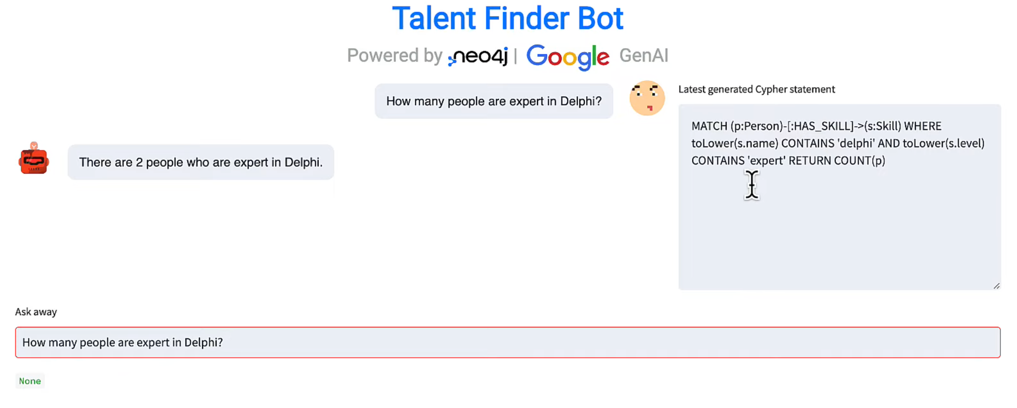
Generative AI And Graph Databases – Natural Language Queries And Natural Language Responses In Neo4j - Generates Cypher Queries From Text
DBMS
3
1
2
query
results
prompt
Generated cypher query
4
prompt with results
Graph DBMS
LLM
Generated natural language answer
5

Slide 53
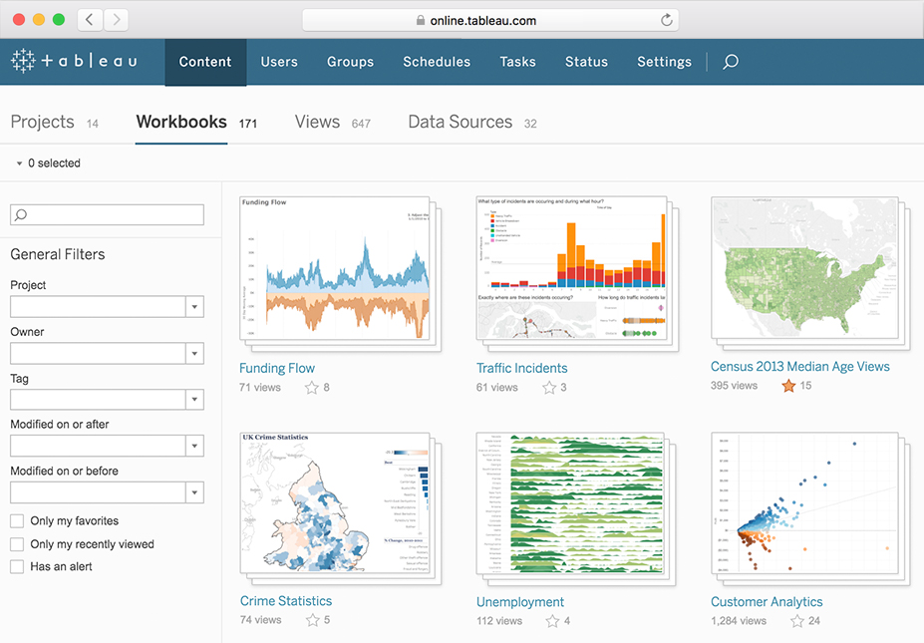
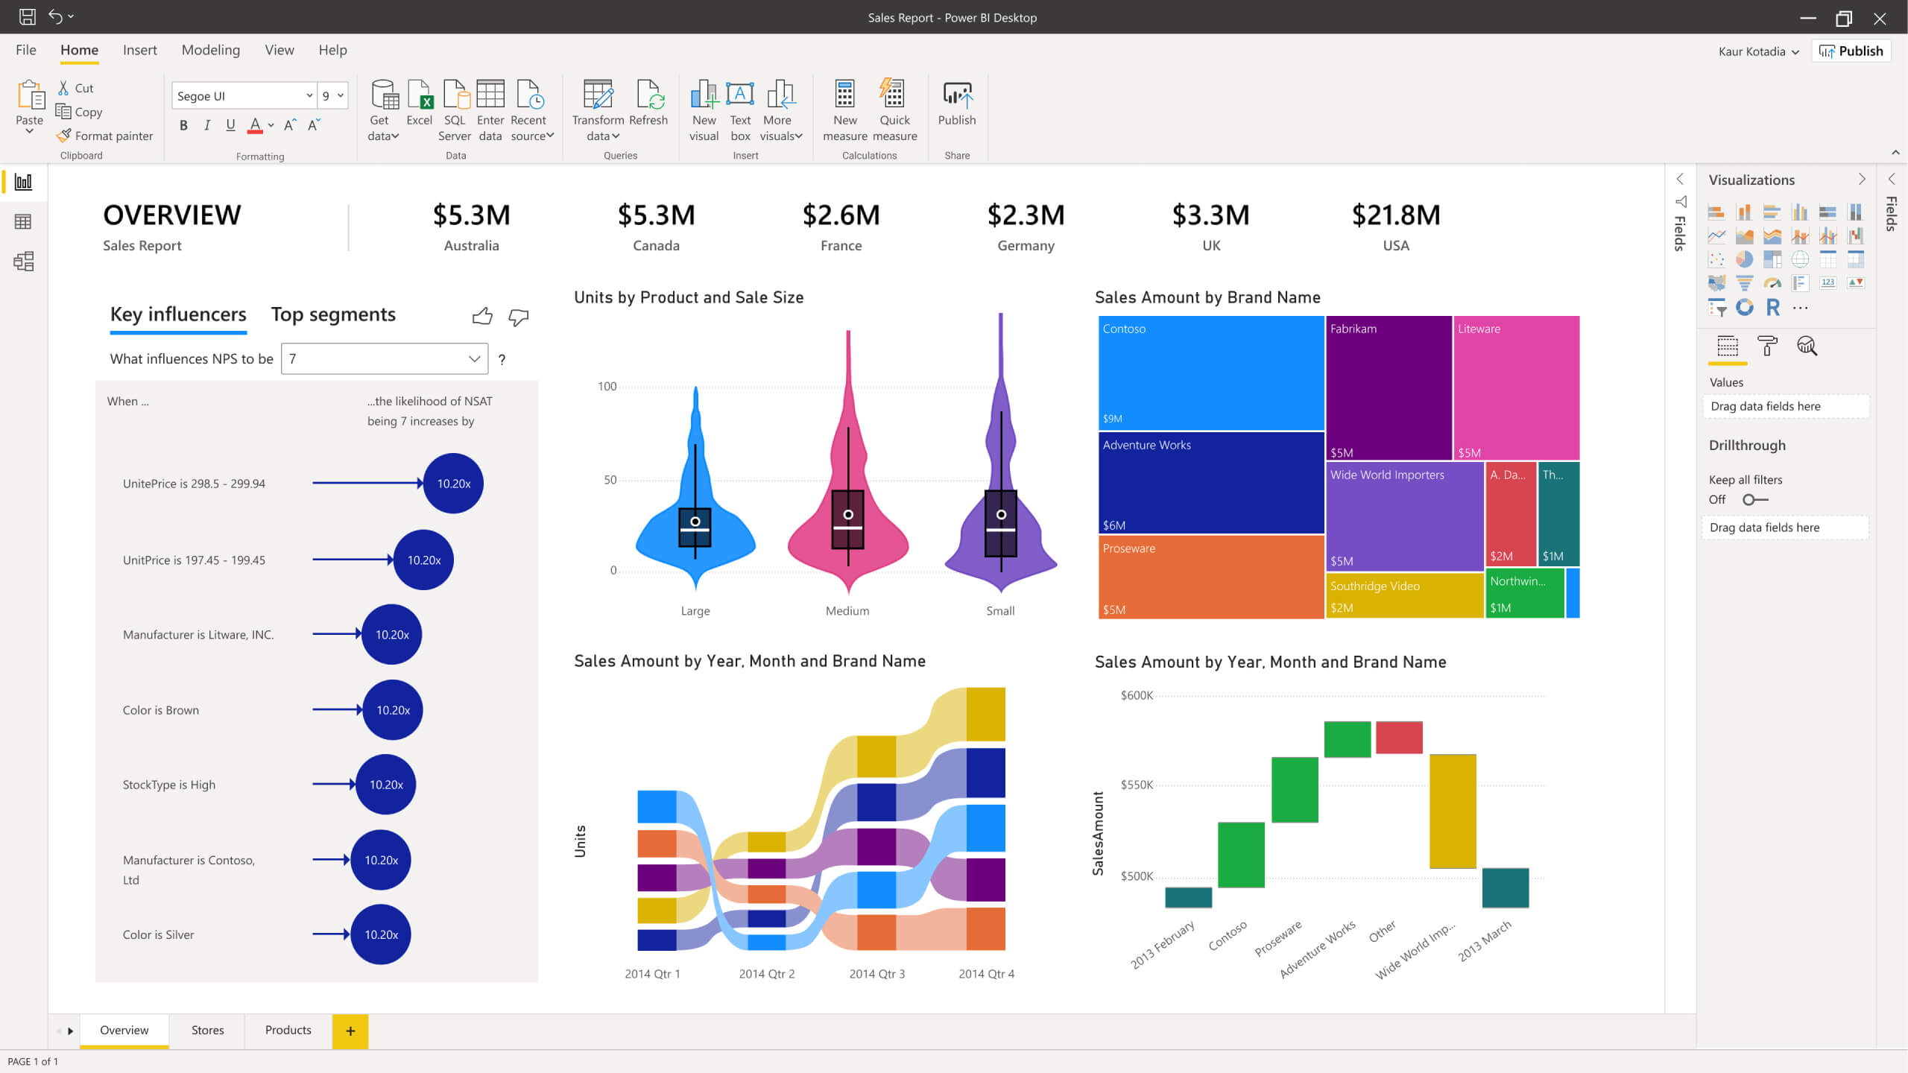


Generative AI In DW Migration – Automated SQL Translation To Your New DBMS
x
y
Operational application
Analytic application
Helps migrate many reports and identifies the ones that could be more challenging to migrate
Database
Migration
REST APIs
Excel
BI tools
Data Science
ERROR EXPLAIN SELECT…
SQL
DBMS B
DBMS A
Existing Data Warehouse
Cloud DW
EXPLAIN SELECT…
EXPLAIN SELECT…
EXPLAIN SELECT…
EXPLAIN INSERT….
SQL log
mart
mart
mart
mart
CREATE…
SELECT…
SELECT…
GRANT….
INSERT….
script
Cloud storage
Generated prompts
Translated SQL
LLM

Slide 54
Generative AI In Data Governance
Provide a generative AI-Assistant to data stewards
Data Governance
Data Governance Discipline | Auto AI-Generation Of
Data Quality | Data quality validation check rules
 | Data quality cleansing rules and code
 | Synthetic data to replace missing values in data to improve data completeness
Master Data Management | Data matching rules
 | Data survivorship rules
 | Master data descriptions
 | Product information e.g., digital assets - catalogs, product brief, marketing content
Data privacy | Data privacy policies
 | Synthetic data that excludes PII data to avoid risks
Data access security | Data access security policies
 | Data loss prevention policies
Data sharing | Data sharing policies
Data retention | Data retention policies

Slide 55
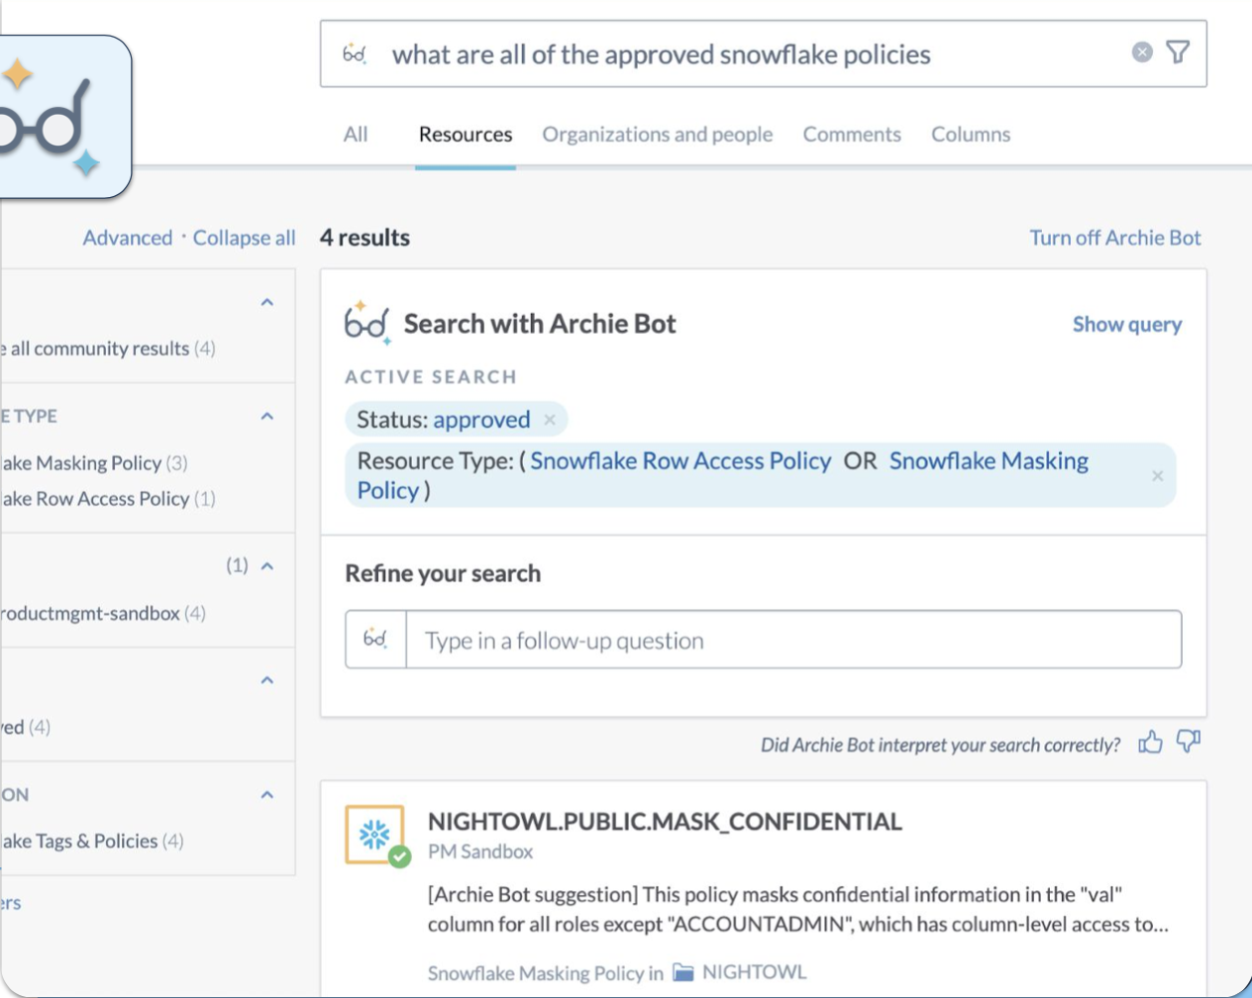


Generative AI In Data Governance – Prompt Based Discovery Of Policies In Source Systems Scanned By The Catalog In Data.world
Data Governance
Source: Data.world

Slide 56
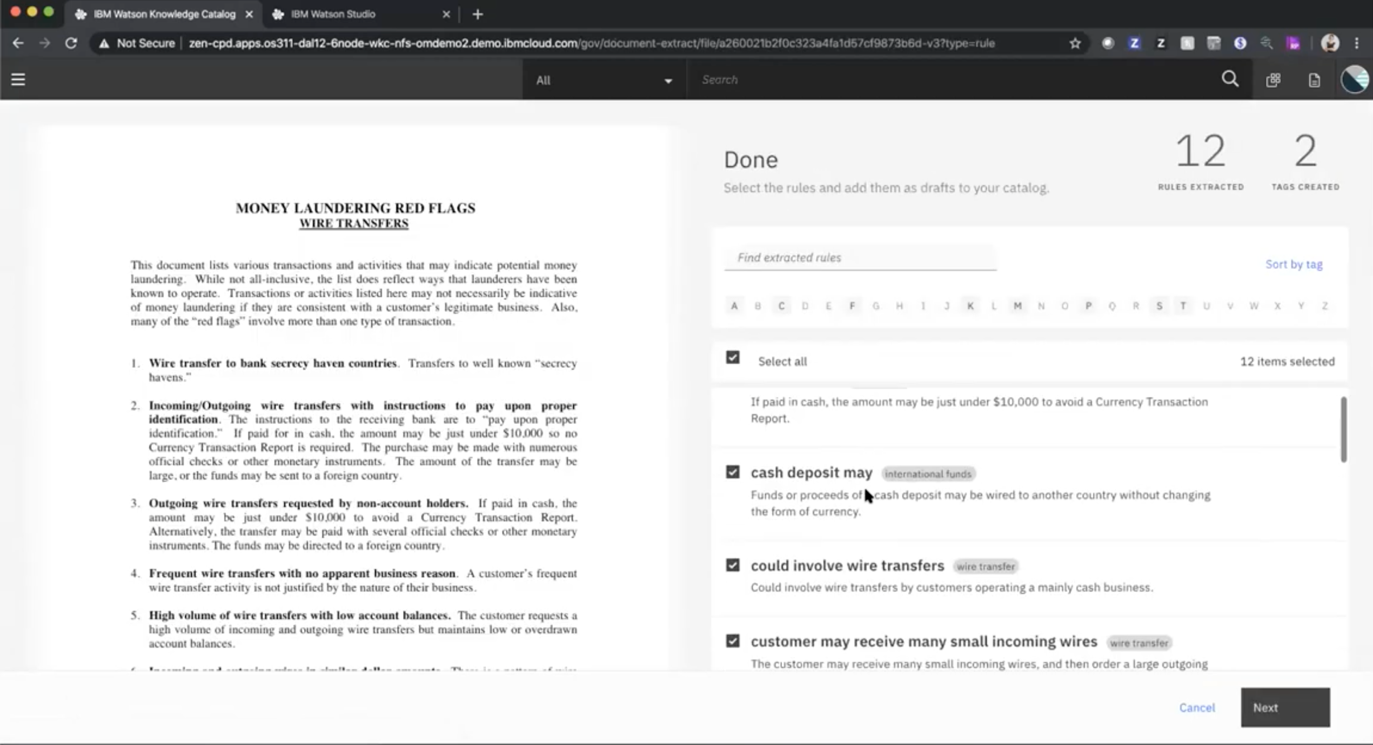
Generative AI In Data Governance – It Is Also Possible To Automatically Extract And Generate Data Governance Rules From Documents, E.g., IBM Watson Knowledge Catalog
Data Governance

Slide 57
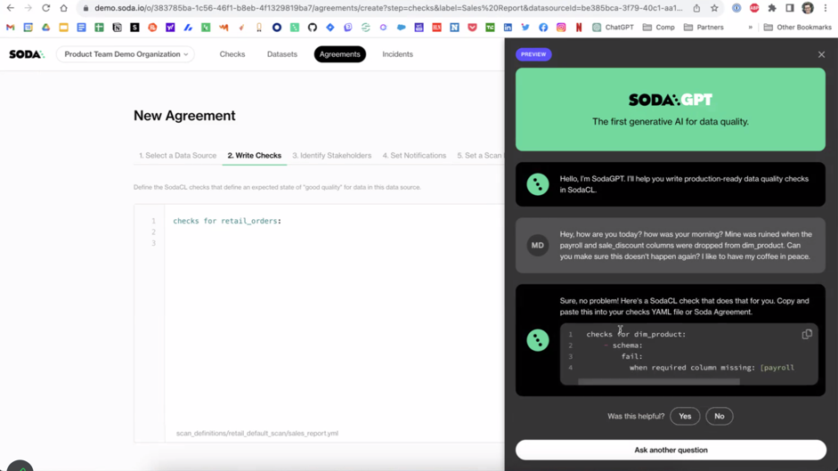

Generative AI In Data Governance – SodaGPT Lets Business Analysts Create Data Quality Checks In Natural Language That Can Be Shared With Data Engineers To Fix Data
Data Governance
SodaCL is a low code abstract language built on SQL and Spark
This automatically generates SODA Check Language (SodaCL) from prompts to check for data quality problems

Slide 58


Generative AI In Master Data Management (MDM)
– Product Example: ViaMedici Product MDM & PIM AI-Powered Text Generation
R
C
asset
prod
cust
U
D
MDM
ViaMedici infuses prompts with master data and passes them to an LLM to generate briefing text, a marketing poem and marketing tweets for a product

Slide 59
Generative AI In Data Marketplaces
Data Marketplace
What data exists about….?
Business user
(natural language query)
Voice UI
What data exists about….?
LLM
metadata infused prompts
response
Data Marketplace
LLM indexed with data catalog metadata and vector embeddings
Data
Catalog

Slide 60
Topics – Where Are We?
What is generative AI?
What are the business benefits of generative AI in data management and analytics?
How is generative AI being used in data management?
How is generative AI being used in data science and BI
What does this mean for business going forward?
What should you do to get started?

Slide 61
Generative AI And Business Intelligence And Data Science
Gen-AI in business intelligence
  AI recommended questions from auto-analysis of your data to quick start query & analysis on your data
  AI-generated queries from voice
  AI-generated queries from natural language text questions
  AI generated answers
  Auto-predict and generate charts from your data
  Natural language generation to explain insights
  Metadata enrichment, e.g., generate synonyms for data
Gen-AI in data science
  AI-generated code
  Prompt based querying of data
  Foundation models and model tuning
  Building generative AI applications
BI tool
Generative AI
BI tool
Data science workbench
Customised LLMs

Slide 62


Generative AI In Business Intelligence – Natural Language Questions
– E.g., ThoughtSpot Sage Auto Analyses The Data First And Recommends Questions
Recommended questions
Source: ThoughtSpot
ThoughtSpot will make use of multiple LLMs

Slide 63

Generative AI In BI Tools - ThoughtSpot Sage Lets You Provide Feedback To Enable The AI Engine To Improve Question Recommendations It Creates
You can say you are not interested in a question so that it learns to get better at generating questions you are interested in
Source: ThoughtSpot

Slide 64

Generative AI In Business Intelligence – ThoughtSpot Sage Generates Search Queries From Natural Language Text Questions While Dealing With Ambiguity
Natural language text question
“what are the best performing products”
“best performing” is ambiguous so ThoughtSpot Sage generates intelligence for a number of options
Source: ThoughtSpot

Slide 65

Generative AI In Business Intelligence – GPT Generates Synonyms So ThoughtSpot Sage Search Engine Understands Synonyms For The Same Data
ThoughtSpot Sage queries the schema and then uses GPT to recommend synonyms to the terms in the schema
This allows users to query using synonyms and still get the same answer
Source: ThoughtSpot

Slide 66

Generative AI In Data Science – You Can Now Build Custom LLMs In Data Science Workbenches – E.g., Google Vertex AI Now Includes A Generative AI Studio
Source: Google

Slide 67

Generative AI In Data Science – IBM Watsonx.ai Data Science Workbench Allow You To Build, And Tune LLMs And Make Use Of A Prompt Lab To Work With LLMs
Source: IBM

Slide 68

Generative AI In Data Science
– Databricks LakehouseIQ Prompt Based Artificially Intelligent Query Generation
Lakehouse
Prompt
LakehouseIQ knows the company has two European sales regions and so automatically adds them to the query.
It has also learned from other queries, dashboards and notebooks that used this dataset and so automatically adds a filter to exclude internal usage
Source: Databricks

Slide 69


Generative AI In Data Science – Databricks English SDK
Generative AI’s expert knowledge about Spark is built into the English SDK
Data ingestion | spark_ai = SparkAI() auto_df = spark_ai.create_df("2022 UK national auto sales by brand")
Dataframes | spark_ai.activate() # Activate the df.ai methods auto_df.ai.plot("pie chart for UK sales market shares, show the top 5 brands and the sum of others")
 | auto_top_growth_df=auto_df.ai.transform("top brand with the highest growth") auto_top_growth_df.show()
Market Share of Top 5 Brands and Others
brand | uk_sales_2022 | sales_change_vs_2021
Toyota | 134726 | 327

Slide 70
Topics – Where Are We?
What is generative AI?
What are the business benefits of generative AI?
How is generative AI being used in data management?
What does this mean for business going forward?
What should you do to get started?

Slide 71
What Does Generative AI In Data And Analytics Mean For Business?
Data Producers
Conversational data search in data catalogs
Automated metadata enrichment at scale
Automated physical schema generation
Prompt-based data engineering
Synthetic data generation
AI-assisted generation of data quality validation rules, master data matching rules and data governance policies
AI-assisted generation of digital product information
AI-assisted generation of product information in MDM (Digital web pages, brochures, marketing content)
Data Consumers
Conversational data search in data marketplaces
Automatic exploration of data, data pipelines and lineage
Natural language queries
AI-generated natural language answers
Auto generated virtual views on data
Generative AI in data and analytics:
  Lowers the skills bar and broadens inclusion
  Accelerates development
  Explains business insights and the business impact
  Shortens the time to value
  Shortens the time to act
Everyone will get a self-learning AI-Assistant!

Slide 72
Topics – Where Are We?
What is generative AI?
What are the business benefits of generative AI?
How is generative AI being used in data management?
What does this mean for business going forward?
What should you do to get started?

Slide 73
Conclusion - Getting Started
Generative AI is rapidly finding its way into many different data management, data governance, BI and data science tools with more to come
Fine tune foundation LLMs to understand your data and your metadata
Exploit generative AI in data management to:
  Improve data catalogs through conversational data search and automated data curation
  Accelerate and start automating data governance tasks
  Increase the number of citizen data engineers
  Accelerate data engineering to produce data products more rapidly
  Accelerate the build of master data
  Auto generate product information and marketing content from product master data

Slide 74





About Mike Ferguson
www.intelligentbusiness.biz
mferguson@intelligentbusiness.biz
@mikeferguson1
(+44) 1625 520700
Mike Ferguson is Managing Director of Intelligent Business Strategies Limited. As an independent IT industry analyst and consultant, he specialises in BI / analytics and data management. With over 40 years of IT experience, Mike has consulted for dozens of companies on BI/Analytics, data strategy, technology selection, enterprise architecture, and data management. Mike is also conference chairman of Big Data LDN, the largest data and analytics conference in Europe and a member of the EDM Council CDMC Executive Advisory Board. He has spoken at events all over the world and written numerous articles. Formerly he was a principal and co-founder of Codd and Date – the inventors of the Relational Model (which caused the birth of relational databases and the SQL language), and Chief Architect at Teradata on the Teradata DBMS He teaches popular master classes in Data Strategy, Data Warehouse Modernisation, Practical Guidelines for Implementing a Data Mesh, Big Data, How to Govern Data across a Distributed Data Landscape, Machine Learning and Advanced Analytics, and Embedded Analytics, Intelligent Apps and AI Automation
Thank You!

