Slide 1


DATA GOVERNANCE
A KEYSTONE FOR
COMPLIANT AI AND DIGITAL TRUST
March 27th, 2024
Jan Henderyckx
Partner
Powered by DALL·E 3

Slide 2
Your Presenter
Regional leader FBLA Data & Analytics and AI
CoE leader for Data Governance
Practice leader Belgium
Data Governance and Data Strategy
AI
Data Architecture And Strategy
Data Quality
Business Intelligence and Analytics
Master- And Reference Data Management
Seminars and workshops
IRMUK, SAI, Adept Events, IT Works
Involvement in non-profit initiatives
Past International Board member DAMA
President of DAMA Belux Chapter
JAN HENDERYCKX, Partner, BearingPoint
JanHenderyckx
JANHENDERYCKX

Slide 3



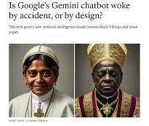
“CHALLENGING SYSTEMATIC PREJUDICES:
AN INVESTIGATION INTO GENDER BIAS IN LARGE LANGUAGE MODELS”.
The Sentinel
Powered by DALL·E 3

Slide 4
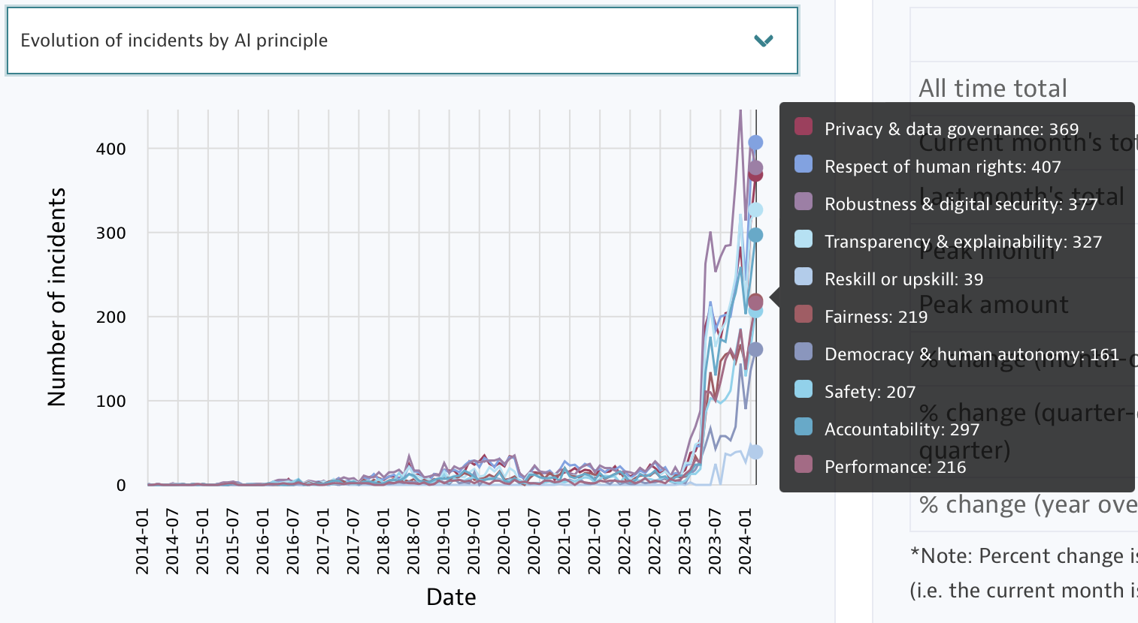

Are we experiencing a
“monkey with a hand grenade” moment?
Powered by DALL·E 3

Slide 5
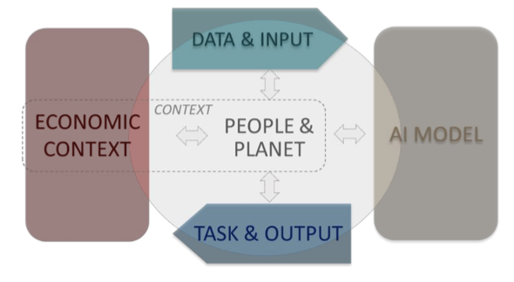
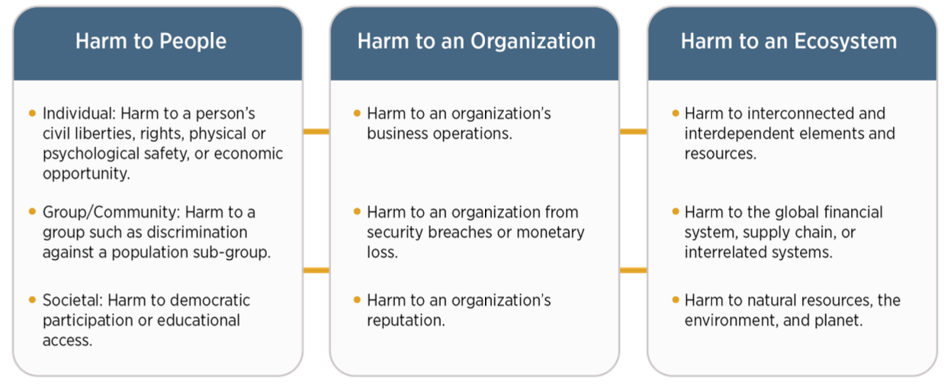
What could go wrong with the application of (GEN)AI?
© OECD 2022
Key high-level dimensions of the OECD Framework for the Classification of AI Systems
NIST AI 100-1

Slide 6

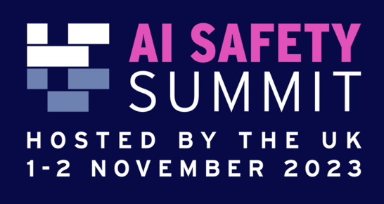
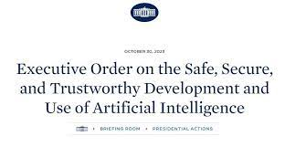
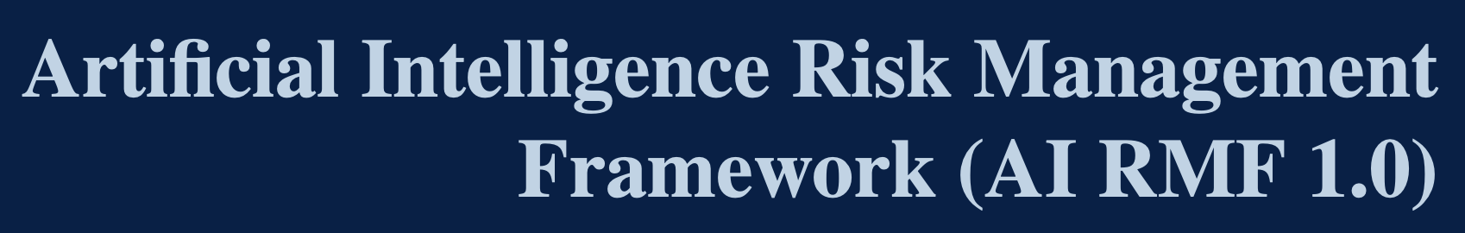
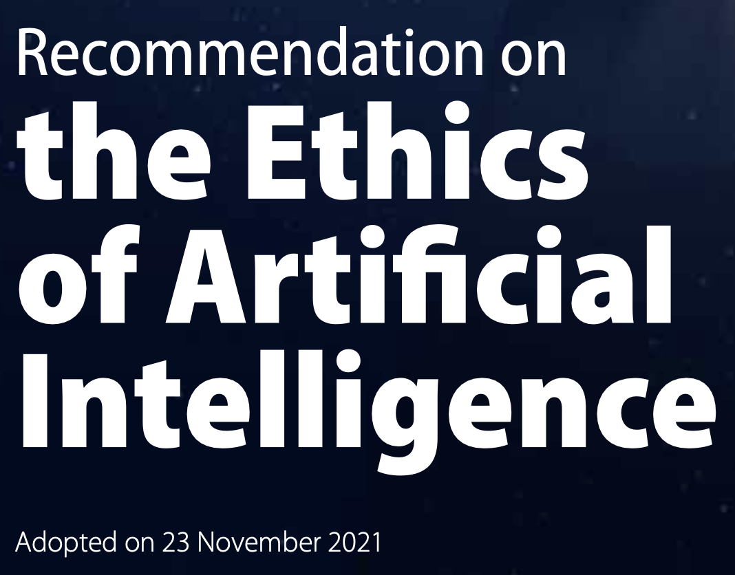

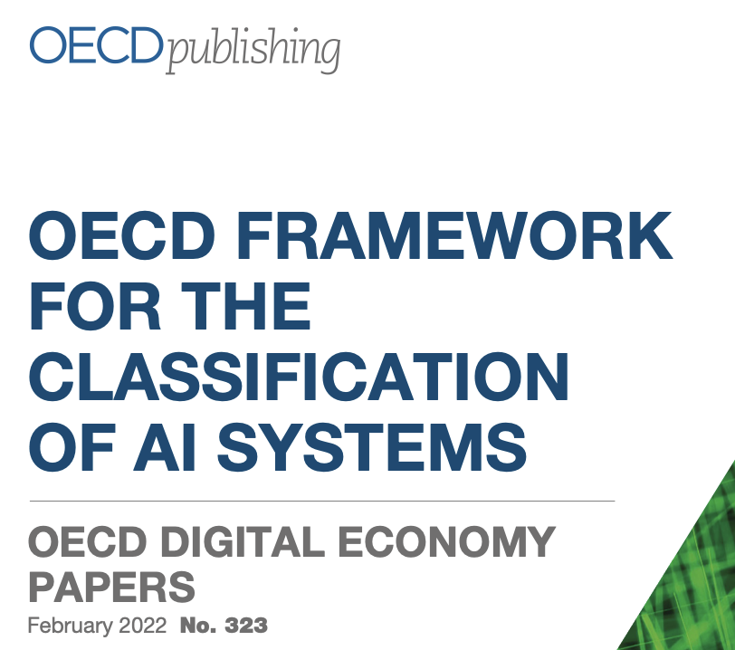


The evolving landscape of regulations and standards shaping ethical data use.
REGULATIONS
FRAMEWORKS
BEST PRACTICES
A/78/L.49
Notes:
UK: NO direct AI regulation
General AI Framework for HMG (18th of January 2024)
Regulation by sector, the UK relies on existing regulators.
Establishment of the UK AI Safety Institute

Slide 7

Establishing the US approach to AI development and use
Principles:
  Safety, security, and trustworthiness in AI development and use
  Economic growth, national security, and global competitiveness
Key actions
  Promoting research and development in AI
  Enhancing access to data and computing resources for AI development
  Fostering public trust in AI and ensuring ethical and legal use
  Establishing guidelines for AI use in collaboration with stakeholders
  Encouraging international cooperation in AI development
Powered by DALL·E 3
Notes:
USA:
Various federal laws, bills, executive orders and frameworks on AI have been passed or proposed on a range of matters (from strategic or administrative initiatives to regulation of specific AI issues or applications such as deepfakes and foundation models). A key landmark development was Executive Order 14110 (Nov 2023) which established a comprehensive suite of regulatory, economic and strategic initiatives in AI
Some US states have direct AI regulation, with the top 3 states (in terms of number of AI-related bills passed in 2016-2022) being Maryland, California and Massachusetts.
•AI Executive Order 14110: Presidential Executive Order on AI (30.10.2023) and 29th of January 2024 completed actions already announced.
•AI Foundation Model Transparency Act (12.2023)
•AI Safety Summit (11. 2023)
•Draft blueprint for an US AI Act (Blumenthal-Hawley proposal); Draft discussion bill “No fakes Act”
•Direct AI regulation in some U.S. states..... etc

Slide 8

EU AI ACT*
Overview
On March 13th 2024, the European Parliament has approved the AI Act.
WHAT’S THE DEFINITION OF AI?
a machine-based system designed to operate with varying levels of autonomy, that may exhibit adaptiveness after deployment and that, for explicit or implicit objectives, infers, from the input it receives, how to generate outputs such as predictions, content, recommendations, or decisions that can influence physical or virtual environments;
WHAT AI CLASSIFICATIONS ARE DEFINED?
Prohibited AI Systems:
  Certain AI practices deemed unacceptable will be banned. (social scoring, facial recognition etc..)
General Purpose AI Systems:
  AI system designed to perform general-purpose functions such as image and speech recognition, pattern recognition, translation, and others.
  Systemic Risk:
  a risk that is specific to the high-impact capabilities of general- purpose AI models, having a significant impact on the Union market due to their reach, or due to actual or reasonably foreseeable negative effects on public health, safety, public security, fundamental rights, or the society as a whole, that can be propagated at scale across the value chain
High-Risk AI Systems:
  AI systems intended to be used for biometrics, critical infrastructure, education, employment, access to essential services, law enforcement, migration/asylum/border control management, and administration of justice/democratic processes.
  Strict obligations and requirements for AI systems considered high-risk.
  Minimal-Risk AI Systems:
  All other AI systems
Powered by DALL·E 3
Powered by DALL·E 3
* This material is for general information purposes only and it does not contain a complete description, analysis or advice. Informations are based on the latest (March 2024) version of the AI Act.
Notes:
- **High-risk AI systems**:
- Covered under Article 6(2).
- Includes various areas such as biometrics, critical infrastructure, education, employment, access to essential services, law enforcement, migration/asylum/border control management, and administration of justice/democratic processes.
- **Biometrics**:
- Includes remote biometric identification systems.
- Excludes systems solely for biometric verification.
- Also covers AI systems for biometric categorization and emotion recognition.
- **Critical Infrastructure**:
- Involves AI systems for safety in managing critical digital infrastructure, road traffic, and supply of utilities like water, gas, heating, or electricity.
- **Education and Vocational Training**:
- Covers AI systems for access, admission, and evaluation in educational institutions.
- Also includes systems for assessing education levels and monitoring prohibited behavior during tests.
- **Employment and Workers Management**:
- Encompasses AI systems for recruitment, selection, and decision-making in work-related relationships.
- Also includes task allocation, performance evaluation, and behavior monitoring.
- **Access to Essential Services**:
- Includes AI systems used by public authorities to evaluate eligibility for essential public assistance benefits and services.
- Also covers creditworthiness assessment, risk assessment for insurance, emergency call classification, and dispatching services.
- **Law Enforcement**:
- Covers AI systems for assessing risk of becoming victims, polygraphs, evidence reliability evaluation, predicting offending behavior, and profiling in criminal investigations.
- **Migration, Asylum, and Border Control Management**:
- Includes AI systems for assessing risks related to entry into Member States, assisting in processing applications for asylum, visas, or residence permits, and detecting or identifying natural persons.
- **Administration of Justice and Democratic Processes**:
- Involves AI systems for assisting judicial authorities in researching, interpreting facts and law, and applying the law.
- Also covers AI systems influencing election outcomes or voting behavior, excluding administrative/political campaign optimization tools.

Slide 9
EU AI ACT*
What are you expected to do?
ASSURE AI LITERACY OF STAFF
Companies need to assure as sufficient level of AI literacy of their staff and other persons dealing with operations and use of AI systems.
RISK ASSESSMENT:
Companies must assess the risk level of their AI systems based on the intended use and potential harm to individuals or society.
High-risk AI systems will be subject to stricter requirements.
DATA QUALITY:
Companies must ensure that the data used to train and test their AI systems is relevant, representative, and free from errors or bias.
TRANSPARENCY:
Companies must provide clear and understandable information about their AI systems, including their purpose, functionality, and limitations.
HUMAN OVERSIGHT:
Companies must ensure that their AI systems are designed and used in a way that allows for effective human oversight, including the ability to intervene and override the system's decisions.
ROBUSTNESS AND ACCURACY:
Companies must ensure that their AI systems are robust, accurate, and secure, and that they perform consistently in different environments.
RECORD-KEEPING:
Companies must keep records of their AI systems' development, testing, and deployment, and make them available to regulatory authorities upon request
Powered by DALL·E 3
Powered by DALL·E 3
* This material is for general information purposes only and it does not contain a complete description, analysis or advice. Informations are based on the latest (March 2024) version of the AI Act.

Slide 10
EU AI ACT*
What are you expected to do?
PROVISIONS FOR HIGH-RISK AI-SYSTEMS
Specific technical documentation to consider.
Testing according to previously defined metrics, thresholds
Implementation of risk management systems
Consideration of persons under 18 years of age
Test, validation and training data must meet the quality criteria of the AI Act
Logs must be recorded and kept for several years
Can only be used with human inspection
Works council must be informed
Registration obligations also for deployers
Obligations in terms of transparency, quality management....etc.
Powered by DALL·E 3
Powered by DALL·E 3
* This material is for general information purposes only and it does not contain a complete description, analysis or advice. Informations are based on the latest (March 2024) version of the AI Act.

Slide 11
EU AI ACT*
Overview
What will be the penalties?
Penalties and fines: (based on worldwide annual turnover for the preceding financial year )
  Sanctions for violations of the regulations are higher than those for GDPR.
  7% of the turnover or 35M EUR whichever is higher for violation of prohibited activities
  3% of the turnover or 15M EUR whichever is higher for violation of other previsions
  3% for SME of turnover
When will it enter into force?
  It will enter into force 20 days after publication. (forecast June/July)
  Fully applicable 24 months after entry in force, with a graduated approach:
    6 months after entry into force, Member States shall phase out prohibited systems.
    12 months: obligations for general purpose AI governance become applicable.
    24 months: all rules of the AI Act become applicable including obligations for high-risk systems defined in Annex III.
    36 months: obligations for high-risk systems defined in Annex II (list of Union harmonization legislation) apply.
European AI Board:
    Establishment of a regulatory body to support the implementation of the AI Act.
Powered by DALL·E 3
Powered by DALL·E 3
* This material is for general information purposes only and it does not contain a complete description, analysis or advice. Informations are based on the latest (March 2024) version of the AI Act.

Slide 12
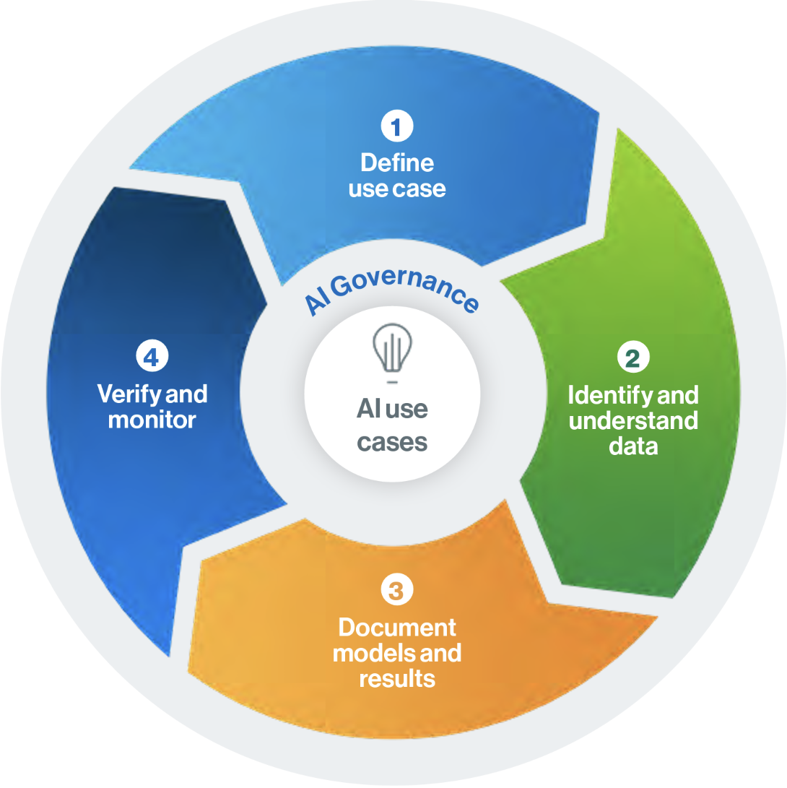
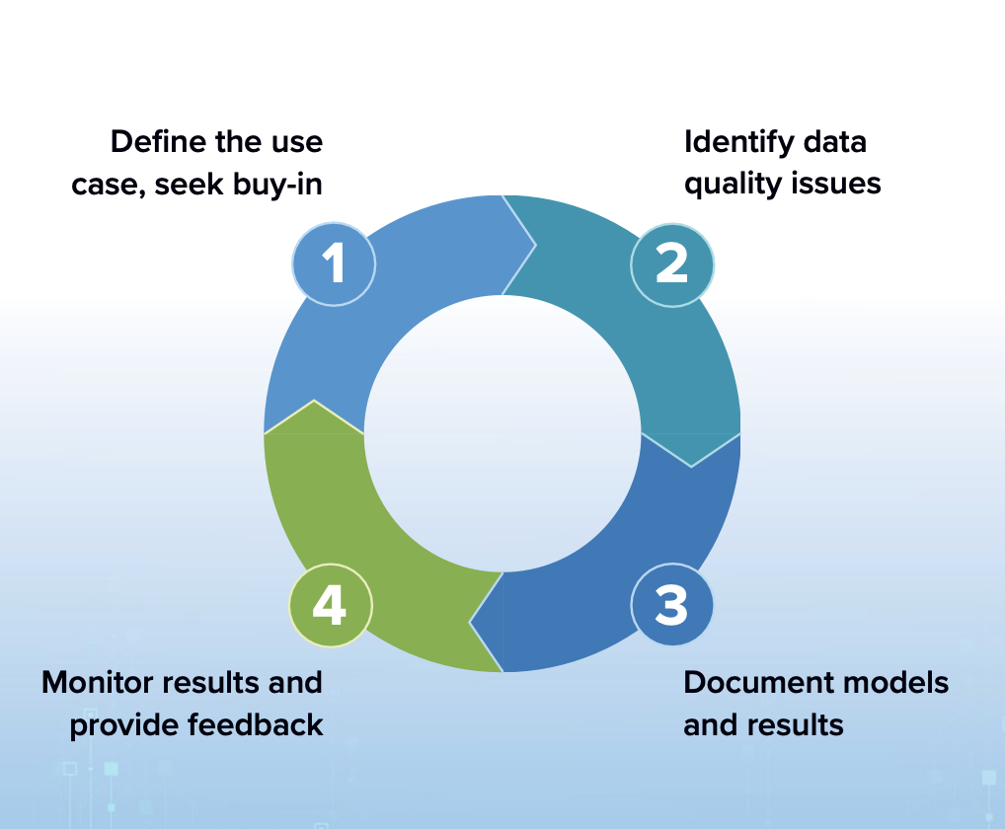
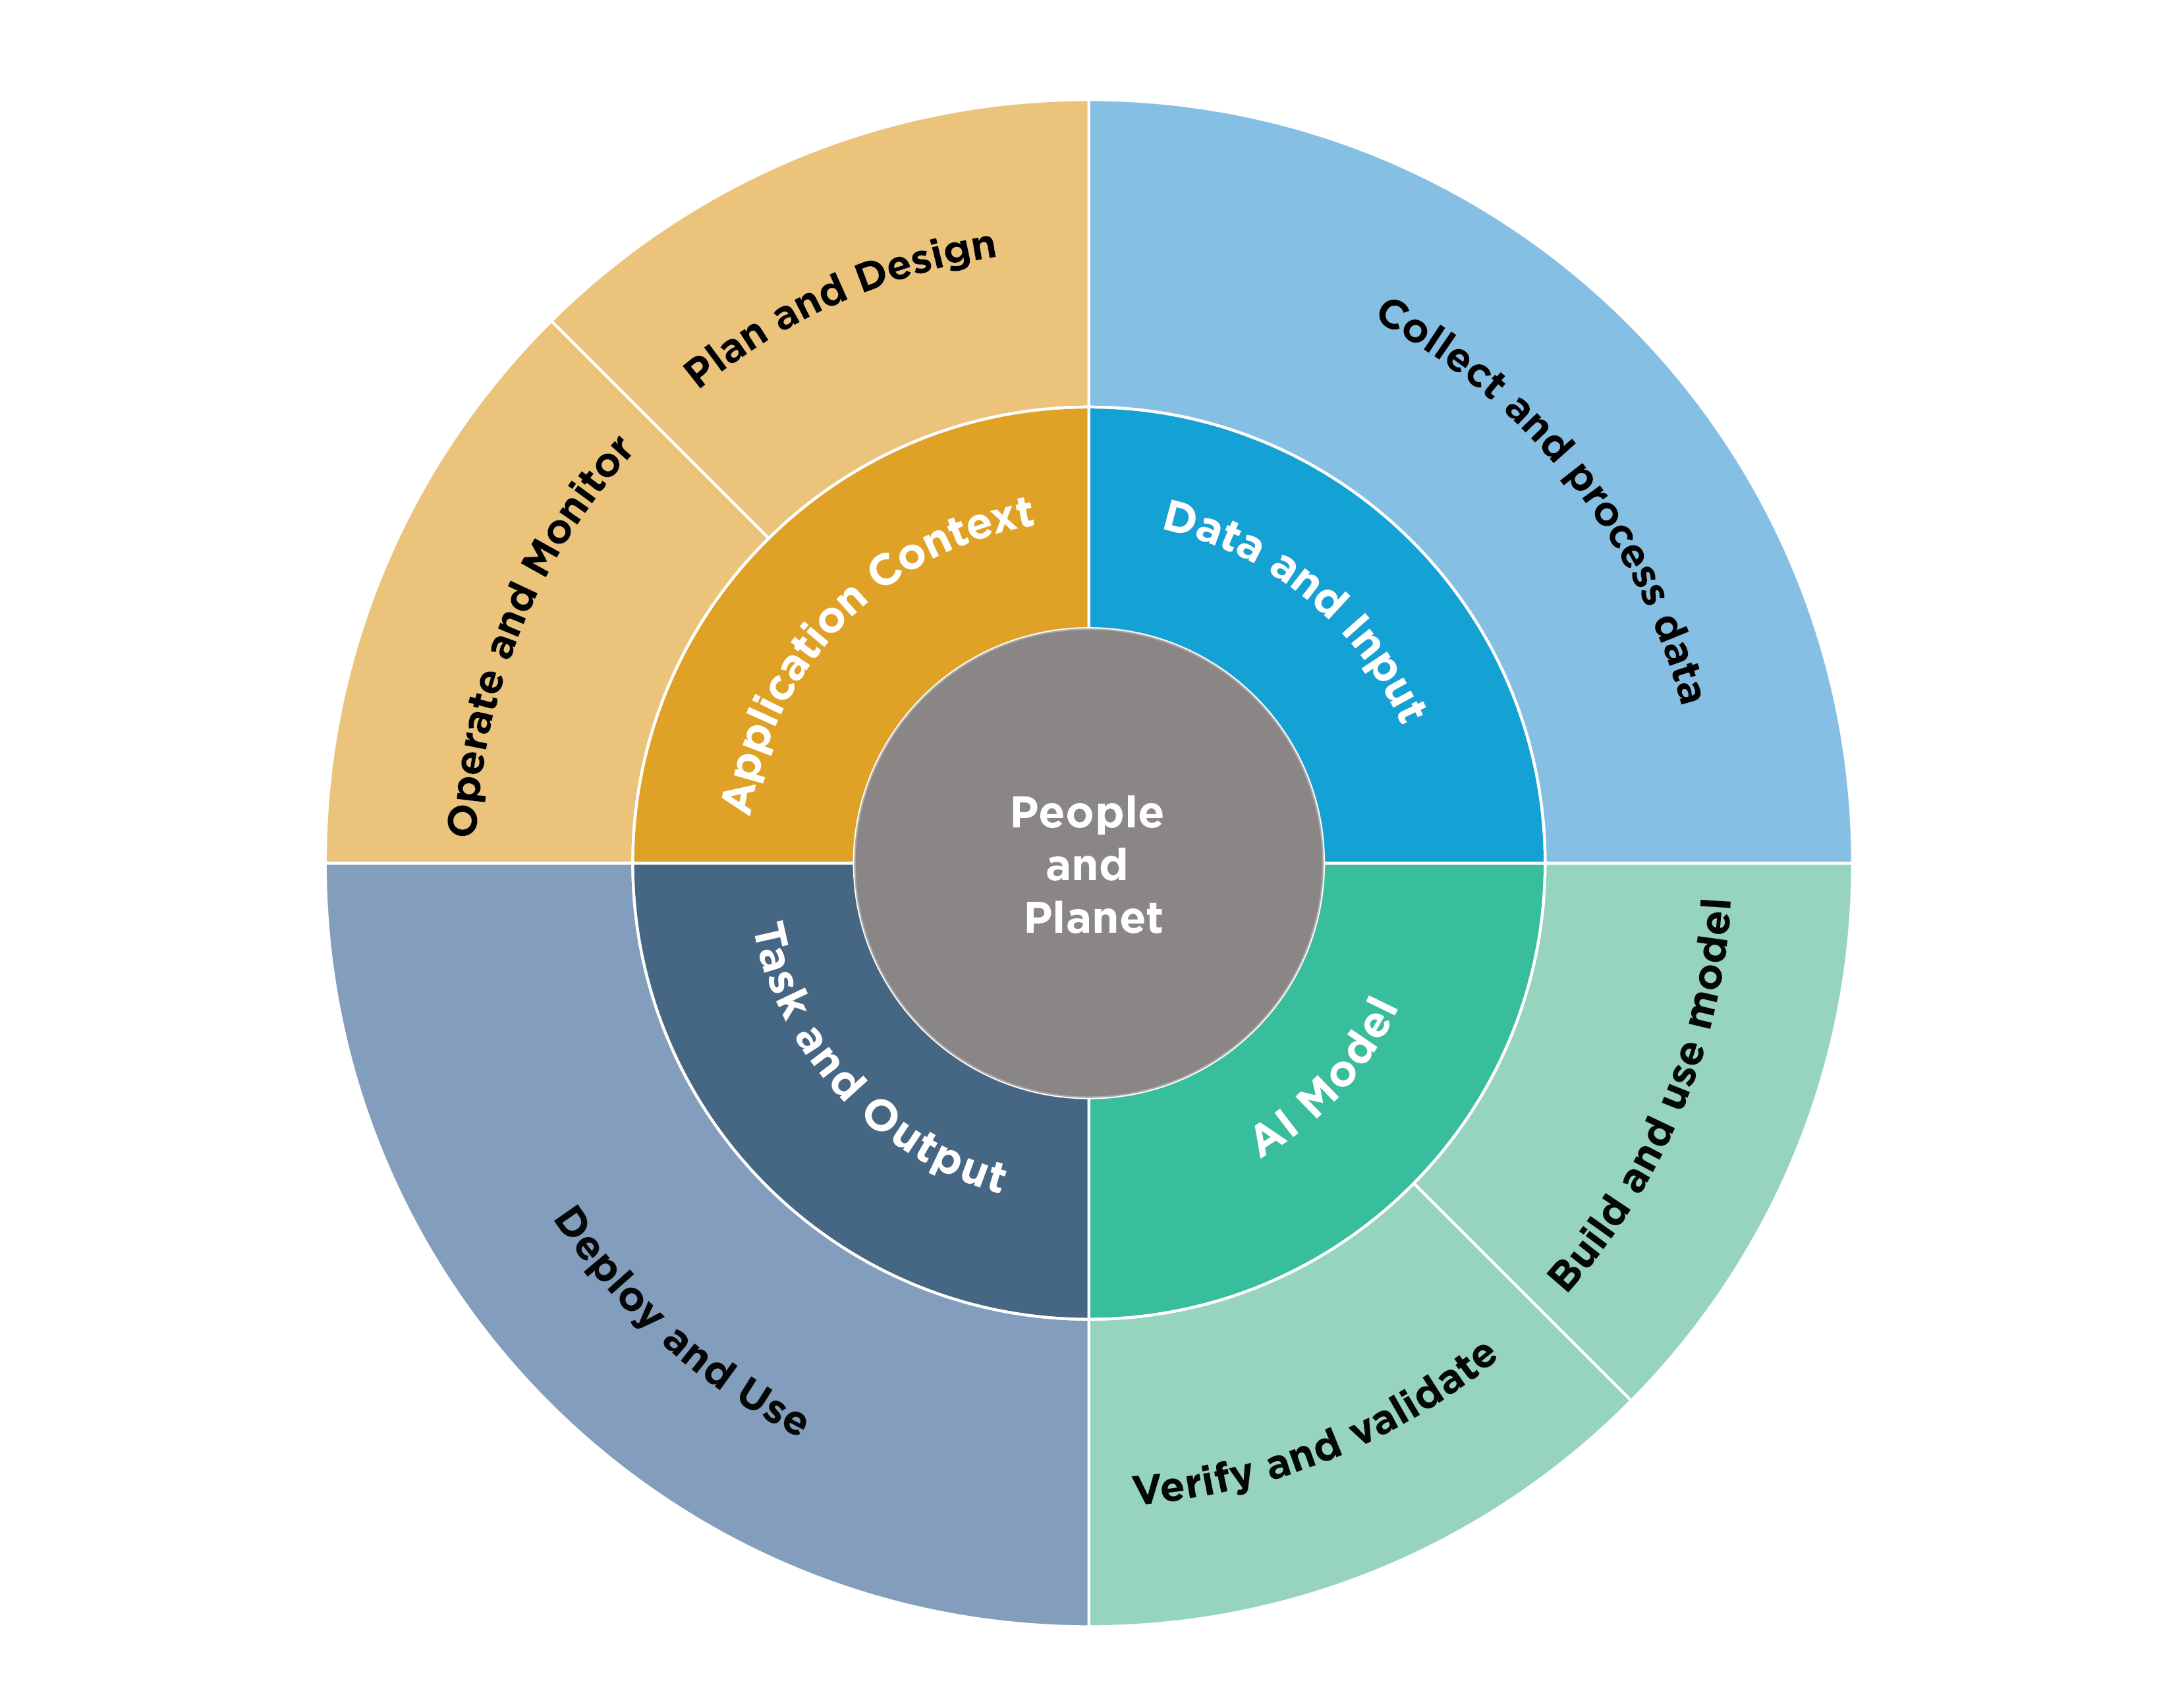
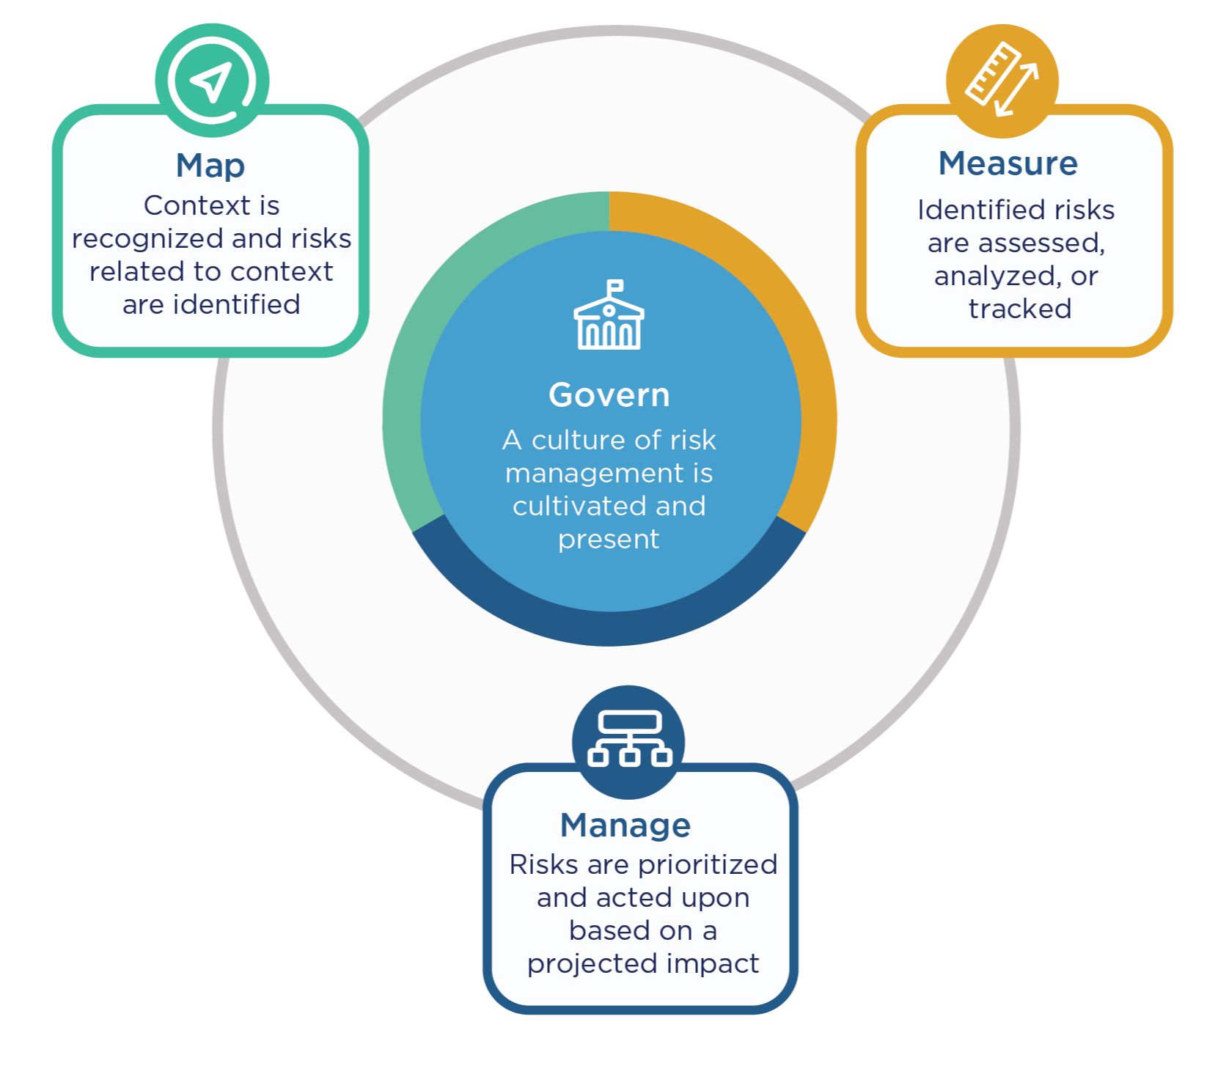
Managing the “monkey with a hand grenade” AI risks
Towards an AI Governance Framework
NIST AI 100-1
“Risk management refers to coordinated activities to direct and control an organization with regard to risk” (Source: iso 31000:2018).

Slide 13
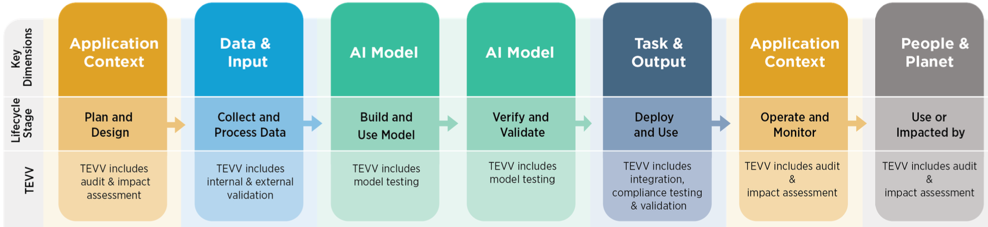
AI Lifecycle Activities
Handling the “monkey with a hand grenade” AI risks
Use Case Planning:
  What’s the purpose/objective of the use case? Are we allowed to do the processing? Are the use cases documented?
Use Case Design:
  Do we have the data to train the model? What about the ownership of the data? Are there any Data Privacy/IP rights constraints? Are there industry specific obligations?
Model Building:
  Are we using the most relevant model approach? Is the relevant data available in the right format?
  Will public- or GPAI model datasets, third-party components or open-source models be used? Do we have training -and testing methodology?
Model Validation:
  Is the model fair and transparent? Is the data quality of the source data sufficient?
Model Deployment:
  Can we do proper model governance? Is the model secure?
Model Operations:
  Is there model drift? Is there human oversight? Can a person exercise their rights?
  Is the full lifecycle documented?
Powered by DALL·E 3

Slide 14
Towards a mature AI Governance Framework
How does a typical Data Governance Framework link to a regulatory compliant AI Governance Framework?
2
3
4
AI
USE CASE
1
2
Plan
Implement
1
3
2
3
Specify
Create
& Acquire
Maintain
4
Use
Dispose
Business
Processes
6
4
6
Improve
Monitor
5
4
5
Data Lifecycle
Data Governance
Business Process
NIST AI 100-1
AI USE CASE

Slide 15
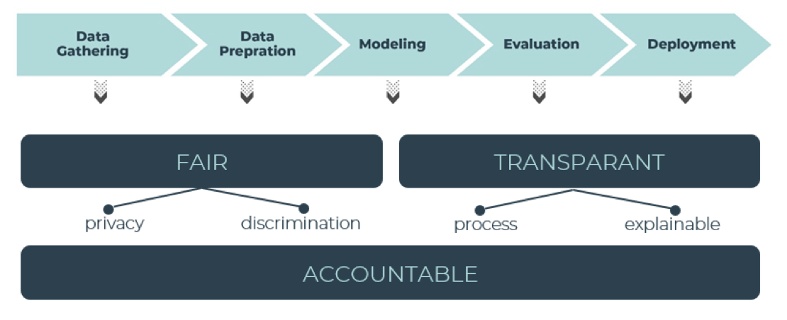
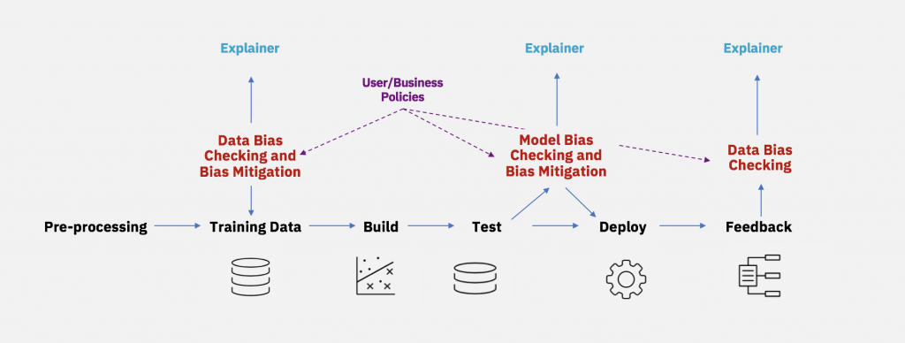
Towards a mature AI Governance Framework
Assure your AI is FAT Compliant:
Fair:
  Do you respect privacy, IP and copyright law
  and is there no Bias and Discrimination in the model?
Accountability:
  Implement appropriate and effective measures to ensure that principles are complied with
  Demonstrate compliance of the measures upon request
  Recognize potential negative consequences.
Transparency:
  Extends beyond explaining decisions and encompasses all stages of a data science project.
  Apply techniques such as CHAP or LIME.
  Not necessitate revealing every detail to end-users to protect company secrets and privacy. Feature importance analysis can support this.
FAT Flow: a Data Science Ethics Framework David Martens (UNIVERSITY OF ANTWERP)
IBM: AI Fairness 360

Slide 16

Towards a mature AI Governance Framework
Assure your AI is FAT Compliant:
It’s highly likely that your don’t have the adequate infrastructure to assure your model deployment is error proof
Reduce the risks by:
Putting a « red team » in place
Adapt the model size to match the purpose (LORA, QLORA, RAG)
Assuring there is sufficient AI literacy in the organisation
Powered by DALL·E 3

Slide 17
Towards a mature AI Governance Framework
Assure AI Literacy
AI Literacy Definition (EU AI Act):
skills, knowledge and understanding that allows providers, deployers and affected persons, taking into account their respective rights and obligations in the context of this Regulation, to make an informed deployment of AI systems, as well as to gain awareness about the opportunities and risks of AI and possible harm it can cause;
To effectively deploy a GPT (Generative Pre-trained Transformer)
1. Understanding of Natural Language Processing (NLP)
2. Python Programming
3. Knowledge of Deep Learning
4. Data Pre-processing
5. Model Selection and Fine-tuning
6. Evaluation Metrics
7. GPU and Cloud Computing
8. Ethical Considerations
9. Domain Expertise
Powered by DALL·E 3
Notes:
To effectively use a GPT (Generative Pre-trained Transformer) model, you need a combination of technical skills and domain expertise. Here are the key skills required:
1. Understanding of Natural Language Processing (NLP): Familiarity with the basics of NLP, including tokenization, text normalization, and language modeling, is essential. You should understand concepts like word embeddings, attention mechanisms, and transformer architectures.
2. Python Programming: Proficiency in Python is crucial, as most GPT models and related libraries are implemented in Python. You should be comfortable writing code, manipulating text data, and working with popular NLP libraries such as TensorFlow or PyTorch.
3. Knowledge of Deep Learning: GPT models are based on deep learning techniques. Understanding the fundamentals of deep learning, including neural networks, backpropagation, and optimization algorithms, is important. Additionally, familiarity with deep learning libraries like TensorFlow or PyTorch is beneficial.
4. Data Preprocessing: GPT models require properly preprocessed data for optimal performance. You should be skilled in handling data preprocessing tasks such as cleaning, tokenization, removing stop words, and dealing with special characters or punctuation.
5. Model Selection and Fine-tuning: You need to have a good understanding of different GPT architectures and their specific use cases. Depending on your requirements, you should be able to choose the appropriate GPT model and fine-tune it for specific tasks, such as text generation, question answering, or sentiment analysis.
6. Evaluation Metrics: Assessing the performance of a GPT model requires knowledge of evaluation metrics specific to the task at hand. For instance, for text generation tasks, metrics like perplexity or BLEU scores are commonly used. Understanding these metrics and how to interpret them is essential.
7. GPU and Cloud Computing: Training and running GPT models can be computationally intensive, especially for larger models. Familiarity with GPU programming and cloud computing platforms like Google Cloud Platform or Amazon Web Services (AWS) can be beneficial to efficiently utilize computational resources.
8. Ethical Considerations: GPT models have the potential to generate biased, inappropriate, or misleading content. Understanding the ethical implications of using such models and being aware of the responsible use of AI are important skills. It's crucial to address bias, handle sensitive information appropriately, and ensure that the generated content aligns with ethical guidelines.
9. Domain Expertise: Depending on the specific application of the GPT model, having domain expertise can significantly enhance your ability to use the model effectively. This knowledge helps you interpret the model's outputs, fine-tune it for specific tasks, and provide meaningful context to the generated results.
By acquiring these skills, you'll be well-equipped to utilize GPT models effectively for various NLP tasks.
Critical thinking, when applied to the use of GPT models, refers to the ability to analyze, evaluate, and question the outputs, limitations, and ethical implications of the model. Here's how critical thinking can be applied:
1. Evaluating Output: Critical thinking involves carefully examining the outputs generated by the GPT model. Rather than accepting the generated content blindly, you should assess its accuracy, coherence, relevance, and potential biases. You should question whether the generated text aligns with the desired outcome and whether it contains any inaccuracies or misleading information.
2. Identifying Limitations: GPT models have certain limitations that critical thinkers should be aware of. These models may struggle with context comprehension, lack common sense reasoning, and generate content that may be factually incorrect or biased. It's important to understand these limitations and critically assess the reliability and credibility of the model's outputs.
3. Considering Ethical Implications: Critical thinking involves considering the ethical implications of using GPT models. These models have the potential to generate biased, harmful, or inappropriate content. It's crucial to critically evaluate the ethical implications of the generated outputs, including issues related to fairness, privacy, bias, and the impact on individuals or communities. Being mindful of ethical guidelines and responsible AI practices is an essential aspect of critical thinking.
4. Challenging Assumptions: Critical thinking requires questioning assumptions and biases that may be present in the GPT model itself or in the training data. It involves being skeptical and seeking evidence to support or refute the claims made by the model. This mindset helps in uncovering potential flaws or limitations that might affect the reliability and generalizability of the model's outputs.
5. Seeking Alternative Perspectives: Critical thinkers actively seek alternative perspectives and diverse viewpoints. When using GPT models, it's important to consider different sources of information and verify the outputs generated by the model against external resources. By incorporating multiple viewpoints and sources of knowledge, critical thinkers can gain a more comprehensive understanding of the topic and avoid potential pitfalls or biases.
6. Continuous Learning and Improvement: Critical thinking involves a commitment to continuous learning and improvement. Stay updated with the latest advancements and research in the field of NLP and GPT models. Actively seek feedback, experiment with different approaches, and be open to refining your understanding and methods over time.
By applying critical thinking to the use of GPT models, you can make more informed decisions, avoid potential pitfalls, address biases, and ensure responsible and ethical usage of AI technologies.
Sure! Here are the key points about critical thinking when applied to the use of GPT models, presented in bullet point format:
- Evaluating output:
- Analyze accuracy, coherence, and relevance of generated content.
- Question potential biases and misleading information.
- Identifying limitations:
- Understand context comprehension and common sense reasoning limitations.
- Assess reliability and credibility of model's outputs.
- Considering ethical implications:
- Evaluate potential biases, harm, and inappropriate content.
- Address fairness, privacy, and impact on individuals or communities.
- Challenging assumptions:
- Question biases in the model and training data.
- Seek evidence to support or refute model claims.
- Seeking alternative perspectives:
- Incorporate diverse viewpoints and external resources.
- Verify model outputs against multiple sources of information.
- Continuous learning and improvement:
- Stay updated with NLP and GPT advancements.
- Seek feedback, experiment, and refine understanding over time.
By applying critical thinking, you can make informed decisions, address biases, and ensure responsible and ethical use of GPT models.

Slide 18
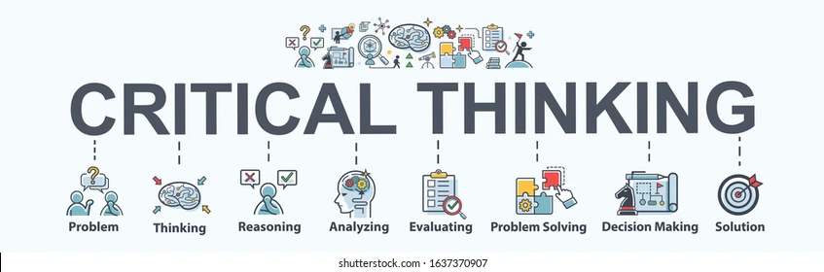
Towards a mature AI Governance Framework
Apply critical thinking
What are the Trust requirements for you data product?
  Is statistical relevance (inferred or trained) appropriate for the use of your data product?
We need to extend the notion of data literacy to include both the question and the answer side of the equation.
Plan for a broad data (science) and AI awareness session in your organisation in the long run and GPT solutions immediately.
Evaluate the output thoroughly.
Identify limitations clearly.
Consider ethical implications.
Challenge assumptions boldly.
Seek alternative perspectives actively.
Commit to continuous learning and improvement persistently.
Notes:
To effectively use a GPT (Generative Pre-trained Transformer) model, you need a combination of technical skills and domain expertise. Here are the key skills required:
1. Understanding of Natural Language Processing (NLP): Familiarity with the basics of NLP, including tokenization, text normalization, and language modeling, is essential. You should understand concepts like word embeddings, attention mechanisms, and transformer architectures.
2. Python Programming: Proficiency in Python is crucial, as most GPT models and related libraries are implemented in Python. You should be comfortable writing code, manipulating text data, and working with popular NLP libraries such as TensorFlow or PyTorch.
3. Knowledge of Deep Learning: GPT models are based on deep learning techniques. Understanding the fundamentals of deep learning, including neural networks, backpropagation, and optimization algorithms, is important. Additionally, familiarity with deep learning libraries like TensorFlow or PyTorch is beneficial.
4. Data Preprocessing: GPT models require properly preprocessed data for optimal performance. You should be skilled in handling data preprocessing tasks such as cleaning, tokenization, removing stop words, and dealing with special characters or punctuation.
5. Model Selection and Fine-tuning: You need to have a good understanding of different GPT architectures and their specific use cases. Depending on your requirements, you should be able to choose the appropriate GPT model and fine-tune it for specific tasks, such as text generation, question answering, or sentiment analysis.
6. Evaluation Metrics: Assessing the performance of a GPT model requires knowledge of evaluation metrics specific to the task at hand. For instance, for text generation tasks, metrics like perplexity or BLEU scores are commonly used. Understanding these metrics and how to interpret them is essential.
7. GPU and Cloud Computing: Training and running GPT models can be computationally intensive, especially for larger models. Familiarity with GPU programming and cloud computing platforms like Google Cloud Platform or Amazon Web Services (AWS) can be beneficial to efficiently utilize computational resources.
8. Ethical Considerations: GPT models have the potential to generate biased, inappropriate, or misleading content. Understanding the ethical implications of using such models and being aware of the responsible use of AI are important skills. It's crucial to address bias, handle sensitive information appropriately, and ensure that the generated content aligns with ethical guidelines.
9. Domain Expertise: Depending on the specific application of the GPT model, having domain expertise can significantly enhance your ability to use the model effectively. This knowledge helps you interpret the model's outputs, fine-tune it for specific tasks, and provide meaningful context to the generated results.
By acquiring these skills, you'll be well-equipped to utilize GPT models effectively for various NLP tasks.
Critical thinking, when applied to the use of GPT models, refers to the ability to analyze, evaluate, and question the outputs, limitations, and ethical implications of the model. Here's how critical thinking can be applied:
1. Evaluating Output: Critical thinking involves carefully examining the outputs generated by the GPT model. Rather than accepting the generated content blindly, you should assess its accuracy, coherence, relevance, and potential biases. You should question whether the generated text aligns with the desired outcome and whether it contains any inaccuracies or misleading information.
2. Identifying Limitations: GPT models have certain limitations that critical thinkers should be aware of. These models may struggle with context comprehension, lack common sense reasoning, and generate content that may be factually incorrect or biased. It's important to understand these limitations and critically assess the reliability and credibility of the model's outputs.
3. Considering Ethical Implications: Critical thinking involves considering the ethical implications of using GPT models. These models have the potential to generate biased, harmful, or inappropriate content. It's crucial to critically evaluate the ethical implications of the generated outputs, including issues related to fairness, privacy, bias, and the impact on individuals or communities. Being mindful of ethical guidelines and responsible AI practices is an essential aspect of critical thinking.
4. Challenging Assumptions: Critical thinking requires questioning assumptions and biases that may be present in the GPT model itself or in the training data. It involves being skeptical and seeking evidence to support or refute the claims made by the model. This mindset helps in uncovering potential flaws or limitations that might affect the reliability and generalizability of the model's outputs.
5. Seeking Alternative Perspectives: Critical thinkers actively seek alternative perspectives and diverse viewpoints. When using GPT models, it's important to consider different sources of information and verify the outputs generated by the model against external resources. By incorporating multiple viewpoints and sources of knowledge, critical thinkers can gain a more comprehensive understanding of the topic and avoid potential pitfalls or biases.
6. Continuous Learning and Improvement: Critical thinking involves a commitment to continuous learning and improvement. Stay updated with the latest advancements and research in the field of NLP and GPT models. Actively seek feedback, experiment with different approaches, and be open to refining your understanding and methods over time.
By applying critical thinking to the use of GPT models, you can make more informed decisions, avoid potential pitfalls, address biases, and ensure responsible and ethical usage of AI technologies.
Sure! Here are the key points about critical thinking when applied to the use of GPT models, presented in bullet point format:
- Evaluating output:
- Analyze accuracy, coherence, and relevance of generated content.
- Question potential biases and misleading information.
- Identifying limitations:
- Understand context comprehension and common sense reasoning limitations.
- Assess reliability and credibility of model's outputs.
- Considering ethical implications:
- Evaluate potential biases, harm, and inappropriate content.
- Address fairness, privacy, and impact on individuals or communities.
- Challenging assumptions:
- Question biases in the model and training data.
- Seek evidence to support or refute model claims.
- Seeking alternative perspectives:
- Incorporate diverse viewpoints and external resources.
- Verify model outputs against multiple sources of information.
- Continuous learning and improvement:
- Stay updated with NLP and GPT advancements.
- Seek feedback, experiment, and refine understanding over time.
By applying critical thinking, you can make informed decisions, address biases, and ensure responsible and ethical use of GPT models.

Slide 19
Data Quality
What are relevant dimensions to govern?
We have been using 6 data quality dimensions to cover the needs to govern our data quality framework.
They have been proven largely sufficient to cover DQ related risks including Data Privacy requirements.
Can they cover all aspects of AI Governance such as bias, fairness, …?

Slide 20






Data Quality
What specific AI and machine learning quality dimensions should be observed?
RELEVANCY: The data should be relevant to the problem the AI model is trying to solve. Irrelevant data can introduce noise and negatively impact model performance.
BALANCE: In classification problems, the dataset should ideally have a balanced representation of each class. Imbalanced data can lead to biased models that perform poorly on the underrepresented class.
ABSENCE OF BIAS: The data should be free of biases to prevent the AI model from learning and perpetuating these biases. Biased data can lead to unfair or discriminatory outcomes.
REPRESENTATIVENESS: The data should be representative of the real-world scenarios where the AI model will be applied. If the training data is not representative, the model may not generalize well to unseen data.
VARIABILITY: The data should cover a wide range of scenarios and edge cases to ensure the model can handle a variety of inputs.
FEATURE QUALITY: The features or variables used in the model should be well-engineered, informative, and have minimal multicollinearity.

Slide 21
Towards a mature AI Governance Framework
AI Observability
A comprehensive AI Governance Framework covers both:
The static metadata
  Use case description
  Model documentation
The dynamic metadata
  The actual training dataset
  The model test case and test results
  The model usage data (prompts) and outcome

Slide 22
Extending the Data Governance Operating Model
We need to extend the data governance framework with AI specific roles, policies, procedures and deliverables.
AI Ethics and Trustworthiness need to be transparent.
AI engineers must be aware of the constraints, business users need to understand the underlying principles and limitations.
AI ethics need to be integrated in the data strategy.
3rd Line of defense
Audit and Review
Internal Audit
HIA
2nd Line of defense
Risk and Compliance
Risk
CRO
Compliance
DPO
CSO
CO
ERM
Support 1st Line of defense
Facilitate Data Management for Business
Data
Management
CTO
Technology
CDO
Data Governance Analyst
Data Custodians
Data Quality Analyst
1st Line of defense
Business, Executing Data Management Processes
Data Owners
Data Stewards
Data Asset Owner
Business Users

Slide 23
Getting ready to manage (Generative) AI?
Include AI in your data strategy but recognize it’s just a tool
  Actively consider the potential use case
Extend your Governance Framework to include AI aspects
  Data landscape
  Ethical use
  Legal considerations such as IP infringement
Put a strong focus on Data Literacy, don’t miss the potential but also mitigate the risks
Actively manage Your data (quality) throughout its full lifecycle

Slide 24

"With great power comes great responsibility!”
Famous philosopher, Spider-Man
RESPECT HUMAN DIGNITY AND AUTONOMY:
GENAI should not be used to create fake news, deepfakes, or propaganda that can harm people's reputation, privacy, or freedom.
PROMOTE DIVERSITY AND INCLUSION:
GENAI should not generate content that is racist, sexist, or offensive to any group of people.
ENSURE TRANSPARENCY AND ACCOUNTABILITY:
GENAI should not be a black box that hides its logic, data, or outcomes from its users or regulators.
FOSTER TRUST AND COLLABORATION:
GENAI should not replace human workers, but rather augment their skills and creativity
Powered by DALL·E 3

Slide 25

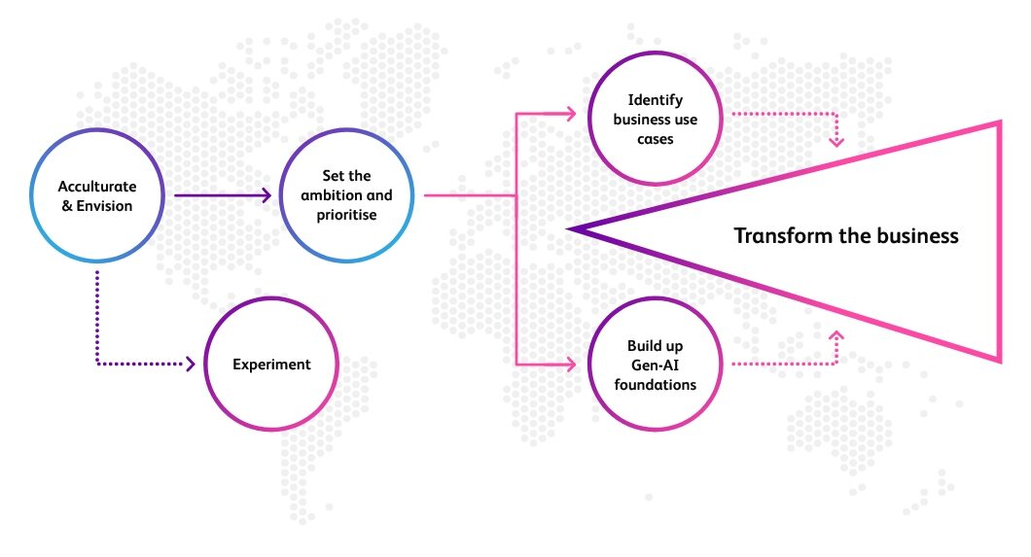
Is your organization ready?
Take our self assessment

Slide 26


https://digital-strategy.ec.europa.eu/en/policies/expert-group-ai
Powered by DALL·E 3

Slide 27

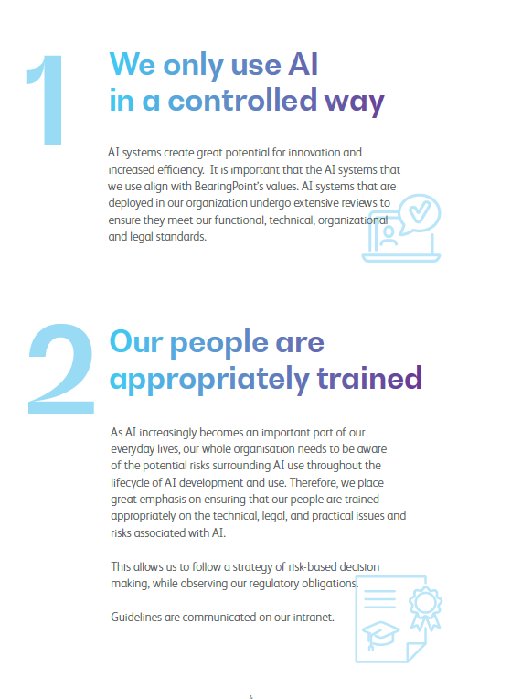
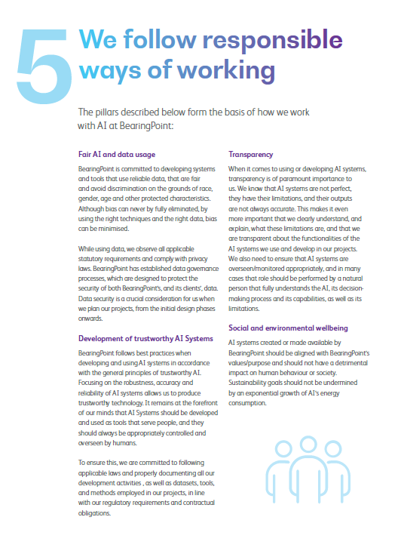
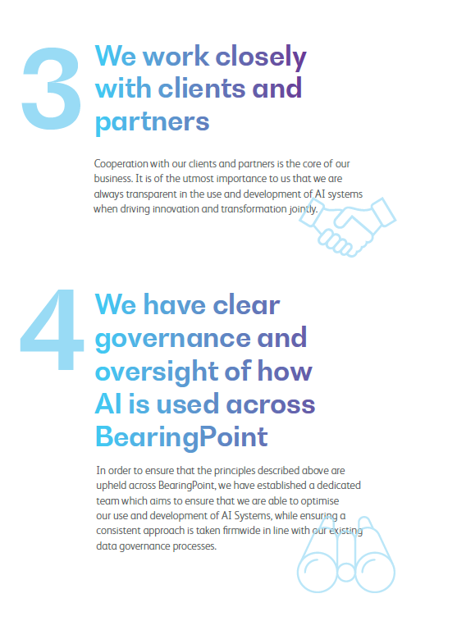

Slide 28
DATA GOVERNANCE
A KEYSTONE FOR
COMPLIANT AI AND DIGITAL TRUST
March 27th, 2024
Jan Henderyckx
Partner
Powered by DALL·E 3

