Slide 1

Concept Modelling and The Data-Process Connection:
How Concept Modelling Supports
Business Process Change and Business Analysis
Adept Events Data Warehousing and Business Intelligence Summit
27 maart 2024 in Utrecht NL
Alec Sharp
Senior Consultant, Clariteq
West Vancouver, Canada
asharp@clariteq.com
www.clariteq.com
www.adeptevents.nl
www.clariteq.com

Slide 2
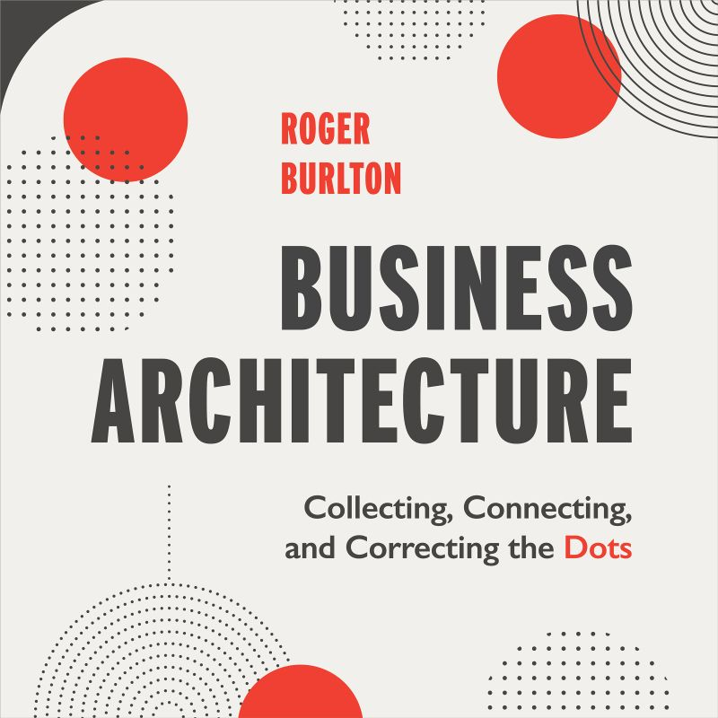
Presentation background…
First requested for IRMUK's EA-BPM Conference –
I introduced my data approach to process folks
Then, adapted for IRMUK's ED-BIA Conference –
I introduced my process approach to data folks
Then, asked by Adept to put them together leading to today's session –
The Data-Process Connection – techniques & examples
The plan…
Note – I won't go through every slide –
some are included for reference
Reminders: how "process people" and "data people" complicate things
A few points about Process & Data
How Concept Modelling (Data Modelling) supports Business Analysis, Process Change, and Architecture

Slide 3

"Process people" make "process" far too difficult
1 – No clarity on what "Business Process" means…
We need some help with our Product Lifecycle Management process.
I spend all day writing business processes, like the process to
Revise Product Brochure Image.
Not a single process –
it's a family of multiple business processes
(a process area or process domain)
Not an entire process –
it's a procedure providing instructions for a single task
(SWI – standard work instructions)
A whole spectrum of interpretations of process.
Seek balance –
a “business process”
lies between the extremes
Most people hear process and think procedure!
The key issues – granularity and orientation
Notes:
Process:
(or “end to end, cross-functional, Business Process”)
A sequence or set of activities that delivers significant results for the process’ customer and other stakeholders
involves multiple participants (actors or roles)
and multiple organisation units / functions
may or may not have a defined workflow
initially break a process into five to seven major activities
(subprocesses, phases, or milestones)
each made up of more granular activities or tasks
each of which might contain one or more documented procedures
Procedure:
A set of work instructions for a specific task or activity that will yield identical results every time.
usually one person or a small number of persons;
usually within a single function or organisational unit;
a type of job aid, also known as
Standard Work Instructions (SWI)
or Standard Operating Procedure (SOP)

Slide 4
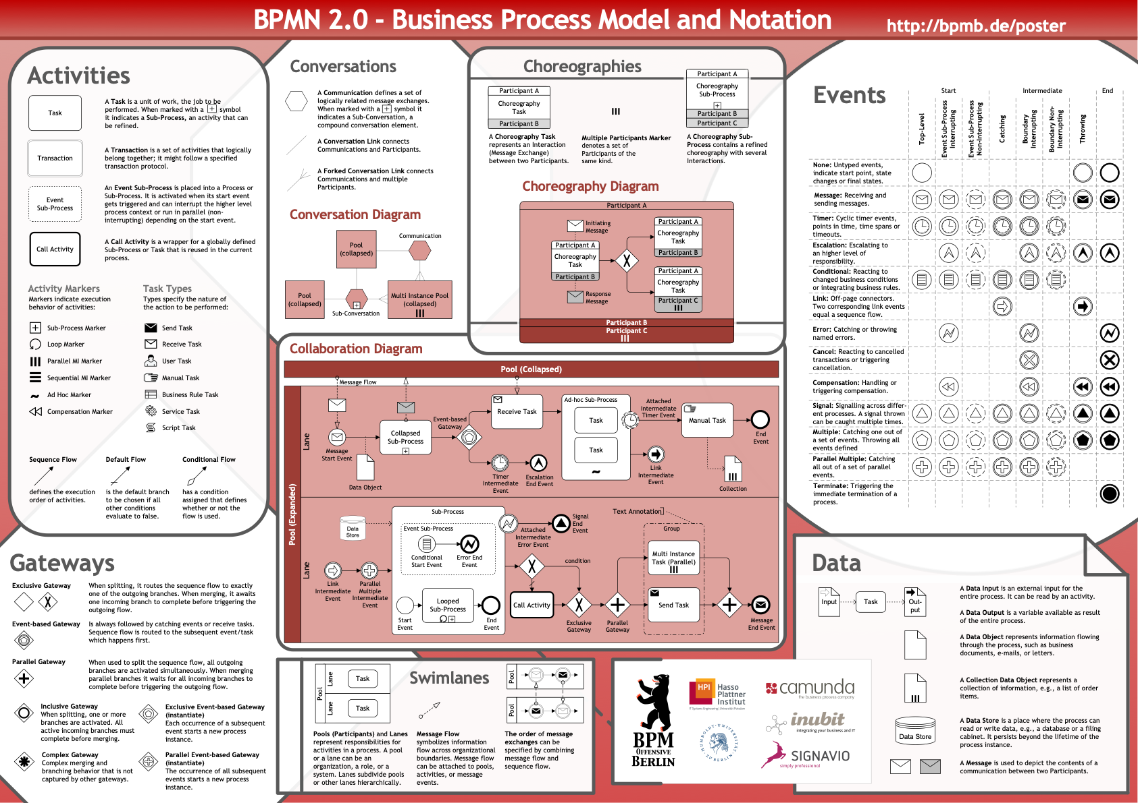
"Process people" make "process" far too difficult
2 – Technically oriented standards…
Notes:
Process:
(or “end to end, cross-functional, Business Process”)
A sequence or set of activities that delivers significant results for the process’ customer and other stakeholders
involves multiple participants (actors or roles)
and multiple organisation units / functions
may or may not have a defined workflow
initially break a process into five to seven major activities
(subprocesses, phases, or milestones)
each made up of more granular activities or tasks
each of which might contain one or more documented procedures
Procedure:
A set of work instructions for a specific task or activity that will yield identical results every time.
usually one person or a small number of persons;
usually within a single function or organisational unit;
a type of job aid, also known as
Standard Work Instructions (SWI)
or Standard Operating Procedure (SOP)

Slide 5
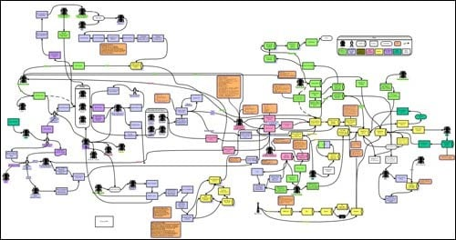
"Process people" make "process" far too difficult
3 – The sudden deep dive into detail…
Notes:
Process:
(or “end to end, cross-functional, Business Process”)
A sequence or set of activities that delivers significant results for the process’ customer and other stakeholders
involves multiple participants (actors or roles)
and multiple organisation units / functions
may or may not have a defined workflow
initially break a process into five to seven major activities
(subprocesses, phases, or milestones)
each made up of more granular activities or tasks
each of which might contain one or more documented procedures
Procedure:
A set of work instructions for a specific task or activity that will yield identical results every time.
usually one person or a small number of persons;
usually within a single function or organisational unit;
a type of job aid, also known as
Standard Work Instructions (SWI)
or Standard Operating Procedure (SOP)

Slide 6
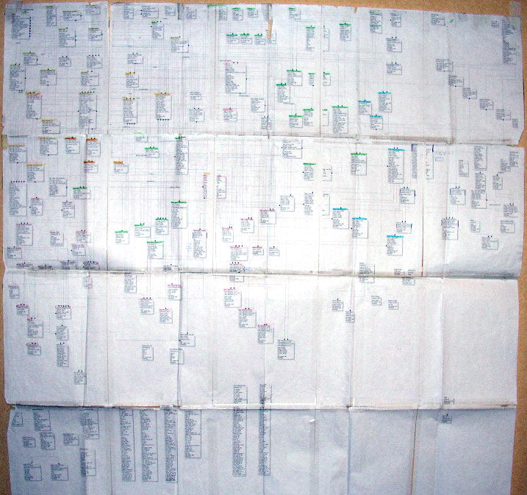
"Data people" make "data" far too difficult
1 – Confusion between
data modelling and
database design…
"Help –
everyone hates our data model.”
Notes:
Process:
(or “end to end, cross-functional, Business Process”)
A sequence or set of activities that delivers significant results for the process’ customer and other stakeholders
involves multiple participants (actors or roles)
and multiple organisation units / functions
may or may not have a defined workflow
initially break a process into five to seven major activities
(subprocesses, phases, or milestones)
each made up of more granular activities or tasks
each of which might contain one or more documented procedures
Procedure:
A set of work instructions for a specific task or activity that will yield identical results every time.
usually one person or a small number of persons;
usually within a single function or organisational unit;
a type of job aid, also known as
Standard Work Instructions (SWI)
or Standard Operating Procedure (SOP)

Slide 7
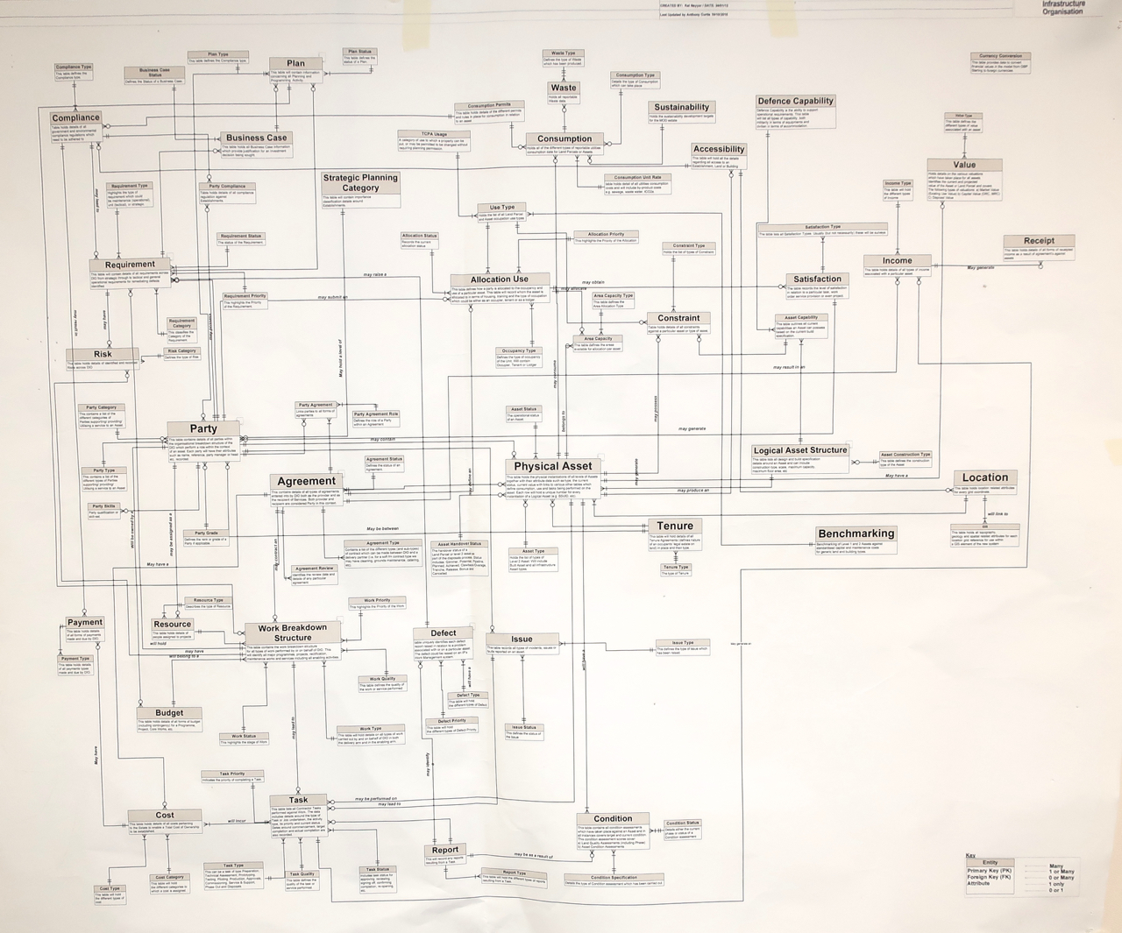
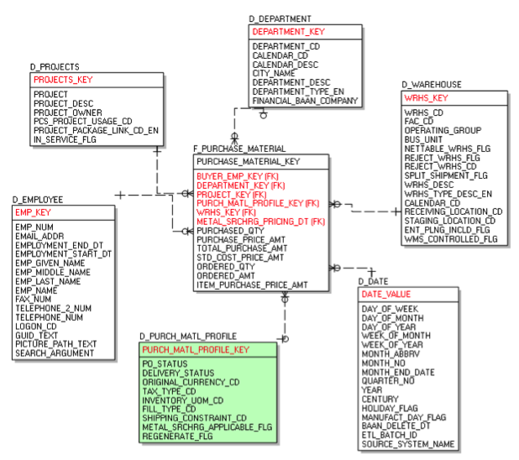
"Data people" make "data" far too difficult
2 – Terrible diagramming…
A common error –
"the most important entity should go in the centre of the diagram."
An excellent model structurally, but very difficult to follow –
no sense of direction.
Concept Models / ER Models should be drawn top-down by dependency.
"Fact" in the middle

Slide 8
For review: specifics – contextual, conceptual, logical
For 18 years, my most plagiarised diagram!
Contextual
(Scope)
Conceptual (Overview)
Logical
(Detail)
1
2
3
Agree context or “big picture” –
the scope in terms of topics or subjects that are in or out,
plus core terms and definitions
May be a simple
block diagram of topics/subjects,
or primarily textual (a list)
Optional – not necessary on smaller projects
Agreement on basic concepts and rules
Full detail for physical design
Ensures everyone is using the same vocabulary and concepts before diving into detail
Overview: main entities, attributes, relationships, rules
Lots of M:M relationships
Relationships show cardinality
No keys
Few or no reference entities
Unnormalised – most M:M relationships unresolved, many attributes will be multi-valued, redundant, and non-atomic
Verified directly by clients plus other techniques: Use Cases…
A “one-pager”
20% of the modelling effort
Provides all detail for initial physical database design and requirements specification
Detailed: ~ 5 times as many entities as the conceptual model
M:M relationships resolved
Relationship optionality added
Primary, foreign, alternate keys
Lots of reference entities
Fully normalised – no multi-valued, redundant, or non-atomic attributes. All attributes defined and “propertised”
Verified by other means: sample data, report mockups, scenarios, …
May be partitioned
80% of the modelling effort
3 – No clarity on different types of models for different perspectives
Notes:
Note that across the industry, there is a lack of consistency in defining these types of models. In the “Zachman Framework” these would be the planner's, owner's, and designer's views.
Analogies:
the contextual model is like the site plan with a definition of what will be built
the conceptual model is like a floor plan and sketches for a building
the logical data model is like the detailed blueprints for a building
A basic message for conceptual modelling –
“Resist the urge to normalise or generalise until it matters!!!
The logical model is not necessarily the “as built” model – the physical database design. The database designer or DBA will make changes in the interest of performance, recoverability, distribution, etc.
Everyone who currently supports an application should:
draw the application's logical data model following strict top-down drawing conventions.
abstract the model “up” to a conceptual data model
at least consider reviewing the conceptual model with analysts, developers, and subject matter experts to ensure that it reflects the intentions of the business.

Slide 9
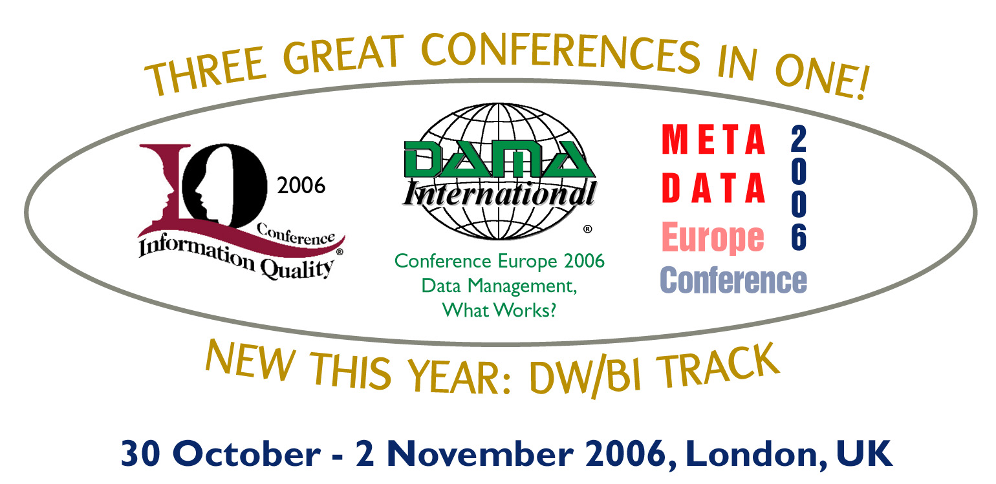

The Lost Art of Conceptual Modeling
Alec Sharp, Acetta LLC
alec.sharp@acetta.com or
asharp@clariteq.com
I've been making this point for a long time…
2004 DAMA – The Human Side of Data Modeling
2005 DAMA Symposium panel
2006 DAMA – Lost Art of Conceptual Modeling
Notes:
Note – not Data Management processes – Process Orientation for DM Professionals

Slide 10

And, of course, they usually don't understand each other

Slide 11
Moving along…
Reminders: how "process people" and "data people" complicate things
A few points about Process & Data
How Concept Modelling (Data Modelling) supports Business Analysis, Process Change, and Architecture

Slide 12
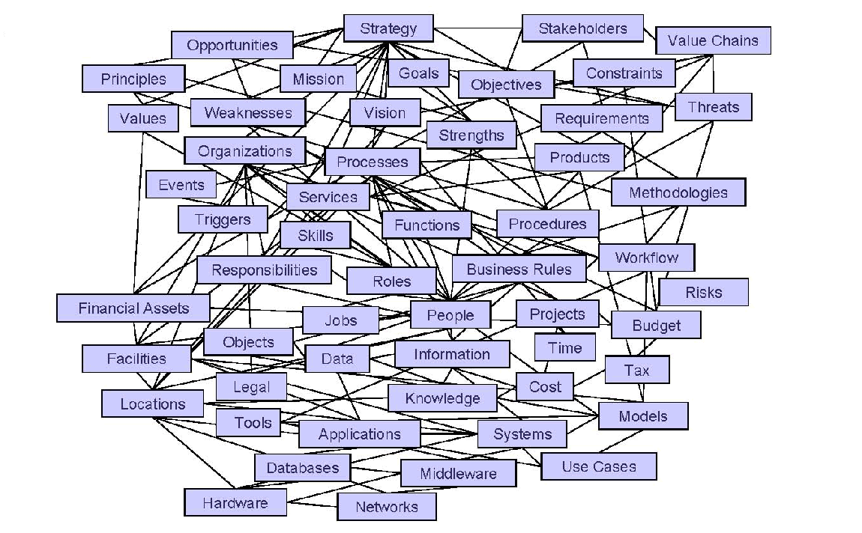

So, a few central ideas…
"Data modelling" tools confused data modelling with
detailed database design – this discouraged
the use of concept modelling / data modelling –
Professional data modellers often make it
too complex, too detailed, too abstract, too soon!
Initially, “data” is not the issue – we model:
  the “things” / concepts a business cares about:
  terms and definitions, policies and rules
  “things first, data later”
A business-oriented “concept model” provides a great platform for requirements discovery, package selection, business process change, architecture development, etc.
Notes:
Guerilla, not gorilla

Slide 13

A core idea – "essential" models
“All models are wrong, but some are useful.”
Two especially useful models
Business Process Scope Model
Business Concept Model
(a.k.a Conceptual Data Model)
Both are “essential” – they show the essence – the “what” – of a subject with no reference to who, how, why, etc.
George E. P. Box
1919–2013

Slide 14
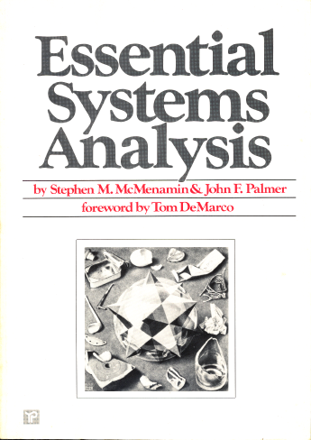
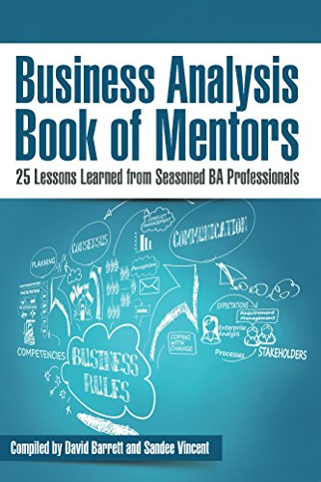
Concept Model – an Essential* model
Concept Model:
a description of a business in terms of
what things it needs to know about to operate –
entities, business objects, classes, things, …
what facts it needs to know about those things –
relationships & attributes
what policies & rules govern those things–
definitions, constraints, and assertions
A shared language of the nouns
that are central to the enterprise.
Always start here!
* Essential -
The "essence" of the subject
The "what" with no reference to
"who" (role or organisation) or
"how" (implementation or technology)

Slide 15
Process Scope Model – an Essential* model
Communicate System Outage
Confirm Outage
triage & route notification
perform system diagnostics
Determine
scope
impact
audience
Communicate Situation
(as appropriate)
Communicate Resolution
Assess Communication Process
(lessons learned)
Identify and Communicate Next Steps / Follow Up
Triggering
Event:
Notification of degradation or lack of Service
internal system
external provider
calls to Service Desk
Cases:
new
recurring
Other factors:
severity
key operations periods / areas
(registration, summer, course evaluation season)
time of year
time of day
Results:
Communications about the Outage and the progress on resolving it are delivered:
internally and externally
informally and formally
Final Results:
Service is restored and root cause is known (or is determined to be unknowable) and resolution is communicated:
Externally (“good news”)
Internally (“cause & resolution)
Process Scope Model using “TRAC” -
what is the Trigger, what are the Results,
what are the main Activities
(7 ± 2 milestones, phases, or subprocesses,)
and what are the main cases or variations?
Notes:
May incorporate many, even hundreds of services

Slide 16
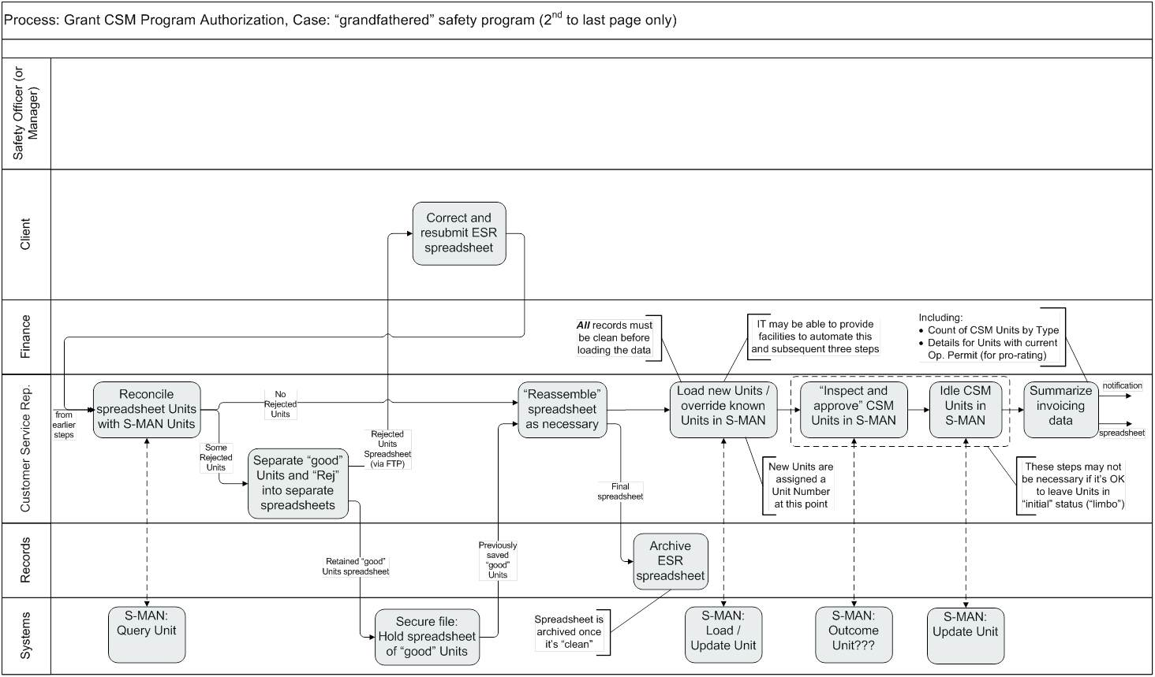
Much later, we'll add the who and how in a swimlane diagram
3) …by interacting with
1) This Actor (or Role)…
2) …completes this Activity…
4) … this Service offered by a System
(which collectively is a Use Case)
Notes:
This shows how this style of diagram pulls together process workflow, use cases, and services.
“Actor – Service (verb-noun) – Platform” forms a Use Case – “Customer Service Rep Idles Units via S-MAN”

Slide 17

Reminder – nouns (entities) help identify processes
“Active verb – noun” naming that indicates primary result
Triggered by an event (decision, time, data) outside process’ control
At the end are results that makes one or more stakeholders happy
In between are ~5 to 7 phases, milestones, or major activities
Activities linked 1:1 are probably part of the same process;
a 1:M or M:1 connection between activities is probably a boundary
The same token moves through the whole process,
changing state, e.g. a Loan, from applied to booked;
there will be a change of token across a process boundary
Acquire Customer
Grant Loan
Collect Payment
Settle Loan
Identify
Prospect
1:1
Qualify
Prospect
1:1
Solicit
Prospect
1:1
Register
Customer
1:M
Accept
Loan
Application
1:1
Assess
Loan
Application
1:1
Fund
Loan
1:1
Book
Loan
1:M
Solicit
Loan
Payment
1:1
M:1
Etc.
Etc.
change
of token
change
of token
change
of token
token:
a Customer,
from prospect to registered
token:
a Loan,
from applied to booked
token:
a Payment,
from solicited
to distributed
token:
a Loan,
from
zero balance
to notified
Clear, objective guidelines – science, not just opinion
Notes:
This illustrates why a simple definition of a business process is inadequate, and it's necessary to demonstrate the concept.
As noted earlier, don't confuse a result with an objective.
- Result: a “countable” output of a process; “what” the process achieves, e.g.
“A service problem is resolved” or
“A process revision is implemented”
- Objective: a performance target for the business as a whole, or for a specific process. Objectives are stated in “topic, target, timeframe” format, e.g.
“Customer telephone hold time will be less than 90 seconds for 98% of all calls by Q2 of next year” or
“The cycle time to implement a process revision across all factories will be reduced to six months by year-end.”
The point of this is that you can have a process to Resolve Service Problem, but you can't have a process to Have Short Phone Calls
“Mechanisms” are another source of confusion. They are techniques or technologies for implementing or supporting a business process, e.g., “Fill in Form MS-17” or “Develop Solutions Database.” They should generally be ignored when looking for results.

Slide 18
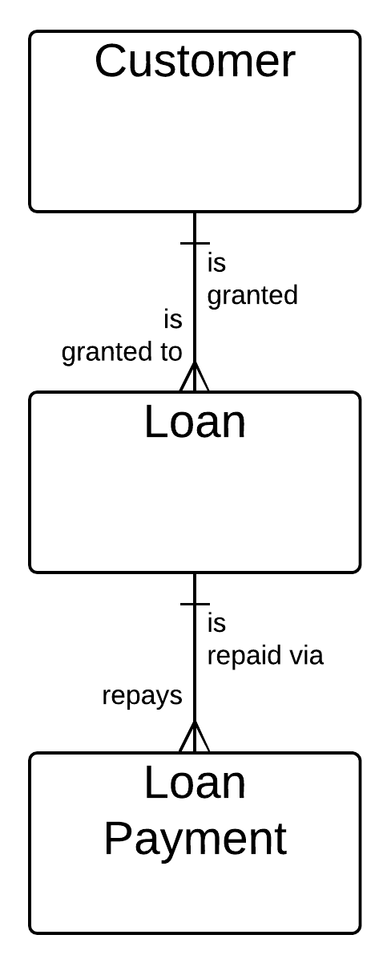
Correspondence to the Concept Model
  The nouns in your verb-noun process name are most often the entities in your Concept Model,
  and each will usually have one primary process
  The relative number of process instances
  (e.g., 1:M or M:1) aligns with relationship cardinality
  This does not mean there is only one process per entity
    Assess Customer Performance
    Retire Customer
    Merge Loans
    Write Off Loan
    …
Acquire
Customer
1:M
Grant
Loan
1:M
Collect
Payment

Slide 19



Making concept modelling relevant & accessible
The assignment, a painful but useful lesson –
facilitating a concept modelling session for a railway’s Track & Structures group
I began by explaining
data modelling...
“An entity is a uniquely identifiable person, place, thing, event, ...”
Bad idea!!!
"I can't stand you IT guys!"

Slide 20
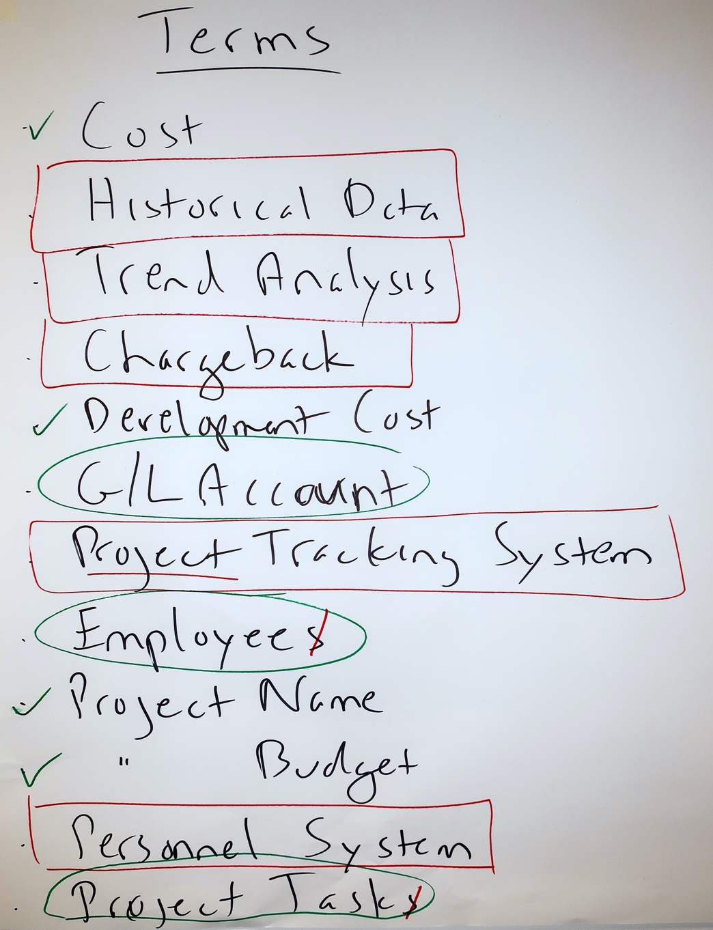
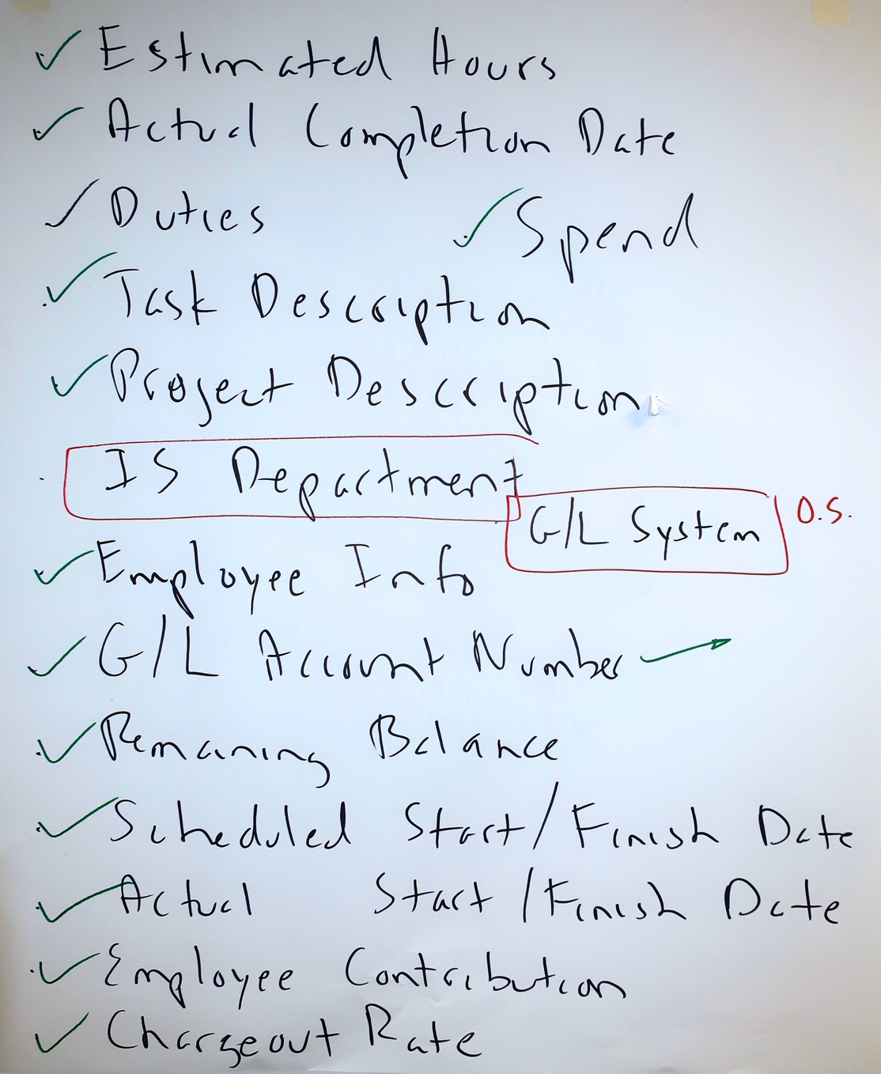
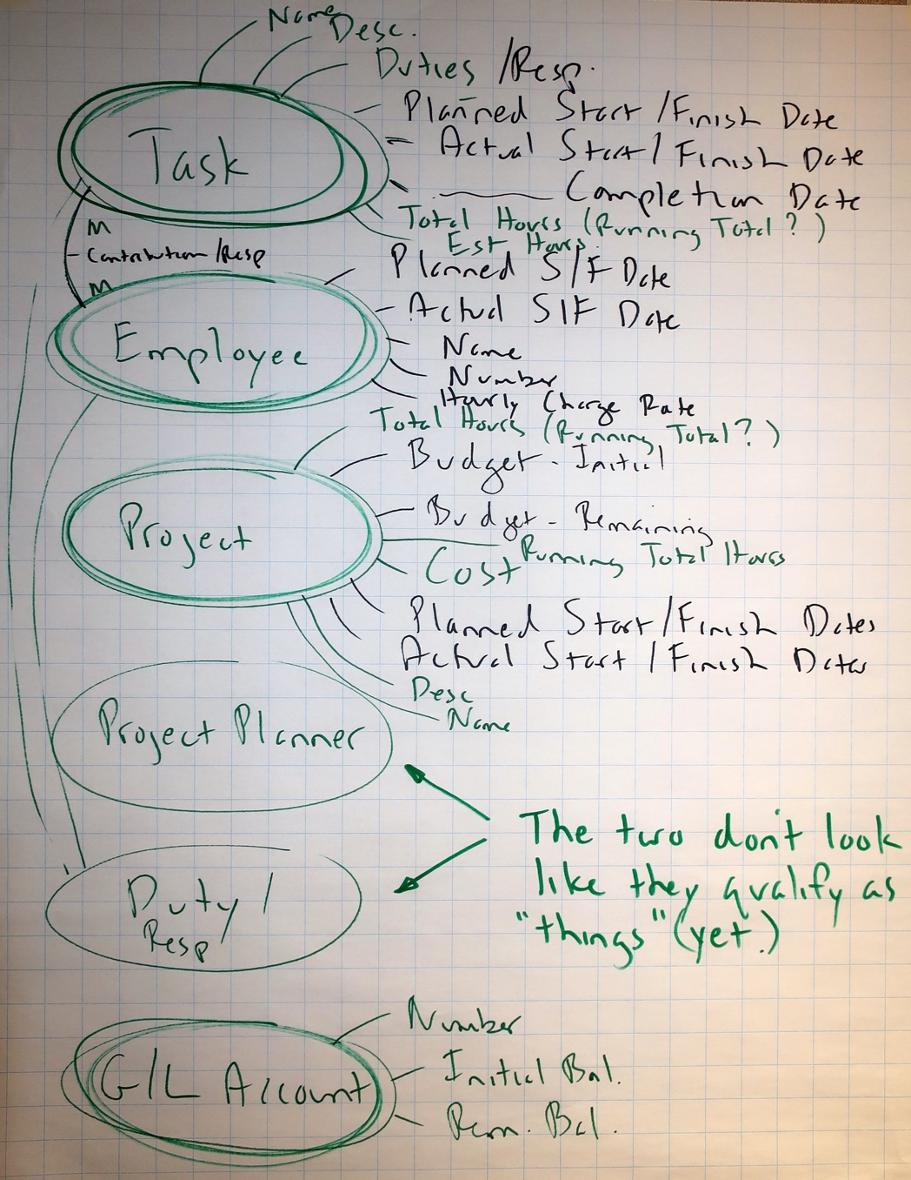
It all begins with language
“Why don’t you learn our language?” “Fair point!”
Brainstormed over 200 terms –
Track, Structure, Line, Siding, Mileboard, Segment, Sector, Route, …
Oh-oh... “Now what?” Then, an idea!
Is this “a thing, a fact about a thing, or other stuff?”
Here’s a Project Management example…
Introduce "thing criteria" as necessary:
  singular noun – can talk about one of them
  (Worker not Staff, Item not Items)
  multiple instances
  must need to and be able to
  track each instance (uniquely identify each)
  has facts that must be recorded
  NOT an artifact like a spreadsheet or report
  (not a Call Log or Worker Directory or…)
Track & Structures were VERY happy with the 40 entity concept model they built.

Slide 21
Or brainwrite, interview, gather by email, virtual whiteboard, …
For a Concept Modelling session with C-level executives and senior managers at a Credit Union
("a Member-owned bank") I sent the participants this email in advance…
Before the session, it would be very helpful if everyone could do two things:
Spend up to 10 minutes or so listing any terms you use on a frequent basis. Each item in your list could be the name of some thing you need to track, a fact about a thing, a spreadsheet, a report, a metric, a system, a database, or anything else that comes to mind. I’m hoping everyone can list thirty or forty things. There is no “right or wrong” – this helps me learn your language and provides clues to what the most critical terms might be.
Think of one to three examples of information you’d like to be able to get, but either you can’t, or you’re not sure how accurate it is. For instance, at a US university last week, a Vice-Provost said she would like to know “How many non-resident, tenure-track Faculty do we have.” Of course, this means agreeing what is meant by “Faculty,” “tenure-track,” and “non-resident.” (I've done a LOT of work in higher education, and can promise you there is not agreement on what those terms mean.)
That’s the whole point of our sessions next week. :-)

Slide 22
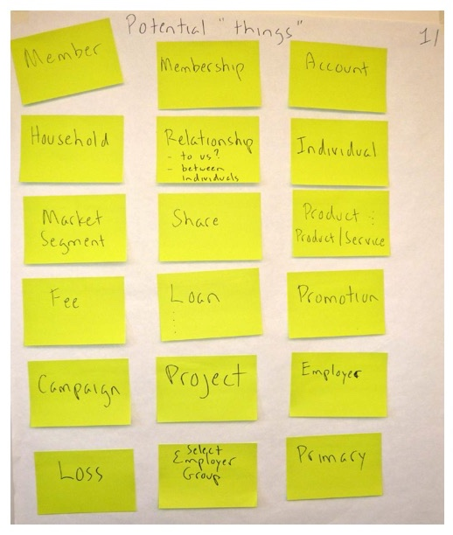
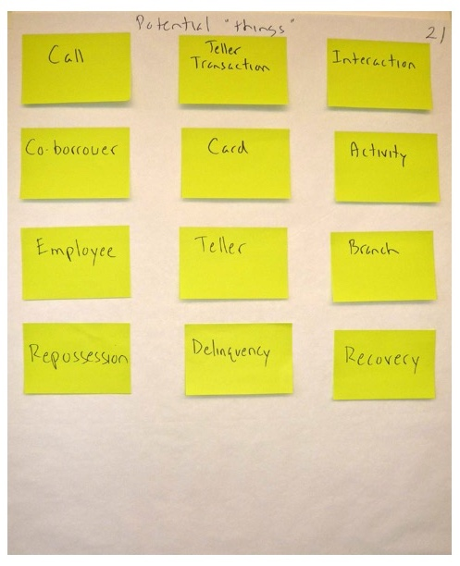
More than enough to work with
Hundreds of terms came back – before the sessions I selected 35 that looked like "good" entities

Slide 23
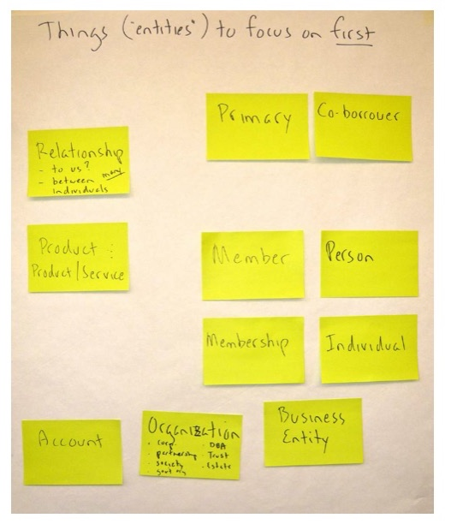
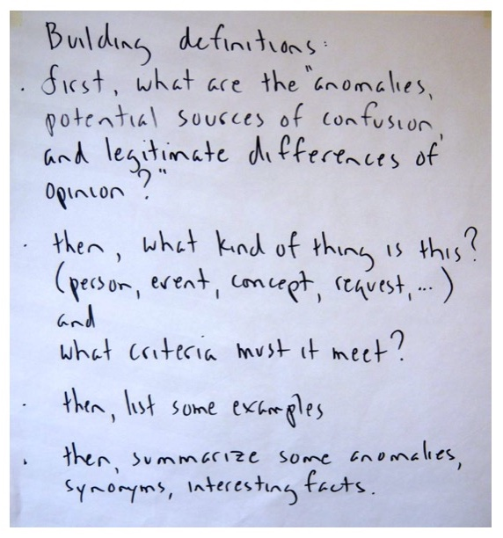
And now we have a plan!

Slide 24
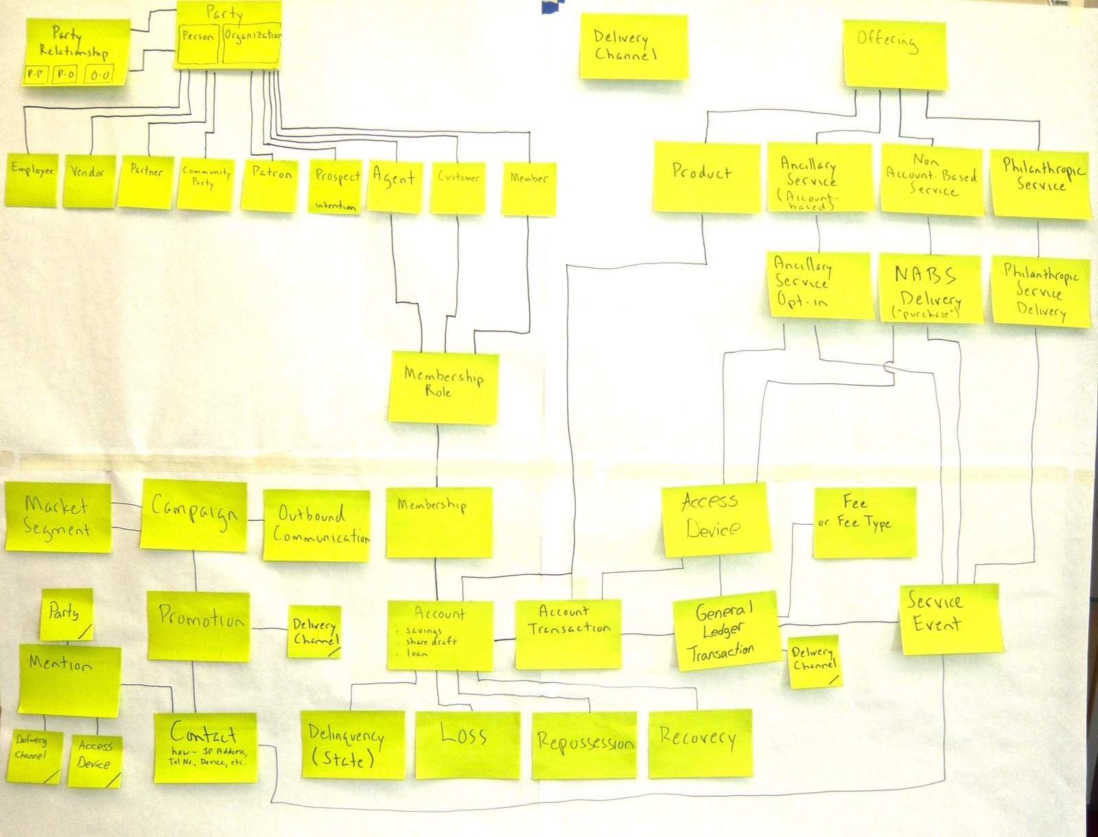
And after three partial days, a ~40 entity concept model
Plus…
Over 50 flipcharts of notes – issues, goals, decisions, etc.
Definitions for all entities
Very positive feedback

Slide 25
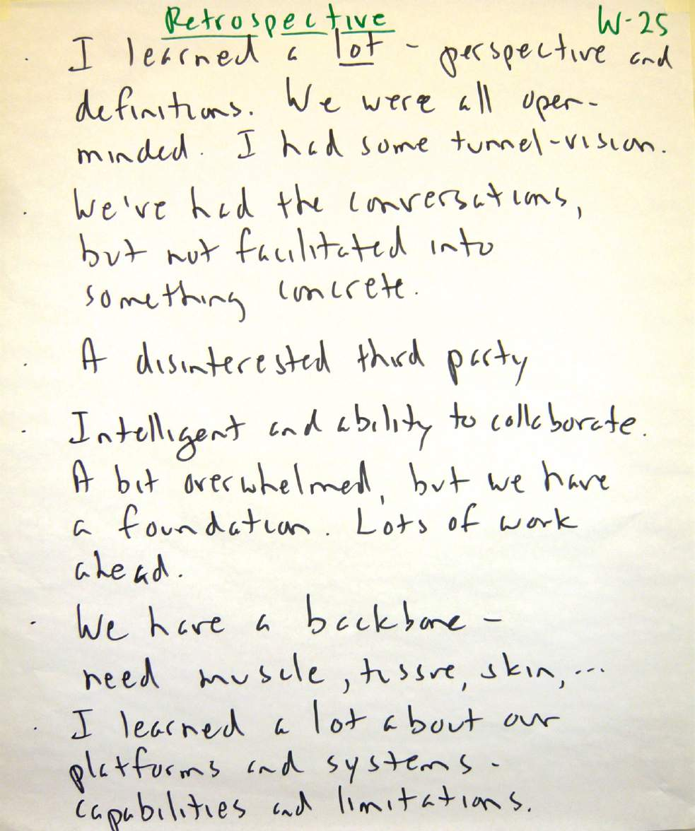
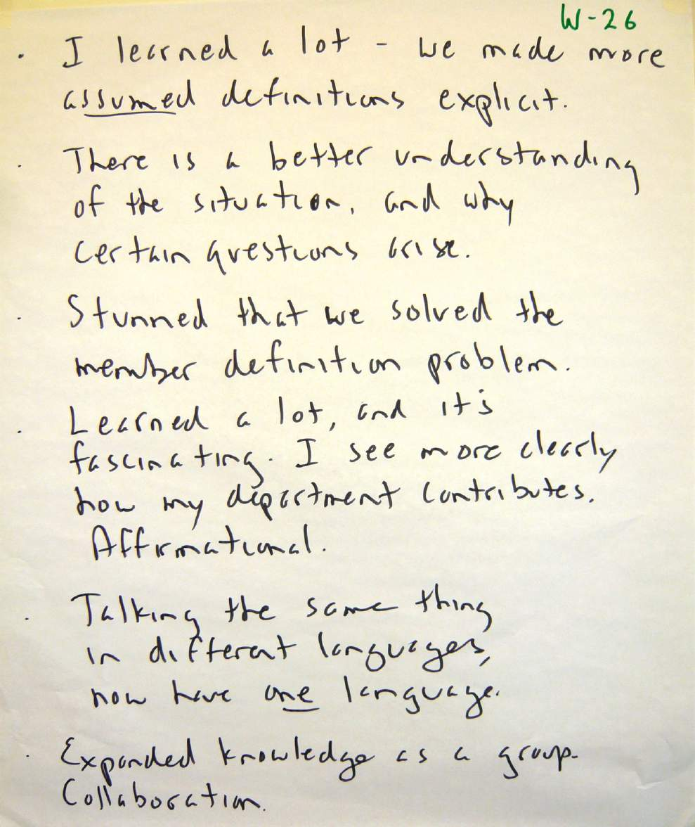
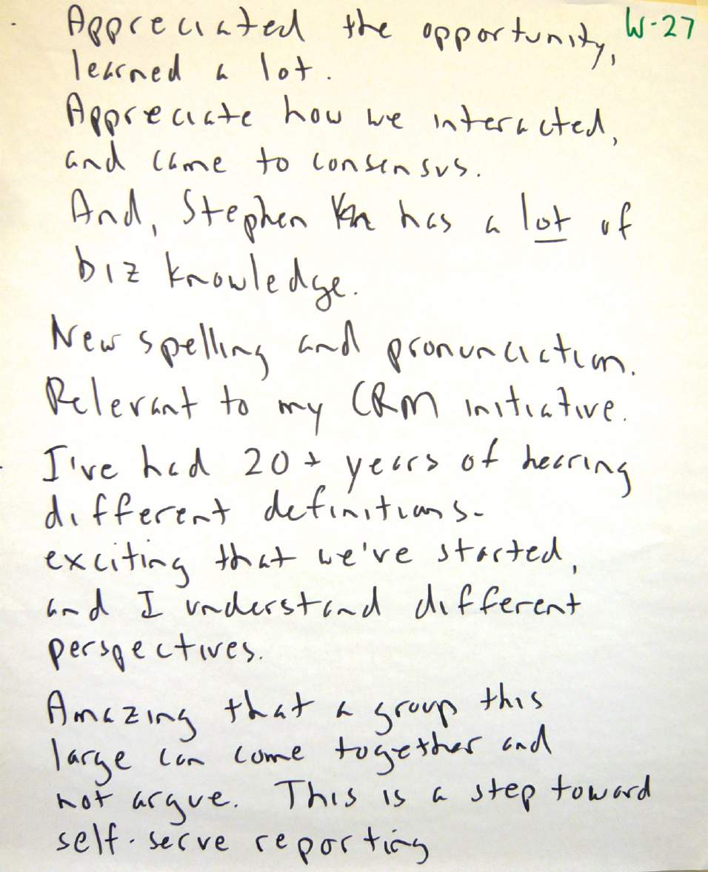
They were very pleased with the outcome
Plus… "we should have done this 20 years ago."

Slide 26
Putting it together…
Reminders: how "process people" and "data people" complicate things
A few points about Process & Data
How Concept Modelling (Data Modelling) supports Business Analysis, Process Change, and Architecture

Slide 27
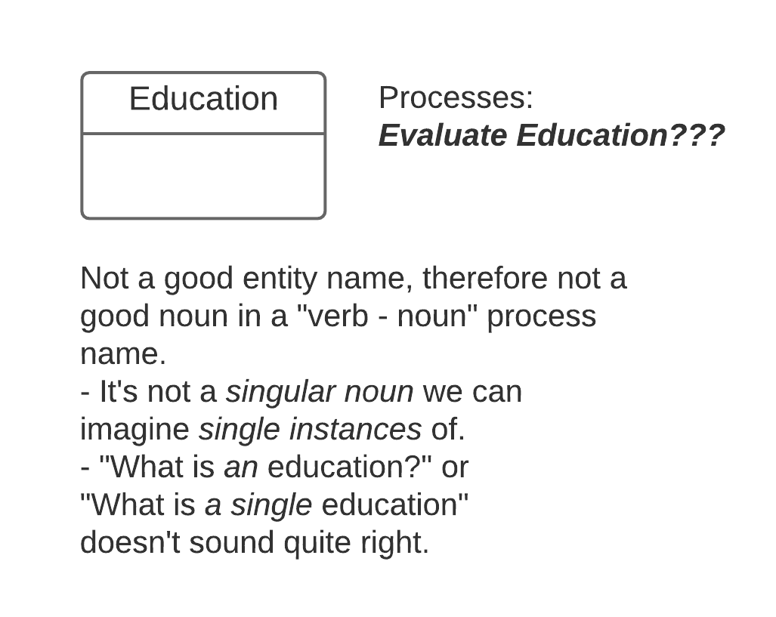
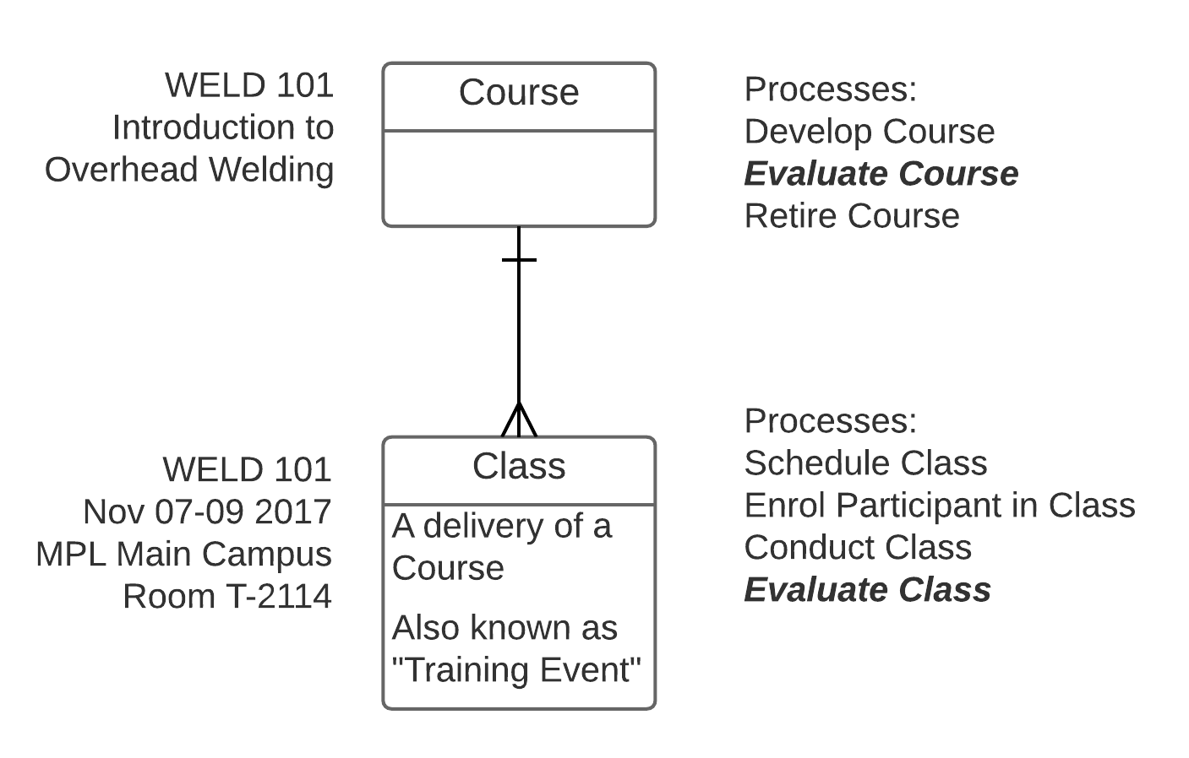
Example – simple Concept Modelling to clarify the process
Analyst struggles to model “Evaluate Education” – timing disconnects,
1:M and M:1 connections within the process, token changes, …
A few minutes of Concept Modelling showed two distinct tokens and processes. “Education” was a “mushy noun.”

Slide 28
Example – Data Modelling as the basis for COTS* configuration
COTS –
Commercial
Off-The-Shelf
software
“Data modelers won't be needed anymore because the software company has already done it!”
Will consult
for food
The beginning of the end?
Various commentators on my
data modelling career, mid-1990s
Notes:
A real concern in the emerging era of COTS dominance, circa 1994
(Plus, of course, all the wireheads claiming that the D in DM stood for “dinosaur” – the hip new generation could prototype or object-analyze right into IS nirvana)

Slide 29
Redemption!
The client...
Alec...
Could you come on over and do that thing you do?
I guess. What thing in particular?
That entity data stuff with the boxes and lines
Oh, data modelling.
Sure - what's the project?
We're implementing something called SAP. Our CEO told us to!
Uh-huh. Why do you want my help?
When you did that stuff on our Work Order Management System, we all felt we understood our business better than we ever had
Great! And what do your SAP consultants say about this?
They say it's a terrible idea and a waste of time and could you please just stay home.
I'm on my way!
Notes:
What's significant
client was non-IT
Felt data modelling would “reveal” their desired business practices to them (the business people and the implementers)

Slide 30
The outcome – using DM for ERP configuration
The situation:
Manufacturer selects SAP as platform for process transformation
Desire to understand as-is business processes to map to package and decide on configuration options
Client felt the integrator was coercing them, wanted my help
The #1 reason for unhappiness with the selected COTS solution –
a data model mismatch!
The approach:
Team of 7 builds 45 entity concept model over two days
Identify “what's good, what's not good”
about current business rules, revise concept model
Use this knowledge on configuration activities with
concept model as an overall map
Vendor
Country
Site
Plant
Plant Location
Equipment Item & Type
PO, PO Line Item
Req'n, Req'n Line Item
Release, Release Line Item
Work Definition, WD Line Item
etc. etc. etc.
The key points:
Client-initiated, not IT
Now a global showcase account
Client – “More value from those two days
than anything else we did!”
Me – “I'm not irrelevant!”
Notes:
This example employed straight conceptual data modelling without any additional techniques such as event analysis or process mapping.
Key points
data model revealed a lot of about business policies and assumptions – this is surprising to anyone who might assume that only a process model would do that
conceptual model delivers high value, detailed models aren't necessary yet
Sally Fields - “You like me! You really, really like me!”

Slide 31
“Quick wins” example – selecting an application with verbs and nouns
Selecting of new Financials app is hopelessly bogged down despite huge effort to develop and maintain a BDM*
BDM issues
Time consuming
Most apps meet most criteria
Still can't tell if an app will work well in your environment
* Big Dumb Matrix
Notes:
Selecting in a hurry!!!
BDM actually more complex
each requirements had a weight
Y/N included factor (how well)
What we had here was a classic case of over-analysis

Slide 32
Using DM for purchased application selection – verbs and nouns
The problem:
Selection of new Financials app is hopelessly bogged down
(and a matrix of almost 1000 “requirements” wasn't helping)
Worse – matrix points to the app no one wants!
“Things we track…”
Project, Work Order
Plant, Plant Equipment
Product Type, Product Lot
Product Inventory
Sale, Transfer
Location, Ledger Entity
Financial Category
Responsibility Center
Account, Sub-Account
Fixed Asset
The approach:
Small team builds “thing model”
(concept model, ~60 entities total, 15 “core”)
For each core entity,
identify 3 to 5 life cycle events
For each event, develop scenario w. data
Turn over to paid app vendors – “Show us!”
  “How do you support the data model?”
  “How do you handle scenarios?”
Events that happen to them…”
Fixed Asset is
Acquired or Constructed
Depreciated
Transferred
Disposed Of
The key points:
It worked! – saw how an app would support the business
Didn't initially call it “data modelling”
Left vendor some room - “Here's how we'd do it.”
Notes:
This example employed conceptual data modelling plus event analysis, a “minimalist methodology”

Slide 33
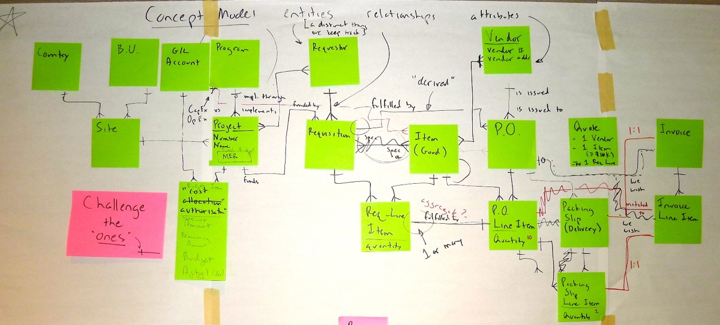
Another example – Concept Model shows possibility of major process change
Global mining company
hires me to help with
Business Process in
support of ERP
changeover.
I "snuck in" some
quick, informal
Concept Modelling.
This highlighted many
areas lacking clarity:
Program vs. Project
Site vs. BU Location vs. Country
Requisition vs. Quote vs. Purchase Order
The 1:1 relationships among PO/PO Line Item, Packing Slip/Packing Slip Item, and
Invoice/Invoice Line Item showed that Invoiceless Payment, a major process change, was possible
I did not use any data modelling terminology until the end!

Slide 34
From Entities to Events (Services) to Use Cases
Use Case
Use Case or
User Story
- add Who and
How
Service Specification
(Events)
Service (or Event)
- add a Verb
to the Noun
Concept
Model
Entity
or simply a "thing"
- a core Noun
A Concept Model is a great
starting point for discovering your
Services and Use Cases (User Stories)
Supports Service-Oriented Business Analysis

Slide 35
Example – simple Concept Modelling to clarify the process
University looking to implement e-Signature
  Pilot project selected to test the technology on "Approve Letter of Offer"
  Suggestion – "Get Alec in and be sure you understand the process." (Thank you!)
Everyone fixated on physical “Letter of Offer” (“how”)
Concept Modelling revealed the “what” –
actually a selection from a set of “Standard Employment Terms”
formatted using a standard (legally unchangeable) “Employment Offer Template.”
Major process implications! E.g., no need for anyone to "see" the actual Letter.
Customer result:
(hired Employee)
relatively pain-free, timely, correct first pay cheque correctly deposited
Accurate, agreed Terms of Employment (a contract) and Position Description.
etc.
Customer result:
(other Applicants)
receive results before Letter of Offer, but must feel well-tested
…and many more for
other stakeholders
Trigger:
Need to appoint a person to a Position (aka, “hire a person”) due to:
vacant Position
new Position
modified Position
Includes contract expiration/modification
Recruit, Hire, and Onboard Employee
Prepare to Recruit
Recruit Applicants
Evaluate Applicants & Select Finalist
Negotiate Terms of Employment
Finalise Terms of Employment
Onboard Employee
Main Activities (or Milestones, Phases, or Subprocesses)
Cases:
Full-time Faculty – tenure-track, non tenure-track, fixed-term research,
fixed-term instructional, …
Academic Professionals
Classified… and many more

Slide 36
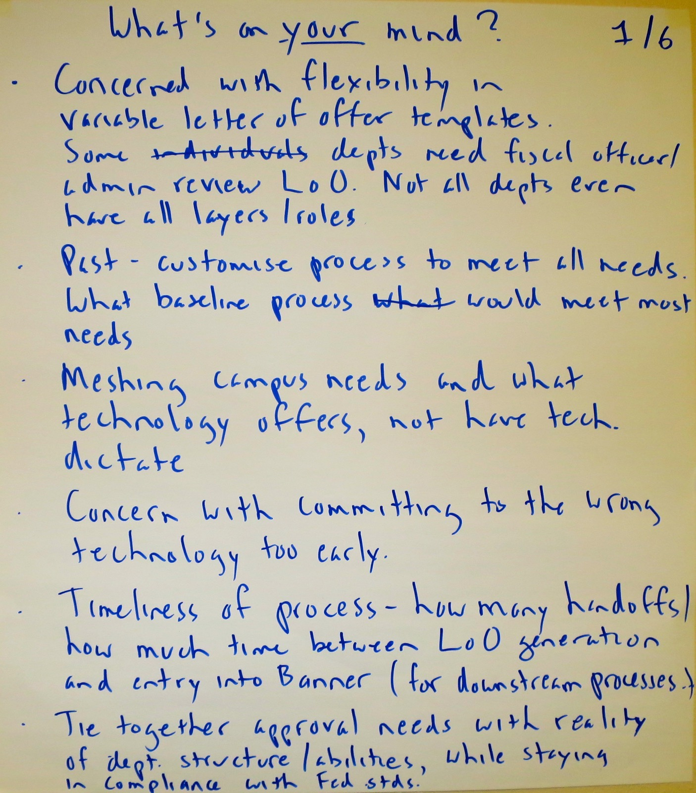
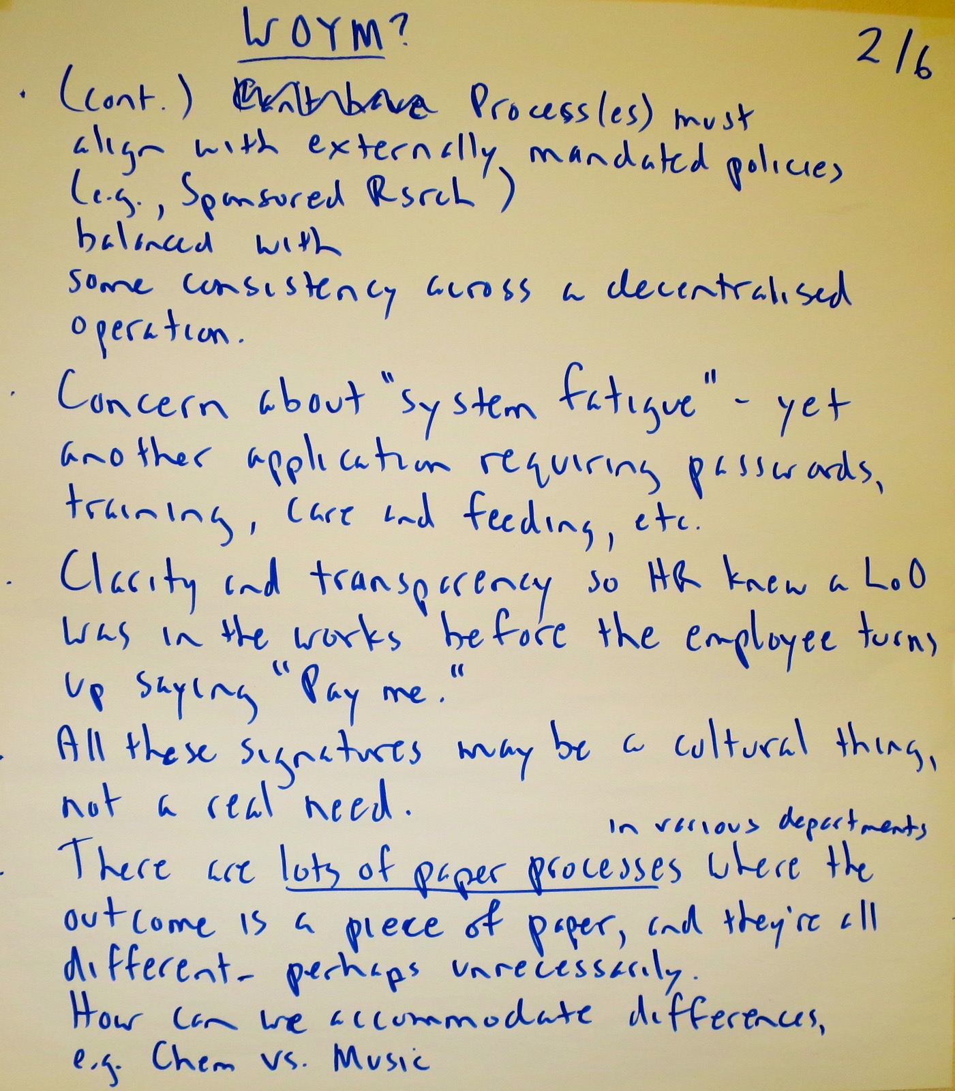
How we got there – Venting! (1 and 2 of 6)

Slide 37
“Venting” reveals three key points
There are MANY more interested parties (stakeholders) than anyone realised
Agreement that “Venting” surfaced the main issues and goals of each key Stakeholder – no need to do “Stakeholder-based assessment” later in the plan
Everyone fixated on physical “Letter of Offer” (“how”)
but “Venting” revealed “what” – actually a selection from a standard set of “Standard Employment Terms”
formatted using a standard (unchangeable)
“Employment Offer Template.” Major implications!

Slide 38
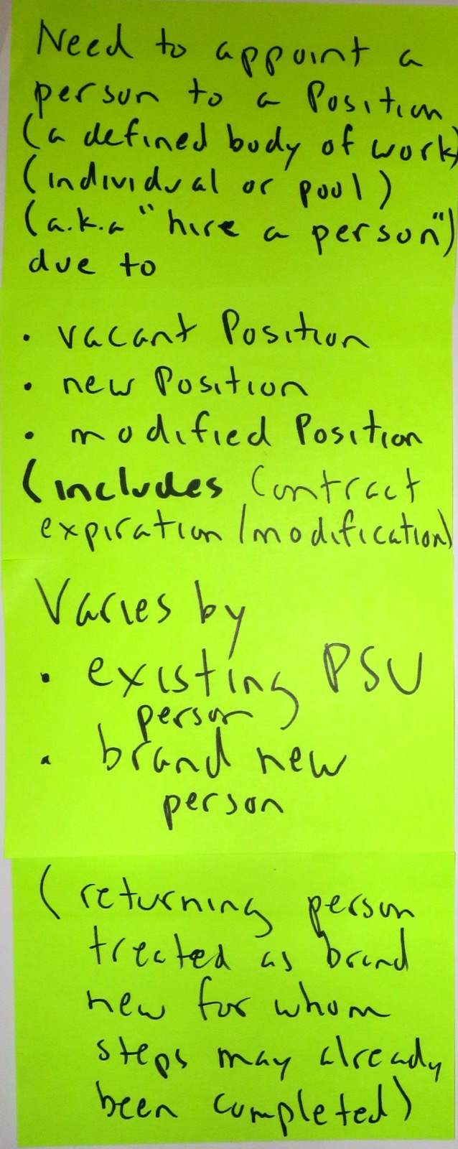
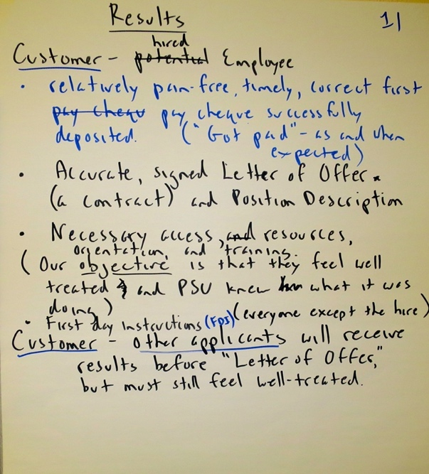
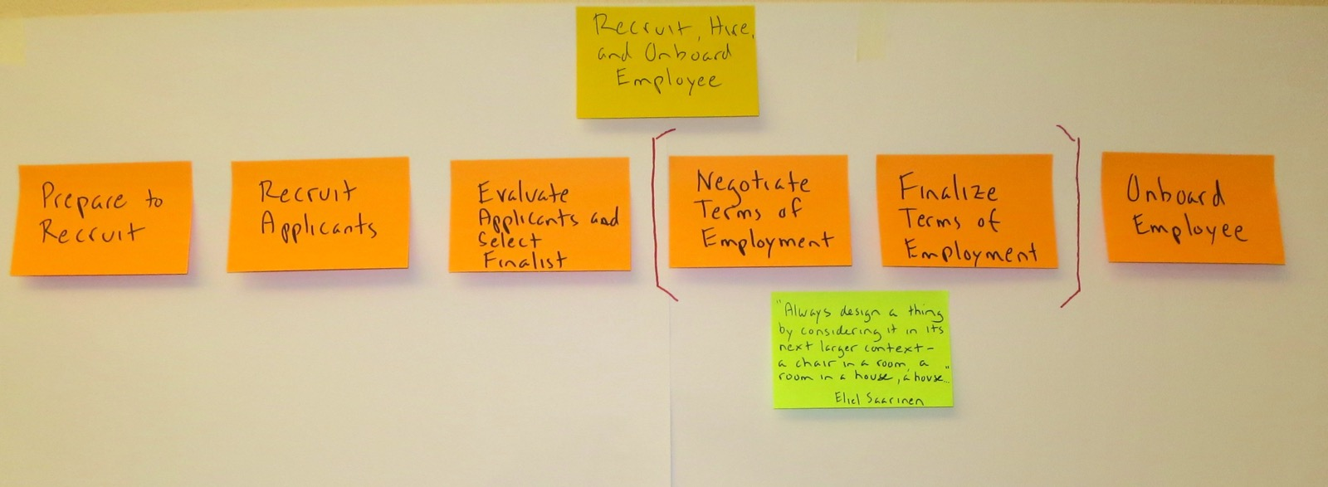
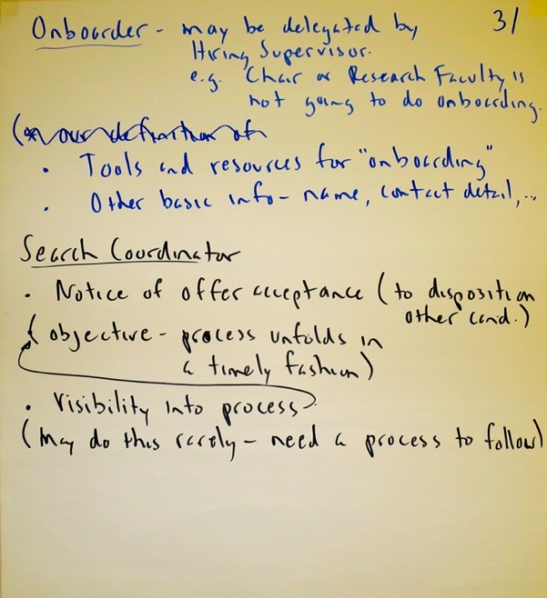
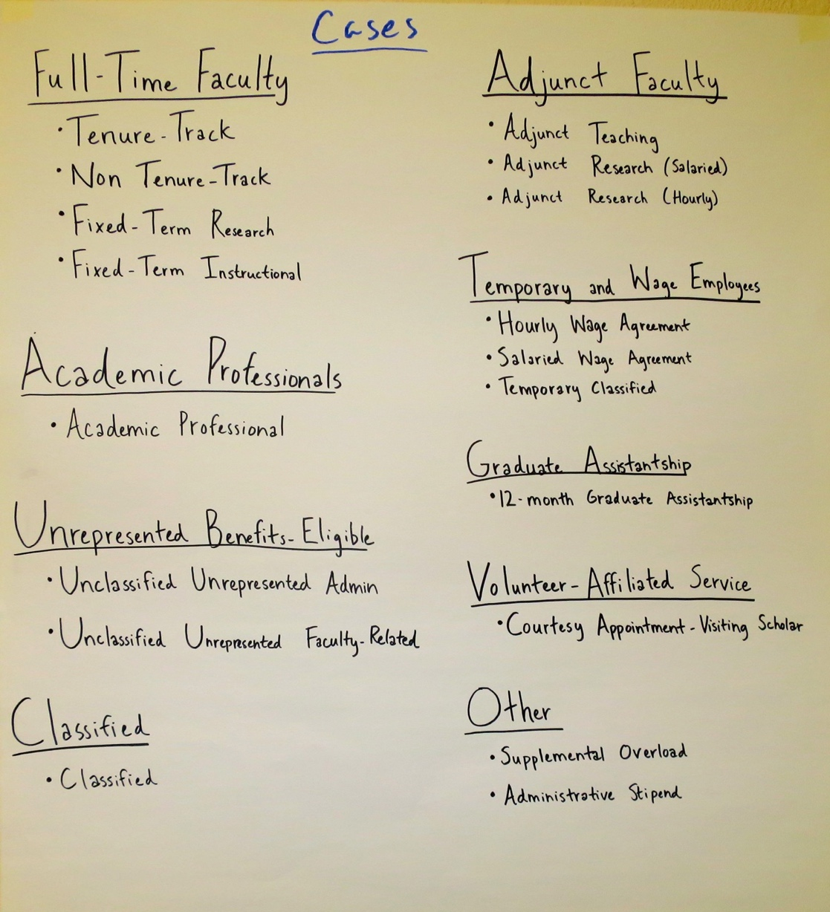
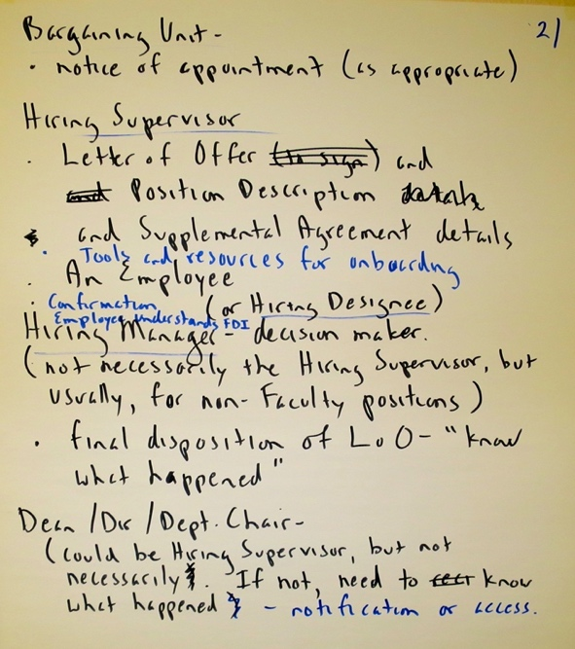
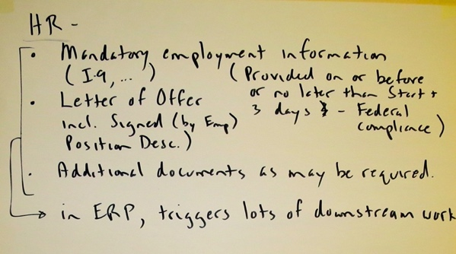
Using TRAC we built a Scope Model

Slide 39
Scope Model (TRAC) – the legible version
Recruit, Hire, and Onboard Employee
Prepare to Recruit
Recruit Applicants
Evaluate Applicants & Select Finalist
Negotiate Terms of Employment
Finalise Terms of Employment
Onboard Employee
Main Activities (or Milestones, Phases, or Subprocesses)
Trigger:
Need to appoint a person to a Position (aka, “hire a person”) due to:
vacant Position
new Position
modified Position
Includes contract expiration/modification
Customer result:
(hired Employee)
relatively pain-free, timely, correct first pay cheque correctly deposited
Accurate, agreed Letter of Offer (a contract) and Position Description.
etc.
Customer result:
(other Applicants)
receive results before Letter of Offer, but must feel well-tested
Bargaining Unit result:
Notice of Appointment, as appropriate
…and many more for
other stakeholders
Cases:
Full-time Faculty
tenure-track
non tenure-track
fixed-term research
fixed-term instructional
Academic Professionals
academic professional
Unrepresented Benefits-Eligible
unclassified unrepresented admin
unclassified unrepresented faculty-related
Classified… and many more

Slide 40
“Letter of Offer” = “Terms of Employment”
Employment Offer
formatted
using
Employment Offer Template
Standard
Employment
Term
comprised
of
Employment
Term
references
Classic “how” (Letter of Offer) vs. “what” (Employment Offer)
Realisation: if Employment Terms are agreed, and Template is standard and unchangeable, no one needs to review the Letter!
Eventually, the term “Letter of Offer” became unused

Slide 41
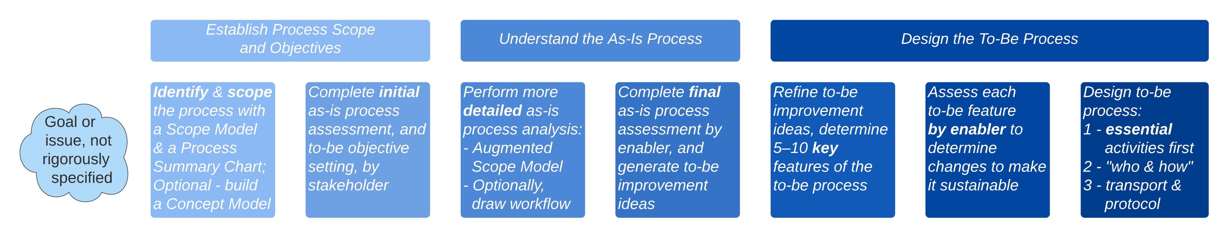
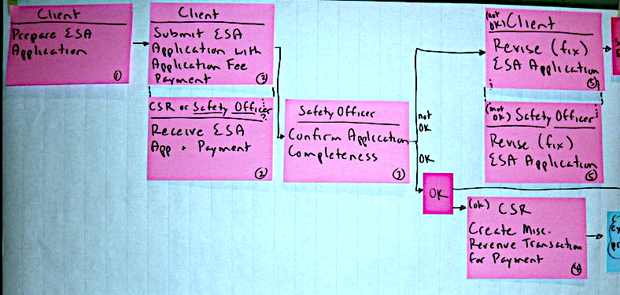
For reference: Design to-be process – overview
Skip to 43
Key points:
As with the as-is process –
"What first, who and how later"
Design around essential steps,
not administrative steps
Use an Augmented Scope Model to determine what the
essential activities are
Next, factor in who will perform each activity, then how
    a person as a manual activity
    a person interacting with a system, e.g. a use case
    a system, e.g., RPA (Robotic Process Automation)
Link essential activities by dependency – a PERT chart
Adjust – e.g., verify activity is assigned to the correct role
Only then redraw as a swimlane diagram
Finally, add non-value-added but necessary activities:
    transport, record keeping, notification, etc.
    ensure any approval steps are really necessary
    ("Don't confuse notification with approval.")
Who: Safety Officer
What: Confirm Application Completeness
How: S-MAN (system)

Slide 42
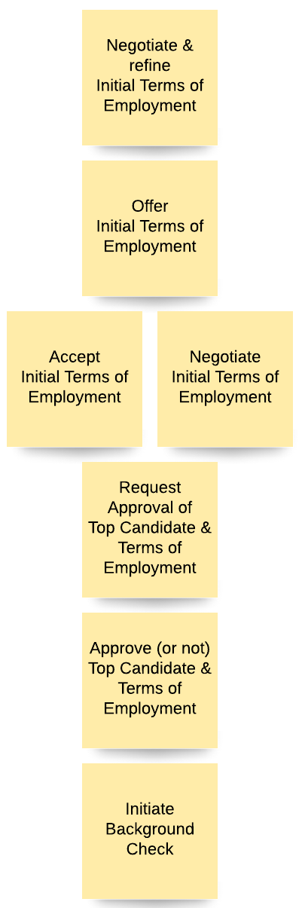
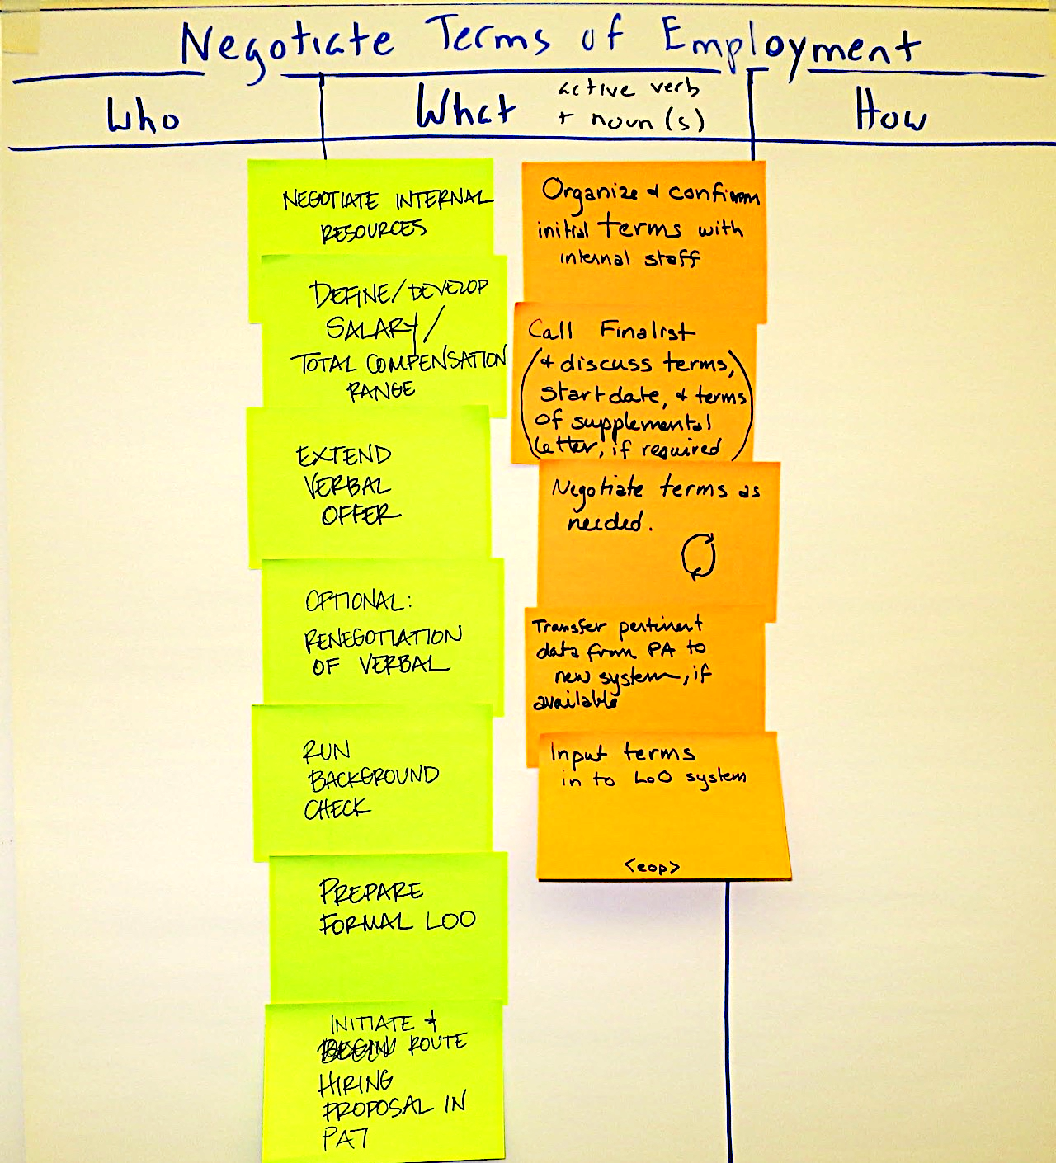
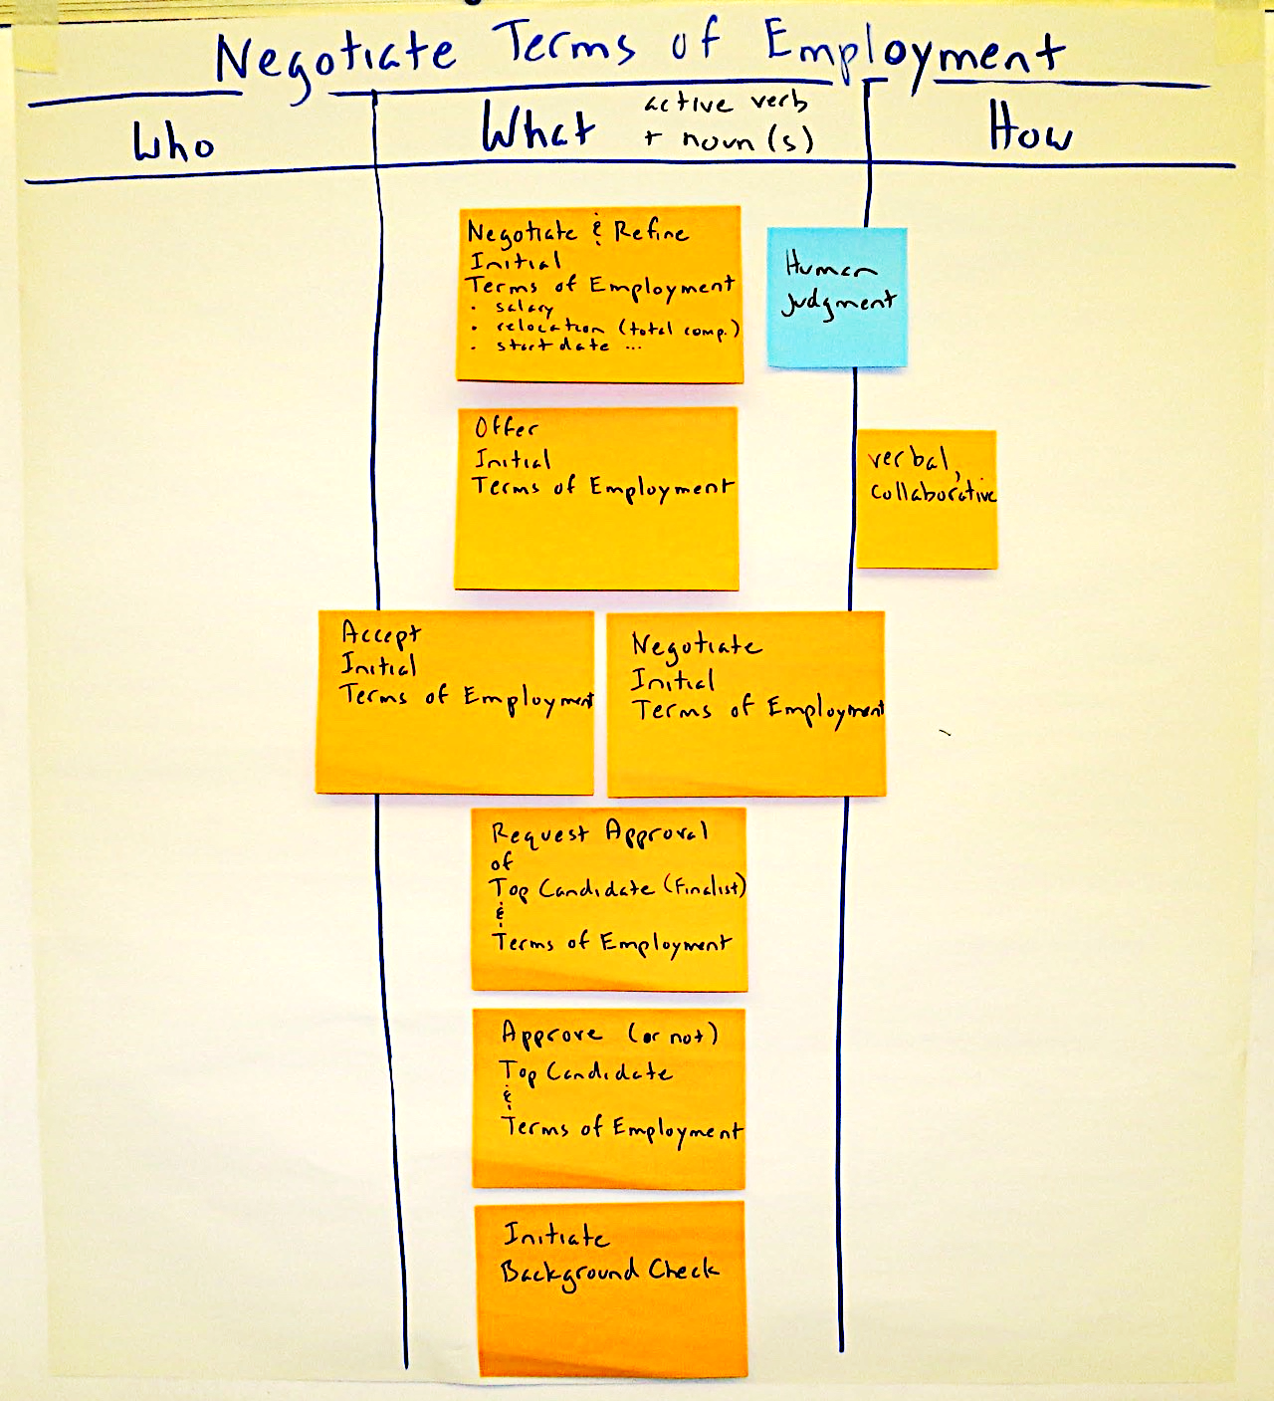
For reference: Design to-be process – Identify essential activities
Recruit, Hire, and Onboard Employee
Lucidchart version
Prepare to Recruit
Recruit Applicants
Evaluate Applicants & Select Finalist
Negotiate Terms of Employment
Finalise
Terms of Employment
Onboard Employee
1 – Two groups brainwrite essential activities.
They are "augmenting" the Scope Model.
2 – The full group
synthesises a list of essential activities.

Slide 43

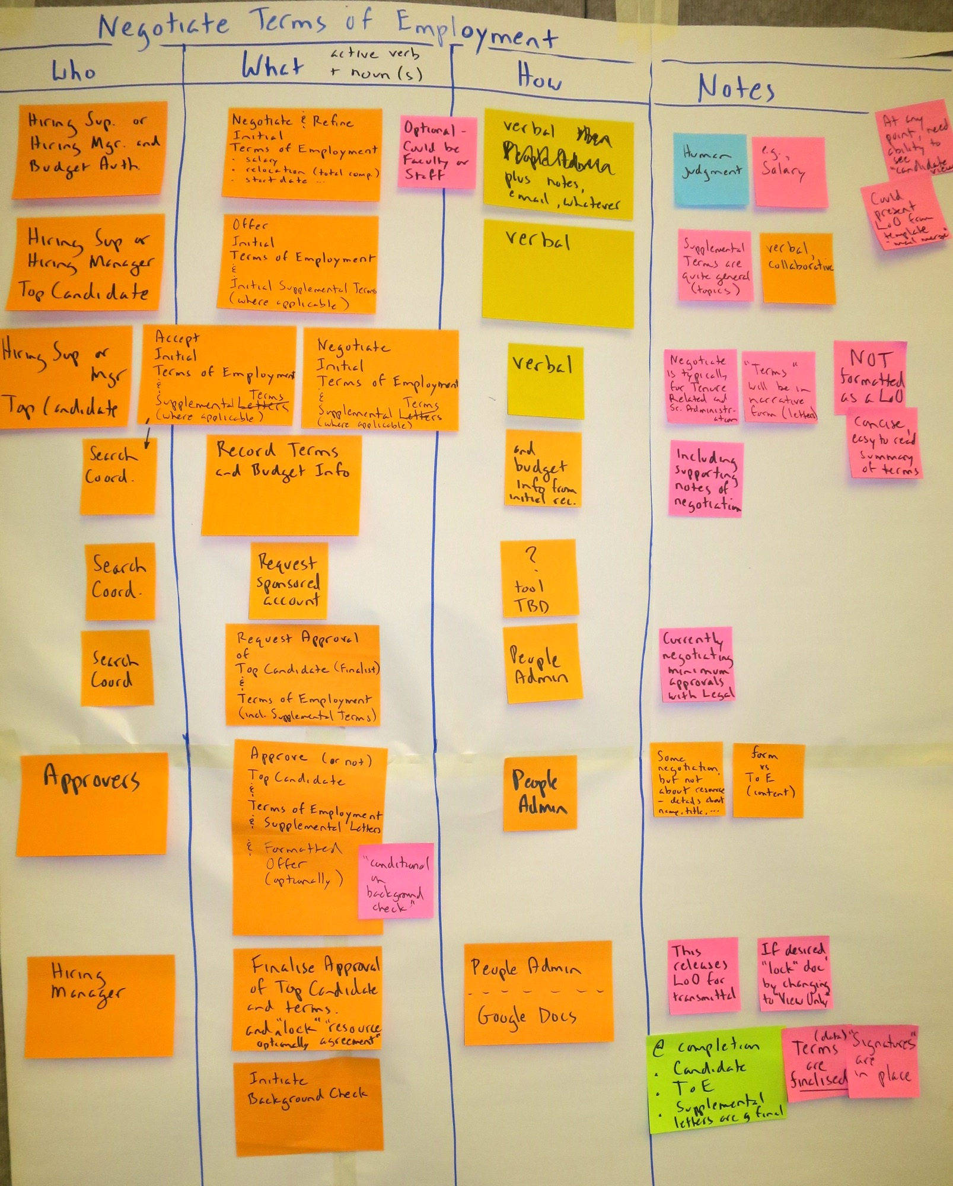
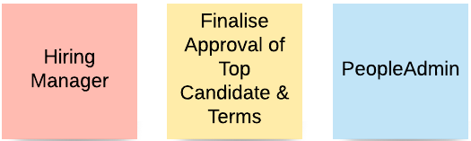
For reference: For each essential Activity, add "Who," "How,” and lots of “Notes”
We have the core of the
to-be process design
Going immediately to a
Swimlane Diagram would be overwhelming!
But now, developing the to-be
flow model (swimlane diagram)
is straightforward – We Can Do It!
We have:
  actors (swimlanes)
  steps
  how the steps will be done
  sequence
  (approximate, but OK for now)

Slide 44
Example – is a new process concept viable?
Classroom tech support at major US research university
  Goal: “Uber-style” tech support for classrooms – when an Incident is raised in a Classroom, dispatch it to one or more appropriate Techs (qualified, available, assigned to the appropriate Support Unit) who will bid on it.
  Approximately 20 “assertions” described the planned state:
    Each Tech may be badged for one or more Service Category Levels, and for each Service Category Level there may be one or more Badged Techs.
    Each Tech may be assigned to one or more Support Units during a given time period, and for each Support Unit there may be one or more assigned Techs.
    A Tech can only be assigned to one Support Unit at a time.
    An Incident for a particular Classroom can be raised by either a Customer (the “reporter” – Faculty, Staff, Tech, …?) or an automated Alert raised by an Equipment Unit located on a particular GP Classroom.
    many more…
  The assertions led to the development of an ERD.
  Note – the complete “Concept Model”
  is the combination of the definitions, the assertions, and the graphic (ERD)

Slide 45
Example 5 – Assertions. Lots of assertions.
Sorry about the fine print. And, no, this was not a simple job. It took some real effort to build the enabling concept model, but we could not have done it without the assertions – they made the needs granular!

Slide 46
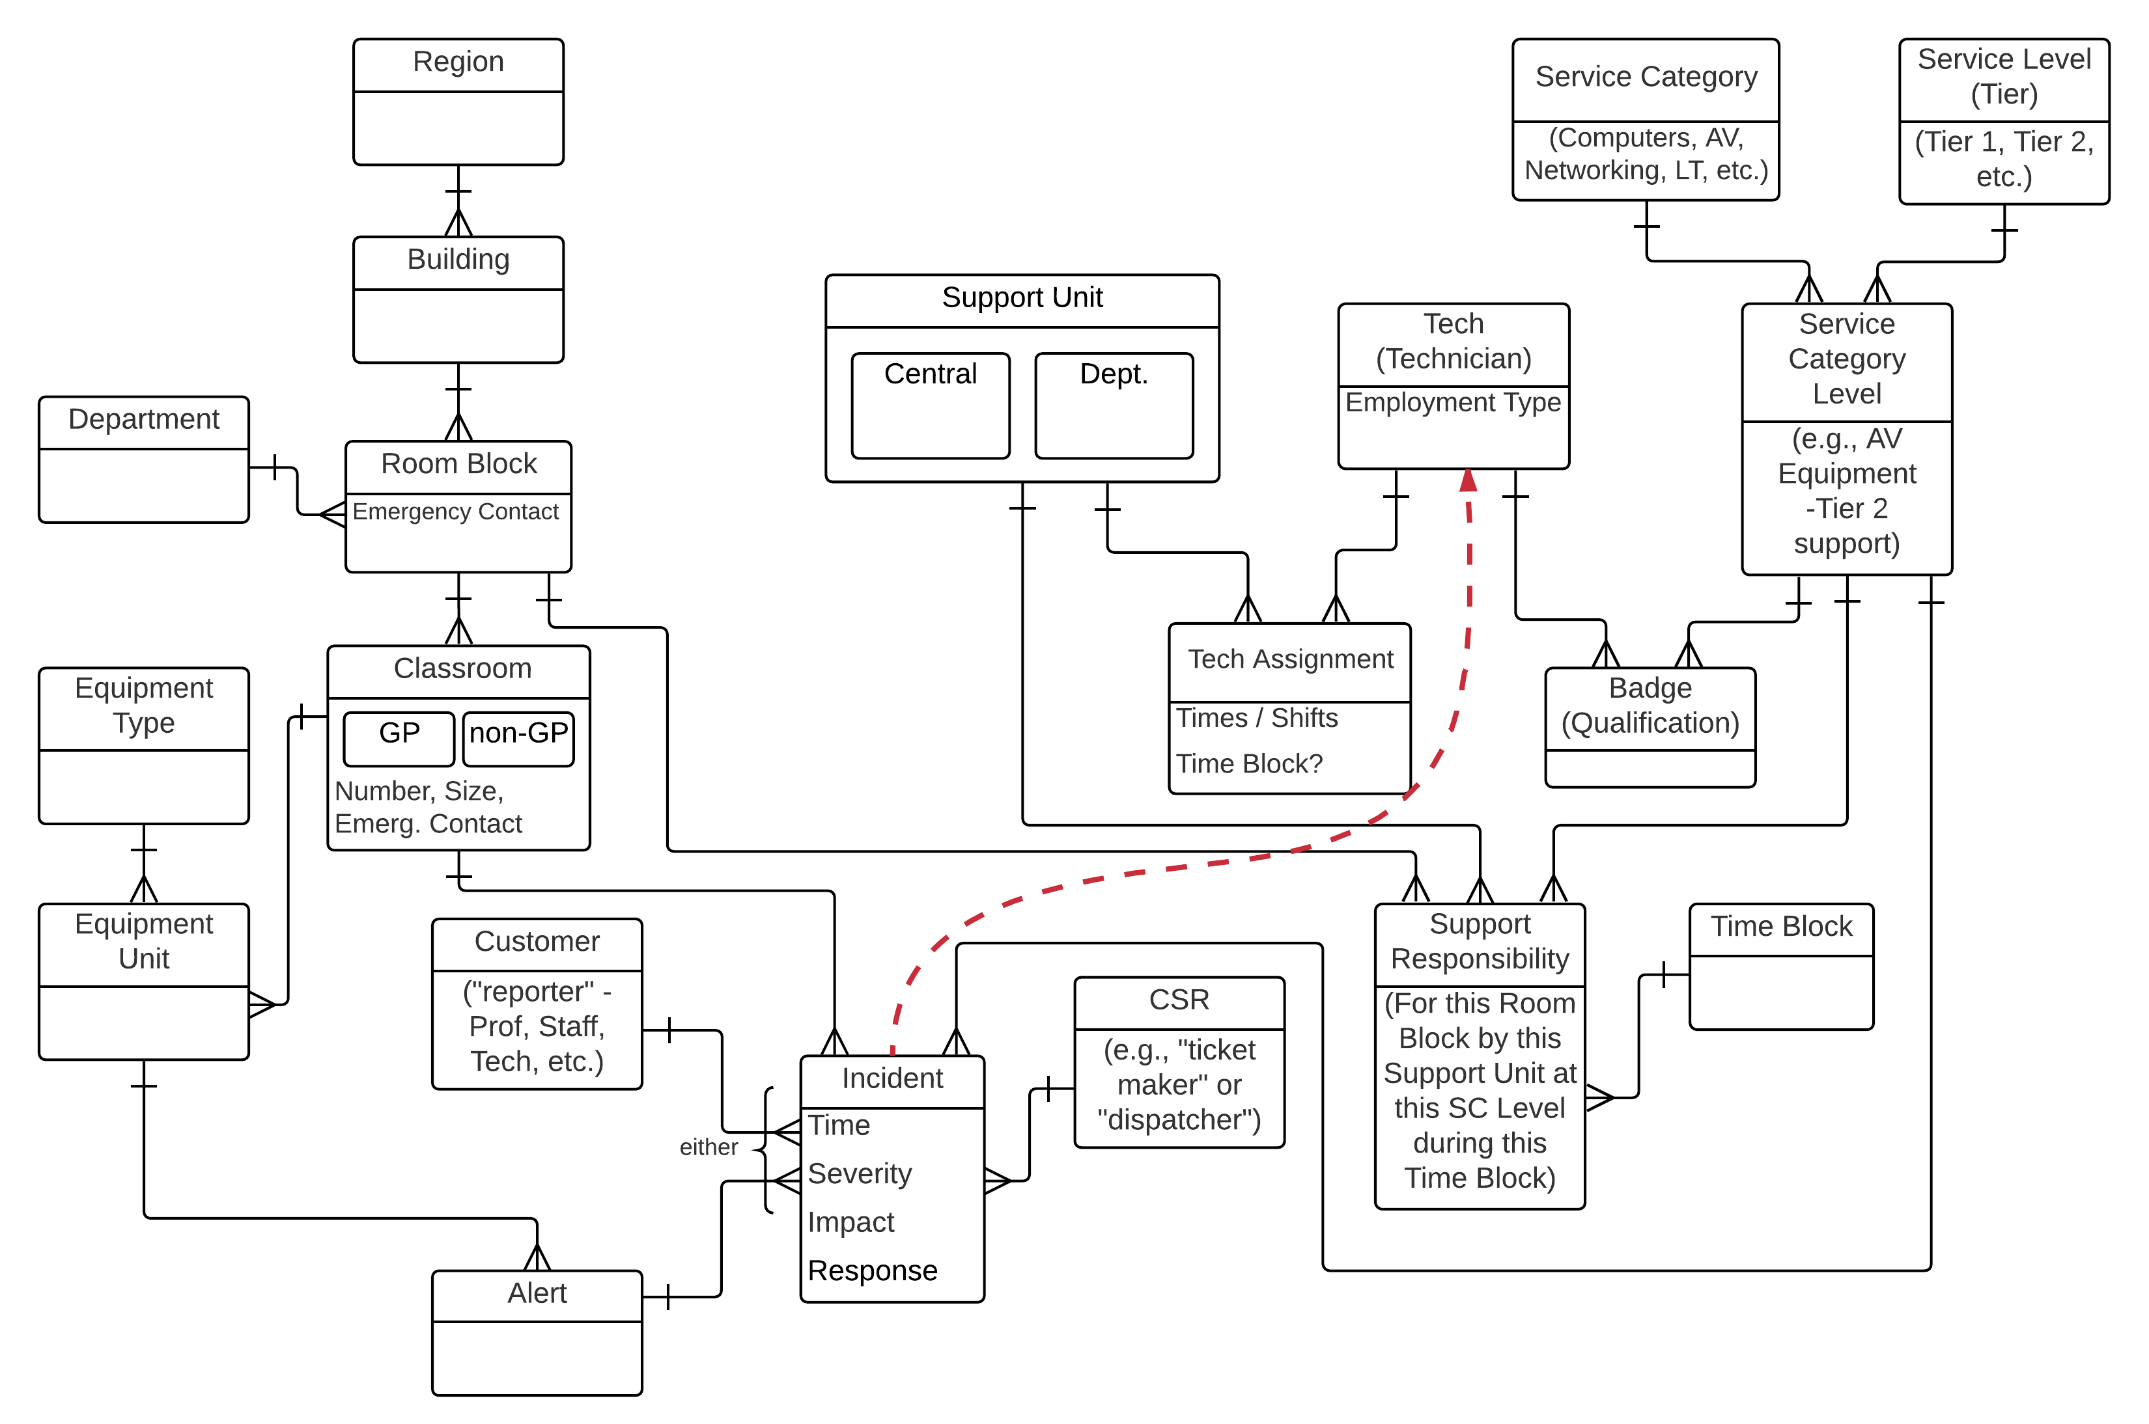
The underlying “Conceptual Plus” Model

Slide 47
Remember, it all starts with language
Concept Modelling (Conceptual Data Modelling) is crucial to Business Process work
The “things” you define in your concept model are the things that
  processes act on
  (in verb-noun process naming, the noun is a “thing” – an entity)
  businesses want information about
  applications revolve around
Businesses needs a common language
more than ever
Note – works best if you don't begin with a lecture on Data Modelling!
Just Do It! Go forth and model!
“Now! That should clear up
a few things around here!”
Notes:
Alan Kay at a DAMA conference – Data Administration and Management Association??? Boy, do you guys need a new name.
Also works best if you do it in conjunction with other business analysis (process and requirements modelling) – the world has gone parallel, and there is less tolerance for standalone data modelling activities that are a serial step in the process

Slide 48
Other courses for analysts by Alec Sharp

Slide 49
Thank you!
Alec Sharp, West Vancouver, BC, Canada
If you have questions or comments…
don't be shy, get in touch!
e: asharp@clariteq.com
ig: @alecsharp01
m: +1 604 418-3352
Notes:
Alec's bio:
Alec Sharp, a senior consultant with Clariteq Systems Consulting, has deep expertise in a rare combination of fields – business process analysis and redesign, application requirements specification, and data modelling. With almost 35 years of hands-on consulting experience, his practical approaches and global reputation in model-driven methods have made him a sought-after resource in locations as diverse as Ireland, Illinois, and India.
He is also a popular conference speaker, mixing content and insight with irreverence and humour. Among his many top-rated presentations are “The Lost Art of Conceptual Modeling,” “The Human Side of Data Modelling,” “Crossing the Chasm - From Process Model to IT Requirements,” and “Getting Traction for Process – What the Experts Forget.”
Alec literally wrote the book on business process modelling – he is the author of “Workflow Modeling: Tools for Process Improvement and Application Development, Second Edition” The first edition was published in 2001, and the second edition was published in 2009. It has consistently been the top-selling title on business process modelling, and is widely used as a consulting guide and as an MBA textbook. He was also the recipient of DAMA's 2010 Professional Achievement Award, a global award for contributions to the Data Management field.
Alec's popular workshops on Working With Business Processes, Data Modelling (introductory and advanced,) and Use Cases and Services are conducted at many of the world's best-known organisations. His classes are practical, energetic, and fun, with the most common participant comments being “best course I've ever had.”

