Slide 1
Testing in a BI & Data Landscape
Suzanne Kraaij
https://www.linkedin.com/in/suzanne-kraaij/

Slide 2
Agenda
1.
Testing Basics
The goal of testing
Quality
VOICE-model
2.
Test techniques
Data profiling
Other techniques
3.
Data Quality Dimensions
Data Quality Approach
4.
GenAI
AI Act
When to use GenAI

Slide 3
Testing Basics
The goal of testing
Quality
VOICE-model

Slide 4
What is the goal of testing?
Raising
the quality
Finding bugs
Providing insight into the quality!
Notes:
Gevolgen van testen

Slide 5
What is quality?
Value for the business
Explicit:
Stated needs
“What is described”
Implicit:
Implied needs
“What is needed”
Notes:
Kwaliteit = waardevol, geen kwaliteit = waardeloos
Expliciet/impliciet -> voorbeeld: systeem niet gebruikt

Slide 6
What is testing?
“Testing consists of verification, validation and exploration activities that provide information about the quality and the related risks, to establish the level of confidence that a test object will be able to deliver the pursued business value.”
TMAP, Quality for DevOps Teams
https://www.tmap.net/
Notes:
Gezegd wordt: vinden van bugs en verhogen kwaliteit. Gevolgen van testen

Slide 7
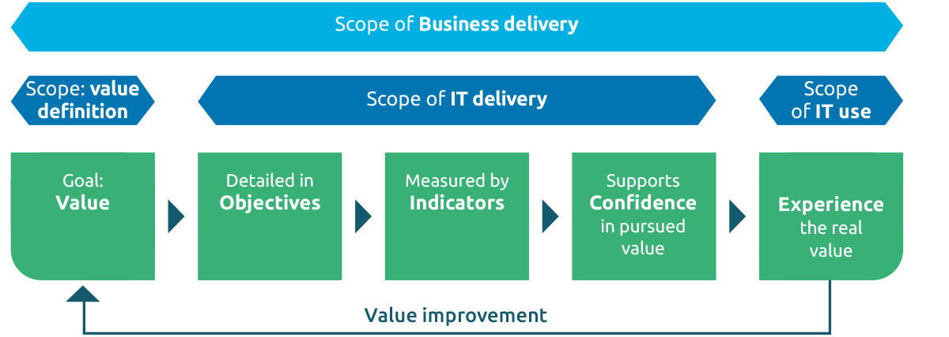
The starting point of organizations is to deliver business value

Slide 8
The starting point of organizations is to deliver business value
Notes:
C -> Confidence, vertrouwen. Testen heeft daar grote bijdrage. Black box -> niet getest? Niet vertrouwd!

Slide 9
Testing in a Data Environment
Converging versus Dverging
Quality of the data
Quality of the system
Quality of data flow
Notes:
3 stromen. Waarom dev niet testen? Verschillende blikken.
Flow -> risk-based testen, voorbeeld: 1 flow, maar vertrouwen nodig. Balans risico en vertrouwen. Niet negeren!

Slide 10
Risk-Based Testing & Keeping the balance
Risk
=
Confi-dence
Risk
Chance
X
Impact
Notes:
Risico = kans dat het fout gaat * impact als het fout gaat. Kans bijv. technische complexiteit.
Balans risico en benodigde vertrouwen. Terug naar data flow -> voorbeeld 1 flow maar business maakt zich zorgen

Slide 11
Testability
How easy or difficult is it to test this software or product and determine its quality?
“The degree of effectiveness and efficiency with which test criteria can be established for a system, product or component and tests can be performed to determine whether those criteria have been met.”
TMAP, Quality for DevOps Teams

Slide 12
The Joy of a Testable Data System
Dedicated test environment
ETL-steps can be kicked off separately
Activity log
Error log
Metadata columns:
Status
originating source
mutation dates
https://labs.sogeti.com/quality-coaching-encouraging-testability/
Observable
Understandable
Testable

Slide 13
Quality is a team effort!
Quality Engineering
Quality Engineering is about teammembers and their stakeholders taking a shared responsibility to deliver IT-systems with the right quality at the right time to the business.
Quality = value
Engineering = building
Quality Engineering = building value together!

Slide 14
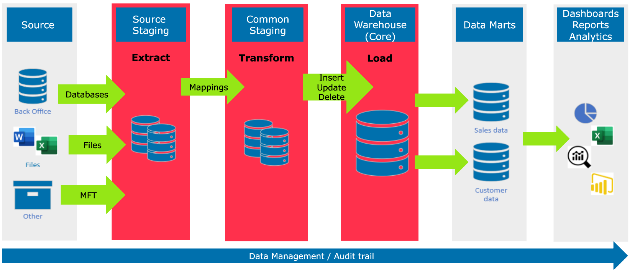
Where is the testing in a BI & Data landscape?
Migration
Migration
Transformations
Access rights
“Fit for purpose”
End-to-End Data Flow
Logging;
“Right to be forgotten”
Data Quality

Slide 15
Test Techniques
Data Profiling
Other Techniques

Slide 16
Data Profiling
Dataprofiling is the process of examining the data available from an existing information source and collecting statistics or informative summaries about that data.

Slide 17
Test Basis: Source-to-Target-Mapping (STM)
Points of interest:
Name fields: Check for diacritic characters and character sets used in the source (ASCII, Cyrillic, Greek, Arabic, etc.). Any missing values?
Gender: are Male, Female and Unknown the only values in the source? Case sensitivity?
ID: Check the maximum value length and check for uniqueness and missing values. Are there only numbers present?
Email: Check patterns.

Slide 18
Benefits of Data Profiling
Shift-left: Find bugs in the design early, helping to improve the data model
Null values when the target field is not nullable
Values unaccounted for in the transformations
Mismatch in datatypes
Improved tests
Find those names with special characters or “too long” streetnames, etc.
Assess the data quality
Example: email addresses with spaces or written out [at] instead of a @.

Slide 19
Other test Techniques
Checklists
Naming conventions
GDRP guidelines
In Reporting/Dashboarding
Syntactic
Special characters
NULL handling
Data formats
Boundary Value Analysis
Aggregations
Categories
Prediction queries
Format / Layout
Required calculations present
Business translation (technical column names ‘translated’ to correct business terminology)

Slide 20
Prediction Queries
Create your own ETL flow! (simplified)
Select Firstname as CUST_FN,
Lastname as CUST_LN,
case gender when “Male” then “M”
when “Female” then “F”
when “Unknown” then “U”
else “E” – so you can see if anything does not fall into the specified category) end as CUST_SX,
This can then be compared to the actual ETL results! Which assumptions were made?

Slide 21
Data Quality Dimensions
Data Quality Approach

Slide 22
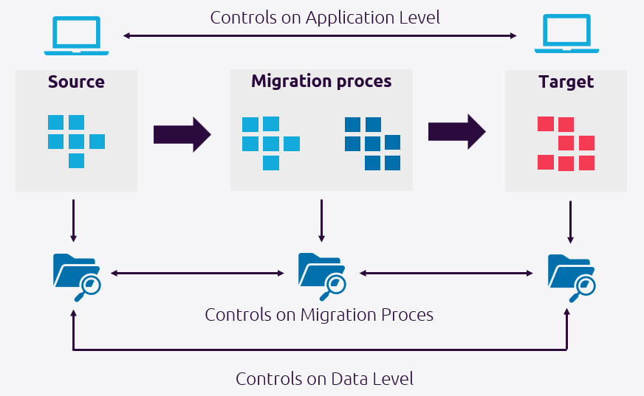
Data Quality in different roles
Front end Tester
Migration Specialist
BI & Data Tester

Slide 23
Six Dimensions of Data Quality
Completeness
Uniqueness
Timeliness
Validity
Accuracy
Consistency
Data
Quality
Dimensions

Slide 24
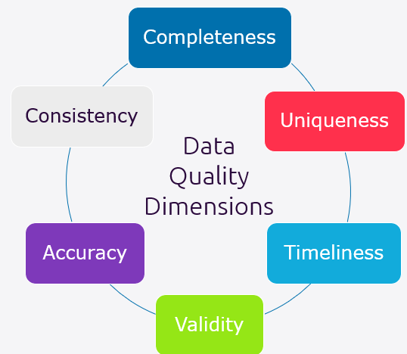
Data Quality Dimensions - Continued
Completeness: is all data from the source present in staging/datawarehouse?
Uniqueness: are there double records?
Timeliness: are changes in the source/DWH reflected on time in the dashboard?
Validity: is the data valid? Does it adhere to the business/syntax rules?
Accuracy: is the data accurate? e.g. no customers with impossible age: 121
Consistency: is the data consistent across sources?

Slide 25
Further Data Quality Considerations
This list is in no way complete, but it gives an idea on what else to consider:
Usability: is the data understandable and relevant?
Security: is the data auditable and are privacy regulations maintained (e.g. "right to be forgotten")?
Value: Is there a good cost/benefit case for the data in terms of capacity (and therefor money)?
Sustainability: Is there a good cost/benefit case for the data in terms of power usage?

Slide 26
Data Quality approach
Step 1
Identify which data items need to be assessed for data quality
Step 3
define values or ranges representing good and bad quality data
Step 5
Review the results
Step 2
Assess which data quality dimensions to use and their associated weighting
Step 4
Apply the assessment criteria to the data items
Step 6
Take corrective actions if needed

Slide 27
GenAI
AI Act
When to use AI

Slide 28
AI Act of the European Union - The 6 AI principles
1. Human oversight and accountability: AI systems should assist humans in decision-making, and humans should be able to override decisions made by the system.
2. Technical robustness and safety: Providers and developers of AI systems should be designing AI systems to work well, be predictable, and be safe to use. AI providers should ensure that their systems comply with quality management systems.
3. Privacy and data governance: AI system providers and developers should be designing AI systems with data privacy and data protection in mind. The datasets used to train AI systems should be properly governed.
4. Transparency AI systems should be transparent. AI providers should provide clear information about the system’s capabilities and limitations, as well as the data sources used to train it.
5. Diversity, non-discrimination, and fairness: Developers and providers of AI systems should be creating AI systems to avoid discrimination and bias and promote diversity. Providers should carefully examine data sources for bias and use proper measures to mitigate any potential biases.
6. Social and environmental well-being: Creators of AI systems should be designing AI systems to contribute to sustainable and inclusive growth, social progress, and environmental well-being. Providers should consider the potential impact of AI systems on society and the environment.

Slide 29
AI Act of the European Union The 6 AI principles
1.
Human oversight and accountability
2.
Technical robustness and safety
3.
Privacy and data governance
4.
Transparency
5.
Diversity, non-discrimination, and fairness
6.
Social and environmental well-being

Slide 30
When to use GenAI and when NOT to use GenAI
USE GenAI
Legal, Ethical, Financial, Reputational, etc.
NO
Does it matter if the output is correct
?
Are you willing and able to take full responsibility for any inaccuracies
?
Start
USE GenAI WITH CAUTION
YES
YES
YES
Do you have the expertise and means to verify if the output is correct
?
NO
NOT SAFE TO USE GenAI
NO

Slide 31
Key Takeaways
Quality = Value
Explicit and implicit needs
Business Activation: VOICE
Which value is created? What is the user experience? What confidence do we bring?
Think like a tester
Quality of the data, the system and the flow
Risk-based testing
Can help improve your tests and to shift left
Test techniques & Data Quality
Can help evaluate your data
https://www.tmap.net/page/bi-testing
The TMAP body of knowledge for quality engineering and testing

