Slide 1
Federated Computational Data Governance in Practice
How to maintain consistent governance standards while allowing domain teams the flexibility they need?
Winfried A. Etzel
DATAWAREHOUSING & BUSINESS INTELLIGENCE SUMMIT
Utrecht 2025
Notes:
Welcome everyone to this session on Federated Computational Data Governance, a key part of the Data Mesh approach. In this presentation, we'll explore how to maintain consistent governance standards while giving domain teams the flexibility they need to innovate. Many organizations struggle with this balance between control and autonomy when it comes to data. Today, you'll learn practical strategies to address this challenge. Whether you're just starting your data governance journey or looking to evolve your existing practices, these insights will help you build more scalable, agile, and accountable data systems. Let's dive in and get started!

Slide 2
Winfried A. Etzel
«voluntarily» in Stavanger​
Married with children​
Background in history, political science and law​
Sr Specialist Data Management @ Equinor​
Deputy Board Member @ DAMA Norway​
Podcast Host MetaDAMA

Slide 3
Notes:
On this day in 1997, Starship Troopers was released. A movie that very much combines past and future, the value of communicating correctly, and the fight around roles and responsibilties.

Slide 4
Agenda
1
Hard Truths
2
Data Teams & Models
3
Data Governance
How misconceptions built the understanding of Data Governance
Building the right data teams and structures.
The Future of Data Governance.

Slide 5
What Does It Mean to Treat Data as an Asset?
The Asset Perspective
The Service Paradigm
The Organizational Gap
Data is a strategic business asset that drives value.
Organizations often treat data through IT service frameworks.
Team structures remain misaligned with data's value.
Requires investment, maintenance, and governance.
Ticket-based systems disconnect data from business outcomes.
Data teams typically mimics IT structures, limiting potential.
Notes:
Data is a strategic business asset that drives organizational value, just like financial assets Data requires investment, maintenance, and governance to be effectively leveraged Many organizations still treat data through traditional IT service frameworks, with ticket-based operations that disconnect data from business outcomes Despite recognizing data's value, team structures often remain misaligned, and data governance tends to mimic IT governance, limiting data's potential The way forward is for data teams to function as business teams, not just IT service providers Federated governance models can balance control with domain-specific flexibility, empowering data to drive business value

Slide 6
The Operational Reality: Challenges in Data Management
Build-centric mindset
Reactive governance
Failed enterprise initiatives
Organizations prioritize system development over lifecycle management, treating data as project-based initiatives rather than ongoing assets.
Data governance becomes reactive when separated from business strategy, undermining long-term value creation.
Large-scale data projects often collapse because they lack domain-specific understanding and ownership.
Operational vs. analytical divide
"Democratization" misconception
The separation between operational and analytical data creates governance blind spots.
True data empowerment requires clear accountability, not just equal access in non-democratic organizational structures.
Notes:
The challenges we face in data management are deeply rooted in how organizations approach and prioritize data Many companies have a build-centric mindset, focusing on system development rather than ongoing data lifecycle management Data is often treated as a project-based initiative rather than a strategic, long-term asset Data governance tends to be reactive, disconnected from overall business strategy, limiting the value it can create Large-scale data projects frequently fail because they lack deep domain-specific understanding and clear ownership The divide between operational and analytical data creates blind spots in governance and oversight The misconception of "democratization" - providing equal access alone does not empower true data-driven decision making without clear accountability

Slide 7
The Executive Reporting Game
1
Board-Level Matter
2
Business Disengagement Risk
Data governance requires attention at the highest organizational level. Strategic decisions about data affect enterprise value creation.
When business leaders abdicate data decisions, technical teams make business choices by default. This creates strategic misalignment.
3
Reporting Structure Confusion
4
Governance's Unique Position
Competing reporting lines between CIO, CFO, and CDO blur accountability. Clear authority channels are essential.
Data governance requires distinct organizational representation. It bridges technical implementation with business strategy.
Notes:
• Data governance is a critical board-level issue that requires attention from the highest levels of the organization. • Strategic decisions about data management and usage have a direct impact on the company's ability to create value. • When business leaders don't engage with data decisions, technical teams end up making choices that may not align with the company's strategic goals. • Competing reporting lines between roles like the CIO, CFO, and CDO can create confusion around accountability for data governance. • Data governance requires a distinct organizational representation that bridges the gap between technical implementation and business strategy.

Slide 8
Data Governance as Negotiator
Regulatory Downward Pressure
Organizational Upward Pressure
External Inward Pressure
Technological preconditions
Business units demand data to cater their operational needs.
Partners, competitors, and market forces shape data needs.
Technological landscapes grow organically and rarely change due to a certain need.
Compliance requirements cascade from regulators to all teams.
Notes:
Data governance is essential for navigating the complex web of pressures that organizations face Regulatory requirements cascade down, necessitating governance to distribute responsibilities and protect teams from excessive overhead Business units demand faster data access, so governance must balance innovation needs with appropriate guardrails External forces like partners, competitors, and market trends shape data strategy, and governance facilitates secure data exchange while protecting competitive advantages Successful governance requires cross-functional leadership to balance stakeholder needs through negotiation and compromise

Slide 9
Disentangling Governance from Operations
Strategic Governance
1
Sets direction and policies
Tactical Implementation
2
Translates policies to processes
Operational Execution
3
Day-to-day management activities
The term "Federated Computational Data Governance Operating Model" confuses distinct organizational functions. Governance establishes the rules. Operations executes within those boundaries.
Notes:
Governance and operations are distinct organizational functions that should be clearly separated Governance sets the strategic direction, policies, and rules for the data ecosystem Operations translates those policies into day-to-day processes and executes the work Effective data ecosystems require this clear separation of roles and responsibilities The "Federated Computational Data Governance Operating Model" blurs the lines between these functions We need to disentangle governance from operations to ensure proper oversight and efficient execution Governance provides the guardrails, while operations works within those boundaries to manage the data

Slide 10
A Holistic Approach to Data Information Knowledge and Wisdom
Effective governance must span the entire knowledge spectrum, not just raw data.
Wisdom
1
Applying knowledge to achieve outcomes
Knowledge
2
Information with context and experience
Information
3
Data with meaning and relationships
Data
4
Raw facts and figures
Each layer depends on the quality of what's beneath it. Governance must encompass all levels to create business value, not just technical compliance.
Computational governance enforces rules across this hierarchy, ensuring integrity at each transformation point.
Notes:
Effective data governance is not just about managing raw data, but spans the entire knowledge spectrum The data pyramid shows the progression from raw data to information, knowledge, and ultimately wisdom Each layer builds on the quality of the layer below it - governance must address all levels to create true business value Computational governance helps enforce rules and ensure integrity at each transformation point as data becomes information, knowledge, and wisdom Governance that only focuses on technical compliance with data rules misses the bigger picture - it must encompass the full knowledge hierarchy to be truly effective

Slide 11
Evolution of Data Governance
1
2
3
Compliance Focus
Enabling Innovation
Automation Motor
Early emphasis on meeting regulatory requirements.
Shift towards aligning governance with business value.
Now, there is a drive for Data Governance automation in complex, distributed landscapes.

Slide 12
What Does It Mean to Treat Data as an Asset?
Discoverable
Accessible
Data must be easily findable through comprehensive catalogs and metadata. Teams across the organization should be able to locate the data they need without excessive searching or departmental barriers.
Once discovered, data should be readily accessible to authorized users through standardized interfaces and protocols. Proper access controls ensure data is available to those who need it while remaining protected.
Trustworthy
Valuable
Data quality, lineage, and provenance must be documented and maintained. Users should have confidence in the reliability of the data they're using for business decisions and analytics.
Data must contribute measurable value to business outcomes. This requires understanding data's context, business relevance, and potential applications across the organization.
Notes:
Data is a critical asset that must be strategically managed, just like financial assets For data to be truly valuable, it needs to be: Discoverable - easily findable through catalogs and metadata Accessible - available to authorized users through standard interfaces Trustworthy - with documented quality, lineage, and provenance Valuable - contributing measurable business value Organizations that fail to treat data as an asset struggle with silos, inconsistent standards, and lack of accountability Proper data governance with clear ownership and protocols is essential to realizing data's full potential

Slide 13
What is Data Governance?
Traditional Definition
Alternative Perspective
The exercise of authority, control, and shared decision-making (planning, monitoring, and enforcement) over the management of data assets.
Data Governance is a human-based system by which data assets in a socio-technical system are directed, overseen, and by which the organization is held accountable for achieving their defined purpose.
Notes:
Accountability in socio-tech - can a machine be accountable? Or even can a machine be accountable for human actions? defined purposes - negotiated requirements

Slide 14
"Roles" of Data Governance
Data Negotiator
Data Director
Data Auditor
Translating business and regulatory requirements into actionable data policies.
Shaping focus and priorities in Data & AI-driven initiatives.
Overseeing and ensuring the accountability for data.

Slide 15
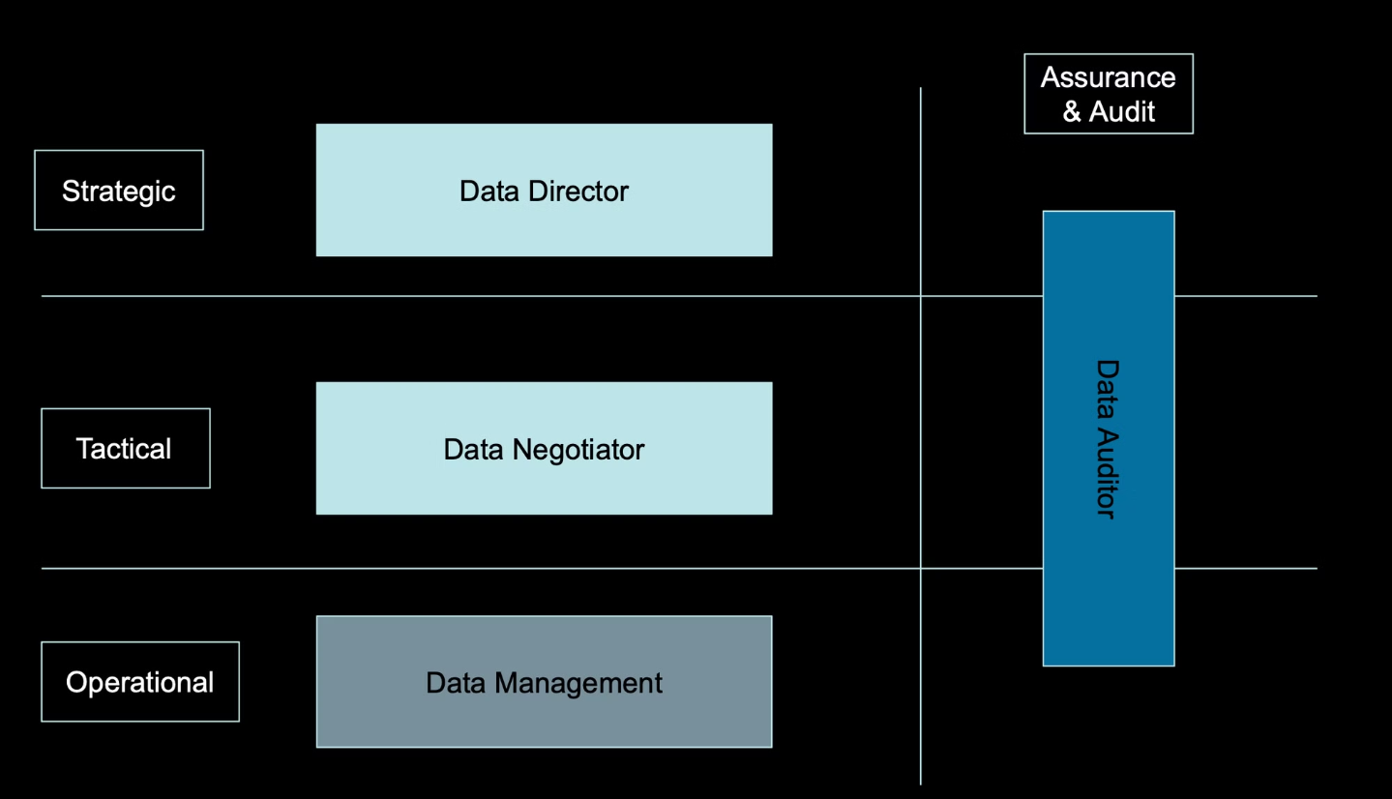
"Roles" of Data Governance

Slide 16
Data Operating Models: Central vs. Distributed vs. Federated
Centralized
Distributed
Federated
Single point of control.
Data dispersed across units.
Balancing control and autonomy.

Slide 17
What is Federated Data Governance?
Federated Data Governance balances local autonomy in data handling with overarching organizational policies to achieve cohesive, secure, and compliant data practices within a socio-technical system.
Central Oversight
Core policies, standards, and frameworks set by a central authority.
Domain Autonomy
Business units manage domain-specific requirements and implementations.
Shared Accountability
Clear ownership at each level with transparent responsibility models.
Notes:
Federated governance balances central oversight with local autonomy. Why federate governance? Ensures domain expertise is leveraged while still aligning with enterprise goals. More agile decision-making in complex organizations. Example: Polar Energy – Offshore installations need autonomous governance but must still align with corporate risk and compliance requirements.

Slide 18
Data Teams for Maximum Impact

Slide 19
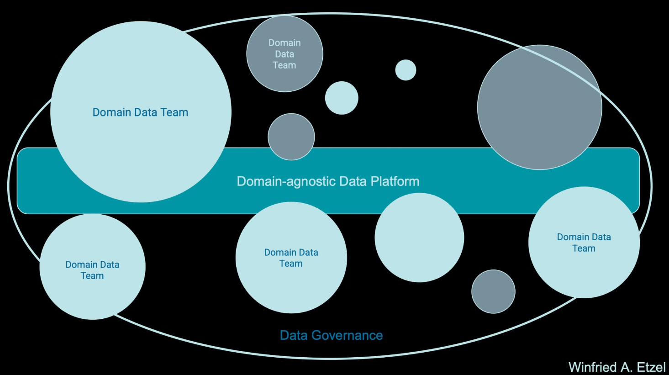
Data Mesh Holacracy

Slide 20
Structuring Data Teams for Agility & Impact
Strategic Layer
1
Central governance & data leadership
Operational Layer
2
Core data teams implementing governance
Distributed Layer
3
Domain data teams managing data products
Notes:
The title of this slide is "Structuring Data Teams for Agility & Impact" It outlines a three-layer model for effective data governance and management The strategic layer is about central governance and data leadership, setting the vision and policies The operational layer is the core data teams that implement the governance framework The distributed layer is the domain data teams that manage specific data products, aligned with the overall governance This federated approach balances centralization and decentralization, empowering subject matter experts while maintaining necessary standards and controls The key is striking the right balance between top-down strategy and bottom-up execution, to drive agility and impact

Slide 21
Data Teams for Maximum Impact
Data Governance
Establish data policies, standards, and controls to enable trusted, ethical, and compliant data use.
Data Strategy
Navigate uncertainty in data towards overall business objectives and priorities.
Data Scientists
Leverage advanced analytics and machine learning to uncover insights from data.
Data Engineering
Build and maintain the data infrastructure, pipelines, and platforms to support data-driven initiatives.
Data Operations
Strategical / Tactical Guidance
Ensure reliable and efficient data processing, monitoring, and incident response.
Distributed Data Management
Data Teams
Empower domain experts to manage data within their business units.
Central Data Management
Distribution
Provide centralized data enablement and support for the entire organization.

Slide 22
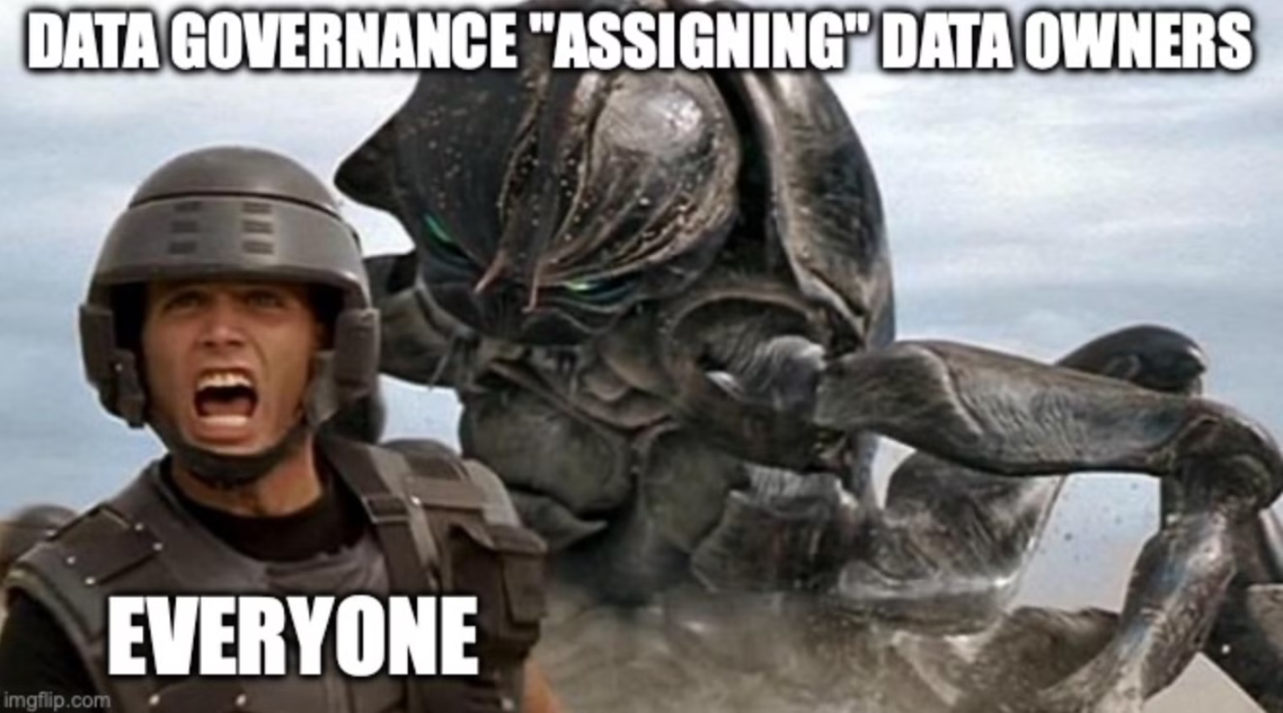

Slide 23
Automation in Data Governance
From Incentives to Automation
Governance by Design
Operational Efficiency
Reduced Compliance Burden
Computational governance shifts from human compliance to machine-enforced standards.
Automated processes enforce policies without requiring constant human intervention.
Management processes become prime candidates for streamlined automation.
Systems that self-govern eliminate the need for economic or social incentives.
Notes:
Data governance has traditionally relied on human compliance and incentives to enforce standards But computational governance allows us to shift towards machine-enforced standards and automated processes This "governance by design" approach embeds compliance directly into the systems and processes Automating key management tasks can drive significant operational efficiency and reduce the compliance burden By building self-governing systems, we can eliminate the need for economic or social incentives to drive adherence to policies The result is a fundamental transformation in how we approach data governance, leveraging technology to enforce standards without constant human intervention

Slide 24
Automation in Data Governance
Data Products
Data Contracts
Governance Scaling
Well-defined, reusable data assets with clear ownership that encapsulate both the data and its governance.
Formal agreements between data producers and consumers that specify access rules, quality expectations, update frequencies, and usage limitations.
The product-contract approach enables governance enforcement to scale by embedding controls and standards directly into data interfaces.
Notes:
Data products are well-defined, reusable data assets with clear ownership that encapsulate both the data and its governance This shifts the mindset from "data as raw material" to "data as consumable asset" with defined interfaces and quality guarantees Data contracts are formal agreements between data producers and consumers that specify access rules, quality expectations, update frequencies, and usage limitations Contracts create accountability and set clear expectations for all parties involved This product-contract approach enables governance to scale by embedding controls and standards directly into data interfaces, rather than trying to enforce them externally through central oversight This shifts responsibility to domain teams who best understand their data, rather than enforcing one-size-fits-all rules from the center The combination of product thinking and contractual agreements provides the foundation for federated governance that balances autonomy with enterprise needs Data products solve governance challenges by shifting responsibility to domain teams who best understand their data. Rather than enforcing one-size-fits-all rules, this approach creates accountability at the source while standardizing how data is exposed and consumed. Meanwhile, data contracts formalize the producer-consumer relationship, preventing misalignment and ensuring consistent expectations. This combination of product thinking and contractual agreements provides the foundation for federated governance that balances autonomy with enterprise needs. Effective federated governance balances centralization and autonomy. The strategic layer establishes enterprise-wide policies, standards, and accountability frameworks, while providing the vision for data's role in the organization. The operational layer consists of specialized teams who implement and enforce governance mechanisms. They serve as the bridge between high-level strategy and domain-specific execution, providing technical expertise and standardized processes. At the distributed layer, domain data teams take ownership of their specific data domains, creating and managing data products while aligning with organizational governance principles. This empowers subject matter experts while maintaining necessary guardrails.

Slide 25
Automation in Data Governance
AI-powered Policy enforcement
MLOps for Governance
Automating governance enforcement within ML pipelines ensures that models adhere to data policies, enhancing model integrity and trust.
Automating policy operationalization and enforcement across systems.
AI-Enhanced Compliance
Audit and Monitoring with AI
Leveraging e.g. natural language processing to review contracts, privacy policies, and regulatory changes for compliance gaps.
AI-powered tools can monitor data usage and AI model performance in real time, identifying potential issues and anomalies, facilitating proactive risk management.

Slide 26
The Data Governance Mindset
From Prerequisite to Guardian
1
Shift the perception of data governance from a mere prerequisite to a guardian that empowers and protects the organization's data assets.
2
From Enforcement to Support
Move away from a heavy-handed enforcement approach and instead position data governance as a supportive framework that enables teams to manage data effectively.
From Excellence to Enablement
3
Refocus data governance efforts from striving for perfection to prioritizing the enablement of data-driven decision making across the organization.
4
From Universal to Adaptive
Recognize that a one-size-fits-all data governance model may not work for every domain, and embrace an adaptive approach that caters to the unique needs of each business area.
From Centralized to Federated
5
Shift from a centralized data governance structure to a federated model that empowers domain experts to manage data within their respective areas while maintaining overall alignment.
6
From Descriptive to Prescriptive
Move beyond just describing data governance policies and instead focus on designing data governance frameworks that actively guide and shape data-related decision making.
From Governmental to Societal
7
Embrace a data governance mindset that considers the broader societal impact of data-driven initiatives, fostering responsible and ethical data management practices.

Slide 28
Key Takeaways & Next Steps
Automate for Sustainable Governance
Implement Data Products & Contracts
Structure Teams for Balanced Governance
Treat Data as a Business Asset
Use AI and automation to monitor quality, enforce policies, and measure governance effectiveness, ensuring consistent standards at scale with minimal overhead.
Package data as consumable products with defined interfaces. Establish contracts that specify quality expectations and usage terms between producers and consumers.
Make data discoverable, accessible, and trustworthy through clear ownership and governance, managing it with the same rigor as financial assets.
Balance strategic, operational, and distributed teams. Centralize for security and compliance; federate where domain expertise matters.
.
Notes:
• Data is a strategic asset that requires intentional management, just like financial assets • Ensure data is discoverable, accessible, trustworthy, and valuable by establishing clear ownership structures and governance protocols • Recognize the importance of data governance and treat it as a critical business function, not just an IT concern • Implement a multi-layered governance approach with strategic, operational, and distributed teams • Centralize only where necessary, such as for security and compliance, and decentralize where domain expertise and agility matter most • This balanced structure allows for both standardization and flexibility • Shift from treating data as raw material to packaging it as consumable products with defined interfaces • Formalize producer-consumer relationships through contracts that specify quality expectations and usage terms • This product-oriented mindset helps ensure data is fit-for-purpose and meets user needs • Leverage AI and automation to monitor data quality, enforce policies, and provide feedback on governance effectiveness • This reduces manual overhead while ensuring consistent standards as the organization scales • Automation is key to sustaining data governance as the business grows and evolves

Slide 29
Future Vision of Data Governance
Agile
1
Adaptive to changing regulatory and business environments.
Resilient
2
Withstanding disruptions in distributed systems.
Accountable
3
Ensuring clear accountability across federated models.

Slide 30
Winfried Adalbert Etzel - LinkedIn
Winfried Adalbert Etzel – Medium

Slide 31
Case Study: FjordStep's Governance Transformation
Problem Identification
1
FjordStep struggled with data inconsistencies across sales, finance and inventory systems. Reports frequently showed conflicting numbers, leading to lost time reconciling differences and eroding executive trust in data-driven decisions.
2
Governance Framework Implementation
The company established a federated governance model with a central data office setting standards while domain teams (sales, finance, operations) took ownership of their respective data domains. Clear accountability was established using the OAR model.
Data Product Development
3
Each domain created standardized data products with formal contracts. The sales team's transaction data product established SLAs for data freshness and quality, with finance as a key consumer. This formalized previously ad-hoc data sharing practices.
4
Results Achieved
After six months, report discrepancies dropped by 78%. Time spent on reconciliation decreased by 15 hours weekly, while data-driven decision confidence increased across executive leadership. The governance framework scaled successfully as the company expanded into new markets.
FjordStep's experience demonstrates how federated governance can transform data practices even in organizations with established but problematic data systems. By clearly defining ownership and implementing product thinking, they achieved both technical improvements and business outcomes.
Notes:
FjordStep, a company that struggled with data inconsistencies across their systems, leading to lost time and eroding trust in data-driven decisions They established a federated governance model, with a central data office setting standards and domain teams owning their respective data This clear accountability, using the OAR model, helped them create standardized data products with formal contracts For example, the sales team's transaction data product had SLAs for data freshness and quality, with finance as a key consumer This formalized previously ad-hoc data sharing practices After 6 months, they saw a 78% drop in report discrepancies, 15 hours weekly saved on reconciliation, and increased confidence in data-driven decisions The governance framework scaled successfully as the company expanded into new markets FjordStep's experience demonstrates how federated governance can transform data practices, even in organizations with established but problematic data systems

Slide 32
Data Stewardship: Evolving Roles in Federated Organizations
Traditional stewardship models struggle in distributed environments where business domains maintain autonomy.
From Control
Stewards once acted as gatekeepers enforcing standardized rules across the enterprise.
To Domain Enablement
Modern stewards coach domain teams on governance within computational boundaries.
To Value Acceleration
Today's stewards facilitate cross-domain data contracts that unlock business value.
To Governance Automation
Future stewards implement computational guardrails that scale governance seamlessly.
Notes:
The traditional model of centralized data stewardship is no longer effective in today's federated, distributed business environments Modern data stewards need to shift their role from being gatekeepers enforcing rigid rules, to coaches that enable domain teams to govern data within their own boundaries The goal is to facilitate cross-domain data sharing and unlock business value, rather than just controlling access In the future, data stewards will need to implement more automated, scalable governance mechanisms as the volume and complexity of data continues to grow

Slide 33
Long-Term Maintenance of Data Governance Practices
Monitor
1
Enforce
Track governance KPIs and compliance
2
Apply policies through automated controls
Improve
4
Adapt
Enhance processes based on feedback
3
Evolve governance to meet changing needs
Sustaining data governance is a continuous process rather than a one-time project. Organizations must establish feedback loops that provide visibility into governance effectiveness while enabling adaptation to evolving business needs and regulatory requirements.
AI and automation play crucial roles in making governance sustainable at scale. AI-powered monitoring can detect anomalies in data quality or usage patterns, while automated policy enforcement reduces manual overhead and ensures consistent application of standards. Together, these capabilities allow governance to become embedded in daily operations rather than existing as a separate compliance activity.
Notes:
• Data governance is an ongoing process, not a one-time project • Key aspects are monitoring, enforcement, adaptation, and continuous improvement • Monitoring tracks KPIs and compliance to provide visibility into governance effectiveness • Automated enforcement applies policies consistently and reduces manual overhead • Adapting governance allows it to evolve and meet changing business needs and regulations • Improvement comes from feedback to enhance governance processes over time • AI and automation are crucial to make governance scalable and embedded in daily operations • Monitoring can use AI to detect anomalies, while automation ensures consistent policy application • Together, these capabilities help make data governance a sustainable, integrated part of the organization

Slide 34
Ensuring Data Accountability with Clear Ownership
Role
Ownership
Accountability
Responsibility
Domain Lead
Decides domain data strategy
Reports on data quality KPIs
Reviews critical data elements
Business Function Leader
Approves data access policies
Ensures governance policy adherence
Allocates resources for data work
Data Engineer
Defines technical implementations
Documents data lineage
Executes data transformations
Data Steward
Owns metadata standards
Monitors data quality
Resolves data issues
Notes:
The OAR (Ownership, Accountability, Responsibility) model helps provide clarity on data governance in federated environments It defines the roles and responsibilities for different stakeholders - domain leads, business function leaders, data engineers, and data stewards Domain leads own the data strategy and review critical data elements Business function leaders approve data access policies and ensure governance policy adherence Data engineers define technical implementations and document data lineage Data stewards own metadata standards and monitor data quality This approach embeds accountability within business units rather than isolating it in IT By mapping these distinctions using frameworks like RACI, organizations can eliminate confusion and prevent governance gaps

