Slide 1
Workshop - Federated Data Governance: Structuring Teams and Driving Accountability
Data is not just a service—it's a core asset. This workshop explores how to structure data teams and governance effectively.
Winfried A. Etzel
DATAWAREHOUSING & BUSINESS INTELLIGENCE SUMMIT
Utrecht 2025
Notes:
Welcome everyone to this session on Federated Computational Data Governance, a key part of the Data Mesh approach. In this presentation, we'll explore how to maintain consistent governance standards while giving domain teams the flexibility they need to innovate. Many organizations struggle with this balance between control and autonomy when it comes to data. Today, you'll learn practical strategies to address this challenge. Whether you're just starting your data governance journey or looking to evolve your existing practices, these insights will help you build more scalable, agile, and accountable data systems. Let's dive in and get started!

Slide 2
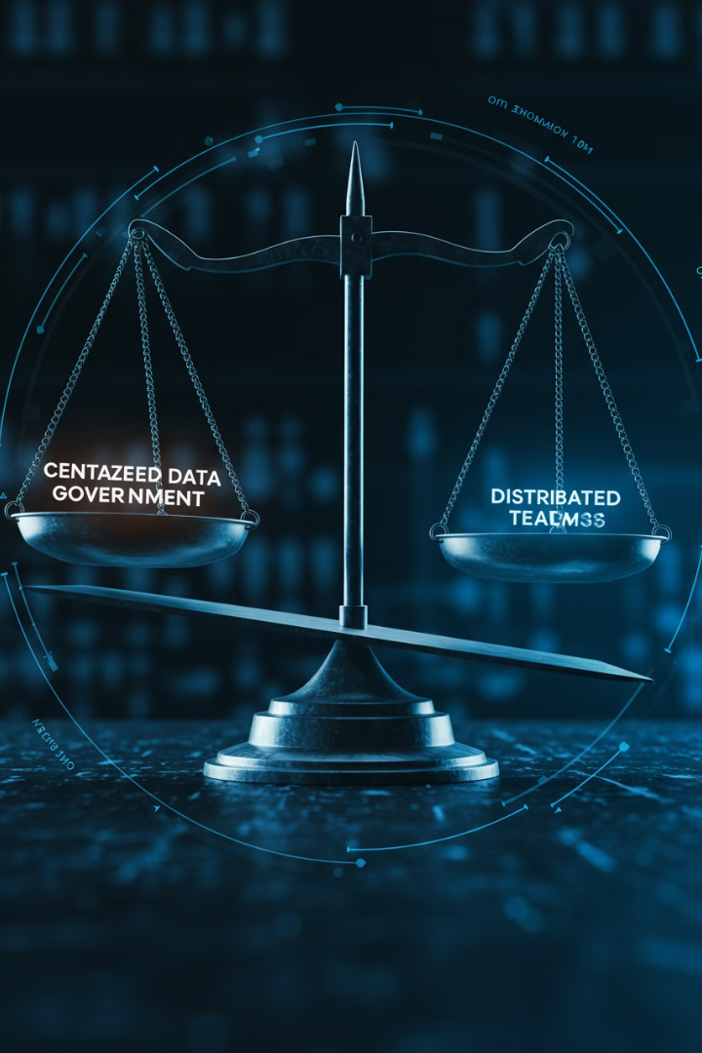
Workshop Overview
1
Traditional Approaches Falling Short
2
Rethinking Management
Organizations must rethink how they manage, govern, and structure their data functions.
Traditional governance and team organization can no longer keep pace with today's distributed data landscapes.
3
Balancing Act
Learn to balance centralized oversight with distributed autonomy while ensuring accountability.
Notes:
• Traditional governance and team organization can no longer keep up with today's distributed data landscapes. • Organizations must rethink how they manage, govern, and structure their data functions. • We'll learn to balance centralized oversight with distributed autonomy while ensuring accountability. • This is a critical challenge facing data-driven organizations today - finding the right balance between control and flexibility. • The goal is to empower distributed teams while maintaining the necessary oversight and governance.

Slide 3
Key Topics & Objectives
Topics Covered
Learning Objectives
Federated Data Governance
Build federated governance frameworks
Data Products and Contracts
Structure data teams effectively
Team Structures for Impact
Embed accountability at every level
Sustainability in Governance
Implement sustainable practices

Slide 4
Why We Need a New Approach
Current Limitations
Modern Needs
Data governance often provides static policies focused on compliance rather than enabling innovation.
Organizations need flexible, computational, and adaptive data governance frameworks.
Federated Solution
Accountability Gaps
Federated data governance balances control with innovation through decentralized decision-making.
Unclear ownership leads to quality issues and compliance vulnerabilities.
Notes:
The current approach to data governance is often too rigid and focused on compliance, rather than enabling innovation within the organization. Organizations today need more flexible, computational, and adaptive governance frameworks to keep up with modern data and digital transformation needs. Federated data governance can help balance control with innovation by enabling decentralized decision-making across the organization. Unclear ownership and accountability in data governance can lead to quality issues and compliance vulnerabilities that need to be addressed.

Slide 5
What is Data Governance?
Traditional Definition
Alternative Perspective
The exercise of authority, control, and shared decision-making (planning, monitoring, and enforcement) over the management of data assets.
Data Governance is a human-based system by which data assets in a socio-technical system are directed, overseen, and by which the organization is held accountable for achieving their defined purpose.
Notes:
Accountability in socio-tech - can a machine be accountable? Or even can a machine be accountable for human actions? defined purposes - negotiated requirements

Slide 6
What is Federated Data Governance?
Federated Data Governance balances local autonomy in data handling with overarching organizational policies to achieve cohesive, secure, and compliant data practices within a socio-technical system.
Central Oversight
Core policies, standards, and frameworks set by a central authority.
Domain Autonomy
Business units manage domain-specific requirements and implementations.
Shared Accountability
Clear ownership at each level with transparent responsibility models.
Case Study: Polar Energy implemented federated data governance across offshore operations, reducing compliance issues by x% while accelerating data-driven decisions.
Notes:
Federated governance balances central oversight with local autonomy. Why federate governance? Ensures domain expertise is leveraged while still aligning with enterprise goals. More agile decision-making in complex organizations. Example: Polar Energy – Offshore installations need autonomous governance but must still align with corporate risk and compliance requirements.

Slide 7
"Roles" of Data Governance
Data Negotiator
Data Director
Data Auditor
Translating business and regulatory requirements into actionable data policies.
Shaping focus and priorities in Data & AI-driven initiatives.
Overseeing and ensuring the accountability for data.

Slide 8
Data Accountability
Why It Matters
Without clear accountability, data quality, security, and availability suffer.
Creating Ownership Culture
Team members must feel responsible for data.
Defining Clear Roles
Data needs well-defined roles across the organization.
Practical Implementation
Set up reporting structures and implement checks and balances for data.
Notes:
The core challenge in federated governance: Ensuring data is trusted, usable, and responsibly managed across domains. What happens without accountability? Inconsistent data definitions across teams. Lack of responsibility for data quality and availability. Regulatory risks due to non-compliant data usage. How do we enforce accountability? Data products provide structure—they define who owns what, how data is used, and who can access it. Data contracts ensure alignment—they prevent conflicts by making data expectations explicit.

Slide 9
Understanding Data Accountability
Concept
Definition
Key Question
Ownership
The person or team with long-term control and decision rights over a dataset or data product.
Who ultimately governs and defines this data?
Responsibility
The person or team actively managing, maintaining, or using the data on a day-to-day basis.
Who works with this data and ensures quality?
Accountability
The person or role that ensures compliance, alignment, and that responsibilities are fulfilled—but may not handle the data directly.
Who ensures that governance is followed and enforces policies?
Notes:
One of the biggest challenges in federated data governance is ensuring clear roles for decision-making and compliance. Accountability, responsibility, and ownership are often confused, leading to gaps in governance and misalignment between teams. This slide clarifies the differences to ensure governance is structured effectively.

Slide 10
Data Ownership
Balancing ownership across organizational levels is key to effective federated governance.
Central Ownership
Enterprise-wide policies, standards, and compliance frameworks.
Domain Ownership
Business units manage domain-specific implementations and requirements.
Shared Responsibility
Clear RACI matrices define handoffs between central and local teams.
Case Study: FjordStep
Implementing a decentralized ownership models during retail expansion, allowing regional data teams to adapt while maintaining compliance with central standards.

Slide 11
Ensuring Accountability in Distributed Landscapes
Clear accountability frameworks prevent data governance gaps in federated models. RACI matrices define who does what across domains.
Responsibility Area
Finance
Marketing
Inventory
Sales
Maintaining Customer Data Quality
Managing Data Contracts & Compliance
Ensuring Sales Data Accuracy
Inventory Data Reconciliation
Customer Data Access & Sharing Rules
Analyzing Customer Behavior for Insights
Revenue & Cost Reporting
R=Responsible, A=Accountable, C=Consulted, I=Informed. This matrix enables data governance by clarifying cross-functional ownership.
Notes:
Key challenge: Who owns decisions in a federated model? Principles for distributed authority: Data ownership is at the domain level. Compliance is centrally coordinated. Clear accountability is defined through governance roles. Example: FjordStep – As the company expanded, governance moved from start-up agility to a structured federated model, ensuring accountability across retail locations. Interactive Exercise: Map governance responsibilities for an organization using a RACI matrix.

Slide 12
Ensuring Accountability in Distributed Landscapes
Data Ownership
Data Contracts
Culture of Responsibility
Establish agreements between producers and consumers to clarify expectations and responsibilities.
Define clear roles and responsibilities for maintaining data quality and ethical use.
Ensure every team member understands their role in the data ecosystem.

Slide 13
What Are Data Products?
Shifting from project-based to product-based thinking transforms data management effectiveness.
Reusable Assets
Well-defined interfaces and documentation enable teams to leverage existing data assets without rebuilding.
Self-Service Analytics
Packaged data, metadata, and access controls empower business users to explore insights independently.
Interoperability
Data products connect seamlessly across domains while maintaining federated accountability structures.
Retail Case Study
A multinational retailer increased analytics adoption by implementing composable data products with clear ownership boundaries.
Notes:
Data products = managed, reusable, and governed data assets that ensure data is: Discoverable Accessible Well-defined Trustworthy Accountability through ownership: Every data product has an owner—this enforces responsibility for data quality, documentation, and updates. Example: FjordStep ensures that each region’s customer analytics data product is owned by the marketing teambut adheres to global governance rules. Federated teams manage their own data products while aligning with enterprise-wide metadata and quality standards.

Slide 14
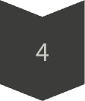
Designing Data Contracts
The foundation of effective federated data governance enforcement lies in clear agreements between data producers and consumers.
Define Ownership
Establish clear data ownership and stewardship responsibilities across organizational boundaries.
Specify Access Rights
Document who can access what data, when, and under which conditions.
Set Service Levels
Outline quality standards, refresh rates, and support expectations.
Prevent Bottlenecks
Create standardized interfaces that reduce dependencies between teams.
Notes:
Data contracts define how data should be structured, shared, and used. They prevent common issues like: Mismatched expectations between teams. Breakages when schemas change. Lack of clarity on access rights. What does a data contract contain? Who owns the data? What format does it follow? What SLAs govern freshness & availability? Who has access, and under what conditions? Example: FjordStep uses data contracts between Sales & Finance to ensure revenue data is always reconciled properly.

Slide 15
Structuring Data Teams
Centralized Functions
Decentralized Functions
Core data infrastructure and governance oversight.
1
2
Domain-specific data expertise embedded in business units.
Balancing Innovation
Modern Roles with right Mindset
Teams must support both transformation and foundational infrastructure.
4
3
Data Science, Data Engineering, DataOps, and Data Management.

Slide 16
Three-Dimensional Approach to Data Teams
Strategic Level
1
Align with organizational goals
Operational Efficiency
2
Build robust processes and tools
Distributed Autonomy
3
Embed data functions in business units
This multi-layered approach ensures data teams can balance innovation with foundational stability, creating a system that supports agility without sacrificing control.
Notes:
Strategic Layer (Central Office) → Sets governance direction, defines policies, and ensures compliance. Operational Layer (Core Data Teams) → Engineers, analysts, and governance professionals ensure policies are executed. Distributed Layer (Domain Data Teams) → Own data products and contracts, ensure local alignment.

Slide 17
Data Teams for Maximum Impact
Data Governance
Establish data policies, standards, and controls to enable trusted, ethical, and compliant data use.
Data Strategy
Navigate uncertainty in data towards overall business objectives and priorities.
Data Scientists
Leverage advanced analytics and machine learning to uncover insights from data.
Data Engineering
Build and maintain the data infrastructure, pipelines, and platforms to support data-driven initiatives.
Data Operations
Strategical / Tactical Guidance
Ensure reliable and efficient data processing, monitoring, and incident response.
Distributed Data Management
Data Teams
Empower domain experts to manage data within their business units.
Central Data Management
Distribution
Provide centralized data enablement and support for the entire organization.

Slide 18
Cross-Team Collaboration & Accountability
Data Director
Data Negotiator
Data Auditor
Oversees strategic vision and standards across the organization.
Facilitates agreements between data producers and consumers.
Verifies compliance with governance policies and data contracts.
Aligns data initiatives with business goals and regulatory requirements.
Mediates conflicts and ensures data contracts are properly designed.
Monitors data quality metrics and reports on governance effectiveness.
FjordStep successfully transitioned from startup agility to structured governance by clearly defining these roles while maintaining innovation.
Notes:
Challenge: Avoiding over-centralization (slow, bureaucratic) vs. over-decentralization (chaotic, misaligned). How do federated teams stay aligned? Data Direction ensures long-term governance alignment. Data Negotiation resolves conflicts in real time. Data Auditing enforces accountability without excessive overhead. Example: FjordStep ensures its federated data teams retain flexibility while adhering to financial reporting requirements globally.

Slide 19
Federated Data Governance Models
Central Oversight
Distributed Ownership
1
Ensures alignment across organization
2
Maintains autonomy across data hubs
4
Continuous Process
Governance Framework
3
Ongoing maintenance of standards
Roles, access controls, compliance
The "Gravitational Pull" of strong governance ensures central alignment while allowing decentralized teams to maintain necessary autonomy.

Slide 20
Lessons from NASA's Mars Missions
Mars Global Surveyor
1
Teaches us about long-term data management challenges and sustainability.
2
Mars Climate Orbiter
Highlights the importance of standardized data practices and clear accountability.
Human-in-the-loop
3
Critical for managing complex systems and ensuring quality control.
4
Sustainable Practices
Ensure your data organization remains agile and maintainable over time.
Notes:
Long-term data management challenges. The importance of human involvement (Human-in-the-loop) in managing complex systems. Sustainability in data practices: How to ensure that your data organization remains agile and maintainable over time. Why: entirely unknown -> forced to think out of the box break down problem in known, tangible pieces

Slide 21
Key Takeaways
Team Structure
Structure data teams for maximum flexibility and impact across strategic and operational dimensions.
Accountability
Ensure data accountability through clear roles, ownership, and data contracts.
Governance Model
Design federated governance to balance distributed autonomy with central oversight.
Sustainability
Implement practical steps to create a sustainable, future-proof data organization.

Slide 22
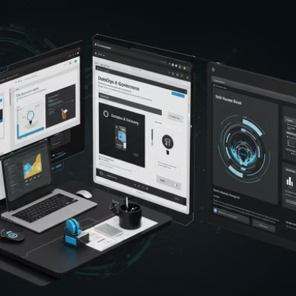
Post-Workshop Resources
Access workshop materials, slides, and recommended reading on DataOps, Data Governance, and team organization strategies.

