Slide 1
Modeling the Mesh
Understanding data products and domains
Juha Korpela – Datakor Consulting

Slide 2


About me
Juha Korpela
Based in Helsinki, Finland
15+ years in Data Management in a variety of industries with diverse expertise:
  Data Products
  Data Governance
  Data Modeling
  Data Engineering
  Data Strategy
Entrepreneur & Consultant @ Datakor Consulting
Founder & Chairman @ Helsinki Data Week
Podcast host @ Helsinki Data Mafia
Speaker: Data Day Texas, IRM UK Enterprise Data, Data Mesh Live...
ex-CPO @ Ellie Technologies Inc.
ex-Head of Data Platform @ UPM-Kymmene Oyj
Follow me on LinkedIn:
linkedin.com/in/jkorpela

Slide 3
Agenda
Data Mesh basics
Why context matters – semantic interoperability
Data modeling as the key to context
Modeling at two levels – data products and domains
The Big Picture of semantics across the enterprise

Slide 4
Data Mesh basics
The paradigm, its principles, and how it works in reality

Slide 5
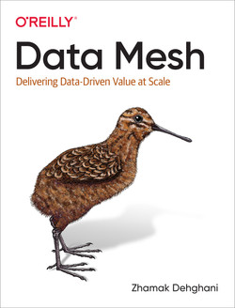
Data Mesh: background
A framework developed by Zhamak Dehghani
Domain-oriented, decentralized model
Domain teams are responsible for all the data within a domain & distributing it outside the domain
All data distribution & consumption done through data products
Domains and their data products form a mesh
The Data Mesh is supported by shared capabilities: technology platforms + governance model

Slide 6
Data Mesh in a nutshell
Domain
Data Product
Data Product
Data Product
Platforms & technical capabilities
Metadata management & governance

Slide 7
Four principles of Data Mesh
Domain-driven Ownership of Data
Data as a Product
Self-serve Data Platform
Federated Computational Governance

Slide 8
Four principles of Data Mesh
Everything is organized around business “domains”
Domains have their own data teams
Domains are responsible for their own data
Operational & analytical data management are tightly coupled within the domain
The internal activity of a domain is not visible outside
Domain-driven Ownership of Data
Data as a Product
Self-serve Data Platform
Federated Computational Governance

Slide 9
Four principles of Data Mesh
Domain-driven Ownership of Data
Data as a Product
Domains share data via Data Products
Domain teams are responsible for maintaining good-quality, accessible products
Product Thinking is applied in all domains, and domains have Product Owners for their data
Self-serve Data Platform
Federated Computational Governance

Slide 10
Four principles of Data Mesh
Domain-driven Ownership of Data
Data as a Product
A centralized Platform Team offers tools for the domain teams to use, but doesn’t implement Data Products itself
Tools and platforms operate on a self-service principle; domain teams can set up everything they need by themselves
Common rules & policies for tools and platforms ensure that domains don’t start to diverge too much
Self-serve Data Platform
Federated Computational Governance

Slide 11
Four principles of Data Mesh
Metadata management and related governance policies are created collaboratively between all domains
Decisions on rules & policies are made jointly, implementing them happens within each domain by the domain teams
The platform itself offers the capabilities to implement and monitor governance for all domains & Data Products
Domain-driven Ownership of Data
Data as a Product
Self-serve Data Platform
Federated Computational Governance

Slide 12
Data Mesh in reality
100% pure Data Mesh implementation is rare
Significant technology effort
Massive organizational effort
Benefits from scale - example organizations: PayPal, Spotify, Roche...
HOWEVER...
Real-life benefits in shifting data responsibilities closer to value-creation
“Data as a Product” –thinking valuable for everyone
Separating Platform teams (building capabilities) and Domain teams (building solutions) clarifies roles and boundaries
If you want to do decentralized data products, you will end up scaling to Data Mesh!

Slide 13



Product thinking: from projects to products
Demand-driven value delivery
Product ownership
Loosely coupled architecture
Build for identified use cases
Know your users
Explicit UX design
Governance for products
Lifecycle management
Prioritization by owner
Clear boundaries
Shared platforms
Independent development

Slide 14
What is a “Data Product”? My definition!
Data sources
Users and use cases
A “packaged” set of data and components, that has:
  Clear boundaries
  One owner
  A lifecycle
  Identified users and benefits
  Input and output interfaces
  Understandable definition
  “Data and code”!
DATA PRODUCT
INPUT
OUTPUT
Internal components
Product Owner
Product definition

Slide 15
Why context matters
Semantic interoperability of Data Products & Domains

Slide 16
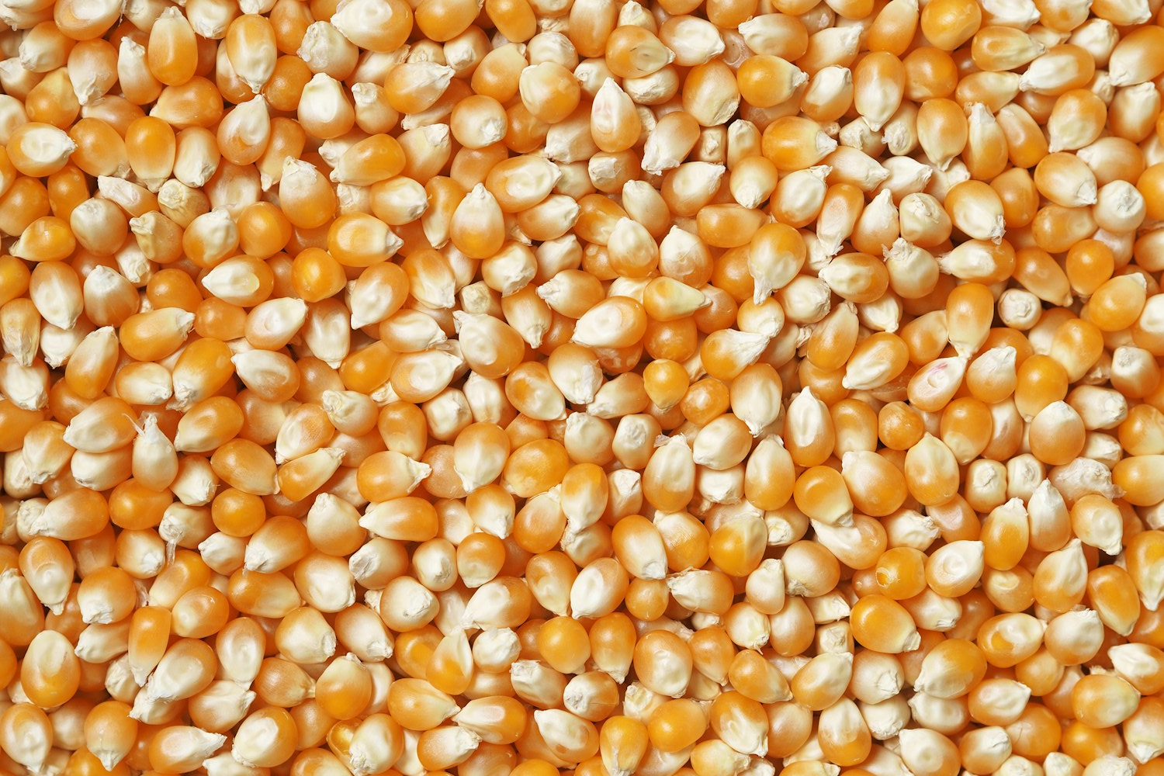
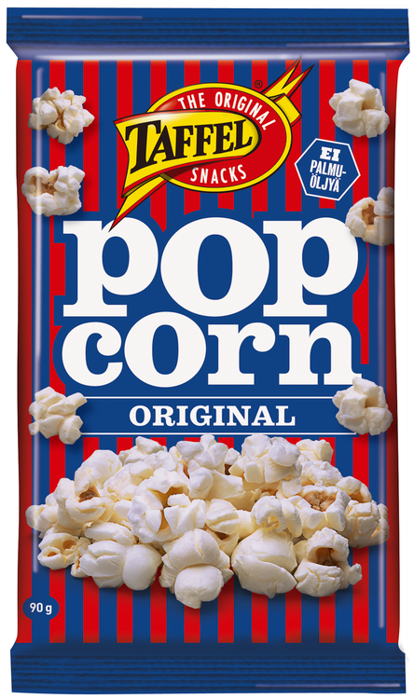
Data
”Productized” data

Slide 17
Product definition
Contents of the product: raw materials, allergens, production method…
Instructions & policies: what can be done with the product and how (microwave & eat!)
Warnings & limitations: how the product is NOT to be used
Technical information: size, structure, packaging material, recycling…
Producer and their contact details

Slide 18
Data Product metadata
What information should we have in the “wrapper” for a Data Product?
Contents: semantic description of the data
Instructions & policies: what are the intended use cases, how to get access
Warnings & limitations: infosec, legal limitations (e.g. GDPR), deployment status (in production or just for testing?)
Technical information: database objects, files, pipelines, authentication methods
Producer: who owns the Data Product, who to ask for help, who is responsible for operations

Slide 19


The need for semantics
Enterprise
Knowledge Graph
Data Product Definitions need to expose semantics for enterprise-wide discoverability across domains
“This product is about Leads and Prospects”
Data Product Definition
Data Product Definition
Data Product Definition
“This product is about Customers and Deliveries”
DATA PRODUCT
DATA PRODUCT
DATA PRODUCT

Slide 20
Data modeling as the key to context
Capturing semantics & structure

Slide 21
Three levels of data modeling
Business
IT
Conceptual
Logical
Physical
What the business looks like in data terms
How the data should be organized for the use case
How to implement the model with a particular technology

Slide 22
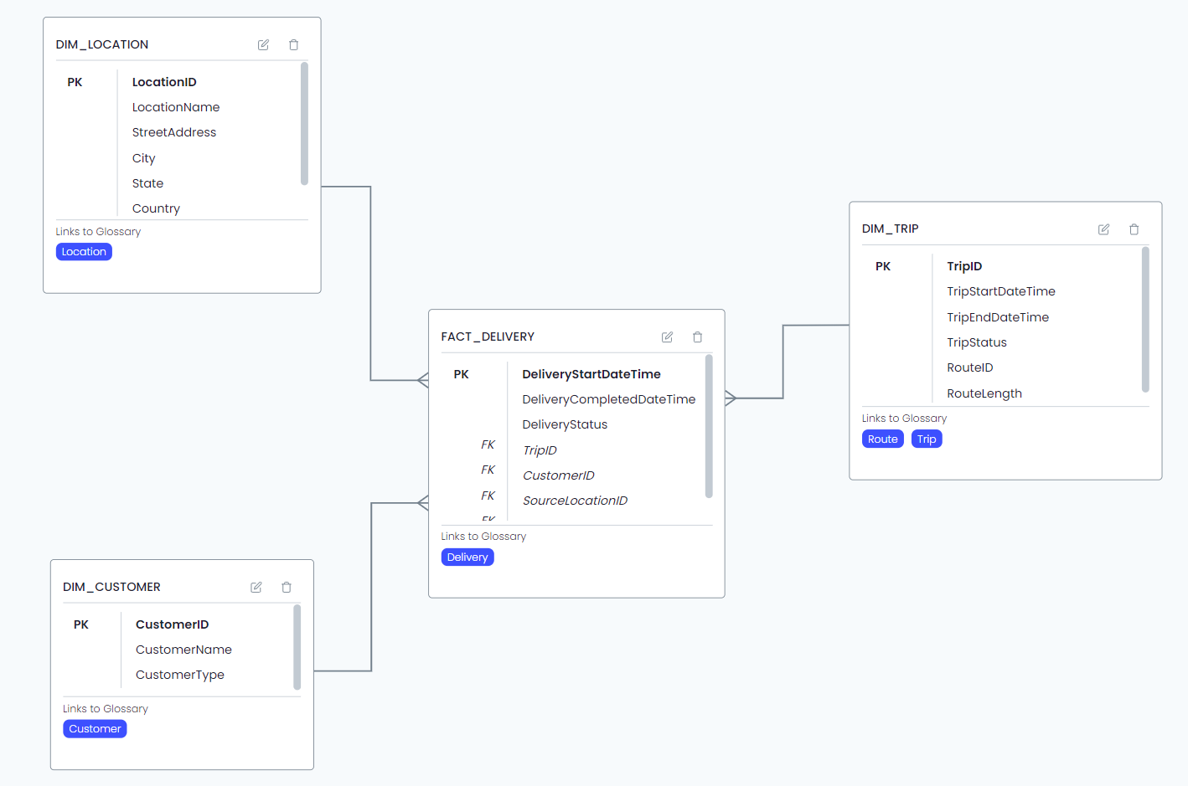
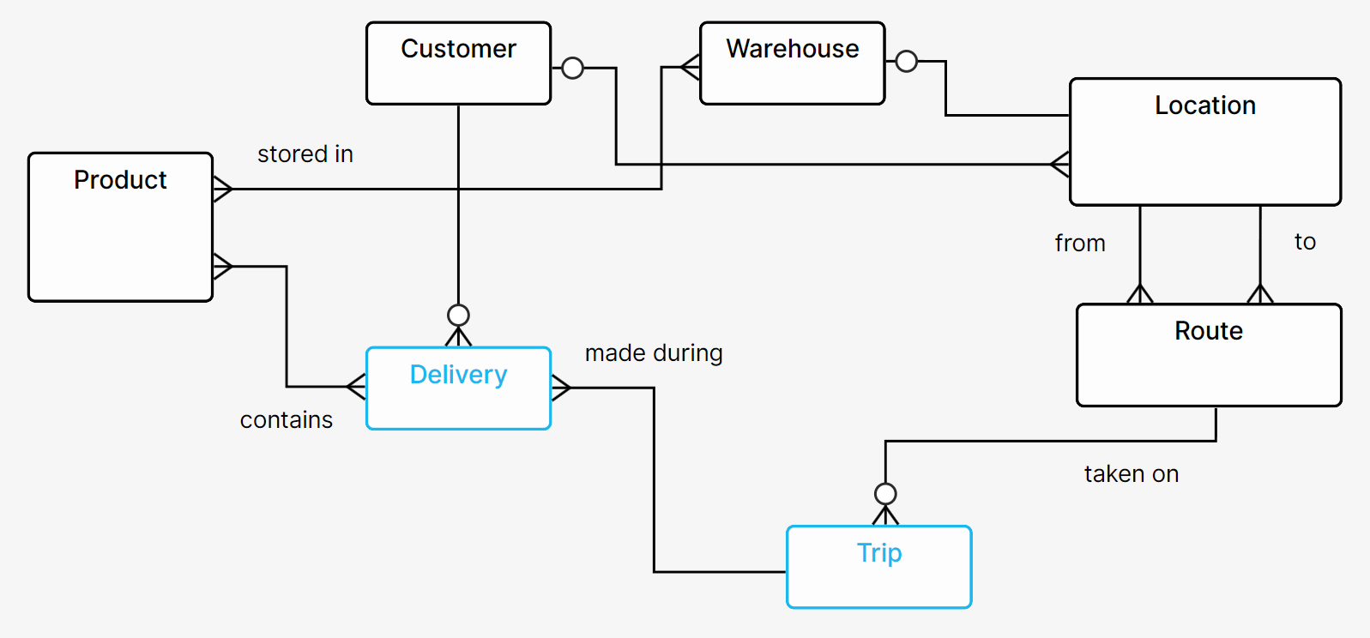
Capturing context with data models
Business entities and relationships of the domain
Derived design of a Data Product
Conceptual model: semantics
Logical model: use case-specific structure

Slide 23
Business-driven data design & development
Modeling questions
Where do we find the data?
How should we integrate the data?
What kind of a data product is needed?
What does the business need to know for the use case?
What things exist in the business?
How does the business make money?
Design
Data product
Use case
€€€
Development
Bronze
Silver
Gold
Source systems
Data platform
Business reality
Value creation

Slide 24
How modeling happens during the process
Logical Data Models
(implementation design)
Conceptual Data Models
(business design)
Design
Data product
Use case
€€€
Development
Physical Data Models
(development focus)
Bronze
Silver
Gold
Source systems
Data platform
Business reality
Value creation

Slide 25
Modeling Domains & Data Products
Working on two levels

Slide 26
Two problems to solve at the same time
“SMALL PROBLEM”
“BIG PROBLEM”
How does an individual Data Product deliver as valuable results as possible, as efficiently as possible?
How does the whole organization ensure that ALL Data Products can CONSISTENTLY deliver valuable results efficiently?

Slide 27
Different approaches needed
“SMALL PROBLEM”
“BIG PROBLEM”
Focus:
Understanding the use case
Development velocity
Technical optimization
Minimal documentation overhead
Focus:
Reusable components & templates
Shared ways of working
Avoiding reinventing the wheel
Shared semantics for interoperability

Slide 28
Organizing data modeling on two levels
Enterprise-level information architecture
Standards & policies ensure high-quality “official” domain models with maximum trust and reusability
Business domain understanding
Conceptual model
(domain scope)
Conceptual model
(domain scope)
Individual solutions feed into enterprise-level domain modeling
(bottom-up)
Information architecture standards & policies
Shared ways of working ensure right balance of freedom & common methods for data product development
Data product development
Design & development ways of working
Conceptual model
(product scope)
Conceptual model
(product scope)
Conceptual model
(product scope)
Use case needs & requirements
Logical model
Logical model
Logical model
Data products utilize domain-level models to speed up work & increase interoperability
(top-down)
Data product

Slide 29
Key success factor: feedback loops
Enterprise/domain level
Canonical, reusable patterns and templates:
components, data models, policies, practices, semantics…
New and updated patterns
and templates:
components, data models, policies, practices, semantics…
Product-level workflows
Product-level workflows
Product-level workflows

Slide 30
The Big Picture
Managing semantics across the enterprise

Slide 31
Design & discovery paths
Understanding the business
Business Glossary
Taxonomy
Ontology
Conceptual models
DISCOVERY
Logical models
Physical models
DESIGN
Data-to-meaning mapping
Data Product

Slide 32
Cross-domain interoperability
Enterprise Knowledge Plane
Business Glossaries
Taxonomies
Ontologies
Domain
CDM
CDM = Conceptual Data Model
LDM = Logical Data Model
Domain
Domain
CDM
CDMLDM
CDMLDM
Domain
CDM
CDMLDM
Domain
Domain
Data Product
Data Product
Domain
CDM
Data Product
Domain

Slide 33
Goal: context-aware data utilization
AI
Apps
Humans
SEMANTICS
Business context
Knowledge Plane
DISCOVERY
Data-to-meaning mapping
Data Modeling
DATA PRODUCTS
Data sharing & reuse
DESIGN
Source-to-target mapping
Data Plane
SYSTEMS
Operational data

Slide 34
Conclusions

Slide 35
Build interoperability with shared semantics
Federated model requires common rules & shared understanding
Data Products must be self-describing – metadata “wrapper”
Capture semantics with Conceptual models, design product structures with Logical models
Solve for both product-level delivery and enterprise-level consistency at the same time
Enable context-aware data use by building a Knowledge Plane of shared semantics

Slide 36

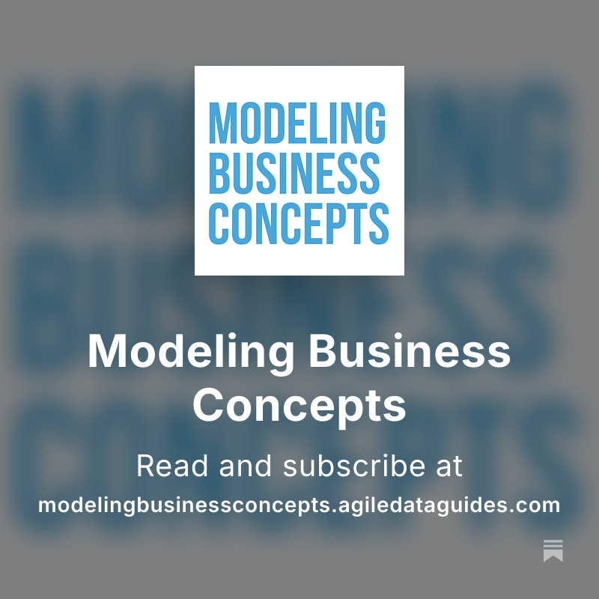
More thoughts on Substack!

