Slide 1
Data Mesh Information Architecture
Modeling data products and domains

Slide 2


About me
Juha Korpela
Based in Helsinki, Finland
15+ years in Data Management in a variety of industries with diverse expertise:
Data Products
Data Governance
Data Modeling
Data Engineering
Data Strategy
Entrepreneur & Consultant @ Datakor Consulting
Founder & Chairman @ Helsinki Data Week
Podcast host @ Helsinki Data Mafia
Speaker: Data Day Texas, IRM UK Enterprise Data, Data Mesh Live...
ex-CPO @ Ellie Technologies Inc.
ex-Head of Data Platform @ UPM-Kymmene Oyj
Follow me on LinkedIn:
linkedin.com/in/jkorpela

Slide 3
Agenda
Data Mesh basics
Conceptual models for cross-domain understanding
Hands-on exercise: modeling a domain
Data modeling as part of data product design
Ensuring semantic interoperability at the domain boundary
Data Mesh information architecture operating model
Conclusions

Slide 4
Goals
Understand the basics of the Data Mesh paradigm and its challenges relating to information architecture and semantics
Learn the basics of conceptual modeling as a method of defining the business context of domains and data products
Learn the basics of logical modeling as a part of data product design process
Learn how solution-level metadata (e.g. data contracts) can expose domain-level context across domain boundaries
Understand the basic operating model of information architecture management in the context of independent domain teams within a Data Mesh setup

Slide 5
Data Mesh basics

Slide 6
Data Mesh basics
General idea
Four pillars of Data Mesh according to Dehghani
Domains and domain teams
Data products
The interoperability challenge

Slide 7
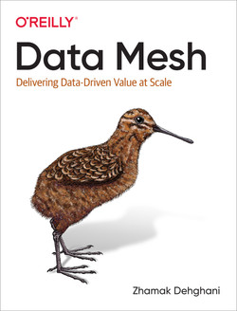
Data Mesh: background
A framework developed by Zhamak Dehghani
Domain-oriented, decentralized model
Domain teams are responsible for all the data within a domain & distributing it outside the domain
All data distribution & consumption done through data products
Domains and their data products form a mesh
The Data Mesh is supported by shared capabilities: technology platforms + governance model

Slide 8
Data Mesh in a nutshell
Domain
Data Product
Data Product
Data Product
Platforms & technical capabilities
Metadata management & governance

Slide 9
Four principles of Data Mesh
Domain-driven Ownership of Data
Data as a Product
Self-serve Data Platform
Federated Computational Governance

Slide 10
Four principles of Data Mesh
Everything is organized around business “domains”
Domains have their own data teams
Domains are responsible for their own data
Operational & analytical data management are tightly coupled within the domain
The internal activity of a domain is not visible outside
Domain-driven Ownership of Data
Data as a Product
Self-serve Data Platform
Federated Computational Governance

Slide 11
Four principles of Data Mesh
Domain-driven Ownership of Data
Data as a Product
Domains share data via Data Products
Domain teams are responsible for maintaining good-quality, accessible products
Product Thinking is applied in all domains, and domains have Product Owners for their data
Self-serve Data Platform
Federated Computational Governance

Slide 12
Four principles of Data Mesh
Domain-driven Ownership of Data
Data as a Product
A centralized Platform Team offers tools for the domain teams to use, but doesn’t implement Data Products itself
Tools and platforms operate on a self-service principle; domain teams can set up everything they need by themselves
Common rules & policies for tools and platforms ensure that domains don’t start to diverge too much
Self-serve Data Platform
Federated Computational Governance

Slide 13
Four principles of Data Mesh
Metadata management and related governance policies are created collaboratively between all domains
Decisions on rules & policies are made jointly, implementing them happens within each domain by the domain teams
The platform itself offers the capabilities to implement and monitor governance for all domains & Data Products
Domain-driven Ownership of Data
Data as a Product
Self-serve Data Platform
Federated Computational Governance

Slide 14
Data Mesh in reality
100% pure Data Mesh implementation is rare
Significant technology effort
Massive organizational effort
Benefits from scale - example organizations: PayPal, Spotify, Roche...
HOWEVER...
Real-life benefits in shifting data responsibilities closer to value-creation
“Data as a Product” –thinking valuable for everyone
Separating Platform teams (building capabilities) and Domain teams (building solutions) clarifies roles and boundaries
If you want to do decentralized data products, you will end up scaling to Data Mesh!

Slide 15
What is a “domain”?
A problem space within business reality
Based on Domain-Driven Design (DDD) thinking (Eric Evans)
Domains can be organized along different lines:
Business capability
Value chain
Core process
Organizational unit
Domains should never be based on technology!

Slide 16
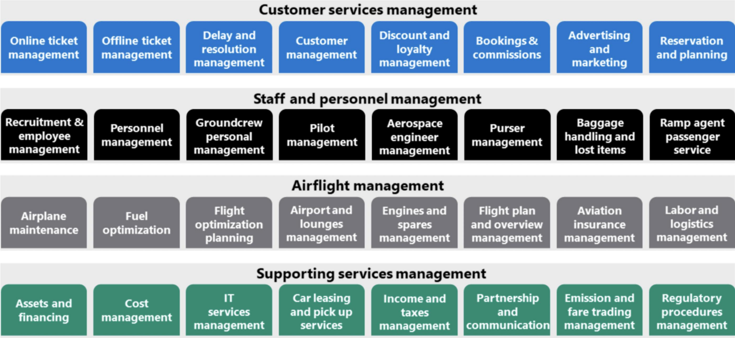
Example: business capability domains
Piethein Strengholt
https://towardsdatascience.com/data-domains-where-do-i-start-a6d52fef95d1

Slide 17
Cross-domain data sharing
Data as a Product
Domains share data via Data Products
Domain teams are responsible for maintaining good-quality, accessible products
Product Thinking is applied in all domains, and domains have Product Owners for their data

Slide 18
Product thinking
Agile methods bring extra focus on products
Products are meant to deliver value for known users
Products are designed for known use cases
Products have clear boundaries
Tech and platforms are secondary enablers; products are the primary output
Products have Product Owners
Products have a description, product management processes, and lifecycle
“A product is a vehicle to deliver value. It has a clear boundary, known stakeholders, well-defined users or customers. A product could be a service, a physical product, or something more abstract.”
Scrum Guide
(Schwaber & Sutherland)
WE HAVE NOT BEEN DOING THIS FOR DATA & ANALYTICS

Slide 19



From projects to products
Demand-driven value delivery
Product ownership
Loosely coupled architecture
Build for identified use cases
Know your users
Explicit UX design
Governance for products
Lifecycle management
Prioritization by the owner
Clear boundaries
Shared platforms
Independent development

Slide 20
What is a “Data Product”? My definition!
Data sources
Users and use cases
A “packaged” set of data and components, that has:
Clear boundaries
One owner
A lifecycle
Identified users and benefits
Input and output interfaces
Understandable definition
“Data and code”!
DATA PRODUCT
INPUT
OUTPUT
Internal components
Product Owner
Product definition

Slide 21

A Data Product under the hood
input
interfaces
output
interfaces
financial controllers
data sources
Excel
ETL
internal components
PBI
CRM API
script
PBI
business analysts
SQL
view
DW
ETL
application XYZ

Slide 22
Types of Data Products
Source-aligned
Offers unmodified “raw” data from an operational source system
Safe way to utilize source data without affecting operational use
Users: other systems, other data products
Aggregate
Re-models and integrates data from one or more source systems or source-aligned data products
Aims at maximum reusability, acts as a source for other data products – modeled according to domain entities
Users: consumer-aligned data products
Consumer-aligned
Specifically aimed at and optimized for a known use case
Limited, “tight” scope, maximum use case fit for maximum business impact
Users: humans, various applications

Slide 23
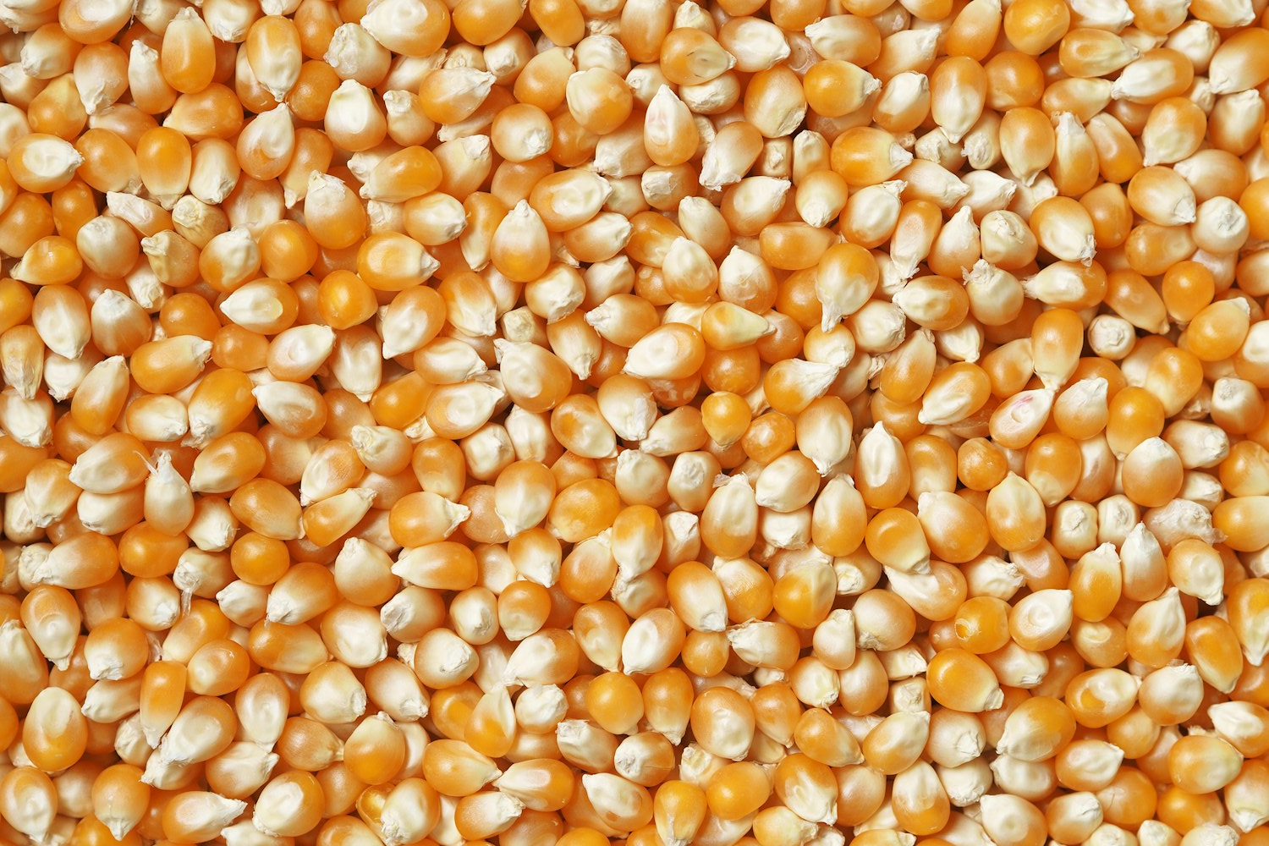
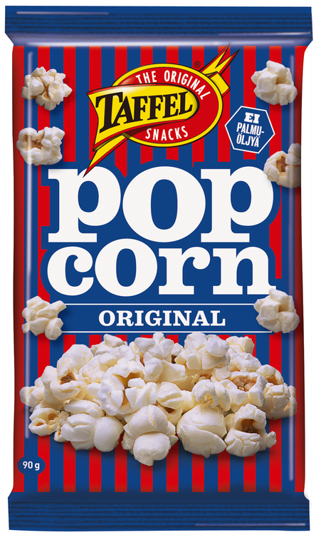
Data
”Productized” data

Slide 24
The interoperability challenge
Semantic interoperability
Domain language
Domain language
?
What Data Products are available?
How can they be accessed?
What does the data mean?
Technical interoperability
Domain
Domain
?
Data Product
Data Product
Data Product
?
Domain

Slide 25
Conceptual models for cross-domain understanding

Slide 26
Conceptual models for cross-domain understanding
Basics of conceptual modeling: entities, relationships, and attributes
How to identify the real business objects
Building definitions and glossaries

Slide 27
What is data modeling?
Data modeling is a way to describe reality in a structured format.
“A data model is a wayfinding tool for both business and IT professionals, which uses a set of symbols and text to precisely explain a subset of real information to improve communication within the organization and thereby lead to a more flexible and stable application environment.”
- Steve Hoberman
“A data model is a structured representation that organizes and standardizes data to enable and guide human and machine behavior, inform decision-making, and facilitate actions.”
- Joe Reis

Slide 28
Three levels of data modeling
Business
IT
Conceptual
Logical
Physical
What the business looks like in data terms
How the data should be organized for the use case
How to implement the model with a particular technology

Slide 29
Data modeling levels & methods
This is what we need for semantic interoperability
Conceptual model
Business entities & natural relationships – modeling the business reality
3NF
Logical model
Kimball
Different methods for different use cases – modeling the solution
OBT
etc…
Physical model
Technology-specific
– modeling the implementation

Slide 30
What is a Conceptual Data Model?
A business-language description of some part of business reality
A narrative of “what’s going on” represented by a diagram
Depicts things the business needs to know about and the associations between those things
“Entities” and “relationships” → “Entity-Relationship Diagram”, ERD
Note! Not technical components, but things!
Is NOT about systems or reports, but the reality behind the system or report

Slide 31
Therefore, a conceptual model is…
“a description of the business in terms of the things it needs to know about”
- Alec Sharp

Slide 32
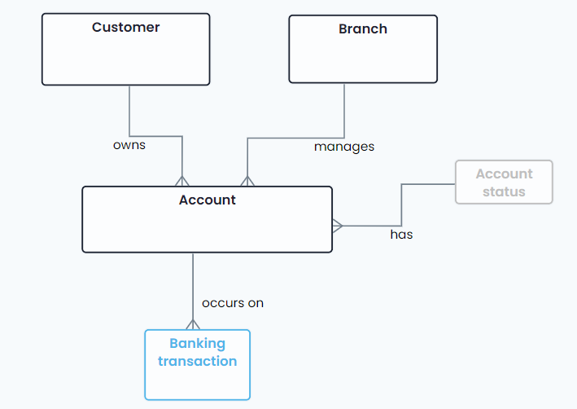
Conceptual model: a simple example

Slide 33
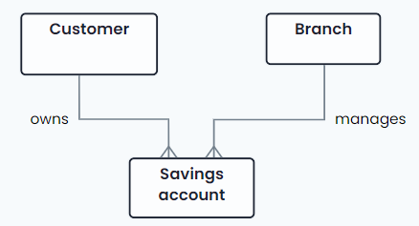
Entities
An entity is a noun in a sentence
Narrative: “A customer owns a savings account which is managed by a branch”
Entities: “Customer”, “Savings account”, “Branch”
Good practice: always use singular nouns (“Customer” instead of “Customers”)
Listen to the business expert and write down all nouns → entity candidates

Slide 34
Attributes
An attribute is information about an entity
“Customer” = entity
“Customer name” = attribute of the “Customer” entity
Attributes can’t exist on their own!
In conceptual models, attributes are often not included
Sometimes useful to list a few important attributes for the entities already in early stages
E.g. “Customer Lifetime Value” is an attribute of “Customer”

Slide 35
Relationships
An association between two entities that we want to maintain information about
Based on real-life associations
It’s possible that a relationship exists in real life, but it’s not (yet) recorded in any system!
Relationships are named with verbs
Narrative: “A customer owns a savings account which is managed by a branch”
Find the verb describing the real-life association – maintain the narrative!

Slide 36
Identifying entities: common pitfalls
Most data modeling failures are caused by poorly chosen entities!
Technical objects instead of real-life entities
Avoid applications, reports, tables, components, or system messages – find the business entities behind these
Attributes as entities
“Customer name” is not an entity but an attribute of the “Customer” entity (more about attributes later)
Non-business language
Don’t think about system names or official naming – use whatever the business uses!
Non-countable abstractions
Find the countable things: not “Staff” but “Employee”, not “Bank statement” but “Financial transaction”
Too much generalization too soon
“Object instance type” is not a business entity!

Slide 37
Entity definitions & Glossary
Every entity should have an understandable, business-language definition
Answers the question: “what do we mean by <entityname>?”
Entity definitions form a Glossary
Often domain-specific: “Account” for Sales is different from “Account” for Finance
Need to be written down so that they’re available for everyone
Domain Glossaries capture the domain’s language

Slide 38
Example: entity definitions
GOOD
Debit Card
“Payment card issued by a financial service provider that enables the cardholder to access funds in a demand deposit account.”
Credit Card
“Card issued by a financial service provider that enables the cardholder to borrow funds.”
Savings Association
“Depository institution that is (a) any federal savings bank or association chartered under section 1464 of the Federal Deposit Insurance Act; (b) any state chartered building and loan association, savings and loan association, or homestead association; or (c) any cooperative bank (other than a cooperative bank which is a state bank as defined in subsection (a)(2)) of the Federal Deposit Insurance Act, which is organized and operating according to the laws of the State (as defined in subsection (a)(3)) in which it is chartered or organized; and (c) any corporation (other than a bank) that the board of directors and the comptroller of the currency jointly determine to be operating in substantially the same manner as such a depository institution.”
GOOD
NOT SO GOOD?

Slide 39
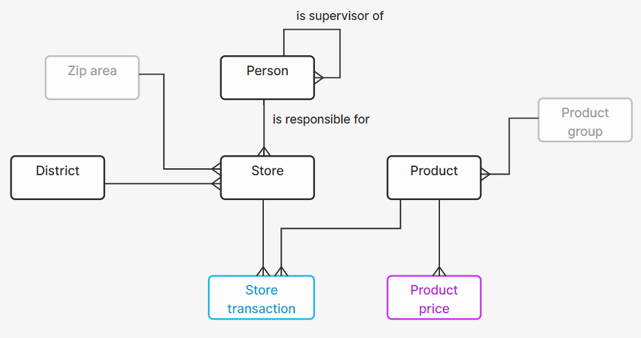

The scope of a conceptual model
Real world
What are we really modeling?
The scope of a conceptual model must always be a slice of reality – the part of the real world behind our data needs
Boundaries often defined by:
Business process area
Current business problem
Departmental responsibility
What is covered by another technical solution…
Important: we are not modeling a solution, we are modeling reality
“Slice of reality” can be a Domain!
“Solution” can be a Data Product!
Scope
Data model
Solution

Slide 40
Hands-on exercise: modeling a domain

Slide 41
Hands-on exercise: modeling a domain
Domain boundaries
Identifying entities within the domain
Definitions and Domain Glossary

Slide 42

Introducing “Storefront”
Storefront is a mid-sized online retailer specialising in consumer electronics. The company sells directly to consumers through its website and mobile app, handling everything from product discovery to doorstep delivery.

Slide 43
EXERCISE Storefront’s domain structure
There is no single right answer – we’ll continue with these four:
Let’s come up with some example domains for Storefront
Choose according to e.g.
Business capability
Value chain
Core process
Organizational unit
Customers
Product Catalog
Orders
Fulfillment

Slide 44
You are now responsible for “Orders”
The Orders domain team owns everything that happens between a customer deciding to buy something and the payment being settled. This is the commercial heartbeat of the business.
Your mission: Capture, track, and complete every customer purchase from the moment of intent to the moment of payment.
Your responsibilities
Business questions
Accepting and recording customer orders
Applying pricing rules, promotions, and discount codes
Processing and confirming payments
Managing order status through the purchase lifecycle
Handling cancellations and returns
How many orders were placed today, and what is their total value?
Which orders are awaiting payment confirmation?
What is the return rate for orders placed in the last 30 days?

Slide 45
EXERCISE Domain boundaries – who owns what?
Customers
Product Catalog
Orders
Fulfillment
You are here
Product
Order
Product category
Customer address
Payment
Warehouse
Order line
Return
Discount code
Delivery date
Product description
Invoice
Delivery
Customer

Slide 46
EXERCISE Conceptual model for the Orders domain
Orders
Let’s build a model!
Include all YOUR data
What is an ENTITY, what is an ATTRIBUTE?
Add named RELATIONSHIPS
Identify where you need to REFERENCE some other domain’s data

Slide 47
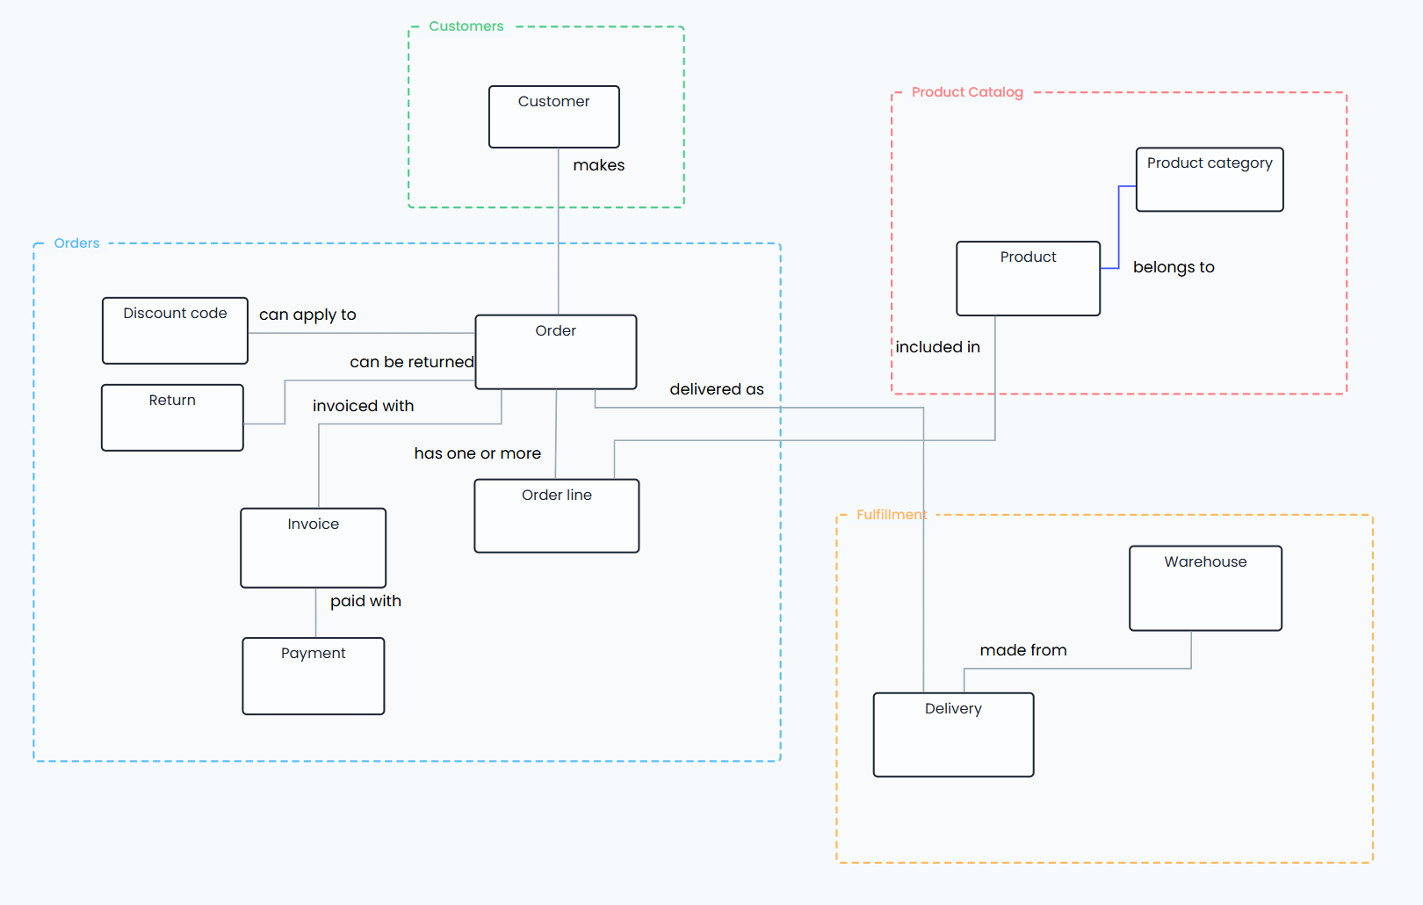
Overall conceptual model - example

Slide 48
EXERCISE Creating a Domain Glossary for Orders
Define!
Order
Invoice
<definition: what do we mean by...?>
<definition: what do we mean by...?>
Order line
Payment
<definition: what do we mean by...?>
<definition: what do we mean by...?>
Return
Discount code
<definition: what do we mean by...?>
<definition: what do we mean by...?>

Slide 49
Domain Glossary for Orders: examples
Order
Invoice
A customer's confirmed intent to purchase one or more products from Storefront, creating a commercial commitment that the business is obligated to fulfill.
The formal record of the financial obligation arising from an order, stating what was purchased, at what agreed price, and what payment is due.
Order line
Payment
A single product and quantity within an order, capturing what was bought and at what price at the moment of purchase. Each order contains at least one order line; the order line is the atomic unit of what was sold.
A record of a customer’s settlement of an invoice, whether it is settled fully or partially.
Return
Discount code
A customer's request to reverse all or part of a fulfilled order, triggering a commercial process that typically results in a refund or exchange.
A code applied by a customer at checkout that reduces the payable value of an order, as authorised by a promotion.

Slide 50
Data modeling as part of data product design

Slide 51
Data modeling as part of data product design
Understanding product scope as part of the domain model
Logical model as product-level design & documentation
Deriving logical models from conceptual model
Maintaining links with the domain model

Slide 52
Recap: three levels of data modeling
Business
IT
Conceptual
Logical
Physical
What the business looks like in data terms
How the data should be organized for the use case
How to implement the model with a particular technology

Slide 53
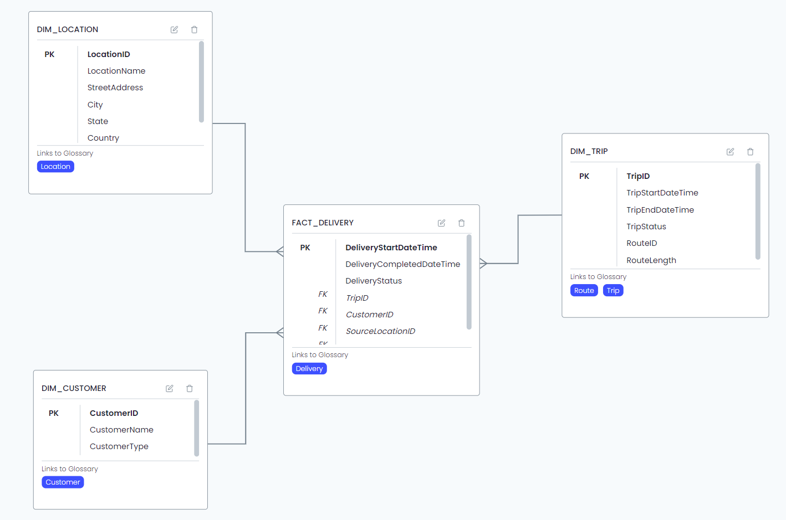
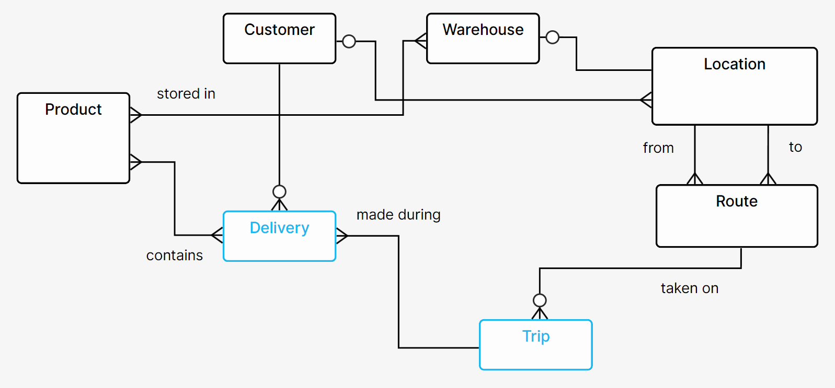
Capturing context with data models
Business entities and relationships of the domain
Derived design of a Data Product
Conceptual model: semantics
Logical model: use case-specific structure
Often the domain-level model is enough, sometimes a product-level conceptual model is needed!

Slide 54
Business-driven data design & development
Modeling questions
Where do we find the data?
How should we integrate the data?
What kind of a data product is needed?
What does the business need to know for the use case?
What things exist in the business?
How does the business make money?
Design
Data product
Use case
€€€
Development
Bronze
Silver
Gold
Source systems
Data platform
Business reality
Value creation

Slide 55
How modeling happens during the process
Logical Data Models
(implementation design)
Conceptual Data Models
(business design)
Design
Data product
Use case
€€€
Development
Physical Data Models
(development focus)
Bronze
Silver
Gold
Source systems
Data platform
Business reality
Value creation

Slide 56
From conceptual to logical modeling
CONCEPTUAL: FOCUS ON BUSINESS OBJECTS
Understand the DOMAIN
Understand what THINGS people need data ABOUT
Understand what the THINGS are
Understand how the THINGS are related in the real world
Result:
A RE-USABLE data model
A model that is true regardless of implementation
A model that stays true (unless the business itself changes)
A model that describes reality
LOGICAL: FOCUS ON TECHNICAL OBJECTS
Understand the USE CASE
Design a structure for a suitable DATA PRODUCT
Understand what information is available about the business objects
Design how that information fits the chosen structure
Result:
A DATA PRODUCT-specific data model
A model that is only true for a specific implementation
A model that is directly usable as implementation blueprint
A model that describes a single solution
Ask:
“What is a suitable data structure for my product, given a) the existing conceptual model and b) the needs of my use case?”

Slide 57
Logical model: the “shape” of data
Some examples:
S
D
D
S
S
H
S
F
H
S
L
D
D
H
S
L
H
S
3NF
“normalized”
Each piece of information only exists once
Many tables and joins
Reusable
Easy to update
Complex queries
Star Schema
“dimensional”
“Facts” and “Dimensions”
Few tables
Easy to query
Sometimes complex to update
Limited reusability
Good for reporting
Data Vault
“DV” and “DV2.0”
“Hubs”, “Links”, and “Satellites”
Very large number of tables and joins
Easy to update (insert-only)
Highly complex queries
Self-historizing
Works well with automation

Slide 58
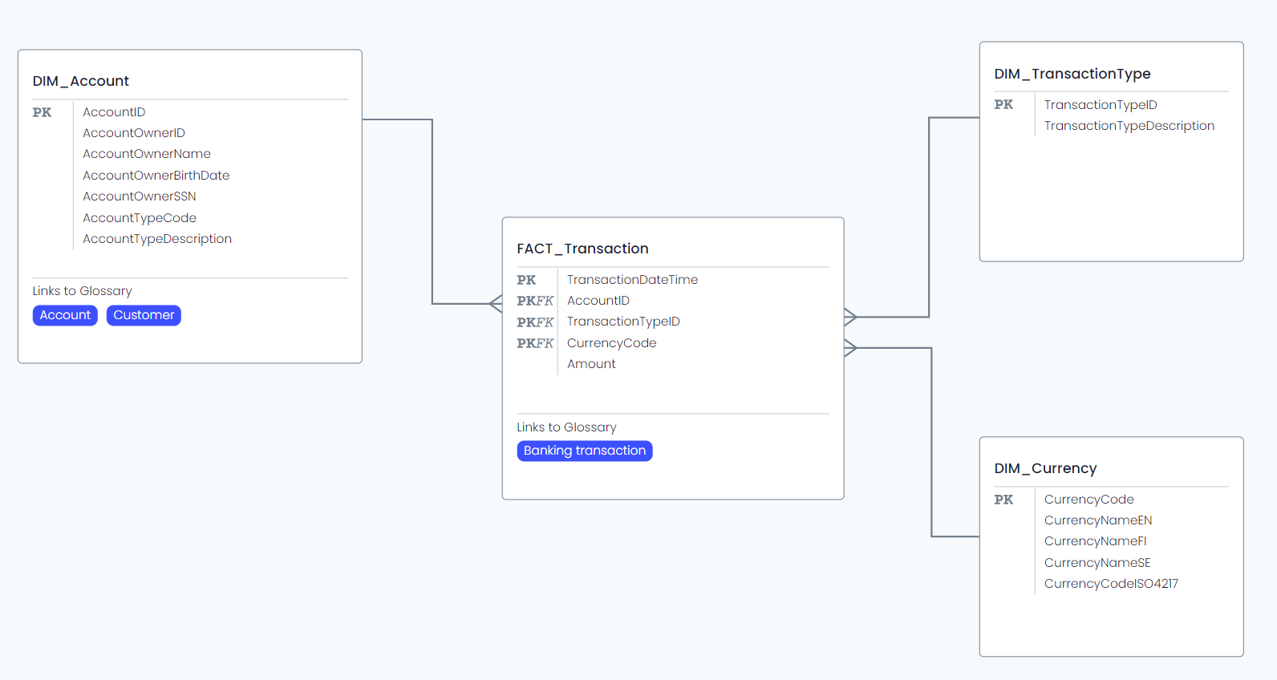
Logical model example: star schema
Note: glossary links
“What is this technical object ABOUT?”

Slide 59
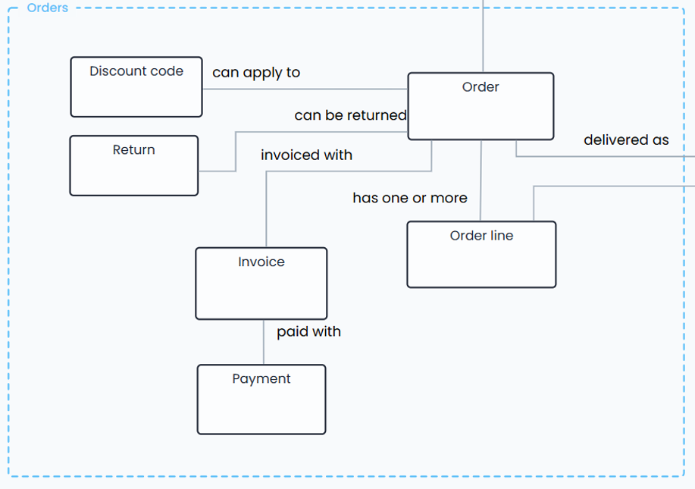
Connecting the Product and its context
Business questions
Which orders are awaiting payment confirmation?
Data Product
Domain conceptual model
Data Product logical model

Slide 60
Ensuring semantic interoperability at the domain boundary

Slide 61
Ensuring semantic interoperability at the domain boundary
Exposing metadata from domains and data products
Data contract basics
Domain glossaries vs. shared enterprise glossaries
Dealing with polysemes

Slide 62
Recap: the interoperability challenge
Semantic interoperability
Domain language
Domain language
What Data Products are available?
How can they be accessed?
What does the data mean?
Technical interoperability
Domain
Domain
?
Data Product
Data Product
Data Product
?
Domain

Slide 63
Data Product Definition = collection of metadata
DATA PRODUCT
Metadata
Business metadata
Technical metadata
Use cases & users
Business logic
Technical components
Authentication & authorization
Ownership & responsibilities
Rules & policies
Update cycle
Monitoring
Semantic content
Data quality
Technical structure
Codebase
etc.
etc.

Slide 64
Data Product Definition & Data Contracts
Output interface metadata
Product metadata
Data Contracts for data producers:
A "promise" of what an interface is and how it behaves
Must be available programmatically (exposes metadata in a machine-readable format)
Should enforce schema compliance in development process (check changes against existing contract on deploy)
Should be versioned (communicate upcoming changes to data consumers!)
Data Contracts for data consumers:
Specification for technical data interface
Can be used to double-check against incoming data (ensure no unexpected changes)
Data Contract
Data Product Definition
Data Contract
Data Product
Data ingestion
Inputs
Outputs

Slide 65
Example standards
Open Data Product Standard (ODPS)
Open Data Contract Standard (ODCS)
Fundamentals
Product Information
Management Ports
Support and Communication Channels
Team
Ancillary Objects: Custom Properties
Ancillary Objects: Authoritative Definitions
Other Properties
Fundamentals
Schema
References
Data Quality
Support & Communication Channels
Pricing
Team
Roles
Service-Level Agreement
Infrastructures & Servers
Custom & Other Properties

Slide 66


Enterprise view on semantics
Enterprise
Knowledge Plane
Data Product Definitions need to expose semantics for enterprise-wide discoverability across domains
“This product is about Customers and Prospects”
Data Product Definition
Data Product Definition
Data Product Definition
“This product is about Customers and Deliveries”
DATA PRODUCT
DATA PRODUCT
DATA PRODUCT

Slide 67
Domain vs. Enterprise Glossaries
Enterprise
Knowledge Plane
Domain-specific glossaries are needed for domain-specific language, but everything must connect at enterprise level
“This is what Domain 1 means by Customer”
Domain Glossary
Domain Glossary
“This is what Domain 2 means by Customer”
“This product is about Customers and Prospects”
Data Product Definition
Data Product Definition
Data Product Definition
“This product is about Customers and Deliveries”
DATA PRODUCT
DATA PRODUCT
DATA PRODUCT

Slide 68
Language problems
Synonym
Homonym
Different word, same meaning
Cross-domain and within-domain
“Customer” – “Client”
Same word, different meaning
Cross-domain and within-domain
“Account” (sales) – “Account” (finance)
Use “preferred labels” and “alternative labels”
Map cross-domain connections at enterprise level
Prioritize within-domain clarity

Slide 69
Data Mesh information architecture operating model

Slide 70
Data Mesh information architecture operating model
Domain team responsibilities
Data product owner responsibilities
Platform team responsibilities
Federated governance

Slide 71


Scaling value
Enterprise-level approach enables value at scale
Value to organization
Product management operating model
Metadata
This is often the focus of the organization
– road to failure!
Individual data products create direct business value
Technology
maturity

Slide 72




Roles and teams
Data Product Owner
Domain Owner
Responsible for a Data Product throughout its lifecycle
Decides on changes and prioritization (backlog)
Primary contact for everything related to the particular Data Product
Often responsible for specifications
Responsible for all data within a domain
Often the “official” data owner across products
Decides on general principles and policies within the domain
Owns the Domain Glossary
Platform Team
Domain DevOps Team
Centralized team, responsible for a technical platform service
Doesn’t do actual Data Product implementation work!
Ensures that Domain Teams have everything they need to create Data Products
Often includes a Platform Owner role
Federated team, responsible for one domain and all the Data Products in it
Can develop new Data Products independently (all necessary skills included)
Good domain knowledge
Sometimes incl. both analytical and operational development

Slide 73



Product ownership & backlog management
Platform team
Domain data team
Product owner
Business stakeholders
Data product
Use case
€€€
Bronze
Silver
Gold
Source systems
Data platform
Business reality
Value creation

Slide 74

Data Product lifecycle management
End user
End user
Data Product Owner
Domain Owner
Data Product Owner
Domain Owner
New data / analytics / AI idea
Decide domain & DP owner
Prioritization & resourcing
GO!
End user
DevOps team
Data Product Owner
DevOps team
Data Product Owner
DevOps team
Data Product Owner
Data Product design
Technical implementation
Deployment & support setup
DevOps team
Data Product Owner
End user
Data Product Owner
Utilization & monitoring
End-of-life

Slide 75

Modeling at design stage
Domain model
Feedback loop
End user
DevOps team
Data Product Owner
Data Product design
Conceptual modeling
Logical modeling

Slide 76
Key success factor: feedback loops
Enterprise/domain level
Canonical, reusable patterns and templates:
components, data models, policies, practices, semantics…
New and updated patterns
and templates:
components, data models, policies, practices, semantics…
Product-level workflows
Product-level workflows
Product-level workflows

Slide 77
Organizing data modeling on two levels
Enterprise-level information architecture
Standards & policies ensure high-quality “official” domain models with maximum trust and reusability
Business domain understanding
Conceptual model
(domain scope)
Conceptual model
(domain scope)
Individual solutions feed into enterprise-level domain modeling
(bottom-up)
Information architecture standards & policies
Shared ways of working ensure right balance of freedom & common methods for data product development
Data product development
Design & development ways of working
Conceptual model
(product scope)
Conceptual model
(product scope)
Conceptual model
(product scope)
Use case needs & requirements
Logical model
Logical model
Logical model
Data products utilize domain-level models to speed up work & increase interoperability
(top-down)

Slide 78
Cross-domain interoperability
Enterprise Knowledge Plane
Business Glossaries
Taxonomies
Ontologies
Domain
CDM
CDM = Conceptual Data Model
LDM = Logical Data Model
Domain
Domain
CDM
CDMLDM
CDMLDM
Domain
CDM
CDMLDM
Domain
Domain
Data Product
Data Product
Domain
CDM
Data Product
Domain

Slide 79
Goal: context-aware data utilization
AI
Apps
Humans
SEMANTICS
Business context
Knowledge Plane
DISCOVERY
Data-to-meaning mapping
Data Modeling
DATA PRODUCTS
Data sharing & reuse
DESIGN
Source-to-target mapping
Data Plane
SYSTEMS
Operational data

Slide 80
Conclusions

Slide 81
Conclusions
Key takeaways
Where to start in your organization
How to learn more

Slide 82
Key takeaways
Federated operating model in Data Mesh creates challenges at the domain boundary (semantic interoperability)
Data modeling helps with design and documentation of both domains and data products
Conceptual data modeling discovers semantics – the meaning of data
Metadata from data products (Data Product Definition) and product interfaces (Data Contract) need to be made available & connected with the domain models
Enterprise-level management of semantic information (Knowledge Plane) connects domains and explains polysemes

Slide 83
Path forward
Shared vision
Bottom-up:
one Data Product at a time
Top-down:
build and iterate the operating model
Ways of working
To-be organization
Metadata management

Slide 84
Data Product Management training & advisory services
Product management
Metadata
Training, consulting & advisory services on Data Products, Data Modeling, and Information Architecture
Technology

Slide 85

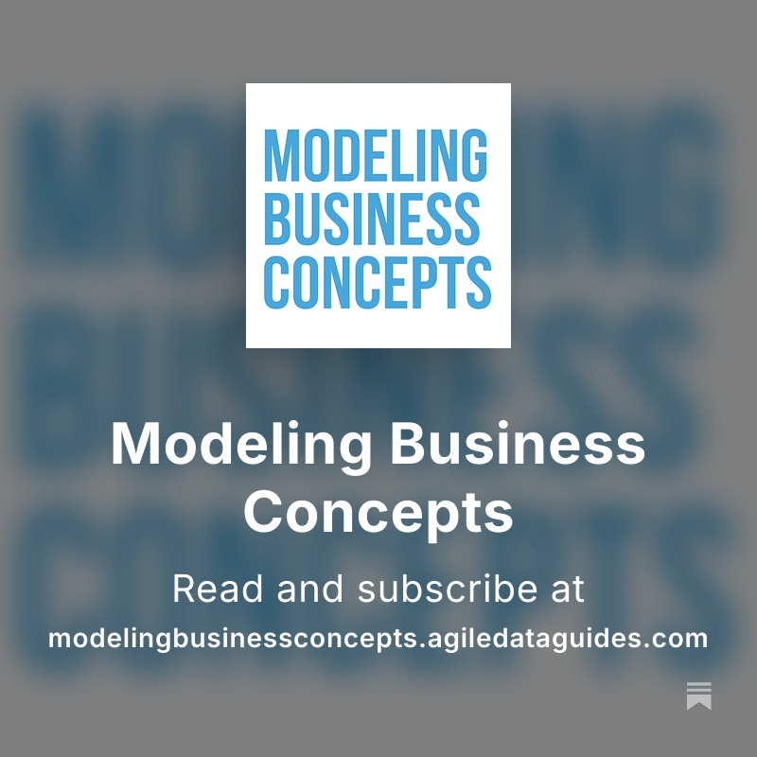
More thoughts on Substack!

