Slide 1


New Times: From Data for AI to AI for Data
Rutger Rienks

Slide 2
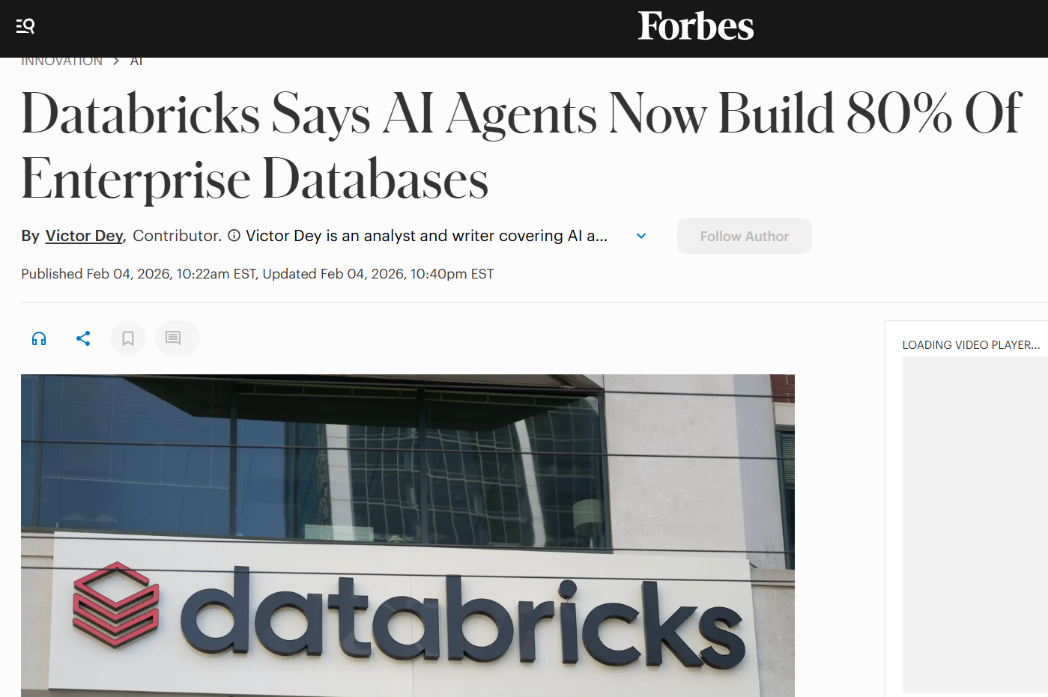

Slide 3

Contents
This presentation outlines the transition from preparing data for AI to using AI to manage data.
01
Market trends and needs
04
Interactive notebook examples
02
Gen- and Agentic AI
05
Tool overview
03
Five data-management tasks
06
Take home message
Copyright © Deloitte Consulting S.r.l. S.B. All rights reserved.

Slide 4
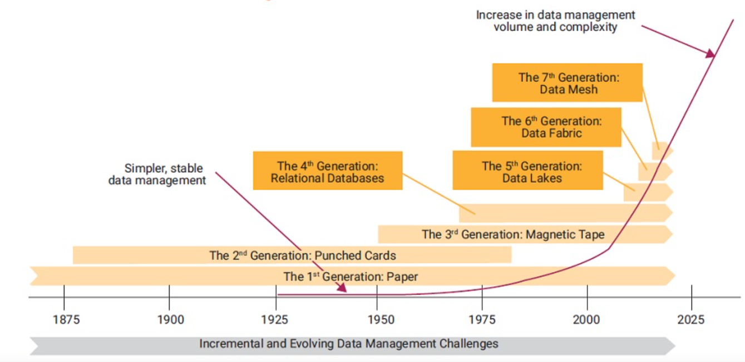

Slide 5




  Data Cataloguing, Lineage, and Governance Challenges
Data volume and complexity is increasing at a pace that exceeds data governance resource bandwidth to support and govern
Organizations should fully embrace automation to scale to demand and expedite Data Cataloguing, Lineage, and governance capabilities
On-demand business analytics and decision-making needs and appetite for high-quality data are increasing
Organization should move towards centralized self-service data & analytics
New technologies and capabilities, such as ML, AI, and GenAI, are generating more data while demanding more high-quality data
Data stewards who report to business functions are typically not in full-time roles and prioritize business activities over steward activities.
Organization should build skills in AI/GenAI to integrate these technologies and capabilities into their data governance program
Data governance organizations are struggling to scale to demand and typically do not have the budget to increase headcount

Slide 6

GENERATIVE AI
AGENTIC AI
Traditional Generative AI and Large Language Models (LLMs) are primarily focused on generating and interpreting content. They excel in tasks such as writing texts, summarizing documents, translating languages, and answering questions based on the context provided. These models respond to specific prompts and perform a single, defined task. Their functionality is reactive; They wait for an input from the user and then produce an output.
An AI agent can act autonomously to achieve a goal. This includes creating plans, calling external tools (such as APIs or databases), performing multi-step tasks, and learning from the results. Characteristic of Agentic AI is the use of a memory to retain context over longer interactions and the ability to make decisions independently. Instead of just responding, an agent can proactively initiate a series of actions to solve a complex problem, such as fully managing a data quality process.

Slide 7

Where does AI intersect with Data Management
The integration of AI and Gen AI into data cataloging, lineage, and governance processes offers numerous advantages, including improved accuracy, efficiency, transparency, and compliance. By leveraging these technologies, organizations can enhance their data management practices, making it easier to discover, understand, and govern their data assets effectively.
Data Governance
Metadata Management
Master Data Management
Data Quality
Data Lineage
Includes data classification and data security; supports scalability, data governance, and access control, data encryption, and continuous monitoring, making data more manageable, secure, and useful
Ensures data accuracy, consistency, and reliability, which are crucial for effective decision-making and operational efficiency.
Provides a comprehensive and accurate view of data flows and transformations, enabling better decision-making and risk management.
Allows organizations to achieve more efficient, accurate, and scalable metadata management, ultimately leading to better data utilization and decision-making.
Supports data enrichment, identifies duplicates, enforces policies, increasing operational efficiency and ensuring accurate and consistent master data

Slide 8
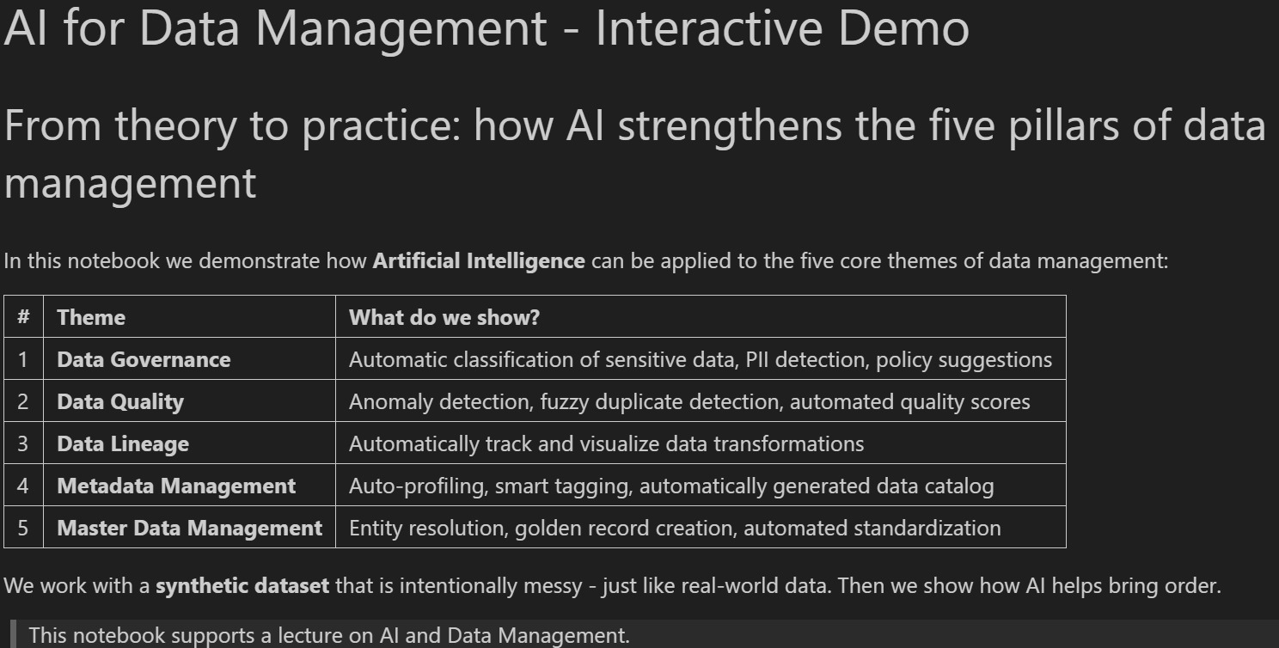
Let’s make it Interactive!
Download the notebooks to follow along the presentation
https://github.com/rutgerrienks/Datamanagement

Slide 9




The framework for managing data assets within an organization to ensure data quality, security, integrity, and proper classification, thereby enabling effective data usage, compliance, and protection against unauthorized access.
Data Governance
Key Data Governance Capabilities:
Data Classification Standards: Tag data with labels such as Public, Confidential, and Personal Information.
Access Control: Ensuring users have data on a need-to-know basis and verifying identity and permissions before granting access
Data Stewardship: Responsibly managing and overseeing an organization's data assets to ensure data quality, integrity, security, and compliance
How AI/GenAI Enhances Data Governance:
Automates Data Classification: AI/GenAI can classify data and apply labels based on predefined criteria, reducing the time and effort required for manual classification and monitoring and classifying new data in real time
Assists Data Stewards: AI/GenAI can automate data management workflows and processes and enable proactive monitoring and compliance through advanced analytics

Slide 10


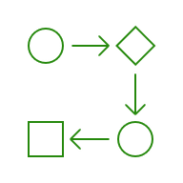

The lifecycle of data, encompassing its origins, movements, transformations, and ultimate destination. It provides a detailed map of how data flows through an organization, from its initial creation or acquisition to its final use
Data Lineage
Key Data Lineage Capabilities:
Data Lineage: Ability to trace data from its origin to its destruction
Data Compliance & Anomaly Detection: Ensuring data meets regulatory compliance at each step of the data lifecycle, with AI-driven anomaly detection to mitigate risk and operational disruption.
How AI/GenAI Enhances Data Lineage:
Contextual Data Lineage Visualization: AI-powered tools offer customizable, interactive visualizations of data lineage, enhancing understanding and decision-making by illustrating data flows and transformations across the organization.
Advanced Anomaly Detection: AI algorithms can detect anomalies and outliers in data lineage, such as unexpected data transformations or unauthorized data access.

Slide 11





The capability to proactively manage the diverse data standards of the enterprise. It involves creating, controlling, enhancing, and maintaining consistency, quality, and usability of metadata
Metadata Management
Key Metadata Management Capabilities:
Data Discovery: Facilitates the business’ ability to quickly find data assets based on metadata attributes
Data Collaboration: Improves communication and understanding by providing context about data and establishing standards across data areas
Impact Analysis: Asses the potential effects of changes in data definitions or structures on downstream processes and systems
How AI/GenAI Enhances Metadata Management:
Ease of Search: AI supports search capabilities using natural language processing (NLP), giving users a simple way to locate data assets
Predictive Impact Analysis: AI can predict the effects of changes in metadata on downstream processes by analyzing historical data and identifying patterns

Slide 12




Data Quality (DQ) refers both to the characteristics of high-quality data and to the processes used to measure or improve the quality of data
Data Quality
Key Data Quality Capabilities:
Data Profiling: Identify potential data quality issues and develop solutions for remediation
Data Cleansing: Correct or remove inaccurate records from a dataset
Data Quality Tracking: Track the success and opportunities with metrics reflecting the progress of data quality efforts
How AI/GenAI Enhances Data Quality:
Automate Data Cleansing and Data Preparation: AI/GenAI can identify and correct errors in datasets. This could include duplicate detection/removal, error correction, and general standardization
Data Quality Rule Creation: Generative AI can help users write DQ rules so organizations can deploy and monitor data in a faster timeframe

Slide 13




Master Data Management (MDM) is the comprehensive process of managing an organization's critical data to ensure consistency, accuracy, and accountability across the enterprise and creating a single source of truth.
Master Data Management
Key Master Data Management Capabilities:
Data Quality Standardization: MDM facilitates the creation of a centralized and consistent definition of attributes, ensuring all data elements adhere to a consistent set of standards and dimensions (parsing, match/merge, profling, enrichment)
Master Data Lineage: Ability to trace and map the origins, movement, transformations and usages of Master Data
How AI/GenAI Enhances Master Data Management:
Automated DQ Operations: Built in AI can detect and remove duplicates, augment and enrich hierarchies with third-party data, check for consistency and correct missing data to prevent manual intervention.
GenAI Powered Data Operations: Gen/AI capabilities can help automate data tasks and create semantic drill downs of data for exploration and analytics

Slide 14






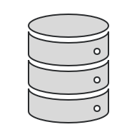



Indicates where the AI agent interacts with a specific part of the architecture.
AI Agent Technical Conceptual Architecture
Input
Processing
Output
Data Lineage
Data Privacy
Issue Management
Data Access Management
Automated Metadata Updated
Automated Governance Process
Data Classification
NLG,BI, dashboard, search and retrieval
Data Sources
Reference Data
Technical Metadata
Data Quality Rules and Metrics
Logical Mappings
Business and Governance Metadata
ETL, API Integration, data enrichment
{REST: API}
Metadata Visualization & Search
Data Quality Rules
Data Dictionary / Logical Model
Business Glossary
Market
Place
Hive
Consumption
Dataset Registration
Logical to technical mapping
Process/Functions
Job Server
Data Quality Metrics
Technical Metadata
Policy and Standard
Chatbots, virtual assistance, dynamic pricing
Catalog
Data Profiling
Reports and KPIs
Metadata Consumption
NLP, data sensitivity classification, etc.
{REST: API}
Data Quality Dimension
KDE Metadata
Sample Data
Reference Data
Reporting / Data Analytics
Job Server
Extraction, enrichment standardization
Reconciliation, validation, anomaly detection, rule creation
Association rule mining, workflow automation
Data quality, data security, data lineage
Microstrategy
Power BI
Tableau
Reporting Delivery
Data Quality
Forecasting, risk assessment, API integration, dashboards
Data Quality Tools
{REST: API}
Datasets
Physical Data Dictionary
Business Glossary
Logical Data Dictionary
Policy and Standards
Export
Canned
Reports
Validation, cleaning, enrichment, anomaly detection
Metadata Store
ETL, NLG, charting and graphing, interactive visualization
Self
Service
ETL, NLP, automated extraction, validation, standardization, enrichment
NOTE: Blue boxes do not represent a 1:1 mapping; multiple AI agents can be implemented within each capability or area.

Slide 15
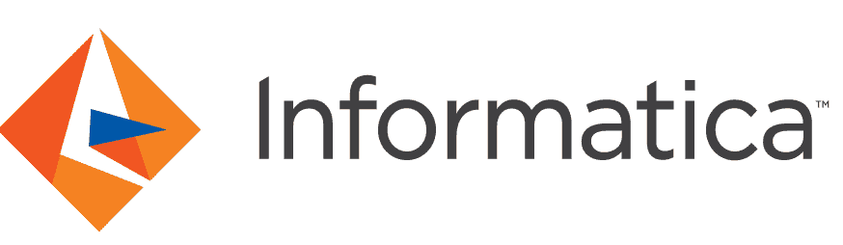


Tool Overview
Different data governance tools have similar overall functions but offer various capabilities and features.
The commonly used tools listed below offer a comprehensive and collaborative platform for data governance. They help automate tasks such as data lineage, data cataloging, and data discovery. They are ideal and popular choices for organizations looking for a complete data management suite that ensures strong data quality, effective metadata management, and scalability.
Collibra's data governance platform offers automated data cataloging, end-to-end data lineage, robust data quality management, and policy enforcement. It supports role-based access, stewardship workflows, and provides collaboration tools and a centralized business glossary. With customizable dashboards and integration capabilities, Collibra ensures data accuracy, compliance, and efficient decision-making across the organization.
Alation's data governance capabilities include automated data cataloging, data lineage tracking, and data stewardship workflows. It provides robust metadata management, policy enforcement, and role-based access control. Alation also offers collaboration tools, a business glossary, and data quality management features to ensure data accuracy, compliance, and effective decision-making.
Informatica's data governance capabilities include automated data discovery, comprehensive metadata management, and robust data quality tools. It offers end-to-end data lineage, policy enforcement, and role-based access control. The platform supports collaboration through a business glossary and stewardship workflows, ensuring data accuracy, compliance, and effective decision-making across the organization.

Slide 16
Tool Overview
/
/
= High / Medium / Low Maturity
Use Case | Collibra | Alation | Informatica | AI Capabilities for Each Tool
Metadata Management |  |  |  | Collibra: Supports automated data cataloging, automated asset curation, and NLP search capabilities. Alation: Uses Behavior I/O, an AI-powered engine to automatically identify meaningful patterns about how data Us being used, then giving users recommendations. Informatica: Uses active metadata management to create predictive recommendations, supports automated data cataloging and NLP search.
Data Quality |  |  |  | Collibra: Has AI/GenAi-generated AdaptiveRules, supporting automated DQ tracking, and GenAI supported DQ rule creation using NLP. Alation: Integrates Snowflake’s Data Quality Metric Functions (DMFs) with its data quality framework, creating high-quality data for AI model development. Informatica: Has CLAIRE AI copilot, which supports automated data profiling, quality analysis, and can generate data quality rules.
Data Lineage |  |  |  | Collibra: Has intelligent filtering through lineage diagrams and automated end-to-end data lineage tracking with Collibra Lineage. Alation: Leverages machine learning algorithms analyze user behavior, data usage patterns, and metadata to identify relevant data assets. Informatica: Supports automated end-to-end data lineage tracking, including automated scanning for data transformation details.
Data Classification |  |  |  | Collibra: Can automatically classify data with industry-specific context Alation: Supports automated mapping and categorization of data, including tagging Informatica: CLAIRE supports intelligent similarity detection and domain discovery with tags, streamlining classification
Data Security |  |  |  | Collibra: Automatically discovers and classifies sensitive data across existing organizations’ AI systems, allowing owners to manage access controls Alation: Alation AI and data governance framework flags non-compliant datasets and ensures AI models are built on reliable, governed data Informatica: CLAIRE has data privacy solutions that enable sensitive data tracking, detect anomalies, and simulate risk
Master Data Management |  |  |  | Collibra: N/A Alation: N/A Informatica: Automatically identifies master data, traces source lineage, and finds mappings between attributes in data models

Slide 17
The three main conclusions
KEY MESSAGES SUMMARIZED
The focus is shifting from manual data preparation to leveraging AI for autonomous data management
Agentic AI significantly increases efficiency by deploying autonomous agents to enrich, validate, and integrate data.
Strong governance and Human-in-the-Loop controls are essential to manage risk and ensure the reliability of the AI.

