Slide 1
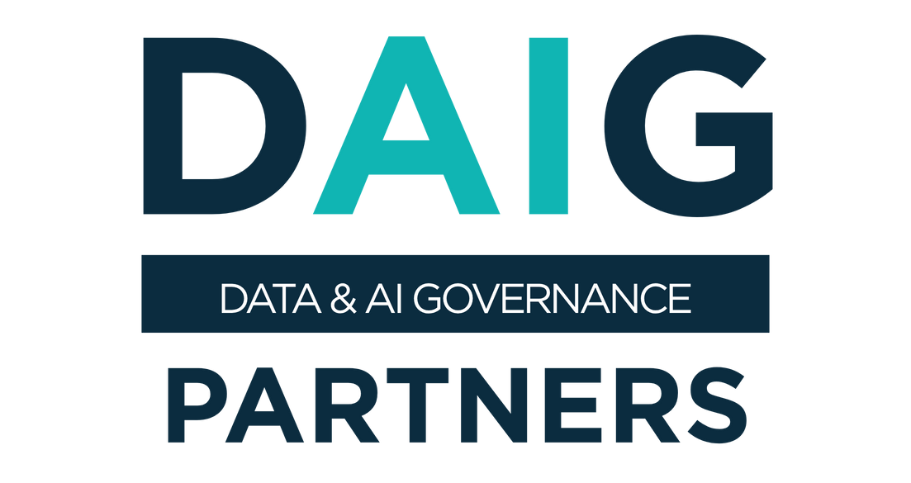
Data Governance SprintTM
Establish Data Governance in Weeks instead of Months
DW & BI Summit 2026
Utrecht – March 24, 2026
© 2026 Data & AI Governance Partners
Reproduction without permission is prohibited.

Slide 2



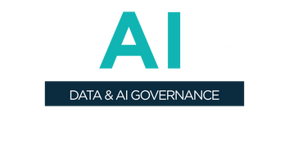
PhD in Data Governance (AMS, 2025 - 2029)
MSc in Business Economics (2012, Ghent University)
BSc in Sociology (2009, Ghent University)
Who is MATHIAS Vercauteren
Consulting & Advisory Services
Educational Services
DAMA –DMBOK 3.0 (Project Manager)
UZA (Hospital)
MLOZ (Healthcare Insurance)
Monument Group (Insurance)
De Lijn (Logistics)
MPET (Logistics)
Securex (Professional Services)
Federal Insurance (Insurance)
Flemish Government (Governmental Institution)
Belfius (Financial Services)
Barry Callebaut (Manufacturing)
Carrefour (Retail)
Hilti (Manufacturing)
Training and Coaching Engagements – both in-house and classroom:
Data Governance
AI Governance
DAMA-DMBOK® / CDMP®
Data Strategy
Data Qualtiy
Master Data Management
Speaking Engagements:
DGIQ/EDW (San Diego, 2026)
Data Modeling Zone (San Francisco, 2026)
DGIQ/EDW (Anaheim, 2025)
Data and AI Conference (London, 2025)
Data Modeling Zone (Phoenix, 2025)
DGIQ East (Washington DC, 2024)
Data and AI Conference (London, 2024)
DGIQ West (San Diego, 2024)
Enterprise Data World (Orlando, 2025)
DG & MDM Conference (London, 2023)
DGIQ East (Washington DC, 2023)
Research
President of Data & AI Governance Research Institute (2026, founding phase)
PhD in Data Governance (AMS, 2025 - 2029)
Book “Data Governance Sprints” (Technics Publication, est. Q2 2026)
Data Governance Digest (LinkedIn newsletter)
© 2026 Data Vantage Consulting | All Rights Reserved
https://daigpartners.com

Slide 3
AGENDA: Welcome to “Data Governance SprintsTM”
We’ll cover the following topics
1
2
3
Data Governance is Failing!
Why Workshops are Better
Breaking Free from
Legacy Data Governance
4
5
Data Governance SprintTM:
Week by Week
Must See Case Studies

Slide 4
Back to Agenda
1
Data Governance is Failing!

Slide 5
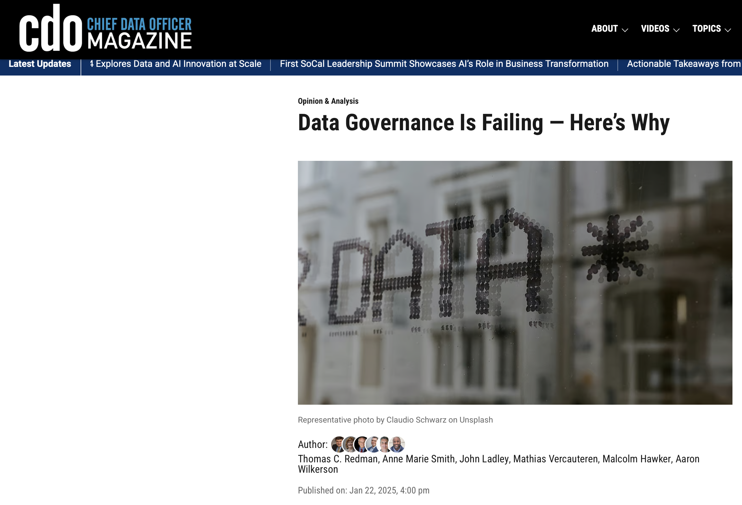
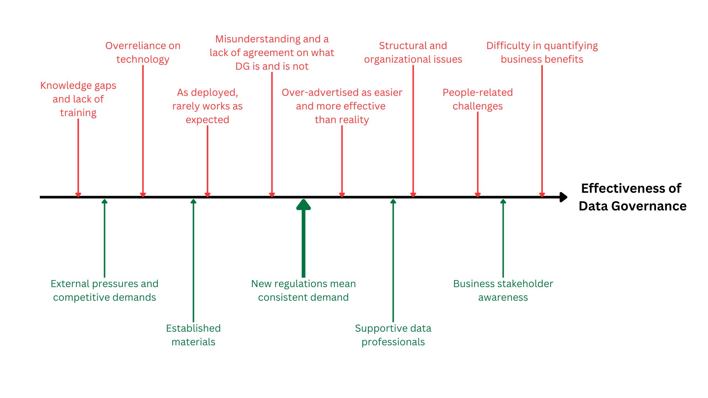
Source: Redman, T. C. (2025, January 22). Data governance is failing—Here’s why. CDO Magazine. https://www.cdomagazine.tech/opinion-analysis/data-governance-is-failing-heres-why

Slide 6
MOST Data Governance programs fail!
Most businesses today are unfit for data.
Data Governance programs are bolted on, not built in.
Policies, standards, glossaries, roles all exist on paper.
The data office is a supplicant.
People experience it as extra work added on top of their “day job”, competing with “real work”.
People side versus Technology side!
Growing complexity of modern data organizations.
Where's the value? And what about the communication?
Data governance, as practiced, is still an unproven theory.
Disconnect between speed of business and speed of a data governance program.
Traditional Data Governance strategies fail…time and time again!

Slide 7
What is DATA GOVERNANCE?
The exercise of authority, control, and shared decision-making (planning, monitoring, and enforcement) over the management of data assets. ~ DAMA DMBoK
Rules: The standards and guidelines for data use.
Roles: The people responsible for managing, governing, and overseeing data.
Control: The mechanisms that ensure compliance and enforcement.
Purpose: Define how data should be managed to maintain quality, ensure compliance, and protect sensitive information.
Examples:
Data privacy policies
Data quality standards
Access control protocols
Purpose: Establish accountability, define responsibilities, and ensure collaboration across the organization.
Examples:
Data Stewards
Data Owners
Data Custodians
Purpose: Monitor adherence to rules, enforce policies, and mitigate risks through oversight and governance structures.
Examples:
Data audits and compliance reviews
Data governance councils or committees
Data quality monitoring
Rules, Roles, and Control work together to turn data into a valuable, trusted asset.

Slide 8






Data Governance is MANAGING data as an ASSET
Core Business Function
Supply Chain
Facilities Management
Human Resources
Finance
Information Technology
Data Governance
Strategic Assets
Medical Equipment & Supplies
Patient Care & Work Locations
Employees & Contractors
Capital & Expenses & Revenue
Software & Hardware
Data & Analytics Solutions
Enterprise Capabilities
Purchasing
Inventory Mgmt.
Logistics & Distribution
Supplier Mgmt.
Asset Management
Plumbing
Electricity
Construction Waste Mgmt.
Safety & Compliance
Talent Acquisition
Performance Mgmt.
Benefits
Payroll
Time & Attendance
Budgeting
Forecasting
Cost Accounting
Capital Mgmt.
Audit & Compliance
Hardware Mgmt.
Cybersecurity
Data Communications
Networking
Application Support
Software Mgmt.
Data Quality Mgmt.
Master & Reference Data
Metadata
Analytics & BI
Data Stewardship
Notes:
All companies have been down this road of managing assets.
With data governance we want to put in place policies, processes, standards and roles and responsibilities to take care of our strategic asset called data.
Basically, it’s assets management for data.

Slide 9
Back to Agenda
2
Why Workshops are Better

Slide 10




How effective are your MEETINGS?
Endless debate cycles
Biased meetings & wrong priorities
Frustrated teams & loss of momentum
Communication barriers

Slide 11
Why workshops are BETTER than meetings?
Grab pen and paper
I flash some words on the screen
Take 20 seconds to write down every word you remember
I’ll show the words again, how many did you remember?

Slide 12
Flower
Tape
Cat
Fish
Tree
Door
Head
Key
King
Square
Ball
Hammer
Shoe
Box
House
Apple
Milk
Ball

Slide 13

The magical number 7 (plus or minus 2)
Some limits on our capacity for processing information.
So how does this play out in a meeting?
George Miller

Slide 14
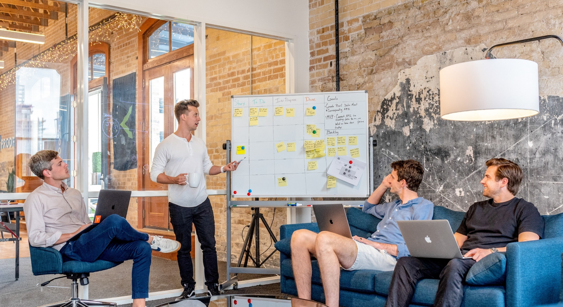
A TYPICAL meeting
Data Point B
Data Point A2
Data Point A
Data Point C

Slide 15

The BRAIN stuff
In meetings, you have a ton of information being produced, but people don't actually remember. Our brains struggle to process this data avalanche, especially when cognitive biases like recency bias and primacy bias come into play.
Our brains are just not made to process the amount of data that happens in a meeting.

Slide 16
A workshop is a POWERHOUSE!
Workshops allow you to visualize meetings and make decisions based on the data that is visualized around you.
Notes:
A workshop visualizes & standardizes the conversation and removes the need for the participants to remember all the information. This takes away the need of the participants to remember all this data and rely on memory to make decisions (or hopefully on some notes they took).

Slide 17
Back to Agenda
3
Breaking Free from
Legacy Data Governance

Slide 18

The SPEED PROBLEM in data governance
The gap between rapid business movement and slow data governance implementation, plus the failure of traditional strategies, highlights the need for a more flexible and pragmatic approach.
Image Credit: Image generated by DALL-E, OpenAI.
Notes:
Data Governance is as Slow as a Snail While Business Moves at Race-Car Speed

Slide 19
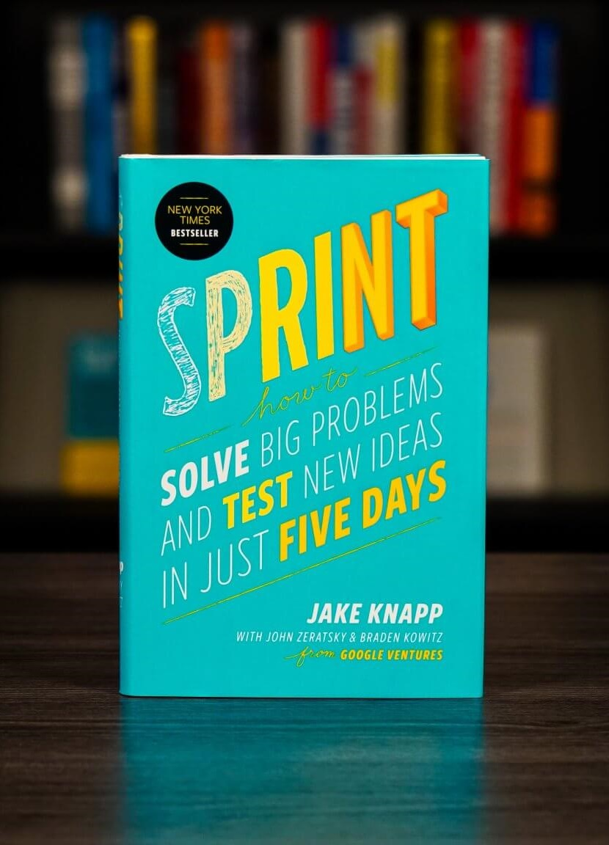
History of the DESIGN SPRINT
Jake Knapp worked at Microsoft and later at Google.
He experienced firsthand how building products would often take months, or even a year, before they could be launched.
Something clicked for Jake in 2009 when he was in Stockholm for 1 week in January. During that short amount of time, he designed, prototyped, and tested an idea - which turned out to be Google Hangout.
That's when he realized that there had to be a better way to build products!

Slide 20
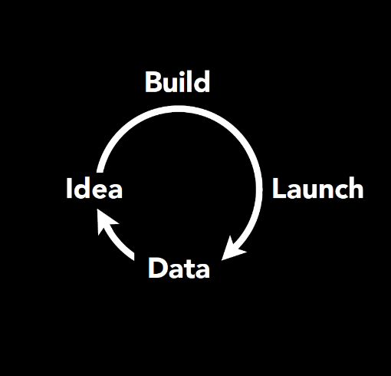
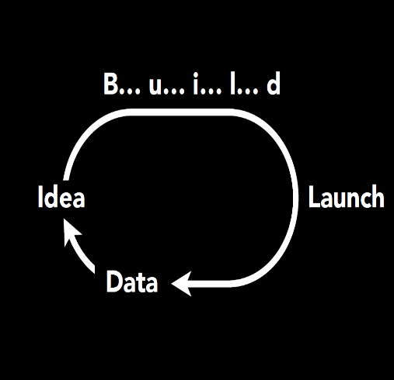
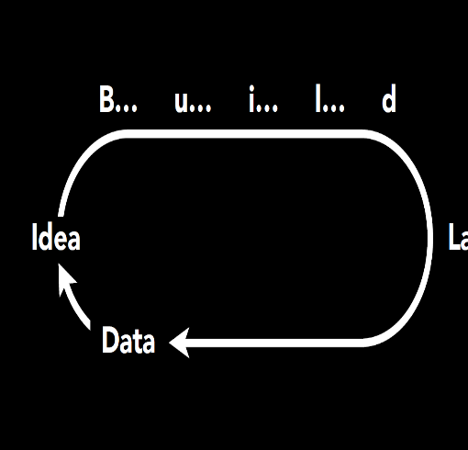
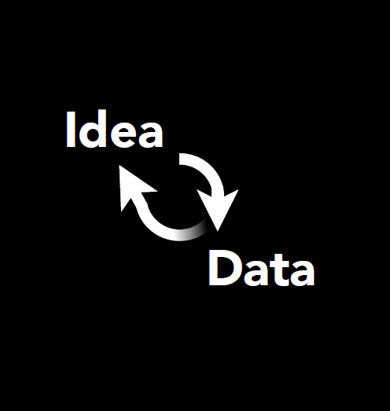
Get data about an idea FAST!
The Design Sprint
Notes:
The default product development cycle doesn't check how customers will react until after you launch. The Design Sprint validates new ideas fast before you invest time and money to build them.
- Typical process: Idea --> Build --> Launch --> data (classic Lean startup loop)
- Building phase is stretching out over time
- Design sprint: idea --> data

Slide 21
The STANDARD design sprint
MON
TUE
WED
THU
FRI
Decide
Map
Sketch
Prototype
Test
Storyboard

Slide 22
DATA GOVERNANCE SPRINTTM: The secret to speed
Imagine a five-week journey where you design, build, and test core components of your data governance program. This is what our Data Governance SprintTM is all about.
It’s a structured, hands-on experience for data leadership teams, that uses a proven, repeatable approach that transforms your data governance concepts into reality in weeks, not months.
From designing a winning, action-oriented data governance strategy that moves your company to managing data as an asset, to creating a business glossary and piloting an operating model with engaged data stewards—this iterative approach helps you make tangible progress in no time, while keeping momentum and morale high.

Slide 23





Data Governance SPRINTTM to the rescue
1
Establishing Data Governance CAPABILITIES
FOUNDATIONS
STRUCTURE & ROLES
PROCESSES & WORKFLOWS
MEASURES & FEEDBACK
COMMUNICATION & ENABLEMENT
FRONTLINE GOVERNANCE
2
Through Incremental Implementation of USE CASES
3
In WEEKS Instead of Months
Data Quality
Metadata
Critical Data Elements
Data Literacy
Data Governance SprintTM

Slide 24
Data Governance SPRINTTM
Current State Mapping
What are our challenges?
Purpose
What is our goal?
Workshop #1
Understanding ‘As Is’ and defining ‘To Be”
Guiding Principle #1
How we realize purpose
Guiding Principle #2
How we realize purpose
Guiding Principle #3
How we realize purpose
Initiatives
Identifying the gaps
Prioritization
Workshop #2
Bridge to Governance
Roadmap

Slide 25
Data Governance SPRINTTM
Roles & Responsibilities Role Roster
Workshop #3
Operating Model
Target and minimum viable versions
Processes
Focus on Critical Data Elements
Workshop #4
Measurement Dashboard
Business Glossary
Communication Plan
Training Plan
Workshop #5
Workshop #6
Prototype Prep
User test flows and creating a storyboard
Workshop #7
Prototyping
User Testing

Slide 26
Back to Agenda
4
Data Governance SprintTM:
Week by Week

Slide 27


WEEK 1 of 5 Laying the Groundwork | The Fundamentals
MON
TUE
WED
THU
FRI
Set-up & Onboarding
Onboarding
Interviews
ca. 45 min. per participant, 1-on-1
Internal Research
Synthesizing onboarding interviews & document analysis
Workshop 1 of 7
The Fundamentals
ca. 6h,
with the entire team
Workshop 2 of 7
Bridging the Gap
ca. 6h,
with the entire team
Awareness Session
ca. 45 - 60 mins
Workshop set-up
Preparing for the upcoming
workshop
Onboarding Interviews
ca. 45 min. per participant, 1-on-1
Involves stakeholders (block time for these)

Slide 28
WEEK 1 of 5 The Fundamentals | Workshops 1 and 2 of 7
Week 1
1
The Fundamentals Workshops: Establishing the Foundation for Data Governance
The Fundamentals workshops are the cornerstone of our Data Governance SprintTM, where we take a comprehensive look at how your organization currently manages its data assets and chart a clear path toward your desired future state.
By the end of The Fundamentals workshops, you’ll have a thorough understanding of the “As Is” state, the “To Be” vision, and the gaps that need to be bridged. This clarity will provide a strong, actionable foundation for the remainder of the DG SprintTM and beyond, ensuring that your data governance efforts are aligned with your strategic objectives and ready to drive meaningful progress.
Workshop 1: Thursday Full-Day
Workshop 2: Friday Full-Day
Focus on understanding the current state of data management within your organization.
Identify existing challenges and examine current practices.
Define the “To Be” state, our vision for data governance, aligned with business objectives and strategic goals.
Work through four key exercises: The Challenges Map, Challenges Interview, Purpose, and Guiding Principles.
Highlight the gaps between the current state and the future vision established on Thursday.
Prioritize the actions needed to bridge these gaps.
Focus on improving the quality and understanding of critical data elements.
Work through five engaging exercises designed to create a clear roadmap with prioritized use cases.

Slide 29
WEEK 1 of 5 The Fundamentals | Workshop 1 of 7
Thursday
1
Exercise 1. The Challenges Map
We start by capturing the data challenges and pain points on a Challenges Map.
The purpose is to get a high-level overview of how the key components (data, processes, people, & technology) interact with the information life cycle within the organization.
It helps to identify root causes and determine improvements needed to correct existing problems and prevent them from reappearing.
Exercise 2. Challenges Interview
Exercise 3. Purpose
Exercise 4. Guiding Principles

Slide 30
The challenges MAP
Location (Where) and Time (When and How Long)
Plan
Obtain
Store & Share
Maintain
Apply
Dispose
Data
(What)
MA
GH
DR
Processes
(How)
KN
JJ
People
(Who)
JP
ST
Technology
(How)
BJ
McGilvray, D. (2008). Executing Data Quality Projects: Ten Steps to Quality Data and Trusted Information (Framework for Information Quality). Morgan Kaufmann Publishers.

Slide 31
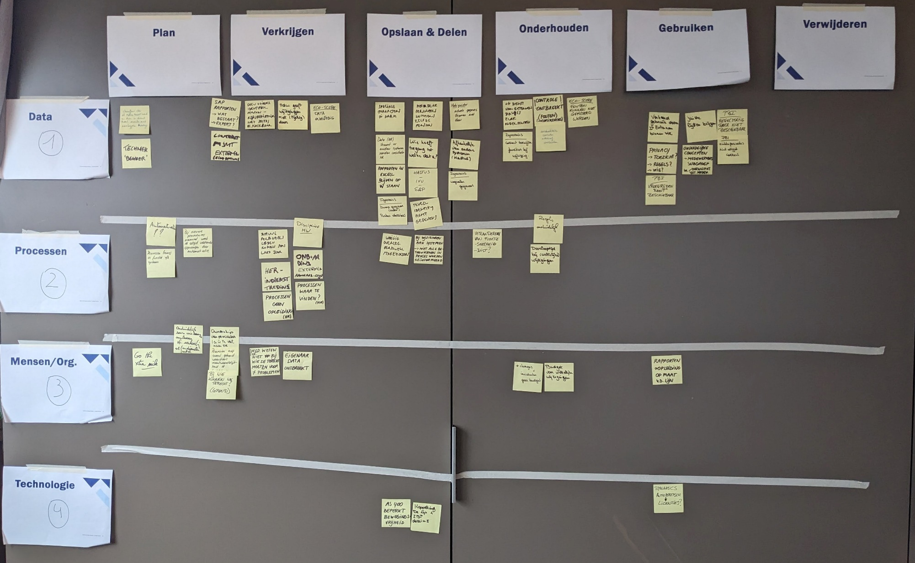
The Challenges Map
Workshop 1
1
Exercise 1

Slide 32
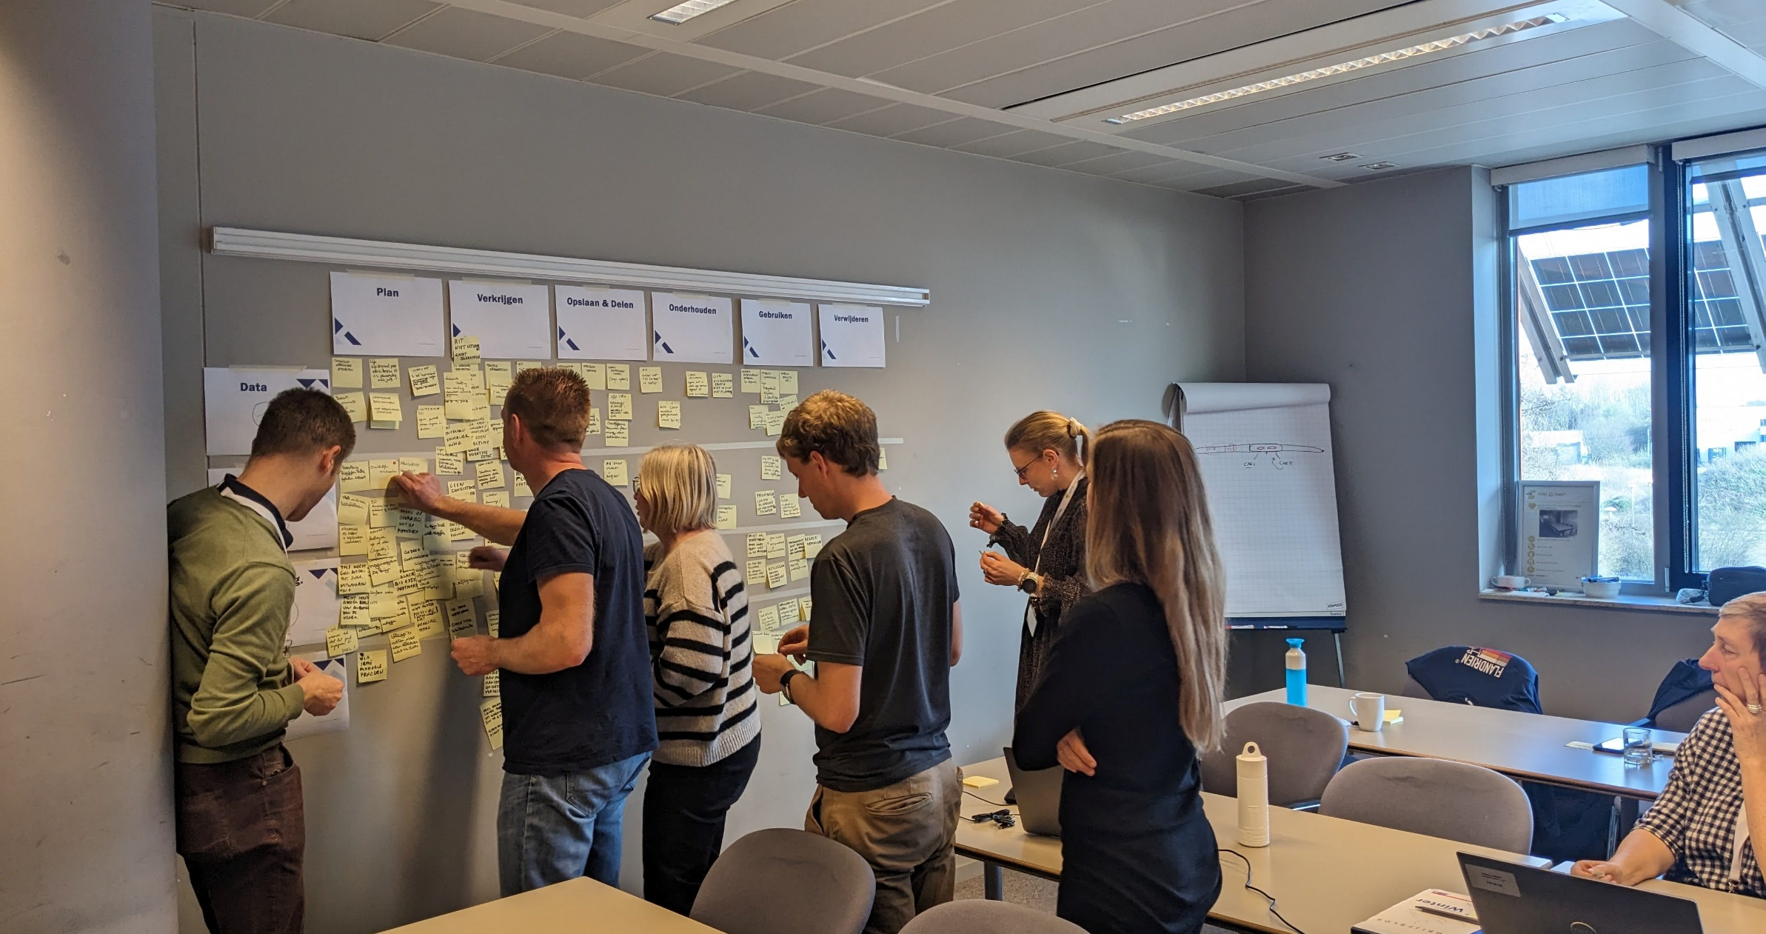
The challenges MAP
Image © Data Vantage Consulting. Used with permission.

Slide 33
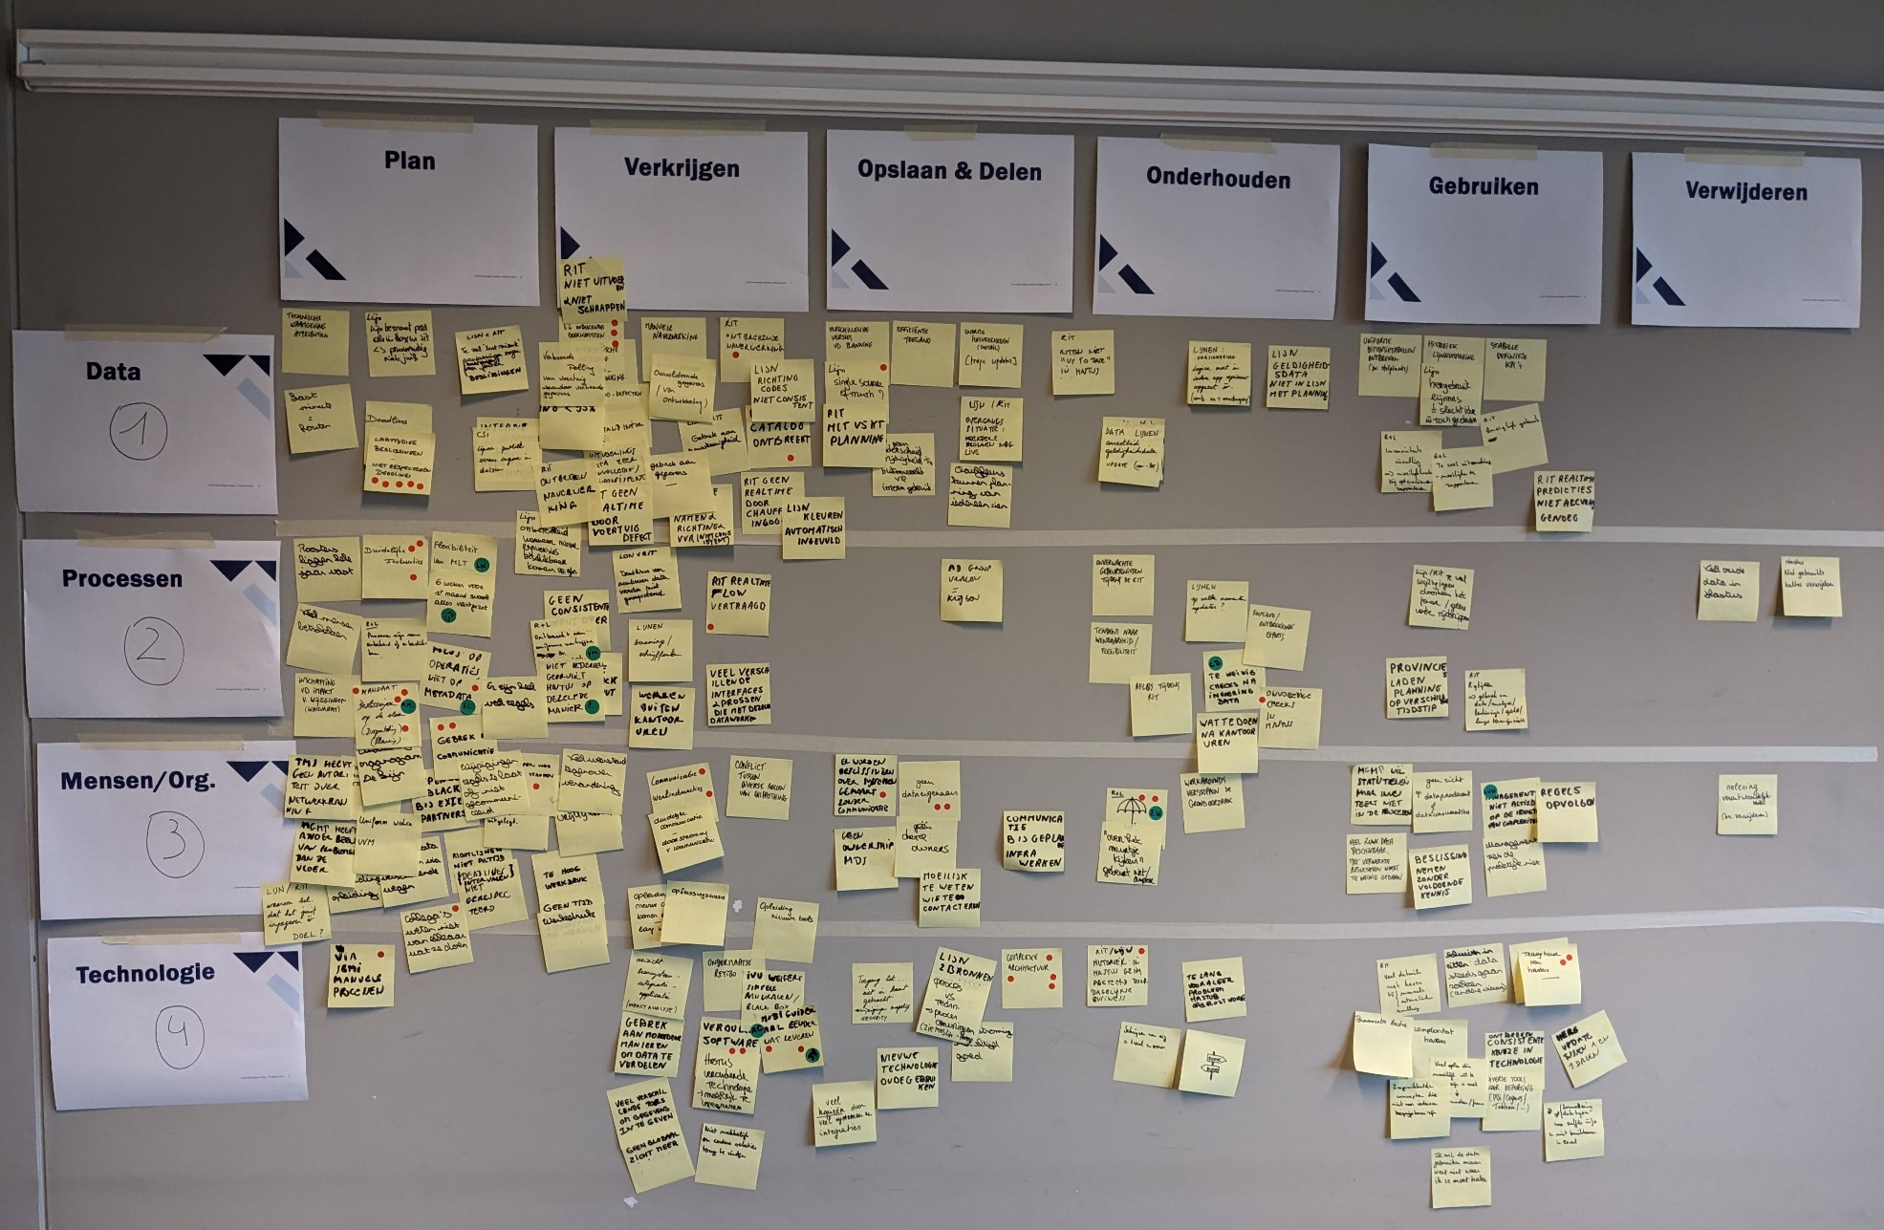
The Challenges Map
Workshop 1
1
Exercise 1

Slide 34
WEEK 1 of 5 The Fundamentals | Workshop 1 of 7
Thursday
1
Exercise 1. The Challenges Map
We will try to get a deeper understanding of the challenges and the broad-impact components that affect the quality of information.
This is a structured discussion where we listen to our participants and collect all the challenges that come up during the interview.
We capture our thoughts as questions in the 'How Might We' format. The HMW format helps us define our biggest challenge without prescribing a solution.
Next, we narrow down the Challenges Interview (written in the form of “How Might We” questions) and identify focus areas in the Challenge Map.
Exercise 2. Challenges Interview
Exercise 3. Purpose
Exercise 4. Guiding Principles

Slide 35

Challenges INTERVIEW
Business, User, Functional, Technology, Legal, Regulatory, Compliance, Contractual, Industry, Internal Policies, Access, Security, Privacy, Data Protection
Accountability, Authority, Ownership, Governance, Stewardship, Motivation, Reward
Continuous Improvement, Root Causes, Prevention, Correction, Enhancement, Audit, Controls, Monitoring, Metrics, Targets
Definitions, Relationships, Metadata, Standards, Reference Data, Data Models, Business Rules, Architecture, Semantics, Taxonomies, Ontologies, Hierarchies
Workshop 1
1
Awareness, Engagement, Outreach, Listening, Feedback, Trust, Confidence, Education, Training, Documentation
Exercise 2
Management of Change and Associated Impact, Organizational Change Management, Change Control
Let the broad-impact components guide your open-ended questioning
Individual and Societal Good, Justice, Rights and Freedoms, Truthfulness, Standards of Conduct, Avoiding Harm, Supporting Well-Being
Requirements and Constraints
Responsibility
Improvement and Prevention
Structure and Meaning
Communication
Change
Ethics
Source: Broad Impact Components © 2005, 2020 Danette McGilvray, Granite Falls Consulting, Inc. www.gfalls.com

Slide 36
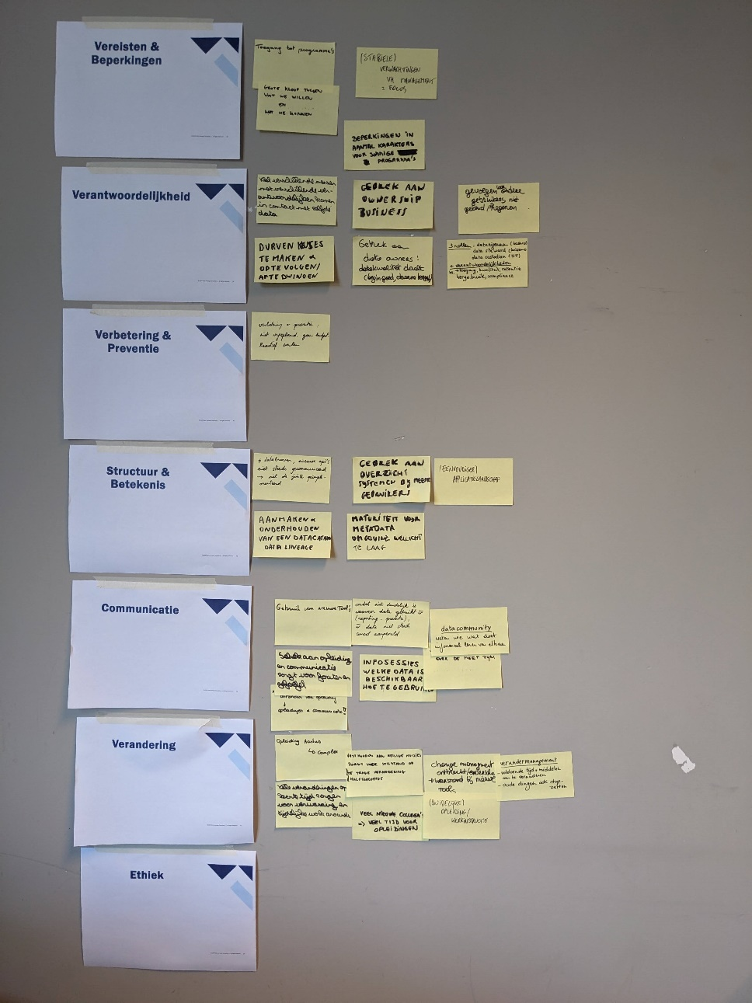
Challenges INTERVIEW
Workshop 1
1
Exercise 2

Slide 37
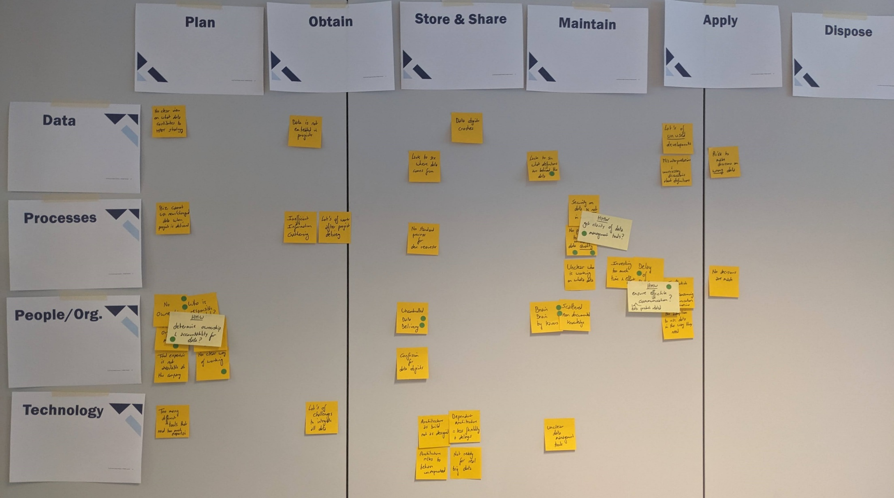
The challenges MAP
Workshop 1
1
Exercise 2

Slide 38
WEEK 1 of 5 The Fundamentals | Workshop 1 of 7
Thursday
1
Exercise 1. The Challenges Map
In this exercise, we will focus on identifying the fundamental reason why we are implementing data governance within our organization. This isn't just about the technical aspects or the tasks we need to perform; it's about aligning our data governance efforts with the overarching business objectives and goals.
Understanding this purpose will ensure that every data governance initiative we undertake directly contributes to the success and strategic direction of the company.
A well-defined purpose will become our Vision, guiding our decisions, helping us prioritize, and making sure that everyone—across all levels—understands the critical role that data governance plays in our collective success.
Exercise 2. Challenges Interview
Exercise 3. Purpose
Exercise 4. Guiding Principles

Slide 39
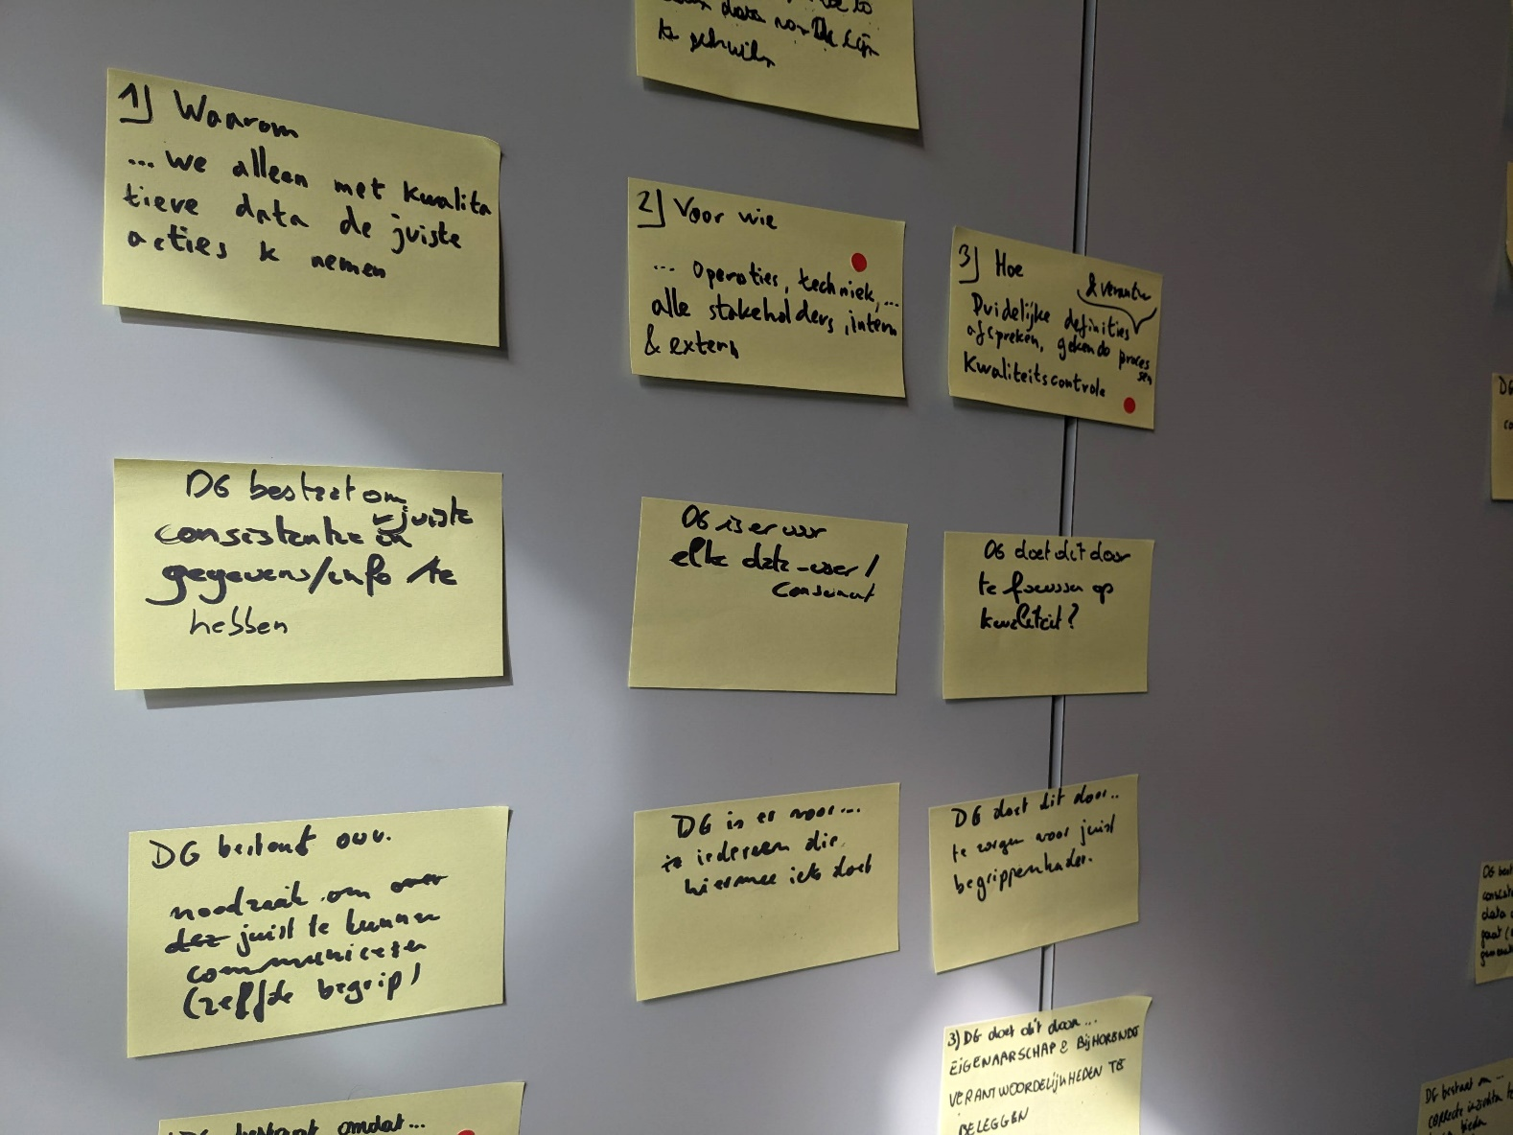
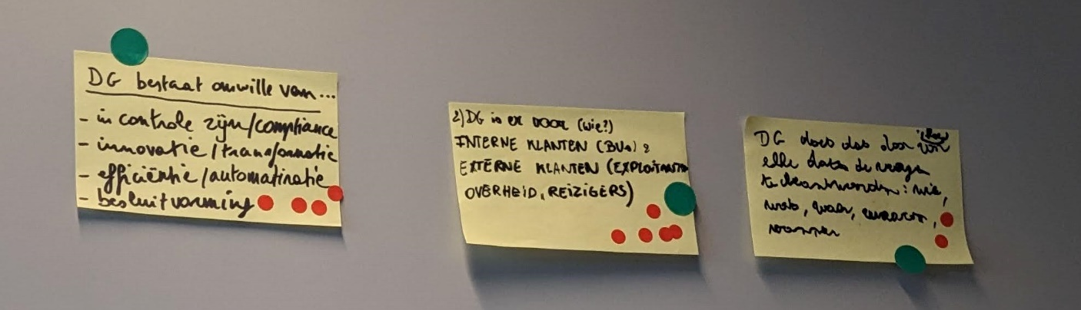
Purpose MAPPING
Workshop 1
1
Exercise 3
DG exist to…
DG does this for…
DG does this by…
Why do we do what we do?
For whom are we doing this?
How do we accomplish this?

Slide 40
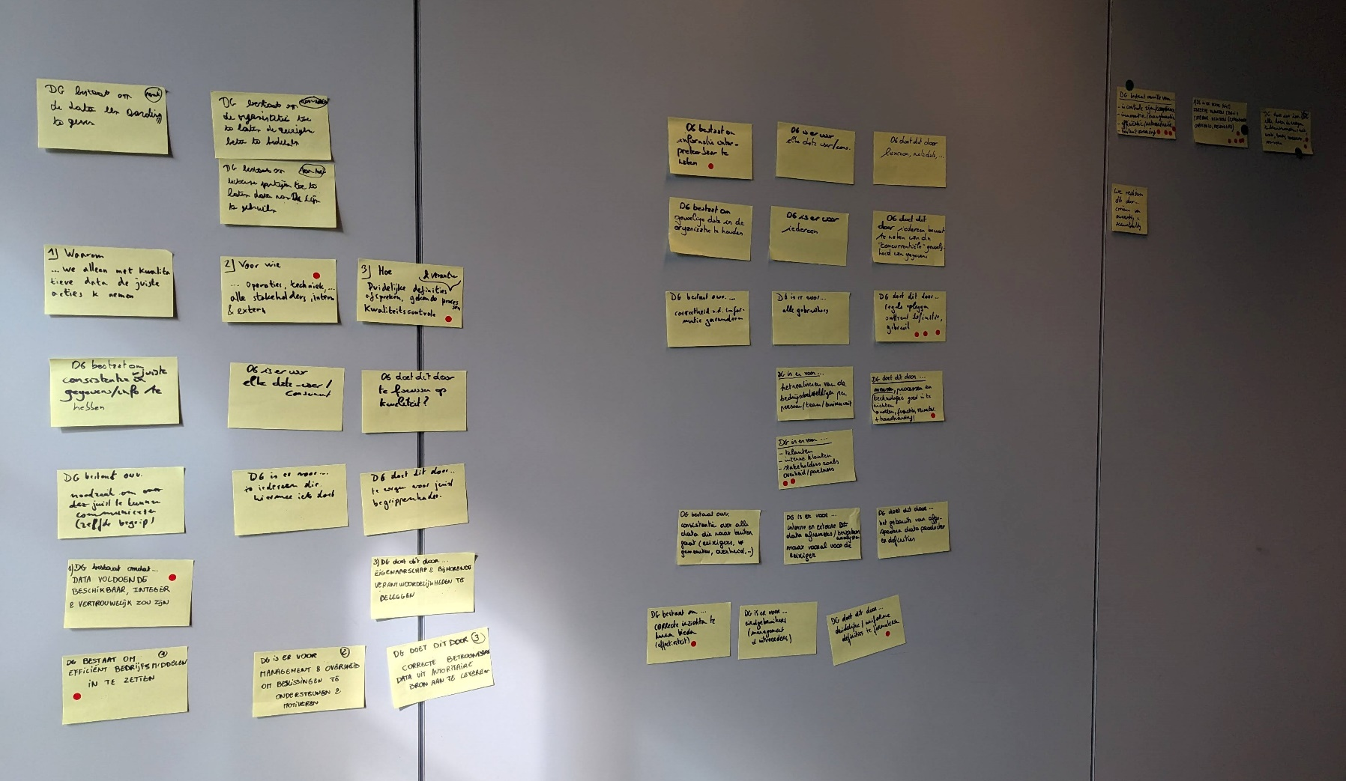
Purpose MAPPING
Workshop 1
1
Exercise 3

Slide 41
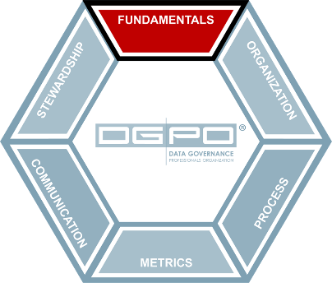
WEEK 1 of 5 The Fundamentals | Workshop 1 of 7
Thursday
1
As we build upon the foundation we've established in our previous exercises—assessing the current state of our data landscape, highlighting key use cases and pain points, and defining our vision and purpose—it's now time to finalize our approach by defining our Guiding Principles.
These principles are the fundamental beliefs that will steer your organization’s approach to data. Think of them as your North Star, providing clear direction and setting the stage for how data should be managed and treated within your company.
Exercise 1. The Challenges Map
Exercise 2. Challenges Interview
Exercise 3. Purpose
Exercise 4. Guiding Principles
Current State Mapping
What are our challenges?
Purpose
What is our goal?
Guiding Principle #1
How we realize purpose
Guiding Principle #2
How we realize purpose
Guiding Principle #3
How we realize purpose

Slide 42
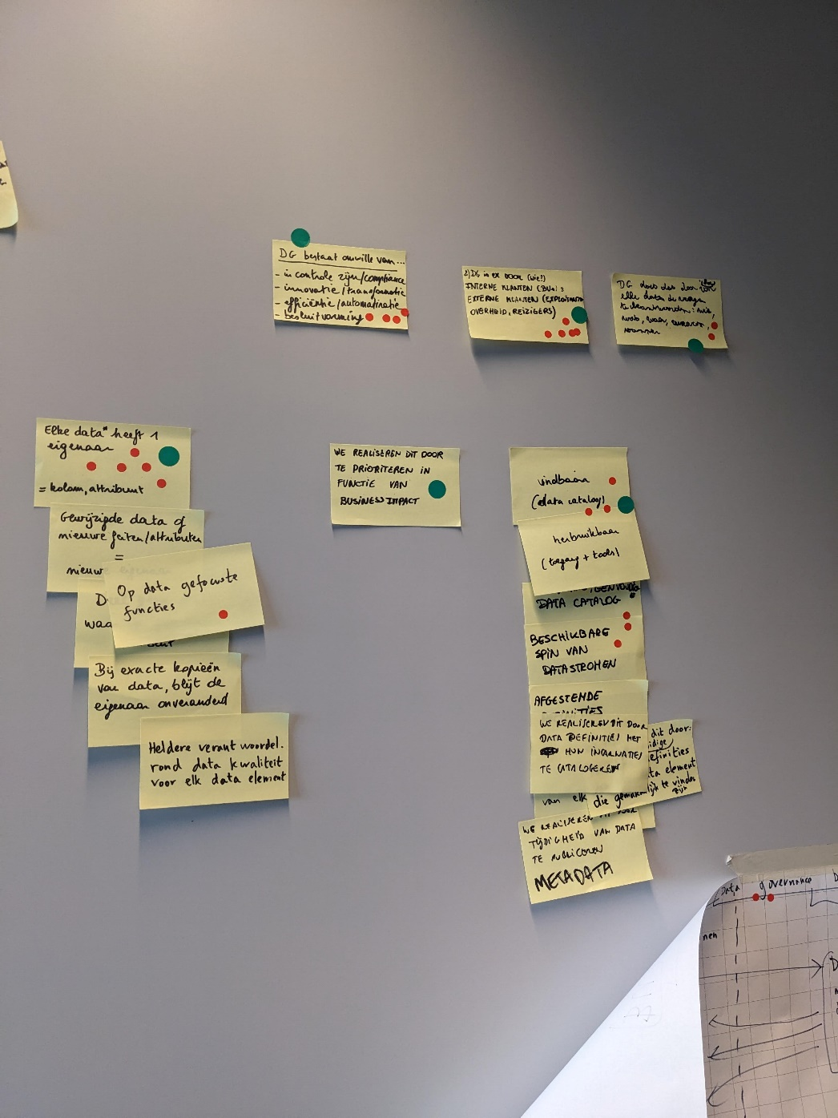
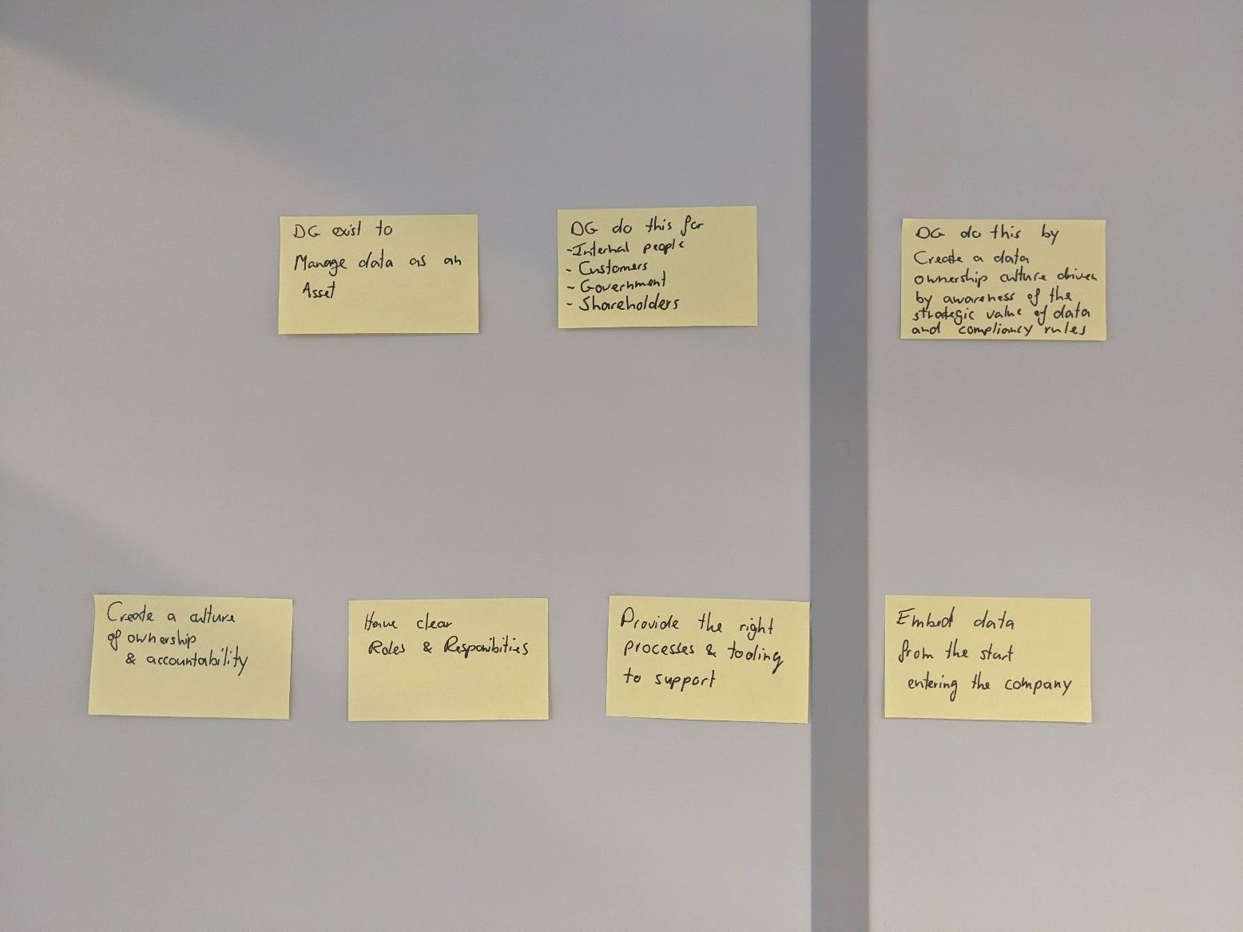
Guiding PRINCIPLES
Workshop 1
1
Exercise 4
We realize this by…
We realize this by…
We realize this by…

Slide 43
WEEK 1 of 5 The Fundamentals | Workshop 1 of 7
Thursday
1
Purpose
What is our goal?
DG exist to…
manage data as an asset.
DG does this for…
Internal people
Customers
Government
Shareholders
DG does this by…
creating a data ownership culture driven by awareness of the strategic value of data and compliancy rules
Guiding Principle #1
How we realize purpose
Guiding Principle #2
How we realize purpose
Guiding Principle #3
How we realize purpose
Guiding Principle #4
How we realize purpose
We realize this by…
creating a culture of ownership & accountability
We realize this by…
having clear roles & responsibilities
We realize this by…
providing the right processes & tooling to support
We realize this by…
embedding data from the start entering the company

Slide 44
WEEK 1 of 5 The Fundamentals | Workshop 2 of 7
Friday
1
Let’s kick off our creative engines with the 10 for 10 Brainstorm! This exercise is all about generating a wide range of ideas to bridge the gap between our current state and the future vision for data governance.
In this session, we'll draw inspiration from our Purpose, Guiding Principles, and the focus areas identified in our Challenges Map. The aim is to come up with as many ideas as possible—whether they seem practical or far-fetched, all ideas are welcome!
Why is this important? Because the more ideas we generate, the more likely we are to uncover innovative solutions that will propel us forward.
Exercise 1. 10 for 10 Brainstorm
Exercise 2. Action Board
Exercise 3. Action Steps
Exercise 4. Roadmap
Exercise 5. CDE Shortlist

Slide 45
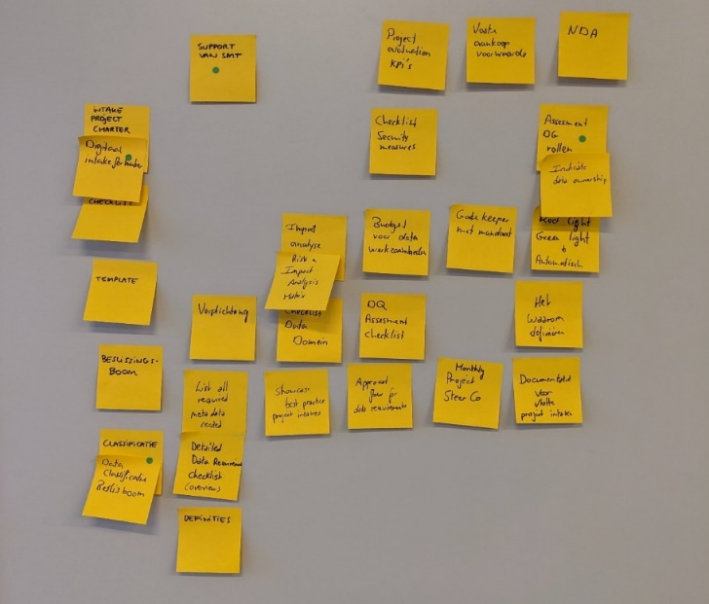

10 for 10 BRAINSTORM
Workshop 2
1
Exercise 1
Presenting the ideas
Voting on the ideas
Revisualizing

Slide 46
WEEK 1 of 5 The Fundamentals | Workshop 2 of 7
Friday
1
Welcome to our Action Board exercise, where we’ll take all the great ideas generated during the 10 for 10 Brainstorm and prioritize them based on their impact and feasibility.
The Action Board is a powerful tool that helps us focus on what really matters—those initiatives that will drive the most significant change with the least amount of effort. By the end of this exercise, we’ll have a clear understanding of which ideas we should tackle first and which ones may require more time and resources.
Why is this important? Because prioritization is key to ensuring that our efforts are directed toward the most valuable and achievable goals. This process will help us create a realistic and actionable roadmap that aligns with our data governance objectives.
Exercise 1. 10 for 10 Brainstorm
Exercise 2. Action Board
Exercise 3. Action Steps
Exercise 4. Roadmap
Exercise 5. CDE Shortlist

Slide 47
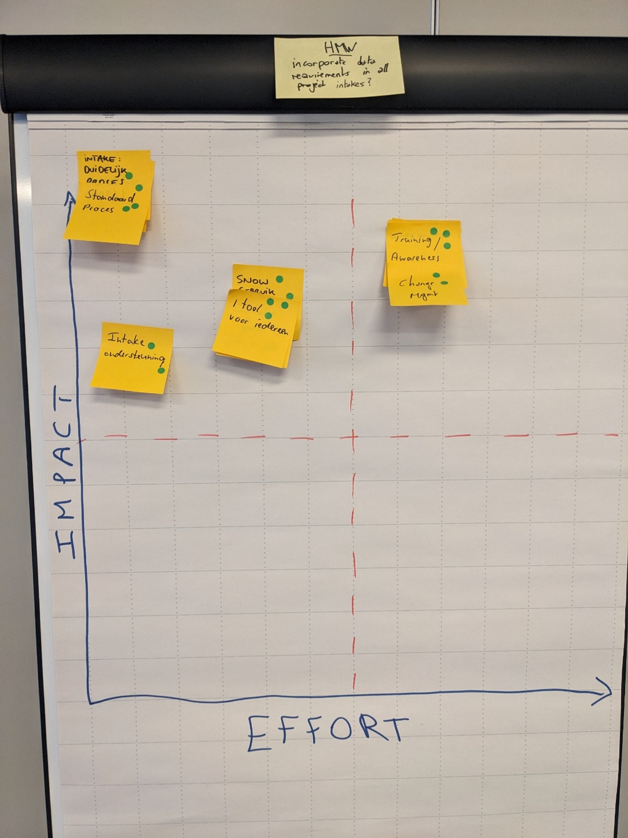

Workshop 2
1
ACTION Board
Exercise 2
Do these things first
Turn these into a longer-term project
Impact
Ignore these
Add to the task backlog
Effort

Slide 48
WEEK 1 of 5 The Fundamentals | Workshop 2 of 7
Friday
1
Next up, the Action Steps exercise, where we’ll transform our prioritized “quick win” ideas from the Action Board into actionable steps.
This exercise is crucial because it turns concepts into concrete actions, ensuring that we can effectively implement our ideas and start seeing tangible results.
The focus here is on high-level, strategic steps that will guide us in bringing these quick wins to life, moving us closer to achieving our data governance goals.
Why is this important? Because having a clear, actionable plan is what separates good ideas from real, impactful change. By the end of this session, we’ll have a series of task flows that outline the steps necessary to implement each of our selected initiatives.
Exercise 1. 10 for 10 Brainstorm
Exercise 2. Action Board
Exercise 3. Action Steps
Exercise 4. Roadmap
Exercise 5. CDE Shortlist

Slide 49
Define roles for data accountability
Workshop 2
1
ACTION Steps
Exercise 3
Identify key data stakeholders
Review with leadership team
Monitor role effectiveness
Assign roles to individuals
Communicate roles to all teams
Provide training on responsibilities
Monitor role effectiveness
Outline responsibilities for each role
Draft role descriptions
Integrate roles into governance framework
Bobby
Pam
Sue Ellen
J.R.

Slide 50
WEEK 1 of 5 The Fundamentals | Workshop 2 of 7
Friday
1
Let’s hit the road, Jack! In this Roadmap exercise we’ll take the prioritized initiatives and their corresponding task flows and strategically place them on a timeline.
This exercise is critical because it transforms our ideas and plans into a clear, actionable roadmap that outlines when and how each initiative will be implemented.
By the end of this session, we’ll have a comprehensive plan that not only reflects our data governance goals but also aligns with the organization’s overall strategy and priorities.
Why is this important? Because having a well-structured roadmap ensures that our efforts are organized, realistic, and geared toward achieving tangible results within a defined timeframe. This roadmap will serve as our guide, helping us maintain momentum and focus as we move forward with our Data Governance Sprint.
Exercise 1. 10 for 10 Brainstorm
Exercise 2. Action Board
Exercise 3. Action Steps
Exercise 4. Roadmap
Exercise 5. CDE Shortlist

Slide 51



Workshop 2
1
ROADMAP Exercise
Exercise 4
December
Jan
Feb
9 – 12 months
12+ months
Define roles for data accountability
12/01
01/31
08/01
Create a centralized data catalog
12/20
02/15
11/01
BE
SE
SE
BE
PM
PM
SE
J.R.
BE
J.R.
BE
J.R.

Slide 52
WEEK 1 of 5 Workshop 2 of 7 | Roadmap
Workshop 2
1
Template
2026
2026
2026
Roles & Responsibilities
Implemented the new organization model
New organization model
Implement and embed the roles & responsibilities in the organization
New organization model
Defined and agreed on the new organization model. Starting to implement
PEOPLE
Skills & Knowledge
Have the principles about skills & knowledge implemented
Data Governance
Have the key elements of Data governance implemented
Data Usability
Implemented the FAIR strategy
Data Strategy
Have the full Data strategy ready and accepted
Project management
Embed Data & Analytics in all projects based on the defined principles
Data Quality
PROCESS
Have an automated framework in place to monitor ACME’s data quality
Data Lineage
Data Integration
Build a solution to set-up a data lineage environment
Completed data integration environment
Data Usability
Strategy ready how to make data FAIR
Technology
DATA
Moved to Azure
Analytics Tools
Decommissioned old tools and redesigned/configured new tools
Architecture
Have a Data Architecture design in place
TECHNOLOGY
Notes:
FAIR = Findable, Accessible, Interoperable and Reusable

Slide 53
WEEK 1 of 5 The Fundamentals | Workshop 2 of 7
Friday
1
Welcome to the final exercise of our workshop, the Critical Data Element (CDE) Shortlist. In this session, we’ll focus on identifying and prioritizing the most important data elements within our organization.
By narrowing down our focus to the top 10 CDEs, we lay the foundation for effective data governance, enabling us to make fast progress and demonstrate value quickly.
These CDEs will later be central to our prototyping phase, where we’ll conduct data quality assessments and define these elements in our business glossary. For now, our goal is to identify and select these key data elements that are crucial to our organization’s success.
Exercise 1. 10 for 10 Brainstorm
Exercise 2. Action Board
Exercise 3. Action Steps
Exercise 4. Roadmap
Exercise 5. CDE Shortlist

Slide 54
Workshop 2
1
CDE Shortlist
Exercise 5
Customer Email Address
Shipping Method
Payment Terms
Contract Expiry Date
Compliance Status
Product Dimensions
Customer Segment
Inventory Level

Slide 55
WEEK 2 of 5 The Data Players | The Rules of the Game
MON
TUE
WED
THU
FRI
Documentation
Summarizing the outcomes
and draft deliverables
Workshop 3 of 7
The Data Players
ca. 6h,
with the entire team
Documentation
Summarizing the outcomes
and draft deliverables
Workshop 4 of 7
The Rules of the Game
ca. 6h,
with the entire team
Documentation
Summarizing the outcomes
and draft deliverables
Workshop set-up
Preparing for the next
workshop
Workshop set-up
Preparing for the next
workshop
Workshop set-up
Preparing for the next
workshop

Slide 56
WEEK 2 of 5 The Data Players | The Rules of the Game
Week 2
2
Welcome to Week 2: Building the Data Governance Framework
In Week 2, we transition from strategic visioning to the practical development of your data governance framework. This week is dedicated to defining the key roles, responsibilities, and operating models that will drive your data governance efforts, as well as establishing the foundational processes for managing your Critical Data Elements (CDEs).
Through two targeted workshops, we’ll develop clear, actionable deliverables that will ensure your data governance structure is both robust and sustainable. By the end of this week, you’ll have a well-defined framework that aligns with your organization’s goals and prepares you for the next steps in your data governance journey.

Slide 57
Data Governance SPRINTTM
Roles & Responsibilities Role Roster
Workshop #3
Operating Model
Target and minimum viable versions
Processes
Focus on Critical Data Elements
Workshop #4
Measurement Dashboard
Business Glossary
Communication Plan
Training Plan
Workshop #5
Workshop #6
Prototype Prep
User test flows and creating a storyboard
Workshop #7
Prototyping
User Testing

Slide 58
WEEK 2 of 5 The Data Players | Workshop 3 of 7
Tuesday
2
Exercise 1. Responsibility Mapping
In this exercise, we’ll embark on a journey to uncover and define the key responsibilities that are essential for achieving our data governance vision.
Rather than starting with predefined roles, we’ll focus first on identifying what needs to be done—what are the crucial tasks, decisions, and accountabilities that will drive our success?
By mapping these responsibilities, we’ll then naturally evolve into defining the roles that will carry them out. This approach ensures that our roles are rooted in the real needs of our organization, making our data governance framework both practical and impactful.
Exercise 2. Lightning Demos
Exercise 3. Concept Creation
Exercise 4. Roles Roster

Slide 59
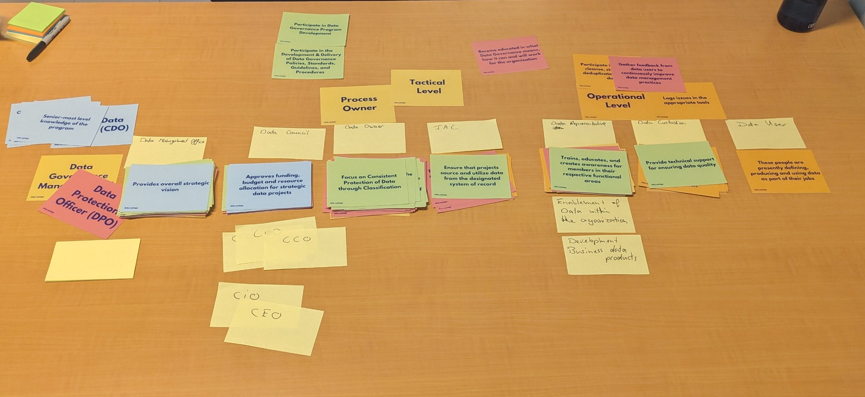
Workshop 3
2
RESPONSIBILITY Mapping
Exercise 1

Slide 60
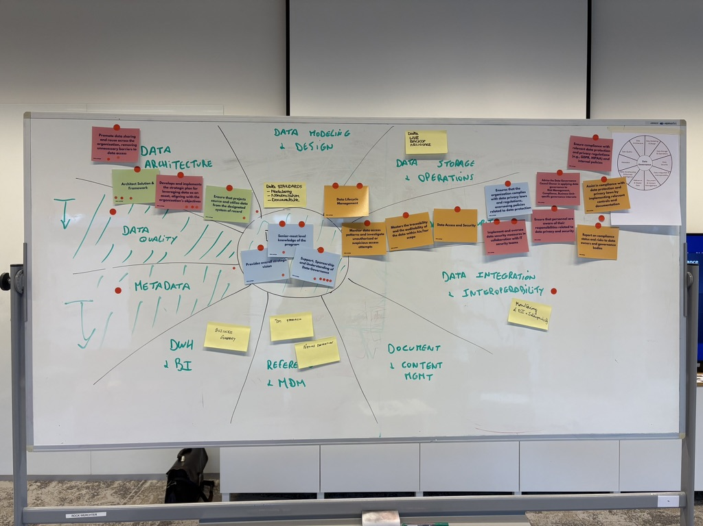

Slide 61
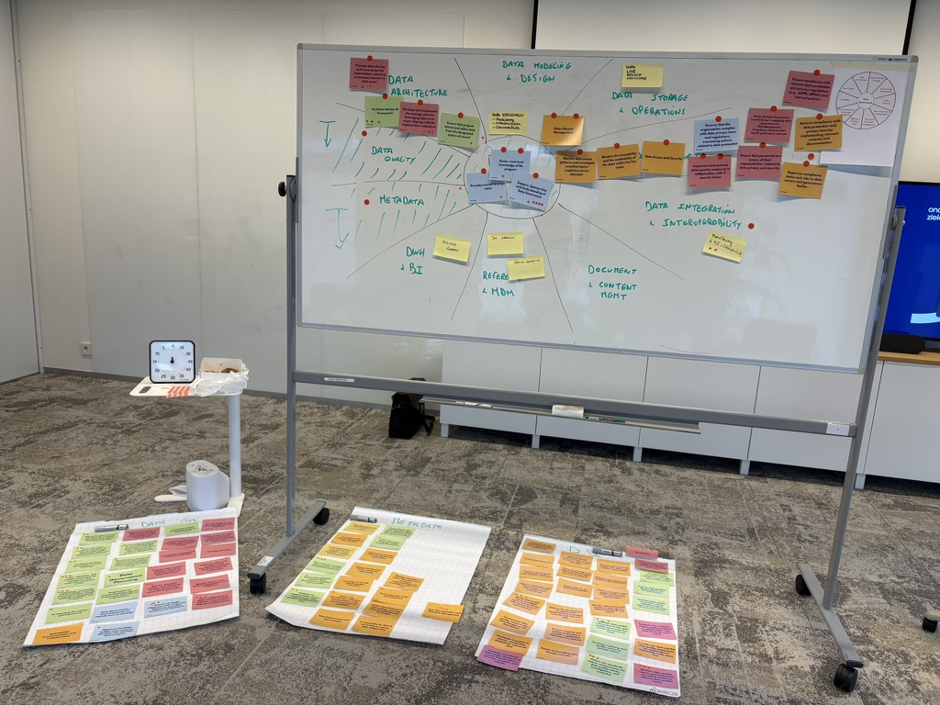

Slide 62
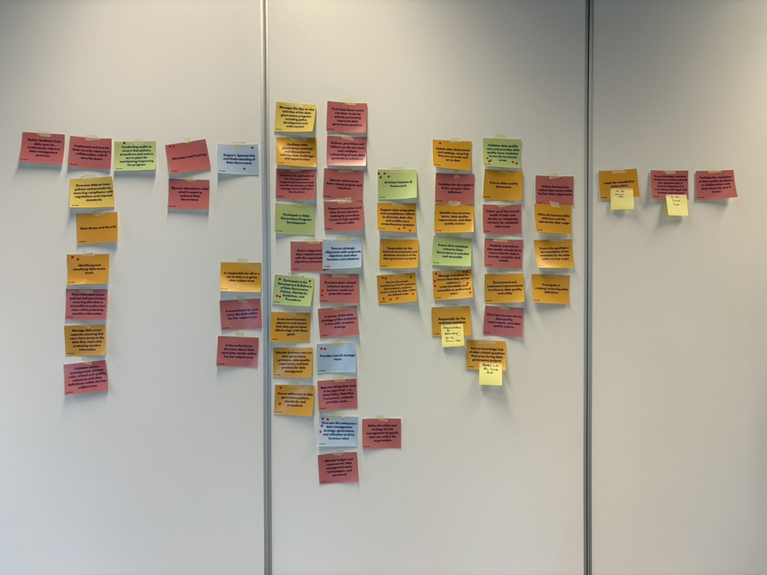

Slide 63
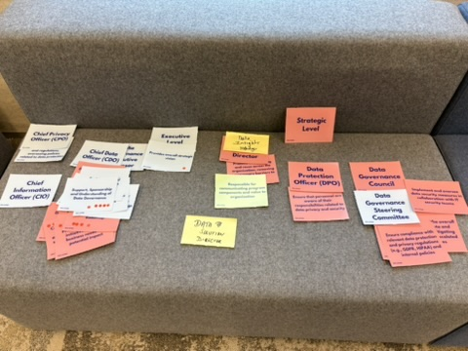
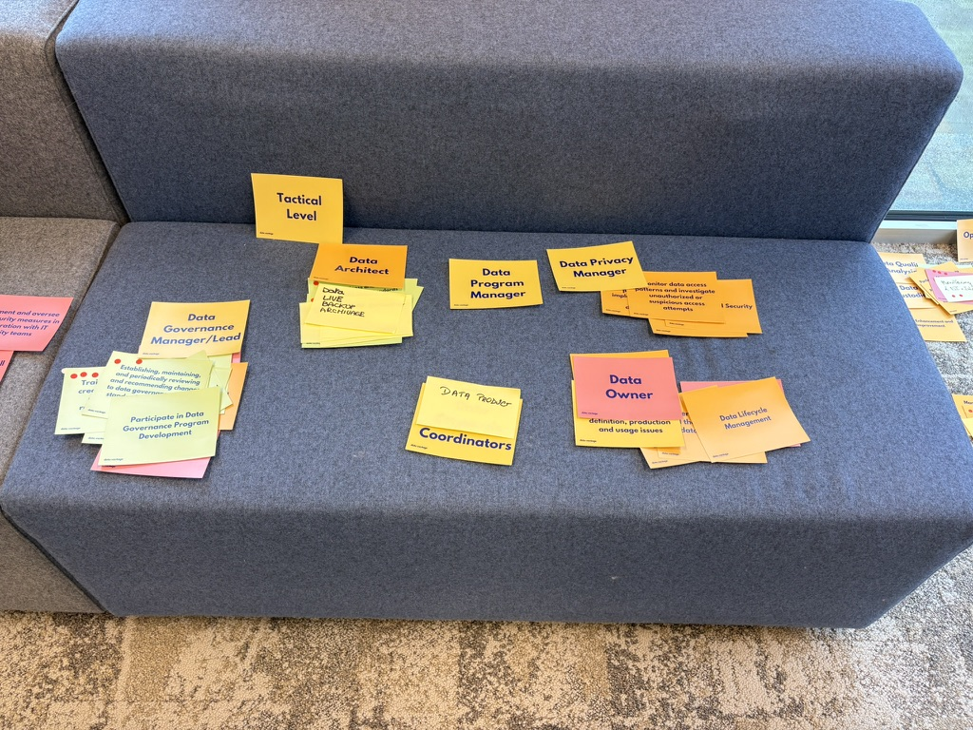
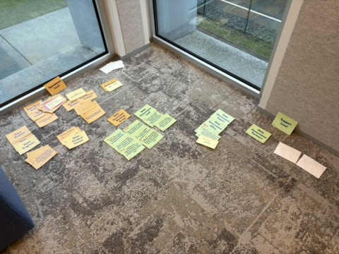

Slide 64
WEEK 2 of 5 The Data Players | Workshop 3 of 7
Tuesday
2
Exercise 1. Responsibility Mapping
Now that we’ve identified and prioritized the key roles and responsibilities crucial to our data governance framework, it’s time to explore how these elements will interact within an effective operating model.
This exercise is an inspiration-gathering exercise to stimulate creativity before concept creation and is aimed to inspire creative and practical ideas for structuring our data governance operating model.
This fast-paced, idea-generating session is designed to spark innovation by showcasing different approaches to data governance structures.
Exercise 2. Lightning Demos
Exercise 3. Concept Creation
Exercise 4. Roles Roster

Slide 65
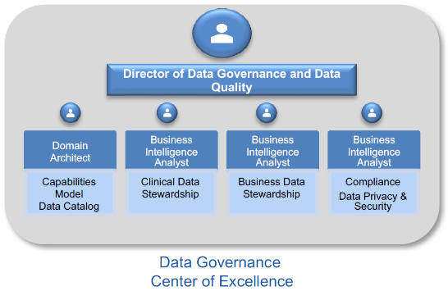
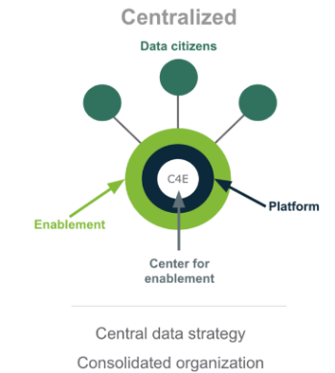
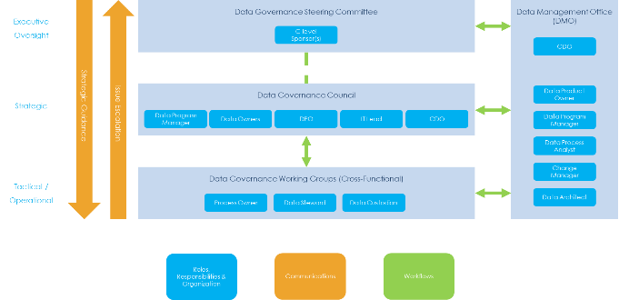
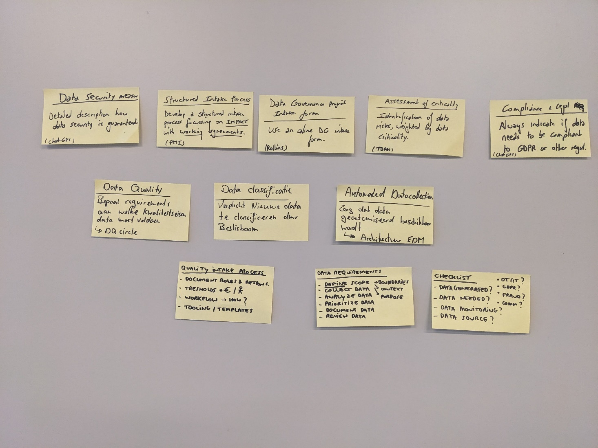
Workshop 3
2
LIGHTNING Demos
Exercise 2
HOSPITAL
Big Idea:
A Data Governance Center of Excellence
LARGE BANK
Big Idea:
Federated operating model with support structure
COLLIBRA
Big Idea:
Centralized operating model with Data citizens

Slide 66
WEEK 2 of 5 The Data Players | Workshop 3 of 7
Tuesday
2
Exercise 1. Responsibility Mapping
Next up, we’ll take the insights gained from our Lightning Demos and the roles and responsibilities we’ve defined to design a set of operating model concepts tailored to our organization.
This is where creativity meets strategy—each participant will have the opportunity to envision how our data governance framework could be structured to optimize communication flows, workflows, and organizational bodies.
The goal is to create a robust, effective operating model that aligns with our data governance purpose and strategic goals. By the end of this exercise, we’ll collaboratively refine these ideas into a cohesive target operating model that will guide our future efforts.
Exercise 2. Lightning Demos
Exercise 3. Concept Creation
Exercise 4. Roles Roster

Slide 67
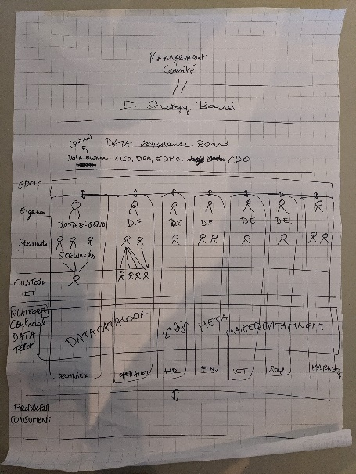
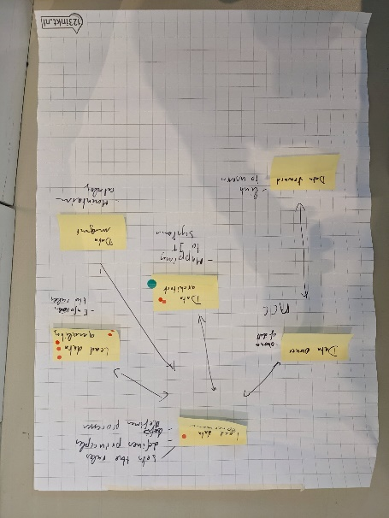
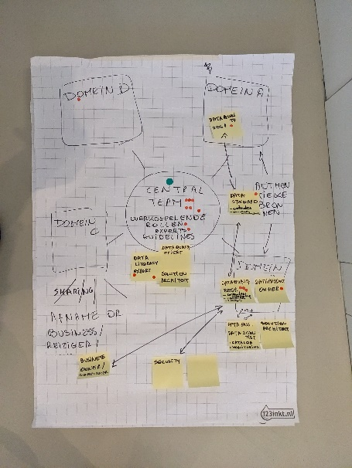
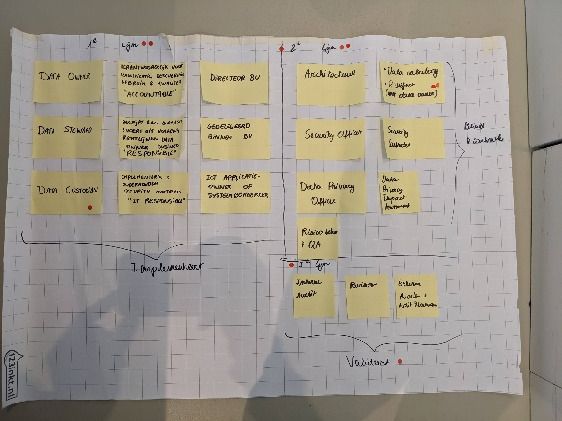
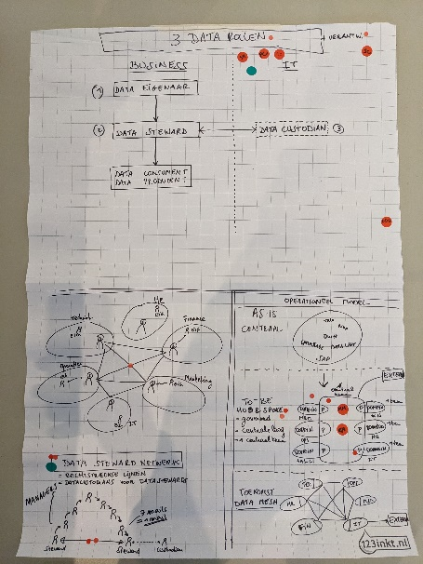
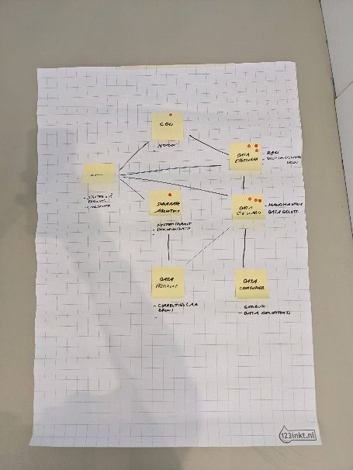
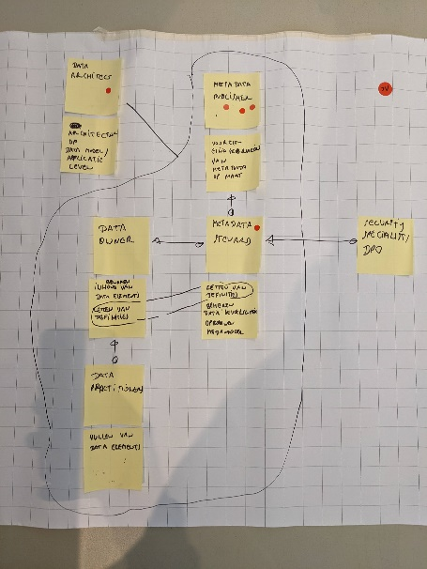
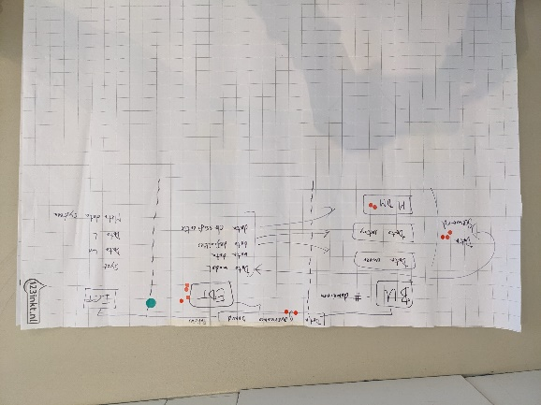
Workshop 3
2
CONCEPT Creation
Exercise 3
BE
JR
PJ
SE
TL
DB

Slide 68
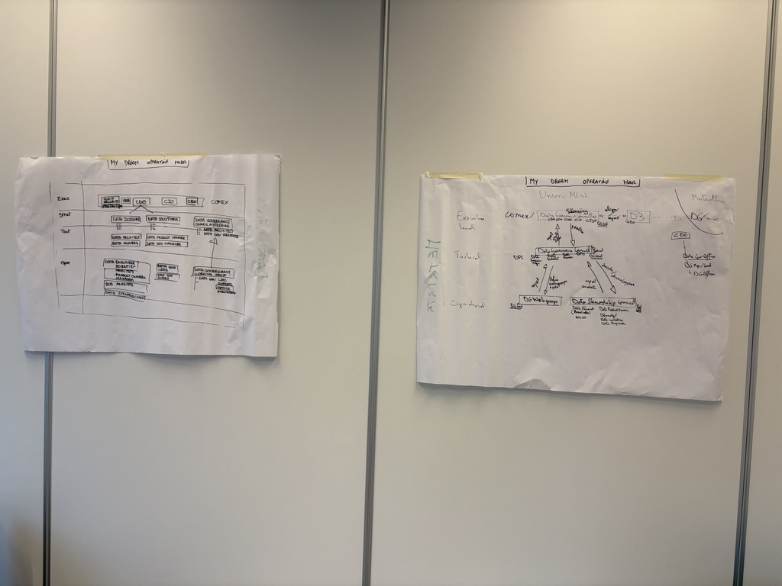

Slide 69
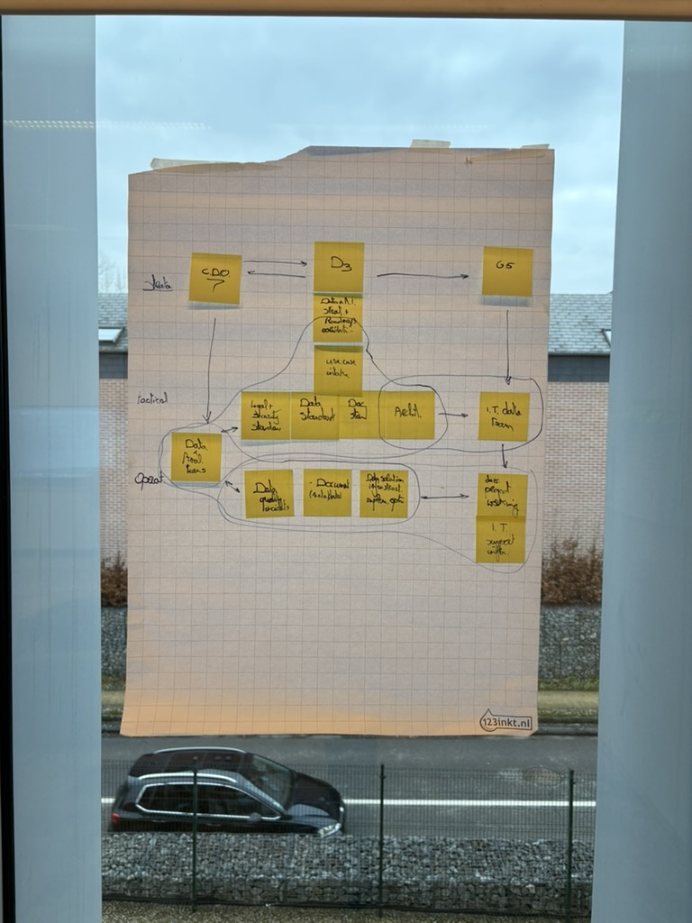
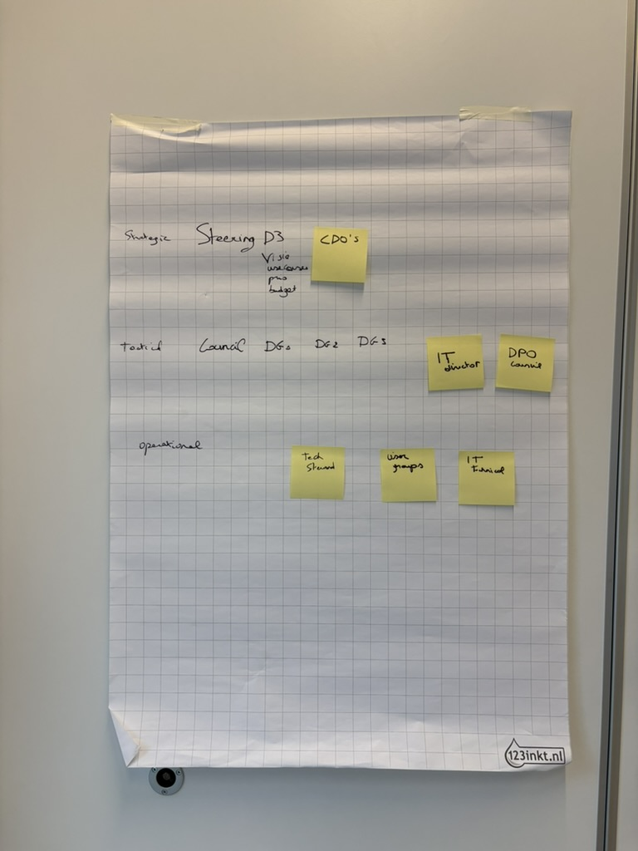
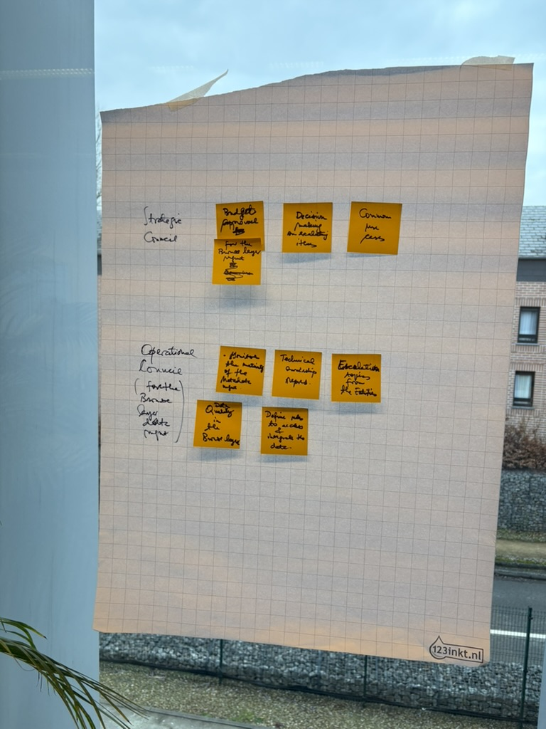
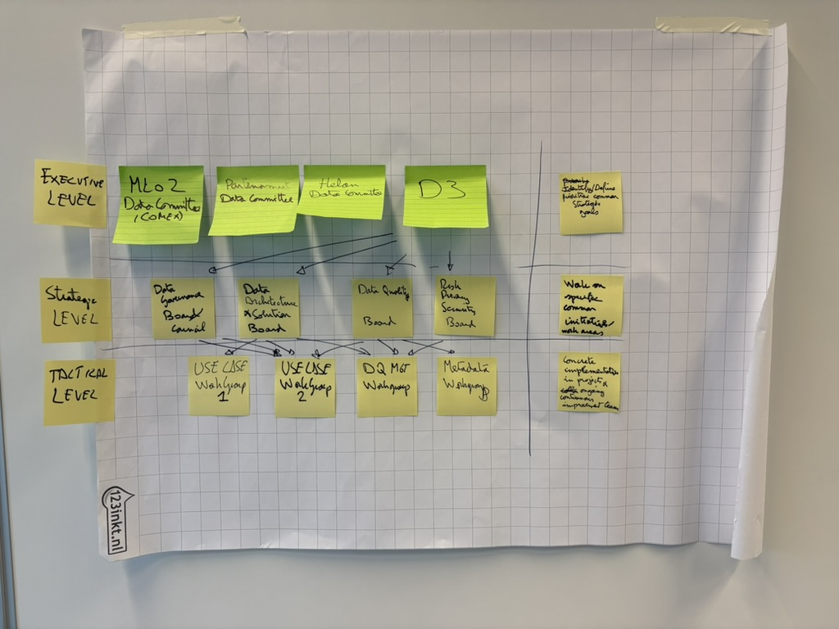

Slide 70
TARGET Operating Model – version 0.3
Executive
COMEX
Data Health
Steering Committee
DG Office
Center of Excellence
Strategic
DG Manager
Data Directors
Business Directors
CDO
Data Governance Council
Tactical
Data Governance Manager
Product Owner
Data Owner
Data Architect
Data Security & Protection
IT Partner
CDO
Data Domain X
Data Domain Y
Data Domain Z
…
Support
Data Stewardship Forum
Issue Escalation
Policies, Standards & Strategic Guidance
Business
Data Owner
Data Owner
Data Owner
Data Steward Coordinator
Data Steward(s)
Data Steward(s)
Data Steward(s)
Data Stewards
DG Manager
Operational
Data Architect
Data Architect
Data Architect
DG Officer
Data
Data Manager
Data Manager
Data Manager
Data Program Manager
Data Custodian
Data Custodian
Data Custodian
Change Manager
IT
Information Asset Custodian
Information Asset Custodian
Information Asset Custodian
Support
Business Stakeholders
Data Health
Stakeholders
IT Enablement
Notes:
Security
3 domeinen: klant, verzekering, uitkering
Niveaus classificatie: openbaar, intern, PII, geheime
Klant -> naam = PII; category = openbaar
Verzekering →

Slide 71


Helan
MLOZ
Partenamut
Strategic
CD MLOZ (CODIR)
Data Health SteerCo
Strategic Committee
CA Mutual IT
GDT
Platform Data
Data Insights
D&A Team
Platform AI
Data Health
2
3
1
Customer Data Working Group
Knowledge Mgmt Working Group
Tactical
MutualIT
G5
D3 Council
Data Quality
4
Council Chair
CDO’s
Tactical Collaboration
Business Data Analyst
Metadata Mgmt
Issue Escalation
Data Architect
Data Architecture
Tactical Guidance
Data Governance Manager
DPO & Legal
Data Security
Operational
MutualIT
Sarah
Project Manager
IT (Data) Team
Operational Guidance
Data Solution Architect
Security

Slide 72
WEEK 2 of 5 The Data Players | Workshop 3 of 7
Tuesday
2
Exercise 1. Responsibility Mapping
The goal of this final exercise – Roles Roster - is to identify the bare minimum responsibilities and roles necessary to effectively maintain data quality and document metadata for the selected CDEs.
By downsizing our target roles, responsibilities, and operating model, we will establish the most efficient and sustainable structure that can be practically implemented during our prototype and testing phase.
This simplified version will ensure that we are focusing our resources where they matter most, while still upholding the core principles of our data governance strategy.
Exercise 2. Lightning Demos
Exercise 3. Concept Creation
Exercise 4. Roles Roster

Slide 73
Back to Agenda
Week 2
1
2
3
4
5
Monday
Tuesday
Wednesday
Thursday
Friday

Slide 74
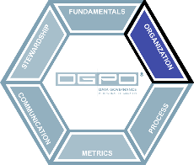
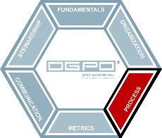
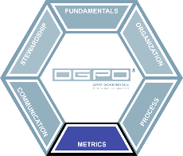


Data Governance SPRINTTM
Roles & Responsibilities Role Roster
Workshop #3
Operating Model
Target and minimum viable versions
Processes
Focus on Critical Data Elements
Workshop #4
Measurement Dashboard
Business Glossary
Communication Plan
Training Plan
Workshop #5
Workshop #6
Prototype Prep
User test flows and creating a storyboard
Workshop #7
Prototyping
User Testing

Slide 75
WEEK 2 of 5 The Rules of the Game | Workshop 4 of 7
Thursday
2
Round 1: Data Quality Focus
In this exercise, we will dive into the practical aspects of maintaining and improving the quality of our Critical Data Elements (CDEs).
By mapping out the story of how data quality is managed within our organization, we’ll create a clear, step-by-step process that ensures our data remains accurate, reliable, and valuable.
This is where strategy meets action—each of you will bring your insights to the table, mapping out how data quality issues are identified, addressed, and resolved.
By the end of this exercise, we’ll have a well-defined process that can be implemented to safeguard the integrity of our most critical data.
Exercise 1. Applied Users Story Mapping
Exercise 2. The Process Map
Exercise 3. Applied Users Story Mapping
Exercise 4. The Process Map

Slide 76


Workshop 4
2
Applied Users STORY MAPPING
Exercise 1

Slide 77


WEEK 2 of 5 Workshop 4 of 7 | Applied Users Story Mapping
Workshop 4
2
Exercise 1
Step 2: Create the Story
1. Timing
2. What you’ll need
3. Introducing the exercise
4. Flow

Slide 78


WEEK 2 of 5 Workshop 4 of 7 | Applied Users Story Mapping
Workshop 4
2
Exercise 1
Step 2: Create the Story
1. Timing
2. What you’ll need
3. Introducing the exercise
4. Flow

Slide 79


WEEK 2 of 5 Workshop 4 of 7 | Applied Users Story Mapping
Workshop 4
2
Exercise 1

Slide 80


WEEK 2 of 5 Workshop 4 of 7 | Applied Users Story Mapping
Workshop 4
2
Exercise 1

Slide 81
WEEK 2 of 5 The Rules of the Game | Workshop 4 of 7
Thursday
2
Round 1: Data Quality Focus
After exploring individual concepts in the previous exercise, it's time to bring our ideas together and collaboratively create a unified process map for maintaining and improving the data quality of our Critical Data Elements (CDEs).
This exercise will synthesize the best elements from our individual efforts into a clear, practical process that can be implemented across the organization.
By working together, we’ll ensure that the final process map is comprehensive, effective, and aligned with our data governance objectives.
Exercise 1. Applied Users Story Mapping
Exercise 2. The Process Map
Exercise 3. Applied Users Story Mapping
Exercise 4. The Process Map

Slide 82
WEEK 3 of 5 Designing Governance Essentials | Define & Decide
MON
TUE
WED
THU
FRI
Workshop 5 of 7
Keeping Score &
Language of the Game
ca. 6h,
with the entire team
Documentation
Summarizing the outcomes
and draft deliverables
Workshop 6 of 7
Rooting for the Game &
Training Camp
ca. 6h,
with the entire team
Workshop 7 of 7
Prototype Prep
ca. 4h,
with the entire team
Prototyping
Design a hi-fidelity
interactive prototype
Workshop set-up
Preparing for the next
workshop
Documentation
Summarizing the outcomes
and draft deliverables
User Recruiting
Find and schedule users

Slide 83
WEEK 3 of 5 Designing Governance Essentials | Define & Decide
Week 3
3
Welcome to Week 3: Designing Governance Essentials
This week marks a critical phase in our Data Governance SprintTM as we shift our focus to creating and building the tangible, essential elements of our data governance program. Our goal is to develop practical tools that are ready for immediate use, starting with a simple yet effective measurement dashboard and a business glossary template. These tools will provide the foundation for consistent communication and tracking of our data governance efforts.
Recognizing that change management and communication are pivotal to the success of any data governance program, we'll also identify and plan the communication and training activities that will ensure all stakeholders are informed, engaged, and prepared to execute their roles.
As we progress, we'll prepare for the prototyping phase, where we’ll bring together everything we've built and create a minimum sustainable version of our data governance program. This version will be put into practice and tested next week. To support this, we will also begin recruiting our test audience. The entire week is centered around defining the practical aspects of our program and making crucial decisions that will guide our next steps.

Slide 84
Data Governance SPRINTTM
Roles & Responsibilities Role Roster
Workshop #3
Operating Model
Target and minimum viable versions
Processes
Focus on Critical Data Elements
Workshop #4
Measurement Dashboard
Business Glossary
Communication Plan
Training Plan
Workshop #5
Workshop #6
Prototype Prep
User test flows and creating a storyboard
Workshop #7
Prototyping
User Testing

Slide 85
WEEK 3 of 5 Designing Governance Essentials | Workshop 5 of 7
Monday
3
Keeping Score Workshop: Creating a Measurement Dashboard
The first part of Monday’s workshop focuses on creating a Measurement Dashboard that will serve as the backbone of our data governance performance tracking. We’ll work together to identify the most meaningful metrics that align with our business goals and governance objectives.
By the end of this session, we’ll have a clear, actionable dashboard template that includes both quantitative and qualitative metrics.
The Language of the Game Workshop: Setting up the Business Glossary
In the second part of the day, we shift our focus to establishing a Business Glossary. This glossary will be the cornerstone of consistent and effective communication across all data governance efforts.
The template we will design will help define critical terms and concepts, ensuring that everyone in the organization is on the same page.

Slide 86
WEEK 3 of 5 Keeping Score | Workshop 5 of 7
Monday
3
Round 1: Measurement Focus
Exercise 1. Metrics Mapping
In this first exercise, we will identify and map out the key data quality metrics and governance KPIs that will form the foundation of our data governance dashboard.
These metrics will allow us to measure not only the health and integrity of our Critical Data Elements (CDEs) but also the efficiency and effectiveness of our overall data governance program.
By selecting the right metrics, we ensure that our data governance initiatives are driven by meaningful, measurable goals. Through collaboration, we will narrow down the most important metrics, enabling us to track progress and drive impactful decision-making
Exercise 2. Lightning Demos
Exercise 3. Concept Creation
Exercise 4. Lightning Demos
Exercise 5. 10 for 10 Brainstorm
Exercise 6. Concept Creation

Slide 87












METRICS Mapping
Workshop 5
3
Exercise 1

Slide 88
WEEK 3 of 5 Keeping Score | Workshop 5 of 7
Monday
3
Round 1: Measurement Focus
Exercise 1. Metrics Mapping
In this exercise, we’ll take a moment to step outside our own organization and gather inspiration from the world around us.
By looking at how other companies and industries visualize their data quality metrics and governance KPIs, we can uncover fresh ideas and discover innovative ways to design our own dashboard.
These “Lightning Demos” will help spark creativity, ensuring that we create a dashboard that is not only functional but also intuitive and engaging for stakeholders. Think of it as a quick dive into the best practices and visualizations that can elevate our data governance efforts.
Exercise 2. Lightning Demos
Exercise 3. Concept Creation
Exercise 4. Lightning Demos
Exercise 5. 10 for 10 Brainstorm
Exercise 6. Concept Creation

Slide 89



Workshop 5
3
LIGHTNING Demos
Exercise 2
HEAT MAP
Big Idea:
A summary heatmap showing the progress of DG implementation
STEWARDSHIP DASHBOARD
Big Idea:
Steward dashboard showing metadata metrics
SCORE CARD
Big Idea:
Colored scorecard to show progress

Slide 90
WEEK 3 of 5 Keeping Score | Workshop 5 of 7
Monday
3
Round 1: Measurement Focus
Exercise 1. Metrics Mapping
Now that we’ve drawn inspiration from a range of dashboards through our Lightning Demos, it’s time to shift gears and start creating our own.
In this Concept Creation exercise, we’ll design the foundation of our data metrics dashboard, turning ideas into a tangible, workable structure. This is where creativity meets practicality.
Each participant will map out their vision for a dashboard that effectively displays the key metrics we’ve prioritized. The goal is to create something simple, intuitive, and impactful—something that will help drive data governance forward by keeping the most essential metrics front and center.
Exercise 2. Lightning Demos
Exercise 3. Concept Creation
Exercise 4. Lightning Demos
Exercise 5. 10 for 10 Brainstorm
Exercise 6. Concept Creation

Slide 91

Workshop 5
3
CONCEPT Creation
Exercise 3

Slide 92
WEEK 3 of 5 Workshop 5 of 7 | Lightning Demos
Workshop 5
3
Exercise 4
Exercise 1. Metrics Mapping
Reference to the previous Lightning Demos exercise from Exercise 2 in the "Keeping Score" part of the workshop. This time, participants will focus on gathering examples of Business Glossaries and Data Dictionaries.
Specifically, they should look at the essential metadata elements that other organizations use to document their data assets, such as descriptions, data types, definitions, and governance-related metadata.
The goal is to get inspired by how others organize and structure their business glossaries, ensuring participants can bring back useful ideas for the next exercises.
Exercise 2. Lightning Demos
Exercise 3. Concept Creation
Round 2: Business Glossary Focus
Exercise 4. Lightning Demos
Exercise 5. 10 for 10 Brainstorm
Exercise 6. Concept Creation

Slide 93


WEEK 3 of 5 Workshop 5 of 7 | Lightning Demos
Workshop 5
3
Exercise 4
Exercise 1. Metrics Mapping
Show some real examples before the exercise starts.
Exercise 2. Lightning Demos
Exercise 3. Concept Creation
Round 2: Business Glossary Focus
Exercise 4. Lightning Demos
Exercise 5. 10 for 10 Brainstorm
EXCEL
Big Idea:
A simple data dictionary and business glossary in Excel
SHAREPOINT
Big Idea:
Data dictionary in SharePoint, including approval flow
COLLIBRA
Big Idea:
Fancy glossary in a high-end tool
Exercise 6. Concept Creation

Slide 94
WEEK 3 of 5 The Language of the Game | Workshop 5 of 7
Monday
3
The "10 for 10 Brainstorm" is where the creative ideas flow freely, allowing the group to generate as many ideas as possible about what metadata elements we should include in the business glossary.
This exercise is critical because the success of the glossary depends on capturing the right data about each Critical Data Element (CDE) and business term. We want to think beyond just the typical fields and get creative, but also practical. What are the metadata elements that will bring the most clarity and value to the organization?
From descriptions and business rules to data quality guidelines and possible values, we will aim to identify every potential metadata element that could help ensure consistency and understanding across the organization.
Exercise 1. Metrics Mapping
Exercise 2. Lightning Demos
Exercise 3. Concept Creation
Round 2: Business Glossary Focus
Exercise 4. Lightning Demos
Exercise 5. 10 for 10 Brainstorm
Exercise 6. Concept Creation

Slide 95

WEEK 3 of 5 Workshop 5 of 7 | Concept Creation
Workshop 5
3
Exercise 6
Exercise 1. Metrics Mapping
Exercise 2. Lightning Demos
Exercise 3. Concept Creation
Round 2: Business Glossary Focus
Exercise 4. Lightning Demos
Exercise 5. 10 for 10 Brainstorm
Exercise 6. Concept Creation

Slide 96
Data Governance SPRINTTM
Roles & Responsibilities Role Roster
Workshop #3
Operating Model
Target and minimum viable versions
Processes
Focus on Critical Data Elements
Workshop #4
Measurement Dashboard
Business Glossary
Communication Plan
Training Plan
Workshop #5
Workshop #6
Prototype Prep
User test flows and creating a storyboard
Workshop #7
Prototyping
User Testing

Slide 97
WEEK 3 of 5 Designing Governance Essentials | Workshop 6 of 7
Wednesday
3
Rooting for the Game Workshop: Defining Communication Plan
On Wednesday, we’ll focus on creating a structured Communication Plan that ensures that data governance efforts are clearly communicated across the organization and that all stakeholders are properly informed.
Effective communication is critical for creating awareness, securing buy-in, and fostering ongoing engagement from stakeholders. We’ll explore multiple strategies, prioritize key activities, and craft a detailed communication roadmap.
Training Camp Workshop: Defining Training Plan
In the second half of the day, we’ll shift our attention to developing a Training Plan that equips all data governance roles with the necessary skills and knowledge.
We will brainstorm training activities and key topics, prioritize the most essential ones, and develop a roadmap to deliver targeted training initiatives that align with our governance milestones.
Notes:
The goal for both sessions is to gather a wide range of ideas on initiatives, events, and artifacts related to communication and training. By the end of each session, we will have prioritized and fleshed out the top ideas and placed them on a roadmap for execution.

Slide 98



WEEK 3 of 5 Workshop 6 of 7 | Lightning Demos
Workshop 6
3
Exercise 1
Round 1 + 2: Same exercises
Exercise 1. Lightning Demos
Show some real examples before the exercise starts.
Morning Session:
Exercise 2. 10 for 10 Brainstorm
Exercise 3. Action Board
Exercise 4. Concept Creation
Exercise 5. Roadmap
WEBSITE
Big Idea:
Data Governance SharePoint site
ARTICLES
Big Idea:
Quarterly Data Literacy articles
INFOGRAPHIC
Big Idea:
Engaging infographic showcasing the DG Program

Slide 99



WEEK 3 of 5 Workshop 6 of 7 | Lightning Demos
Workshop 6
3
Exercise 1
Round 1 + 2: Same exercises
Exercise 1. Lightning Demos
Show some real examples before the exercise starts.
Afternoon Session:
Exercise 2. 10 for 10 Brainstorm
Exercise 3. Action Board
Exercise 4. Concept Creation
Exercise 5. Roadmap
VIDEOS
Big Idea:
Short, targeted videos that explain data governance
QUICK REFERENCE CARDS
Big Idea:
Printable or digital cheat sheets
SKILLS MATRIX
Big Idea:
Outlining the required competencies and skills for each role

Slide 100
WEEK 3 of 5 Workshop 6 of 7 | 10 for 10 Brainstorm
Workshop 6
3
Exercise 2
Round 1 + 2: Same exercises
Reference to the previous 10 for 10 Brainstorm exercise from Exercise 6 in the "Keeping Score" part of Monday workshop, but this time with a specific focus.
Morning Session: focus on generating ideas for communication events, activities, and artifacts that will support the rollout and ongoing promotion of the data governance program.
Afternoon Session: focus on brainstorming training methods, events, activities, and artifacts that will empower and educate the key data governance roles, such as data stewards, data owners, and data custodians.
The goal is to generate a wide range of creative ideas that can be further refined and prioritized for the development of effective communication and training strategies.
Exercise 1. Lightning Demos
Exercise 2. 10 for 10 Brainstorm
Exercise 3. Action Board
Exercise 4. Concept Creation
Exercise 5. Roadmap

Slide 101
WEEK 3 of 5 Workshop 6 of 7 | 10 for 10 Brainstorm
Workshop 6
3
Exercise 3
Round 1 + 2: Same exercises
Exercise 1. Lightning Demos
Exercise 2. 10 for 10 Brainstorm
Do these things first
Turn these into a longer-term project
Exercise 3. Action Board
Impact
Exercise 4. Concept Creation
Exercise 5. Roadmap
Ignore these
Add to the task backlog
Effort

Slide 102

WEEK 3 of 5 Workshop 6 of 7 | 10 for 10 Brainstorm
Workshop 6
3
Exercise 4
Round 1 + 2: Same exercises
An example of a communication concept:
Exercise 1. Lightning Demos
Exercise 2. 10 for 10 Brainstorm
Exercise 3. Action Board
Exercise 4. Concept Creation
Exercise 5. Roadmap

Slide 103

WEEK 3 of 5 Workshop 6 of 7 | 10 for 10 Brainstorm
Workshop 6
3
Exercise 4
Round 1 + 2: Same exercises
An example of a training concept:
Exercise 1. Lightning Demos
Exercise 2. 10 for 10 Brainstorm
Exercise 3. Action Board
Exercise 4. Concept Creation
Exercise 5. Roadmap

Slide 104


WEEK 3 of 5 Workshop 6 of 7 | 10 for 10 Brainstorm
Workshop 6
3
Exercise 5
Round 1 + 2: Same exercises
December
Jan
Feb
9 – 12 months
Exercise 1. Lightning Demos
01/31
Exercise 2. 10 for 10 Brainstorm
Exercise 3. Action Board
02/15
Exercise 4. Concept Creation
Exercise 5. Roadmap
11/01

Slide 105
Data Governance SPRINTTM
Roles & Responsibilities Role Roster
Workshop #3
Operating Model
Target and minimum viable versions
Processes
Focus on Critical Data Elements
Workshop #4
Measurement Dashboard
Business Glossary
Communication Plan
Training Plan
Workshop #5
Workshop #6
Prototype Prep
User test flows and creating a storyboard
Workshop #7
Prototyping
User Testing

Slide 106
WEEK 3 of 5 Prototype Preparation | Workshop 7 of 7
Thursday
3
Prototype Prep Workshop: Bringing Everything Together
In this final workshop, we bring everything together and begin preparing the prototypes that will be used during the testing phase. The goal is to take the elements we’ve developed so far—such as the process flows, business glossary, measurements dashboard, training materials, and communication plans—and downsize them into small, actionable prototypes focused on the top-voted and easily accessible Critical Data Elements (CDEs).
We aim to create a minimum sustainable version of key processes like the CDE data quality and CDE metadata documentation process, ensuring they are pragmatic and easy to implement on a small scale. This workshop will zoom in on the 1 to 3 key responsibilities of essential data roles (data steward, data custodian, and data owner) to test how these roles function in real-world scenarios.
Through two targeted exercises—Users Test Flow and Storyboard—we will establish a clear sequence for prototyping and testing, making the implementation phase smoother and more actionable.
Workshop 7: Thursday Half-Day
Preparing the sequence of steps for each prototype, ensuring we have a clear roadmap for testing once we’ve settled on the concepts and ideas.
By using a Storyboard, we create a step-by-step guide that outlines the implementation of each prototype in a clear and concise manner, ensuring all aspects of the chosen solution are covered and ready for testing.

Slide 107
WEEK 3 of 5 Prototype Preparation | Workshop 7 of 7
Thursday
3
In this exercise, we’ll focus on creating detailed user flows for the key data governance roles—data steward, data owner, and data custodian—specifically in the context of managing data quality and metadata. The goal is to map out how these roles will interact with the processes we’ve defined, ensuring that the workflows are practical and efficient for our upcoming prototype testing phase.
We'll explore how each of these roles will engage with the Critical Data Elements (CDEs) and manage their responsibilities. This will help us identify pain points, optimize the flow, and ensure that each role’s actions align with the overall governance objectives. The end result will be a clear map of how these roles operate in practice, giving us a solid foundation for testing and validation in the next phase.
Exercise 1. Users Test Flow
Exercise 2. Storyboard

Slide 108

WEEK 3 of 5 Workshop 7 of 7 | Users Test Flow
Workshop 7
3
Exercise 1

Slide 109
Workshop 7
3
USERS Test Flow
Exercise 1
Guiding axes
1
2
3
4
5
6
7
8
…
1
2
3
4
….

Slide 110
WEEK 3 of 5 Prototype Preparation | Workshop 7 of 7
Thursday
2
In this exercise, we will take the best user story flow from the previous exercise and transform it into a detailed, step-by-step guide, much like a storyboard for a movie.
Just as a movie storyboard maps out each scene in sequence, our storyboard will map out each step of the data governance process, focusing on the actions of the data steward, data owner, and data custodian.
The goal is to create a clear, actionable plan that outlines every step necessary for executing the chosen process, including the roles, responsibilities, activities, and key decision points. This storyboard will serve as the blueprint for moving from concept to reality, from prototype to testing.
Exercise 1. Users Test Flow
Exercise 2. Storyboard

Slide 111



Workshop 7
3
STORYBOARD
Exercise 2

Slide 112
Data Governance SPRINTTM
Roles & Responsibilities Role Roster
Workshop #3
Operating Model
Target and minimum viable versions
Processes
Focus on Critical Data Elements
Workshop #4
Measurement Dashboard
Business Glossary
Communication Plan
Training Plan
Workshop #5
Workshop #6
Prototype Prep
User test flows and creating a storyboard
Workshop #7
Prototyping
User Testing

Slide 113
WEEK 4 of 5 Design Sprint | Design & Validate
MON
TUE
WED
THU
FRI
Prototyping
Design a hi-fidelity
interactive prototype
Prototyping
Design a hi-fidelity
interactive prototype
Prototyping
Design a hi-fidelity
interactive prototype
Onboarding Session
ca. 90 mins
User Testing
Get qualitative feedback from 5 testers (plus backup testers)
User Testing
Get qualitative feedback from 5 testers (plus backup testers)
User Recruiting
Find and schedule users

Slide 114
WEEK 4 of 5 Design Sprint | Design & Validate
Week 4
4
Welcome to Week 4: From Concept to Reality
In Week 4, we transition from planning and concept development into the hands-on phase of prototyping and validation. This is the time to bring everything we've built over the past few weeks into tangible forms that can be tested.
We'll start by refining and creating prototypes of our core data governance tools—such as the Data Governance Website, the business glossary template, and process documentation—ensuring they are ready for user interaction.
By the end of Week 4, our goal is to have not only tested the prototypes but also gathered initial insights on how they can be improved. The results of these tests will be critical as we move into the final stages of refining and implementing the data governance program.

Slide 115
WEEK 5 of 5 Design Sprint | Refine & Implement
MON
TUE
WED
THU
FRI
User Testing
Potential spillover from previous week
Synthesizing Test Results
Analyzing test results
Iteration Workshop
Refinement
ca. 6h,
with the entire team
Documentation
Summarizing the outcomes
User Testing
Get new qualitative feedback on adjusted prototype
Feedback Interviews
ca. 30 min. per participant,
remotely, 1-on-1.
Documentation
Summarizing the outcomes
Prototype Adjustments
Adjust the hi-fidelity
interactive prototype

Slide 116
WEEK 5 of 5 Design Sprint | Refine & Implement
Week 5
5
Welcome to Week 5: The Final Stretch
In Week 5, we enter the critical phase of refining and implementing our data governance solutions, putting the finishing touches on everything we've built and tested so far.
This is the culmination of our Data Governance SprintTM—where we turn insights from user feedback into actionable adjustments, ensuring our prototypes are not just functional but optimized for real-world use.
This week is all about refinement, ensuring that we leave with a strong, actionable version of our prototypes that can be scaled confidently and with momentum. It’s the final push towards making the Data Governance Sprint a success, ensuring that the groundwork is set for long-term adoption and growth.

Slide 117
WEEK 5 of 5 Design Sprint | Iteration Workshop
Wednesday
5
Iteration Workshop: Refining for Success
Welcome to the Iteration Workshop, where we take everything we've learned from our user testing and make it better. Today is all about getting hands-on with the feedback we’ve gathered and transforming those insights into improvements for our data governance prototypes.
It’s our chance to spot what’s working well and tackle the pain points head-on. We’ll kick off by reviewing what the users told us, and then we’ll dive into exercises that let us brainstorm, create, and refine. By the end of the day, we aim to have sharper, smarter prototypes that are ready for the next stage. This is the workshop where everything comes together, so let’s roll up our sleeves and build something great!
Iteration Workshop: Wednesday Full-Day
Refined prototypes based on user feedback, ensuring improved tools for data governance.
A clear understanding of what’s working, what’s not, and actionable insights to guide improvements.
Strategic priorities and focus areas identified, setting the direction for the next steps.
Finalized concepts chosen through team discussions and voting, ready for further development.

Slide 118
WEEK 5 of 5 Design Sprint | Iteration Workshop
Wednesday
5
Exercise 1. Review Feedback
Exercise 2. Sailboat
Exercise 3. Strategic Questions
Exercise 4. Lightning Demos
Exercise 5. Concept Creation

Slide 119


WORKSHOP ACTIVITY: The sailboat exercise
Images © Data Vantage Consulting. Used with permission.

Slide 120
WEEK 6+ LiftOff | Embedding & Scaling Data Governance
Week 6+
6
Next Steps After the Data Governance SprintTM
As we wrap up the Data Governance SprintTM, it’s important to reflect on the solid foundation we’ve built in just five weeks.
Throughout this DG SprintTM, we have designed, tested, and refined core elements of a data governance framework that can be scaled and embedded within the organization.
The journey, however, doesn’t end here—this is just the beginning. The next phase is LiftOff, where we transition from prototypes to fully operational systems, further embedding governance practices and scaling them across the organization.

Slide 121
WEEK 6+ LiftOff | Embedding & Scaling Data Governance
Week 6+
6
Next Steps After the Data Governance SprintTM
As we move forward with LiftOff, the focus shifts to making data governance a core part of the organization's culture. The prototypes will evolve into embedded practices and capabilities that not only improve data quality but also enhance decision-making, transparency, and compliance across the organization.
By continuously implementing the use cases on the roadmap, maturing our prototypes into fully integrated solutions, and scaling the framework using agile methodologies, we will ensure that data governance drives real business value and creates a sustainable data-driven culture where you manage your data as an asset.

Slide 122
Moving fast without sacrificing QUALITY
1. Adaptability to change
Agile methods allow data governance initiatives to quickly adapt to evolving business needs, regulatory requirements, and market changes. This flexibility ensures that governance efforts remain relevant and effective without slowing down progress.
2. The power of prototyping
Prototyping allows organizations to test data governance practices on a small scale, gathering feedback and making adjustments before broader implementation. This minimizes risks and ensures high-quality, practical solutions that can be scaled effectively.
3. Incremental improvements
Agile emphasizes iterative development, enabling organizations to achieve quick wins by implementing manageable improvements. These incremental steps enhance data quality over time while focusing on high-impact areas.
4. Enhanced collaboration across teams
Agile fosters cross-functional collaboration, uniting IT, business, and compliance teams. This collaborative approach improves alignment, ensures governance practices meet diverse needs, and promotes collective accountability for data quality.

Slide 123
Back to Agenda
5
Must See Case Studies

Slide 124






Bringing your data governance framework to life with PROTOTYPING
Images © Data Vantage Consulting. Used with permission.

Slide 125




CASE STUDY: Success with small teams and budgets!
Team size: 2 people (1 DG lead, 1 support)
Budget: Stand-up completed within a $24K budget
Objective
Approach & Key Deliverables
To establish a structured data governance framework tailored to this insurance company, enhancing data quality, supporting compliance, and aligning with the organization’s strategic goals.
1. Business glossary and data dictionary
Created a central repository (Sharepoint) of key business terms and definitions to ensure consistent understanding across departments.
2. Data governance charter and operating model
Developed a charter outlining the goals, roles, and responsibilities within the data governance framework, aligning with the company’s corporate strategy.
Key Takeaways
Quick wins: Addressed immediate issues, like inconsistent customer data, using real-world applications of data governance.
Strategic alignment: Aligned data governance with company’s key business goals.
Scalable foundation: Established a framework ready for future expansion of data governance.
3. Data quality policy and measurement scorecard
Introduced a policy to improve data accuracy and created a scorecard (Excel) to track data quality metrics, ensuring ongoing monitoring and accountability.
4. Communication and training plan
Established a plan to raise awareness, train staff, and foster a data-centric culture across the organization.

Slide 126





CASE STUDY: Data quality initiative for financial institution
Objective
Approach & Key Deliverables
Establish a data quality framework to improve the accuracy of critical Key Performance Indicators (KPIs) in executive reports.
1. Business glossary creation
Established clear definitions and standards for critical data elements, using and SAS Business Data Network (BDN), ensuring consistent understanding and use across departments.
Key Takeaways
Enhanced consistency: The business glossary standardized terminology, reducing misinterpretations and improving interdepartmental communication.
Improved decision-making: Reliable KPIs supported better executive decisions and compliance with regulatory requirements.
Proactive data monitoring: The SAS-based dashboard allowed early detection of data issues, fostering continuous quality improvement.
2. Data quality rules setup
Defined data quality rules for each KPI, aligning them with business objectives to monitor and maintain data integrity.
3. Data quality dashboard implementation
Utilized SAS Visual Analytics (VA) to create an initial data quality dashboard, providing real-time insights for proactive data management.

Slide 127




CASE STUDY: Foundational activities at public transportation company
Objective
Approach & Key Deliverables
To establish a foundational data governance framework to support a larger data quality initiative.
1. Challenge Map workshops
Conducted 7 workshops across departments to identify data pain points, resulting in a comprehensive list of 585 issues.
Provided a clear view of the organization’s current data challenges, creating a prioritized action list.
Key Takeaways
2. Prioritized issue list and use cases
Identified key pain points: Conducted Challenge Map workshops, surfacing nearly 600 data-related issues to target.
Strategic alignment: Defined the purpose of data governance and established guiding principles through a strategy workshop.
Building blocks for future growth: Set the groundwork to enable scalable and sustainable data quality improvements.
Enabled the organization to prioritize critical data governance initiatives, focusing on use cases that would deliver quick wins and long-term value.
3. Data governance strategy workshop
Facilitated a strategy session to define the overarching purpose of data governance and establish guiding principles.
Created a unifying vision for data governance that aligns with organizational goals and sets a clear direction.

Slide 128

CASE STUDY: Enhancing data literacy at a large container terminal
Objective
Approach & Key Deliverables
Boost data literacy and raise awareness of data governance principles across the organization through creative engagement.
1. Creation of "Container Chris" character
Developed a relatable cartoon figure, "Container Chris," who personifies data governance concepts, making them more accessible and engaging for employees.
Key Takeaways
2. Comic story development
Increased engagement: The cartoon and storytelling approach made data governance fun and engaging, boosting interest and retention.
Improved data literacy: Simplified concepts in the comic helped employees understand data governance basics, enhancing data literacy.
Foundation for culture change: Container Chris is now a recognizable symbol, strengthening the company's commitment to data governance and supporting a data-driven culture.
Designed an easy-to-understand comic story featuring Container Chris. The storyline explains the importance of data governance and covers essential topics, such as data quality, security, and compliance.
3. Lunch & Learn sessions
Hosted interactive "Lunch and Learn" sessions to introduce Container Chris to employees and dive deeper into the core data governance principles, fostering open discussions and increasing engagement.

Slide 129
What success looks like: KEY DELIVERABLES
Foundational Deliverables
Communication Deliverables
Business glossary: A shared vocabulary for key terms and data definitions.
Data governance charter: A formal document outlining the purpose, principles, and framework.
Roles & responsibilities matrix: Clearly defined accountability for Data Owners, Stewards, and Custodians.
Awareness materials: Posters, website, newsletters, or infographics to promote data governance.
Training materials: Structured guides, videos, and presentations to educate teams.
Stakeholder engagement plan: Strategies for engaging and maintaining stakeholder buy-in.
Process Deliverables
Success Tracking Deliverables
Data quality dashboard: Visual representation of data quality metrics and trends.
Critical data elements (CDEs) documentation: Defined and prioritized CDEs with data quality rules.
Workflow and process maps: Clear diagrams of key governance processes like issue resolution or metadata management.
Metrics scorecard: A summary of data governance KPIs to monitor progress.
Roadmap: A phased plan of initiatives, milestones, and timelines.

Slide 130
Key SUCCESS Factors! …but also PITFALLS
Start with the problem and assess the current state
Data Governance must be problem-focused—address specific business problems that need solving. But don’t boil the ocean!
Evaluate your existing data landscape to understand the current state before initiating efforts.
Focus on critical data and deliver measurable benefits
Start with governing Critical Data Elements (CDEs) to create the greatest impact.
Ensure the focus is on improving data quality, accessibility, security, privacy, and retention.
Deliver early wins and demonstrate value
Deliver measurable benefits early on to build momentum and maintain stakeholder support.
Data Governance must demonstrate real and ongoing value to the organization, so link it to the business strategy.
Secure commitment and communicate effectively
Gain ongoing support both from the top (leadership) and the bottom (operational level).
Keep stakeholders informed and engaged—communicate the value of Data Governance consistently.
Prioritize process over tools
Focus on establishing strong processes for Data Governance rather than relying on technology alone.
Define control measurements and evolve into business as usual
Set clear metrics to track progress and success.
Treat Data Governance as a continuous process that evolves into business as usual, not a one-off initiative.

Slide 131
Questions? Feel free to contact me
mathias@daigpartners.com
+32 468 258 947
https://daigpartners.com
© 2026 Data & AI Governance Partners
Reproduction without permission is prohibited.

