Slide 1


Concept Modelling with Normal People –
Five Key Lessons From 45 Years of Modelling
Adept Events
Data Warehousing & Business Intelligence Summit
24 March 2026 in Utrecht NL
Alec Sharp
Senior Consultant
Clariteq Systems Consulting Ltd.
West Vancouver, BC, Canada asharp@clariteq.com www.clariteq.com
45 in 55
© Copyright Alec Sharp / Clariteq 2026

Slide 2

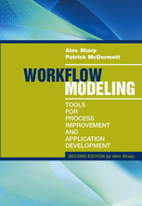
Alec's background…
Alec Sharp, Clariteq Systems Consulting – asharp@clariteq.com
45 years global experience as an independent consultant:
  Data Modelling and Management
  Business Process Modelling &
  Business Process Change – discover, scope,
  analyse, and design/redesign processes
  Application Requirements Specification
  Facilitation & Organisational Change
  Project Recovery
Awarded DAMA’s global Professional Achievement Award for contributions to "human-friendly" data modelling
Author of “Workflow Modeling”
- best-selling book on process modelling & improvement
- second edition – a complete re-write
My roots!
Process
Application
Data
Business Process Modelling
Use Case Modelling
Service Specification
Concept Modelling
Check out the nice reviews
on Amazon - http://amzn.to/dHun1o
Notes:
Bio:
Alec Sharp, a senior consultant with Clariteq Systems Consulting, has deep expertise in a rare combination of fields – process modelling, analysis, and redesign; business analysis and requirements specification; and business-oriented data modelling. Increasingly, his work involves facilitation and organisational change. His 40 years of hands-on consulting experience, practical approaches, and global reputation in model-driven methods have made him a sought-after resource in locations as diverse as Ireland, Illinois, and India.
He is also a popular conference speaker, mixing content and insight with irreverence and humour. Among his many top-rated presentations are “Crossing the Chasm - From Process Model to IT Requirements,” “Days not Weeks or Months – Process Change in Agile Timeframes,” “The Human Side of Data Modelling – Communicating With Stakeholders and Other Mere Mortals,” “Analyst or Stenographer? – Myths, Half-truths, and Successful Methods in Business Analysis,” “From Business Analyst to Business Synthesist – Making a Vital Contribution to Business Change,” and “Agile and Modelling – What Works, What Doesn’t.” His 90-minute briefing “Five Things You Need To Know About Business Processes” has been delivered to senior executives at major organisations around the globe.
Alec literally wrote the book on business process modelling, “Workflow Modelling: Tools for Process Improvement and Application Development.” Popular with process improvement specialists, business analysts, consultants, and business professionals, it is consistently a top-selling title on business process modelling, analysis, and design, and is widely used as an MBA textbook. Alec was awarded DAMA's Professional Achievement Award, a global award given to one professional a year for contributions to the Data Management profession.
Alec's popular workshops “Working With Business Processes,” “Advanced Business Process Techniques,” “Business-Oriented Data Modelling,” “Business-Oriented Data Modelling Masterclass,” and “Requirements Modelling” are conducted on four or five continents each year (pre-COVID!), at many of the world's best-known organisations. His classes are practical, energetic, and fun, consistently earning “excellent” ratings.
Contact Alec – asharp@clariteq.com

Slide 3


Clariteq – small, husband & wife company, global clients
© Clariteq 2023
www.clariteq.com

Slide 4
What we'll cover…
ê | Five Key Points
Start with a nice conversation Understand the "what" vs. "who and how" distinction Patience is a virtue (so are Simplicity and Consistency) Be fearless yet vulnerable - you don't know it all Graphical design principles matter and along the way… we can use Concept Models for so much more
The presentation slides provide a structure, but mostly I plan to
tell stories.
Notes:
A note on how we'll conduct the workshop:
First, work through an exercise, “learning by doing”
Along the way, write “key learnings” on flipcharts
Later, “fill in the blanks” by reviewing material in the workbook,
but not necessarily every slide
Pace will be adjusted to suit the needs of the class

Slide 5


1 – Start with a conversation
Don't begin with a lecture on data modelling
“Before we begin our data modelling session, let's go over some key points about data modelling. First, an Entity is any uniquely identifiable person, place, thing, event, concept, or organisation of interest to the enterprise about which facts may be recorded. Any questions? I didn't think so…”
“Before I begin my speech, let's cover a few of the basic rules of grammar. A noun is any... ”
If you avoid starting with the theory and practice…
If you can,
don't even call it “data modelling”
Modelling sessions go better
Allows use of concept modelling in non-typical situations
Notes:
May be counterintuitive – at one client, all data modelers were instructed to start with a “lecture” – and they wondered why the clients shut down!
Must tell the BC Rail story – “You IT guys really bleep me off”
Why not?
Can you think of a less inspiring term than “Data Modelling?” (Alan Kay story)
“Purple monkey water wrench” – a phrase I saw in an article making the point that our IT terms (foreign key, referential integrity, cardinality, …) aren't any clearer to the client
May lead to boredom, mental shutdown, resentment, and non-participation
It's unnecessary! Some things are easier to just do. Coaching basketball - initially, by example.
The Turing Test
Non-typical situations
Goal Setting and Planning
BPx
Package Evaluation and Selection

Slide 6



Painful but useful learning experience
The assignment –
facilitating a Concept Modelling session for a railway’s
Track & Structures group
I began by explaining
data modelling...
“An entity is a uniquely identifiable person, place, thing, event, ...”
Bad idea!!!
"I can't stand you IT guys!"

Slide 7
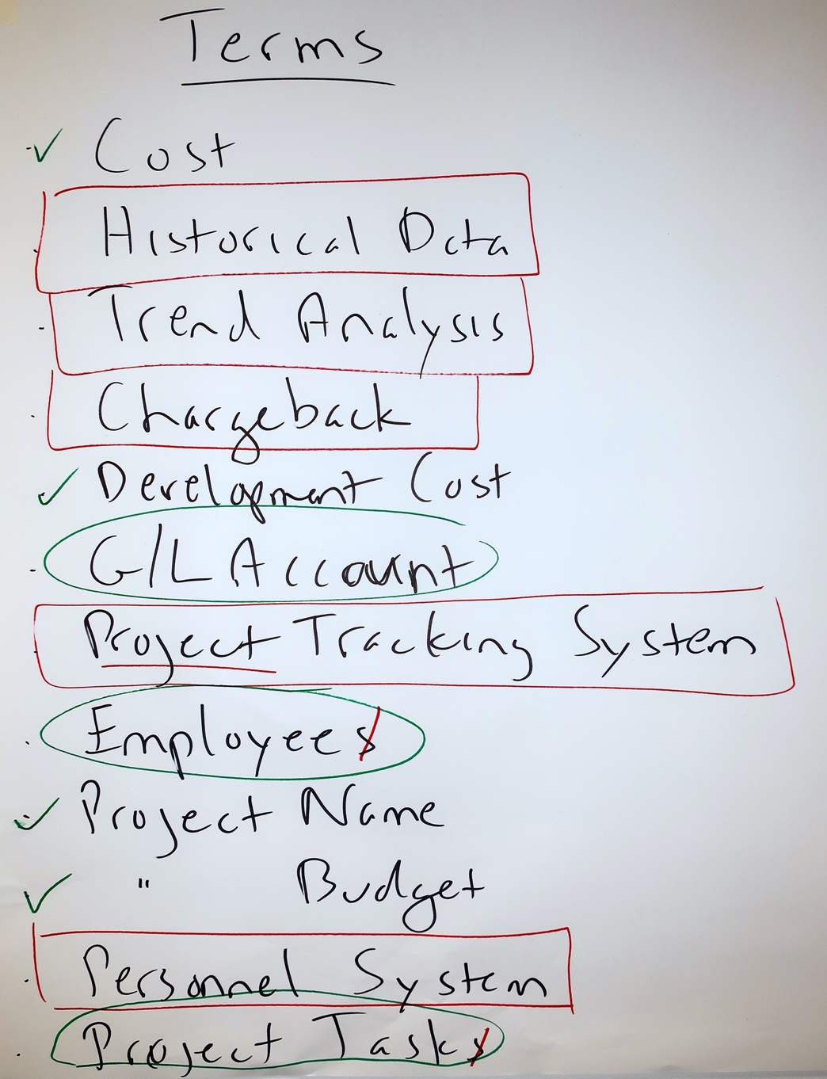
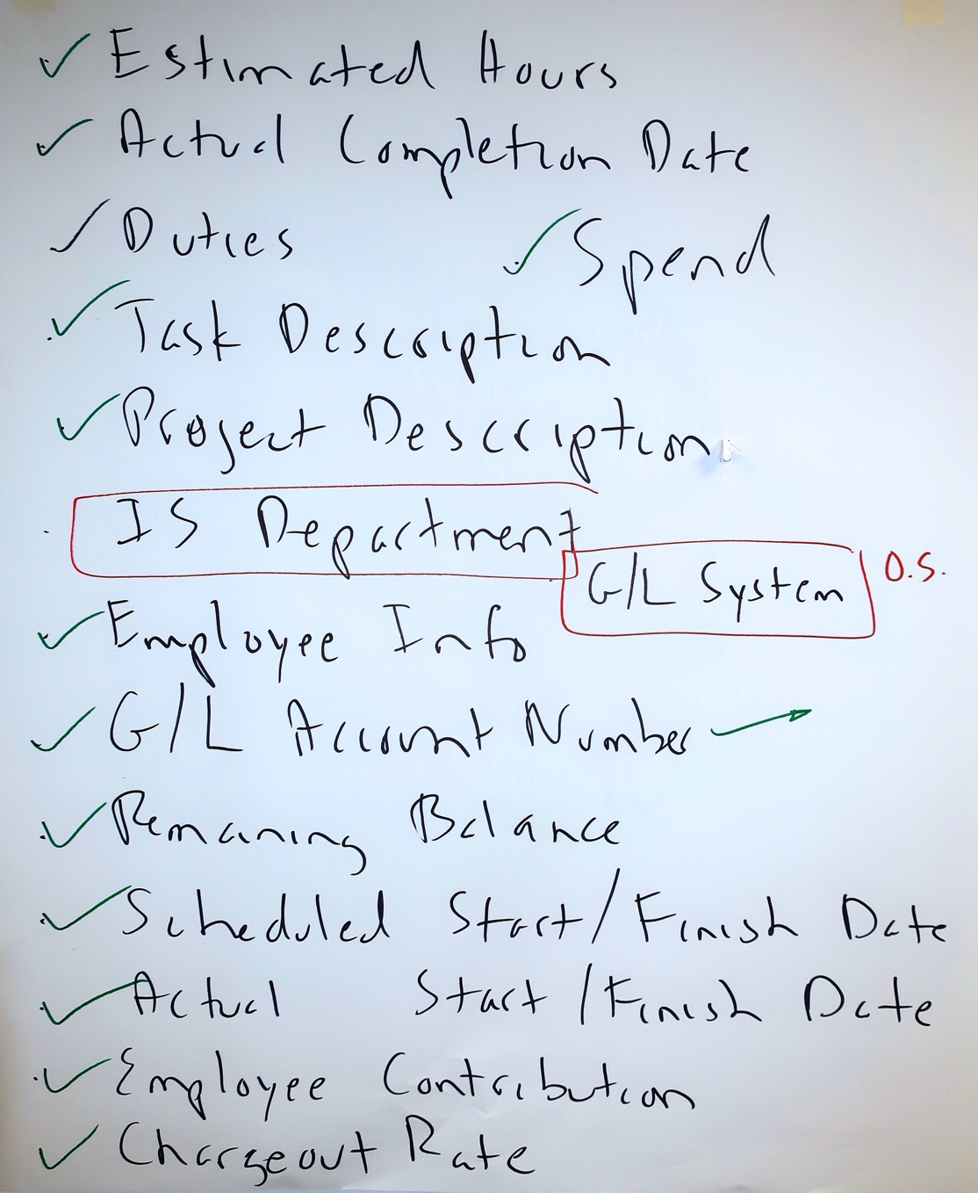
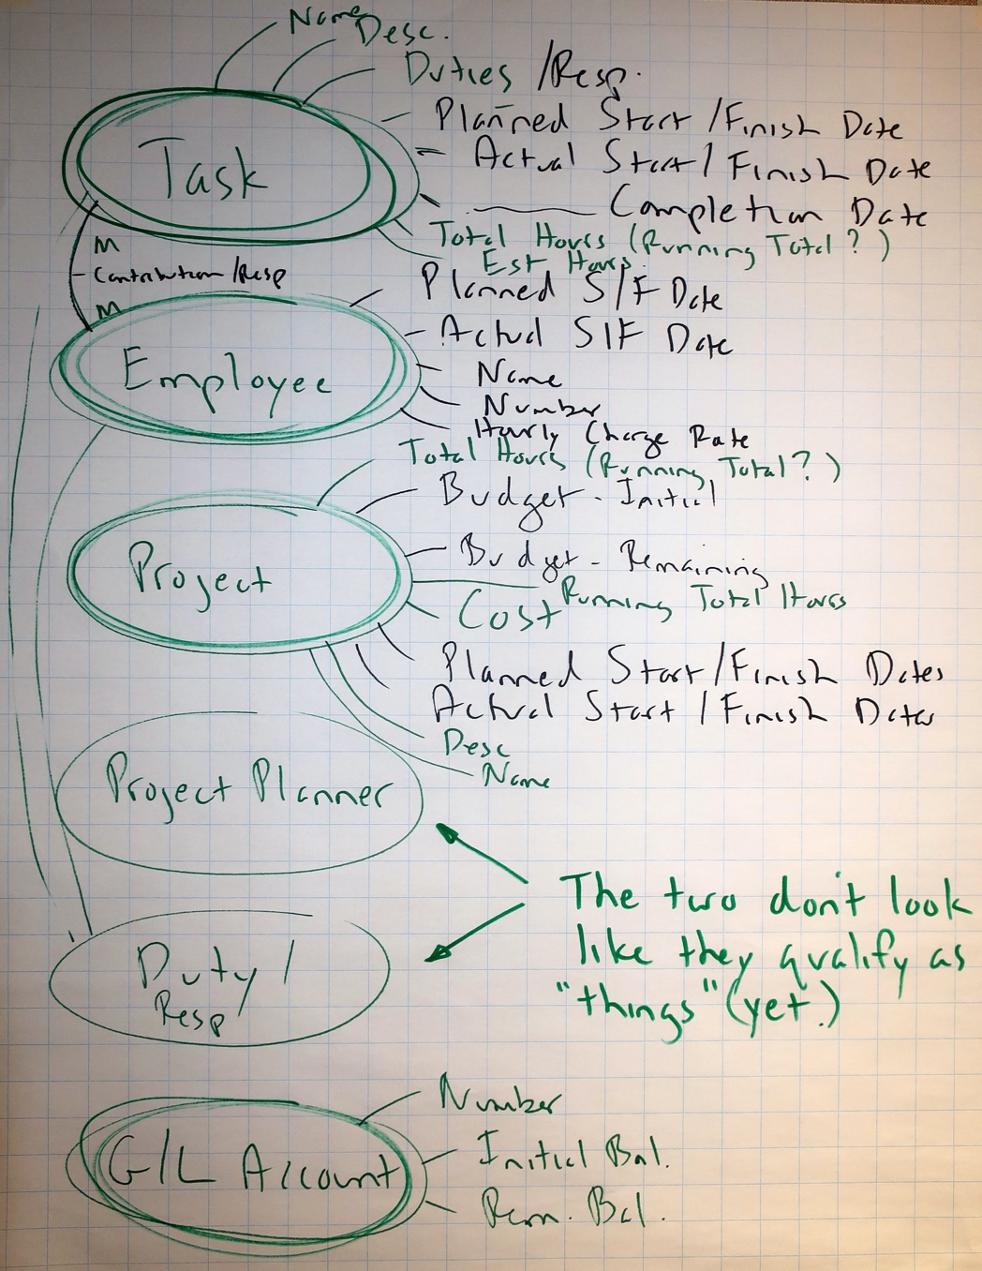
It all begins with language
“Why don’t you learn our language?” “Fair point!”
Brainstormed over 200 terms –
Track, Structure, Line, Siding, Mileboard, Segment, Sector, Route, …
Oh-oh... “Now what?” An idea!
Is this “a thing, a fact about a thing, or other stuff?”
Here’s a Project Management example…
A thing
Things
a fact about a thing
Track & Structures were VERY happy with the 40 entity concept model they built.
"other stuff"
Facts

Slide 8
Or, start with one-on-one interviews
Interview business representatives about their area:
mandate and activities, goals and objectives, issues and opportunities,
needs and wants, likes and dislikes, etc.…
Nod sympathetically, but ignore it all (almost!)
Instead, capture “terms” – anything that goes by a name.
Later, write each term on a large Post-it
In a facilitated session, participants sort terms into categories:
  Things (entities, but don’t use the term… yet)
  Facts about things (add new “thing” if it's not there already)
  “Other stuff”
  As needed, introduce criteria to be a“thing” (an entity)
  “Other stuff” includes:
  Metrics
  Organisations, departments, jobs, roles, …
  Processes, functions, activities, tasks, …
  Systems, tools, equipment, mechanisms, …
  Reports, forms, screens, queries, …
  Other – too vague, only one instance,
  a “fact of life,” not a thing we track, etc.
Notes:
Throughout, when a term is placed in “other stuff” check to see if it is a clue to a new “thing” that should be added.

Slide 9
Or, start with an email (or other) survey
Virtual first, in-person later
Via email, we gave a "homework assignment"
  Please spend ~10 minutes listing terms you use daily.
  Please identify information you need but can't get, or don't trust
  No right or wrong – goal is familiarity with your terminology
The actual text of our email…
Before the session, it would be very helpful if everyone could do two things:
Spend up to 10 minutes or so listing any terms that come to mind that you use on a frequent basis. Each item in your list could be the name of some thing you need to track, a fact about a thing, a spreadsheet, a report, a metric, a system, a database, or anything else that comes to mind. I’m hoping everyone can list thirty or forty things. There is no “right or wrong” – this helps me learn the language and provides clues to what the most critical terms might be.
Think of one to three examples of information you’d like to be able to get, but either you can’t, or you’re not sure how accurate it is. For instance, at a US university last week, a Vice-Provost said she would like to know “How many non-resident, tenure-track Faculty do we have.” Of course, this means agreeing what is meant by “Faculty,” “tenure-track,” and “non-resident.” (I've done a LOT of work in higher education and can promise you there is not agreement on what those terms mean.)
That’s the whole point of our sessions next week. :-)

Slide 10
Some had little to say, others had lots

Slide 11

All were useful
I went through all the "homework" and selected ~40 terms that qualified as "things"
(or entities, or business objects,
or classes, or…)

Slide 12
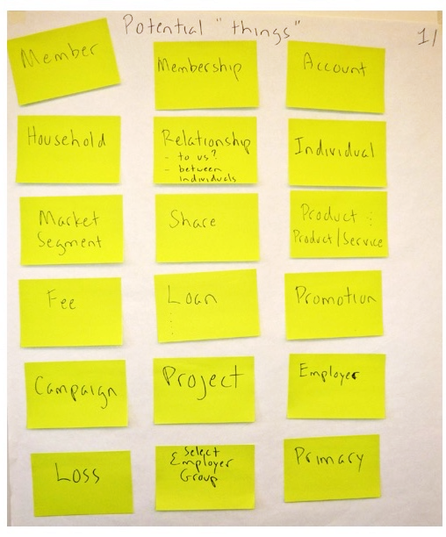
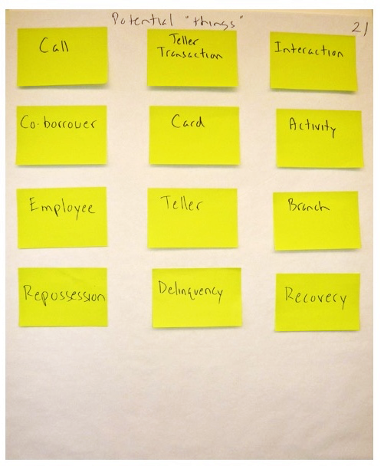
At the first session - "Here are the 'things' you mentioned"
More than enough to work with – here are 30:
They added more…
"Wow – you actually did something with our homework!"

Slide 13
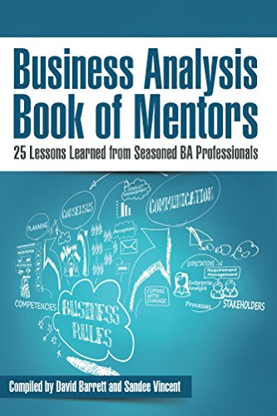
2 -– Use the distinction between the "what" and the "who & how"
My chapter in the “BA Book of Mentors”
The premise of the book:
25 experienced BAs from around the world would each write a chapter on “The Most Important Lesson I Learned in my BA Career.’
I knew mine instantly –
separate the “what” from the “who, how, and why”
In other words, separate the “essence” from the “accident”

Slide 14

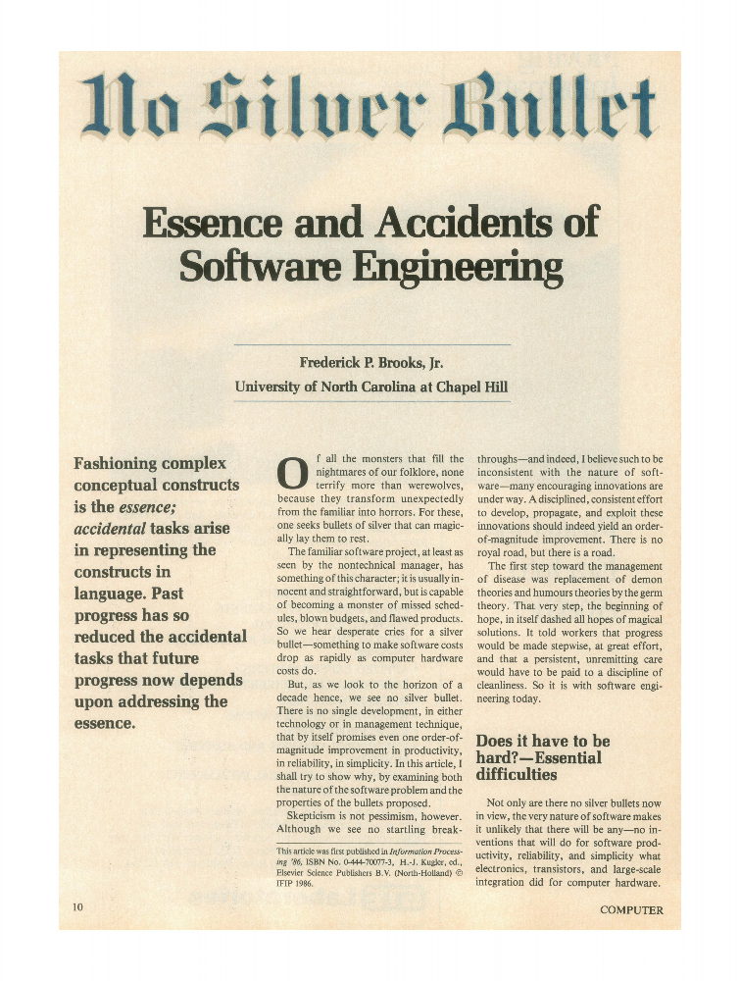
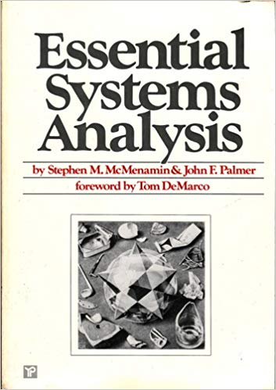


Essence and Accident?
Essential:
absolutely necessary; extremely important.
something's basic or most important characteristics;
the intrinsic, inherent, or fundamental nature of something
Cup:
The essential characteristics:
a round, handheld container
for drinking from.
What it is.
The accidental characteristics:
ceramic vs. bamboo, handle or not, …
how it is designed or made and
who it will be used by

Slide 15
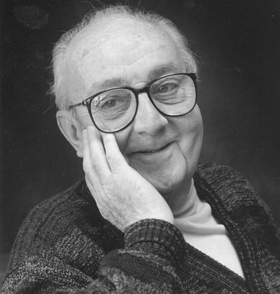
“All models are wrong, but some are useful.”
Two especially useful models
Business Process Scope Model
Business Concept Model
(a.k.a Conceptual Data Model)
Both are “essential” –
they show the essence – the “what” – of a subject with no reference to who, how, why, etc.
George E. P. Box
1919–2013

Slide 16
"What" - a Process Scope Model
Communicate System Outage
Confirm Outage
triage & route notification
perform system diagnostics
Determine
scope
impact
audience
Communicate Situation
(as appropriate)
Communicate Resolution
Assess Communication Process
(lessons learned)
Identify and Communicate Next Steps / Follow Up
Triggering
Event:
Notification of degradation or lack of Service
internal system
external provider
calls to Service Desk
Cases:
new
recurring
Other factors:
severity
key operations periods / areas
(registration, summer, course evaluation season)
time of year
time of day
Results:
Communications about the Outage and the progress on resolving it are delivered:
internally and externally
informally and formally
Final Results:
Service is restored and root cause is known (or is determined to be unknowable) and resolution is communicated:
Externally (“good news”)
Internally (“cause & resolution)
Process Scope Model using “TRAC” -
what is the Trigger, what are the Results,
what are the main Activities
(7 ± 2 milestones, phases, or subprocesses,)
and what are the main cases or variations?
Why 7± 2?
Notes:
May incorporate many, even hundreds of services

Slide 17
"What" – a Concept Model
A description of a business in terms of
things it needs to maintain records of – entities
facts about those things –
relationships & attributes
policies & rules –
definitions, constraints, and assertions governing those things and facts

Slide 18
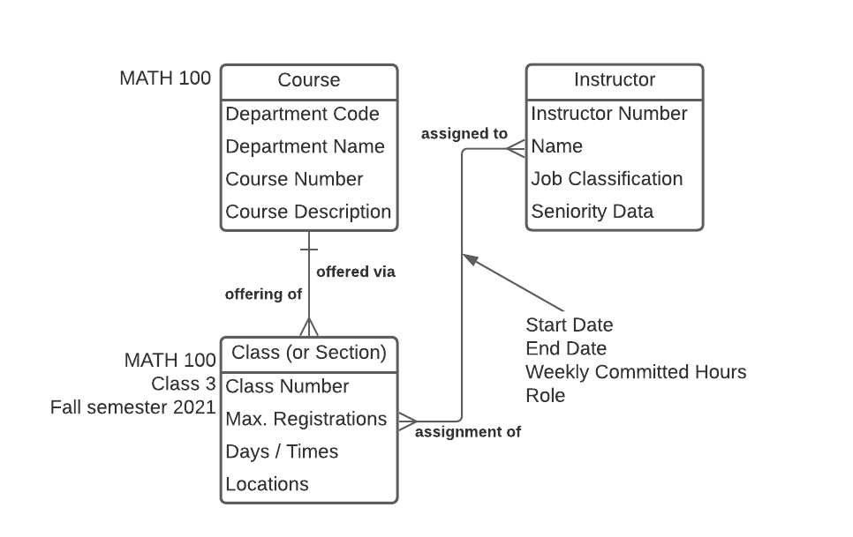
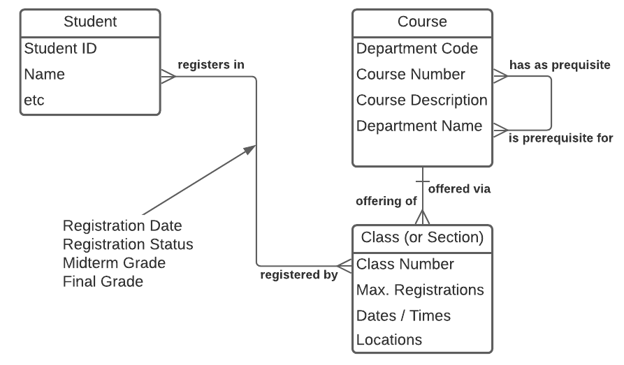
Use a Concept Model to demonstrate what's possible
When Concept Modelling in a university environment,
everyone wants their favourite report (or artifact) to show up on the data model.
We need to be ready to show a near-infinite number of reports etc. can be produced from one essential model:
Class Roster
Student Transcript
Instructor Assignments
…

Slide 19
3 – Patience is a virtue
Two examples I'll illustrate with stories:
Don't rush people into agreeing on an
entity definition (the heart of concept modelling.)
First, establish there are legitimate differences of opinion
Don't rush to generalise or create supertypes.
First, help everyone see the similarities.
  Recent student comments -
  "I learned modelling should proceed at the pace the group is comfortable with"
  and
  "Move faster by slowing down"

Slide 20
Entity definition - start by opening minds
“Can anyone think of examples that might surprise someone else –
that is, anomalies or potential sources of confusion."
E.g., how could we legitimately have different ideas what “Employee" means?
Employee
Project
Account
Task

Slide 21
Starting an Entity definition
“Can anyone think of examples that might surprise someone else –
that is, anomalies or potential sources of confusion."
E.g., how could we legitimately have different ideas what “Employee" means?
F/T vs. P/T?
Only IS Department?
Include management, or only individual contributors?
Still in recruitment (an applicant)?
Onboarded? on probation? active? retirees?
Include contractors, student interns, vendor staff, etc.?
Volunteers?
A type of worker (DBA or tester) or a specific person?
A robotic, automated, or AI agent?
Employee
Project
Account
Task

Slide 22
Starting an Entity definition
“Can anyone think of examples that might surprise someone else –
that is, anomalies or potential sources of confusion."
E.g., how could we legitimately have different ideas what “Employee" means?
Let's see what the group decided
F/T vs. P/T?
Only IS Department?
Include management, or only individual contributors?
Still in recruitment (an applicant)?
Onboarded? on probation? active? retirees?
Include contractors, student interns, vendor staff, etc.?
Volunteers?
A type of worker (DBA or tester) or a specific person?
A robotic, automated, or AI agent?
Employee
– Both
– No
– Yes, everyone
– No
– Yes, all
– Yes, all
– Yes
– No, only a specific person
– No, only a real person
Project
Account
Task

Slide 23
Defining the Entity "Employee" – "Worker"
Definition format:
A description of which real-world things are within in scope, and any specific inclusions (“This includes…” or “This is...”)
Illustrate with examples – 5 to 10 sample instances or types
Interesting points – anomalies, synonyms, common points of confusion, etc.
May include specific exclusions
(“This excludes…” or “This is not...”)
Worker (renamed from Employee):
A Worker is a person, whether or not directly employed by
the company, but with some sort of employment contract or arrangement, who has been or may be assigned to a Project.
Worker includes:
Full or Part-time Employees who have been onboarded,
including Probation, Active, Seconded, Suspended, Retired…
Contractors
Consultants
Student Interns
Vendor Staff Persons
Company Owners and Managers
Key points:
"Worker" was chosen as the entity name because
it is more generalised than "Employee."
A Worker may not necessarily be billable on a Project,
e.g., a non-chargeable Subject Matter Expert or Volunteer
Worker excludes:
  Job Roles, e.g., DBA or Technical Writer
  Robotic, Automated, or AI Agents (this might change)

Slide 24
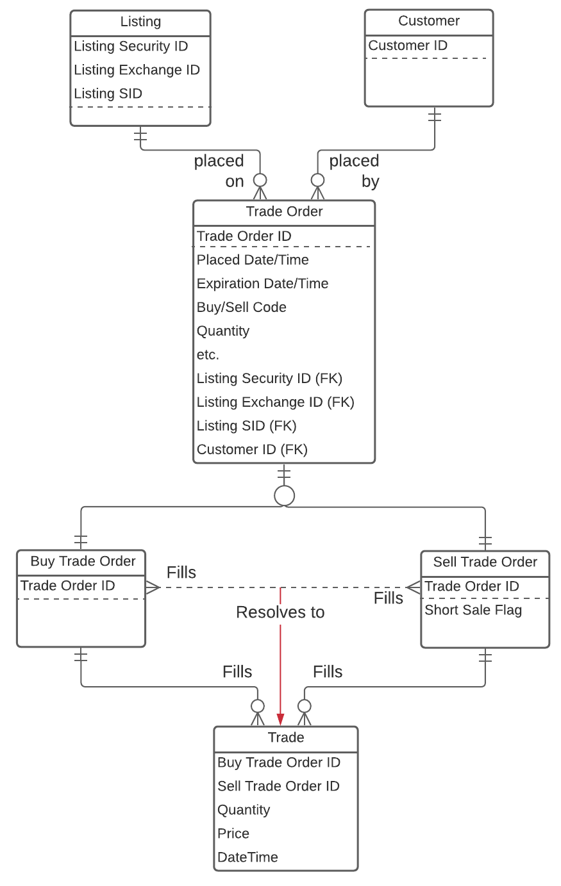
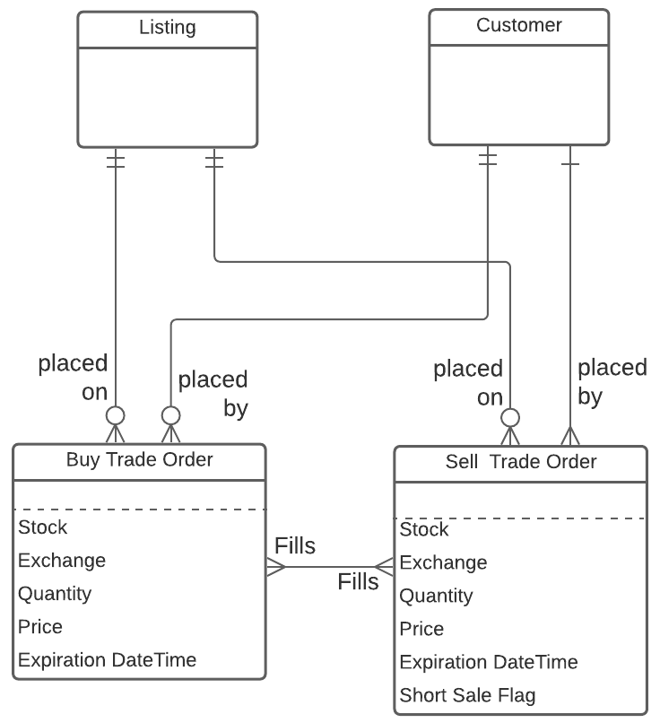
A real example - specifics first, generalisation later
Delaying supertyping / generalisation -
a real example
Patience
is a virtue!
Generalisation
Client:
"Wow! Buy and Sell Trade Orders
look very similar!"
Me:
"Omigosh!
That's amazing!"
Specifics

Slide 25

4) The Principle of Constructive Ignorance
- Myth -
- Reality -
Never be afraid to ask “dumb” questions…
“I've got to have all the answers.
I can't show my ignorance.”
You're not paid to know - you're paid to ask
Someone will be glad you did
The number of different
answers will surprise
everyone
Just one more question, ma'am. Nothing too important...
There's one thing I'm not clear on...
Could we go over this just once more to be sure I've got it right?
Lieutenant Columbo takes up Data Modelling
Notes:
The less I know, the better I facilitate. Why? (Principle of Constructive Ignorance”
Example – “What's the difference between a - ”
Device
Part
Component
Assembly
Sub-assembly
System
…?
My cultural references are either out of date or geographically limited!
By the way – DON'T answer the dumb questions. That's what they (participants) are there for.

Slide 26
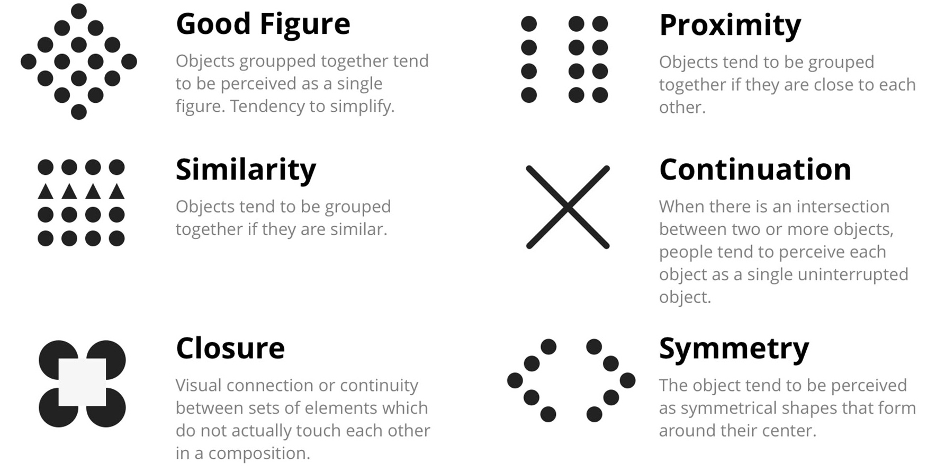
5) Graphical design principles matter
It's learnable! e.g., Gestalt principles (study them on your own)
how humans instinctively organize individual visual elements
groups, patterns, and unified wholes vs. separate parts.
key principles:
  proximity
  similarity
  closure
  continuity
  symmetry

Slide 27
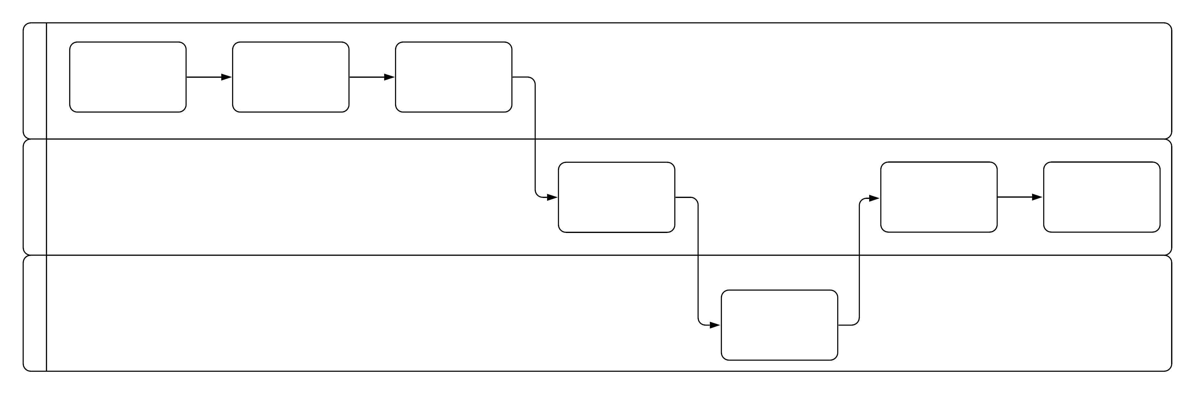

Cognitive psychology of diagramming - a process example
What do people first perceive on a diagram?
relative size
relative X-Y position
an
important
step
a less
important
step
Make all the steps the same size,
unless you're trying to make a point
Actors
Y
X
Flow (time)
Notes:
It could be a deployment diagram, a concept model, an organisation chart, or a workflow model – the principles are the same.

Slide 28
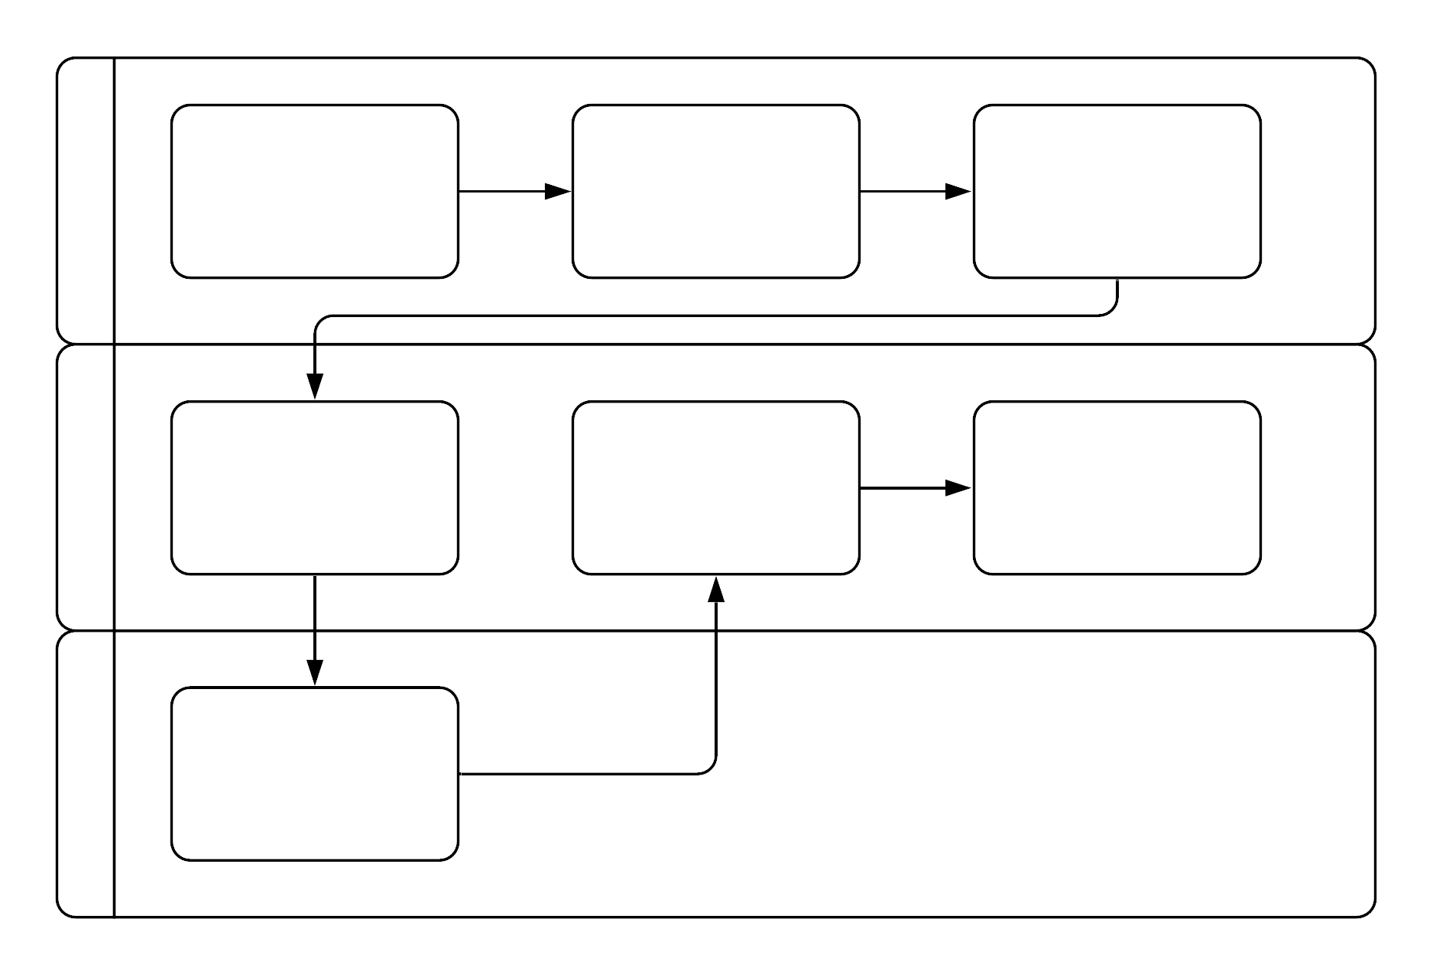
Don't conceal sequence and dependency
Steps perceived as happening in parallel,
even though flow lines indicate sequential.
Critical in analysing a process:
sequential vs. parallel
dependent vs. independent
A simple guideline:
flow lines only leave
the right edge
and only enter
the left edge – never the top or bottom.
And for data…?

Slide 29
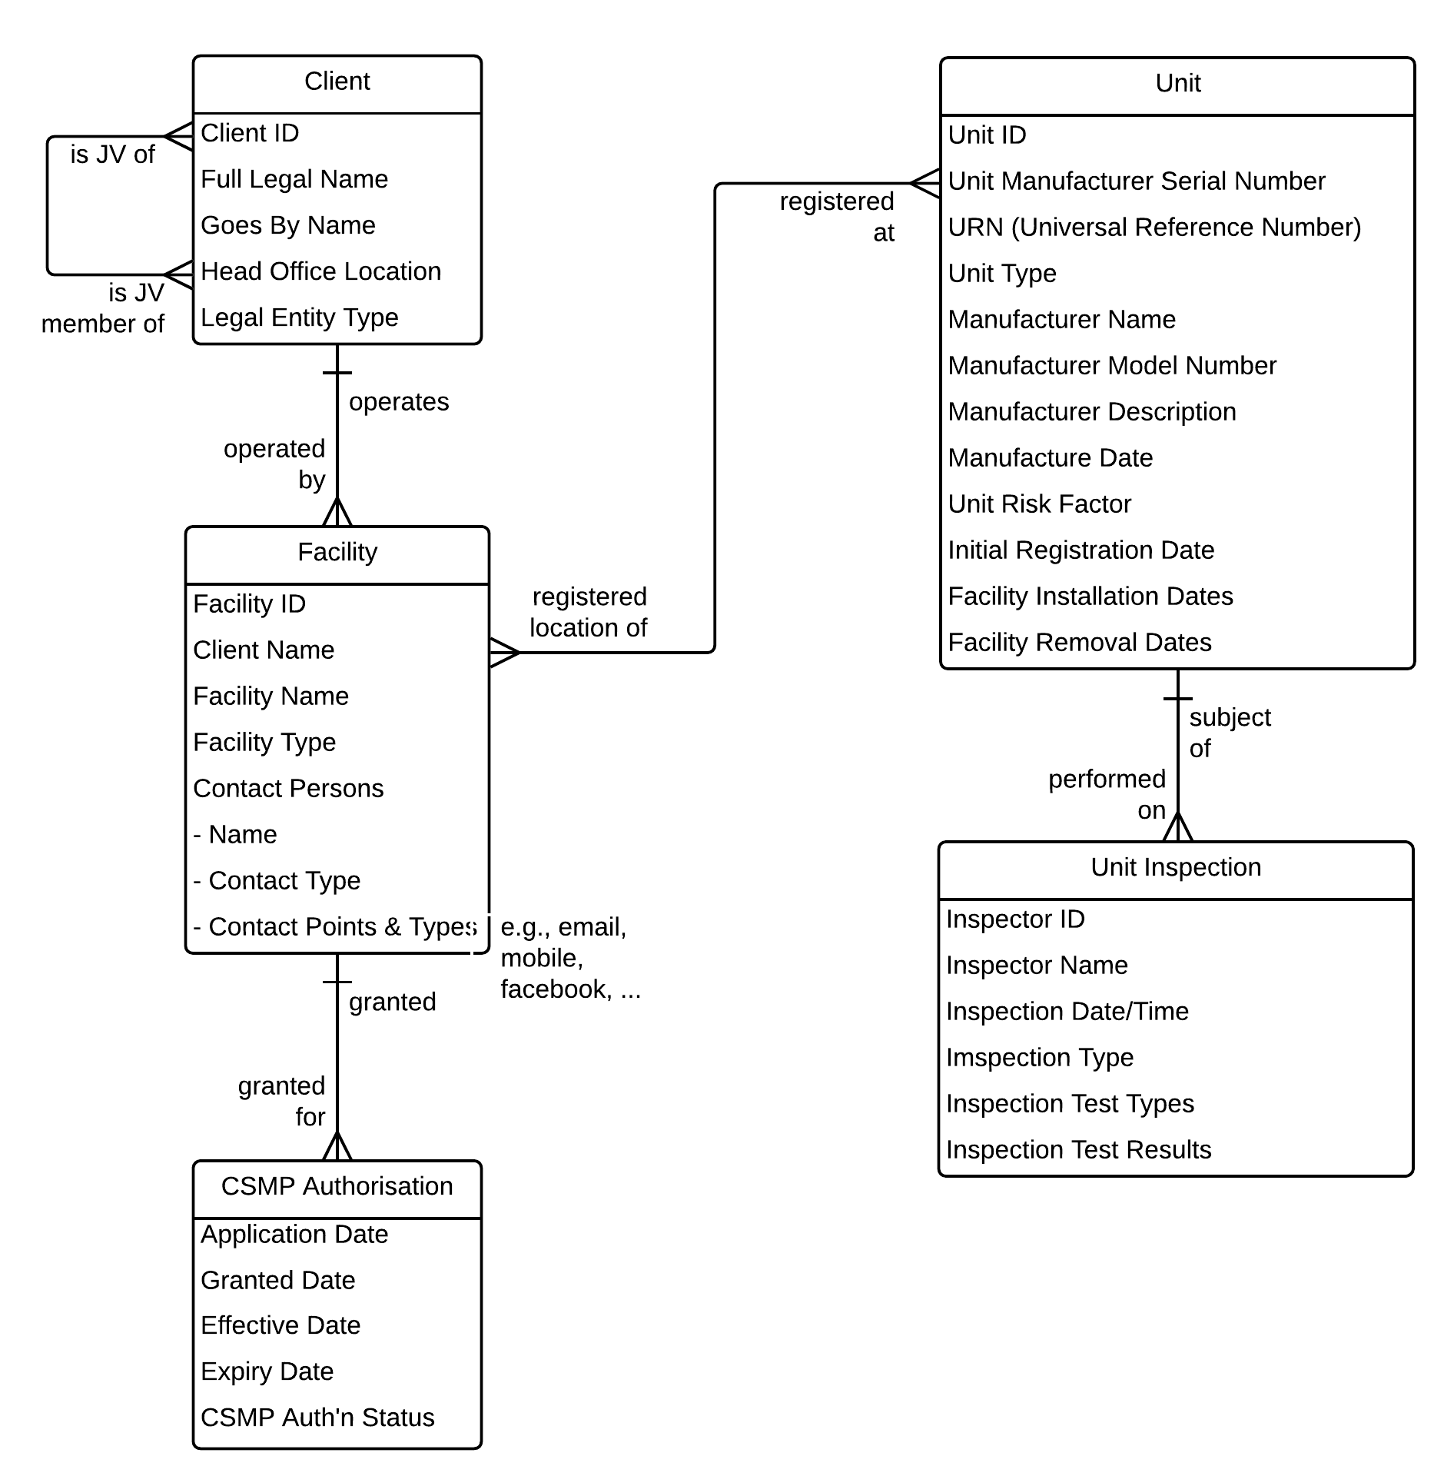
For data models, always draw top-down by dependency
For a Concept Model

Slide 30
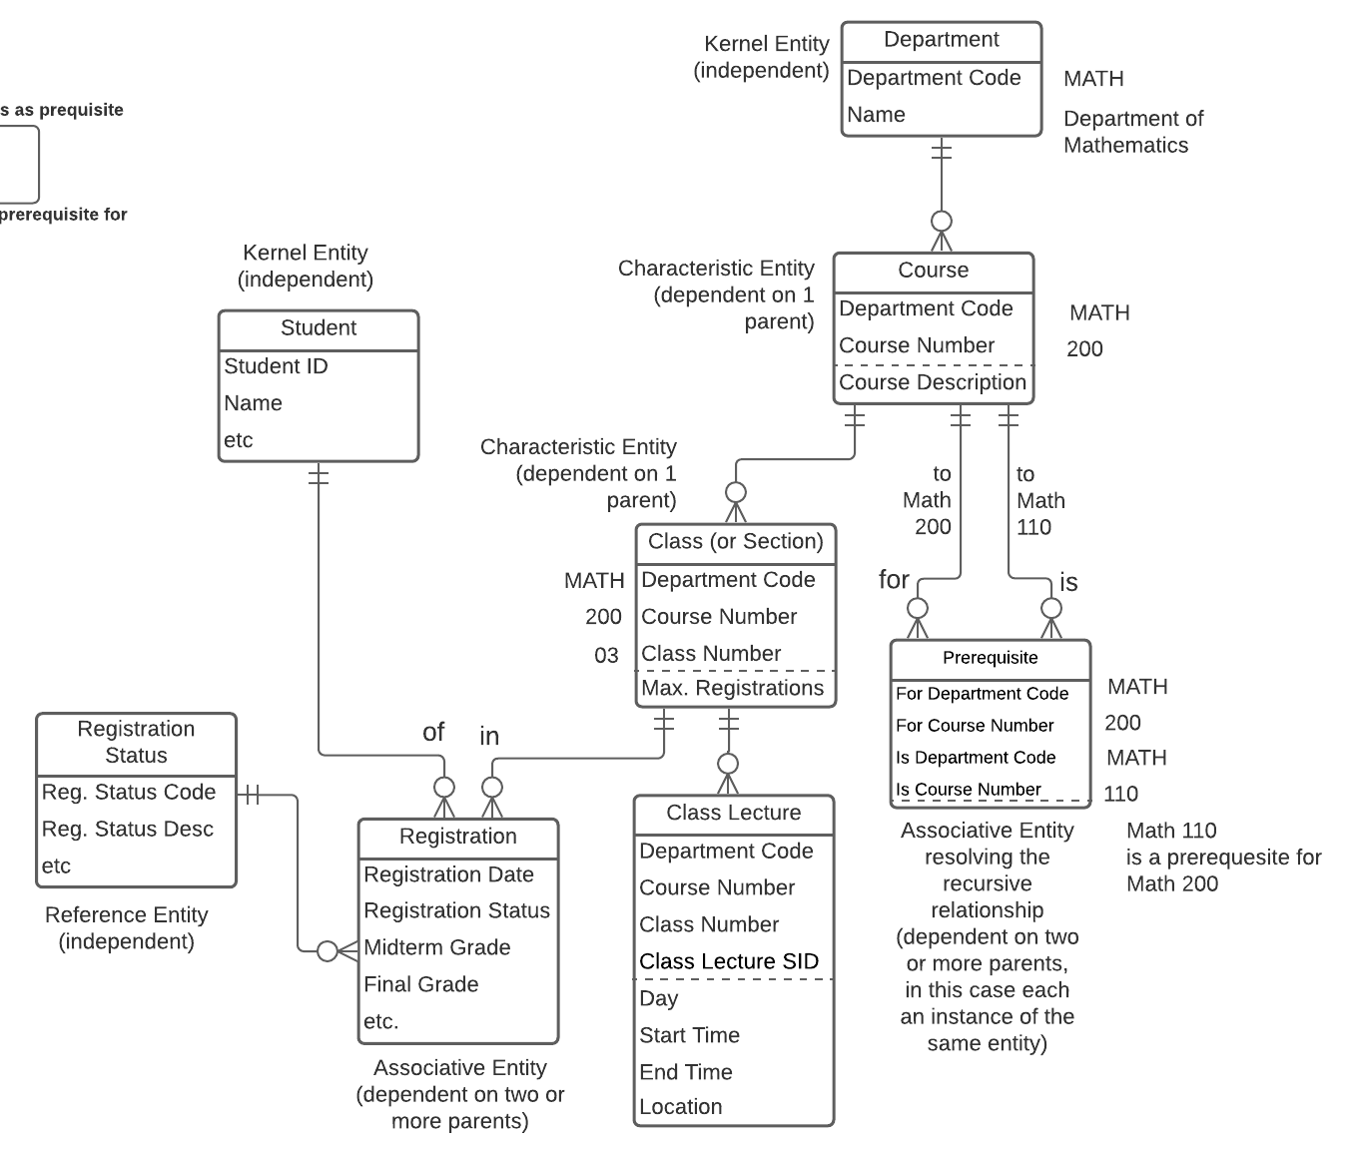
Top-down by dependency
For a Logical Model

Slide 31
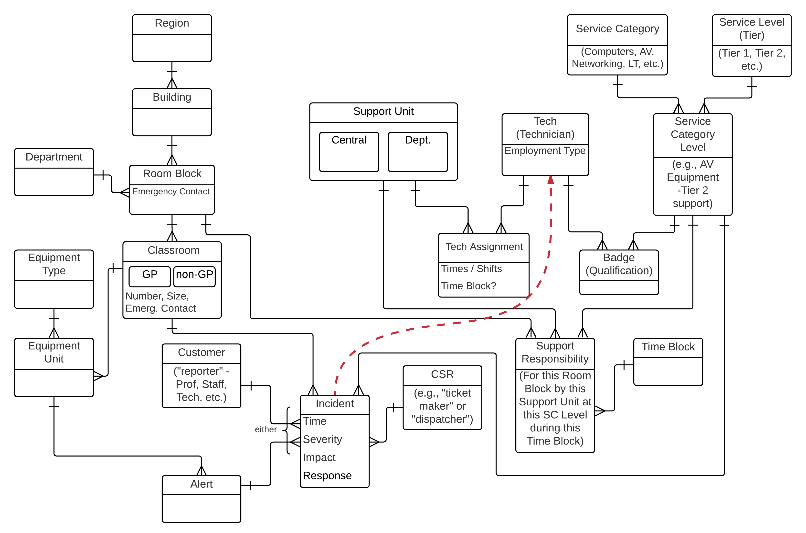
Top-down by dependency
For a
"halfway-house"
model

Slide 32
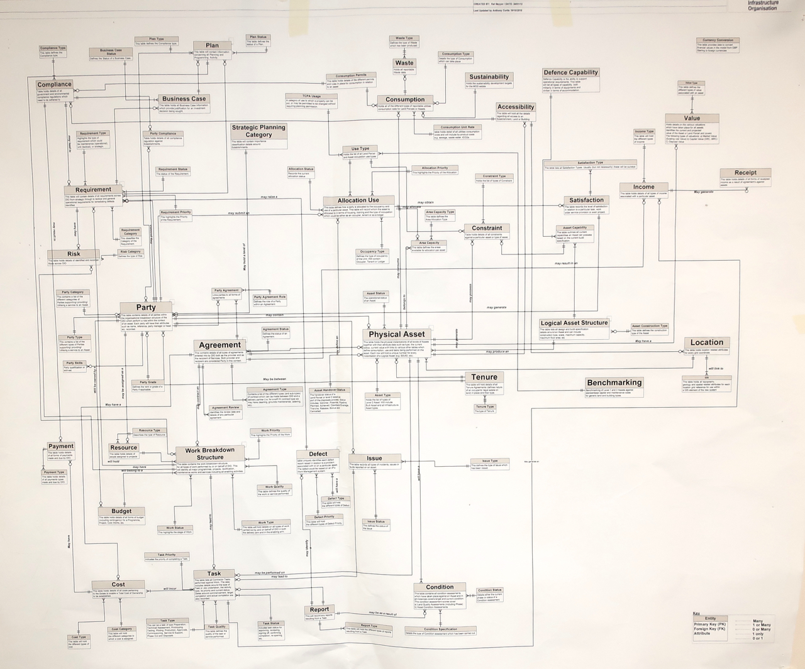
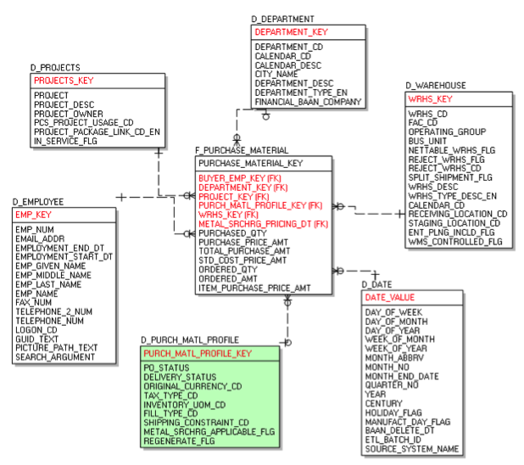
What works for Dimensional Models doesn't for E-R Models
A common error –
"the most important entity should go in the centre of the diagram."
An excellent model structurally, but very difficult to follow –
no sense of direction.
Concept Models / E-R Models should be drawn top-down by dependency.
"Fact" in the middle - fine for Dimensional, terrible for E-R

Slide 33
Graphic guidelines – the “no dead crows” principle
! | Key point
Entity type is obvious from: Placement Relationship connections
Kernels across the upper part of the diagram or subject area
Reference or Types beside or diagonally above;
“classifying” relationship connects at side
Characteristics below; “characterising” relationship connects at top edge
Associatives between & below;
“associating” relationships connect at top edge
Various layouts can work:
top-down best for mere mortals
left to right temporal
bottom-up organic
right to left swimming upstream
Layouts to avoid:
middle-out cosmic
no crossed obsessive
lines compulsive
random Mensa-only
Notes:
Drawing your data model with a sense of direction is the single most important rule for ensuring that data model diagrams are understandable to the widest range of people.
Follow the NO DEAD CROWS rule – crow's feet can point “down” (like a standing crow) or they can point “sideways” (like a crow lying on its side) but they can't point “up” (like a dead crow lying on its back.)

Slide 34
In summary – don't forget the four Ds of Concept Modelling
1
2
Definition
Dependency
  “What is one of these things?”
  List common and unusual instances
  “Are there any known anomalies?”
  “What are the potential differences of opinion?”
  “What type of entity is this?”
  “What other entity does it depend on?”
  Essentially
  - is it a free-standing thing?,
  - is it a type of thing?,
  - is it repeating detail about some other thing?
3
4
Detail
Demonstration
  Don't dive into detail –
  keep it in its place!
  GEFN!* HPDL!**
  Assertions / narrative rules
  Sample data values or instances
  Scenarios or use cases
  Props (e.g., report layouts or common documents)
*Good enough for now!
**Hard part, do later!

Slide 35
What we covered
ê | Five Key Points
Start with a nice conversation Understand the "what" vs. "who and how" distinction Patience is a virtue (so are Simplicity and Consistency) Be fearless yet vulnerable - you don't know it all Graphical design principles matter
We hope you got some
good ideas from this session!
Notes:
A note on how we'll conduct the workshop:
First, work through an exercise, “learning by doing”
Along the way, write “key learnings” on flipcharts
Later, “fill in the blanks” by reviewing material in the workbook,
but not necessarily every slide
Pace will be adjusted to suit the needs of the class

Slide 36
Thank you – stay in touch!
Alec Sharp
Clariteq Systems Consulting Ltd.
West Vancouver, BC, Canada
asharp@clariteq.com
ig: @alecsharp01
www.clariteq.com
http://amzn.to/dHun1o
And most of all, if you have questions or comments…
don't be shy – send me a note!

