Slide 1

Business-Oriented Data Modelling Masterclass –
Balancing Engagement, Agility, and Complexity
Presented by
Adept Events and Clariteq Systems Consulting
Alec Sharp
Consultant
Clariteq Systems Consulting Ltd.
West Vancouver, BC, Canada asharp@clariteq.com www.clariteq.com
© Copyright Alec Sharp / Clariteq 2026 V5.0
www.adeptevents.nl
www.clariteq.com

Slide 2

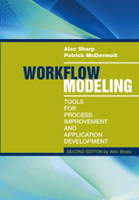
Instructor / course developer background…
Alec Sharp, Clariteq Systems Consulting – asharp@clariteq.com
45 years global experience as an independent consultant:
  Business Process Modelling &
  Business Process Change – discover, scope,
  analyse, and design/redesign processes
  Application Requirements Specification
  Data Modelling and Management
  Facilitation & Organisational Change
  Project Recovery
Awarded DAMA’s global Professional Achievement Award for contributions to "human-friendly" data modelling
Author of “Workflow Modeling”
- best-selling book on process modelling & improvement
- second edition – a complete re-write
Process
Application
Data
Business Process Modelling
Use Case Modelling
Service Specification
My roots!
Concept Modelling
Check out the nice reviews
on Amazon - http://amzn.to/dHun1o
Notes:
Bio:
Alec Sharp, a senior consultant with Clariteq Systems Consulting, has deep expertise in a rare combination of fields – process modelling, analysis, and redesign; business analysis and requirements specification; and business-oriented data modelling. Increasingly, his work involves facilitation and organisational change. His 40 years of hands-on consulting experience, practical approaches, and global reputation in model-driven methods have made him a sought-after resource in locations as diverse as Ireland, Illinois, and India.
He is also a popular conference speaker, mixing content and insight with irreverence and humour. Among his many top-rated presentations are “Crossing the Chasm - From Process Model to IT Requirements,” “Days not Weeks or Months – Process Change in Agile Timeframes,” “The Human Side of Data Modelling – Communicating With Stakeholders and Other Mere Mortals,” “Analyst or Stenographer? – Myths, Half-truths, and Successful Methods in Business Analysis,” “From Business Analyst to Business Synthesist – Making a Vital Contribution to Business Change,” and “Agile and Modelling – What Works, What Doesn’t.” His 90-minute briefing “Five Things You Need To Know About Business Processes” has been delivered to senior executives at major organisations around the globe.
Alec literally wrote the book on business process modelling, “Workflow Modelling: Tools for Process Improvement and Application Development.” Popular with process improvement specialists, business analysts, consultants, and business professionals, it is consistently a top-selling title on business process modelling, analysis, and design, and is widely used as an MBA textbook. Alec was awarded DAMA's Professional Achievement Award, a global award given to one professional a year for contributions to the Data Management profession.
Alec's popular workshops “Working With Business Processes,” “Advanced Business Process Techniques,” “Business-Oriented Data Modelling,” “Business-Oriented Data Modelling Masterclass,” and “Requirements Modelling” are conducted on four or five continents each year (pre-COVID!), at many of the world's best-known organisations. His classes are practical, energetic, and fun, consistently earning “excellent” ratings.
Contact Alec – asharp@clariteq.com

Slide 3


Clariteq – small, husband & wife company, global clients
© Clariteq 2023
www.clariteq.com

Slide 4
Background for this course
Get everyone, even experienced modellers, to the same baseline of concepts, conventions and terminology, and our unique business-friendly approach.
Business-Oriented Data Modelling
2 days
Business-Oriented
Data Modelling
Masterclass
3 days
Advanced Data Modelling
3 days
Learn techniques for modelling more complex situations.
Two important notes:
Our focus is on engaging businesspeople in
conceptual and logical modelling of operational data
(master data, transactional data, & reference data) with some time on BI / Dimensional modelling.
This is not a class on physical database design or implementation strategies (e.g., Data Mesh or Data Lake) and is not a class on Data Governance, Data Management, or Data Strategy – it's about modelling.

Slide 5
Overview and logistics
Æ | Fundamental and Advanced Topics
Introduction and Level-set Introduction, Hands-on Case Study Essentials of Concept Modelling Transition from Conceptual to Logical, and Logical to Dimensional Interesting Structures Types vs. Instances Recursion, Subtyping, & Generalisation Meeting New Requirements Modelling Time, History, & Change Rules on Relationships and Associations Multi-way Associatives & Complex Rules Advanced Normal Forms (4NF & 5NF) Presentation Techniques for Data Modellers Core Techniques for Presenting A Real-life Example
Schedule (CET)
09:00 start
09:00 - 10:30 class
10:30 - 10:45 break
10:45 - 12:30 class
12:30 - 13:30 lunch
13:30 - 15:00 class
15:00 - 15:15 break
15:15 - 17:00 class
17:00 end
Finally…you:
Name (how should I address you?)
Brief description of your work
Is there a topic you are especially interested in?
Please try to keep your introduction to one minute or less

Slide 6
What is a Concept Model / Business Object Model / Domain Model…?
A description of a business in terms of
  things it needs to maintain records of – Entities
  facts about those things – Relationships & Attributes
  policies & rules governing those things and facts
Models a view of the real world, not a technical design
(therefore, stable and flexible)
Can be comprehended by mere mortals
(at least initially)
Graham Witt – “A narrative supported by a graphic”
“Things” first,
data later!
Narrative component
Student definition:
A Student is any person who has been admitted to the University, has accepted, and has registered in a course within a designated time. Faculty and staff members may also be Students.
Plus “Assertions” (policies & rules)
- Each Course is offered through one or more Classes
Each Class is an offering of a single, specific Course
- Each Instructor teaches one or more Classes
- Each Class is taught by one Instructor
(which may or may not be true…)
Many rules can't be shown on the diagram…
- A Student can not register in two Classes of the same Course in the same Academic Term
Graphic component
Entity (thing)
a distinct thing of interest
about which the business
must maintain information
Course
Attribute (fact)
A property of an entity
that can be expressed as a piece of data
Department
Number
teaches
Instructor
Credit Hours
Description
Number
Pre-requisites
Name
offered via
Student
offering of
taught
by
Room
Number
registers in
Class
Number
Name
Days
Times
location of
Building
Address
is registered by
Seating Capacity
One
Major
located in
Equipment
GPA
Relationship (fact)
A named association between two Entities
Many
(or “Multiple” or “One or more”)
Notes:
There are many ways to describe a business...
How it works - Process Model
How it's organised - Organisation Chart
Where it operates - Location Map
and…
What things it deals with, and needs to know about – Concept Model
(or Conceptual Data Model)
Data modelling symbols will vary slightly among the different “dialects”, but the meaning is constant. The symbols are much more standardised than they used to be.
Also known as a "business object model," a “concept model,” a “domain model,” or a “business class model,” among other things.
Data Modelling involves:
Gathering knowledge from Subject Matter Experts (the hard part!)
Representing that knowledge using a set of standard symbols and conventions (the easier part!)

Slide 7
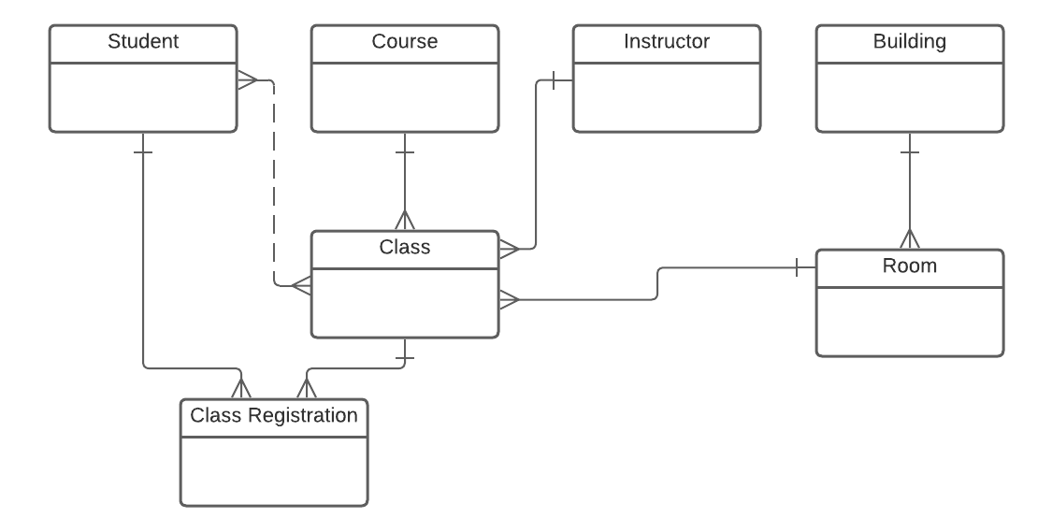
A better looking version of the model on the previous slide
Independent entities across the top
resolves
to
Drawn top-down by dependency
We focus on:
Simplicity and minimising graphic "widgets" -
initially just "boxes & lines"
Placement and direction
Progression through predictable steps

Slide 8
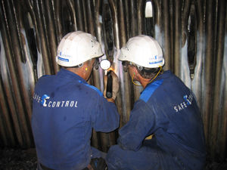









Case study – Concept Model, Services, Use Cases, Business Processes
Client –
Regulatory agency ensuring the safe design, installation, and use of technical equipment
Natural gas systems, electrical systems, boilers and pressure vessels, elevating devices, & many more
Goal –
Shift from an inspection-based model (~800 inspectors!) to client-managed safety programs
Clients will apply for a Client Safety Management Program Authorisation (CSMP Authorisation)
- must show effective processes and accurate record-keeping
Clients will pay a fee for managing their own safety programs! Still beneficial!

Slide 9

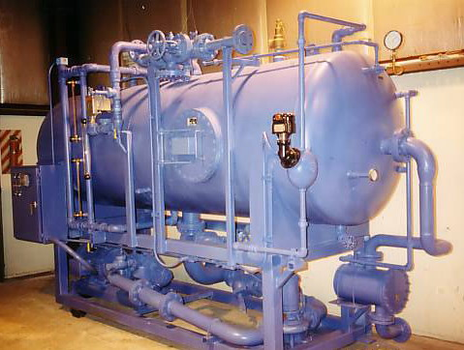
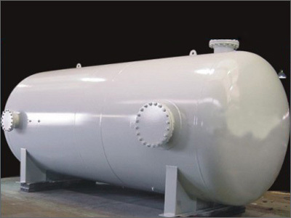
Case study – Concept Model, Services, Use Cases
Business Development chooses Pilot Program –
boilers and pressure vessels in Oil & Gas fields
Current systems won’t support CSMP, time-consuming and expensive to change them –
IT and Finance suggest 18 – 24 months of work
BD is unimpressed by IT and Finance objections (“You're being mindlessly obstructionist!”)
and proposes work-around procedure. Guess which tool they intend to use?
I’m hired to identify end-to-end implications –
“Design a process and determine IT requirements that will allow this procedure to work.”
Concept Modelling was a critical tool in understanding the underlying policies,
and developing the process & requirements

Slide 10
Building your initial Concept Model, step-by-step
Identify and define "Things"
1. Collect terms
1:1 interviews
survey (e.g., email)
group brainstorm
analyse documents
2. Isolate "things"
Ask Is this…
a thing?
a fact about a thing?
or "other stuff?"
3. Identify synonyms
select a term to use
as general as possible
just for this initiative,
not the entire enterprise
4. Define each thing
"good enough for now"
first, identify "anomalies, sources of confusion, and
valid differences of opinion"
select which to include
Develop initial Concept Model
5. Organise things
independent things across the top
then laid out top-down by dependency
6. Draw relationships
show dependency
parent-child drawn bottom-to-top
otherwise, side-to-side
7. Name relationships
in both directions
active verb-based!
not mushy – has
not meaningless – related to
8. Add cardinality
use words first
1:1 is probably wrong
1:M (one to many)
M:M (many to many)
Refine Concept Model
9. State assertions
forcefully, for each relationship
challenge the assertions!
restate the assertion &
why it changed, if it did
10. Redraw the model
shows revised assertions
e.g., 1:M becoming M:M
e.g., dependent things becoming independent
11. Collect attributes
a few for each thing
not all attributes
don't worry about normalisation
12. Move to identifying:
events / services
use cases /
user stories

Slide 11
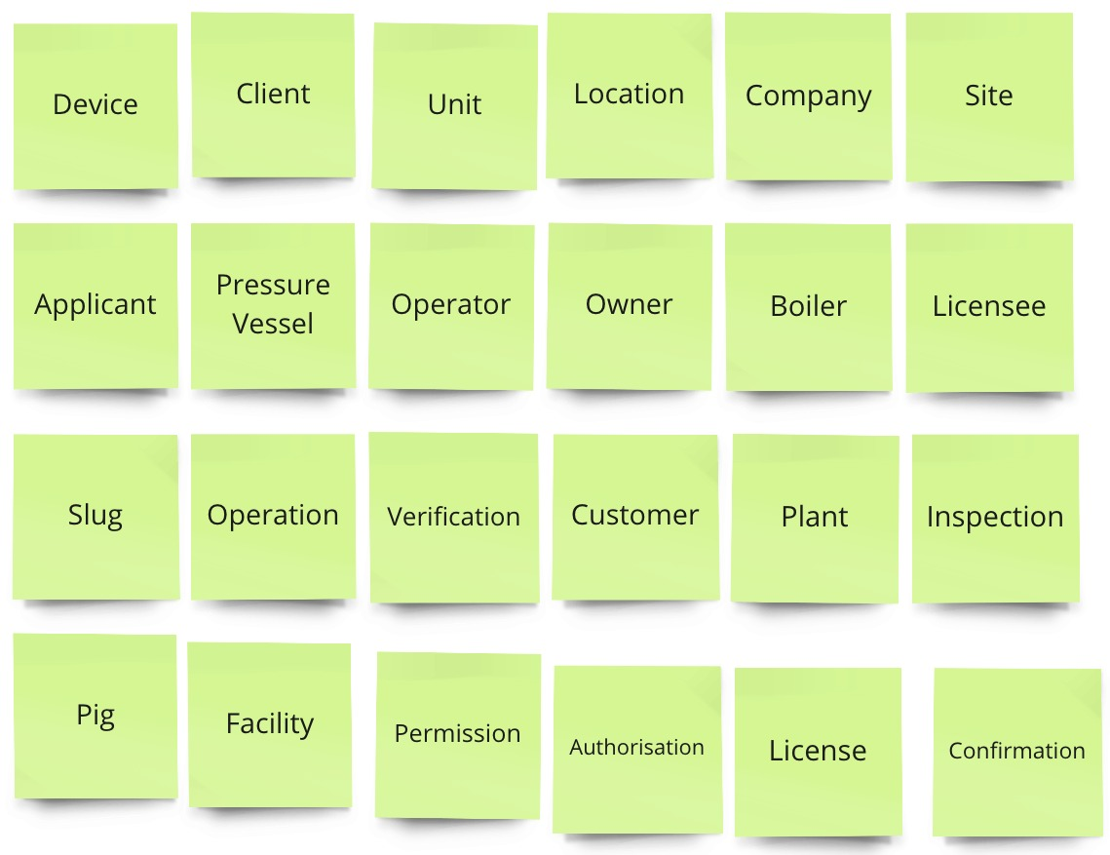
"Terminology Analysis" – usually a great place to start
From one-on-one interviews with 8-10 key stakeholders we gathered ~200 terms related to CSMP (Client Safety Management Program) – "anything that went by a name."
Here are 24 that met the criteria to be a "thing"– the candidate Business Objects.
To isolate the "things"
(Business Objects) we went through the 200 terms, each on a Post-it, and asked "Is this a…
…thing?"
…a fact about a thing?"
…or other stuff?"
(forms, systems, job titles, spreadsheets, activities, organisations, etc.)

Slide 12
3 – Identify synonyms and select a term to use for the initiative

Slide 13
4 – Agree on a "good enough" definition" and important constraints
Agreed terms
("core nouns" or
business objects)
Definition:
A CSMP Authorisation is a permission
(or license) to operate a
self-managed safety program
(a Client Safety Management Program)
at a specific Facility for a specified time period, usually 1, 2, or 5 years.
Constraint (Assertion):
The CSMP Authorisation is "all or nothing" –
it covers all the Units at a Facility.

Slide 14
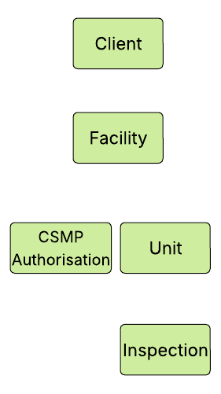
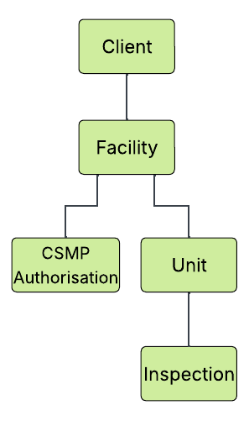
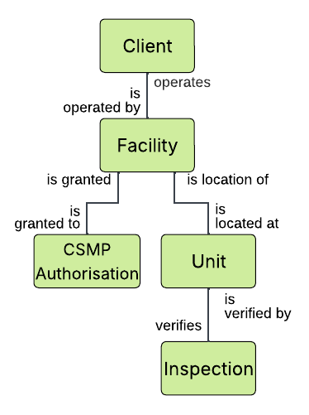
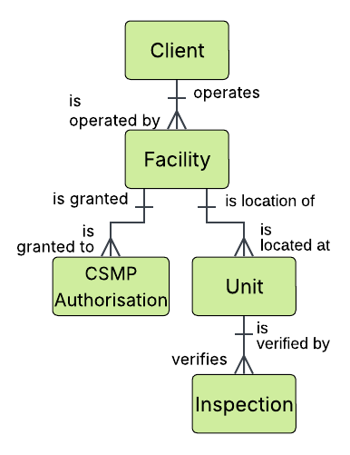
Business Object Model Version 1; not perfect, but a good start
5 – organise objects top-down by dependency
6 – add relationship lines indicating dependency
7 – name relationships in each direction
(verb-based!)
8 – only then add cardinality
(1:1, 1:M, M:M)
Step by step!

Slide 15
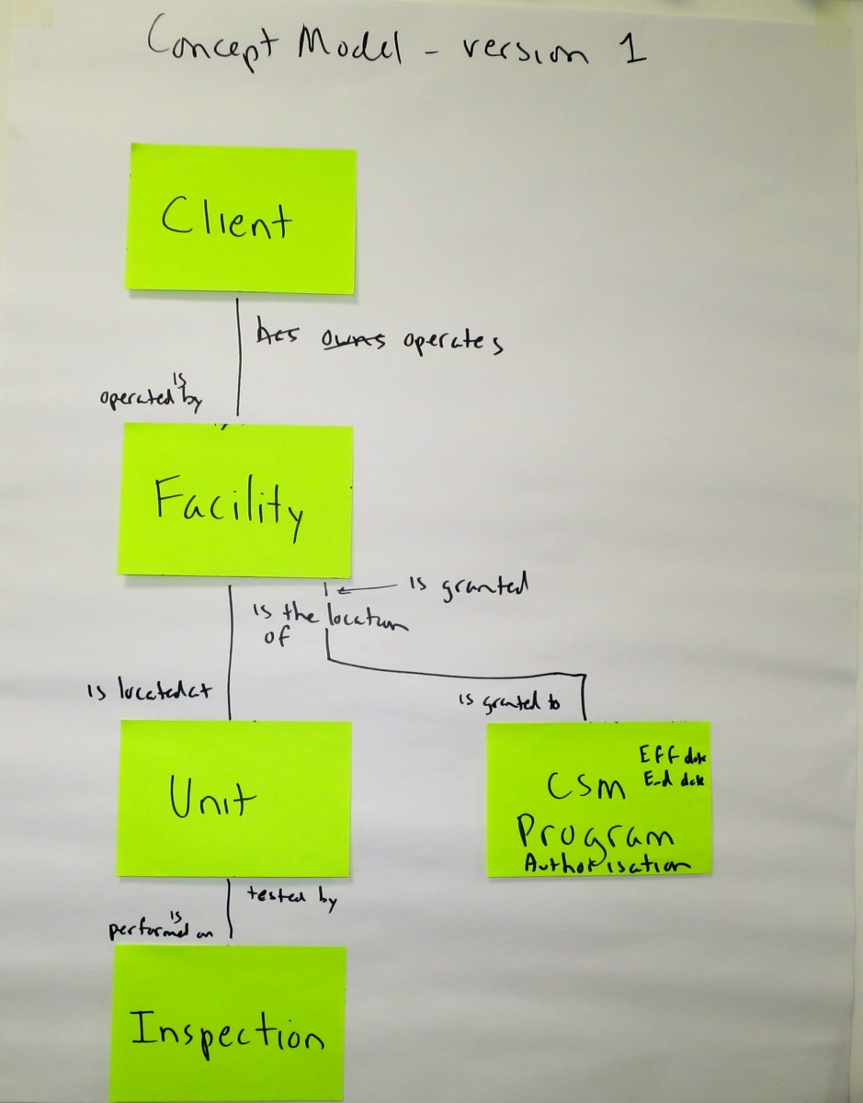
Just boxes and lines, but raises important questions
What do we issue
the Authorisation to?
Are Units permanently
part of one Facility?
What do we Inspect?

Slide 16
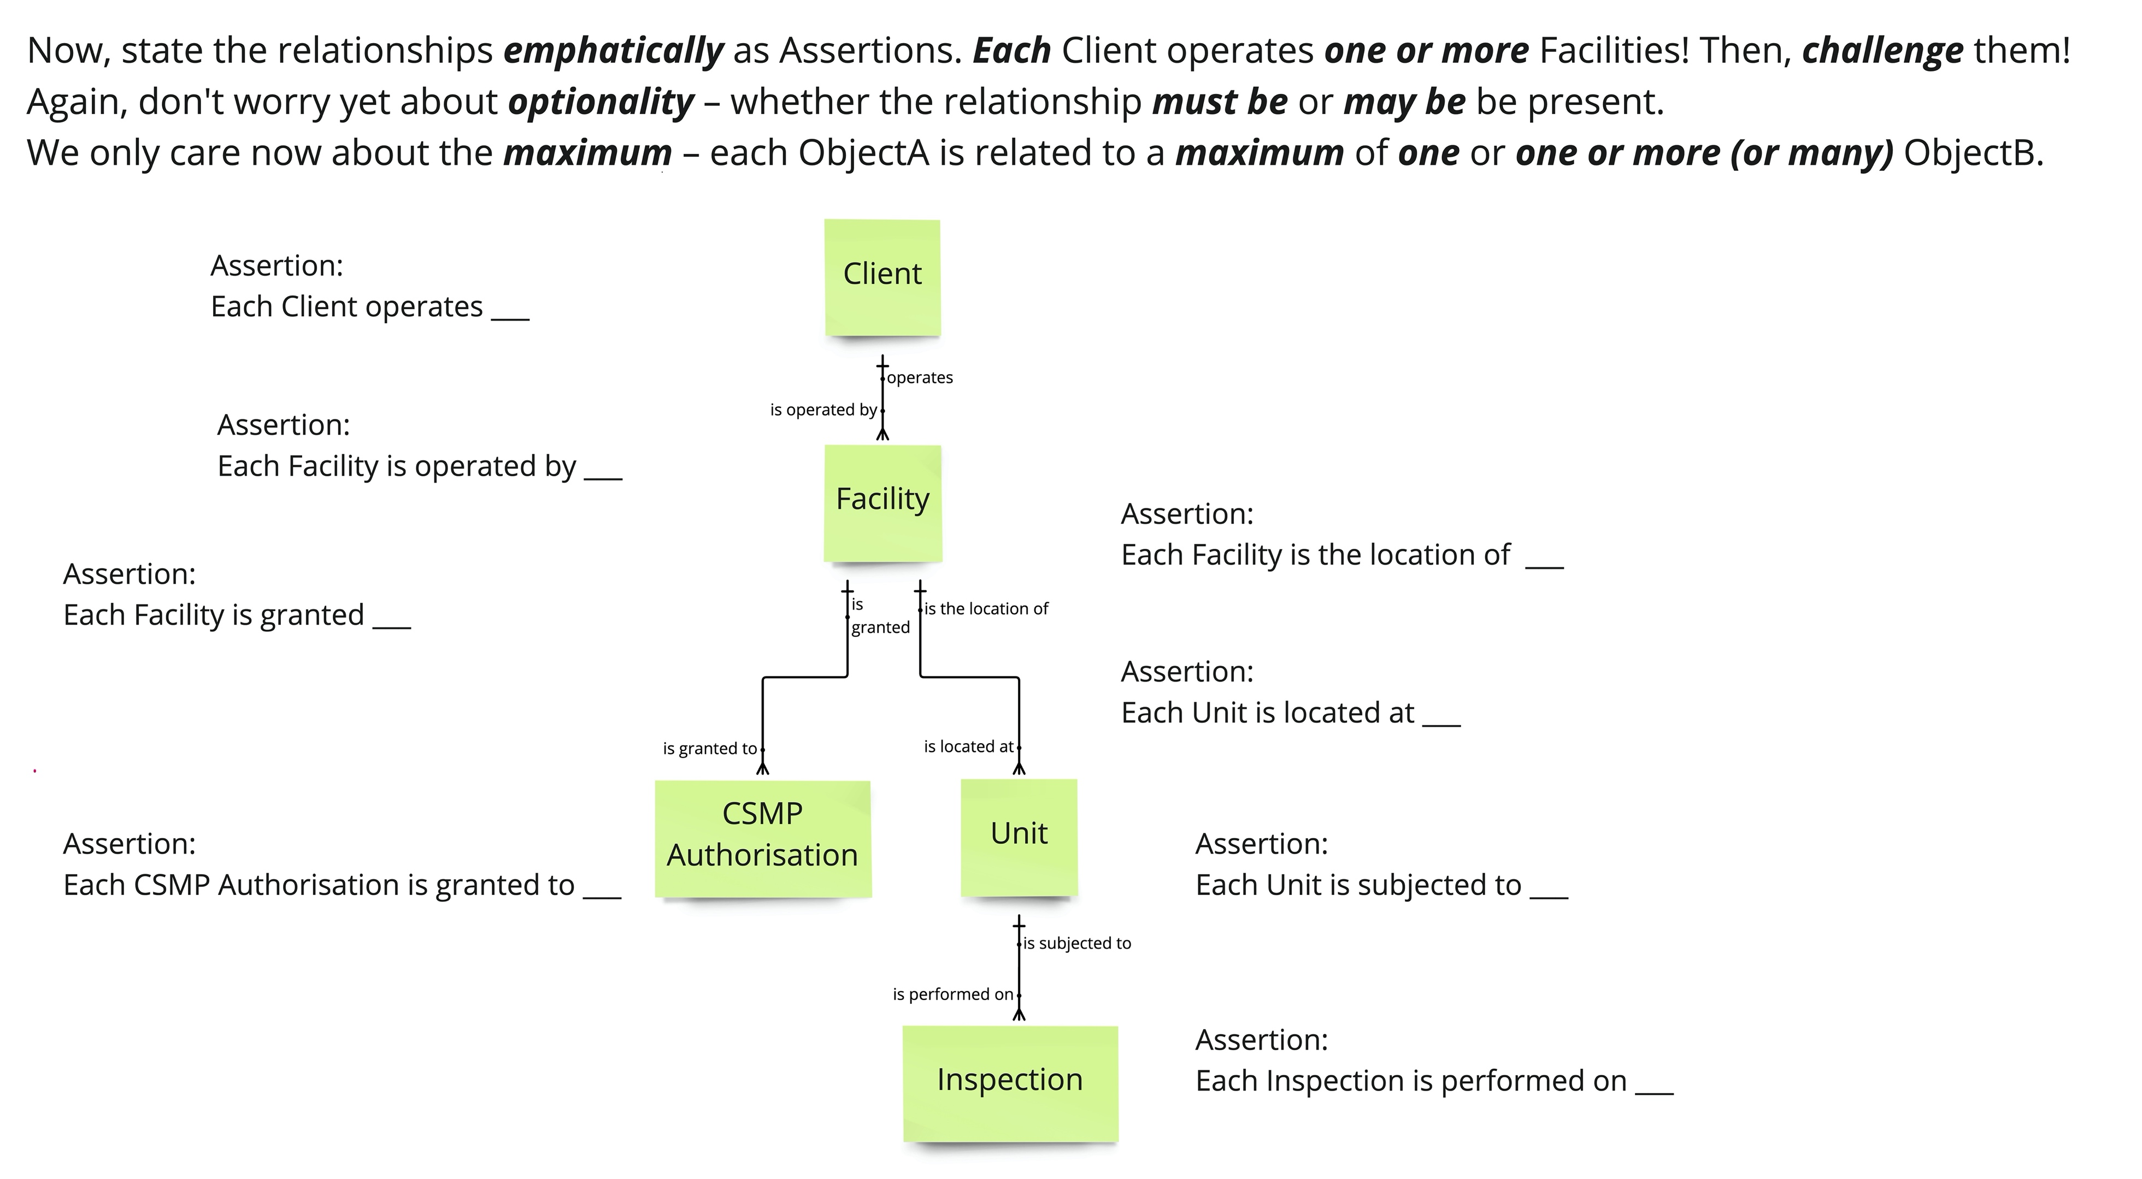
9 – State each relationship forcefully as an assertion, and challenge it

Slide 17
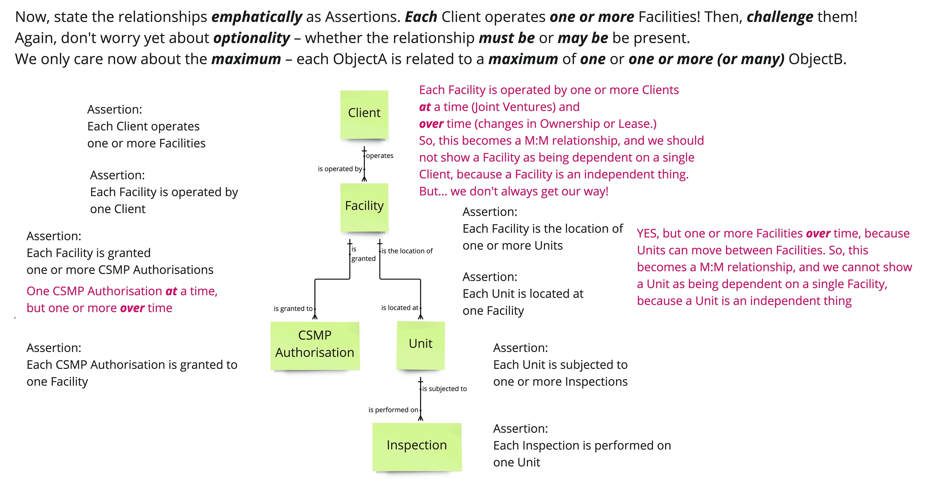
9 – Revised assertions from challenges

Slide 18
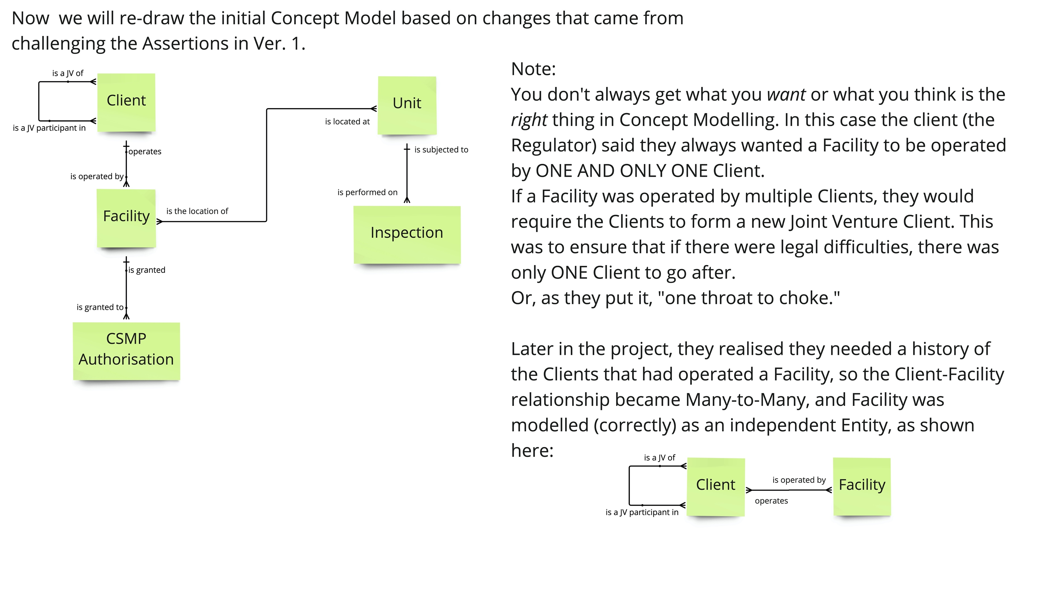
10 – redraw the Business Object Model based on revised assertions

Slide 19
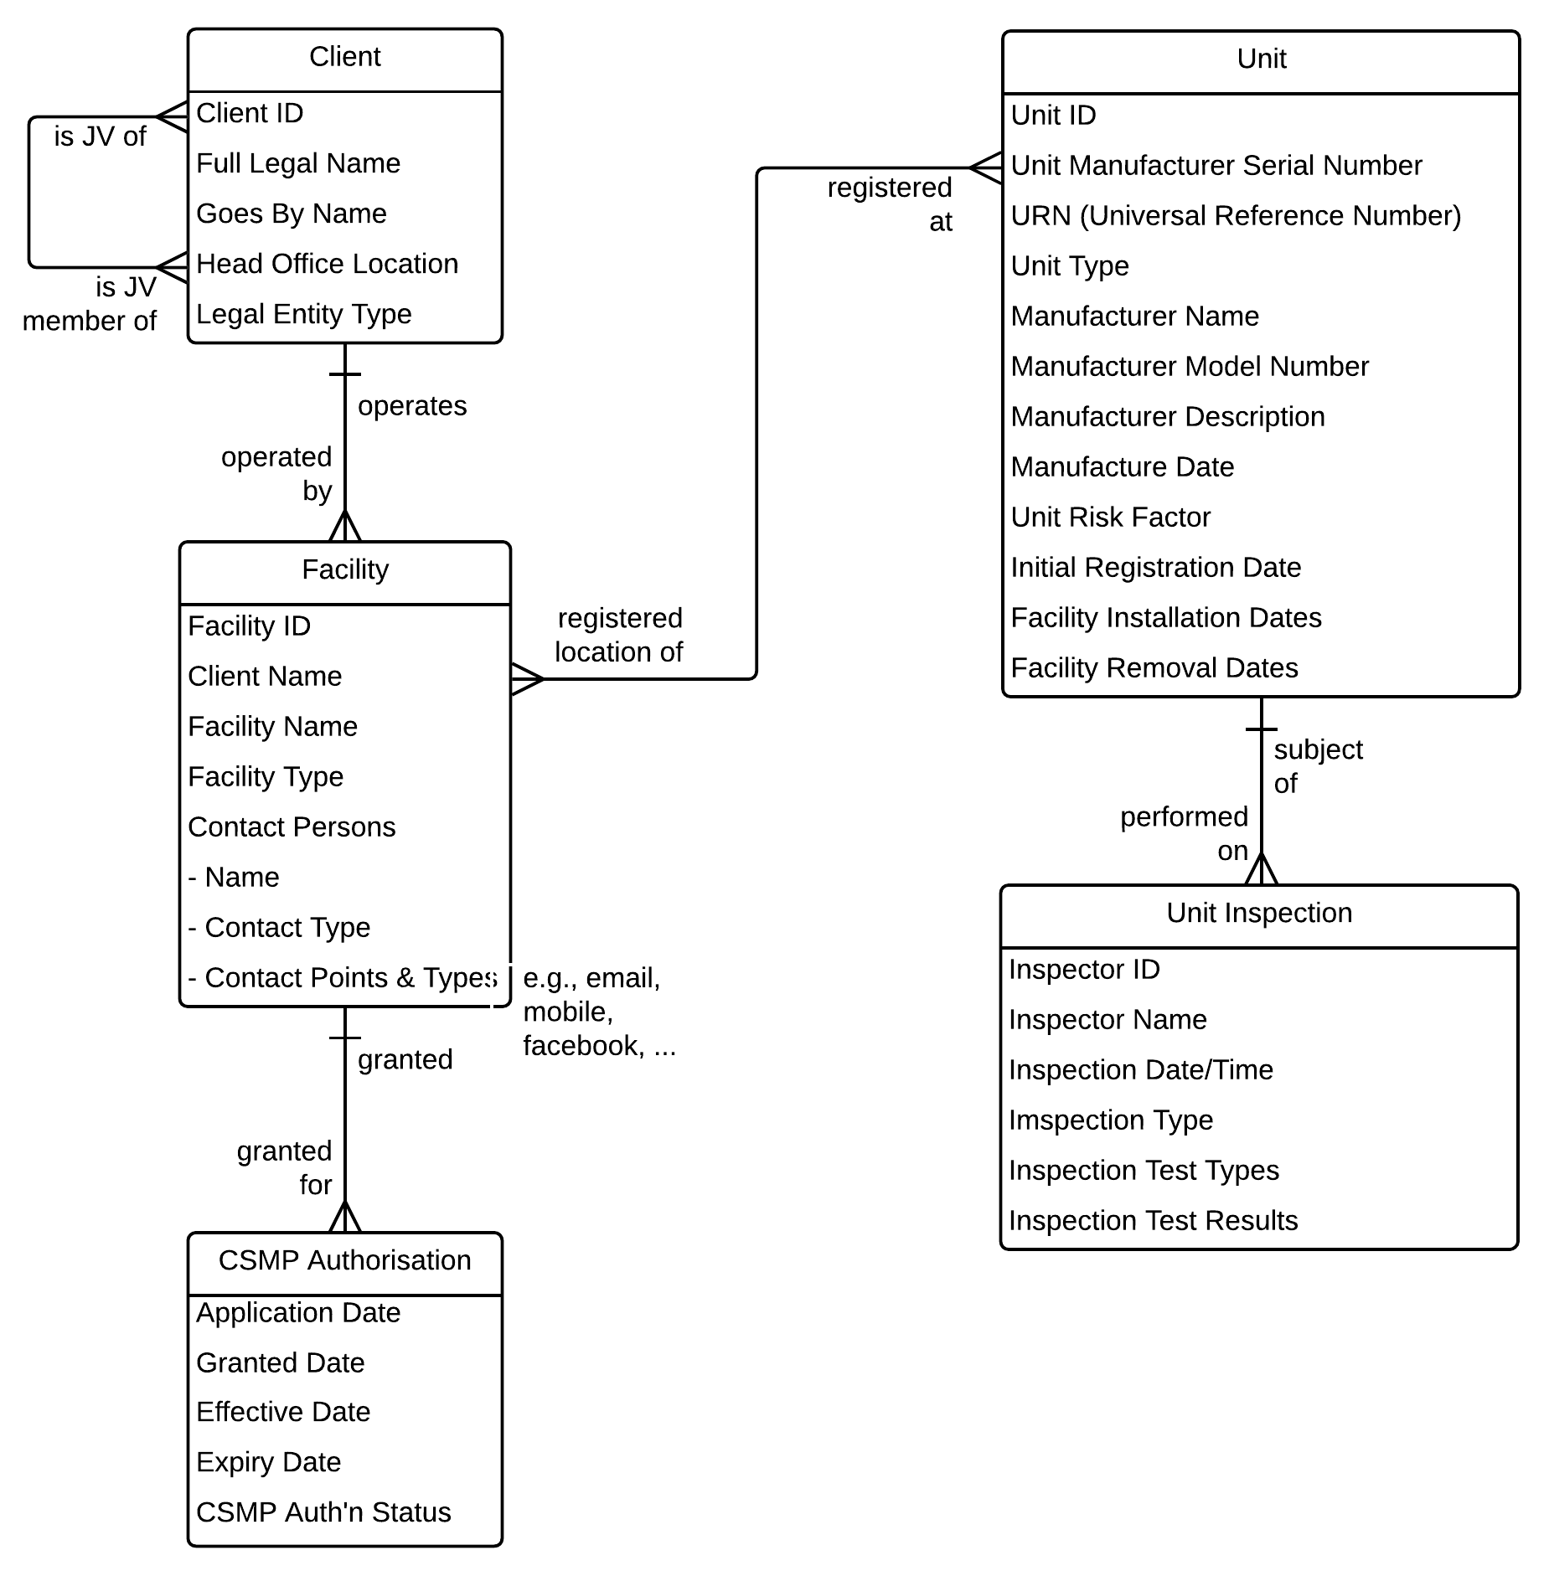
11 – Collect some (not all!) attributes
Sketching this out was fast, and raised important questions that had not occurred to the client!
Highlights:
Model took
~90 minutes
This was done initially without any data modelling terminology or symbols!
It's not perfect, but the businesspeople found it
extremely useful.
Don't worry now about "normalisation" at this point –
that is done in Logical Data Modelling.
Then, "Unit" will become at least 5, more granular entities –
Unit, Manufacturer, Manufacturer Make/Model,
Unit-Facility Registration, and Risk Factor.

Slide 20
12 – Identify Services (Events) then Use Cases / User Stories
Finally, we identified the necessary Services (verb-noun pairs) and Use Cases / User Stories that would access the Services. We developed high-level ("upper conceptual") descriptions to provide the vendor with core requirements and avoid a bulleted list requirements document.
Use Cases
Use Case or
User Story
- add Who and
How
Service Specification
(Events)
Service (or Event)
- add a Verb
to the Noun
Business Object
Modelling
Business object
or simply a "thing"
- a core Noun
These are the essential capabilities.
In Business Analysis "essential" means what with no reference to who or how
A Business Object Model is a great
starting point for discovering your
Services and Use Cases (User Stories)
Something I always do when evaluating/selecting COTS S/W

Slide 21
Note – "User Story" and "Use Case" are not so different
Different format and detail, but the same basic concept.
Initially, at the Scope level, they're much the same:
  User Story (who – what – why):
  "As a Client, I need the ability to Register Unit(s,)
  so I can maintain compliance with my CSMP Authorisation"
  Use Case: (who – what – how):
  "Client Register Unit via Portal"
  When we add detail at the Concept level, they become identical:
  User Story / Use Case abstract
  Main success sequence – dialogue in "when-then" format
  Alternate sequences – variations, exceptions, errors

Slide 22
Clarify scope of the new process and identify participants
Client Result:
Approval granted for a self-managed safety program.
Trigger:
Client submits request to
enter into
a CSMP
Grant Client Safety Management Program
Accept
CSM
Application
Audit
CSM
Program
Verify
CSM
Equipment
Determine & Collect
Equipment
Fees
Determine & Collect
Consultation
Fees
Issue
CSM
Authorisation
Main Activities (or Milestones, Phases, or Subprocesses)
Agency Result:
Revenue collected. New participant in CSMP; confirmation that regulations are satisfied
Cases:
New
Grandfathered
Ownership Change
Process Scope Model – pure “what”…
Applicant
Customer Service
Records Management
Safety Operations
Finance
Grant Client Safety Management Program
Accept
CSM
Application
Audit
CSM
Program
Verify
CSM
Equipment
Determine & Collect
Equipment
Fees
Determine & Collect
Consultation
Fees
Issue
CSM
Authorization
Main Activities (or Milestones, Phases, or Subprocesses)
Process Summary Chart – simplified “what,” plus “who”
Notes:
These are simple, painfully obvious diagrams, but are vastly under-utilised as a mechanism for showing gaps, conflicts, and disconnects between functions. A Process Scope Model helps people “let go” of current implementation constraints/assumptions, and whenever we first draw a Process Summary Chart (also called a “Process-Function Chart”) with a client, the reaction is “We sort of knew that, but we've never seen it put that clearly before.”
We call it a “Process Scope Model” when it doesn't show the functional areas, a “Process Summary Chart” when it does – it's the initial intersection of “what” and “who.” It clearly illustrates the cross-functional scope of the process
Don't forget external participants such as as Customers, Suppliers, Partners, Associations, or Regulators!
Excellent tool for organising analysis. E.g., list detailed activities, objectives, actors, etc. by Function or Main Activity

Slide 23
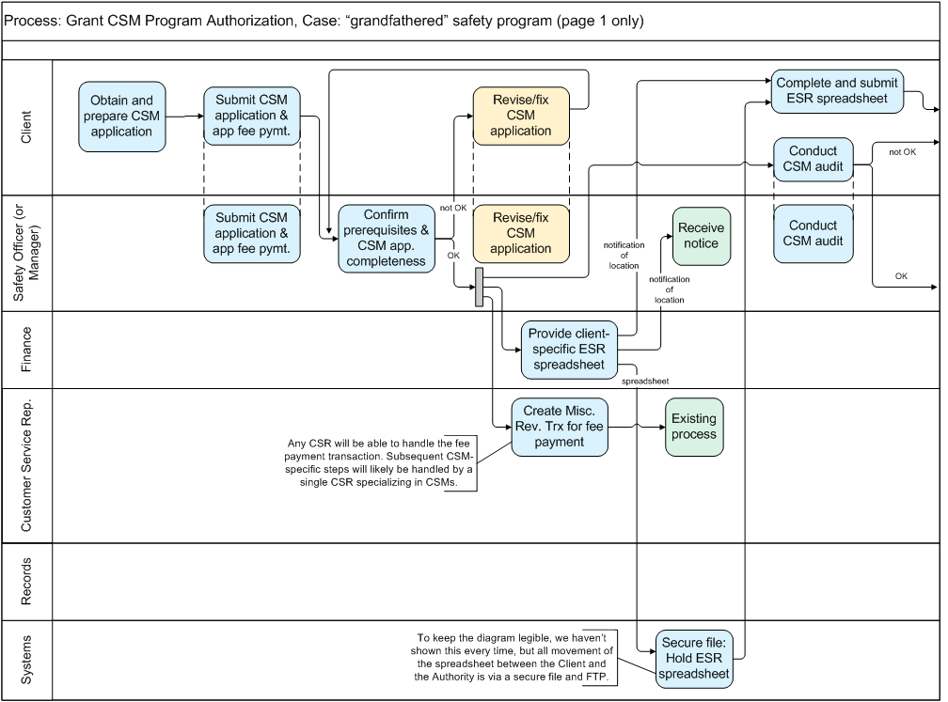
The initial, business-friendly workflow model
A “Handoff Level” workflow model
Notes:
The fact that these are physical models is frequently ignored or glossed over.
Some of these steps represent a LOT of work, but…
“In a handoff diagram,
whenever an actor holds the work,
whether they do a lot or a little,
draw one box and move on.

Slide 24
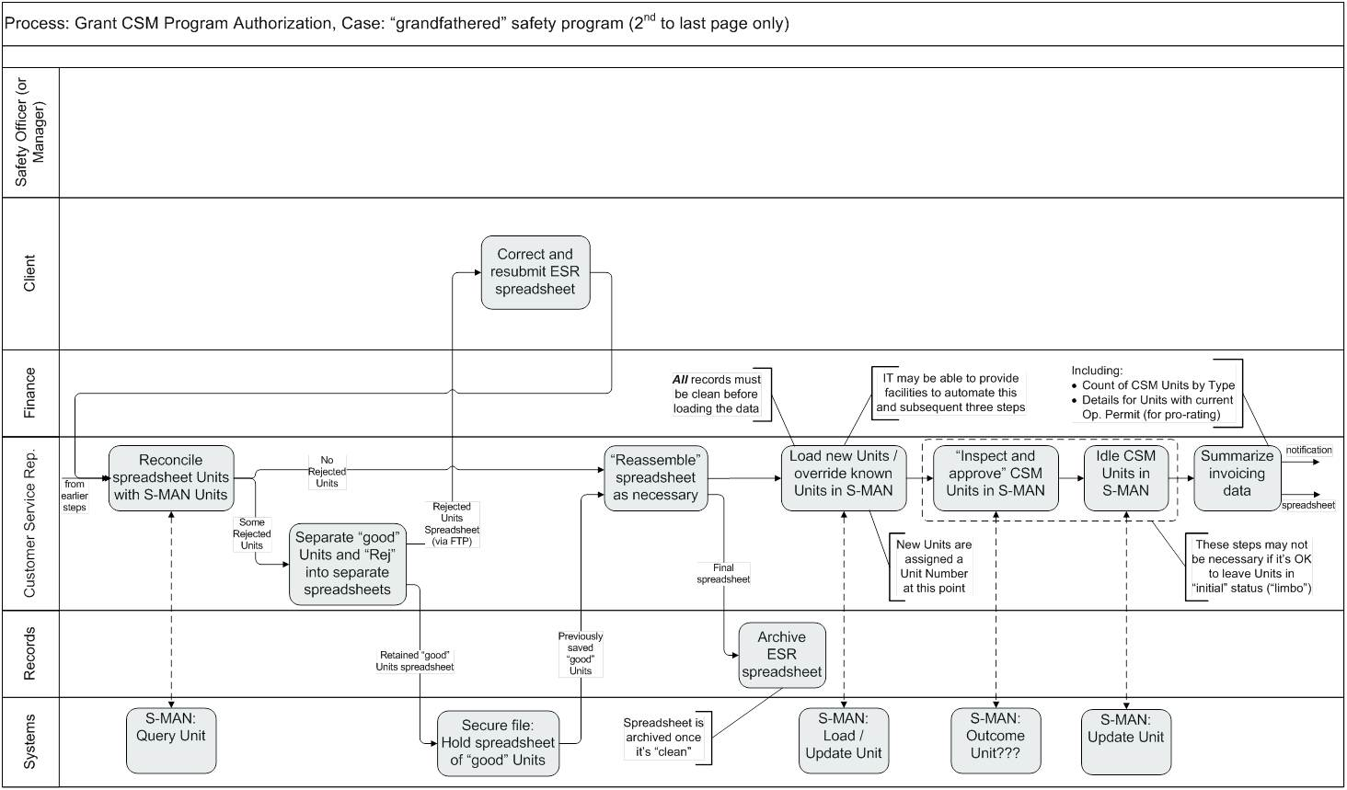
Then detail showing where use cases & services fit
A “Service Level” workflow model
3) …by interacting with
1) This Actor (or Role)…
2) …completes this Activity…
That's a Use Case!
- an actor
- interacting with a system
- to obtain a service
- to help them complete a task or obtain information
is what we mean by a
Use Case
(which may begin as a User Story)
4) … this Service offered by a System
Notes:
This shows how this style of diagram pulls together process workflow, use cases, and services.
“Actor – Service (verb-noun) – Platform” forms a Use Case – “Customer Service Rep Idles Units via S-MAN”

Slide 25
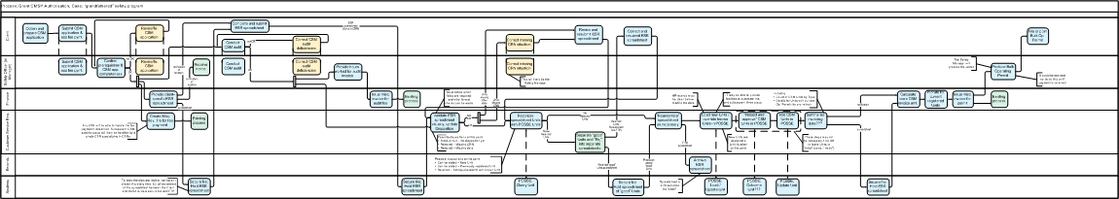
Mission accomplished! Conclusions:
  "Plan A" rejected – agreement that Unit data must get into S-MAN
  “Plan B” (change the app) looks good, but the vendor estimates are HIGH
  “Plan B Minus” (existing functionality plus CSR work) is worth the cost
If requirements, issues, assumptions, etc. are in lists, people will argue endlessly; if they are in an integrated and understandable set of models,
it’s much harder to dismiss the reality of the situation
Process Models, Use Cases, Service Specs, & Concept Models: essential!
Notes:
Business Development Manager wasn’t thrilled, but accepted that this was a fact-based decision.

Slide 26
Data Models in an integrated, model-based framework
Framework Layer
Technique sample
What it covers
The Clariteq Framework for Business Analysis
Business Goals & Objectives
The university is initiating the “Strategic Enrollment” program to raise Student graduation rates in part by ensuring Classes are available for Student registration when needed.
Project Charter – documents the rationale, objectives, scope, and success measures for the project
This is not a sequence!
Business Process
Registrar's
Office
Generate Student Summary Report
Attach Reg Form and forward
Process Model - shows “what” in a Scope Model, then “who & how” in a Workflow Model – the steps done by the actors in the process
Business Process:
gives great context
for Business Analysis
Department Advisor
Check Reg Request for data changes
Register Student in Class
Presentation
Layer
(user interface)
When advisor enters five characters of Last Name
Use Case – models how an actor interacts with a system to obtain (trigger) a service, typically to
complete a step in a process
Then System lists matching Students
When advisor selects list item
Then System displays expanded Student view with needed Classes
Use Cases and Services:
where we capture Functional Requirements
When advisor etc.
Application
Layer
(rules & logic)
Register Student in Class
Service Specification - describes
a service – a package of rules and logic – that is triggered to complete or respond to a business event
Verify Student Status
Verify Student pre-reqs
Confirm Class availability
Create Registration
Input Message:
Student Number
Course ID
Class ID
Output Message:
Results
Data
Layer
(data & storage)
Course
Concept Model - depicts
the things and the facts about things the organisation needs to record;
the things (the entities) are what
processes and solutions act on.
Department
Instructor
Concept Model /
Data Model:
a great platform
for Business Analysis
Student
registers
in
Number
ID
Number
offering of
assigned
to
Name
Name
Rating Code
GPA
Class
Dates
Times
Locations
Notes:
Each layer interacts with others, forming an integrated set of techniques.
The benefits:
Divide and conquer
Everything in its place
Cross-validation
Other terms:
Presentation Services also known as Presentation Layer or User Interface
Business Services also known as Application Layer, Business Logic, Business Rules, Application Services, etc.
Data Management Services also known as Data Management Layer or Persistence Services
Not all methodologies address each perspective equally well.
Information Engineering was weak to non-existent in addressing the business process (workflow) and presentation (use cases) layers
Most O-O and Agile techniques don't address business process well, if at all

Slide 27
Everything relies on the Concept Model / Data Model
All use the language and constraints of the Concept Model (the “thing model”) – the ultimate “what”
Business Goals & Objectives
The university is initiating the “Strategic Enrollment” program to raise Student graduation rates in part by ensuring Classes are available for Student registration when needed.
Registrar's
Office
Use Cases/User Stories:
- Who (Actors) needs access to the Services, and how (Platform)?
Business Process
Generate Student Summary Report
Attach Reg Request and forward
Department Advisor
Check Reg Request for data changes
Register Student in Class
Presentation
Layer
(user interface)
When advisor enters five characters of Last Name
Use Case
actor + service + platform:
Advisor Register Student
in Class via SRS
Then System lists matching Students
Verb-Noun pairs:
- The Services (event-handlers) that are at the heart of a Service Oriented Architecture.
- Also "building blocks" of Business Processes
When advisor selects list item
Then System displays expanded Student view with needed Classes
When advisor etc.
Application
Layer
(rules & logic)
Register Student in Class
Service
verb + noun ( + noun):
Register
Student in Class
Verify Student Status
Verify Student pre-reqs
Confirm Class availability
Create Registration
Input Message:
Student Number
Course ID
Class ID
Output Message:
Results
Data
Layer
(data & storage)
Course
Entity
noun:
Class
Department
Instructor
The core Nouns or Things in your enterprise. Also known as
Business Objects.
Student
registers
in
Number
ID
Number
offering of
assigned
to
Name
Name
Rating Code
GPA
Class
Dates
Times
Locations
Bonus – great starting point to discover your
Events/Services and Use Cases/User Stories
Notes:
Key point – every type of model references the entities in the concept model, illustrating why concept modelling (conceptual data modelling) is a critical technique.
We often follow an “inside-out” approach, as illustrated here:
Discover the Nouns: things of interest, e.g. “Customer”
Discover “Verb – Noun” pairs: activities that must be performed (process, sub-process, service, …) in order for the enterprise to operate, e.g. “Register Customer”
Discover “Actor – Verb – Noun “ combinations: Use Cases or a steps within a business process, the intersection of all three, e.g. “Sales Rep Registers Customer”

Slide 28
With progressive detail, Concept Modelling supports Agile
Clariteq framework for analysis and architecture
Business Objectives
Project Charter: primarily “Scope” level - may evolve
Goals
Business Goals & Objectives
Scope
Concept
Detail
Process
Business Process
Process Landscape showing target and related processes, Process Scope Model, initial assessment and goals.
As-is (and later, to-be) Workflow Models for the process’ main variations (cases) to the Handoff level.
As-is Workflow Models to the appropriate detail, and to the Service level for to-be. Optionally, document procedures for manual to-be steps.
Process Modelling
Application
Presentation
Layer
(user interface)
List of the main Use Cases in the form: Actor + Service + (optionally) Technology / Platform
(named only.)
Initial Use Case Modelling (goal, stakeholder interests, use case abstract) for each Use Case. May include initial dialogs.
Use Case dialogs in “when-then” format, annotated, and including alternate sequences. Optionally, Use Case Scenarios.
Use Cases
List of main
Business Services
(named only.)
Initial Service description - result, main actions, cross-referenced to Concept Model
Each service fully documented, including input/output messages, validation, business rules, and data updates to the attribute level.
Service Specification
Application
Layer
(rules & logic)
Data
Data
Layer
(data & storage)
Contextual Model (optional) and a glossary defining the main entities and other important terms.
Concept Model (Business Object Model or Conceptual Data Model) with main entities, relationships, attributes, and rules.
Fully normalised Logical Data Model with all attributes fully defined and documented.
Concept Modelling
Plan
Understand
Specify
The "Agile Zone"
Notes:
Model-based techniques go through three progressive levels of detail, each serving a different audience and purpose
On a smaller project, the same person might work on all perspectives at all levels of detail; the larger the project, the more likely it is that different, specialised roles will be involved.
The reason that the “concept” level is important, and that we don't dive right into the “detail” level is that…
…the level of precision, rigor, and detail that you need in order to build something
is far greater and different in nature than that which is necessary for the business person to know if they're going to like what you build!
The idea of these progressive, well-defined levels of detail is something that largely fell by the wayside during the last few generations of silver bullets:
client server
web-based applications
packaged solutions (“COTS” – Commercial Off-The-Shelf)
RAD, XP, and other Agile methodologies
…

Slide 29
Techniques and methodologies
The same techniques are used in different sequences,
with different emphasis, in different situations.
Concept Modelling to clarify language is a great starting point.
Larger project (enterprise-wide, cross-functional): process-oriented / “outside-in” –
Project
Scope & Objectives
Initial
Concept Model (vocabulary)
As-is
Business
Process Models
To-be
Business
Process Models
Business Service Specifications
Use Case Models
These are typical overall flows:
there are many variations
there is always much iteration
Refine Concept Model & Logical Data Model
Smaller project (local, departmental): service or use case-oriented / “inside-out” –
Project
Scope & Objectives
Initial
Concept Model (vocabulary)
Business Event Identification
Business Service Specifications
Use Case Models
To-be
Business
Process Models
Refine Concept Model & Logical Data Model
Notes:
In general, you will start with:
Scope and objectives (Project Charter)
Agreement on a fundamental vocabulary
(a little Data Modelling or “Concept Modelling”)
Large projects are best handled “outside in”
Start with an understanding of the overall process then the jobs or departments that are involved (Process Scope Model and Process Summary Chart) and then, as needed, the "flow of work" in a Process Workflow Model (Swimlane Diagram.)
Then identify steps requiring automated support – Business Services and Use Cases
Small projects are often best handled “inside-out”
Start by identifying the main objects the system will deal with (Concept Modelling)
Then identify the events and services that act on the main objects (Events, Service Specifications, State Transitions)
Then identify how these Services will be invoked (Use Cases, then overall Process Workflow)

Slide 30
A blank slide to maintain balance and page numbering

Slide 31
Overview and logistics
Æ | Fundamental and Advanced Topics
Introduction and Level-set Issues, Principles, Hands-on Case Study Essentials of Concept Modelling Transition from Conceptual to Logical, and Logical to Dimensional Interesting Structures Types vs. Instances Recursion, Subtyping, & Generalisation Meeting New Requirements Modelling Time, History, & Change Rules on Relationships and Associations Multi-way Associatives & Complex Rules Advanced Normal Forms (4NF & 5NF) Presentation Techniques for Data Modellers Core Techniques for Presenting A Real-life Example

Slide 32
The basics: ERA – Entities
Weddings
  An entity is a distinct thing the business needs to know about -
  a person, place, thing, event, concept, or organisation, and…
  is named with a singular noun that implies a single instance
    not a plural or collective noun, list, set, collection, report, etc.
    we can discuss “one of them,” e.g. "Weather" is not a good name
  has multiple occurrences (or instances)
we need to and can keep track of (differentiate) each occurrence
  has facts that must be recorded, e.g.
    Student attributes: Number, Name, Birth Date, Major, GPA, …
    Student relationships: “majors in” Subject, “enrolls in” Section
  is acted on by processes, so they make sense in a “verb-noun” pair
  refers to the essence, not the implementation –
  the most common error is to identify artifacts
  (forms, reports, spreadsheets, …) as entities!
  Named - a business-oriented noun / noun phrase
  Defined - “What is one of these things?” or
  “What do you mean by ________?”
Staff
Marriage
Laws
Employee
Regulation
“event”
“person”
Inventory
“concept”
Locations
Corporate
Structure
Part
Site
Department
“thing”
“place”
“organisation”
Two basic types
Independent
- can stand alone
- no relationships “on top”
(no parents)
Dependent
- must have one or more parents –
one or more relationships “on top”
to parent(s)
These are the ones our business partners often struggle with.
Notes:
An occurrence is also referred to as an instance.
To check that we are dealing with single occurrences, the question “What is a (entity name)?” or “What is one of these things?” may help.
E.g.
“What is an Inventory?” doesn't sound quite right - the singular “What is an Inventory Item?” sounds better.
Similarly, “What is a Product Price History?” sounds alright, but it doesn't refer to a single thing (a Product Price) it refers to a collection or list of things (a History.)

Slide 33

Naming and definition – the essence of Concept Modelling
Agreement on naming is essential – entities are the nouns at the heart of business language. They are what processes act on, applications manipulate, databases record,
and BI & analytics tools provide info about.
So, organisations need a common language more than ever, for…
Data integration (data lake, data mesh, data fabric,
data virtualisation, data warehouse, …)
SLMs (Small Language Models vs. Large)
Mergers/acquisitions/partnerships/…
Business analysis – most requirements can't be stated without using a term from the Concept Model
Performance measures, e.g., KPIs
Note – it works best if you don't start by talking
about Concept Modelling or Data Modelling…
“Now! That should clear up
a few things around here!”
Notes:
Also works best if you do it in conjunction with other business analysis (process and requirements modelling) – the world has gone parallel/Agile, and there is less tolerance for standalone data modelling activities that are a serial step in the process

Slide 34
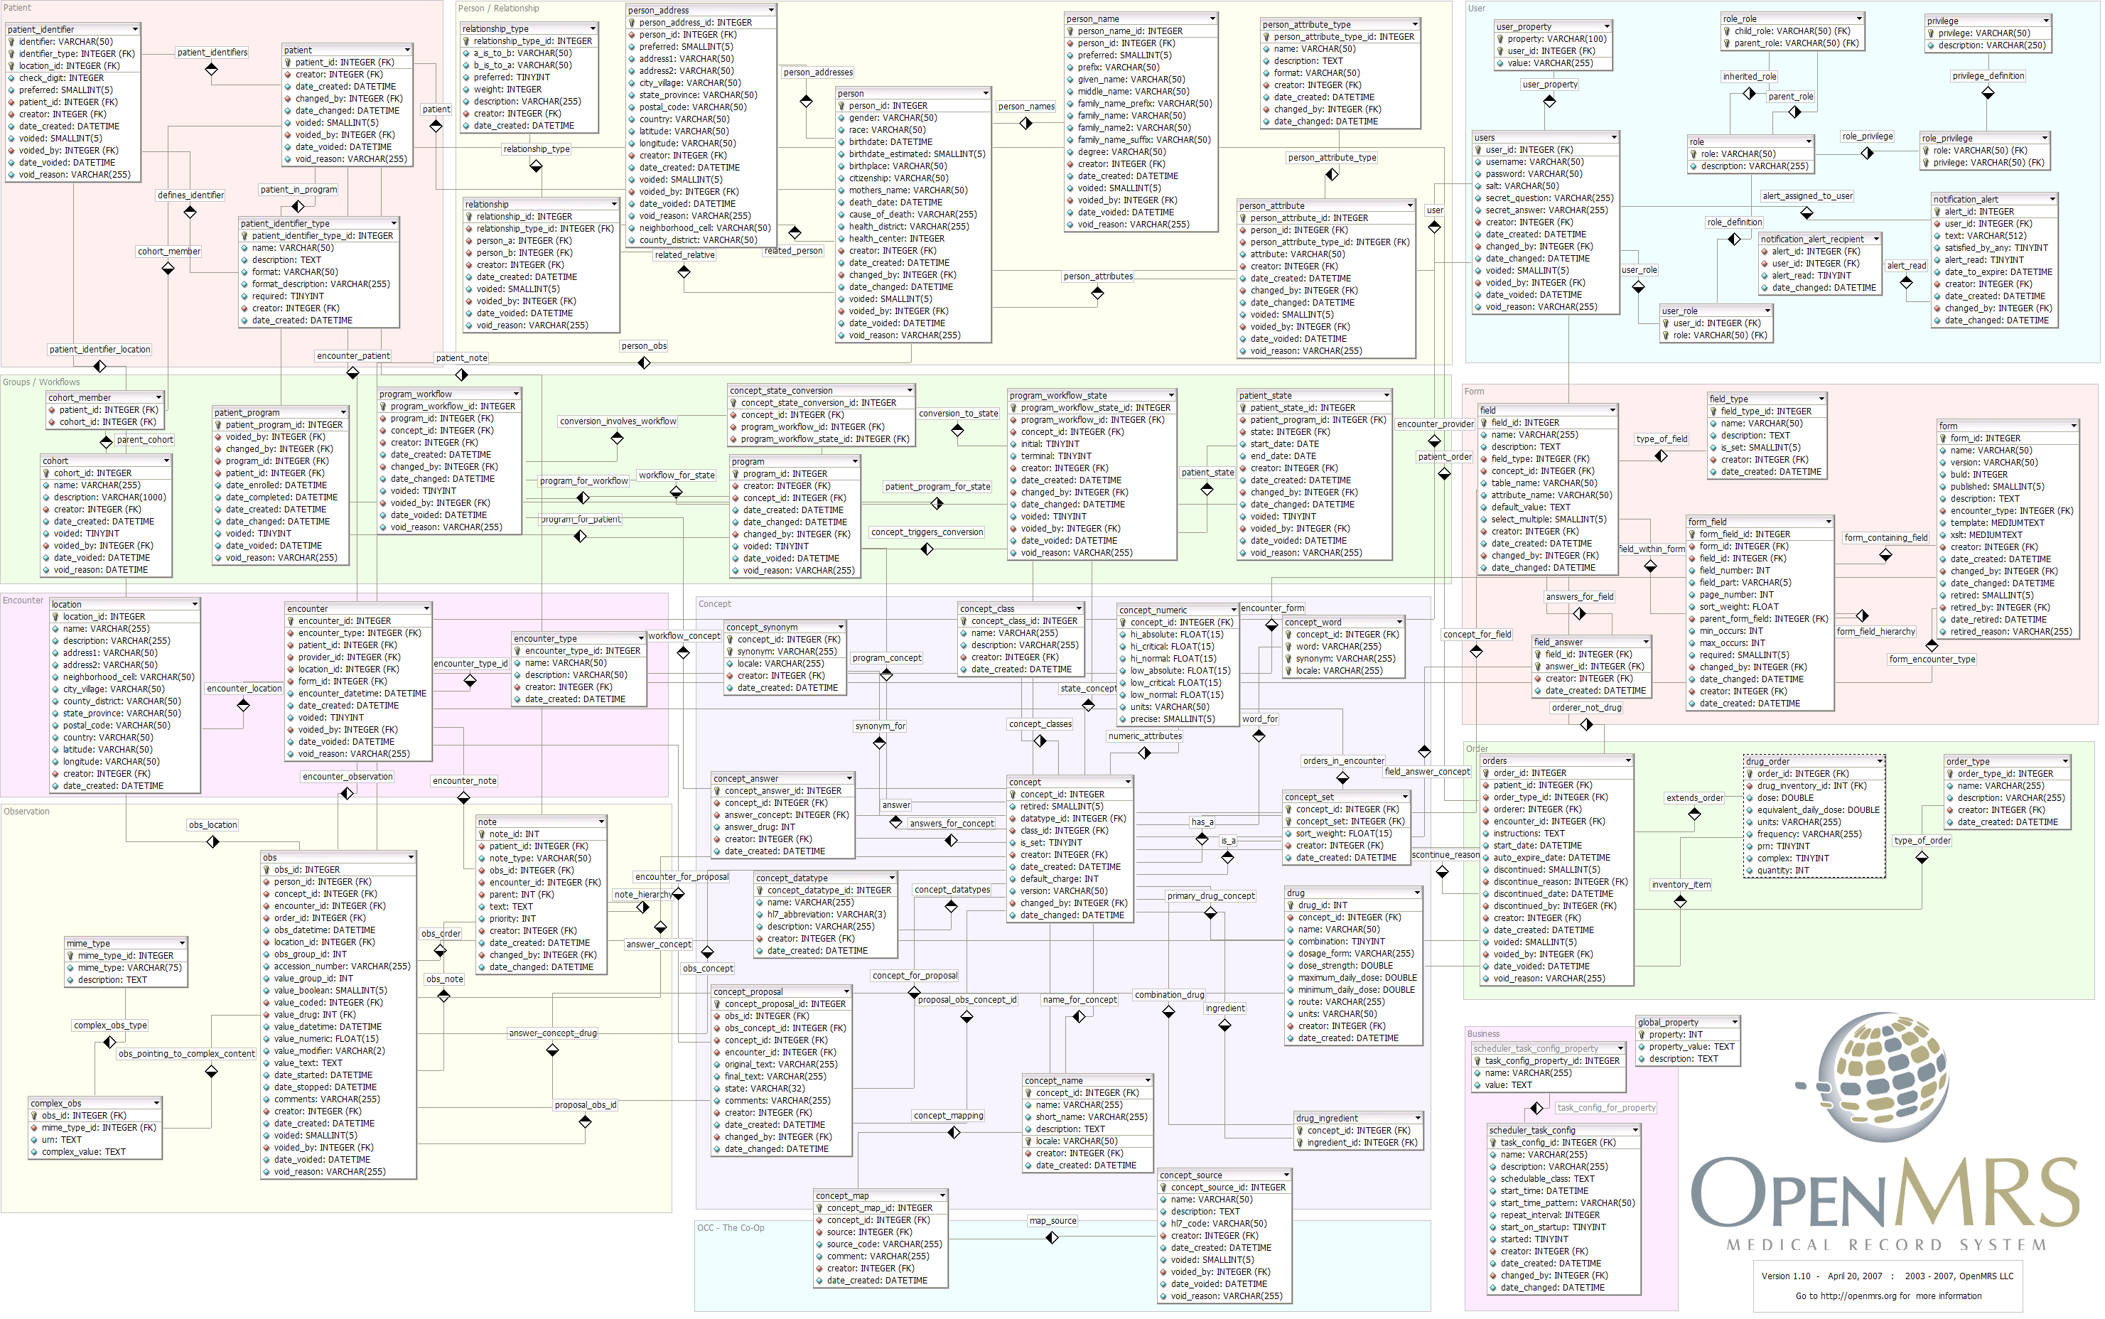
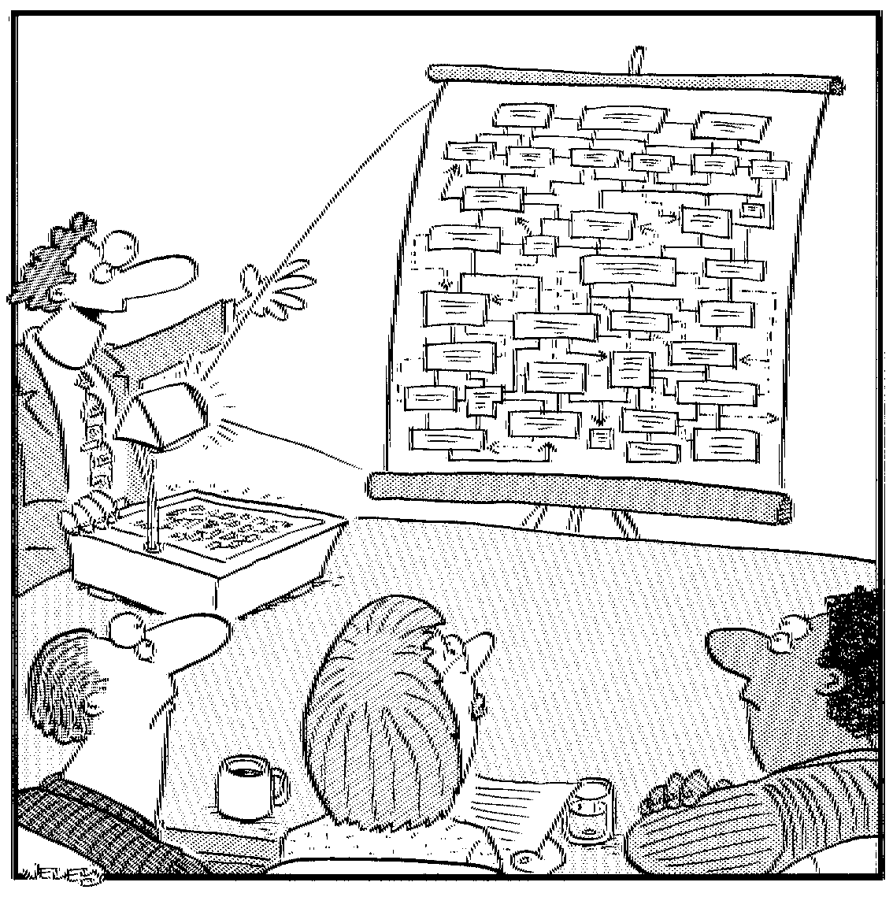
Concept Modelling principles
Models should:
Mask unnecessary detail
Highlight what matters
Use visual cues consistently
We will focus on:
Directionality
(top-down by dependency)
Simplicity and abstraction
Minimizing graphic "widgets"
“Let's start here with
Special Tax Rate Variation Comment Type…”

Slide 35
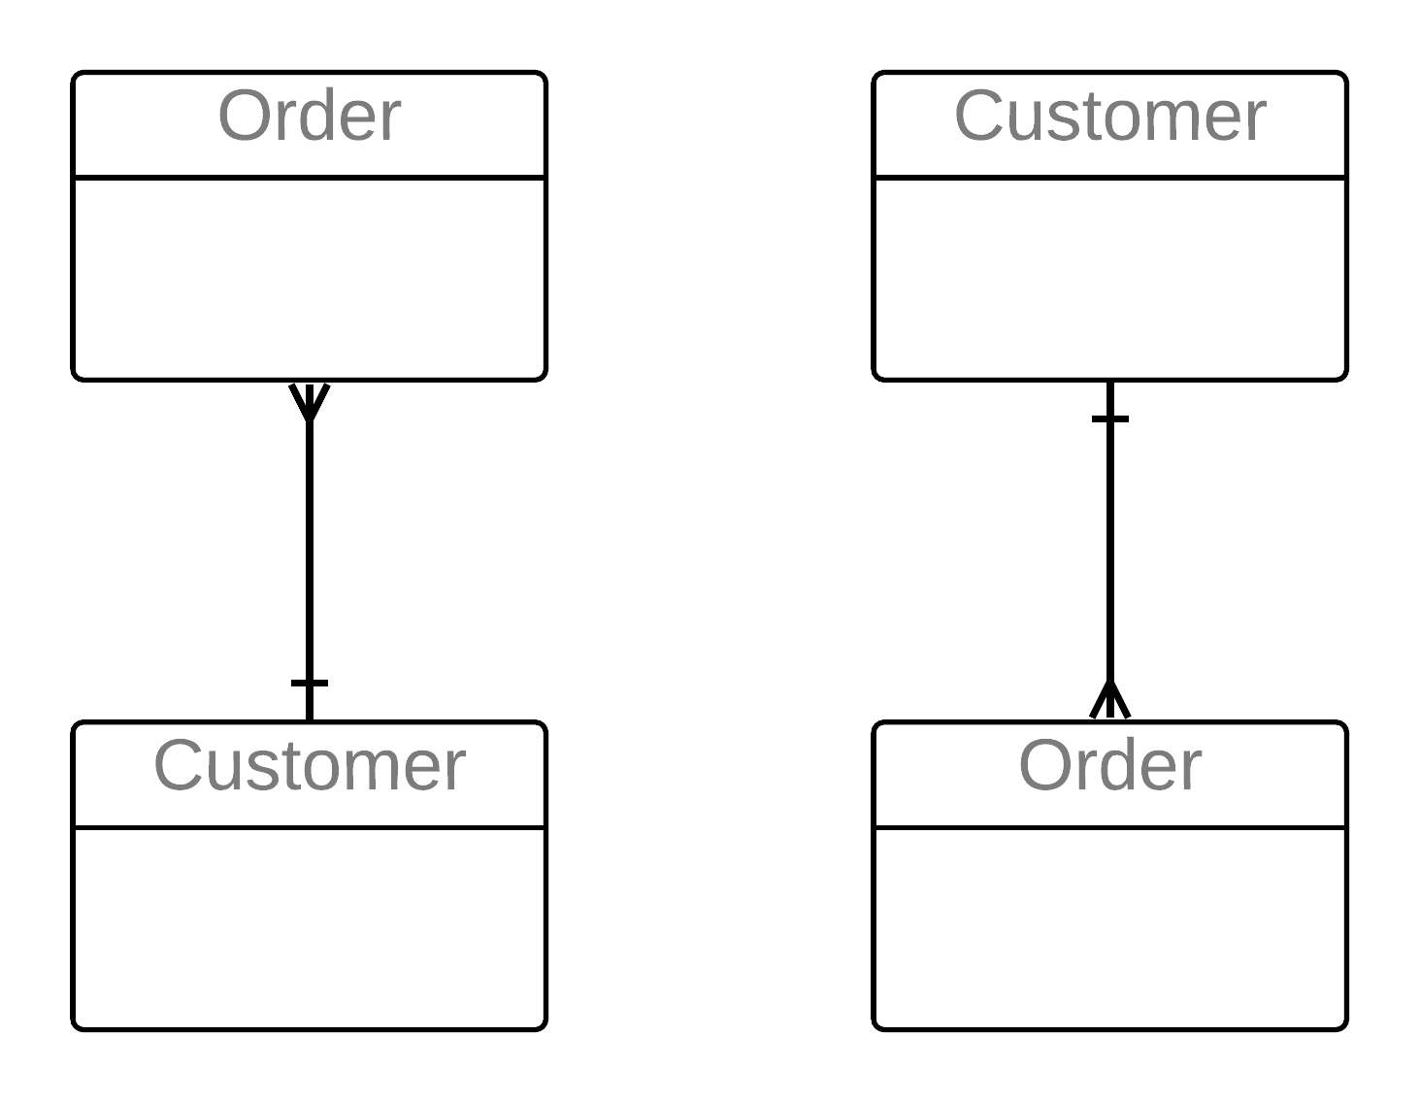
The basics – ERA – Relationships
An association between Entities that the business must keep track of
Named in both directions
  verb-based phrase
  the line tells us they are related,
  the name tells us how
Different types of relationships
  parent-child or characterising – “bottom to top” relationship
  from an entity to a dependent entity (1:M)
  associating – “side to side” relationship
  between entities that are not dependent on one another (usually M:M)
  classifying – “side to side” relationship
  from reference data to the classified entity
  (seldom shown in the Concept Model)
Dependency is shown top down – No Dead Crows
Relationships have rules
  cardinality – 1:1 (almost certainly wrong,) 1:M, M:M
  optionality – relationship may be present or must be present
  (not shown until later, in the logical model)
3
2
1
❌️
✔️

Slide 36
Relationship cardinality (maximum cardinality)
A kind of “business rule”
that applies to relationships
Organisation
Unit
Job
Category
classifies
One
Many
(One or More)
is contained
in
contains
is classified
by
Building
is the location of
Position
followed
by
is filled by
Employee
is located at
List Item
fills
Each Building is the location of
a maximum of Many Positions
(or, ... One or More Positions)
Each Position is located at
a maximum of One Building
follows
One to One (1:1) relationships in a
conceptual or logical model are almost invariably an error except in recursive relationships.
To determine cardinality, first name the relationships properly, and only then:
  for each entity, ask
  “Can one of these be related to a maximum of One of the other or a maximum of Many of the other?”
  record the answer (One or Many) at the “other” end;
  "One or More" works better for businesspersons than "Many"
  possibilities – 1:1 (error), 1:M (common), M:M (more work, eventually)
Notes:
Some methods use the term “multiplicity” instead of cardinality.
Check for cardinality of “One at a time, Many over time”;
if so, the diagram will always show “Many”
record the “One at a time” rule in “Constraints” or “Additional Business Rules” for the entity; enforce the rule with program logic
a common example for Characteristic and Associative entities:
“Under a given parent (or parents) only one instance at a time can be active, so Effective Date Range (“Effective Date” to “End Date”) must not overlap.”

Slide 37
Relationships – state as assertions
You must state the relationship name as an assertion,
in both directions (for clarity and confirmation)
Be clear on whether cardinality is “one” or “one or more” (don't worry about “may” and “must” at first)
Emphatically begin the assertion with the word “Each”
Try it on this model…
Each Instructor teaches one or more Classes
(Sounds good…)
Each Class is taught by one Instructor…
Course
Department
teaches
Number
Instructor
Credit Hours
Student-Class
Course-Class
Instructor-Class
Room-Class
Which ones might be incorrect?
Description
Number
Pre-requisites
Name
offered via
Student
offering of
taught
by
Room
Number
enrolls in
Class
Number
Name
Days
Times
Rooms
location of
Building
Address
is enrolled by
Seating Capacity
Major
located in
Equipment
GPA
Note –
A Class is a scheduled offering of a Course during an Academic Time Period, e.g. a Semester or an Academic Year.
During an Academic Time Period there may be one or more Classes for a Course.
Each Class is held on specific Days (e.g. Monday & Wednesday,) at specific Times (e.g. 10:30-11:30,) in specific Rooms (e.g. AQ3100 & CC7232.)
Notes:
Entity definitions and uniqueness constraints are also assertions.
Note that you can't challenge or confirm an assertion unless the terms have been clearly defined. The above example requires that we understand what is meant by:
an Instructor
a Class
“teaches” and “taught by”

Slide 38
Discussion – state as assertions, identify incorrect ones
Math 100
Course
In some universities, Students in the same Class could be earning credit for different Courses – it could be a M:M relationship.
Department
teaches
Number
Instructor
Credit Hours
Description
Number
Pre-requisites
Name
is offered via
Each Class is taught by One or More Instructors. On what basis?
team teaching
backup
replacement
specialist
guest lecturer
lab assistant
teaching assistant
…
We are discovering reference data to describe an Instructor's Role.
All of this has an impact on the Business Process! It's easier to resolve these rules before working on the Process.
Student
is an offering of
is taught
by
Room
Number
registers in
Class
Number
Name
Days
Times
is the
location of
Building
Address
is registered by
Seating Capacity
Major
is located in
Equipment
GPA
Math 100, Class 3,
Spring Semester 2022
Student-Class
Each Student registers in one or more Classes
Each Class is registered by one or more Students
Course-Class
Each Course is offered via one or more Classes
Each Class is an offering of one Course
Instructor-Class
Each Instructor teaches one or more Classes
Each Class is taught by one Instructor
Room-Class
Each Room is the location of one or more Classes
Each Class is located in one Room
P
? – depends on Policy
❌️
One or More Instructors
❌️
One or More Rooms

Slide 39
The basics: ERA – Attributes
Eventually, in the logical model, an entity will contain only base / fundamental / essential attributes:
an essential fact about that thing (entity)
not multi-valued
not redundant
(a redundant attribute is an attribute that is really an essential fact about a different entity, so its value is recorded multiple times, redundantly)
and not derived or calculated from other attributes;
otherwise, clearly flagged "derived"
A fact about an entity recorded as a piece of data.
If facts are needed about a relationship,
we will later (in the Logical Data Model) create an entity that represents the relationship and records its facts
Like Entities, attributes are named and defined
Not every possible fact – just the ones we need
Have properties that we address during the transition from Concept Model to Logical Data Model
  base or fundamental attribute
  single-valued vs. multivalued –
  one attribute can have multiple values,
  at a time or over time
  fundamental vs. redundant –
  the same value is recorded multiple times
  in different entities
  “user-entered” vs. constrained –
  attribute can only come from a limited set,
  as in a drop-down list
  Traditionally alphanumeric data; now includes richer types e.g., retinal scan image or voice audio clip
1
2
Contact Points
E.g., Mobile Number,
Office Telephone Number. Facebook ID,
LinkedIn ID, …
3
4
2
Notes:
Another property – base or fundamental vs. derived – the value of a derived attribute can be calculated from other attributes and/or relationships.

Slide 40
Summary – three types of data models
A more detailed version is on Page 74
Different levels of detail support different perspectives
1
2
Conceptual (Overview)
3
Logical
(Detail)
Contextual
(Scope)
Context model
Agreement on “big picture,” context, and some vocabulary
A block diagram of “subject areas,” higher level than individual entities
Shows the scope or “footprint”
Optional –
not useful on smaller projects
Concept Model
Agreements on basic
concepts, vocabulary,
and rules
Logical Data Model
Complete detail for physical design
Some important differences
Main ("recognisable") entities only - a singular noun used daily
Main attributes only, many are non-atomic
M:M relationships
Doesn't show keys
Not normalised
A “one-pager”
All granular entities – many too detailed to come up daily
All attributes included,
all are atomic
All M:M resolved
Shows primary & foreign keys
Fully normalised
Five times as many entities
My most plagiarised diagram ever!
Notes:
By “granular entities,” we mean the entities are “fully normalised” – in their most precise, non-redundant, high-integrity form

Slide 41
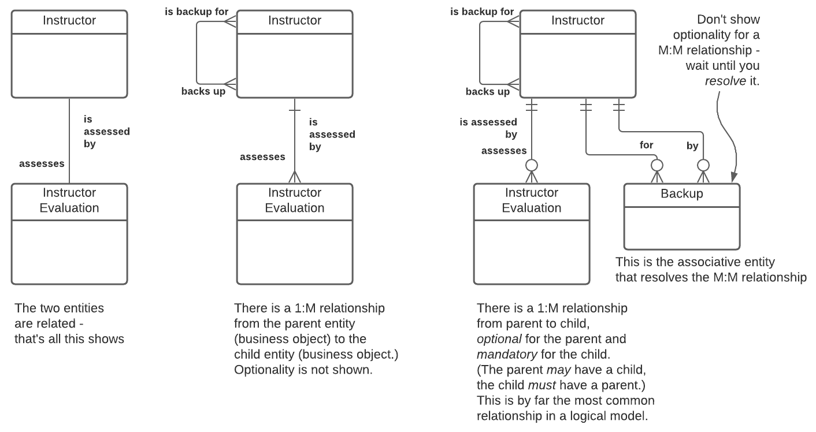
For reference – the Information Engineering symbol set
This symbol set was refined and developed by Clive Finkelstein.
Known in some tools as the "Martin IE" symbol set.
Strengths are:
  symbols are not "overloaded" – they explicitly convey only one idea.
  can show as much or as little as needed in terms of rules.

Slide 42
A natural progression
Contextual
Focus – scope
context and boundaries,
glossary of main terms and definitions
Conceptual
Focus – overview / shared understanding
business perspective, all terms and definitions,
overall structure, major facts and rules
traditional modelling and development
Logical
Focus – detail
all facts, detailed rules,
input to initial physical design
Physical
DB
Design
reverse engineering
! | Get into the high “value-added” space
Contextual – helpful for large models Conceptual – a great way to add value Improve communication among all players Highlight disconnects – terms, rules, scope, …
The “Danger Zone” Analysts should not worry about physical design issues while data modelling.

Slide 43
Different ways to get started
Starting the model
Developing the model
Identify the main “topics” within scope, and what needs to be known about them.
Contextual
Top-down
Study reports, screens, forms, policies, laws, regulations, training material, industry standards, and other current artifacts or sources
“Sideways-in”
Conceptual
Top-down
Bottom-up
Gather the terms used by
businesspeople,
isolate "things" (potential entities,) assemble initial concept model
Logical
Notes:
In this workshop, we'll start our case study in a bottom-up fashion. In the Advanced Data Modelling workshop we look at starting a data model in a top-down fashion.
Note – whether you start bottom-up or top-down or even “sideways-in,” once you have an initial conceptual data model you will continue in a top-down fashion.

Slide 44
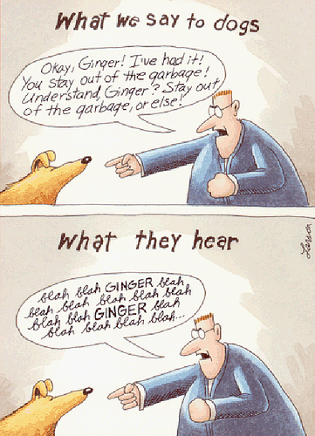
Some advice on starting the concept model
Don't begin with a lecture on data modelling
(but I have a painful story that had a happy ending)
If you can, don't even mention “data modelling”
Gary Larson on business analysis
Blah blah NOUN blah blah blah blah NOUN blah blah blah blah blah blah NOUN blah blah
We use “terminology analysis” – starting with the nouns –
at the outset of every project.
This was demonstrated earlier in the Client Safety Management example.
Notes:
Get started on data modelling during your first conversation!

Slide 45
Starting a Concept Model bottom-up
Interview business representatives about their area:
mandate and activities, goals and objectives, issues and opportunities,
needs and wants, likes and dislikes, etc.…
Nod sympathetically, but ignore it all (almost!)
Instead, capture “terms” – anything that goes by a name.
Later, write each term on a large Post-it
In a facilitated session, participants sort terms into categories:
  Things (entities, but don’t use the term… yet)
  Facts about things (add new “thing” if it's not there already)
  “Other stuff”
  As needed, introduce criteria to be a“thing” (an entity)
  “Other stuff” includes:
  Metrics
  Organisations, departments, jobs, roles, …
  Processes, functions, activities, tasks, …
  Systems, tools, equipment, mechanisms, …
  Reports, forms, screens, queries, …
  Other – too vague, only one instance,
  a “fact of life,” not a thing we track, etc.
Notes:
Throughout, when a term is placed in “other stuff” check to see if it is a clue to a new “thing” that should be added.

Slide 46
Exercise 1: building an initial Concept Model
The assignment:
The following describes project tracking at Amalgamated Automaton. Read it over and be prepared to discuss the things about which the business needs to record information, and the important facts about them. The instructor will lead the development of an initial data model.
Amalgamated Automaton, Inc. has a growing Information Systems department. Until recent years, the department was concerned almost entirely with selecting, installing and maintaining purchased software packages. Recently, however, the focus has shifted towards the in-house development of application software.
One of the problems confronting the IS department is that they have no base of historical data to aid in trend analysis or estimating development effort, nor any effective means of charging back development costs. The proposed solution is to develop a simple Project Tracking System, which will work in conjunction with the existing Personnel and General Ledger Systems.
When a development project is initiated, a project name and a short description are recorded, among other things. Soon, before any further work is done on the project, a new account is created on the G/L System, identified by a G/L account number. Project costs will be charged to this account, and the project budget is recorded as the initial account balance in dollars.
Project planners break a project down into many tasks, perhaps hundreds. A typical project task might be “Test Order Entry Module”. Some of the facts which are required about tasks include a brief task description, estimated work hours, and the scheduled start and finish dates.
Eventually, individual employees are assigned responsibility for the tasks. Some tasks will be the responsibility of many employees, and an employee might be assigned to many tasks. As each employee is assigned to a project task, their planned start and finish dates, their contribution to the task (not a “kind of work,” but their specific duties on the task – e.g., “Develop test scripts”), and the estimated number of hours they are to spend on the task are recorded. Employee information such as the employee name and number are available from the existing Personnel System, although it will have to be modified to record the employee's hourly charge out rate.
When an IS employee begins work on a new task, their actual start date is recorded. A running total of the number of hours that they have worked on each started task is updated regularly. At the same time, the remaining balance in the project account is updated. When an employee completes a task assignment, the actual completion date is recorded.
Notes:
Read this over, and then the instructor will lead the development of the initial data model.

Slide 47
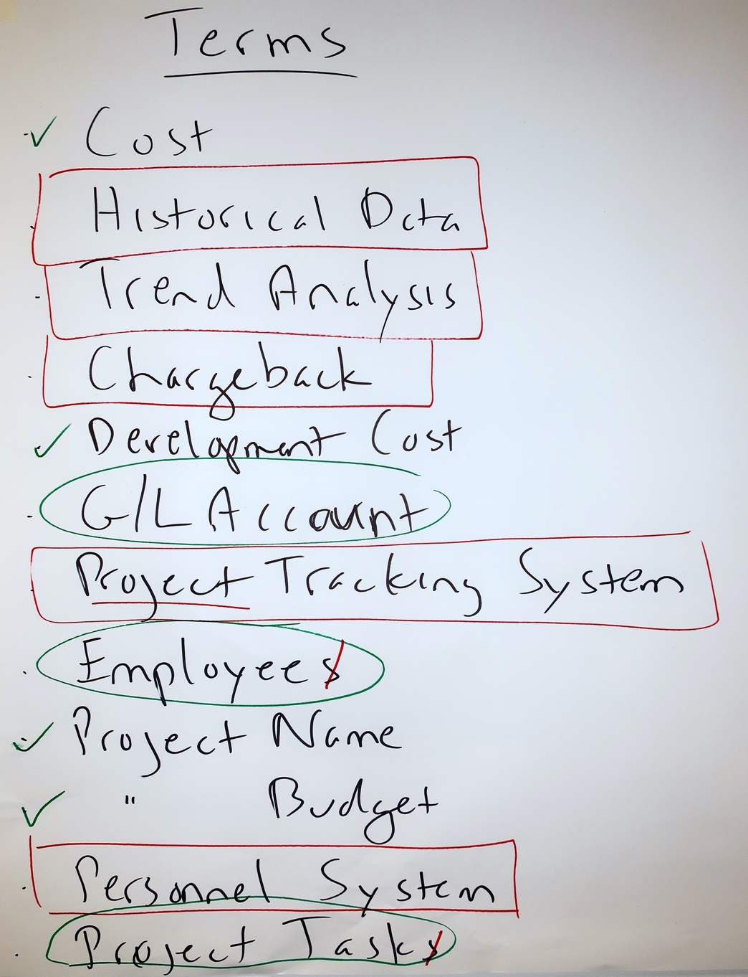
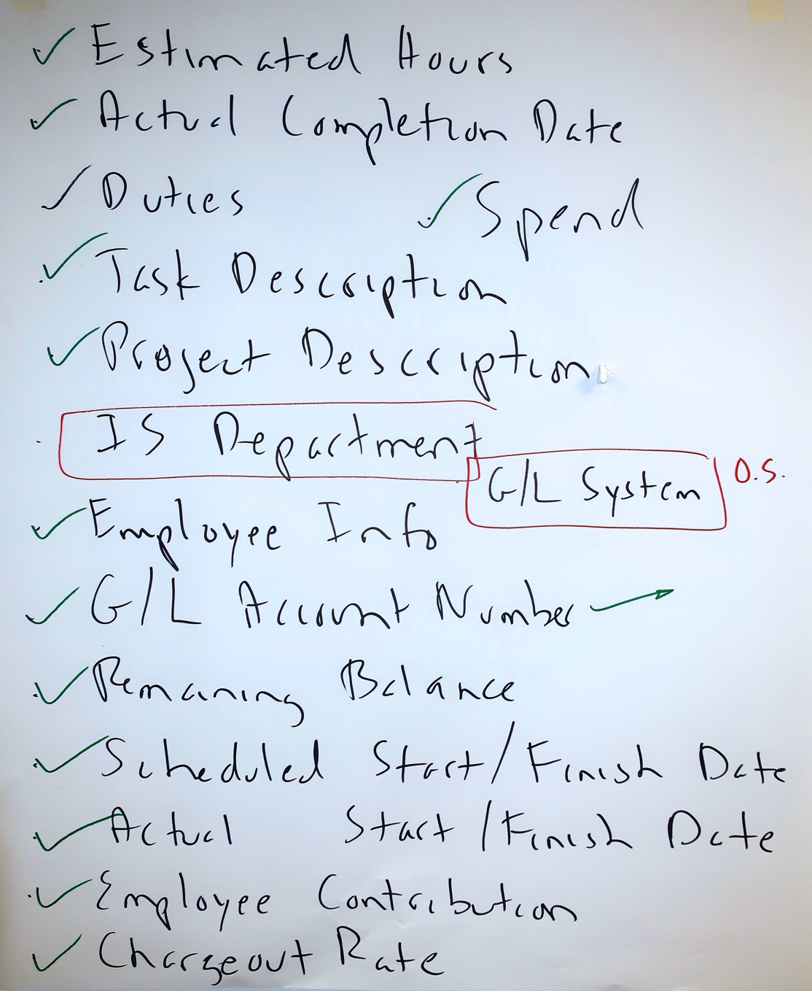
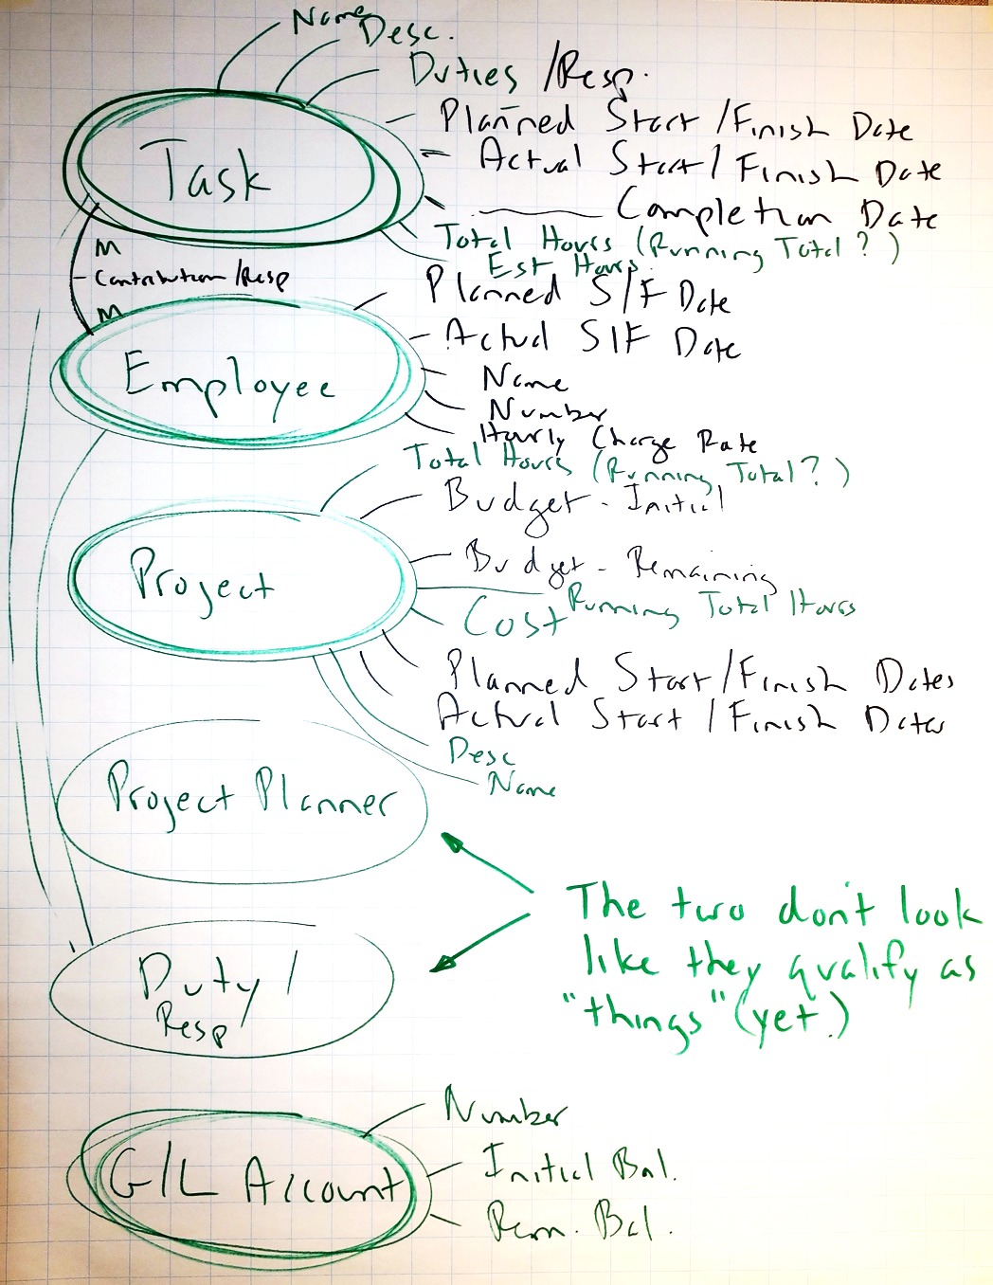
Workshop example
Introduce "thing criteria" as necessary:
  singular noun – can talk about one of them (Worker not Staff, Item not Inventory)
  multiple instances
  must need to and be able to track each instance (uniquely identify each)
  has facts that must be recorded
  makes sense in a "verb-noun" pair
  NOT an artifact like a spreadsheet or report (not a Call Log or Worker Directory or…)

Slide 48
Identifying Entities – three common errors
Treating an “artifact” (a spreadsheet, report, web page, form, etc.) as an Entity –
an Entity is a fundamental, singular thing with no reference to implementation –
Artifacts reflect implementation (form, DB, spreadsheet, list, …)
and contain attributes from
- multiple different Entities or
- multiple instances of the same Entity
e.g., “Admission Request Form” or “Orders Summary Spreadsheet”
or “Daily Call Log” or “Materials List Fax” or “Class Roster” or “Course List” or…
Identifying an Entity that exists in the real world,
but whose instances can't be uniquely identified
e.g., “Transit System Passenger” or "Event Attendee"
The “types vs. instances” problem – failing to clarify if the Entity deals with
types of things (or categories or kinds or classes of things)
vs. specific instances of things
e.g., “Test” – is this a type of Test, or a specific instance of a Test?
more examples coming…
Notes:
Also:
Too much generalisation, for instance in the super-generalised models some people favor which have one main entity – “Thing.”
Too little generalisation, which is also known as “literalism.” E.g., instead of having a separate entity for each of Division, Department, Business Unit, Section, Work Group, etc. (which is very “literal”) it might be better to generalise and have just one entity called “Organisation Unit”, possibly with a related “Organisation Unit Type” entity indicating whether the Organisation Unit was a company, division, department, and so on.

Slide 49
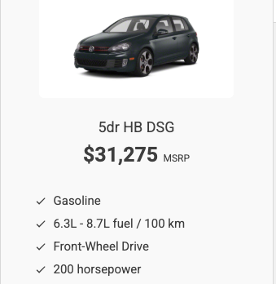

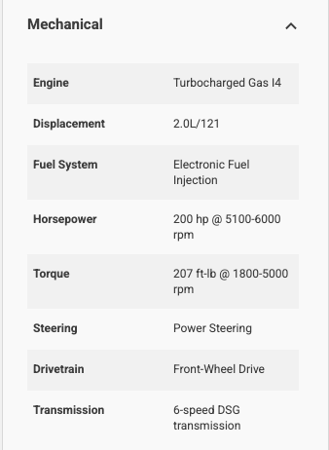
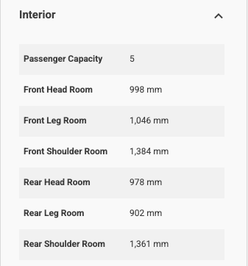
Types vs. Instances example
Specifications for a type of vehicle –
a 2011 Volkswagen GTI
Failing to distinguish these is a common modelling error.
Alec's 2011 Volkswagen GTI
A "type" entity – Vehicle Make/Model
An "instance" entity – Vehicle

Slide 50
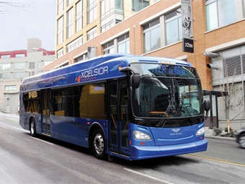
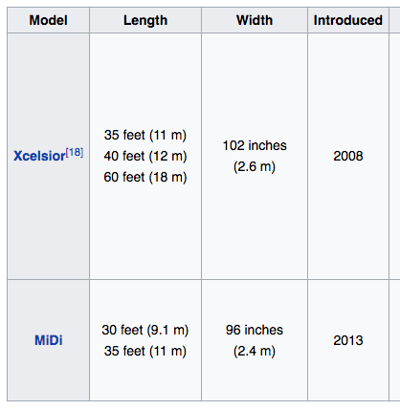
Types vs. Instances – “What do you mean by a Bus?”
A category of Bus – a "meta-Type?"
(transit, articulated, intercity, minibus, …)
A Make and Model of Bus – a Type?
An individual Vehicle? – an Instance?

Slide 51
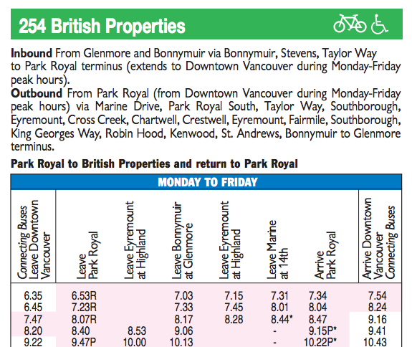
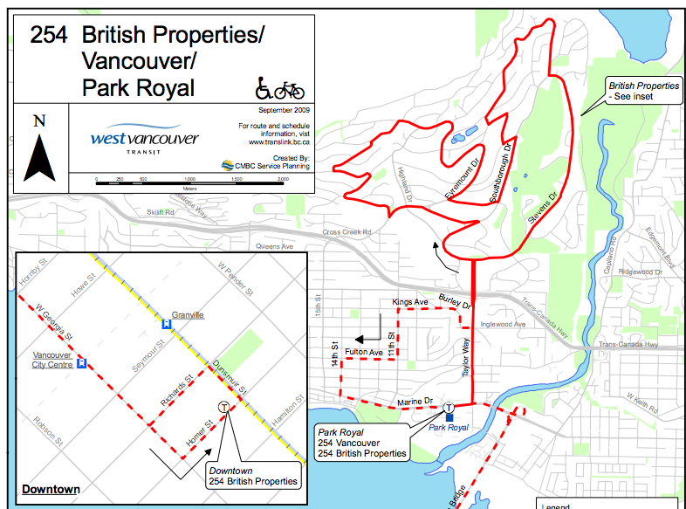
“What do you mean by a Bus?”
A Bus Route?
A Bus Route Scheduled Departure
An instance of a Bus Route Scheduled Departure?

Slide 52
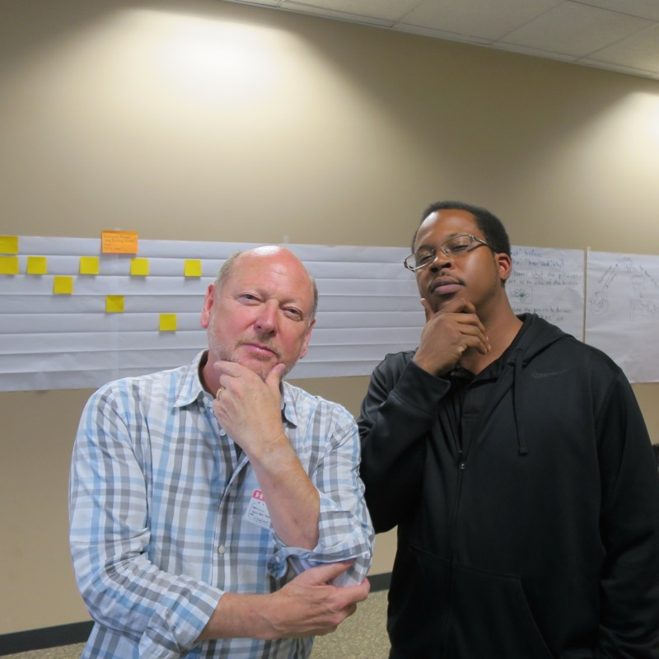
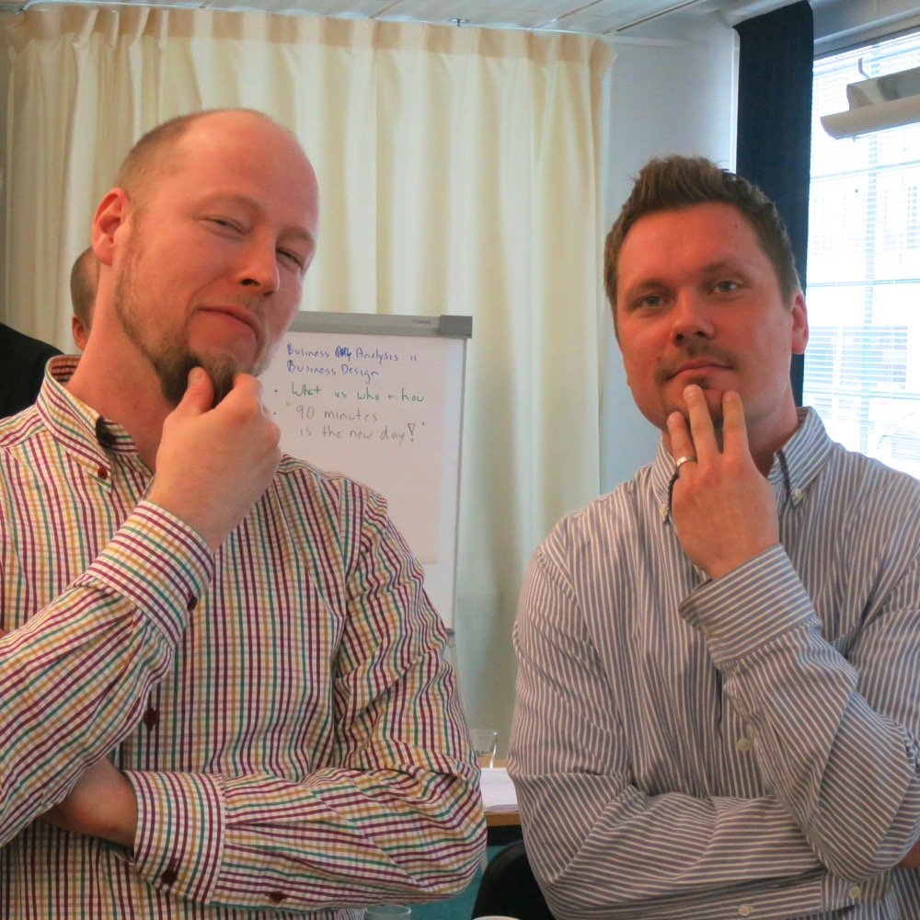

Never be afraid to ask “What do you mean by…?”

Slide 53
Discussion – good Entity or not?
  Which of the following might not be valid entities?
  And if not, why not?
Transcript
Student
Building
Student Directory
Faculty
Member
Instructor
History
Department
Course
Organisation Chart
Prerequisite List
Payment
Student Body
Class Roster
Scholarship
Faculty
Assistant
Dean
Admission
Date
Phillips
Building
Registration
Section
Course
Catalogue
Physics
Class
Professor
Admission
Request
Form
  And a bonus…
Time

Slide 54
Discussion – good Entity or not?
  Which of the following might not be valid entities?
  And if not, why not?
❌️
✔️
✔️
❌️
✔️
Transcript
Student
Building
Student Directory
Faculty
Member
❌️
Instructor
History
a report
a report
a list, "history" is not singular, and a history of what?
✔️
✔️
❌️
❌️
✔️
Department
Course
Organisation Chart
Prerequisite List
Payment
❌️
Student Body
a visual report
a list
not singular
Class Roster
✔️
Scholarship
✔️
❌️
❌️
❌️
❌️
Faculty
Assistant
Dean
Admission
Date
Phillips
Building
a report
a Job Title
an attribute
an instance
✔️
✔️
❌️
✔️
Registration
Section
❌️
❌️
Course
Catalogue
Physics
Class
Professor
a report
an instance
a Job Title
Admission
Request
Form
❌️
❌️
Time
  not a distinct thing ("what is a time?")
  but can you think of any time-related entities?
a form (artifact)

Slide 55
Entity definition – bad example then a good format
Customer
We have a variety of Customers that operate in multiple geographies, and these must be tracked in order to consolidate purchasing statistics and enable our rating process to identify our best Customers.
Not a good definition
  Interesting background and miscellaneous points
  Doesn't answer the question “What is one of these things?”
Customer
1. A Customer is a person or organisation that is a past, present, or potential user of our products or services.
2. Current examples include Solectron (contract manufacturer,) Cisco Systems (OEM,) Arrow Electronics (distributor,) Best Buy (retailer,) M&P PCs (assembler,) and individual consumers.
3. Excludes the company itself when we use our own products or services but includes cases where the Customer doesn't have to pay (e.g., a charity.)
Entity definition format:
A description of which real-world things will be included in scope.
This might be developed from a list of standard “thing types” – person, organisation, request, transfer, item, location, activity, etc.
Be sure to identify any specific inclusions (“This includes…” or “This is...”)
Illustrate with examples:
  5 – 10 sample instances
  diagrams or scenarios
  illustrations such as reports or forms
Interesting points – anomalies, synonyms, common points of confusion, etc.
May include specific exclusions (“This excludes…” or “This is not...”)
Notes:
Why we do them - to avoid potentially expensive misunderstandings by discovering differences of opinion and new requirements early in the project
A simple example:
Building:
A ground based structure which supports company business operations by housing employees, equipment, or supplies.
examples: office building, retail store, warehouse
can be owned or leased
may or may not have a street address
Developing entity definitions almost invariably uncovers new requirements. For instance, in the “Building” example above we can see at least two likely requirements:
We must be able to record whether or not a Building is owned or leased, and we will probably also need to record lease details.
We must be able to record the location of Buildings that do not have a street address.

Slide 56
Entity definition - start by opening minds
“Can anyone think of examples that might surprise someone else –
that is, anomalies or potential sources of confusion."
E.g., how could we legitimately have different ideas what “Employee" means?
Employee
Project
Account
Task

Slide 57
Starting an Entity definition
“Can anyone think of examples that might surprise someone else –
that is, anomalies or potential sources of confusion."
E.g., how could we legitimately have different ideas what “Employee" means?
F/T vs. P/T?
Only IS Department?
Include management, or only individual contributors?
Still in recruitment (an applicant)?
Onboarded? on probation? active? retirees?
Include contractors, student interns, vendor staff, etc.?
Volunteers?
A type of worker (DBA or tester) or a specific person?
A robotic, automated, or AI agent?
Employee
Project
Account
Task

Slide 58
Starting an Entity definition
“Can anyone think of examples that might surprise someone else –
that is, anomalies or potential sources of confusion."
E.g., how could we legitimately have different ideas what “Employee" means?
Let's see what the group decided
F/T vs. P/T?
Only IS Department?
Include management, or only individual contributors?
Still in recruitment (an applicant)?
Onboarded? on probation? active? retirees?
Include contractors, student interns, vendor staff, etc.?
Volunteers?
A type of worker (DBA or tester) or a specific person?
A robotic, automated, or AI agent?
Employee
– Both
– No
– Yes, everyone
– No
– Yes, all
– Yes, all
– Yes
– No, only a specific person
– No, only a real person
Project
Account
Task

Slide 59
Defining the Entity "Employee" – "Worker"
Definition format:
A description of which real-world things are within in scope, and any specific inclusions (“This includes…” or “This is...”)
Illustrate with examples – 5 to 10 sample instances or types
Interesting points – anomalies, synonyms, common points of confusion, etc.
May include specific exclusions
(“This excludes…” or “This is not...”)
Worker (renamed from Employee):
A Worker is a person, whether or not directly employed by
the company, but with some sort of employment contract or arrangement, who has been or may be assigned to a Project.
Worker includes:
Full or Part-time Employees who have been onboarded,
including Probation, Active, Seconded, Suspended, Retired…
Contractors
Consultants
Student Interns
Vendor Staff Persons
Company Owners and Managers
Key points:
"Worker" was chosen as the entity name because
it is more generalised than "Employee."
A Worker may not necessarily be billable on a Project,
e.g., a non-chargeable Subject Matter Expert or Volunteer
Worker excludes:
  Job Roles, e.g., DBA or Technical Writer
  Robotic, Automated, or AI Agents (this might change)

Slide 60
Another example – starting an entity definition for Task
“Can anyone think of examples that might surprise someone else –
that is, anomalies or potential sources of confusion."
E.g., how could we legitimately have different ideas what “Task" means?
Worker
Project
Account
Task

Slide 61
Another example – starting an entity definition for Task
“Can anyone think of examples that might surprise someone else –
that is, anomalies or potential sources of confusion."
E.g., how could we legitimately have different ideas what “Task" means?
Worker
Key points that typically arise:
A type of Task or a specific Task?
(the types vs. instances problem)
Part of a specific Project or
used across multiple Projects?
Produces a specific deliverable or state?
Time-bounded or ongoing?
Performed by one Worker or
one or more Workers?
…
A Task is a specific, time-bounded, unit of work, within a single Project, intended to be performed by one or more Workers, that produces an intended deliverable or achieves a specific state.
Examples:
Code Place Order service
Test Place Order service
Excludes:
types of Tasks
ongoing (non time-bounded) activities such as management or administration
Project
Account
Task

Slide 62
Now we have definitions – it's "safe" to draw the ER model
Worker
assigned
to
Project
charged
to
Account
funds charges for
partitioned
into
part
of
Task
assigned
to
First arrange entities top-down by dependency.
Then add relationships with a verb-based phrase.
Then add cardinality (1:1, 1:M, M:M.)

Slide 63
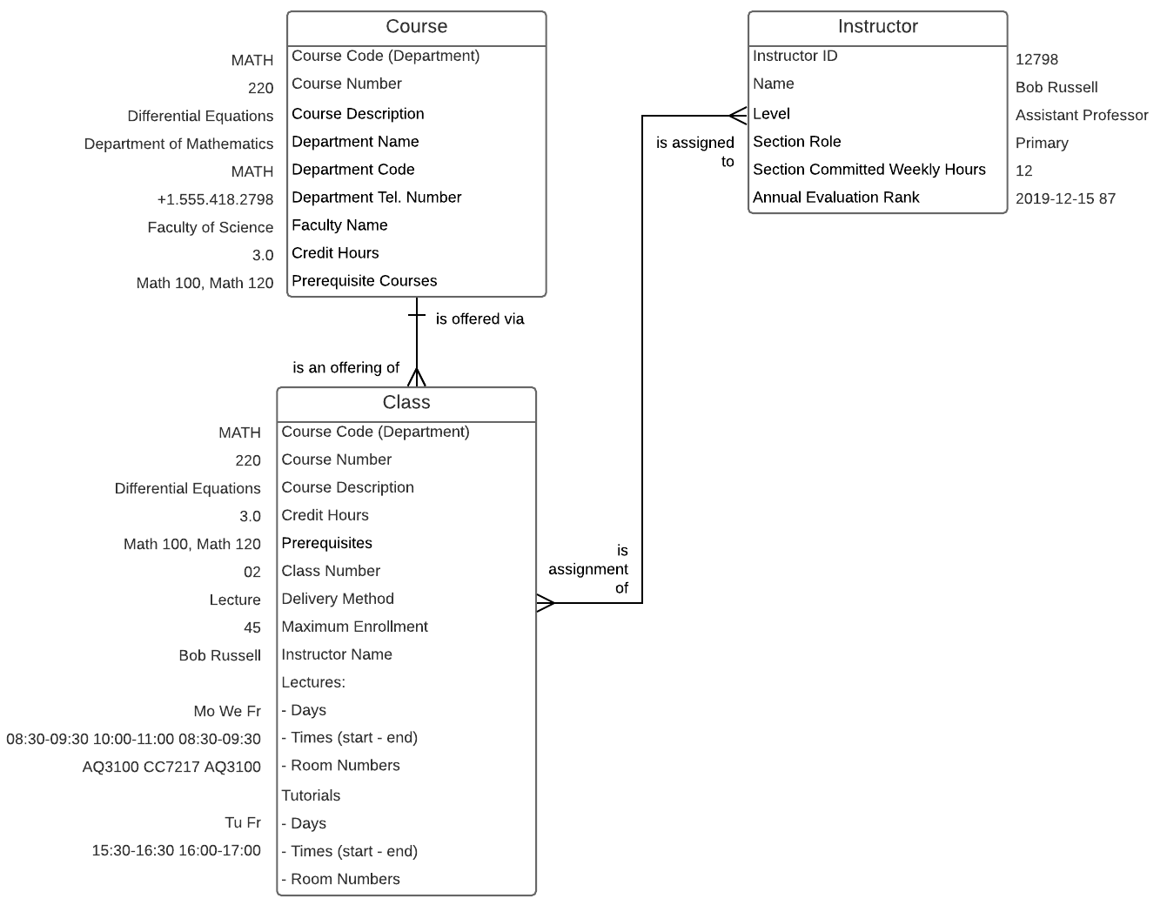
"Demonstrate the Data"
In addition to Entity definitions, it can be helpful to show
sample data values on an E-R Diagram.

Slide 64
Relationships – a few more points
A significant, named association between entities –
one of the types of facts about entities that data models depict
No “shortcuts” -
redundant or
“transitive”
relationships
partitioned
into
A relationship can be “recursive”
(self-referencing)
Organisation
Unit
X
classifies
Job
Category
is part of
contains
is
classified by
assigned to
is contained in
Building
is the location of
Position
Employee
is located at
is filled by
fills
No irrelevant
relationships
X
visited
Guidelines
  named with a descriptive, verb-based phrase – not “has” or “is related to”
  (the line tells us they are related; the name tells us how)
  named in both directions – try to use the same root word at both ends (e.g., “classifies” and “is classified by”)
  the complete name reads like a sentence (noun verb noun) –
  “Position is classified by Job Category”
Notes:
The relationship name will be “verb-based” (assigned to, located in, transported by, etc.)
Watch out for “redundant” relationships - it's very easy to build a “spaghetti” model where every entity is connected to every other entity.
Establish relationships as “low” as possible – e.g., to a dependent rather than to the parent, if it makes sense.

Slide 65
1:1 relationships – almost always an error!
Note – a 1:1 relationship might be necessary in the Physical Database Design
e.g., “Fixed Asset” records financial data about a “Network Component” but they are in
two separate systems (the G/L System and the Configuration Management System)
connected by a 1:1 relationship
Incorrect analysis
e.g., Project costs are probably prorated across many Accounts
Failing to account for changes over time
e.g., an Employee may hold only one Credit Card at a time, but many over time,
and we virtually always want history.
The most common written constraint
in Concept Modelling is
"one at a time but many over time."
Notes:
Physical implementation might be two separate databases – the point is to recognise that they represent the same entity so they can be synchronised.
During physical database design and tuning, a table might be split into two tables joined by a 1:1 relationship. This could be to
put the highly-used data in one, and less used data in the other for performance reasons
put widely used data in one, and more secure or sensitive data in the other

Slide 66
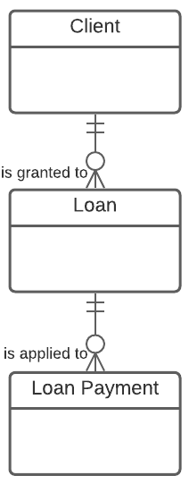
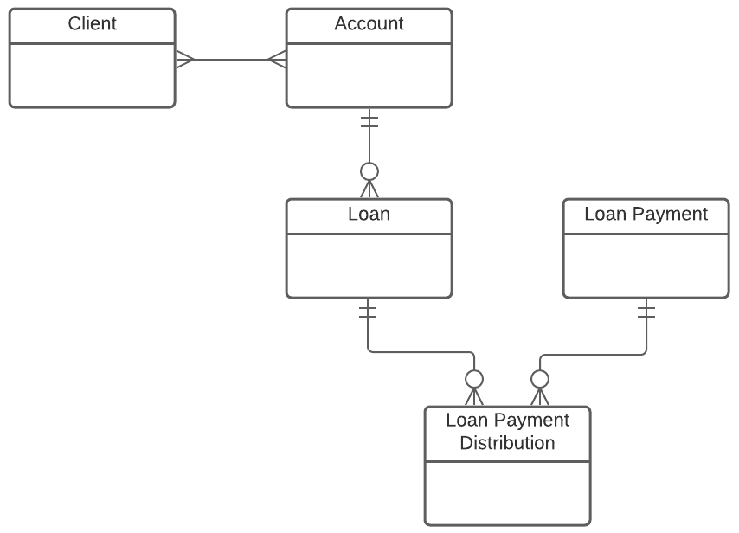
Future-proofing – "Challenge the Ones"
This revised model
meets the new requirements.
A Loan is granted to
one and only one Client –
really?
No – multiple Clients can participate in a Loan via a shared Account.
(A new requirement.)
This M:M would
also be resolved.
repaid via
distributed
to
A Loan Payment applies to
one and only one Loan –
really?
No – one Loan Payment could be distributed across multiple Loans.
(A new requirement.)
M:M resolves to a
new associative

Slide 67
Relationship optionality (logical models only)
Each Building is the location of a minimum of Zero Positions
(and a maximum of Many Positions)
Each Position is located at a minimum of One Building
(and a maximum of One Building)
Job
Category
Organisation
Unit
classifies
One
One or More
contains
is contained in
is classified
by
Building
Position
is the location of
Employee
is located at
is filled by
fills
One
(Must Be)
Zero
(May Be)
is assigned
is assigned to
Key point
or,
Each Building May Be the location of One or More Positions
Each Position Must Be located at One Building
Additional
Duty
Typically, only shown in logical data models – don’t bother with optionality on M:Ms
Be careful of Mandatory with Many!
To determine optionality (a.k.a. minimum cardinality)
  for each entity ask “Can one of these be related to a minimum of Zero
  or a minimum of One of the other entity?”
  record the answer – 0 or 1 – at the “other” end
  “zero” means an optional relationship (May Be) and
  “one” means a mandatory relationship (Must Be)
  easier form: "Each one of these May Be be or Must Be related to the other?"
Notes:
When considering whether an entity's relationships are optional or mandatory, always consider the earliest stages of the entity's life cycle (e.g., when the entity is first created)

Slide 68
Don't forget the four Ds of Data Modelling
1
2
Definition
Dependency
  “What is one of these things?”
  List common and unusual instances
  “Are there any known anomalies?”
  “What are the potential differences of opinion?”
  “What type of entity is this?”
  “What other entity does it depend on?”
  Essentially
  - is it a free-standing thing?,
  - is it a type of thing?,
  - is it repeating detail about some other thing?
Please let us know the key point (or points)
that mattered most to you in this first section.
3
4
Detail
Demonstrate the Data
  Don't dive into detail –
  keep it in its place!
  GEFN!* HPDL!**
  Assertions / narrative rules
  Sample data values or instances
  Scenarios or use cases
  Props (e.g., report layouts or
  common documents)
  Also demonstrate the value of the model
*Good enough for now!
**Hard part, do later!

Slide 69
Overview and logistics
Æ | Fundamental and Advanced Topics
Introduction and Level-set Issues, Principles, Hands-on Case Study Essentials of Concept Modelling Transition from Conceptual to Logical, and Logical to Dimensional Interesting Structures Types vs. Instances Recursion, Subtyping, & Generalisation Meeting New Requirements Modelling Time, History, & Change Rules on Relationships and Associations Multi-way Associatives & Complex Rules Advanced Normal Forms (4NF & 5NF) Presentation Techniques for Data Modellers Core Techniques for Presenting A Real-life Example

Slide 70
Phase 2 of three phases in data modelling
1) Establish initial Concept Model
2) Develop initial Logical Data Model
3) Refine & extend Logical Data Model
Focus is on developing a core set of entities:
  named
  defined
  minimally attributed
  bound by basic rules and relationships
  placed on an ERD
Might start bottom-up:
brainstorm details then synthesising “up”
Might start top-down:
build a contextual model, then flesh out required details analysing “down”
Experiment w. alternatives
Refine the contextual model, if you had one.
Focus shifts to attribute rigor and structure when going to the logical level
First check attributes for:
  completeness
  necessity
  name and definition
  placement
Resolve attributes that are:
  multi-valued
  redundant
  constrained
Continue experimenting with alternate structures
Refine conceptual model
Focus is on refinement, and validation via new requirements using…
…an event-based approach: fast and easy…
…or full business analysis:
  process workflow model
  use cases (external)
  service specs (internal)
  profiling existing data
  informational needs
Resolve attributes that are semantically overloaded, non-atomic, or derived
Document attribute properties and validation
Specify identifiers
Refine conceptual model
Notes:
Of course, step 0) is to establish Project Scope and Objectives

Slide 71
From conceptual to initial logical
The progression from conceptual to logical is largely based on identifying and dealing with three attribute characteristics
Multi-valued - the attribute can have multiple different values for one instance of the entity, either “at a time” or “over time”
E.g., “Employee Name” if aliases or previous names are tracked
  move it down to the “many” end of a 1:M relationship into a characteristic entity
  if it's a fact about a M:M relationship between entities, move it down to the “many” end of a 1:M relationship into an associative entity
  this puts the data structure into 1st Normal Form – 1NF
Redundant - the same attribute value is recorded multiple times, in different entity instances, possibly inconsistently
E.g., “Company Name” in a “Department” entity
  move it up to the “one” end of a M:1 relationship
  to one of the parent (or higher) entities (2nd Normal Form – 2NF)
  You might have to create a new parent entity where none existed before
Constrained - a descriptive attribute needs to be restricted to a set of standard (or “allowable”) values to improve integrity and reporting
E.g., “Employee Type”
  move it out to the “one” end of a M:1 relationship
  to a reference or other related entity (3rd Normal Form - 3NF)
Notes:
For multi-valued attributes, ask “On what basis does the attribute repeat?” The answer should be in the form “It occurs once per …” This will provide a clue as to what entity the multi-valued attribute should be moved to.

Slide 72
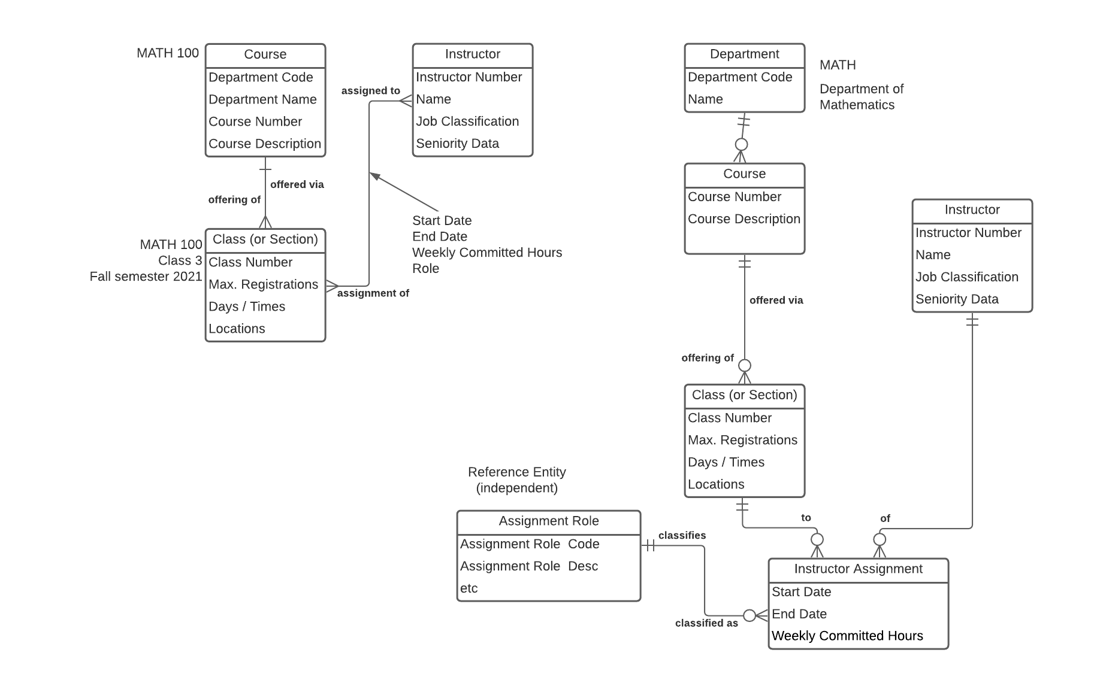
A simple Concept Model to Logical Data Model example
partial Concept Model
beginning the Logical Data Model
Kernel
Characteristic
Kernel
In this example we:
resolve the M:M relationship between Instructor and Class
move redundant Department attributes in Course up into a new Department entity
create a reference entity to standardise the values of "Assignment Role"
Characteristic
Associative
Reference

Slide 73
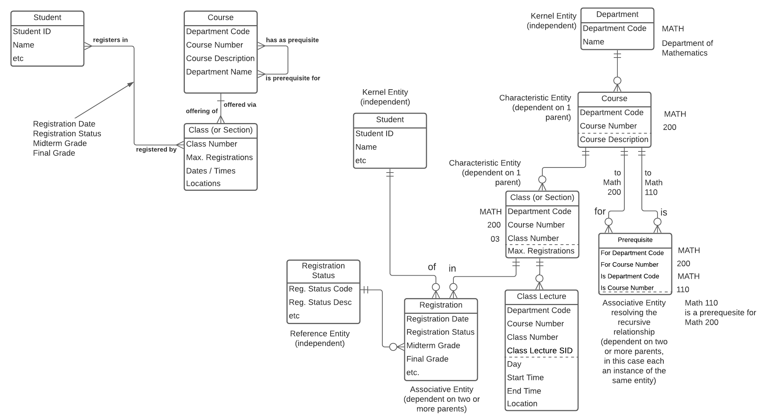
Another Concept to Logical example, drawn top-down
Conceptual
Beginning the
Logical model
Days
}
In this example we:
move multi-valued Class attributes
into their own entity – Class Lecture
resolve the M:M relationship between Student and Class
resolve the recursive Course to Course M:M relationship
move redundant Department attributes in Course up into a
new Department entity
move Registration Status into a reference entity
Code

Slide 74
World's shortest course on normalisation
Unnormalised (UNF or 0NF)
  Contains multivalued attributes (a “repeating group”)
First Normal Form (1NF)
  Repeating attributes moved down to a dependent Characteristic or Associative entity (create a new dependent entity if necessary.) This makes data "reportable."
Second Normal Form (2NF)
  Only applies to dependent entities
  No attribute in a child entity is really a fact about a parent (or grandparent or…)
  That is, no Characteristic or Associative entity redundantly contains facts from its parent(s) – if it does, move the fact(s) up (create a new parent entity if necessary)
Third Normal Form (3NF)
  If any entity redundantly contains facts from a related (non-parent) entity, move the fact(s) out to the other entity (create a new entity if necessary)
BCNF (Boyce-Codd NF – “3.5NF”)
  Not an issue if you keep your wits about you
Fourth and Fifth Normal Form (4NF, 5NF)
  “Large” (3-way or more) associatives need to be broken down into more granular entities
UNF
1NF
2NF
3NF
4NF, 5NF?...

Slide 75
For reference – Contextual, Conceptual, & Logical models
Contextual
(Scope –
Planner’s View)
Conceptual (Overview – Owner’s View)
Logical
(Detail –
Designer’s View)
1
2
3
Agree on context or “big picture”
Agree on basic concepts and rules
Full detail for physical design
The scope in terms of topics or subjects that are in or out,
plus core terms and definitions
May be a simple
block diagram of topics/subjects,
or primarily textual (a list)
Optional – not necessary on smaller projects
Ensures everyone is using the same vocabulary and concepts before diving into detail
Overview: main entities, attributes, relationships, rules
Lots of M:M relationships
Relationships show cardinality
No keys
Few or no reference entities
Unnormalised – most M:M relationships unresolved, many attributes will be multi-valued, redundant, and non-atomic
Verified directly by clients plus other techniques: Use Cases…
A “one-pager”
20% of the modelling effort
Provides all detail for initial physical database design and requirements specification
Detailed: ~ 5 times as many entities as the conceptual model
M:M relationships resolved
Relationship optionality added
Primary, foreign, alternate keys
Lots of reference entities
Fully normalised – no multi-valued, redundant, or non-atomic attributes. All attributes defined and “propertised”
Verified by other means: sample data, report mockups, scenarios, …
May be partitioned
80% of the modelling effort
My most plagiarised slide ever!
Notes:
Note that across the industry, there is a lack of consistency in defining these types of models. In the “Zachman Framework” these would be the planner's, owner's, and designer's views.
Analogies:
the contextual model is like the site plan with a definition of what will be built
the conceptual model is like a floor plan and sketches for a building
the logical data model is like the detailed blueprints for a building
A basic message for conceptual modelling –
“Resist the urge to normalise or generalise until it matters!!!
The logical model is not necessarily the “as built” model – the physical database design. The database designer or DBA will make changes in the interest of performance, recoverability, distribution, etc.
Everyone who currently supports an application should:
draw the application's logical data model following strict top-down drawing conventions.
abstract the model “up” to a conceptual data model
at least consider reviewing the conceptual model with analysts, developers, and subject matter experts to ensure that it reflects the intentions of the business.

Slide 76
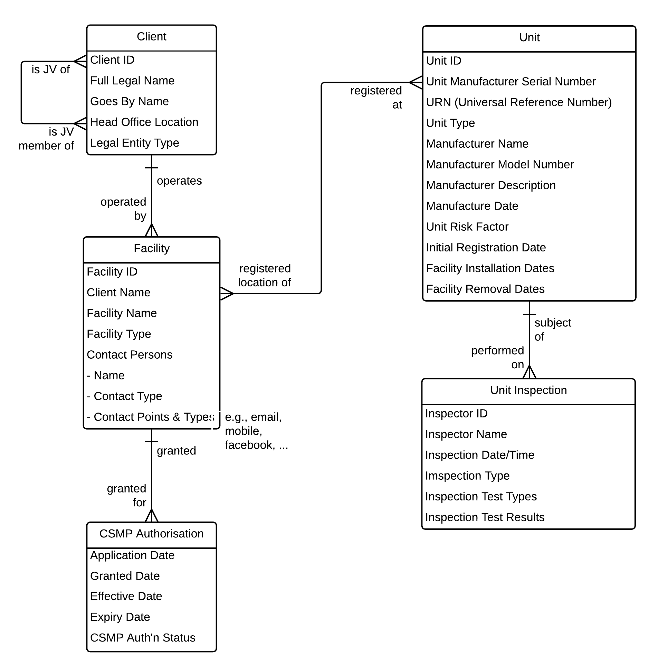
Self-study exercise – from conceptual to logical
This is unnormalised – it contains multi-valued (repeating,) redundant, and constrained attributes.
First, identify the attributes that are "correct" – they are base attributes of the entity they are in.
Then, normalise it to 3NF (Third Normal Form) by identifying and dealing with attributes that are:
  Multivalued, and need to be moved down to a dependent entity. (1NF)
  Redundant and need to be moved up
  to a parent (or higher) entity. (2NF)
  Redundant or constrained and need to
  be moved out (sideways) to a related but non-parent entity, or to a reference entity. (3NF)

Slide 77
Entity types – kernels
Building
Organisation
Unit
Job
Employee
The “central” objects in the model
  “what it's all about”
  everything else either further describes, associates, or classifies the kernel entities
Independent – its existence is not dependent on another entity
  “Does it make sense for one of these to exist on its own?”
  is not a child of another entity
Drawn at the top of the diagram, or subject area within a diagram
Notes:
a.k.a. “Fundamental” entity

Slide 78
Entity types – characteristics
Building
Job
Position
Employee
Room
Job
Qualification
Job
Responsibility
Assignment
Drawn below the characterised (parent) entity
A characteristic of a Kernel
Workstation
A characteristic of another Characteristic
Special
Duty
A characteristic of an Associative
Records repeating, multi-valued facts about a parent entity that have been “cast out” from the parent entity
It “characterises” the parent entity (any type of entity)
Dependent on one parent entity
Drawn below the parent entity
Notes:
a.k.a. “Attributive” entity

Slide 79
Entity types – associatives
Position
Employee
filled by
assigned via
fills
assigns
Assignment
Naming the relationships from an associative is often difficult, because the associative entity itself is a relationship
Drawn between and below the associated (parent) entities with two or more crowsfeet on the top edge
Relates (“associates”) two or more other entities –
records facts about the association (M:M relationship) between those other entities
    sometimes so important it is discovered directly (Order, Contract, …) and is shown on the Conceptual Model – the remainder are added on the Logical Model
    other times it evolves from "resolving" M:M relationships
Can associate any combination of different entity types
Dependent on two or more parent entities
Drawn between and below the parent entities
Notes:
a.k.a. “Intersection” or “Link” entity

Slide 80
Associatives – notes
Benefit
Program
enrolled by
Employee
enrolls in
Where will we record facts about the relationship, such as Enrollment Date?
The M:M relationship name is often the basis for the associative entity name
becomes…
Benefit
Program
Employee
is enrolled
through
defines
participation in
enrolls
through
defines
participation by
Benefit
Program
Enrollment
Associative entities often contain a date range:
Effective Date to End Date (or Last Valid Date.)
Always check for the following:
  Gaps are allowed?
  Must be contiguous?
  Overlaps are allowed?
  Effective Dates can begin in the past or future?
  Is the date range until or through the End Date? (tot en met)
  Must an End Date be specified, and if so, what format is used – “null” or “HighDate – 99991231?”
  Must the date range fit within a parent's date range?
  Do global time zones need to be handled?
End Date
End Date
Effective Date
Effective Date
End Date
End Date
Effective Date
Effective Date
End Date
Effective Date
End Date
Effective Date
Notes:
Sometimes, an associative is so important the business has a name already, otherwise, build the name from the relationship
Sometimes, an associative is so important they seem like Kernels. The reason the business exists is often to maximise the occurrences of a particular association such as
Sale, Contract, Order, Claim, …
As an example of a date range fitting within a parent's date range –
The rule may be that the Effective and End Date for the Enrollment must fit within the Effective and End Date (Hire and Termination Date) for the Employee.

Slide 81
Entity types – reference or type
“Reference” (or “Type” or “Classification” or “Specification” or…) entities
classifies
Vehicle
Make-Model
categorises
Customer
Type
describes
Job
Category
Vehicle
Customer
Job
is a
is a
belongs to
An entity that classifies or categorises other entities and/or allows the recording of standardised values for a descriptive attribute
Independent
Purpose may be served by an attribute in the Concept Model
(i.e., a Customer Type attribute in the Customer entity)
Only critical Reference entities are shown on a Concept Model
(i.e., when a Reference entity ties together different parts of the model)
Drawn beside or diagonally up from the classified entity
Notes:
a.k.a. “Specification,” “Classification,” “Codeset,” or “Lookup” entity
“Reference” entities allow us to constrain the allowable values for a particular attribute by recording each valid value once in an instance of the Reference entity rather than redundantly in multiple instances
Choosing the primary identifier:
Use a mnemonic code if it's desirable for performance reasons to have “recognisable” foreign keys. That is, if you want to be able to display meaningful information without actually using the foreign key to do a lookup (join) with the type entity.
Use a meaningless ID if retrieval of meaningful info isn't a performance issue, and/or there are too many instances for people to learn to recognise the codes

Slide 82
Graphic guidelines – the “no dead crows” principle
  Draw the same kinds of things the same way every time!
Kernels across the upper part
of the diagram or subject area
Reference or Types beside or diagonally above;
“classifying” relationship connects at side
Characteristics below; “characterising” relationship connects at top edge
Associatives between & below;
“associating” relationships connect at top edge
! | Key point
Entity type is obvious from: Placement Relationship connections
Various layouts can work:
top-down best for mere mortals
left to right temporal
bottom-up organic
right to left swimming upstream
Layouts to avoid:
middle-out cosmic
no crossed obsessive
lines compulsive
random Mensa-only
Notes:
Drawing your data model with a sense of direction is the single most important rule for ensuring that data model diagrams are understandable to the widest range of people.
Follow the NO DEAD CROWS rule – crow's feet can point “down” (like a standing crow) or they can point “sideways” (like a crow lying on its side) but they can't point “up” (like a dead crow lying on its back.)

Slide 83
Summary – entity types and conventions
Kernel
Independent
A fundamental thing of interest to the enterprise whose existence does not depend on any other entity – it can “stand alone”
Drawn at the top of its area
Supertype
Contains facts (attributes and relationships) that are common to all instances of the entity. Any kind of entity can be a supertype.
Reference or Type
Independent
Classifies or categorises other entities and/or allows the recording of allowable values for a descriptive attribute
Drawn diagonally out from or beside the classified entity
Organisation
Subtype
Contains facts that are specific to a particular subset of instances of the entity.
Characteristic
Dependent on one parent
Records multi-valued facts about a parent entity that have been “cast out” from that entity
Drawn below parent
Associative
Dependent on two or more parents
Records facts about a relationship (association) between two or more parent entities – is often the resolution of a M:M relationship between the parents
Drawn between and below parents
Recursive relationship
A relationship between instances of the same entity. Can be 1:1, 1:M, or M:M

Slide 84
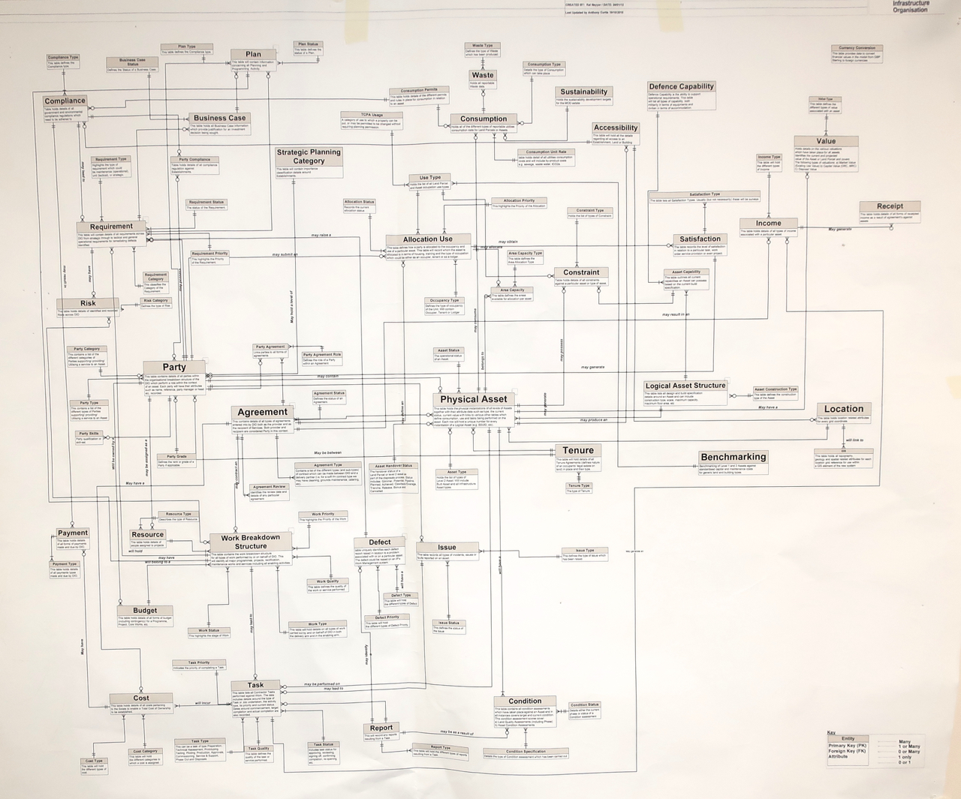
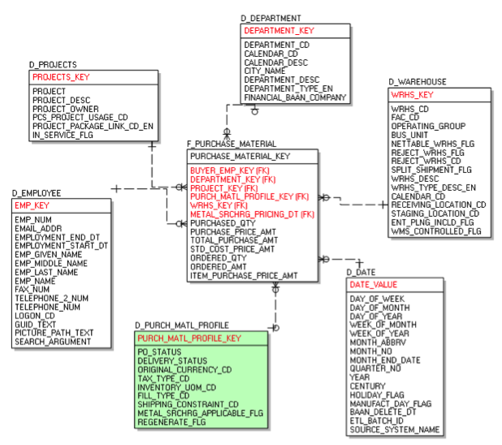
What works for Dimensional Models doesn't for E-R Models
A common error –
"the most important entity should go in the centre of the diagram."
An excellent model structurally, but very difficult to follow –
no sense of direction.
Concept Models / E-R Models should be drawn top-down by dependency.
"Fact" in the middle - fine for Dimensional, terrible for E-R
Let's have a quick look at Dimensional Models and their connection to ER-Models

Slide 85
Two sides of the house
We've looked at techniques that are appropriate for this side of things…
Corporate
mission, strategy,
goals, and objectives
… but other techniques are appropriate for the
information delivery and analytics environment
support
support
Operational
Business Processes
Analytic and Decisioning Processes
We'll look briefly at -
The basics – Facts and Dimensions
A method – from ERD to Dimensional Model
Exercise – developing a basic Dimensional Model
support
support
Operational
Applications
DSS, EIS, BI, visualisation, analytics etc.
supports
Atomic Data Warehouse
supports
Operational
Data
Data Mart,
ODS, …
ETL*
Entity-Relationship Model
Star Schema or
Dimensional Model
* extract, transform, load;
formerly ETML (“move”)

Slide 86
Dimensional models
Used to model and implement data structures
for business intelligence / analytics tools.
(We'll use the terms dimensional model and
star schema interchangeably.)
A central Fact (what you want to analyse) surrounded by Dimensions (how you want to select, filter, group, etc. the Facts)
Each Dimension has a primary key which is referenced by a foreign key in the Fact, so the Fact-Dimension relationship is M:1
Dimension
Dimension
Fact
Dimension
Dimension

Slide 87
Dimensional models
The Fact is measurable, quantitative data about a business event you wish to analyse.
Dimensions are descriptive attributes related to the Fact data.
Dimensions are how you want to analyse the Fact – how you want to "slice and dice" it.
The Fact is usually an associative or characteristic entity from somewhere quite “low” in the ERD
The Fact will usually include a “count” of something, even if the value is implicitly “1” - “dollars” or “hours” or “units” or …
The Dimensions are “clusters” of the Fact's parents, grandparents, etc. entities
Any combination of Dimensions can be used in a query, and the same Dimension will appear in many dimensional models
Calendar
Police Force –
Location
Complaint
("Charge")
Court
Statute

Slide 88
From ERD to Dimensional Model
Any parent (or grandparent or…) entities that are encountered following M:1 relationships from the Fact are possible Dimensions
Any entities that are 1:M or M:M from the Fact cannot be Dimensions without “faking” the data
Additional Dimensions not in the original structure (e.g., Time Period) can be added
Essentially, a basic Dimensional Model (no snowflakes) collapses an ER model to a two-level structure with a 1:M relationship between each Dimension and the Fact
Calendar
Cardholder
Loan
Author
Title

Slide 89
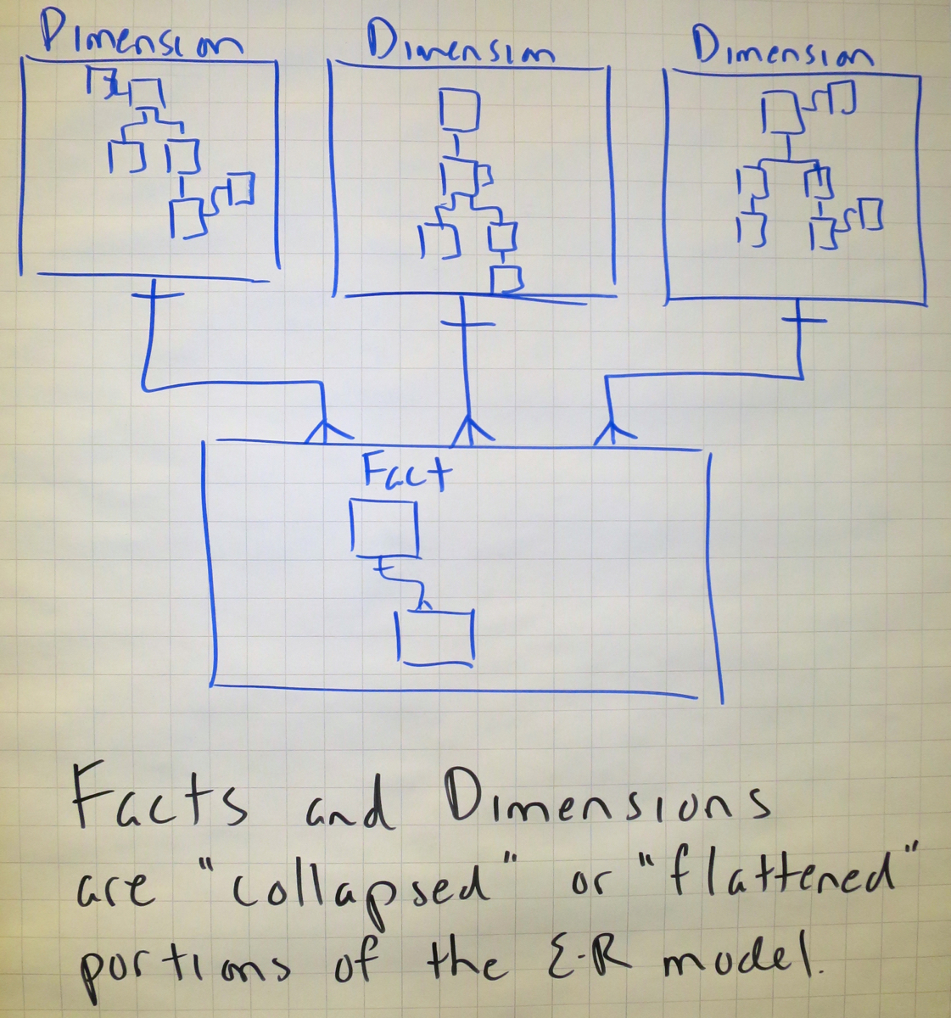
A Dimensional Model is essentially a "flattened" ERD

Slide 90
From ERD to Dimensional Model
Various methodologies are available, but they can
raise client expectations
suggest Dimensional Models not possible with current data
We start with an ERD drawn top-down…
Title
Dimension
Plus –
Calendar Dimension
Branch Dimension
…?
Cardholder Dimension
Title
Dimension
Loan Fact
Title
Dimension
Loan Fact
Note – the Fact is actually "Loan Item," a "flattened" Loan

Slide 91
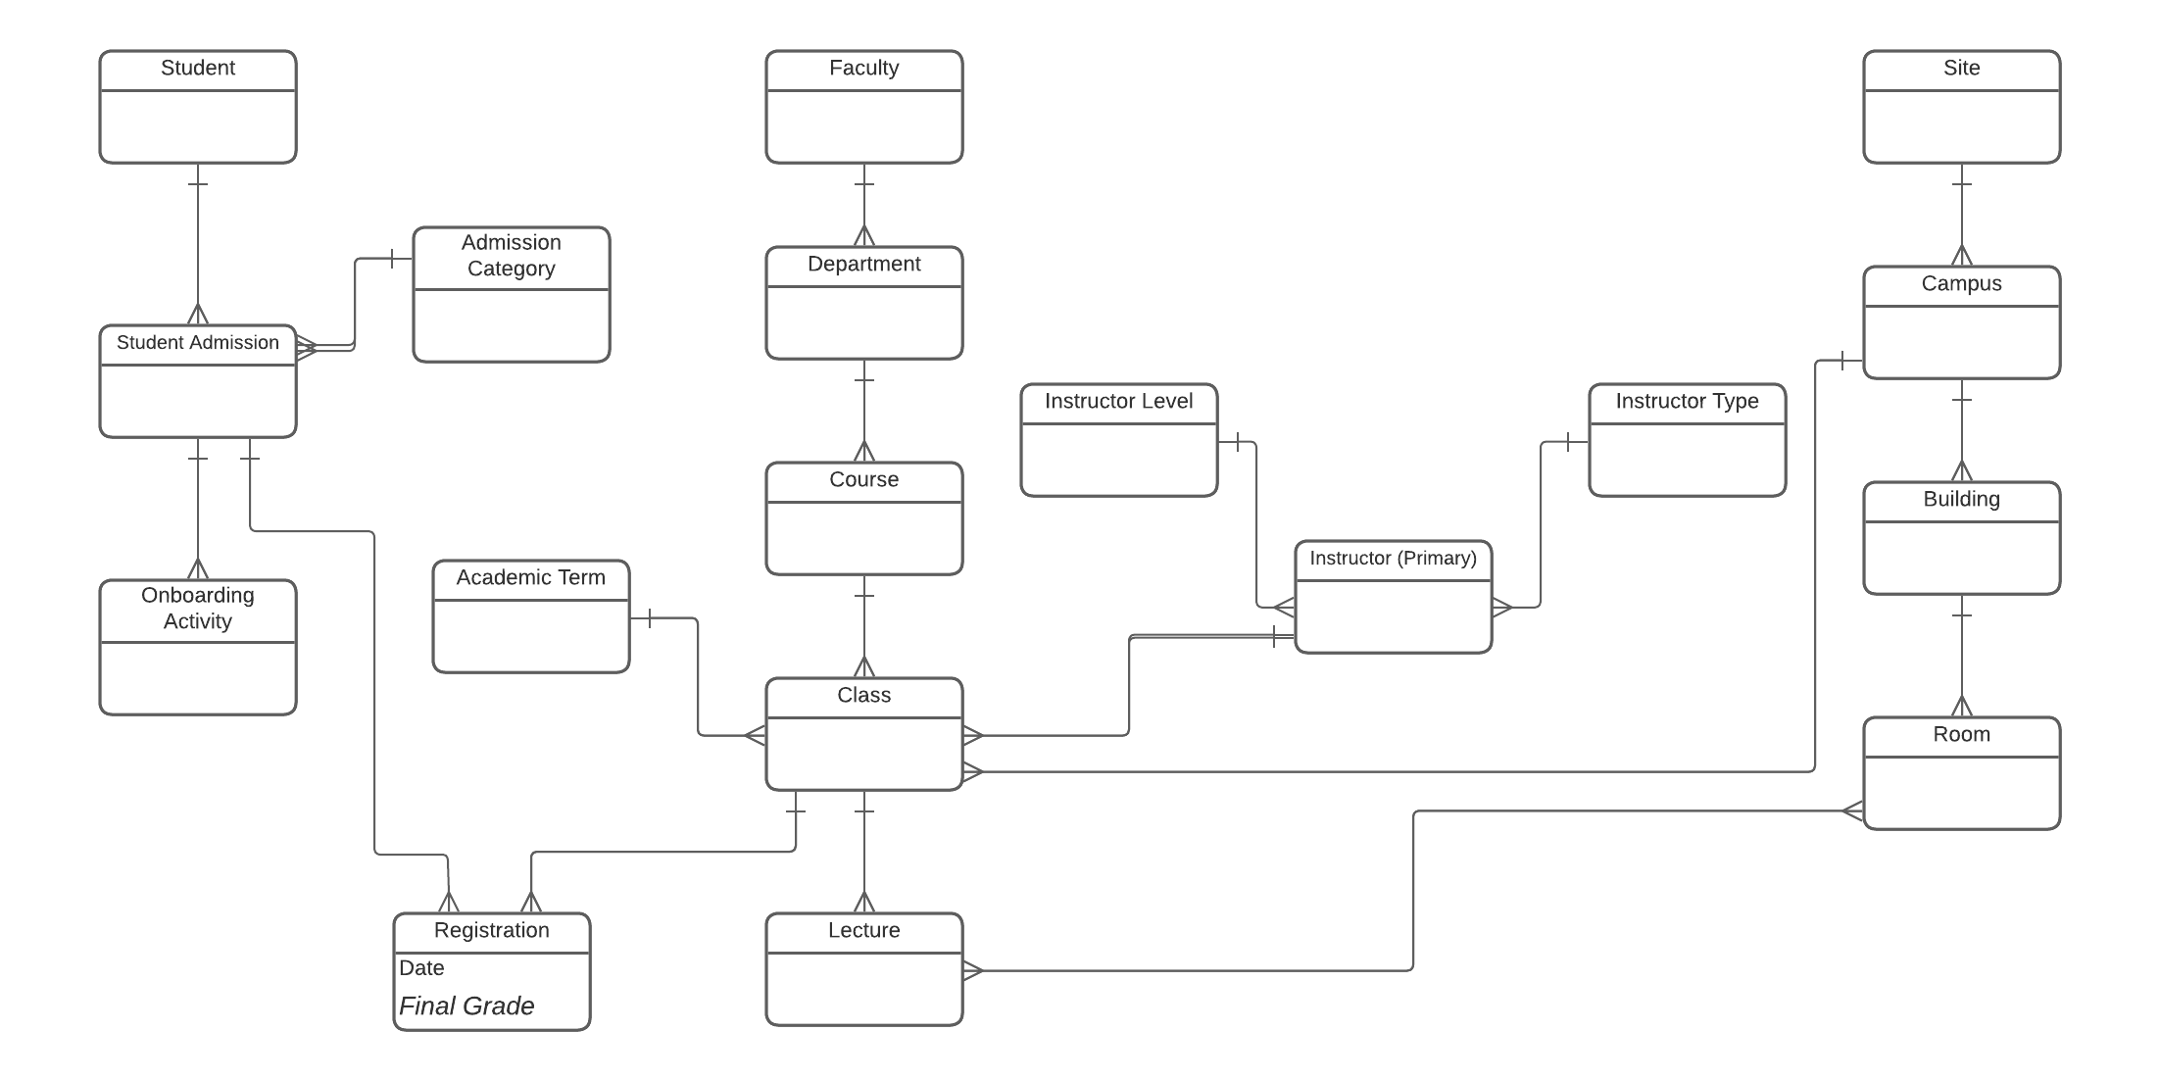
The Fact will be some low-level associative or characteristic

Slide 92
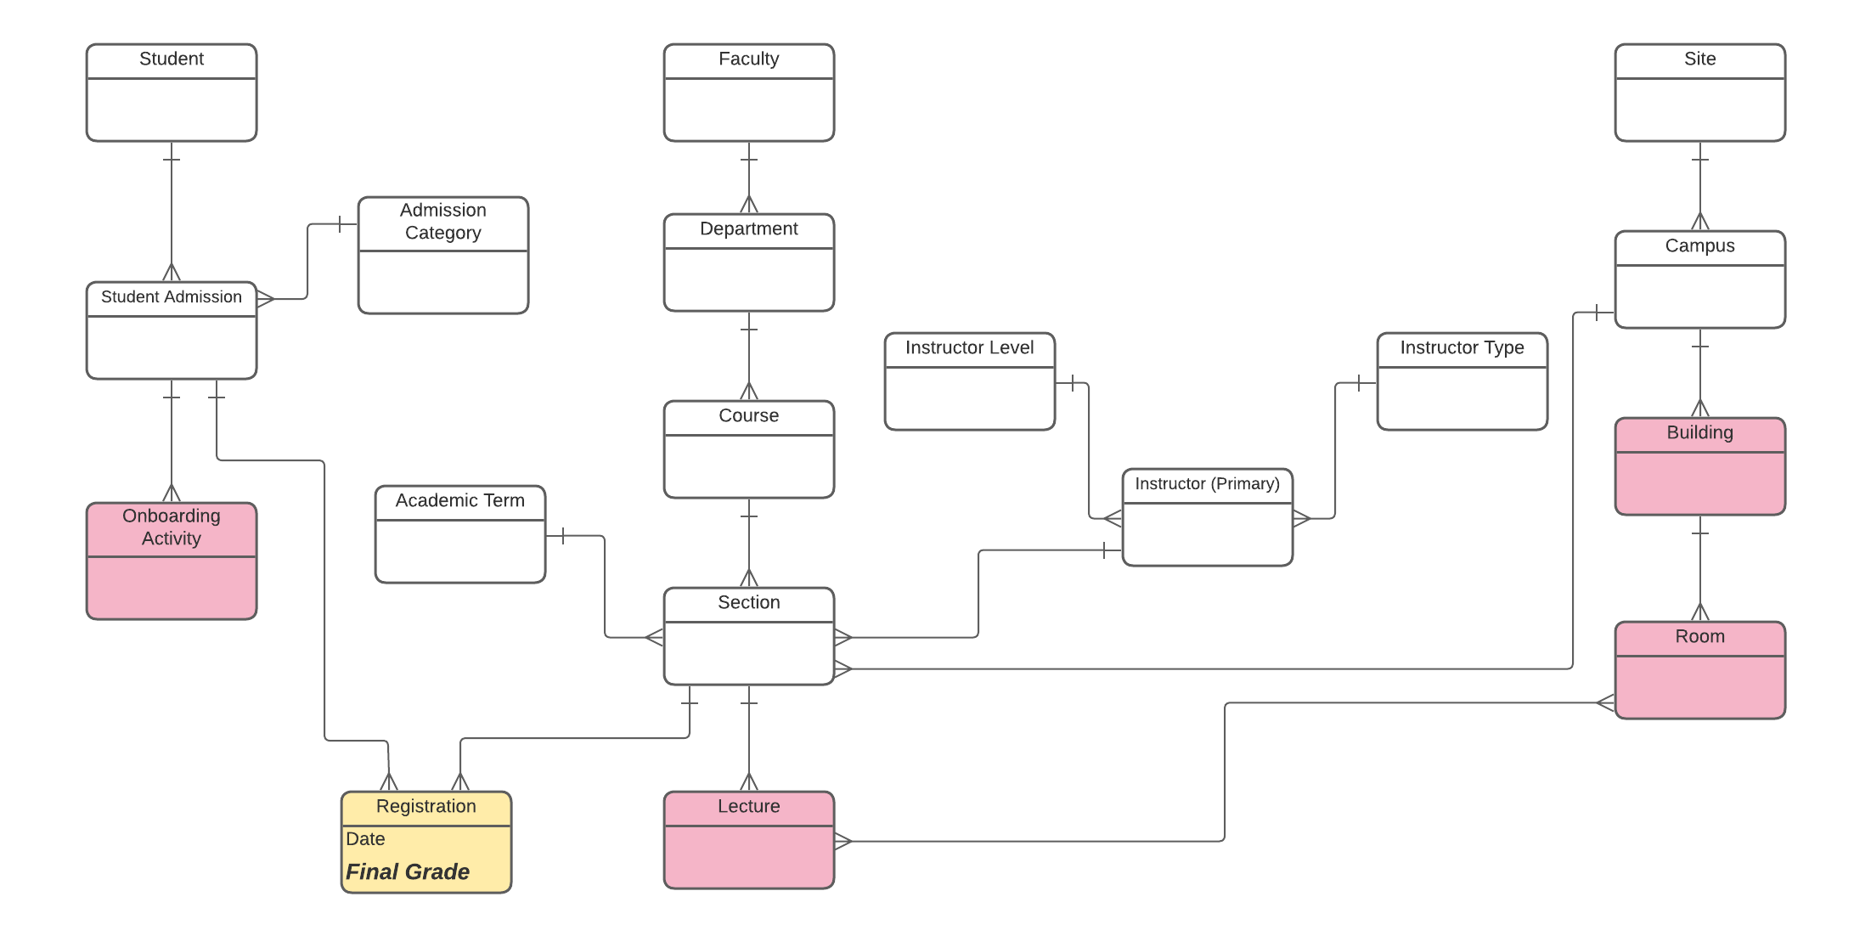
Entities at the far side of a 1:M can't be included

Slide 93
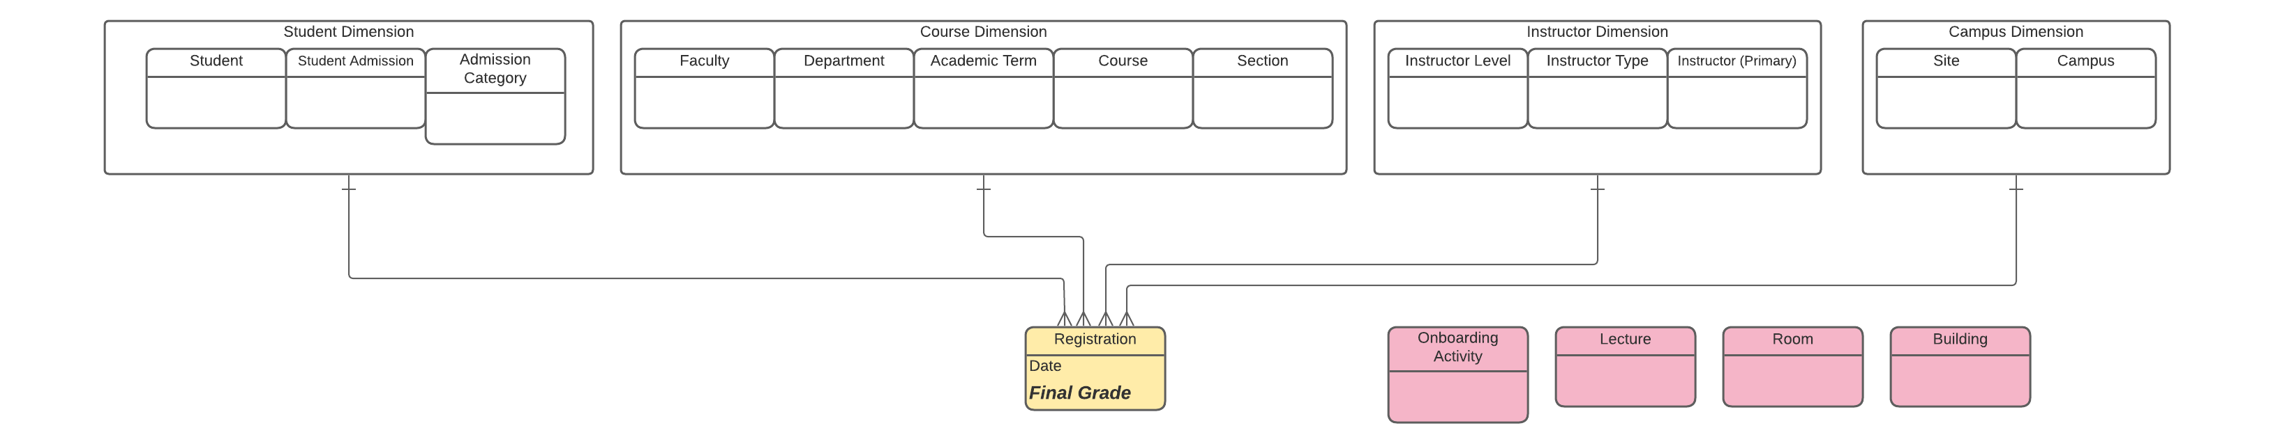
Entities "flattened" into Dimensions

Slide 94
Self-study Dimensional Modelling exercise
Jim's sister-in-law June has just returned from a BI conference, and she has Jim all wound up about building a query database so he can analyse sales (purchases by customers.)
Construct a dimensional model for Jim, using the following E-R model as a starting point. At this point, don't worry about individual attributes – just which entities would collapse into which fact or dimension. A few notes:
- Jim's has grown to a nationwide chain, with stores in many regions. Most regions cover one or more states, although some regions only cover part of a state (e.g., Northern California and Southern California). Each store is in a single city, though, and each city is in only one region.
- The layout of stores (Sections, Aisles, Store Categories, etc.) varies widely across the stores.
- The “Store Category” indicates if the store is a mall location, streetfront, “captive” (contained within another retail outlet,) etc. Web sales are not a factor.
Jim is especially interested in how the same Title sells depending on where in the Store it is displayed, because the same Title might end up in different Sections. He also wants to look at Sales by Store, Region, Artist, Publisher, Supplier, Category, … well, just about everything! You'll have to decide what's possible and then be prepared to explain it to Jim!
Slides 90-96 are a self-study exercise –
skip ahead to 97.

Slide 95
Dimensional Modelling exercise

Slide 96
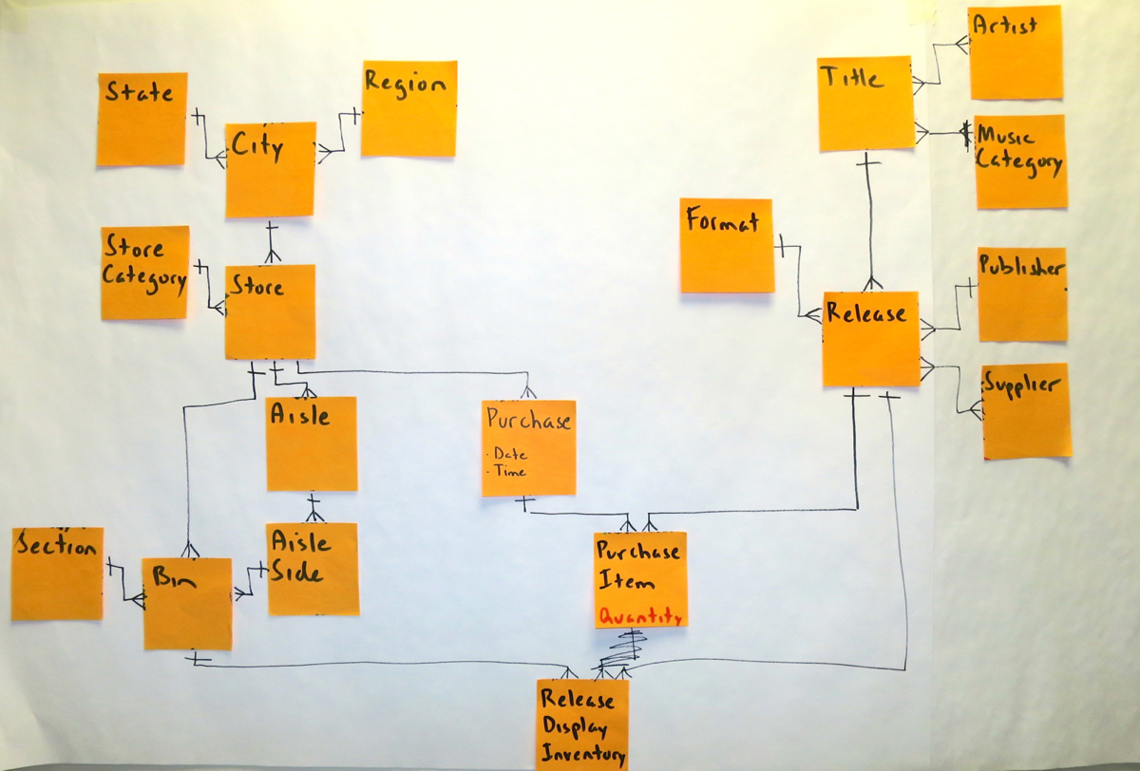
Dimensional Modelling exercise

Slide 97
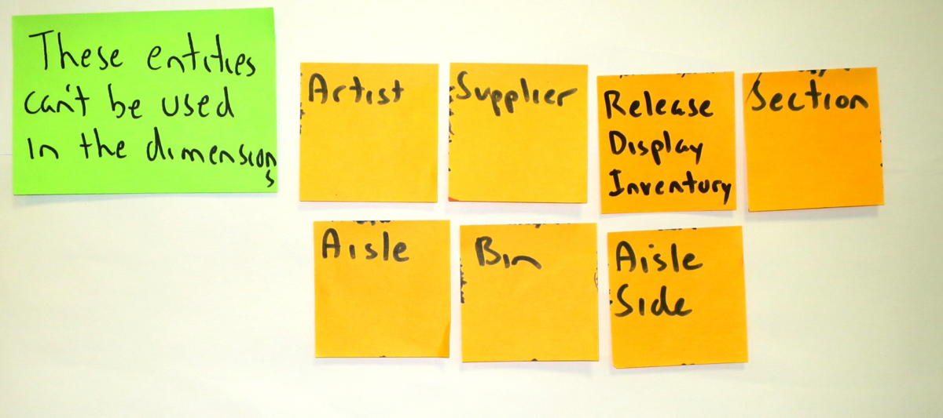
Dimensional Modelling exercise

Slide 98
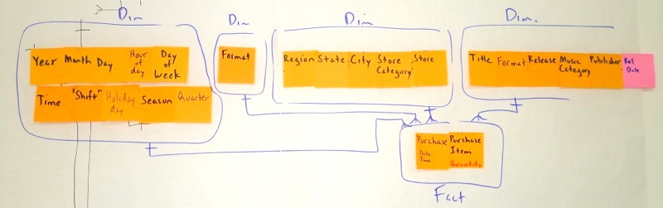
Dimensional Modelling exercise

Slide 99
Solution: Dimensional Modelling exercise
Notes:
As it turns out, having an E-R model is invaluable in producing a valid star schema, although many data warehouse experts will argue the point…

Slide 100
This slide left blank to maintain balance in the universe

Slide 101
Interesting structures
Æ | Fundamental and Advanced Topics
Introduction and Level-set Issues, Principles, Hands-on Case Study Essentials of Concept Modelling Transition from Conceptual to Logical, and Logical to Dimensional Interesting Structures Types vs. Instances Recursion, Subtyping, & Generalisation Meeting New Requirements Modelling Time, History, & Change Rules on Relationships and Associations Multi-way Associatives & Complex Rules Advanced Normal Forms (4NF & 5NF) Presentation Techniques for Data Modellers Core Techniques for Presenting A Real-life Example
ê | Topics
Types vs. Instances Attribute vectors Recursion and generalisation, in general Recognising lists, trees, and networks, and modelling them with recursive relationships Generalisation (subtyping) - when to use it, and when not to Modelling difficult rules

Slide 102
Exercise: libraries and bookstores
Your local library and your local bookstore share some obvious similarities:
  Libraries loan books to cardholders (what the library calls a customer) and bookstores sell books to customers. Customers get to keep their purchases, but cardholders have to return whatever was loaned to them within a stated time period.
  Bookstores and libraries both keep track of all transactions (“purchase” or “loan”), but:
    the library always records the cardholder for the transaction
    the bookstore only records the customer for the transaction if they belong to their “frequent buyer” program.
  Some miscellaneous points:
    Purchases and loans can both cover multiple items.
    Both of them use the term “book” somewhat loosely; they also deal with different Format Types - audiotapes, videotapes, CDs, CD-ROMs, and so on.
    They both call a "book" a "Title," and when a Title is available on a specific Format Type (Softcover, Hardcover, CD, DVD, Audiobook, e-Book, etc.) they call that a "Release."
    Both organisations care about the “Book's” title and author
    Both organisations deal solely with “Books” (whatever you decide to call it) – they do not carry other types of products, or at least Books are all we care about.
What are the most important differences between the two models?
Build a simple data model for the library, and one for the bookstore. Make a guess at a few important attributes for each of the entities in your model.

Slide 103




The big difference - the "Types vs Instances" issue
Library – tracks types and instances
Bookstore – only tracks types
A Title – the type
Library has many instances (Copies) of that Title
Each Copy (instance) of the same Title (type) has its own unique serial number – so we know which Cardholder has each.
Each instance of "Spare" does not have its own unique serial number – we can't tell one from another. All we know is how many we have. ("Quantity On Hand.")

Slide 104


Solution: differences and notes
  Differences – library vs. bookstore
    loan vs. purchase: loan – we want it back; purchase – one-time
    one book is loaned many times in a library, but sold once in a bookstore
    library: cardholder (mandatory); bookstore: customer (optional)
    library – loan has a return date; bookstore – we hope there is NO return
    bookstore – has a price (but the library may sell books)
    types vs. instances –
    bookstore: type (Title); library: each instance (Copy)
  Diane McKellar, civic government –
  "Get it wrong and live in pain forever!"
  An Inventory Management system was selected
  that only tracked TYPES of Items.
  During implementation it was discovered they also
  needed to track INSTANCES of certain Items –
  "Rotables." These were Items that could be rebuilt
  and "rotated" in and out of service.
  The solution was a complex and expensive
  "shadow system" built in Excel.

Slide 105
Solution: libraries and bookstores
basket analysis
Notes:
The famous “types vs. instances” problems
Both the Book Store and the Library keep track of the type of items (“books”) they deal in - the Title.
Only the Library keeps track of individual instances of the items they deal in - the Copy.
The Bookstore keeps track of the total quantity on hand, but not each instance.
A Purchase may have a Customer while a Loan must have a Cardholder.

Slide 106
Handling “vectors” of attributes
Vector:
A fixed number of repeating attributes
Examples of vectors:
7 days of the week
4 quarters in a year
12 months in a year
52 weeks in a year
3 prices for a product
(store price, list price, discount price)
Each row is a vector

Slide 107
Modelling vectors
Flight Dep Time Arr Time Frequency
number from (24 hr) to (24 hr)
SQ017 YVR 1225 SIN 2335+1 1 - - 4 - 6 -
SQ500 SIN 0715 BLR 0900 1 - - - 5 6 -
SQ502 SIN 2000 BLR 2155 1 2 3 4 5 6 7
SQ501 BLR 1015 SIN 1720 1 - - - 5 6 -
SQ503 BLR 2310 SIN 0605+1 1 2 3 4 5 6 7
SQ018 SIN 0950 YVR 1105 1 - - 4 - 6 -
Above are some of the flights you need to know about in order to travel from Vancouver (YVR) to Bangalore (BLR) via Singapore (SIN) on Singapore Airlines (SQ.)
“Frequency” indicates which days of the week the flight operates by using a string of 7 characters, with
position “1” representing Monday, “2” Tuesday, through to
position “7” indicating Sunday.
If the number is present, the flight operates on that day.
If a dash (“-”) is present, the flight does not operate on that day.
SQ017 operates Monday, Thursday, and Saturday,
and not on Tuesday, Wednesday, Friday or Sunday.
SQ502 operates every day of the week.
Build some alternative data models to record this subset of the flight schedule.
Make note of some of the decisions you have had to make in preparation for class discussion.

Slide 108

Modelling vectors – solution
This is an example of the "cast out and classify" pattern
Row-wise solution
+ easy to display data
- inflexible
- queries more difficult
Column-wise solution
+ flexible
(change size of vector)
+ Many queries are
much easier
Many "interesting" physical
implementations are possible.

Slide 109
Recursion
When one entity occurrence can be related to another occurrence of the same entity type
Also know as a
"self-referencing" relationship
Three variations:
  1:1
  1:M
  M:M
Often involves generalising
Division
Department
Organisation
Unit
generalises
Section
etc.
With your colleagues, discuss situations in which you could use recursive 1:1 recursive relationships – they are not common.
1:M and M:M relationships recursive relationships are very common.

Slide 110
Recursion - recognising the data structure
Notes:
The name on the M:M (network) relationship could be more descriptive:
contains / contained in
precedes / follows
substitute with / substitute for
Drawing out examples (the fourth “D” in data modelling) will always help

Slide 111
Recursive 1:1 relationships
The train above is an example of a “linked list”
A linked list can be handled with a
recursive 1:1 relationship
All the items in the list must be generalised into the same type of entity(or a supertype with multiple subtypes - “Rail Car” would subtype into “Freight”, “Locomotive”, “Passenger”, etc.)
The foreign key can either "point ahead"
or "point back" – depends which end you add new instances from
As always, the recursive relationship is
"fully optional"
  the first car doesn't have a car in front of it
  the last car doesn't have a car behind it.

Slide 112
Recursive 1:M relationships
The organisational structure is a “hierarchy”
A hierarchy can usually be
handled with a recursive 1:M relationship
Again, this requires all the items to be
generalised into the same type of entity
The foreign key must be at the “Many” end,
so the child “points to” the parent
As with all recursive relationships,
this is "fully optional"

Slide 113
Recursive M:M relationships
This project plan is a “network”
A network is handled with
a recursive M:M relationship
This resolves to an associative entity linking two different instances of the same entity

Slide 114



Future-proofing – "Avoid fixed hierarchies"
If we implement this model,
what will go wrong?
New types of Organisation Units
will arise
New
connections
will appear
This revised model is far more flexible.
This is an example of the
"generalise, recur, and classify" pattern.

Slide 115
Supertypes and subtypes
all jobs
Job
Supertype
Job Title
Creation Date
Job Type Code
describes
duties of
Employee
Subtypes
performs
Management
Job
Salary Amount
Certification
Bargaining
Unit Job
requires
required
for
Hourly Wage Amt
Confidential Flag
only B.U. jobs
Breaks an entity down into two or more 'subtypes',
or generalises two or more into a single 'supertype'
  common relationships and attributes go into supertype
  unique relationships and attributes go into subtype
Subtypes are mutually exclusive and mandatory –
there is exactly one subtype instance for each supertype
a.k.a., generalisation-specification, or gen-spec

Slide 116
Generalisation vs. subtyping
“Generalisation - Specialisation” is typical O-O terminology;
“Supertype - Subtype” is typical E-R terminology. Gen-spec.
Generalise whenever two or more entities, each with their own distinct attributes and relationships, also share other attributes and relationships
Automobile, Aircraft, and Vessel have common attributes that could be generalised into Vehicle…
…or, Vehicle could be sub-typed into Automobile, Aircraft, and Vessel, with the same outcome
Note that it's common for a subtyped entity to also be classified by a type or reference entity. In this example, Vehicle Type Code is the “subtype discriminator.”
Notes:
The “subtype discriminator” tells us which subtype should be present.

Slide 117
Subtyping - alternative formats
Two different diagramming approaches are widely used -
“Box in box”
(e.g., Oracle modelling tools)
Generalisation hierarchy
(e.g., most ER- or UML-based modelling tools)
Notes:
Note that some people put the “1” multiplicity on the lines, others don't

Slide 118
Don't confuse “roles” and “subtypes”
Employee
Course
Employee ID
Name
etc.
acts
as
acts
as
acts
as
Class
Student
Instructor
Certifier
Employee ID
Grade Point Av.
Employee ID
Ranking Code
Ranking Date
Employee ID
Authority Code
is enrolled in
is qualified to teach
Roles
A “role” structure is used when there are two or more different “roles” that an entity type can take on.
Similar to subtyping
  unique attributes and relationships go in the role entity
Different from subtyping
  the roles are not mutually exclusive
  the parent does not necessarily have to take on any role

Slide 119

An example with supertype, subtypes, and roles
Note that some roles are valid for one subtype (Person or Organisation.) If a role is valid for both, we connect it to the supertype (Party.)
Supertype
What I Am
Subtype
Subtype
Roles
What I Do

Slide 120
When to generalise
Generalisation is good if generalised items -
are fundamentally the same
share common facts and behaviours
Without specification
With specification
Rail Car
Rail Car
Division
Freight
Passenger
Service
Department
Organisation
Unit
generalises
generalises
Section
Freight
Passenger
Service

Slide 121
Don't generalise too soon
“Too soon”
“Just right”
Customer
Service
Customer
Training
Program
Repair
Part
Service
Call
Request
Request
Confuses the client
Reduces the chance of discovering “specifics”
Specifics first, generalisation later

Slide 122
Combining recursion and generalisation
Business rules can often be handled by a recursive relationship involving supertypes and subtypes:
Between subtypes
Between super and subtype
or 1:1 or M:M
Supertype
Supertype

Subtype
Subtype

Subtype
Subtype
or 1:1 or M:M

Slide 123
Meeting a new requirement…
Confirm and extend the model:
discover new requirements, using a variety of techniques
e.g., look for multi-valued attributes
Philosophy
don't dive in – start simple, add detail in layers
start out in “natural language”
See example
on the next page from our "Good entity?" exercise
1) State the new requirement as an assertion
Start out using the client's language
Then, ensure that the assertion uses terms from the data model (entity names, relationship names, etc.)
This “leads” you to the solution.
Confirm it!
Look for the simplest option first: no change needed,
a new reference attribute, a multi-valued attribute(s),
M:M relationship, new entity
Explore rules, like “what is the basis for multi-valued?”
Confirm it!
2) Develop a conceptual solution
3) Develop a
logical solution
Fully normalised, fully attributed
Follow an “orderly script” –
don't get ahead of yourself or the client
Confirm it!, possibly using other easy-to-follow formats such as screen or report mock-ups.
Notes:
As the model nears completion, the entities have been made as granular (normalised) as necessary. Once the model meets known requirements, we'll also “granularise” the attributes by finding and resolving the following:
Non-atomic attributes:
The attribute has “internal structure” - it could be decomposed into more granular (“atomic”) attributes. E.g.,
“Employee Address” is non-atomic,
“Employee Address Street Name” is atomic – it is at the finest level of granularity that will ever be manipulated or displayed
Semantically overloaded attributes:
The attribute is “overworked” - it contains multiple different attributes, typically encoded into a single attribute
in the earlier days of systems, this was done deliberately by designers to save space (think of the Y2K problem…)
now, it will more likely be done inadvertently by business people who don't know the negative consequences of overloaded coding schemes
Finally, name and define each attribute, and document attribute properties

Slide 124

Example – meeting a new requirement
Whether facilitating or presenting,
use all three Learning Styles -
Visual, Auditory, and Kinesthetic.
In this example we used:
Pictures (E-R Model) - Visual
Words (Definition and Assertions) - Auditory
Examples (Instance model) - Kinesthetic

Slide 125

If time permits, an exercise with subtyping, recursion, & rules
Extend the model so that it can record these additional facts:
1 – Organisational structure
An Organisation must be one of the recognised types, such as Corporation, Partnership, or Society.
An Organisation may be made up of multiple Organisation Units (an internal subdivision,) each of which might break down further into lower-level Organisation Units, and so on.
Each Organisation Unit has only one parent Organisation Unit. Some Organisation Units have no parent Organisation Unit, because they depend directly on an Organisation. That is, they are the highest level of Organisation Unit.
2 – Rules on Organisational structure
Each Organisation Unit is of a specific type, such as division, department, area, team, section, etc. Only certain relationships between types are valid. E.g.,
- a division can contain a department, but a department cannot contain a division.
- a team can be contained within an area or a division
Note – only certain types of Organisation Units can be immediately subsidiary to an Organisation, but we won’t model that constraint at this time.
3 – Organisation ownership
An Organisation may have multiple owners, each of which could be another Organisation or a Person.
Key point:
State the constraint or fact you are trying to model in plain language before drawing the model.
Notes:
If the Primary Key of Business Party was “Business Party ID” what would the key of some of the associatives be?

Slide 126
Exercise work area

Slide 127

Solution
Assertions:
Each Party is either a Person or an Organisation
Each Organisation must be classified as one Organisation Type and
Each Organisation Type may classify one or more Organisations
Each Organisation may divide into one or more internal
Organisation Units and
Each Organisation Unit must be part of exactly one Organisation
Each Organisation Unit must be classified as one
Organisation Unit Type and
Each Organisation Unit Type may classify one or more
Organisation Units
Each Organisation Unit may control one or more other
Organisation Units and
Each Organisation Unit may be controlled by one other
Organisation Unit
The controlled and the controlling Organisation Units must be part of
the same Organisation
Each Organisation Unit Type may control one or more other OU Types and Each Organisation Unit Type may be controlled by one or more other OU Types
The Organisation Unit Type of the controlled Organisation Unit and the Organisation Unit Type of the controlling Organisation Unit must be a pair found in Organisation Unit Hierarchy Rule
Each Organisation may be owned by one or more
Persons or Organisations (which is to say one or more Parties) and
Each Party may own one or more Organisations
A Party may own an Organisation multiple times over a period of time
1.
9.
2.
4.
7.
9.
3.
6.
5.
8.
8.
10.
7.
8.

Slide 128
Exercise: stock exchange trading
Please build a data model from the following facts:
Companies issue shares in various stocks. For instance, Algonquin Industries has issued common stock, preferred A stock, and preferred H stock.
Each stock may be listed on multiple stock exchanges. For instance, Algonquin's common stock is listed on the Vancouver and Toronto exchanges, but its preferred stocks are only listed in Vancouver.
When a customer wishes to buy or sell shares of a particular stock, they place an order on one of the exchanges. The order says, in effect, that “I am offering to buy (or sell) X quantity of stock Y for price Z for the next W days” If it is a sell order, the customer must also (by law) indicate if they are short selling (Short Sale Flag is set)
The Automated Trading System matches up buy and sell orders if the prices are within certain parameters. A complex algorithm determines the actual price of the sale. Note that an order may not be satisfied all at once (i.e., with one sale). For instance, an order to sell 10000 shares may be matched with a buy order for 5000 shares, another for 3000 at a later time, and it may expire before the remaining 2000 shares sell.
Build an initial E-R data model illustrating all the relevant entities, and their relationships.
Identify the main entities
Agree simple definitions
State assertions that describe the scenario
Arrange entities by dependency
Add and name relationships
  name the relationship first
  only then add cardinality (ones and manys)

Slide 129

Sample Instance Model

Slide 130
Assertions and clarifications
Each Company may issue one or more Stocks and
each Stock must be issued by one Company
Each Stock must be classified as one Stock Type and
each Stock Type may classify one or more Stocks
Each Stock may be listed on one or more Exchanges and
each Exchange may list one or more Stocks
(The Company chooses which Exchanges to list on)
Each Customer may place
one or more Buy or Sell Trade Orders &
Each Buy or Sell Trade Order must be placed by one Customer
Each Trade Order is either a
Buy Trade Order or a Sell Trade Order
Each Buy Trade Order may be filled by one or more
Sell Trade Orders and each Sell Trade Order may be filled by
one or more Buy Trade Orders
The Buy and Sell Trade Orders for a Trade must be placed by
different Customers
Each Trade must be a match of one Buy Trade Order and
one Sell Trade Order
A Listing is an authorisation to
buy or sell a specific Stock
on a specific Exchange
A Buy Trade Order is an offer to buy …
A Sell Trade Order is an offer to sell…
  a stated quantity
  of a specific Stock
  on a specific Exchange
  at a specified price
  during a specified time period
The matching of a Buy Trade Order and a Sell Trade Order is referred to as:
  a Sale
  a Match
  a Fill
  a Trade
  a Buy/Sell Transaction…

Slide 131

Possible entities for the Stock Exchange model

Slide 132

Initial Concept Model for Stock Exchange Trading
Instead of the "hash mark" (One) and "crowsfoot" (Many) this uses the symbol Miro offered at the time – an arrowhead. Miro now supports "crowsfoot" notation.

Slide 133

Second iteration Concept Model for Stock Exchange Trading
Key point!
Resolving the M:M between Stock and Exchange (creating Listing) and
generalising Sell Order and Buy Order into
Trade Order makes the model easier to understand!

Slide 134

An important constraint to check for
When there are two paths up to the same parent entity always check if the two paths must lead up to:
the same parent entity
different parent entities
either the same or different parent entities
(it doesn't matter)
We must check the paths from
Trade to Customer - different Customers
Trade to Listing - the same Listing

Slide 135


Don't generalise too soon! Specifics first, generalisation later
Patience
is a virtue!
Generalisation
Client:
"Wow! Buy and Sell Trade Orders
look very similar!"
Me:
"Omigosh!
That's amazing!"
Specifics

Slide 136
Complete solution: stock exchange trading

Slide 137
Modelling time, history, and change
Æ | Fundamental and Advanced Topics
Introduction and Level-set Issues, Principles, Hands-on Case Study Essentials of Concept Modelling Transition from Conceptual to Logical, and Logical to Dimensional Interesting Structures Types vs. Instances Recursion, Subtyping, & Generalisation Meeting New Requirements Modelling Time, History, & Change Rules on Relationships and Associations Multi-way Associatives & Complex Rules Advanced Normal Forms (4NF & 5NF) Presentation Techniques for Data Modellers Core Techniques for Presenting A Real-life Example
ê | Topics
Issues in modelling history History vs. audit trail “What’s wrong with this model?” Modelling for “as of” reporting Physical time and Business time Time-specific considerations

Slide 138
History in data models
Ability to record previous values for attributes and relationships
Ability to record history, with care, gives ability to record future cases
Issues
E-R diagramming techniques don't support time-based rules,
e.g., “1:1 at a point in time, 1:M over time”
Two types of change – business data change, and data correction
The client might initially say they don't need history, but…
Notes:
In general, modellers might be more careful about how they model history if SQL had a more extensive set of time-based operators, e.g. “when”, “as of”, “overlap”, etc.
Also, it's common for modellers to worry about the performance of the physical database while they are doing conceptual and logical modelling. This is a terrible mistake – always model reality, e.g. the events that cause data to change, and let the physical database designer determine the best design. Often, a highly normalised design delivers better performance than the highly denormalised structure (e.g., a "snapshot" table) that seems intuitively to deliver better performance.

Slide 139
Exercise: a flawed model including time dependent data
Jim needs to track List Price and Store Price over time for each Title the store carries. It is very important for him to be able to list the history of changes to either price, and the date, so that pricing information can be compared to sales figures.
Either or both prices may change at any time. Often, a price change is known before it is due to take effect.
The model to the right has several flaws – try to list at least five.
Then, construct a model (or a few alternatives) that will support Jim's needs.

Slide 140
A spot for you to think about that "Title Price" model

Slide 141
Solution – what was wrong with the flawed model?
Data modellers only know three numbers –
0, 1, and Many – but this model has two Price types
List and Store Prices are in two places. It's unclear which is current, previous, or future.
"Has" is not a descriptive relationship name
History
is mandatory
"History" is not good in an entity name.
If we change and correct a price on the same date it is not clear which is which
"Effective Date" should not be in the primary key – it is business data so it can change.
There is no "End Date." There is only one situation where you do not have to include an End Date / Expiry Date / Last Valid Date.

Slide 142
Best solution: time dependent data
The most general solution
No price data
Two types of Price –
and two is not a number Data Modellers recognise!
Current & previous prices
of any type
Notes:
The best – have one characteristic Price entity with a Price Type.
Now, let's look at an interesting problem involving corrections…

Slide 143


Future-proofing – "Avoid a fixed number of repeating attributes"
This revised model offers greater flexibility and supports richer queries.
This is an example of the
"cast out and classify" pattern.
This model shows two types of Prices – List and Store.
Tomorrow a third will arise… and a fourth and a fifth…
Data modellers only know three numbers –
0, 1, and Many (One or More.)
We don't recognise 2.

Slide 144
Two important time concepts
Logical Time
Physical Time
Effective date/time,
Start date/time,
Begin date/time,etc.
Time that data reflects the intent of the business at the time of update
Reality
Recorded date/time, Transaction date/time,
Update date/time,etc.
Time when a record was written to the database
Representation
Remember
Remember
Can be updated
Cannot be updated
Wrong – with developments like Sarbanes-Oxley, we don't change stored data, we add new records.
Notes:
A third type of time is “User Time” - any other date/time of interest to the business
(e.g., Reservation Arrival Date)
Note that we always explicitly record the beginning and end of any time period, e.g. Effective Date and End Date. When would it be safe to record only the beginning of a time period?
There are various common alternatives to “Effective Date” and “End Date.” Whichever you choose, it's critical that standard naming be adopted and followed, or the data structure will definitely be misinterpreted.
Begin Date and End Date
Start Date and Stop Date
Effective Date and Expiry Date
First Valid Date and Last Valid Date – this one is clearest about whether the date range includes the ending date (it clearly does, using this naming convention)
choose one and stick with it!
Standard approaches will also allow reuse of application service logic (e.g., interval manipulation)

Slide 145
Change and correction
The situation…
Employees are given a credit limit, which is checked whenever they attempt to make a purchase to ensure that the purchase amount does not exceed the credit limit.
Purchases are approved or rejected based on the credit limit; a record of the transaction is always made.
The credit limit changes over time, and changes to the credit limit can be entered into the system before or after the effective date of the change.
Mistakes in entering data about credit limits are common, leading to frequent corrections. Currently, the business uses a “correct in place” approach and erroneous values are overwritten with correct ones.
The problem is that after an erroneous credit limit data has been corrected, it's often difficult to see in the data why a particular transaction was approved or rejected. We need a data model that will resolve this by recording pre-corrected and corrected data.
For example…
Rochelle, a new employee, was given a credit limit of $5000, effective Sept 01 2019. This was entered into the system on Sept 04 2019, with an End Date of Aug 31, 2020.
Rochelle's attempted $3000 purchase on Sept 03 2019 was rejected.
A year later, Rochelle's credit limit was raised to $10,000 effective Sept 01, 2020 with no end date specified (that credit limit was to be in place indefinitely.) However, the new limit was mistakenly entered into the system as $100,000 on Aug 22, 2020.
That error was corrected on Sept 15 2020, when the credit limit was revised to $10,000.
Before the correction, Rochelle's $17,000 purchase on Sept 08, 2020 was approved.
In late September of 2020, auditors were not able to understand why the $3000 Sept 20190 purchase was rejected, nor why the $17,000 Sept 2020 purchase was approved.

Slide 146
Change and correction solution
 | Initial | Erroneous | Corrected
Amount | $5000 | $100,000 | $10,000
Effective Date | 2019-09-01 | 2020-09-01 | 2020-09-01
End Date | 2020-08-31 | 9999-12-31 | 9999-12-31
Updated End Date | null | null | null
Recorded Date | 2019-09-04 | 2020-08-22 | 2020-09-15
Corrected Date | null | null | null
Notes | Effective and End Dates record business intent; Recorded and Corrected Date reflect database activity. | An open-ended record has an End Date set to a “high date” value. If a specific End Date is later set, it is recorded in Final End Date if you don't want to overwrite End Date. | The Corrected Date of the corrected (previous) record is set to the Recorded Date of this correcting record.
2020-09-15
Notes:
Key point – we don't change erroneous data values; we create new correcting entries. The only data that might change is End Date and Corrected Date. The Corrected Date will be “null” for currently valid records; for records that are no longer valid because a corrected version has been created, the Corrected Date is set to the Recorded Date of the correcting record. In some organisations, changing an open-ended End Date (“high date”) to a specific End Date would upset the auditors; if that's the case at your organisation, you might want to use a Final End Date to record an End Date that is set sometime after the record was created.
Note – in practice, DBAs (and developers!) won't want “null” as a value for dates, so the convention will be to set unspecified (null) values to a “high date” – 9999-12-31.
Note – if there is a time period during which the Employee has no Credit Limit, there are two choices:
(1) Have no record for that date range
(2) Have a record for that date range with a $0.00 Credit Limit.
When would option (2) be better?
What are the constraints on date ranges?

Slide 147

Four approaches to time dependent data
Show only the current state of the entities
Show how the data
was recorded at various times in the past
1
No history, no future
2
Shows database activity -
physical DB update dates
Done “by accident” in older systems that used system clock as effective date
1
2
3
4
Show how the data
was intended at various times in the past
Show both how the data
was intended, and how the data was actually recorded at various times in the past
Shows business intent -
effective/end dates
This is the most common approach
Shows intention and correction
Supports “as of” reporting
Notes:
This classification scheme for the various approaches is fairly widely used, but was first documented by Richard Snodgrass, University of North Carolina at Chapel Hill - “Temporal Databases”, COMPUTER (published by the IEEE), September 1986
By the way, it would be safe to record only the Effective Date (beginning of the time period) if
the time periods are contiguous
no gaps (the beginning of one = the end of the next)
no overlaps
updates arrive in time sequence
the latest record really does go on forever

Slide 148
Time dependent data – key points
Facts that change independently
should be recorded independently
Never name the entity “History” –
it probably includes present and future values
Distinguish between
  business Effective Date
  database Recorded Date
It's tempting to put “Effective Date” in the key,
but it might change, and might prevent two records from having the same Effective Date even when that makes sense
Be sure to define what End Date / Expiry Date date means
("tot en met")
Capture the need (the “reality”) first in the model,
then factor in performance considerations
You might need to consider time zones
  GMT / UMT / UTC
  Local offset
Notes:
Plus –
don't change stored values, add new records
check for “one at a time, many over time” vs. “many at a time, many over time”

Slide 149
Rules on relationships and associations
Æ | Fundamental and Advanced Topics
Introduction and Level-set Issues, Principles, Hands-on Case Study Essentials of Concept Modelling Transition from Conceptual to Logical, and Logical to Dimensional Interesting Structures Types vs. Instances Recursion, Subtyping, & Generalisation Meeting New Requirements Modelling Time, History, & Change Rules on Relationships and Associations Multi-way Associatives & Complex Rules Advanced Normal Forms (4NF & 5NF) Presentation Techniques for Data Modellers Core Techniques for Presenting A Real-life Example
ê | Topics
V-A-K – using all the tools to build a model Multi-way associations and complex rules Advanced normal forms – resolving circular relationships and cyclic dependencies

Slide 150
Four key points about complex associations
You can't tell whether a model is correct or not simply by inspecting it – you must have business involvement
This gives rise to the other three points…
You must draw the model in a top-down fashion (or other systematic approach) so you can actually see dependencies
You must state your assumptions or understanding in narrative form as assertions, using terms (entity names, relationship names, and attribute names) from the data model
You must illuminate the data model by using sample data, schematic diagrams, scenarios, or some other understandable form

Slide 151
A quick exercise…
The company decides which Items will be carried at which Stockrooms.
The company qualifies Suppliers to provide specific Items.
(A Supplier can be qualified to provide multiple Items, and an Item may be provided by multiple Suppliers)
The company enters into a Supply Contract with qualified
Suppliers for each Item they will provide to a specific Stockroom.
Will this model satisfy the business constraints?
If not, identify specific problems and develop a better model
There are insert anomalies -
Can't record the
independent Supplier-Item relationship without including Stockroom –
"Stockroom #9999999" – a dummy Stockroom
Can't record the
independent Stockroom-Item relationship without including Supplier –
"Supplier #9999999" – a dummy Supplier
There are also
delete anomalies
Notes:
A 5NF violation occurs if independent relationships between pairs of entities have been lumped together with other independent relationships.

Slide 152

First, record independent relationships

Slide 153


Then, associate the associatives
Or use one Item ID as part of two foreign keys
Must go up to the
SAME Item, so Item IDs must be the same!

Slide 154


Fourth Normal Form and Fifth Normal Form

Slide 155


More possibilities…
Single-valued attributes
make data more "reportable."
Non-redundant – each attribute value is recorded only once.
Associative entities are as granular as necessary to reflect business rules.

Slide 156
This slide added to maintain balance in the universe

Slide 157
Presentation techniques for data modellers
Æ | Fundamental and Advanced Topics
Introduction and Level-set Issues, Principles, Hands-on Case Study Essentials of Concept Modelling Transition from Conceptual to Logical, and Logical to Dimensional Interesting Structures Types vs. Instances Recursion, Subtyping, & Generalisation Meeting New Requirements Modelling Time, History, & Change Rules on Relationships and Associations Multi-way Associatives & Complex Rules Advanced Normal Forms (4NF & 5NF) Presentation Techniques for Data Modellers Core Techniques for Presenting A Real-life Example
ê | Topics
A learning experience The storyboard A demonstration Five key techniques

Slide 158
Presentations – my “new Customer data model” experience…
Road show version 1
“Here's the new Customer model.
How do you like it?”
“So what?” “Obvious!” “Yawn.” “ZZZZZZzzzzzzzz….”
VP of IS:
  “You're dyin' out there, kid! I want you to drag them through all of the pain and misery of our current files and databases.
  Then show the new model.”
Road show version 2
“Let's try answering some important questions using the current model, and then the new model”
“Fantastic!”
“When do we get it?”
“Do you need funding? We can help!”
Notes:
The moral – the better the data model, the more obvious it will seem

Slide 159
It's a story, so storyboard it
Business
issues have
changed…
Details
Operational to informational
Distributed, component-based
Cross-functional
… and therefore
systems have
changed…
…so methods
for building
have changed
Making these
changes will
be difficult…
Æ | Building the storyboard
Draw 5 "bubbles" Fill in the last (your "closer" - the purpose) Fill in the first (your "hook") Fill in the middle ones (the "body") – add or subtract bubbles as needed Allocate details to bubbles Iterate until it flows and builds properly Only include detail that matters!
…but it is vital
to our
survival
Notes:
Used to evaluate merit and sequence
Presentation should flow like a story
does it make sense?
does it build to the conclusion?

Slide 160
Presenting data models
Try not to call it a data model
I often call it a "world view"
Or… "This is how Application XYZ sees the world."
Start simple, and add details in layers
Begin with two or three fundamental things
Work “across” the model, not a “deep dive” in one area
Draw the model on a whiteboard as you speak to it
Save detail like optionality until later, and primary/foreign keys until much later
Speak exclusively in the language of the business
Don't use terms like entity, relationship, attribute, optionality, supertype, subtype, recursion, etc. Remember, you're describing a business, not a database.
Point to the relevant entity while addressing a concept
Someone overhearing your presentation should not realise you are presenting a data model
Make it real
Back it up with sample data, queries, and scenarios
Identify specific business issues or opportunities, and show how the data model helps
We'll now walk through a successful data model presentation,
followed by a discussion of key points

Slide 161


Storyboard & 1st point for the "Flight Data Model" presentation

Slide 162

"Flight Data Model"

Slide 163

"Flight Data Model"

Slide 164


"Flight Data Model"

Slide 165

"Flight Data Model"
It became a 25-entity concept model, and the businesspeople loved it!

Slide 166
The five techniques that really matter
Technique
Why?
How?
Organise their minds to receive the presentation
Otherwise, you're just "noise"
"Why is this person telling me these things?"
"Here's the point I want to make."
"This is why you care, and how I know."
(even if it's obvious)
"These are the caveats and limitations."
"This is how I'll make my point.“ (storyboard!)
1
Big picture first
Provides context and perspective
Makes subsequent detail understandable
Show contextual data model first,
build up detailed models later
Process context first, process flow later
Describe 5 problem areas first,
specifics of each area later
2
Do it live
Focuses, demands that they watch
Involves them / you
It means 'attending has value'
Use memory triggers, not a script
Build up content progressively on white board, flip chart, or screen
Add brainstorming, discussion, or questions
Have them physically “do stuff”
3
Present information in various forms
Adds interest
Different forms have different strengths
Supplement PowerPoint slides with flip charts, white boards, Post-Its, handouts, etc.
Use props – the thing itself, not a description
Use visual, auditory, and kinesthetic approaches
4
Show, then tell
Point is more meaningful if experienced firsthand
Saves time, simplifies
Scenario / example first, then concept / abstraction
Problem first, solution second
Thing first, description / discussion second
5

Slide 167
Other courses for analysts by Alec Sharp

Slide 168
Thank you – stay in touch!
Alec Sharp
Clariteq Systems Consulting Ltd.
West Vancouver, BC, Canada
asharp@clariteq.com
ig: @alecsharp01
www.clariteq.com
http://amzn.to/dHun1o
And most of all, if you have questions or comments…
don't be shy – send me a note!

