Slide 1

Working With Business Processes Masterclass–
Aligning Process Work with
Strategic, Organisational, and Cultural Factors
Presented by
Adept Events and Clariteq Systems Consulting
Alec Sharp
Consultant
Clariteq Systems Consulting Ltd.
West Vancouver, BC, Canada asharp@clariteq.com www.clariteq.com
© Copyright Alec Sharp / Clariteq 2026 V3.1
www.adeptevents.nl
www.clariteq.com

Slide 2

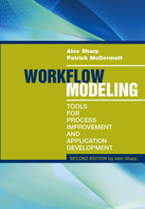
Developer/instructor background…
Alec Sharp, Clariteq Systems Consulting – asharp@clariteq.com
40+ years experience as an independent consultant:
  Business Process Change – discover, model,
  analyse, and design/redesign processes
  Concept Modelling (Business-friendly Data Modelling)
  Application Requirements Specification
  +
  Facilitation & Organisational Change
  Project Recovery
Consulting, teaching, speaking globally
Awarded DAMA’s global Professional Achievement Award
for contributions to "human-friendly" data modelling
Author of “Workflow Modeling”
- best-selling book on process modelling & improvement
- second edition – 2009 (sole author, complete re-write)
Process
Application
Data
Business Process Modelling
Use Case Modelling
Service Specification
Concept Modelling
Check out the nice reviews
on Amazon - http://amzn.to/dHun1o
Notes:
Bio:
Alec Sharp, a senior consultant with Clariteq Systems Consulting, has deep expertise in a rare combination of fields – process modelling, analysis, and redesign; business analysis and requirements specification; and business-oriented data modelling. Increasingly, his work involves facilitation and organisational change. His 40 years of hands-on consulting experience, practical approaches, and global reputation in model-driven methods have made him a sought-after resource in locations as diverse as Ireland, Illinois, and India.
He is also a popular conference speaker, mixing content and insight with irreverence and humour. Among his many top-rated presentations are “Crossing the Chasm - From Process Model to IT Requirements,” “Getting Traction for Process – What the Experts Forget,” “The Multi-Skilled Influencer – Becoming a T-Shaped Professional,” “Integrating Change Into Your Business Process Approach – Timing is Everything,” and “Days not Weeks or Months – Process Change in Agile Timeframes.” His 90-minute briefing “Five Things You Need To Know About Business Processes” has been delivered to senior executives at major organisations around the globe.
Alec literally wrote the book on business process modelling, “Workflow Modelling: Tools for Process Improvement and Application Development.” Popular with process improvement specialists, business analysts, consultants, and business professionals, it is consistently a top-selling title on business process modelling, analysis, and design, and is widely used as an MBA textbook. He was awarded DAMA's Professional Achievement Award, a global award given to one professional a year for contributions to the Data Management profession.
Alec's popular workshops “Working With Business Processes,” “Advanced Business Process Techniques,” “Business-Oriented Data Modelling,” “Business-Oriented Data Modelling MasterClass,” and “Requirements Modelling” are conducted on four or five continents each year (pre-COVID!), at many of the world's best-known organisations. His classes are practical, energetic, and fun, consistently earning “excellent” ratings.
Contact Alec – asharp@clariteq.com

Slide 3


Clariteq – small, husband & wife company, global clients
© Clariteq 2023
www.clariteq.com

Slide 4
Background for this course
Get everyone, even experienced practitioners,
on the same page – conventions, terminology, approach.
Working With Business Processes
2 days
Working With Business Processes
Masterclass
3 days in-person
5 half-days virtually
Advanced Business Process Techniques
2 days
Learn advanced business process techniques,
including building a process architecture, encouraging change, and a feature-based process design method.

Slide 5
Themes and overview...
Three main themes:
Simple techniques, rigorously applied,
help us achieve more in less time.
Communication with and engagement of
the people who do the work.
A holistic not technocratic approach, including
human, social, & organisational factors.
And finally… YOU:
Name – how should I address you?
Role / job title and organisation
Brief description of your work
A topic you are especially interested in?
Please keep your intro under 1 minute
Section 1 – Fundamentals
Sections 2 to 6 – Techniques
Five things you need to know about business processes
How Business Process fits into a framework for Business Analysis:
A three-phase methodology for
Business Process Change
Identifying true, end-to-end, cross-functional
Business Processes
Developing a Process Architecture
(including an interlude on Concept Modelling)
Seven ways to help people embrace Process Change
Human-oriented process modelling
A feature-based Process Design method –
transitioning from as-is to to-be

Slide 6
Five central ideas
It's essential to have clarity on what a business process really is
Existing performance measures are often functionally aligned
and work against business processes
Enterprise system implementations must include
a business process perspective
Success with business processes depends on taking
a holistic view in which six enablers are considered
Business processes can't be great at everything –
a single differentiator or strategic discipline should be chosen

Slide 7
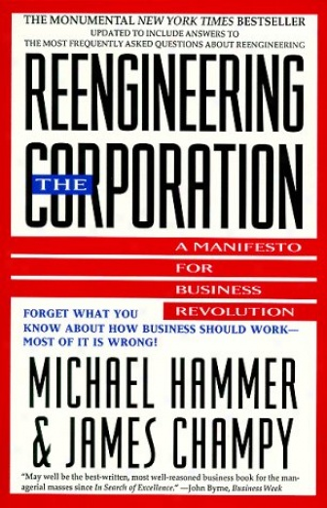
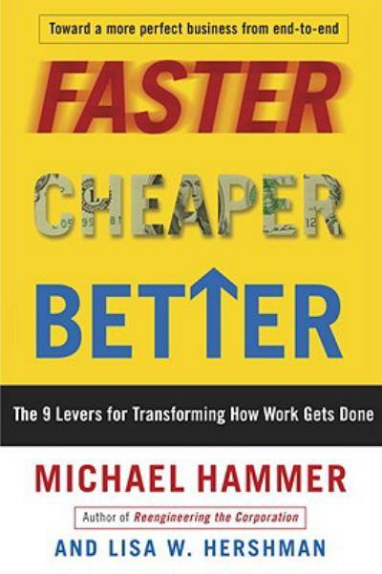
1. Confusion – what is a “business process?”
It is essential to have clarity on what a business process really is
Performance measures may be functionally aligned - work against business processes
Enterprise system implementations must include a business process perspective
(and a concept model, too)
Success with business processes requires a holistic view in which six enablers are considered
A business process can't be great at everything – a single differentiator must be chosen
In the early 1990s, Michael Hammer
popularised the focus on business process
Introduced core terminology:
end-to-end, cross-functional, functional silo, ...
even business process
Still, people and organisations miss the point...
Notes:
Key Point – When major information systems are implemented without regard to end-to-end business processes, overall results range from “okay” to awful. (How awful? Stay tuned…)
When a COTS (commercial off-the-shelf) application is purchased, you're getting more than just software – you're also getting a set of assumptions and implied processes
Companies often re-implement systems they already have in order to make them more process-oriented
Michael Hammer is the man who (more than anyone else) popularised the focus on business processes. He coined the terms "business process reengineering," "cross-functional, end-to-end, business processes,“ and “functional silo.” In fact, we didn't really use the term "business processes" until he wrote his landmark HBR article "Reengineering Work" and later the book "Reengineering the Corporation."
By the mid- to late-1990s though, reengineering was somewhat discredited, and it was SAP consultants that were in demand, so Mr. Hammer started working on SAP implementations. It didn't take long to notice that they didn't all work out favourably. He's a statistician by training, so his firm undertook a study of ~200 companies that had implemented SAP. (Broad sample - all sizes of companies, differing number of modules.)

Slide 8

Lesson #1 – Never assume everyone agrees what a "process" is
We need some help with our Product Lifecycle Management process.
I spend all day writing business processes, like the process to
Revise Product Brochure Image.
Not a single process –
it's a family of multiple business processes
(a process area or process domain)
Not an entire process –
it's a procedure providing instructions for a single task
(SWI – standard work instructions)
A whole spectrum of interpretations of process.
Seek balance –
a “business process”
lies between the extremes
Most people hear process and think procedure!
The key issues – granularity and orientation
Notes:
Process:
(or “end to end, cross-functional, Business Process”)
A sequence or set of activities that delivers significant results for the process’ customer and other stakeholders
involves multiple participants (actors or roles)
and multiple organisation units / functions
may or may not have a defined workflow
initially break a process into five to seven major activities
(subprocesses, phases, or milestones)
each made up of more granular activities or tasks
each of which might contain one or more documented procedures
Procedure:
A set of work instructions for a specific task or activity that will yield identical results every time.
usually one person or a small number of persons;
usually within a single function or organisational unit;
a type of job aid, also known as
Standard Work Instructions (SWI)
or Standard Operating Procedure (SOP)

Slide 9
Taxonomy: a collection of processes vs. a process vs. a procedure
A Process Area or Process Domain –
a “family” of related Business Processes:
Permissions and Agreements
Issue Product Approval
Grant Variance
An end-to-end process – “Grant CSM Program,”
from application to authorisation,
involving many departments, external organisations, participants, and procedures.
Issue Installation Permit
Issue Operating Permit
Renew Operating Permit
Register Design
Register Procedure
Business Process Scope Model (TRAC) – pure “what”…
Grant
CSM (Client Safety Management) Program
Renew
Client Safety Management Program
Grant CSM Program
Trigger
Results
Accept
CSM
Application
Audit
CSM
Program
Verify
CSM
Equipment
Determine
& Collect
Equipment
Fees
Determine
& Collect
Consultation
Fees
Issue
CSM
Authorisation
Business Process:
A sequence or set of activities
that delivers significant results
for the process’ customer
and other stakeholders
main Activities
Cases: New, Legacied, etc.
“how” to complete a task…
Procedure – Calculate Unit Registration Fees:
For each Unit:
Determine Unit Type and Unit Risk Factor;
Apply Registration Fee from Reg. Fee Table;
Identify additional Inspection fees from…
Procedure:
A set of step-by-step work instructions
(a job aid) for a specific task or activity
that will yield identical results every time

Slide 10
A real life (and expensive!) example
As part of a massive system implementation, a global manufacturer identified the business processes that were expected to improve:
Sales process
Manufacturing
process
Logistics process
A/R
process
Fabrication
process
Assembly
process
Packaging
&
Labeling
process
lithography
process
There were huge differences in the granularity of the identified
“business processes”
Most groups took a very functional (organisational) perspective in identifying their “business processes”
The problem? These aren't processes – they're functions!
Notes:
Let's be sure we start with a clear understanding of what a “business process” really is, because just about any body of work can be described as a “process.” This matters because the most common failing in process improvement is incorrect identification of business processes
The usual statements made to define business processes in papers, texts, and courses don't help very much…
Q – “What exactly is a business process?”
A – “A business process is a linked set of activities that collectively deliver value to the customer of the process.”
Q – “Fine, but how big is a business process?”
A – “Don't worry about it, because a business process can be decomposed into a hierarchy of processes.”
“Now I’m really confused…”

Slide 11
The “real” business processes were missed
Everyone confused “process” and “function.”
None of the actual end-to-end processes were correctly identified.
Sales function
Manufacturing
function
Logistics function
A/R
function
Business process: Fulfill Customer Order
“Business Process” =
end-to-end, cross-functional, business process.
“Larger” than people think – from initial trigger to final results.
Notes:
“Process” is a useful term because it can be used for so many different things, but that is also a problem – as illustrated, there are a wide range of interpretations of “process” within the general business community, and even within the “process community.” That's why it's so important to offer a clear demonstration of the concept at the outset of a project.
Note that none of the examples of “processes” on the previous page is actually wrong - “process” is a term that can be used for many different things, but we need to have a specific definition to support modelling, analysis, and improvement. Otherwise, confusion and frustration will be the result.
Saying that “Fulfill Order” is a true business process seems arbitrary – let's justify that statement by providing guidelines for a well-formed process, and then develop a more specific definition of a business process.
(Actually, an end-to-end, cross-functional, business process.)
This is crucial, because modelling, analysis, and improvement begin with identification (discovery) and scoping!

Slide 12
What are the boundaries of the process?
e2e business process:
Fulfill Customer Order
Trigger
Result
Order received? No.
Before that…
Contract is Finalised
Price & Schedule are Negotiated
Specifications are Confirmed
And before that…
Demand is Signalled. Yes.
Order is Shipped? No.
Order is Received? No.
Order is Received, Tested,
and Accepted? Yes.
Any other results?
Yes, for other stakeholders.
Always trace to the earliest trigger,
and to the final results for each stakeholder.

Slide 13
Process Scope Model – “what” first, “who and how” later
I build a
Process Scope Model & a
Process Summary Chart on
~100% of Project Recovery assignments -
Customer
Sales
Manufacturing
Logistics
Finance
Trigger:
Demand is signaled
Cases:
New
Standing
Replenishment
Fulfill Customer Order
Negotiate
Order
Terms
Finalise
&
Book
Order
Develop
Order
Build
Plan
Stage
Order
Material
Fabricate
Order
Assemble
& Test
Order
Package
& Label
Order
Deliver
Order
Collect
Order
Payment
Move Order Work in Process (WIP)
“TRAC” –
1 – Triggering event or events
2 – Results: final outputs
  result(s) received by the process' primary customer
  result(s) for other stakeholders
  (performers, owner, supplier, regulator, …)
3 – Activities: 7 +/- 2 phases, milestones, or sub-processes
  a phase achieves a significant intermediate result
  simply ask the participants for ~5 to 7 milestones within the process
4 – Cases
  main variations, e.g. “new order” vs. “standing order”
  verb – qualifier – noun
5 – Functions or Organisation Units
6 – Actors and responsibilities
7 – Systems, data sources, other mechanisms
Results:
Customer:
Goods received,
tested, & accepted
Owner:
Payment received
Performer:
Commission credited
Industry Association:
Order stats reported
essence of the process (“what”)
Always construct a
Process Scope Model & a
Process Summary Chart before diving into Workflow Modelling / Swimlane Diagramming
as-is elements of the process,
for clarification (“who and how”)
(6 and 7 not shown)
Notes:
The “Process Scope Model” is ESSENTIAL. Skip it at your peril.
Optionally, list:
associated events (e.g., events such as “Order is modified,” “Order is canceled,” etc. that will interrupt normal flow)
termination conditions (conditions along the way that would cause the process to end before delivering stakeholder results)
management or monitoring activities that sit “above” the process,
and the processes that are triggered when exception conditions are detected
(e.g., “Order is projected to be late”)
primary information requirements and current sources
primary information flows or handoffs to other processes
“Cases and variations” is absolutely critical when we get to mapping the process (building a workflow model) – building a separate diagram for each case, or at least considering each case separately, will keep the models much more manageable and understandable. Each case will define at least one “process scenario,” which will be used when validating the process (“walking the flow”) and performing further analysis (e.g., use cases and services)
“Mechanisms” includes information systems, technology, tools, equipment, facilities, physical holding areas, forms, documents, etc. that help the process work

Slide 14
The essential framework
Business Process:
a sequence (or set) of activities (steps and decisions,)
initiated in response to a triggering event,
that achieves a defined result for each process stakeholder
Input –
Process –
Output
Triggering Event
A business process –
a sequence (or set) of activities
(steps and decisions)
Final Results
End…
…to end.
Three types of events:
  Decision-based (action)
  Time-based (temporal)
  Data-based (conditional)
The earliest triggering event
Important processes are virtually always cross-functional
and involve multiple actors / roles
May be a defined sequence,
or a more ad hoc set of activities
First, identify “what” it includes –
Trigger, Results, Activities, Cases (“TRAC”)
Later, we add “who and how,”
then map the process flow, if there is one
Three types of results:
  A service
  A good
  Information
The final result
“What” before diving into the “who and how”
Notes:
As Stephen Covey said, “Start with the end in mind.” The business analyst / process analyst must clarify the expected result before diving into modelling activities and workflow. (Workflow Modelling is simply tracing the flow of work, from a triggering event, through the activities performed by various functions and participants, to the final results.)
We say that result is initially the most important part to comprehend, because the purpose of a business process is to produce a specific result or output. It's important to clarify what the specific result and triggering event are before studying the work, which is where people often start. Otherwise, you can find yourself studying something that isn't actually a complete business process.
These guidelines might seem self evident, and they're certainly simple, but they work, and we always find that clear naming is essential for clear process definition.

Slide 15
Naming conventions will make life easier
The process name must indicate the expected result
  Name potential process in “active verb – noun” format
  Restate that name as a result (“noun is verbed”)
  Ensure this is the intended result of the process:
  discrete, so results are identifiable & countable
  No mushy verbs: manage,
  monitor, administer, handle,
  track, support, maintain, etc.
  Active verbs only: Evaluate Prospect,
  Acquire Customer, Fill Customer Order,
  Resolve Customer Issue, …
  Applies to business processes,
  phases (subprocesses,) activities, steps, …
Name process from customer's perspective
(what do they want from the process?)
Name process in the singular
Acquire
Customer
A (single)
Customer
is
Acquired
Manage Renewals
Renew
Policy
Renewals
are
Managed
A Policy is Renewed
(what the Policyholder
and the company want)
Handle Application
Issue Permit
Staff Organisation
Assign
Worker
Notes:
Processes are named in the singular, to focus attention on the individual customer's instance of the process
Other mushy verbs include Process , Do, Improve, Facilitate, Drive, Review, Analyse, Coordinate, etc. etc. etc.
David Letterman once said “Today the Post Office handled 500 million pieces of mail. They didn't deliver them – just handled them.” Perhaps this was the first time a mushy verb made a joke on late night television work.

Slide 16
2. A common obstacle – misaligned performance measures
Sales
Manufacturing
Logistics
Accounts Receivable
Process: Fulfill Order
Process goal:
Responsiveness by providing the shortest order-to-cash cycle time
Negotiate
Order
Terms
Finalise &
Book
Order
Develop Order
Build Plan
Stage
Order
Material
Fabricate
Order
Assemble &
Test Order
Package &
Label Order
Deliver
Order
Collect
Order
Payment
Move Order Work in Process (WIP)
Late-quarter sales
High and steady machine utilisation
Lower
shipping costs
No “unprocessed” receivables at week-end
It is essential to have clarity on what a
business process really is
Performance measures may be functionally aligned
and work against business processes
Enterprise system implementations must include a business process perspective
Success with business processes requires a
holistic view in which six enablers are considered
A business process can't be great at everything –
a single differentiator must be chosen
But… performance measures were established functionally, before awareness of the end-to-end process
Discuss –
What are the likely impacts of these performance goals?
What will the different functions do to meet the targets?

Slide 17
Misaligned performance measures
Sales
Manufacturing
Logistics
Accounts Receivable
Process: Fulfill Order
Process goal:
Responsiveness by providing the shortest order-to-cash cycle time
Negotiate
Order
Terms
Lower
shipping costs
Finalise &
Book
Order
Develop Order
Build Plan
Stage
Order
Material
Fabricate
Order
Assemble &
Test Order
Package &
Label Order
Deliver
Order
Collect
Order
Payment
Move Order Work in Process (WIP)
Late-quarter
sales
High and steady machine utilisation
Lower
shipping costs
No “unprocessed” receivables at week-end
Hold orders until
last two weeks
of the quarter
Use the backlog of
orders to smooth the
peaks and valleys
Batch the shipments,
use lower cost
(less reliable) carriers
Release unresolved invoices knowing they
would be sent back
Poor performance because each function was
working hard to meet uncoordinated, functional targets
Notes:
Other significant issues:
1 – Failure to properly identify “true” processes and make them visible
2 – Not having a process owner to set overall direction and resolve conflict
3 – Problems – delay, error, expense, risk, and frustration occur in the “white space” between the functions
4 – Each function's “world view” and terminology are not necessarily in alignment. For instance, consider how many different interpretations there are for the word “Customer.” To different functions within the same organisation, it could mean a Corporation, an Operating Location, a Contact Person, an Account, or something else. This situation can be made even more difficult if each function uses their own information systems.
You probably can't solve these on your own, but you can make them visible and blame-free. As Jim McCarthy said – “The problems you perceive are the problems for which you are accountable.”

Slide 18
This doesn't mean functions are bad!
Sales
Manufacturing
Logistics
Accounts Receivable
triggering
event
Process: Fulfill order
final
results
Process
Function
End-to-end business processes deliver essential results by aligning the work of multiple functions
Must be identified and managed
as a whole
A centre of expertise –
an efficient way to provide resources across multiple processes
Specialised skills, knowledge, tools
Organisational design usually based on functional specialties
We prefer not to use the somewhat negative term “functional silos”
cylinder of excellence –
Ultimately, business processes are all about alignment
Notes:
It might be a good idea to stop referring to “functional silos” – it makes it sound like there's something inherently wrong with functions, which there isn't.
Remember – you may be aware of the Process vs. Function distinction,
BUT MANY OTHERS IN YOUR ORGANISATION AREN'T!!!

Slide 19
Processes and functions – three key points
Regulatory Agency
Has an owner!
Customer
Front Office
Finance
Back Office
Operations
Issue Operating Permit
Needs an owner!
The first step in managing processes is to
determine what they are – they don't identify themselves
Performance goals for the functions must align with (or be balanced against) the performance goals of the process
Processes need an owner / steward to set direction, ensure alignment, and resolve conflict
It takes concerted effort – nothing happens by accident
Notes:
Budget authority, control, allegiance, measures, etc. align “up and down” but value flows horizontally

Slide 20
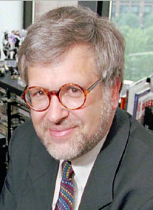
3 – Processes and information systems
“Success with SAP Implementation”
Study by the late Michael Hammer, “godfather of BPR”
Observed that success of SAP implementations
varied wildly
Worked with ~80 companies to assess their
degree of success with SAP implementation
It is essential to have clarity on what a business process really is
Performance measures may be functionally aligned - work against business processes
Enterprise system implementations must include a business process perspective
Success with business processes requires a holistic view in which six enablers are considered
A business process can't be great at everything – a single differentiator must be chosen
Notes:
Key Point – When major information systems are implemented without regard to end-to-end business processes, overall results range from “okay” to awful. (How awful? Stay tuned…)
When a COTS (commercial off-the-shelf) application is purchased, you're getting more than just software – you're also getting a set of assumptions and implied processes
Companies often re-implement systems they already have in order to make them more process-oriented
Michael Hammer is the man who (more than anyone else) popularised the focus on business processes. He coined the terms "business process reengineering," "cross-functional, end-to-end, business processes,“ and “functional silo.” In fact, we didn't really use the term "business processes" until he wrote his landmark HBR article "Reengineering Work" and later the book "Reengineering the Corporation."
By the mid- to late-1990s though, reengineering was somewhat discredited, and it was SAP consultants that were in demand, so Mr. Hammer started working on SAP implementations. It didn't take long to notice that they didn't all work out favourably. He's a statistician by training, so his firm undertook a study of ~200 companies that had implemented SAP. (Broad sample - all sizes of companies, differing number of modules.)

Slide 21
Success with SAP implementation
Hammer plotted the number of companies for each “success” ranking
Number of enterprises
Guess the line or curve
1
3
|
8
10
Success (ROI, etc.) ranked from 1 - 10
21
Notes:
Michael Hammer worked with each company to assess success of implementation on a 0 - 10 scale. (Not sure exactly how they assessed success - some combination of cost-benefit and achieving objectives.)
10 was wildly successful.
5 was middle of the pack
0 was...

Slide 22
Hammer not sure what the outcome would be
Expected a normal distribution…
Skewed pessimistically
Skewed optimistically
Really
pessimistic
Number of enterprises
1
3
|
8
10
Success (ROI, etc.) ranked from 1 - 10

Slide 23
The surprising result
Losers
Winners
Number of enterprises
IT focus,
Functional orientation
Process first,
IT secondary
1
3
|
8
10
Success (ROI, etc.) ranked from 1 - 10
Notes:
The difference – “winners” treated it as process-driven initiative, losers treated ERP implementation as an IT initiative

Slide 24


Returning to an earlier example
"Process-oriented" implementation began without clarity on “process” –
Sales “process”
Manufacturing “process”
Logistics “process”
A/R
“process”
Sales
module
Manuf'g
module
Logistics
module
Accounts Receivable
module
Poor performance
Conflicts: timing, coding, terminology, data formats, performance targets, …
SAP re-implemented in a process-driven configuration –
Sales function
Manufacturing function
Logistics function
A/R
function
end-to-end process: Fulfill Customer Order
Sales
module
Manuf'g
module
Logistics
module
A/R
module
Great performance
Same software, radically different outcomes
Notes:
Same software, radically different results
Key point – in the first example, the modules were in conflict. In the second example, the different modules are aligned to a common objective (filling an order,) but it's the same software in both cases!!!
Experienced people agree that it is not possible to adequately assess large, purchased applications (e.g., ERP systems) without some amount of process modeling, requirements specification at the event / use case level, and data modelling. The data model is actually the most important, so overview models (conceptual models) should be done for both your desired future state and for each application you are evaluating, and then they should be compared.

Slide 25
Staying “right” in an “entropic” environment
X
There will always be a pull back towards functional comfort
ongoing management of the process is critical!
all enablers must be addressed for a sustainable process

Slide 26
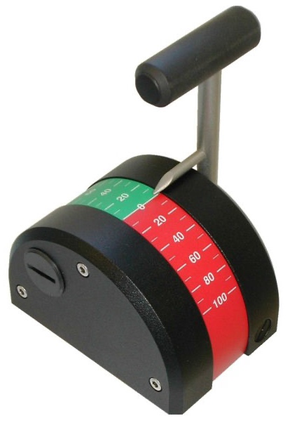

4. A holistic view for process analysis and design
It is essential to have clarity on what a business process really is
Performance measures may be functionally aligned - work against business processes
Enterprise system implementations must include a business process perspective
Success with business processes requires a
holistic view in which six enablers are considered
A business process can't be great at everything – a single differentiator must be chosen
Business mission, strategy, goals, & objectives
Culture, core competencies,
& management style
supports
aligns with
Business Process
enables
enables
enables
enables
enables
enables
Business
Process
Design
(Workflow)
Technology & Information Systems
Motivation & Measurement
Human Resources & Organisation
Policies & Rules
Facilities
(or, Data / Info / Knowledge, Communications, Documents, …)
Unfortunately, these are often ignored!
Roles
Steps & decisions
Flow - sequence and handoffs
Who does what when
Applications
Data
Information
Integration
Devices and platforms
Assessment and incentives
“Reward and punishment”
Implicit and explicit
Process KPIs vs.
Function KPIs
Recruitment & selection
Skills
Role design
Organisation design
Assignment of roles in processes
Constraining or enforced by the process
External
(laws / regs) or internal (real / "anecdotal")
Workplace layout
The 40% office
Remote hubs
Equipment
Fixtures and furnishings
Enabler – A factor that is adjusted to impact process performance.
The usual suspects!
Notes:
Enablers are the “dials and levers” manipulated by a skilled process designer.
What are some typical problems in:
Motivation and Measurement
Human Resources
Policies and Rules
The point – processes are governed by their environment and won't work optimally unless all six enablers are in alignment. Usually, people focus on workflow and IT alone – that's “tunnel vision”
Strategy – what we do, and how we're different
“Which Customers or Markets do we - or should we - serve?”
“What Products or Services do we - or should we - serve them with?”
“What differentiates us?” or, more clearly, “why choose us?”

Slide 27
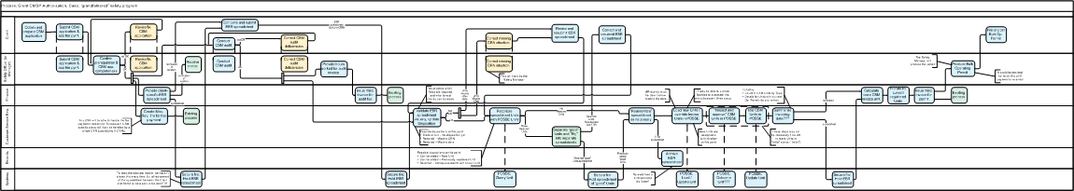
We model the as-is process to support assessment by enabler
As-is modelling maps reality – who, does what, when.
After as-is modelling, assess the process by each enabler, one at a time. This provides a fact-based assessment of the as-is.
Process Workflow
Design:
Is each step adding value, placed at the right point in the process, sequential or parallel as appropriate, performed by the best role, etc.?
Information Systems & Technology:
Are the process,
the steps, and the actors supported by the right systems and technology?
Motivation & Measurement:
How is the performance of the steps, the actors, the participating functions, and the process measured, and what are the consequences?
Human Resources & Organisation:
Are roles suitably broad, are organisations designed properly, and are roles & skills deployed well into the process?
Policies & Rules:
What policies or rules , whether internal or external, constrain or are enforced by the process, and what is their impact?
Facilities
(or other):
Are the layout & furnishings optimal or do they impede the process? (Many clients instead use this enabler to consider data, info, and knowledge.)
Notes:
Having an accurate Augmented Scope Model or Workflow Model that participants have bought into (because they or their peers built it) is vital if the process assessment is to be thought of as “fact based.”
This illustrates why the approach we're describing in this workshop is “holistic.”
For this to work, business involvement is a necessity, which is why we stress simple (not simplistic) modelling techniques that support it.

Slide 28
5. Process goals: know your “differentiator”
It is essential to have clarity on what a business process really is
Performance measures may be functionally aligned - work against business processes
Enterprise system implementations must include a business process perspective
Success with business processes requires a holistic view in which six enablers are considered
A business process can't be great at everything – a single differentiator must be chosen
Great processes don't try to be all things to all people –
they strive to be great at one differentiator, and good at the other two…
Operational
Excellence
Consistent, predictable, error-free, and efficient – focus on low cost
(or safety, in some industries.)
More efficient, but less flexible in changing direction or meeting needs of individual customers.
Good
Continuous and rapid introduction of new products and services,
or changes to the mix
More flexible for adapting
to needs of new offerings,
but less efficient.
Great
Good
Product
Leadership
Customer
Intimacy
Tailors product or service delivery to the processes of individual customers.
More flexible for adapting
to needs of individual customers, but less efficient.
As noted, this is one of
the things I do on ~100% of
Project Recovery assignments -
Build Process Scope Model &
Process Summary Chart
Develop Case for Action – an
As-Is Assessment by Stakeholder
Establish the Differentiator
(Optionally conduct an
As-Is Assessment by Enabler)
The original reference:
The Discipline of Market Leaders
Michael Treacy and Fred Wiersma
Addison-Wesley 1995
Why?
Notes:
A common point of confusion is that “Customer Intimacy” is the same as being “customer focused,” but all three focus on knowing what your customer wants
There isn't really any harm in trying to be great at multiple differentiators, as long as you know what your primary one is. This is critical when you have to make a decision – the differentiator will tip the balance.
Two points we expand on in our “Advanced Business Process Techniques” course:
Differentiators change over time. (E.g., you're Product Leadership at startup, and then grow into Op Ex.)
Different processes (or process areas) within an enterprise can have different differentiators

Slide 29
Example: “differentiator confusion”
Getting it wrong can be expensive…
Insurance company recruits CEO from high tech industry
New CEO decides “innovation is everything” –
$100M spent on
process redesign and system development
in support of “innovative car insurance products” –
Product Leadership
Total failure – customers wanted affordable,
easy to understand, easy to buy insurance –
Operational Excellence (Op Ex)
Customer base:
Operational
Excellence
New CEO:
Product
Leadership
Customer
Intimacy
Notes:
Getting great at one differentiator doesn't guarantee success if it isn't what your customer wants.
We'll spend quite a bit more time on this topic later in the course.

Slide 30
Business Process – part of the Clariteq Framework for Business Analysis
Framework Layer
Technique sample
What it covers
The Clariteq Framework for Business Analysis
Business Goals & Objectives
The university is initiating the “Strategic Enrollment” program to raise Student graduation rates in part by ensuring Classes are available for Student registration when needed.
Project Charter – documents the rationale, objectives, scope, and success measures for the project
This is not a sequence!
Business Process
Registrar's
Office
Generate Student Summary Report
Attach Reg Form and forward
Process Model - shows “what” in a Scope Model, then “who & how” in a Workflow Model – the steps done by the actors in the process
Business Process:
gives great context
for Business Analysis
Department Advisor
Check Reg Request for data changes
Register Student in Class
Presentation
Layer
(user interface)
When advisor enters five characters of Last Name
Use Case – models how an actor interacts with a system to obtain (trigger) a service, typically to
complete a step in a process
Then System lists matching Students
When advisor selects list item
Then System displays expanded Student view with needed Classes
Use Cases and Services:
where we capture Functional Requirements
When advisor etc.
Application
Layer
(rules & logic)
Register Student in Class
Service Specification - describes
a service – a package of rules and logic – that is triggered to complete
or respond to a business event
Verify Student Status
Verify Student pre-reqs
Confirm Class availability
Create Registration
Input Message:
Student Number
Course ID
Class ID
Output Message:
Results
Data
Layer
(data & storage)
Course
Concept Model - depicts
the things and the facts about things the organisation needs to record;
the things (the entities) are what
processes and solutions act on.
Concept Model /
Data Model:
a great platform
for Business Analysis
Department
Instructor
Student
registers
in
Number
ID
Number
offering of
assigned
to
Name
Name
Rating Code
GPA
Class
Dates
Times
Locations
Only four types of models vs. 14 in the UML! (Unified Modelling Language)
Notes:
Each layer interacts with others, forming an integrated set of techniques.
The benefits:
Divide and conquer
Everything in its place
Cross-validation
Other terms:
Presentation Services also known as Presentation Layer or User Interface
Business Services also known as Application Layer, Business Logic, Business Rules, Application Services, etc.
Data Management Services also known as Data Management Layer or Persistence Services
Not all methodologies address each perspective equally well.
Information Engineering was weak to non-existent in addressing the business process (workflow) and presentation (use cases) layers
Most O-O and Agile techniques don't address business process well, if at all

Slide 31
Everything relies on the Concept Model / Data Model
All use the language and constraints of the Concept Model (the “thing model”) – the ultimate “what”
Business Goals & Objectives
The university is initiating the “Strategic Enrollment” program to raise Student graduation rates in part by ensuring Classes are available for Student registration when needed.
Registrar's
Office
Use Cases/User Stories:
- Who (Actors) needs access to the Services, and how (Platform)?
Business Process
Generate Student Summary Report
Attach Reg Request and forward
Department Advisor
Check Reg Request for data changes
Register Student in Class
Presentation
Layer
(user interface)
When advisor enters five characters of Last Name
Use Case
actor + service + platform:
Advisor Register Student
in Class via SRS
Then System lists matching Students
Verb-Noun pairs:
- The Services (event-handlers) that are at the heart of a Service Oriented Architecture.
- Also "building blocks" of Business Processes
When advisor selects list item
Then System displays expanded Student view with needed Classes
When advisor etc.
Application
Layer
(rules & logic)
Register Student in Class
Service
verb + noun ( + noun):
Register
Student in Class
Verify Student Status
Verify Student pre-reqs
Confirm Class availability
Create Registration
Input Message:
Student Number
Course ID
Class ID
Output Message:
Results
Data
Layer
(data & storage)
Course
Entity
noun:
Class
Department
Instructor
The core Nouns or Things in your enterprise. Also known as
Business Objects.
Student
registers
in
Number
ID
Number
offering of
assigned
to
Name
Name
Rating Code
GPA
Class
Dates
Times
Locations
Bonus – great starting point to discover your
Events/Services and Use Cases/User Stories
Notes:
Key point – every type of model references the entities in the concept model, illustrating why concept modelling (conceptual data modelling) is a critical technique.
We often follow an “inside-out” approach, as illustrated here:
Discover the Nouns: things of interest, e.g. “Customer”
Discover “Verb – Noun” pairs: activities that must be performed (process, sub-process, service, …) in order for the enterprise to operate, e.g. “Register Customer”
Discover “Actor – Verb – Noun “ combinations: Use Cases or a steps within a business process, the intersection of all three, e.g. “Sales Rep Registers Customer”

Slide 32
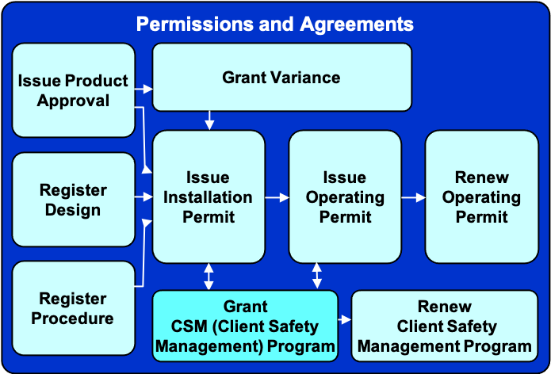
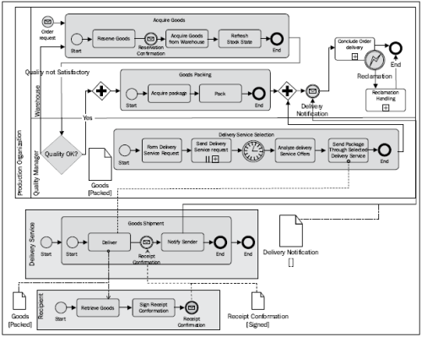
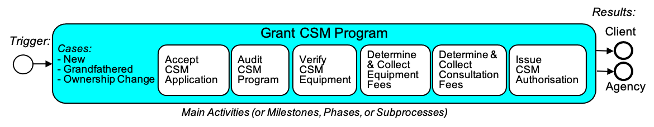
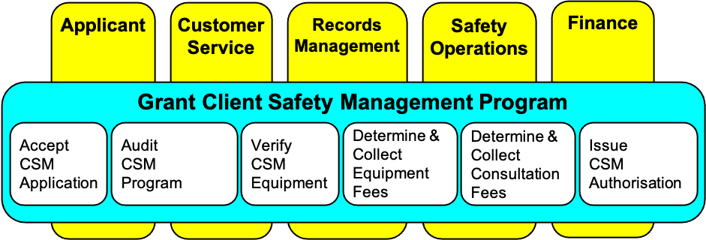
Another key point! Different levels of detail for different purposes
Different models and levels of detail for different audiences and purposes.
Also applies to Use Cases, Services, and Data Models
Scope –
for Planning
Concept –
for Understanding
Detail –
for Specification
Process Landscape (optional):
Augmented Scope Model showing next level activities: who - what - how
“Business-friendly” (just boxes & lines)
flow models to maximise communication and participation
Two levels – Handoff and Service
Detail for technical design, perhaps using full BPMN
Process Scope Model:
etc.
Process Summary Chart:
Boxes, Lines,
& MANY Symbols
Boxes
Boxes & Lines

Slide 33

Our three-phase methodology – proven, practical, & agile
1
2
3
Establish
Process Scope and Objectives
Understand
the As-Is Process
Design
the To-Be Process
Identify & scope
the process with a Scope Model
& a Process Summary Chart;
Optional - build a Concept Model
Complete initial
as-is process assessment, and to-be objective setting, by stakeholder
Perform more
detailed as-is modelling:
an Augmented Scope Model & optionally, Workflow Models
Complete final as-is process assessment by enabler, and generate to-be improvement ideas
Refine to-be improvement ideas and determine 5-10 key features of the to-be process
Assess each
to-be feature
by enabler to ensure the new process is implementable and sustainable
Design the to-be process:
1 - essential activities first
2 - "who & how" next
3 – transport & protocol last
Some
goal or issue,
not rigorously
specified
Customer
Performers
Owner
others…
Process
IT
M&M
HR
P&R
Fac. or…
Re-think!
Select key
to-be Features
Develop as-is models:
  Augmented Scope Model –
  add ~5 – 7 more detailed
  Activities for each main Activity
  (Optional) as-is Workflow Models –
  only enough detail to understand process behaviour
Conduct enabler-based assessment
and identify potential improvements
Assess each key
Feature by enabler
…
...
...
…
...
...
...
...
…
...
...
…
…
...
...
...
...
…
...
...
Identify and sequence
essential activities
Develop Workflow Models for essential activities by adding
who and how
…on to requirements
definition and implementation
ID processes & draw Process Landscape (Optional – only if you have a large scope)
ID Trigger, Results, main Activities, Cases (TRAC) & draw Process Scope Model – focus on what, no reference to who or how
ID involved functions & mechanisms (who and how) & draw Process Summary Chart
Conduct stakeholder-based assessment

Slide 34
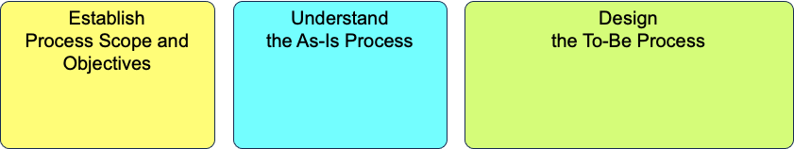
Five key points plus a BA framework plus a methodology
Model-driven
framework
F1
F2
F3
F4
F1
F2
F3
F4
Cross-functional process
Cross-functional process
Process Modelling
Processes:
“large” and X-functional
Misaligned measures
Use Cases
Operational
Excellence
Service Specification
Business mission,
strategy, goals, & objectives
Culture, core competencies,
and management style
X
Business Process
System success
Workflow
Design
Information Systems
Motivation & Measurement
Human Resources
Policies and Rules
Facilities
(or other)
Product
Leadership
Customer
Intimacy
Concept / Data Modelling
Holistic method
Differentiator
…and a proven
Methodology

Slide 35
Identifying and Scoping Business Processes
Five things you need to know about Business Processes
Identify true, end-to-end, cross-functional
Business Processes
Developing a Process Architecture
Seven ways to help people embrace Process Change
Human-oriented process modelling
A feature-based Process Design method –
transitioning from as-is to to-be

Slide 36
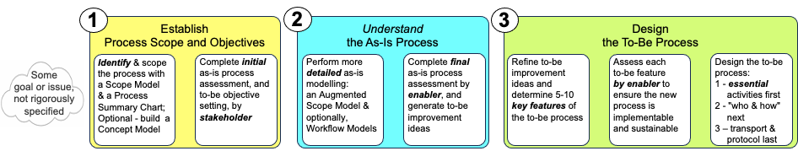
Identify & scope process(es)
Clarify scope and context
I used to dive in here…
… lots of issues!
Whether it’s a new initiative or “project recovery,” always:
Develop a Process Scope Model
Develop a Process Summary Chart
Process Landscape: Permissions and Agreements
Issue Product Approval
Grant Variance
Issue Installation Permit
Issue Operating Permit
Renew Operating Permit
Register Design
Function 1
Function 2
Function 3
Function 4
Cross-functional Business Process
Register Procedure
Grant
CSM (Client Safety Management) Program
Renew
Client Safety Management Program
You might start at a higher level, with a Process Landscape –
a decomposition of a business area into a family of individual business processes

Slide 37
Process discovery example
A bank believed they had identified the 12 business processes in their Commercial Loans Management area, including these 7:
Discuss:
What is wrong with the names of these processes?
Can you think of any questions to help improve these process names?
Loan
Servicing
Booking
Solicitation
Qualification
Business Development
Payment
Processing
Syndication

Slide 38
Bottom-up process discovery – example
Always use
“active verb – noun” naming
with no “who and how”
Client then identified recognisable activities, each producing an essential result (easy!)
Loan
Servicing
Booking
Solicitation
Dubious “business processes”
Qualification
Business Development
Payment
Processing
Syndication
Solicitation???
Solicit…
what?
Solicit
Prospect
Solicit
Loan Payment
a Customer
is registered
Solicit
Payment
Identify
Prospect
Settle
Loan
Book
Loan
Fund
Loan
Register
Customer
Accept
Loan
Application
Distribute
Payment
Let's put these
in sequence, then
use TRAC to determine
Business Processes.
Assess
Loan
Application
Receive
Payment
Solicit
Prospect
Qualify
Prospect
This was done in-person with Post-its and flipcharts but tools like Lucidchart and Miro work well virtually
Notes:
This example come from a case when we were teaching a workshop, and an executive with responsibility for workflow systems challenged the previous illustration of what a business process was. It illustrates why a simple definition of a business process is inadequate, and it's necessary to demonstrate the concept.

Slide 39
Summary – sequence activities
Not usually linear – parallel chains are typical
Identify
Prospect
Qualify
Prospect
Solicit
Prospect
Register
Customer
Receive
Loan
Application
Assess
Loan
Application
Fund
Loan
Book
Loan
Solicit
Payment
Receive
Payment
Distribute
Payment
Settle
Loan
Now we’ll use my “TRAC” framework for
business processes –
Trigger
Results
Activities
(Cases – later)
Solicit
Payment
Book
Loan
Settle
Loan
The clients arranged the activities in sequence:
- easy!
- a learning experience!
Identify
Prospect
Register
Customer
Fund
Loan
Accept
Loan
Application
Assess
Loan
Application
Solicit
Prospect
Distribute
Payment
Qualify
Prospect
Receive
Payment
Notes:
This example was fairly simple in that the activities formed a linear sequence. More often, there are sequences of activities that happen in parallel, independently of one another.
Note that forcing the activities to be ”essential” (“what,” with no reference to “who or how”) prevents getting into too much detail. That is, it prevents getting “into the weeds”

Slide 40
Summary – use TRAC to discover business process boundaries
Customer seeks
loan financing
(decision event)
Time for
repayment installment
(temporal event)
Zero balance
(conditional
event)
Various… (they struggled with this one)
1:M
1:M
M:1
1:1
1:1
1:1
1:1
1:1
1:1
1:1
1:1
Identify
Prospect
Qualify
Prospect
Solicit
Prospect
Register
Customer
Receive
Loan
Application
Assess
Loan
Application
Fund
Loan
Book
Loan
Solicit
Payment
Receive
Payment
Distribute
Payment
Settle
Loan
Acquire Customer
Grant Loan
Collect Payment
Settle
Loan
Customer
(from prospect to registered)
Loan
(from applied to booked)
Payment
(from solicited to distributed)
Loan
Customer:
an Account that enables business with the bank
The Bank:
a new Customer (an asset)
Business Development:
Commission credit
Customer:
Loan funds available
The Bank:
a performing asset (Loan)
Syndication Partners:
a share of the Loan
Bank:
Loan payment received & distributed
Syndication Partners:
Loan Payment received
Customer:
release of Loan liability
The Bank & Syndication Partners:
completed Loan
Regulator:
Loan completion notice
It appears we have discovered
four business processes, each with:
Trigger
Results
Activities
(Cases later)
ID where a final Result of value is delivered to
one or more (usually at least two) stakeholders – “happiness points”
Identify points where a Triggering event (decision, time, condition) beyond the organisation’s control is required before activities can proceed
Identify “cardinality” of connections between Activities (1:1, 1:M, M:1)
Identify “tokens” flowing through the activities
Name business processes with active verbs and nouns (usually the tokens)
Notes:
This example was fairly simple in that the activities formed a linear sequence. More often, there are sequences of activities that happen in parallel, independently of one another.
Note that forcing the activities to be ”essential” (“what,” with no reference to “who or how”) prevents getting into too much detail. That is, it prevents getting “into the weeds”

Slide 41
Four end-to-end business processes, objectively demonstrated
Customer seeks
loan financing
(decision event)
Time for
repayment installment
(temporal event)
Zero balance
(conditional
event)
Various…
Acquire Customer
Grant Loan
Collect Payment
Settle
Loan
Identify
Prospect
Qualify
Prospect
Solicit
Prospect
Register
Customer
Receive
Loan
Application
Assess
Loan
Application
Fund
Loan
Book
Loan
Solicit
Payment
Receive
Payment
Distribute
Payment
Settle
Loan
Customer:
an Account that enables business with the bank
The Bank:
a new Customer (an asset)
Business Development:
Commission credit
Customer:
Loan funds available
The Bank:
a performing asset (Loan)
Syndication Partners:
a share of the Loan
Bank:
Loan payment received & distributed
Syndication Partners:
Loan Payment received
Customer:
release of Loan liability
The Bank & Syndication Partners:
completed Loan
Regulator:
Loan completion notice
Client had faith these were their business processes

Slide 42
Six guidelines for well-formed processes, two clients really appreciate
“Active verb – noun” naming that indicates primary result
Triggered by an event (decision, time, data) outside process’ control
At the end are results that makes one or more stakeholders happy
In between are ~5 to 7 major Activities (phases, milestones, subprocesses, …)
Activities linked 1:1 are probably part of the same process;
a 1:M or M:1 connection between activities is probably a boundary
The same token moves through the whole process,
changing state, e.g. a Loan, from applied to booked;
there will be a change of token across a process boundary
Acquire Customer
Grant Loan
Collect Payment
Settle Loan
Identify
Prospect
1:1
Qualify
Prospect
1:1
Solicit
Prospect
1:1
Register
Customer
1:M
Accept
Loan
Application
1:1
Assess
Loan
Application
1:1
Fund
Loan
1:1
Book
Loan
1:M
Solicit
Loan
Payment
1:1
M:1
Etc.
Etc.
change
of token
change
of token
change
of token
token:
a Customer,
from prospect to registered
token:
a Loan,
from applied to booked
token:
a Payment,
from solicited
to distributed
token:
a Loan,
from
zero balance
to notified
Clear, objective guidelines – science, not just opinion
Notes:
This illustrates why a simple definition of a business process is inadequate, and it's necessary to demonstrate the concept.
As noted earlier, don't confuse a result with an objective.
- Result: a “countable” output of a process; “what” the process achieves, e.g.
“A service problem is resolved” or
“A process revision is implemented”
- Objective: a performance target for the business as a whole, or for a specific process. Objectives are stated in “topic, target, timeframe” format, e.g.
“Customer telephone hold time will be less than 90 seconds for 98% of all calls by Q2 of next year” or
“The cycle time to implement a process revision across all factories will be reduced to six months by year-end.”
The point of this is that you can have a process to Resolve Service Problem, but you can't have a process to Have Short Phone Calls
“Mechanisms” are another source of confusion. They are techniques or technologies for implementing or supporting a business process, e.g., “Fill in Form MS-17” or “Develop Solutions Database.” They should generally be ignored when looking for results.

Slide 43
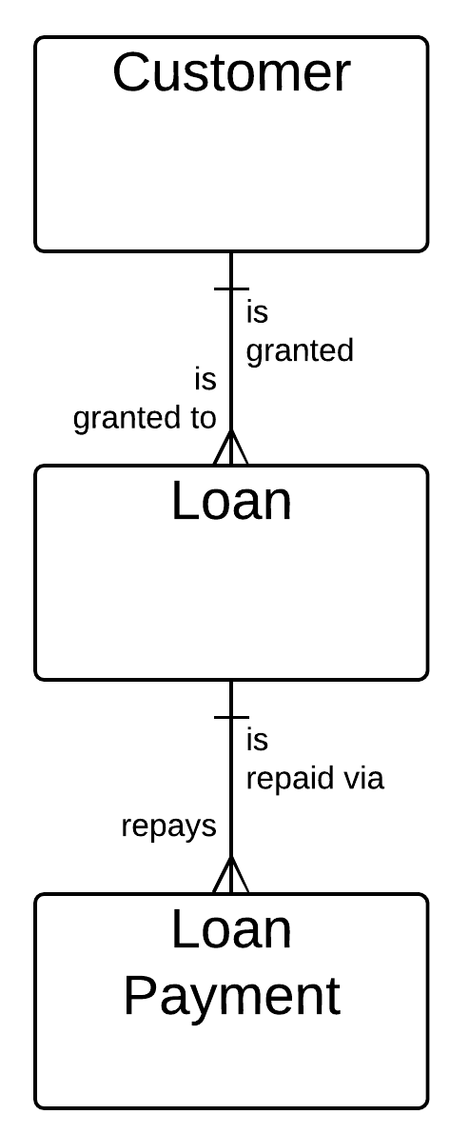
Correspondence to the Concept Model
  The nouns in your verb-noun Process name are most often the Entities in your Concept Model, and each will usually have one primary Process
  The relative number of Process instances
  (e.g., 1:M or M:1) align with relationship cardinality
  This does not mean there is only one Process per Entity
    Assess Customer Performance
    Retire Customer
    Merge Loans
    Write Off Loan
    …
Acquire
Customer
1:M
Grant
Loan
1:M
Collect
Payment

Slide 44
What next?
Commercial Loans Management
A Process Landscape for the Process Area “Commercial Loans Management”
showing its four Business Processes.
More were added later.
This is the beginning of the
Process Architecture.
Acquire
Customer
Grant
Loan
Collect
Payment
Settle
Loan
Simplify “up”
Various…
Acquire Customer
Grant Loan
Collect Payment
Settle
Loan
Identify
Prospect
Qualify
Prospect
Solicit
Prospect
Register
Customer
Receive
Loan
Application
Assess
Loan
Application
Fund
Loan
Book
Loan
Solicit
Payment
Receive
Payment
Distribute
Payment
Settle
Loan
Refine “down”
A Process Scope Model for “Acquire Customer”
Customer: an account…
The bank: a new Customer…
Biz Dev: commission credit…
Acquire Customer
Capture
Prospect Details
Assess
Prospect
Financial
Health
Assess
Prospect
Strategic
Fit
Solicit
Prospect
Register
Customer
Account
Prospect is
identified
Customer,
Bank,
Biz Dev:
no change
Cases: Enterprise, SMB,
Retail, Government

Slide 45
The arc of modelling and analysis
Start bottom-up to build overall framework
– Continue top-down
Draw a Process Landscape,
our overall framework
Use objective criteria to
identify process boundaries
Progressive refinement and elaboration
Develop Process Scope Model,
Process Summary Chart, and
Augmented Scope Model
Sequence activities
into “chains”
top-down analysis
bottom-up synthesis
Granular activities
(real, recognisable work)
Develop Initial Swimlane Diagram
Notes:
1 – Helps identify “true” end-to-end processes
2 – Create Process Landscape, Scope Model, Summary Chart, Augmented Scope Model which keep you out of the weeds before getting into swimlane diagrams.

Slide 46
This slide left blank by accident

Slide 47
Building a Process Architecture
Five things you need to know about Business Processes
Identifying true, end-to-end, cross-functional
Business Processes
Developing a Process Architecture
Seven ways to help people embrace Process Change
Human-oriented process modelling
A feature-based Process Design method –
transitioning from as-is to to-be
…including a bonus –
material on Concept Modelling!

Slide 48








Case study – Process Architecture on a budget, non-invasively
Client –
Regulatory agency ensuring the safe design, installation,
and use of technical equipment
Natural gas systems, electrical systems, boilers and pressure vessels,
elevating devices, & many more
Goal –
Use leftover budget at year-end to develop an Enterprise Process Architecture
Agreement –
We will experiment with novel approaches if we can use it as a case study
Non-invasive – minimal interviews, no sessions
Use available resources – existing models and anything else we could find
Two experienced Business Process Analysts made available part-time

Slide 49
Many routes to the same end
Top-down discovery is often
less effective than expected,
yielding a view that is functional, organisational, or fragmented
Bottom-up discovery is often more effective at the project level –
identify relevant lower-level activities,
link to form complete processes – but can be overwhelming at large scale
We will employ a mix of techniques in a MITM approach -
Meet-In-The-Middle
Top-down
(identify process areas, break them down into processes and activities,
name and define them, …)
Industry-based
reference models
(SCOR, eTOM,
APQC PRF,
ITIL, BIAN, …)
IGOE Charts
or other
context
diagrams
Business
Process
Architecture
(or Business Architecture,
Service Catalogue,
Capability Model, …)
Generic
Business
Model
Value
Chain
Essentially, "what" we do
Make it up out of thin air
Steal one
Bottom-up
(discover activities,
link them into processes,
name and define them, …)

Slide 50
Discovering processes at enterprise scale
Bottom-up techniques alone are impractical for the enterprise
“Classic” approach:
Large project, core team of 5+ people, scores of interviews and sessions with many participants, over many months or even years
“Boil the ocean” – expensive and time-consuming
Alternate approach (Regulatory Agency case study)
Build first-cut (better than “draft”) process architecture
Small team, limited number of interviews and sessions
Use available knowledge, e.g., Business Analysts
Use other available resources, e.g., typical patterns and frameworks, organisation's training materials, job/role descriptions, reference models, industry texts, …
Refine architecture over time, process by process
Notes:
We have found corporate librarians, Training & Development, Human Resources, and other supporting groups to be very helpful.
We'll now look at some techniques for building a starting point in a top-down fashion that will be validated and extended using bottom-up techniques.

Slide 51
Business Process Categories – highest level of Process Architecture
These processes provide guidance to the enterprise on its mission, strategies, goals, and objectives, and coordinate interaction with external agencies and regulators.
Also called Directional or Steering processes.
Governance & External Relations Processes
These processes deliver results that are the essence of why the enterprise exists – they are unique to a particular line of business and provide results that are visible to external stakeholders.
Line of Business (LoB)
Processes
(within scope)
These processes deliver resources – people, facilities, systems, etc. – and services – accounting, risk mitigation, procurement, etc. – which enable the LoB processes to operate.
Supporting
Processes
(within scope)
Sensitivities
about naming
Core
Processes
Supporting
Line of Business
Non-core?
Processes
Supporting
Enabling
Processes

Slide 52
A look ahead – Business Process Architecture taxonomy
“Business on a page”
Individual
Certification and Qualification
Permissions and Agreements
Line of Business
Safety Program Development
Reviews
and
Appeals
Supporting
Contractor Licensing
Compliance Assurance
Education & Awareness Programs
7 “Process Areas” or “Process Domains” – level 0
Process Landscape: Permissions and Agreements
Issue Product Approval
Grant Variance
Applicant
Cust.
Service
Records
Mgmt.
Safety
Operations
Finance
Process: Grant CSM Program
Issue Installation Permit
Issue Operating Permit
Renew Operating Permit
Register Design
Accept
CSM
Application
Audit
CSM
Program
Verify
CSM
Equipment
Determine
& Collect
Equipment
Fees
Determine
& Collect
Consultation
Fees
Issue
CSM
Auth'n
Register Procedure
Grant
Client Safety Management Program
Renew
Client Safety Management Program
1 Business Process with 5 +/- 2 sub-processes (level 2)
Additional detail about each business process is added during “framing”
9 “End-to-end Business Processes” – level 1

Slide 53
How to start – reference models?
Useful for… reference!
Not really “business processes,”
in our terms:
  Functional orientation
  Catalogues of activities
  Extremely inconsistent granularity
8.0 Manage Financial Resources (10009)
8.4 Manage fixed asset project accounting (10731)
8.4.1 Perform capital planning and project approval (10751)
  8.4.1.1 Develop capital investment policies and procedures (10844)
  8.4.1.2 Develop and approve capital expenditure plans and budgets (10845)
  8.4.1.3 Review and approve capital projects and fixed asset acquisitions (10846)
  8.4.1.4 Conduct financial justification for project approval (10847)
8.4.2 Perform capital project accounting (10752)
  8.4.2.1 Create project account codes (10848)
  8.4.2.2 Record project-related transactions (10849)
  8.4.2.3 Monitor and track capital projects and budget spending (10850)
  8.4.2.4 Close/capitalize projects (10851)
  8.4.2.5 Measure financial returns on completed capital projects (10852)
8.5 Process payroll (10732)
8.5.1 Report time (10753)
  8.5.1.1 Establish policies and procedures (10853)
  8.5.1.2 Collect and record employee time worked (10854)
  8.5.1.3 Analyze and report paid and unpaid leave (10855)
  8.5.1.4 Monitor regular, overtime, and other hours (10856)
  8.5.1.5 Analyze and report employee utilization (10857)
8.5.2 Manage pay (10754)
  8.5.2.1 Enter employee time worked into payroll system (10858)
  8.5.2.2 Maintain and administer employee earnings information (10859)
  Etc. etc. etc.
Notes:
Industry-specific process frameworks like eTOM are generally more useful.

Slide 54
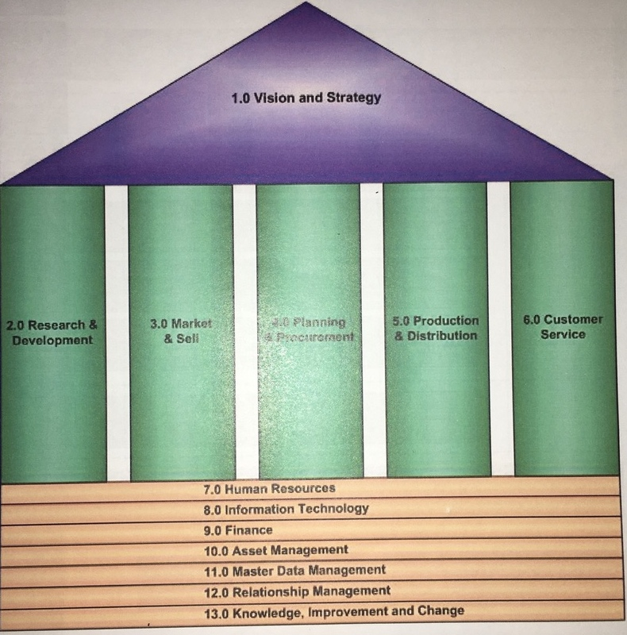
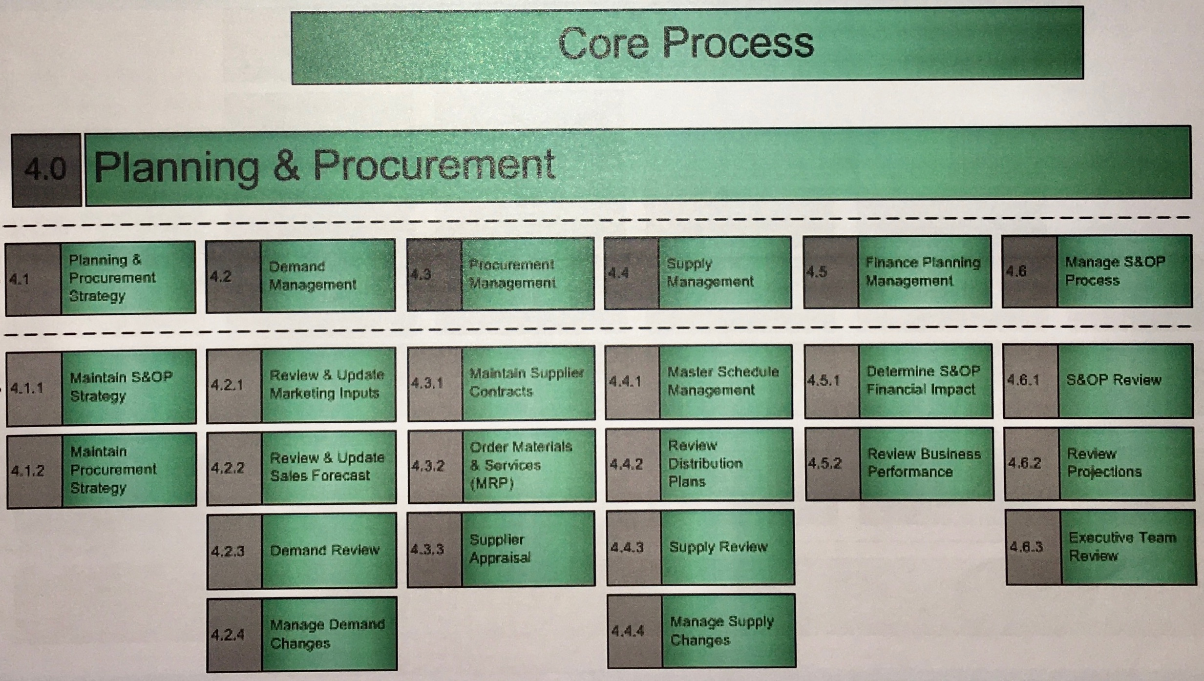
A "stolen" process architecture
6.0 Customer Service
Background –
Client in a unique industry hired a consulting firm to develop a process architecture
They delivered an architecture developed elsewhere
Executives were very unimpressed
I was brought in for ½ day to help client understand why the executives not pleased. Can you guess?

Slide 55
How to start – Michael Porter's “Value Chain?”
Support Activities
– “Supporting Processes”
Firm Infrastructure
Human Resource Management
Technology Development
Procurement
Primary Activities
Inbound
Logistics
Operations
Outbound
Logistics
Marketing
and Sales
Service
– “Line of Business Processes”
Sometimes it works, sometimes not.
Notes:
The order of the Value Chain components is typical for a manufacturing business; for a service-based business the order will be different, e.g.
Inbound Logistics (e.g., Develop route, fleet, ground capabilities, and flight schedule)
Outbound Logistics (e.g., Publish flights to channels and reservation systems)
Marketing and Sales (e.g., Stimulate demand, complete reservations and ticketing)
Operations (e.g., Operate flights and network)
Service (e.g., Provide post-flight service and benefits)

Slide 56
We tried using Value Chain for first cut
Understand needs & environment
Develop
safety
programs
Provide authorization
& ensure compliance
Marketing, education, awareness
Provide Customer Service
“JDFR” – Just Didn't Feel Right
Understand needs & environment
Develop
safety
programs
Authorize
operations, technology,
products, …
Ensure
compliance
Marketing, education, awareness,
service
“CBNC” – Close, But No Cigar

Slide 57
How to start – a generic business model worked better
Simple form:
Assess
Market /
Industry
Developments
Develop it
Sell it
Service it
Assess
Product /
Service
Performance
Develop
Strategy /
Plans
or Build – Sell – Deliver
Develop
Product /
Service
Stimulate
Demand
Sell
Product /
Service
Build / Deliver
Product /
Service
Enhance
Product /
Service
Acquire Capabilities

Slide 58
Generic models worked – first-cut list of process areas
Safety Program Development
Individual
Certification and Qualification
Compliance Assurance
Issue
Resolution
Safety Environment Intelligence and Assessment
Contractor Licensing
Education & Awareness Programs
Not bad, but:
Political issues (“Where's MY group…?”)
Refined through bottom-up work
Notes:
We're building a starting point, top-down. Soon, we'll gather relevant details, bottom-up. When we bring these together, it will be a “meet in the middle” approach.

Slide 59
Generic model for asset management processes
Asset Management Life Cycle:
Starting point for supporting processes, shared resources:
People, Facilities, Fleet, Technology Assets, …
Supporting began with the usual suspects, which didn't last:
However, the Asset Management Life Cycle was a
good starting point for each.
Plan
Acquire
Manage
Dispose
Retire
Allocate
Use
Maintain
Human Resources
Finance
Information
Technology
Plant, Property,
& Equipment

Slide 60
Service maps – a lucky find
For a school project, BAs had catalogued the Services provided by each functional area.
We refined them, then validated them with functional experts –
it was easy!
Discussion –
why did this layout work?
Services ranged from discrete Activities to nearly complete Business Processes.
Services (Activities) could be strung together into plausible Business Processes.
Contractor Licensing
Approve Product
Investigate Incident
Conduct Site Inspection
Issue Commercial / Residential Installation Permit
Issue Commercial / Residential Operating Permit
Grant Qualification
Issue Contractor License
Conduct Disciplinary Event
Resolve Inquiry
etc.
Notes:
Shows the primary services provided by a functional area.
Worked because there was no hierarchy, no "sharp edges," and no explanation was required.
We were able to create new service maps by showing an example (stressing “verb – noun”) and then asking what were the 5 to 7 major services in their area. There were usually more, but we often start with a “draw five boxes” approach.

Slide 61
Another lucky find – role profiles (job descriptions)
Department: “Market Awareness”
Position Title: Communications Officer
Principal Accountabilities:
…
Key Messaging: develop corporate key messages and issues messages aligned to the Strategic Plan to ensure that Agency staff, Executive, and Board consistently utilize strategic messaging in all internal and external documents and ensure marketing and branding initiatives align with strategic communications goals and messages.
Communications: …description of more responsibilities
Media Messaging: …description of more responsibilities etc. etc. etc.
What they did (the essential activities)…
Develop Key Message
Develop Issues Message
Everything else
was why?
Huh…?

Slide 62
Another example
Observation –
the further from core operational responsibilities,
the harder to decipher…
Role Profile –
“…in partnership with internal and external stakeholders, using the full range of traditional and new media along with an integrative framework, disseminates relevant content that will enable self-sufficiency among business and residential constituencies.”
Translation – “Publish procedures.”
It was a lot of work to massage role descriptions into discrete activities, but still a major time saving.
Notes:
Mapped activities to the process areas from our “first cut” then applied the bottom-up technique (sequence then analyse linkages) illustrated earlier.

Slide 63
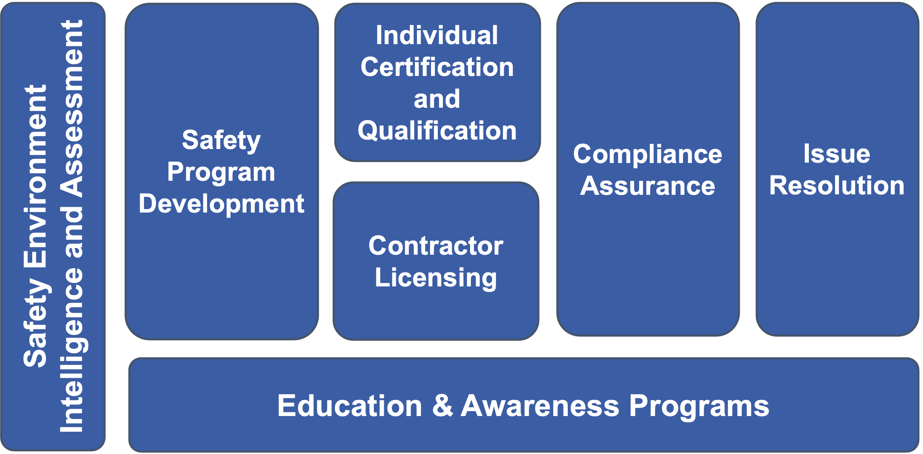
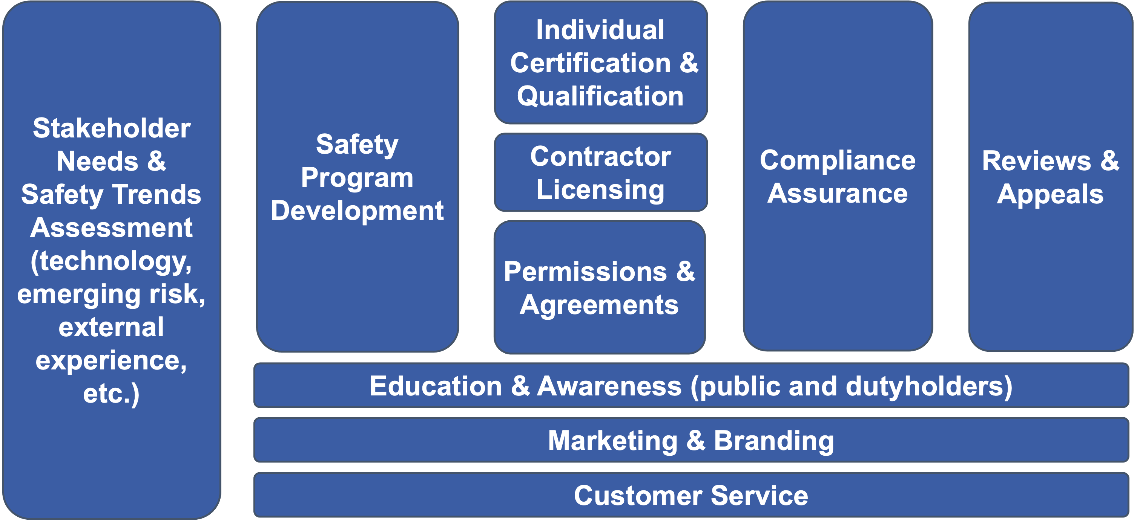
“Meet in the middle” approach to process discovery – overview
Identify high-level process areas
top-down from Value Chain and
Generic Business Model
Identify essential Activities from "massaged"
Role Profiles and Service Maps
Map Activities to Process Areas
(some activities mapped to multiple process areas)
Link Activities into e2e Processes,
identify and name Business Processes
Refine Process Areas
(7 in the original draft model became 10)

Slide 64
“Meet in the middle” approach to discovering processes – example
3.
4.
Map Activities to
Process Areas
(some mapped to multiple Process Areas)
Link Activities into
Business Processes and
name the Processes
Refine Process Areas
(7 became 10)
Because each Activity was linked to its Department (Function) we had the information needed to produce the Process Summary:
 | Department | Role | Activity | Process Area | Process
152 | Corporate Services | Assets & Supplies Coordinator | Arrange office renovation | Procure | “Configure” facility
124 | Corporate Services | Leader, Facilities & Fleet | Negotiate accommodation lease (new and renewal) | Procure | Acquire Facility
125 | Corporate Services | Leader, Facilities & Fleet | Identify office location | Procure | Acquire Facility
126 | Corporate Services | Leader, Facilities & Fleet | Develop office space plan | Procure | Acquire Facility
127 | Corporate Services | Leader, Facilities & Fleet | Arrange office move | Procure | Acquire Facility
128 | Corporate Services | Leader, Facilities & Fleet | Arrange office reconfiguration | Procure | Acquire Facility
138 | Corporate Services | Facilities Coordinator | Complete office move (coordinate w. project managers, designers and planners) | Procure | Acquire Facility
145 | Corporate Services | Assets & Supplies Coordinator | Issue/revise/terminate security access | Procure | Acquire Facility
121 | Corporate Services | Leader, Facilities & Fleet | Identify operational needs | Procure | Acquire Vehicle
129 | Corporate Services | Leader, Facilities & Fleet | Acquire property management service (maintenance and security) | Procure | Service/Repair Facility
130 | Corporate Services | Facilities Coordinator | Provide space planning advice | Procure | Configure Facility
118 | Corporate Services | Leader, Facilities & Fleet | Develop facilities strategic plan | Procure | Develop Facilities Plan
119 | Corporate Services | Leader, Facilities & Fleet | Develop accommodation strategic plan | Procure | Develop Facilities Plan
23 | Finance | Leader, Performance Reporting | Determine replacement schedule of vehicle fleet. | Procure | Develop Fleet Plan
120 | Corporate Services | Leader, Facilities & Fleet | Develop fleet strategic plan | Procure | Develop Fleet Plan
153 | Corporate Services | Assets & Supplies Coordinator | “Liaise” with building maintenance | Procure | Service/Repair Facility
401 | Legal & Policy | Legal Counsel | Retain external counsel | Procure | Obtain service
Function 1
Function 2
Function 3
Function 4
Cross-functional Business Process
Activities
Process
Areas
Processes
Notes:
Mapped activities to the process areas from our “first cut” then applied the bottom-up technique (sequence then analyse linkages) illustrated earlier.

Slide 65
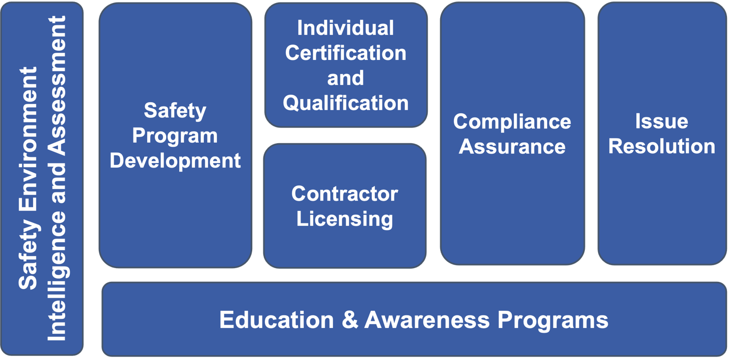
“Final” LOB Process Areas (or "Families" or "Domains")
Line of Business Process Areas
Stakeholder Needs &
Safety Trends Assessment
(technology, emerging risk, external experience, etc.)
Safety
Program Development
Individual
Certification & Qualification
Compliance Assurance
Reviews &
Appeals
Contractor Licensing
Permissions &
Agreements
Education & Awareness (public and dutyholders)
Marketing & Branding
Customer Service

Slide 66
We progressively refined process scope starting with "what"
1) We depict the scope and contents of each
Process Area with a Process Landscape –
a decomposition of the Process Area into
individual Business Processes
Process Landscape: Permissions and Agreements
Issue Product Approval
Grant Variance
Issue Installation Permit
Issue Operating Permit
Renew Operating Permit
2) Next illustrate the scope of a single
Business Process with a Process Scope Model –
a pure statement of “what” in terms of
Trigger, Results, major Activities, and Cases (TRAC)
Register Design
Register Procedure
Grant
CSM (Client Safety Management) Program
Renew
Client Safety Management Program
Client Result:
Approval granted for a self-managed safety program.
Trigger:
Client submits request to enter into
a CSMP
Process Scope Model: Grant CSM Program Authorisation
Accept
CSM
Application
Audit
CSM
Program
Verify
CSM
Equipment
Determine & Collect
Equipment
Fees
Determine & Collect
Consultation
Fees
Issue
CSM Program
Authorisation
Main Activities (or Milestones, Phases, or Subprocesses)
Agency Result:
Revenue collected. New participant in CSMP; confirmation that regulations are satisfied
Cases:
New
Grandfathered
Ownership Change
Always establish “what” (TRAC) first!
Notes:
“Framing” involves identifying, at a minimum, the following “essential” aspects of a business process:
The triggering event(s)
The result for each stakeholder
The main Activities (Sub-processes – usually ~ 5 +/- 2)
Cases (or Variations)
(TRAC - this is the “what” of the process.)
It's also helpful to identify:
The functional areas or organisational units involved
(This is the “who” of the process.)
Later, when you address a specific process, you will complete “framing” by adding:
The individual actors that play a role in the process, and their primary responsibilities
(This is more “who.”)
The systems and mechanisms that support the process
(This is the “how.”)

Slide 67
Now develop the Process Summary Chart
Client Result:
Approval granted for a self-managed safety program.
Trigger:
Client submits request to enter
a CSMP
Process Scope Model: Grant CSM Program Authorisation
Accept
CSM
Application
Audit
CSM
Program
Verify
CSM
Equipment
Determine & Collect
Equipment
Fees
Determine & Collect
Consultation
Fees
Issue
CSM
Authorisation
Main Activities (or Milestones, Phases, or Subprocesses)
Agency Result:
Revenue collected. New participant in CSMP; confirmation that regulations are satisfied
Cases:
New
Legacied
Ownership Change
Process Scope Model – pure “what”…
Applicant
Customer Service
Records Management
Safety Operations
Finance
Grant Customer Safety Management Program Authorization
Accept
CSM
Application
Audit
CSM
Program
Verify
CSM
Equipment
Determine & Collect
Equipment
Fees
Determine & Collect
Consultation
Fees
Issue
CSM
Authorization
Main Activities (or Milestones, Phases, or Subprocesses)
Process Summary Chart – simplified “what,” plus “who”
A powerful communication tool!
Notes:
These are simple, painfully obvious diagrams, but are vastly under-utilised as a mechanism for showing gaps, conflicts, and disconnects between functions.
A Process Scope Model helps people “let go” of current implementation constraints/assumptions.
Whenever we first draw a Process Summary Chart (also called a “Process-Function Chart”) with a client, the reaction is “We sort of knew that, but we've never seen it put that clearly before.”
We call it a “Process Scoping Model” or “Process Scope Model” when it doesn't show the functional areas, a “Process Summary Chart” when it does.
The Process Summary Chart is an absolutely essential communication tool:
It's the initial intersection of “what” and “who.”
It clearly illustrates the cross-functional scope of the process
Excellent tool for organising analysis. E.g., list detailed activities, objectives, actors, etc. by Function or Main Activity
Don't forget external participants such as as Customers, Suppliers, Partners, Associations, or Regulators!

Slide 68
“Final” Supporting Process Areas
Supporting Process Areas
Procurement
Financial Services
Legal Services
Human Resources
Admin & Development
Systems & Technology
Management
Communications & Information Services
Risk Assessment & Mitigation
Business Process, Performance, & Audit
Records & Content Management

Slide 69
Processes within one Supporting Process Area
Human Resources Administration & Development
Organization & Employment Administration
Note – so many processes
we added a "sub-area"
Define & Maintain Org'n Structure
Employee Performance & Development
Recruit & Select Employee
Employee Health, Safety, & Well-being
Assign Employee
to Position
Develop
Capability Plan
Labour & Employee Relations
Record Employee &
Employment Data
Develop Training & Development Program
Implement OHS Program Change
Resolve
Employment Case
Compensation & Benefits
Conduct Training & Development Event
Complete Workplace Incident Response
Assess
Employee Attitudes
Establish Employee Compensation
Assess & Improve Employee Performance
Resolve Occupational Hygiene Issue
Provide
Employee Benefit
Recognize Superior Employee Performance
Compensate Employee
Notes:
HR Administration and Development was such a large area we had to add a level to our hierarchy – sort of a “sub-process area.”

Slide 70
Scoping one Supporting Business Process
Agency Department
Human Resources
Internal Applicants
Recruiting
Service
External Applicants
Trigger:
Hiring
request is approved
Recruit & Select Employee
Create requisition
Post & advertise opening
Receive & assess applications
Select candidates
Assess candidates
Make
offer
Onboard employee
Pay referral / recruiting fees
Agency result:
New employee
is hired and onboarded

Slide 71
Obligatory “Everything on one page” graphic
Strategic Processes
Strategic Planning
Executive Leadership
External Relations/ Reporting
Establish MOU / Partnership
Negotiate Collective Agreement
Develop Regulation / Safety Standard
Stakeholder Needs & Safety Trends Assessment
(technology, emerging risk, external experience, etc.)
Safety
Program Development
Individual
Certification & Qualification
Compliance Assurance
Reviews&
Appeals
Line of Business Processes
Contractor Licensing
Administer CSM Programs
STAKEHOLDERS NEEDS & REQUIREMENTS
Education & Awareness (public and dutyholders)
REDUCED SAFETY RISK & INCREASED CUSTOMER SATISFACTION
Marketing & Branding
Customer Service
Supporting Processes
Procurement
Financial Services
Legal Services
Human Resources
Admin & Development
Systems & Technology
Management
Communications & Information Services
Risk Assessment & Mitigation
Business Process, Performance,
& Audit
Records & Content Management
Organization, Workforce, & Project Management Processes
Notes:
The client seriously considered producing laminated versions of this – like placemats – to remind everyone “what we really do here.”

Slide 72
Notes and numbers
The numbers:
2 Categories: Line of Business and Supporting
27 Process Areas
103 End-to-End Business Processes
~600 Subprocesses
Observations:
Line of Business processes highly cross-functional,
much to everyone's surprise
Supporting functions often had significant involvement in
Line of Business Processes, esp. Financial Services
Supporting processes:
  More numerous and “smaller” – quick transactions
  Less cross-functional
Note – the C-level executives' comments were amazing!
Notes:
The executive reaction at the report-out:
“Wow!
This is fantastic and we can't wait to start using it!”
Plus lots of great questions:
Impact on organization structure?
Identifying process owners?
Establishing process-based performance metrics?
What will the clients notice?
Impact on recruiting?
Mission accomplished!

Slide 73
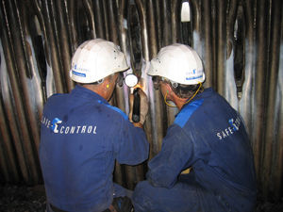

Case study – using the architecture
Soon after completing the architecture, an opportunity arose to put the process architecture to work
Goal –
Shift from an inspection-based model (~800 inspectors!) to client-managed safety programs
Clients will apply for a Client Safety Management Program Authorisation (CSMP Authorisation)
- must show effective processes and accurate record-keeping
Clients will pay a fee for managing their own safety programs! Still beneficial!
The proposal – manage this as a standalone "shadow system"

Slide 74
First, check the Process Architecture!
Administer Client Safety Management Programs
Immediately checked Enterprise Process Architecture
to understand impact areas – every process except one!!!
The “simple” shadow system workaround would have major impact.
Collect
CSM Fee
Grant
CSM
Program Authorization
Renew
CSM Authorization
Revise
CSM Equipment
Terminate
CSM Authorization
Conduct
CSM Audit
The change
Grant CSM (Client Safety Management) Program Authorization
Accept
CSM
Application
Audit
CSM
Program
Verify
CSM
Equipment
Determine & Collect
Equipment
Fees
Determine & Collect
Consultation
Fees
Issue
CSM
Authorization
Notes:
The actual change seemed small – almost tiny.

Slide 75

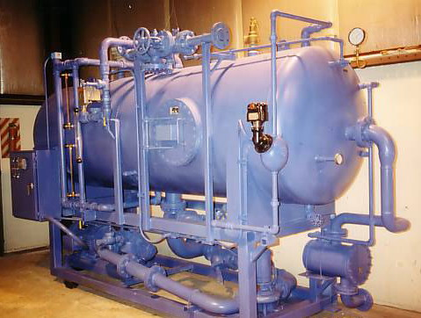
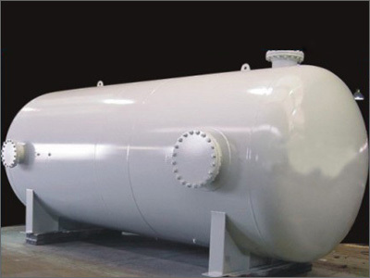
Understanding the situation using a Concept Model, Services, Use Cases
Business Development chooses Pilot Program –
boilers and pressure vessels in Oil & Gas fields
Current systems won’t support CSMP, time-consuming and expensive to change them –
IT and Finance suggest 18 – 24 months of work
BD is unimpressed by IT and Finance objections (“You're being mindlessly obstructionist!”)
and proposes work-around procedure. Guess which tool they intend to use?
I’m hired to identify end-to-end implications –
“Design a process and determine IT requirements that will allow this procedure to work.”
Concept Modelling was a critical tool in understanding the underlying policies,
and developing the process & requirements

Slide 76

An interlude on Concept Modelling
Concept Modelling / Data Modelling is crucial to Business Process work
The “things” you define in your data model are the things that
  processes act on
  (in verb-noun process naming, the noun is a “thing” – an entity)
  businesses want information about
  applications revolve around
Businesses needs a common language more than ever
Note – it often works best if you don't begin with a lecture on Concept Modelling
or Data Modelling…
“Now! That should clear up
a few things around here!”
Notes:
Alan Kay at a DAMA conference – Data Administration and Management Association??? Boy, do you guys need a new name.
Also works best if you do it in conjunction with other business analysis (process and requirements modelling) – the world has gone parallel, and there is less tolerance for standalone data modelling activities that are a serial step in the process

Slide 77
What actually is a Concept Model / Data Model?
A description of a business in terms of
  things it needs to maintain records of – Entities
  facts about those things – Relationships & Attributes
  policies & rules governing those things and facts
Models a view of the real world, not a technical design
(therefore, stable and flexible)
Can be comprehended by mere mortals
(at least initially)
Graham Witt – “A narrative supported by a graphic”
“Things” first,
data later!
Narrative component
Student definition:
A Student is any person who has been admitted to the University, has accepted, and has enrolled in a course within a designated time. Faculty and staff members may also be Students
Plus “Assertions” (policies & rules)
- Each Course is offered through one or more Classes
Each Class is an offering of a single, specific Course
- Each Instructor teaches one or more Classes
- Each Class is taught by one Instructor
(which may or may not be true…)
Many rules can't be shown on the diagram…
- A Student can not register in two Classes of the same Course in the same Academic Term
Graphic component
Entity (thing)
a distinct thing of interest
about which the business
must maintain information
Course
Attribute (fact)
A property of an entity
that can be expressed as a piece of data
Department
Number
teaches
Instructor
Credit Hours
Description
Number
Pre-requisites
Name
offered via
Student
offering of
taught
by
Room
Number
registers in
Class
Number
Name
Days
Times
location of
Building
Address
is registered by
Seating Capacity
One
Major
located in
Equipment
GPA
Relationship (fact)
A named association
between two entities
Many
(or “Multiple” or “One or more”)
Notes:
There are many ways to describe a business...
How it works - Process Model
How it's organised - Organisation Chart
Where it operates - Location Map
and…
What things it deals with, and needs to know about – Concept Model
(or Conceptual Data Model)
Data modelling symbols will vary slightly among the different “dialects”, but the meaning is constant. The symbols are much more standardised than they used to be.
Also known as a "business object model," a “concept model,” a “domain model,” or a “business class model,” among other things.
Data Modelling involves:
Gathering knowledge from Subject Matter Experts (the hard part!)
Representing that knowledge using a set of standard symbols and conventions (the easier part!)

Slide 78
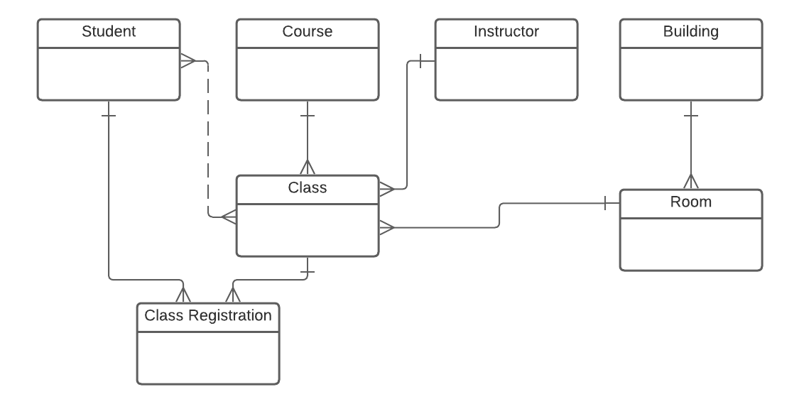
A better looking version of the model on the previous slide
Independent entities across the top
resolves
to
Drawn top-down by dependency
We focus on:
Simplicity and minimising graphic "widgets" -
initially just "boxes & lines"
Placement and direction
Progression through predictable steps

Slide 79
Building your initial Concept Model, step-by-step
Identify and define "Things"
1. Collect terms
1:1 interviews
survey (e.g., email)
group brainstorm
analyse documents
2. Isolate "things"
Ask Is this…
a thing?
a fact about a thing?
or "other stuff?"
3. Identify synonyms
select a term to use
as general as possible
just for this initiative,
not the entire enterprise
4. Define each thing
"good enough for now"
first, identify "anomalies, sources of confusion, and
valid differences of opinion"
select which to include
Develop initial Concept Model
5. Organise things
independent things across the top
then laid out top-down by dependency
6. Draw relationships
show dependency
parent-child drawn bottom-to-top
otherwise, side-to-side
7. Name relationships
in both directions
active verb-based!
not mushy – has
not meaningless – related to
8. Add cardinality
use words first
1:1 is probably wrong
1:M (one to many)
M:M (many to many)
Refine Concept Model
9. State assertions
forcefully, for each relationship
challenge the assertions!
restate the assertion &
why it changed, if it did
10. Redraw the model
shows revised assertions
e.g., 1:M becoming M:M
e.g., dependent things becoming independent
11. Collect attributes
a few for each thing
not all attributes
don't worry about normalisation
12. Move to identifying:
events / services
use cases /
user stories

Slide 80
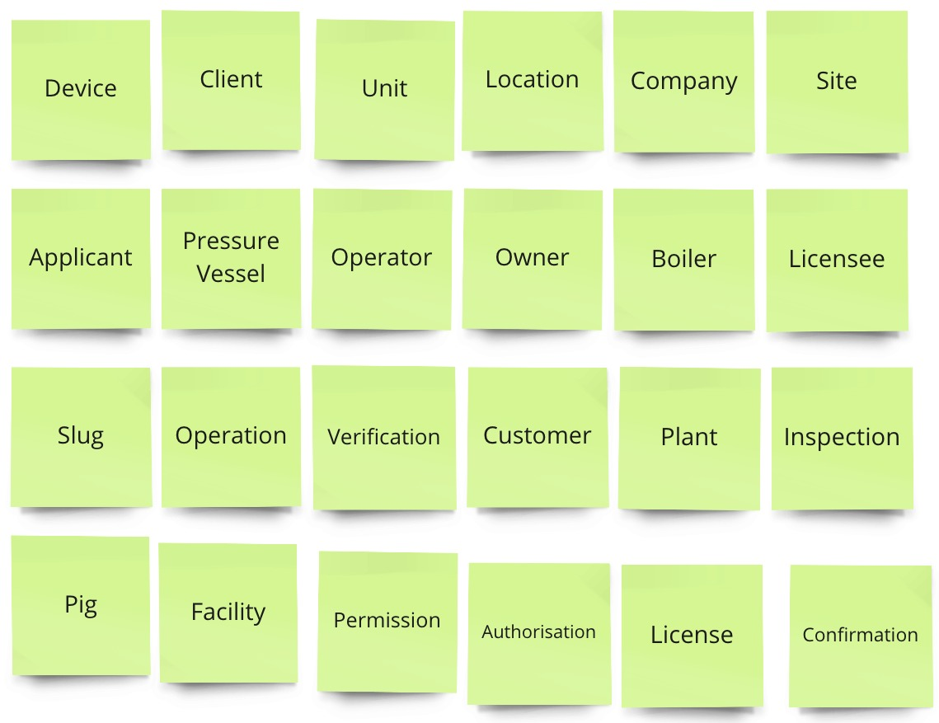
Always start with terminology (the “things”)
From one-on-one interviews with 8-10 key stakeholders we gathered ~200 terms related to CSMP (Client Safety Management Program) – "anything that went by a name."
Here are 24 that met the criteria to be a "thing"– the candidate Entities.
Identify synonyms and select one term.
How do these relate to one another?
What do you need to know about each?

Slide 81
Review from an example using Miro – Terminology Analysis

Slide 82
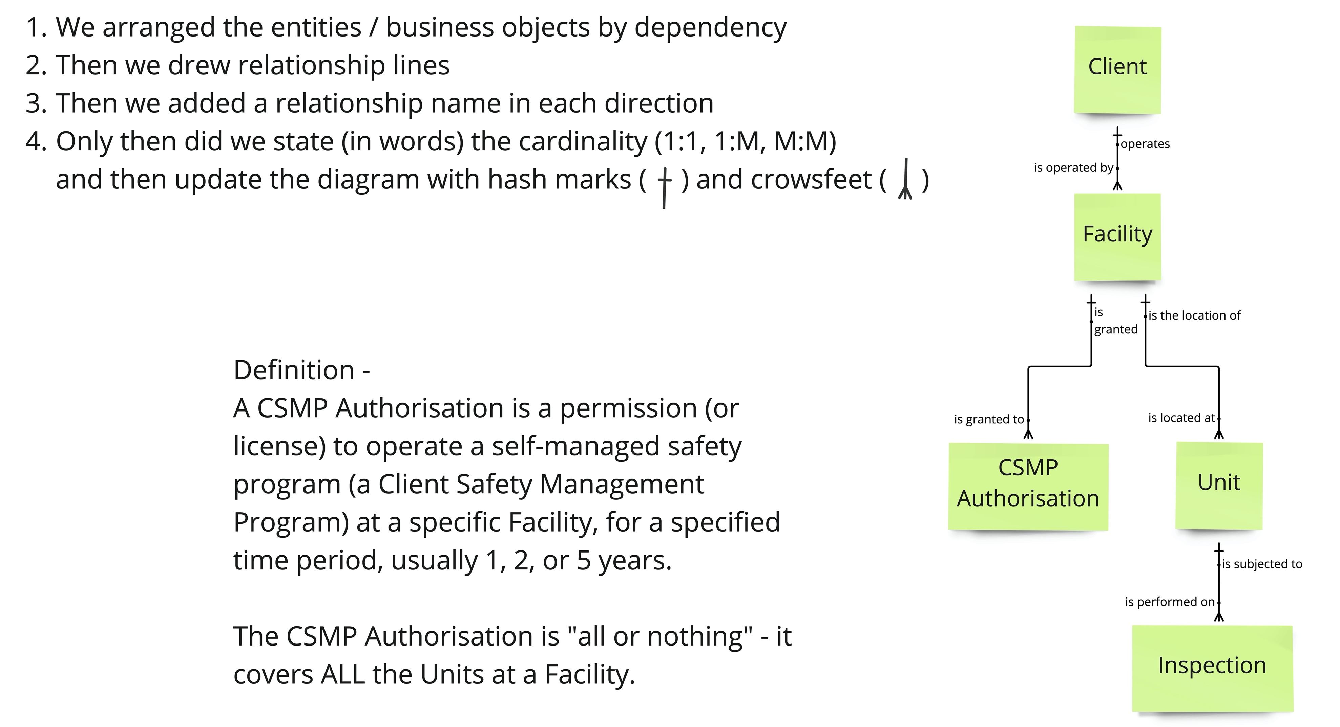
Concept Model Version 1; not perfect, but a good start

Slide 83
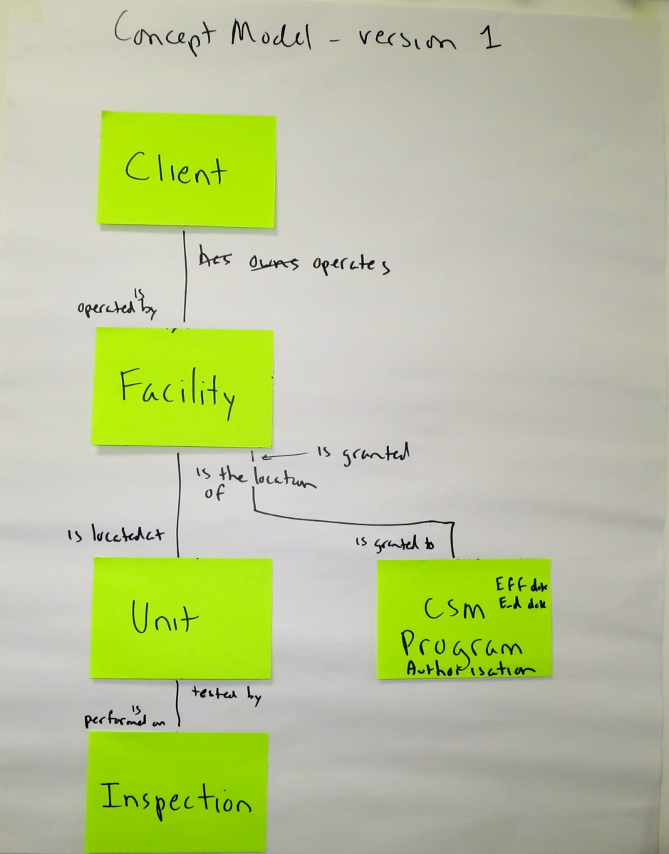
Just boxes and lines, but raises important questions
What do we issue
the Authorisation to?
Are Units permanently
part of one Facility?
What do we Inspect?

Slide 84
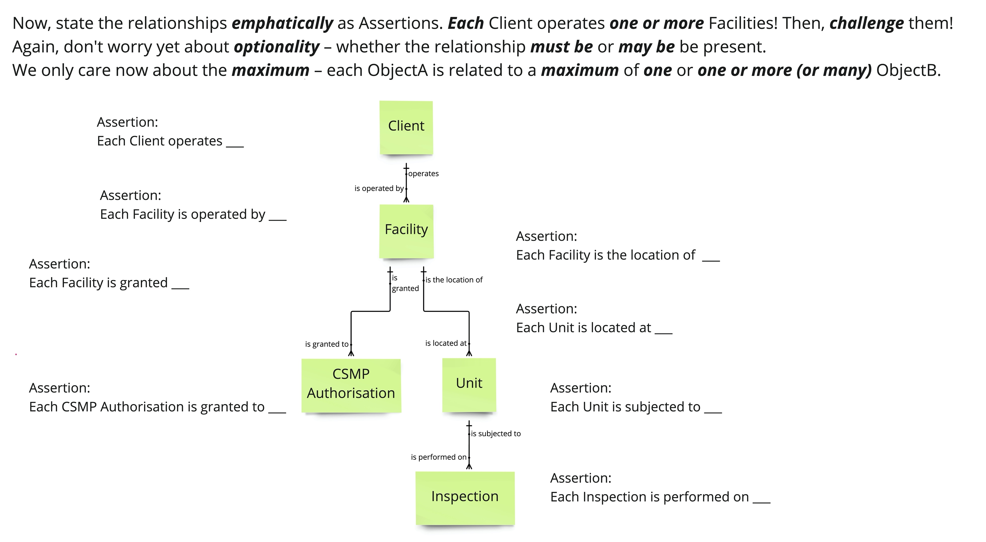
Concept Model Version 1 – state Assertions and challenge them

Slide 85
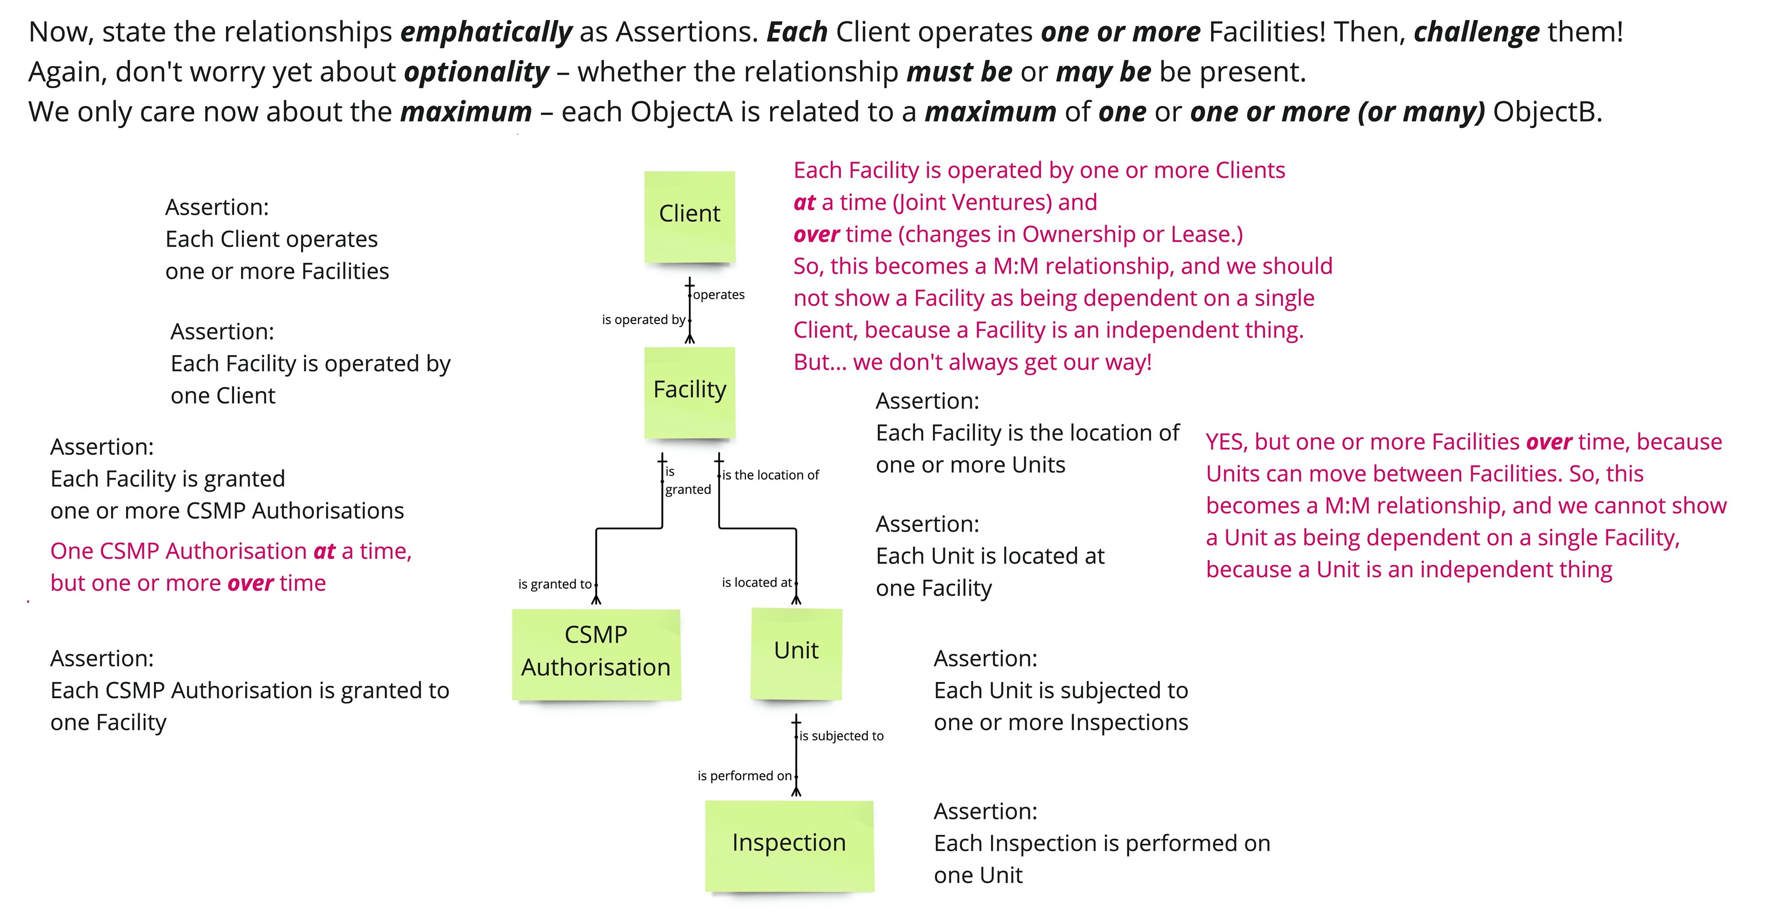
Concept Model Version 1 – revised Assertions from challenges

Slide 86
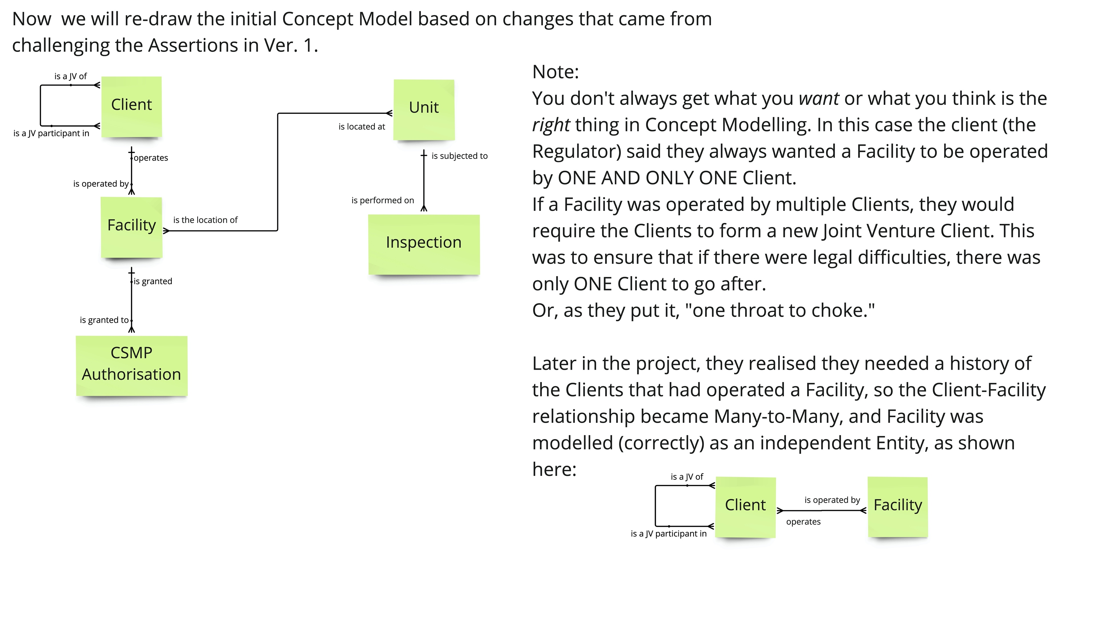
Concept Model Version 2 – revised from challenging Assertions

Slide 87
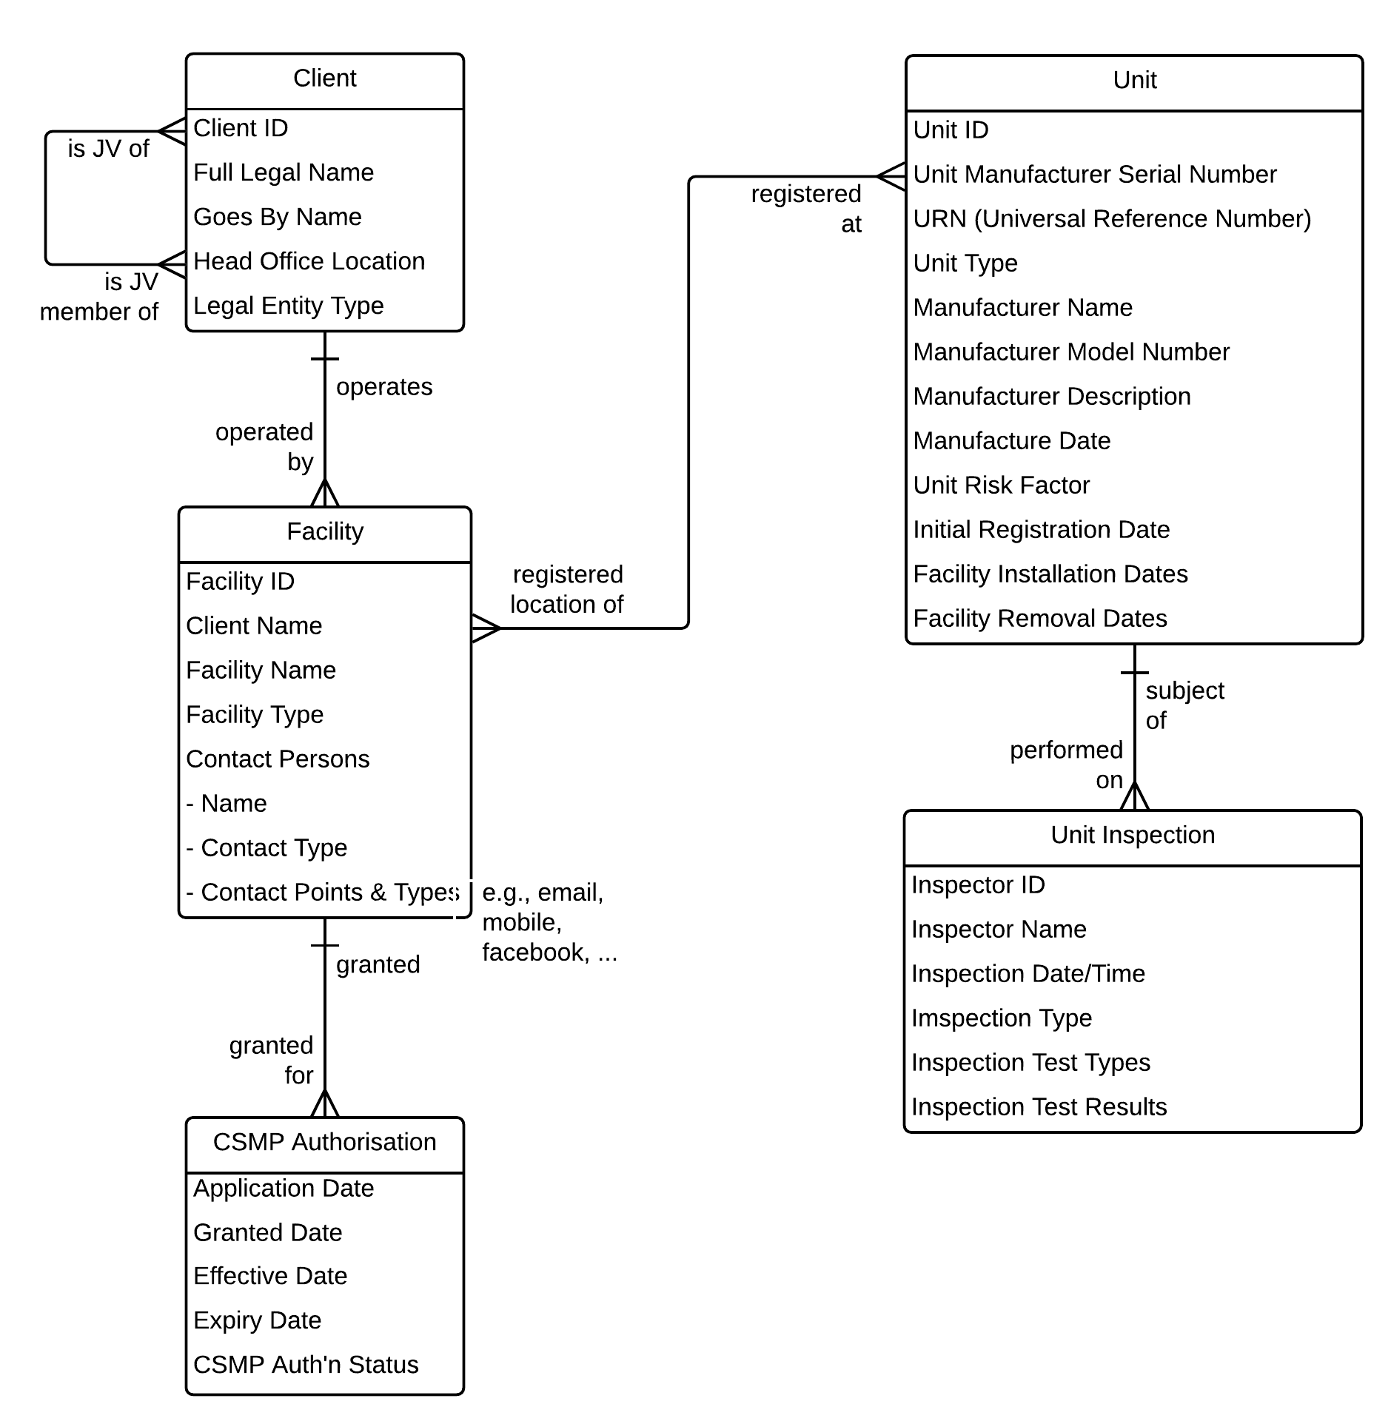
"What do you need to know about the things in the Concept Model?"
Sketching this out was fast, and raised many questions that had not occurred to the client…
  Is there one CSMP per Client, per Facility, or some other basis?
  Do Units frequently relocate, or even turn up at another Client?
  What is inspected –
  the Facility or the Unit?
  Does the CSMP cover all or some Units at a Facility?
  …and MANY more…
It's not perfect, but the businesspeople found it incredibly useful.
Model took
~90 minutes
This was done initially without any
data modelling terminology or symbols!

Slide 88
Identify Services (Events) then Use Cases / User Stories
Use Case
Use Case or
User Story
- add Who and
How
Service Specification
(Events)
Service (or Event)
- add a Verb
to the Noun
Concept
Model
Entity
or simply a "thing"
- a core Noun
A Concept Model is a great
starting point for discovering your
Services and Use Cases (User Stories)
Supports Service-Oriented Business Analysis

Slide 89
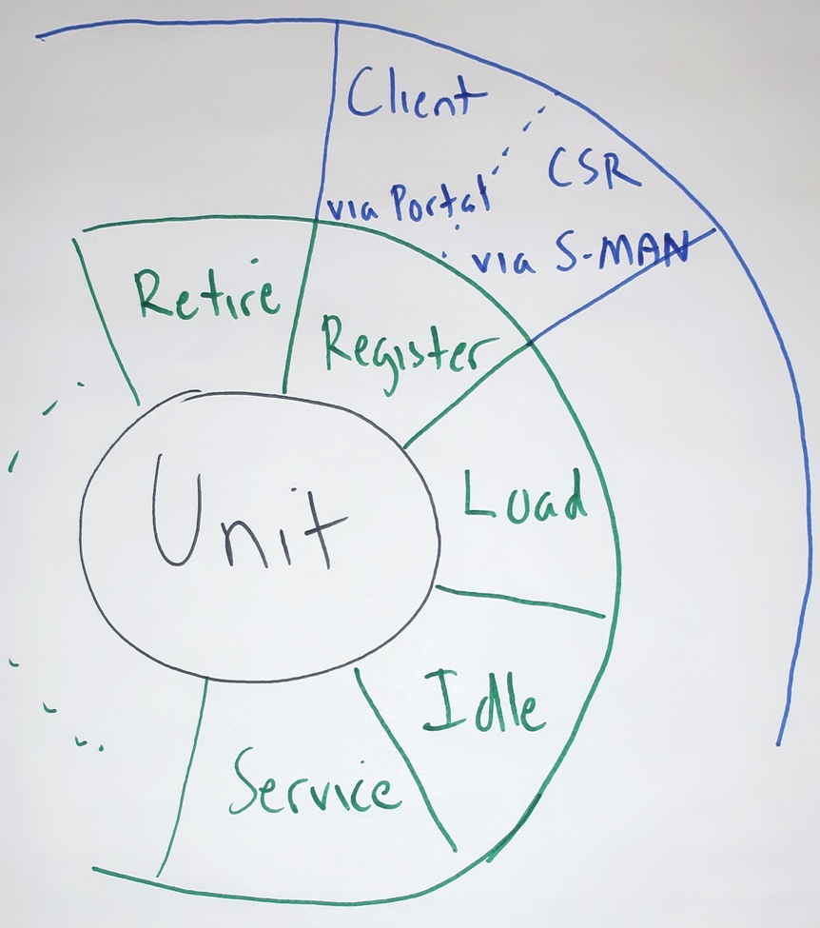
Discussion – one Business Service, one or more Use Cases
One Service
Who | What (the Service – verb + noun) | How
Client | Register Unit | via Portal
Customer Service Rep (CSR) | Register Unit | via S-MAN (the ERP)
Client | Register Unit | via Mobile App
??? | Register Unit | ???
Multiple
Use Cases
What is the value of documenting the Service only once?
("One Service available through multiple channels.")
re-use of the asset, and therefore higher consistency
better chance of getting it right – higher value from less effort
if it's implemented as a single service, easier maintenance – it's in ONE place.
Why would we make a single Service available via multiple Use Cases?
different actors need different "navigation and hand-holding,"
e.g., casual vs. expert users
different technology platforms have different capabilities,
e.g., mobile phone vs. touch-screen kiosk

Slide 90
Summary – what an analyst can do with a Concept Model?
First, clarify language. (A platform)
Second, establish policies and rules.
And then, identify events and services, e.g.,
A Unit is…
Registered (requiring the service “Register Unit”)
Loaded (requiring the service “Load Unit”)
Idled (requiring the service “Idle Unit”)
Reactivated (requiring…)
Repaired
Inspected
Relocated
Retired
…
We did the same for Client, Facility, CSM Program, …
These are the essential capabilities.
In Business Analysis "essential" means what with no reference to who or how
Something I always do when evaluating/selecting COTS S/W

Slide 91
Clarify scope of the new process and identify participants
Client Result:
Approval granted for a self-managed safety program.
Trigger:
Client submits request to
enter into
a CSMP
Grant Client Safety Management Program
Accept
CSM
Application
Audit
CSM
Program
Verify
CSM
Equipment
Determine & Collect
Equipment
Fees
Determine & Collect
Consultation
Fees
Issue
CSM
Authorisation
Main Activities (or Milestones, Phases, or Subprocesses)
Agency Result:
Revenue collected. New participant in CSMP; confirmation that regulations are satisfied
Cases:
New
Grandfathered
Ownership Change
Process Scope Model – pure “what”…
Applicant
Customer Service
Records Management
Safety Operations
Finance
Grant Client Safety Management Program
We saw this example earlier
Accept
CSM
Application
Audit
CSM
Program
Verify
CSM
Equipment
Determine & Collect
Equipment
Fees
Determine & Collect
Consultation
Fees
Issue
CSM
Authorization
Main Activities (or Milestones, Phases, or Subprocesses)
Process Summary Chart – simplified “what,” plus “who”
Notes:
These are simple, painfully obvious diagrams, but are vastly under-utilised as a mechanism for showing gaps, conflicts, and disconnects between functions. A Process Scope Model helps people “let go” of current implementation constraints/assumptions, and whenever we first draw a Process Summary Chart (also called a “Process-Function Chart”) with a client, the reaction is “We sort of knew that, but we've never seen it put that clearly before.”
We call it a “Process Scope Model” when it doesn't show the functional areas, a “Process Summary Chart” when it does – it's the initial intersection of “what” and “who.” It clearly illustrates the cross-functional scope of the process
Don't forget external participants such as as Customers, Suppliers, Partners, Associations, or Regulators!
Excellent tool for organising analysis. E.g., list detailed activities, objectives, actors, etc. by Function or Main Activity

Slide 92
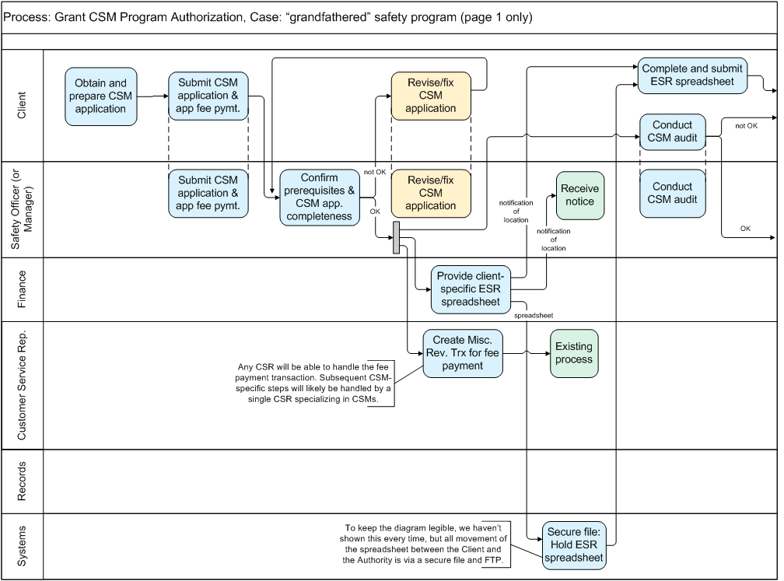
The initial, business-friendly workflow model
A “Handoff Level” workflow model
Notes:
The fact that these are physical models is frequently ignored or glossed over.
Some of these steps represent a LOT of work, but…
“In a handoff diagram,
whenever an actor holds the work,
whether they do a lot or a little,
draw one box and move on.

Slide 93
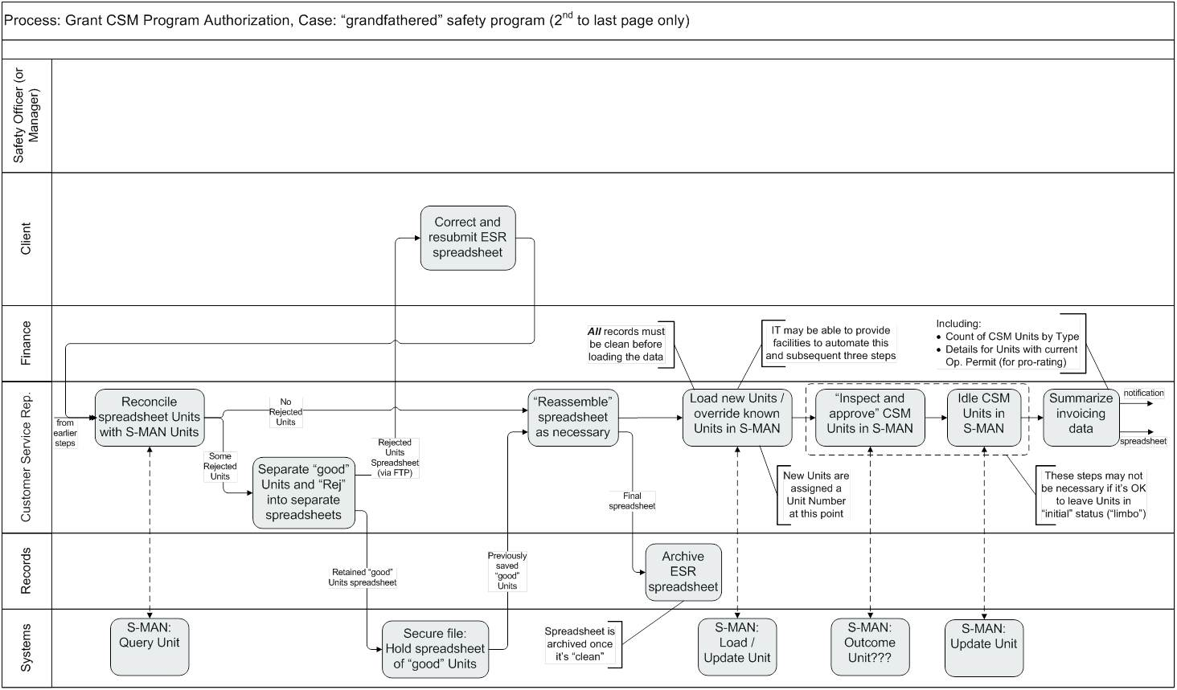
Then detail showing where use cases & services fit
A “Service Level” workflow model
3) …by interacting with
1) This Actor (or Role)…
2) …completes this Activity…
That's a Use Case!
- an actor
- interacting with a system
- to obtain a service
- to help them complete a task or obtain information
is what we mean by a
Use Case
(which may begin as a User Story)
4) … this Service offered by a System
Notes:
This shows how this style of diagram pulls together process workflow, use cases, and services.
“Actor – Service (verb-noun) – Platform” forms a Use Case – “Customer Service Rep Idles Units via S-MAN”

Slide 94
Mission accomplished! Conclusions:
  "Plan A" rejected – agreement that Unit data must get into S-MAN
  “Plan B” (change the app) looks good, but the vendor estimates are HIGH
  “Plan B Minus” (existing functionality plus CSR work) is worth the cost
If requirements, issues, assumptions, etc. are buried in lists and narratives, people will argue endlessly; if they are in an integrated set of models,
it’s much harder to dismiss the reality of the situation
Process Models, Use Cases, Service Specs, & Concept Models: essential!
Notes:
Business Development Manager wasn’t thrilled, but accepted that this was a fact-based decision.

Slide 95
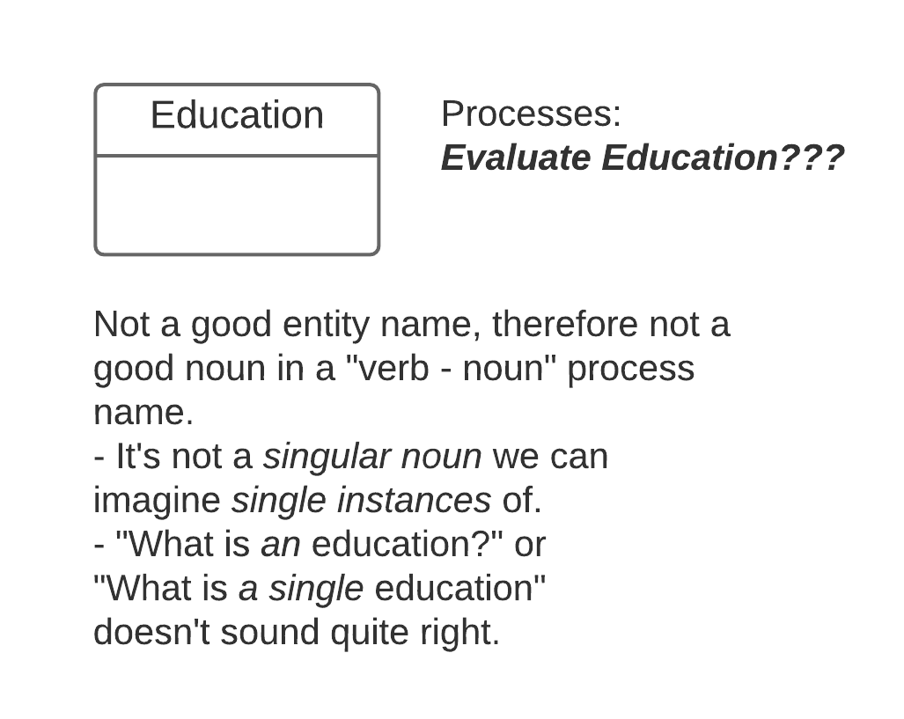
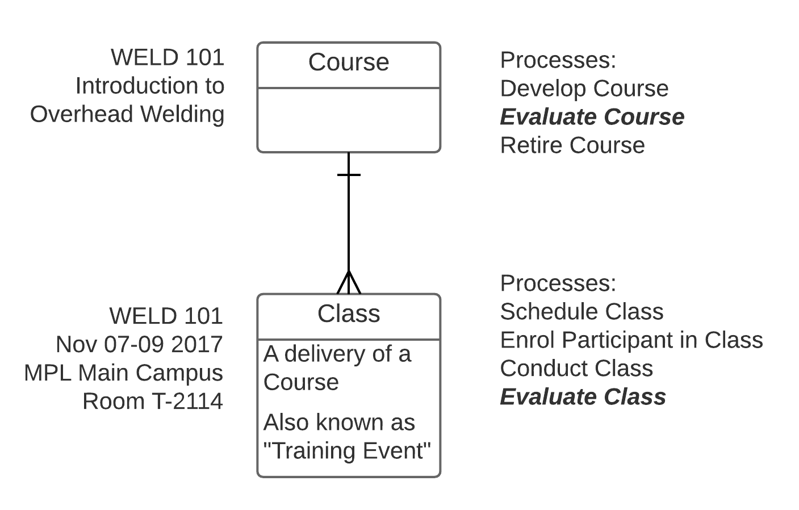
More examples: Example 1 – Concept Modelling to clarify the process
Analyst struggles to model “Evaluate Education” – timing disconnects,
1:M and M:1 connections within the process, token changes, …
A few minutes of Concept Modelling showed two distinct tokens and processes. “Education” was a “mushy noun.”
The key was asking "What do you mean by an Education?”

Slide 96

Never be afraid to ask “dumb” questions…
- Myth -
- Reality -
“I've got to have all the answers.
I can't show my ignorance.”
You're paid to ask, not to know.
Someone will be glad you did.
The number of different
answers will surprise
everyone.
Classic example –
“Case” in a justice system
Just one more question, ma'am. Nothing too important...
There's one thing I'm not clear on...
Could we go over this just once more to be sure I've got it right?
Lieutenant Columbo takes up Data Modelling
Notes:
The less I know, the better I facilitate. Why? (Principle of Constructive Ignorance”
Example – “What's the difference between a - ”
Device
Part
Component
Assembly
Sub-assembly
System
…?
By the way – DON'T answer the dumb questions. That's what they (participants) are there for.

Slide 97
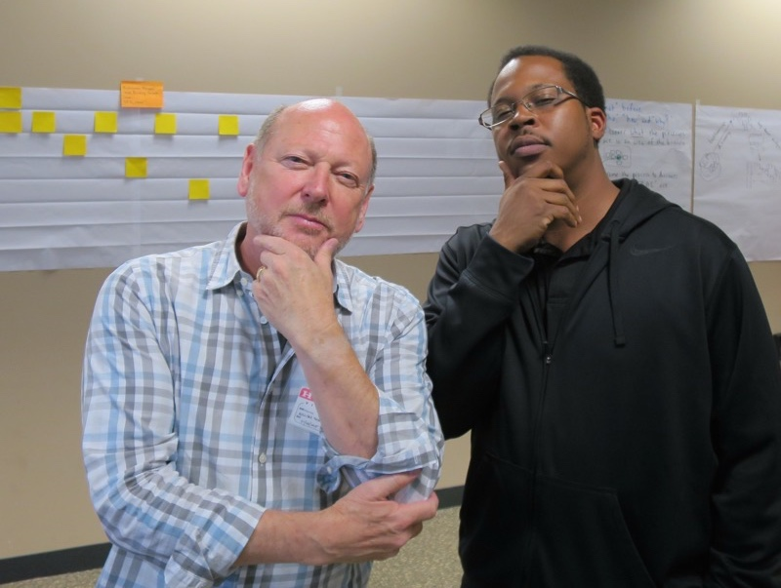
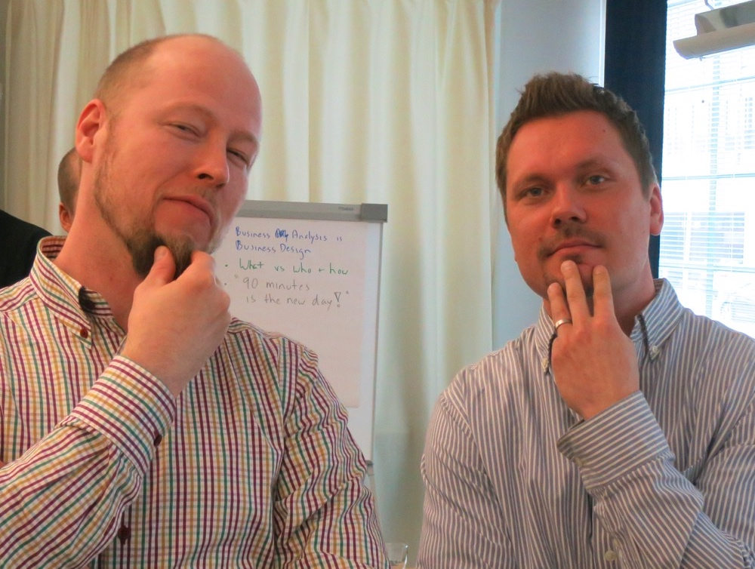

“What do you mean by…?”

Slide 98
Example 2 – if you ignore the process AND the data…
U.S. University implementing cloud-based
Human Resources and Payroll systems from
the same vendor.
  Total spend US$80M, nothing salvageable
  University leadership unamused
  I was brought in for “project recovery”

Slide 99
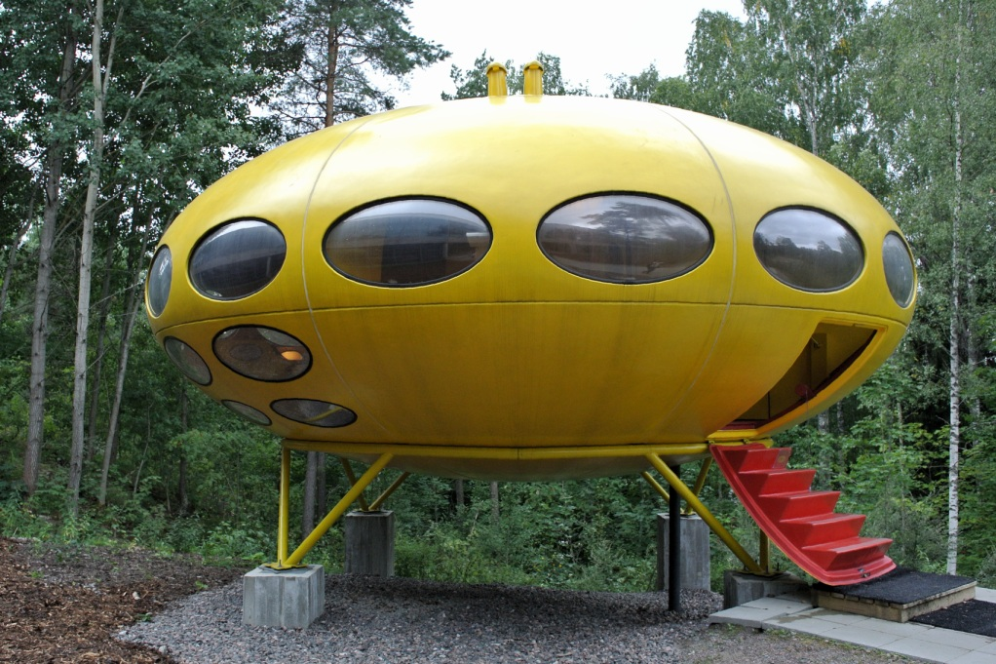
The situation
  My assignment –
  take a large team through a process model
  and data model-based approach –
  run 4-day offsite in “The Capsule”
  (we felt like astronauts)
  What we learned:
  Little time on “business process”
    very generic / unrecognisable as “what we do”
    team tires of this
  Zero time on “data” (no “concept model”)
  Management: "Get on with it – the vendor has seen it all before."
  100+ programmers begin detailed configuration of
  application rules and logic – “Straight to task.”
A "Futuro" house by
Finnish architect Matti Suuronen

Slide 100
Initial focus – too much on "requirements"
Business Process
Process
Over 100 developers coded detailed business rules and contract terms separately into
Payroll Application
HR Application
Note: university had over 35 labour unions with complex payroll and benefits policies/rules –
no rethinking whatsoever!
Application
requirements
Application
Business
Data
Data

Slide 101
Remediation – focus on process and data
Identified, modelled, analysed, redesigned significant process – “Recruit, Hire, and Onboard Employee,"
the Case was "Tenure-Track Faculty”
Developed scope model (invaluable!)
Developed augmented scope model
Assessed and redesigned based on “what”
Added “who & how” to create a to-be
augmented scope model
Business Process
Process
Application
requirements
Application
Modelled seven critical concepts in data –
“what do we mean by…”
Supervisory-Organisational Hierarchy
Position-Based Management
Visible Application Workflow
etc.
Business
Data
Data

Slide 102
First, identify main phases in a Scope Model
Recruit, Hire, and Onboard Employee
Prepare
to Recruit
Recruit
Employee
Extend
Offer
Hire
Employee
Complete
Onboarding

Slide 103
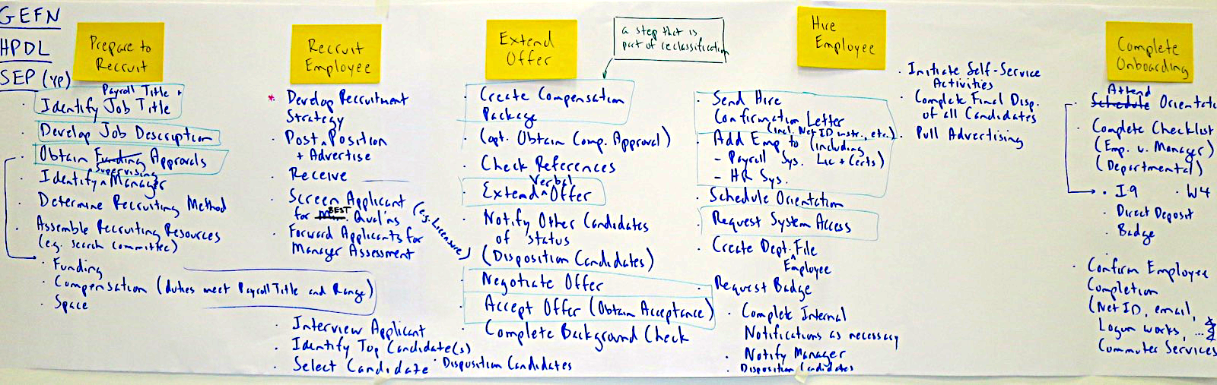
Augmented Scope Model ("what") for the full process
Recruit, Hire, and Onboard Employee
Identify
Payroll Title & Job Title
Develop Job Description
Obtain
Funding, Compensation,
& Space Approvals
Identify
Supervising Manager
Determine
Recruiting Method
Assemble
Recruiting Resources
(e.g., search committee)
Active verbs & nouns
For the first time, the entire end-to-end process is visible
A surprise to everyone how much work it is, and how many functions participate!
Still no reference to “who or how,” just "what" – active verb + noun
This is critical to build support for change – it “depersonalises” in a good way!

Slide 104
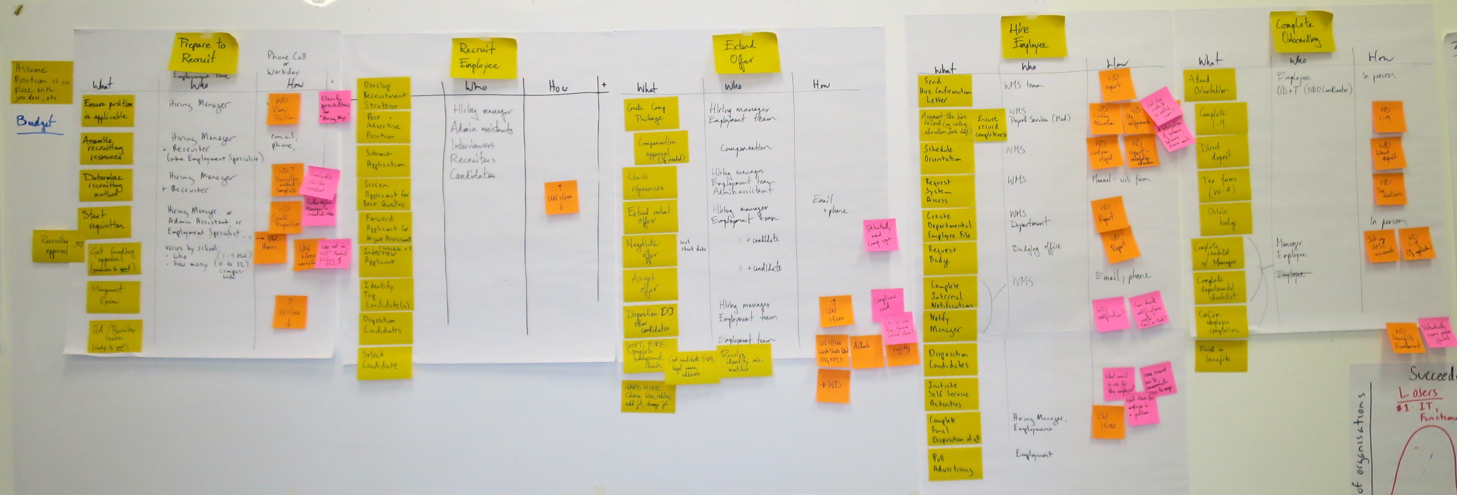
Then add "who and how"
Next, add “who” (which role) and
“how” (which tool or system function) and "notes."
Now we have the basics of a to-be process design, and an understanding of which steps will be supported by which system functions – great for understanding if the COTS app will actually work!
(And easier than jumping into detailed requirements and flow modelling.)

Slide 105
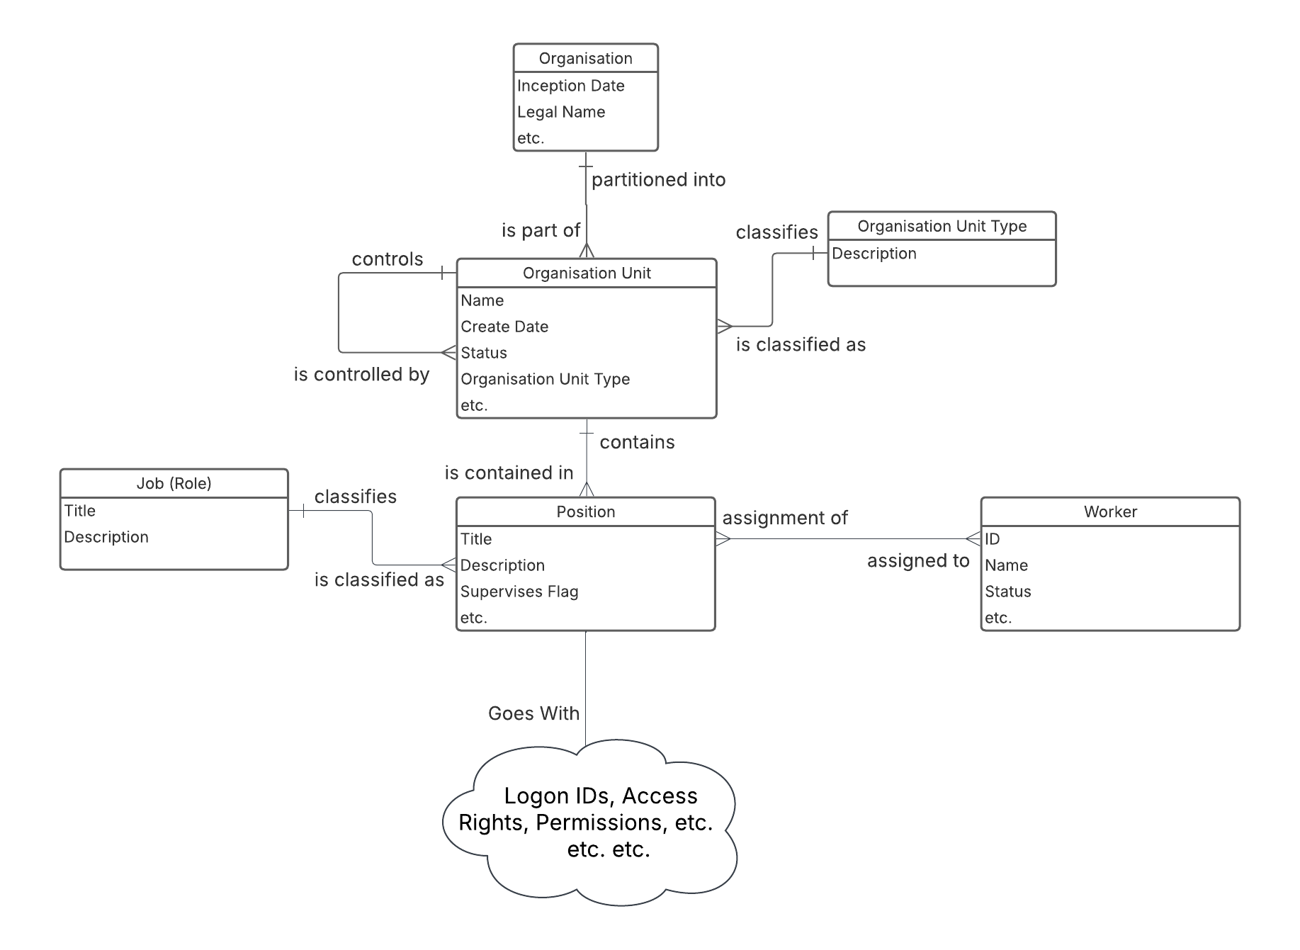
And of course, Concept Modelling was really important
Supervisory-Organisational Hierarchy
Position-Based Management

Slide 106
Example 3 – is a new process concept viable?
Classroom tech support at major US research university
  Goal: “Uber-style” tech support for classrooms –
  when an Incident is raised in a Classroom,
  dispatch it to one or more appropriate Techs
  (qualified, available, assigned to the appropriate Support Unit)
  who will bid on it.
  Approximately 20 “assertions” described the planned state:
    Each Tech may be badged for one or more Service Category Levels, and for each Service Category Level there may be one or more Badged Techs.
    Each Tech may be assigned to one or more Support Units during a given time period,
    and for each Support Unit there may be one or more assigned Techs.
    A Tech can only be assigned to one Support Unit at a time.
    An Incident for a particular Classroom can be raised by
    either a Customer (the “reporter” – Faculty, Staff, Tech, …?)
    or an automated Alert raised by an Equipment Unit located in a particular GP Classroom.
    many more…
  The assertions led to the development of an ERD.
  Note – the complete “Concept Model”
  is the combination of the definitions, the assertions, and the graphic (ERD)

Slide 107
Example 5 – Assertions. Lots of assertions.

Slide 108
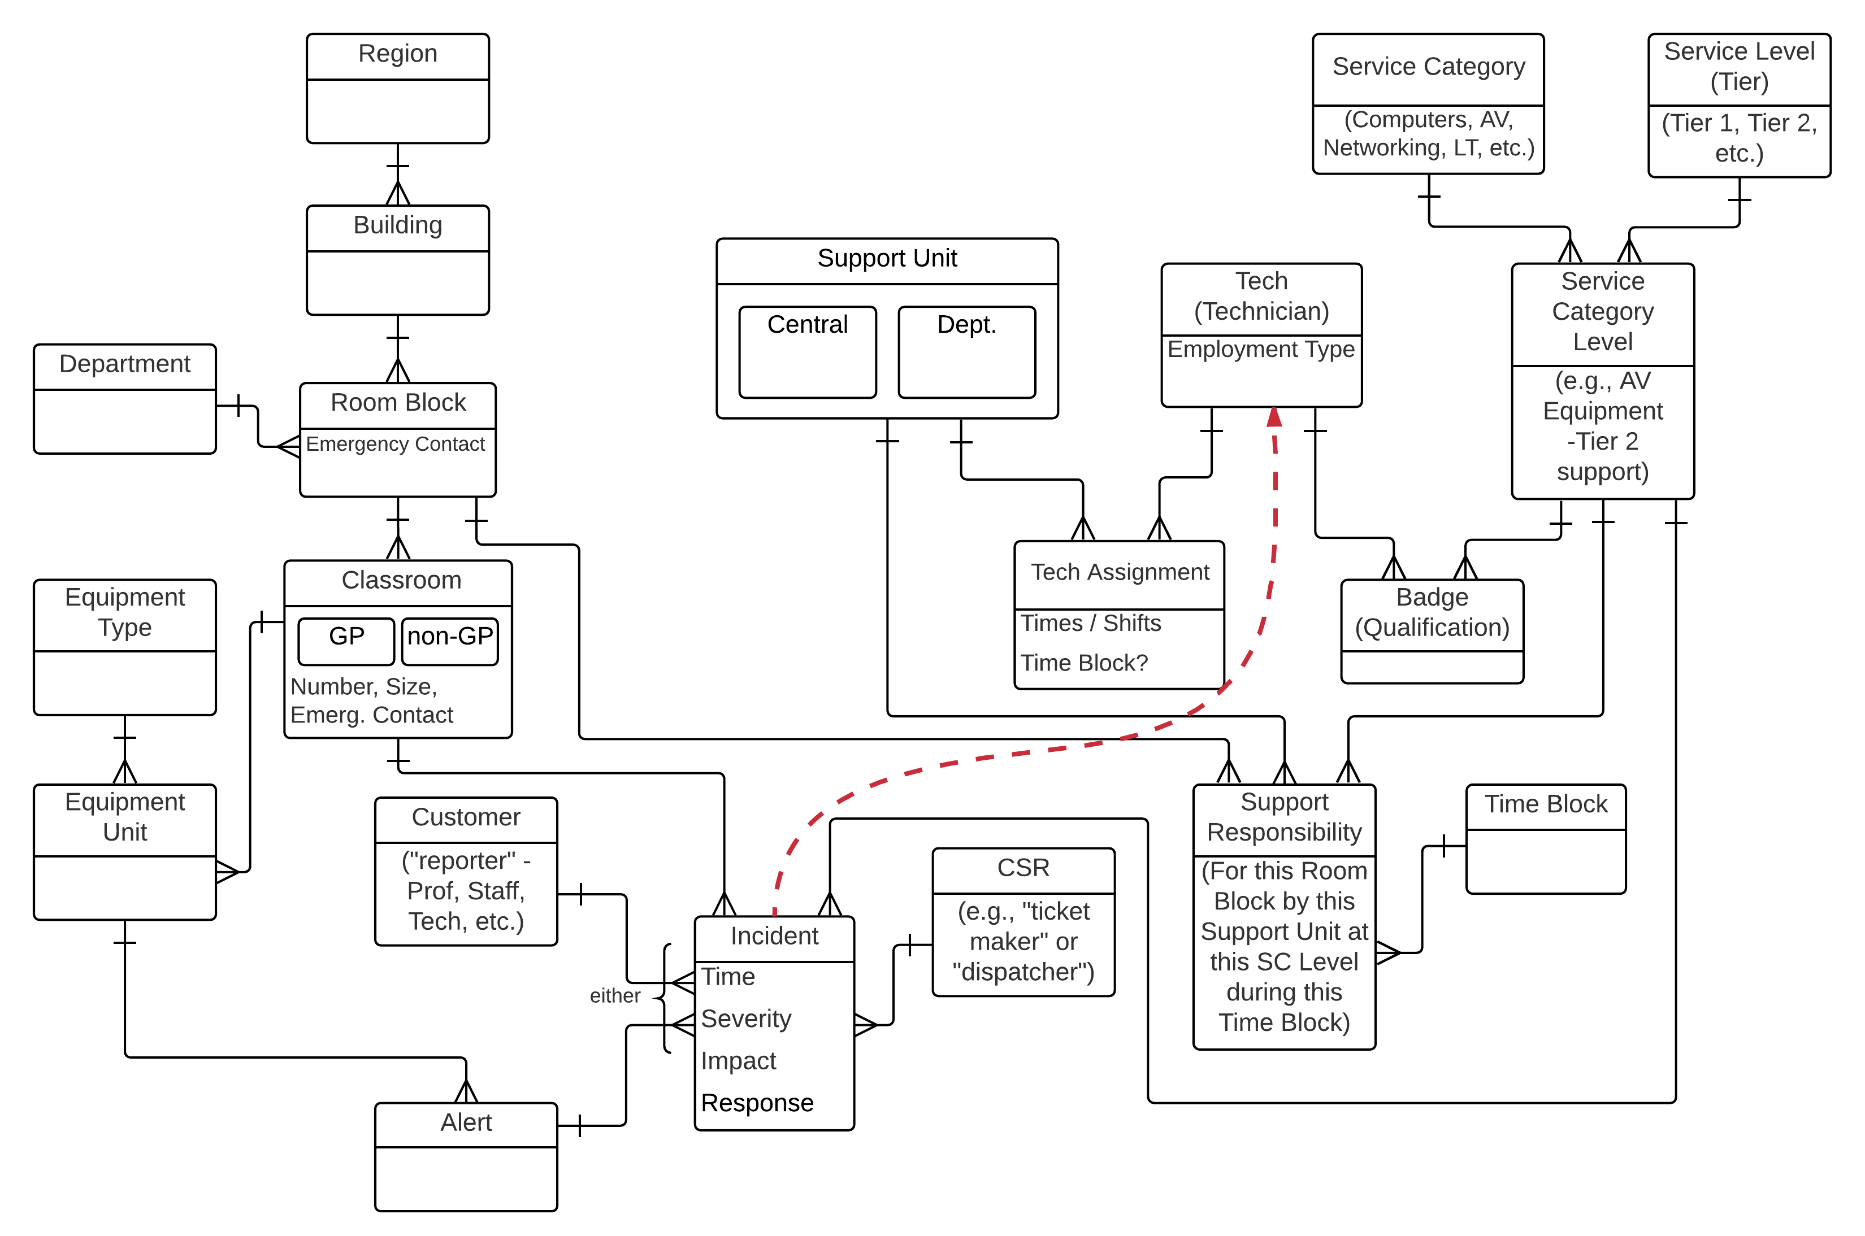
The underlying "Concept Plus" Model

Slide 109
Summary of findings
The assertions and the ERD showed the idea could be implemented:
  When an Incident is raised, we know the Room Block (via Room,) the Time Block,
  and the Service Category Level, therefore we know the Support Responsibility, and therefore the Support Unit.
  We also know which Techs are badged for that Service Category Level, and which Techs are assigned to that Support Unit at that time.
  Now we have a pool of Techs the Incident could be dispatched to, for them to “bid on.”

Slide 110
This slide left blank to maintain balance in the Universe

Slide 111

Encouraging change in people and organisations
Five things you need to know about Business Processes
Identifying true, end-to-end, cross-functional
Business Processes
Developing a Process Architecture
Seven ways to help people embrace Process Change
Human-oriented process modelling
A feature-based Process Design method –
transitioning from as-is to to-be
Seven techniques we can use to build
“change” into our practice.

Slide 112
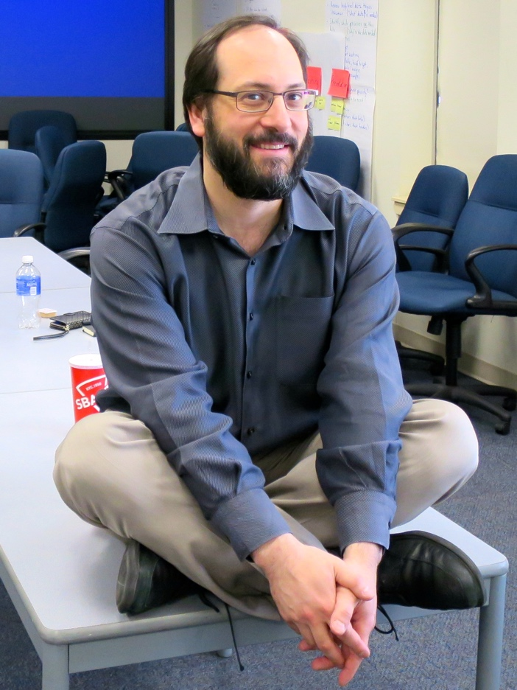


Origins – my clients were ahead of me
“We're using your methods as a generalised approach to any sort of change, not just 'process' change.”
“Do you have a degree in Organisational Psychology?”
Me : “Huh?”
“When we follow the method closely, almost slavishly, the usual resistance to change simply
doesn't materialise.”
“Instead of Change Management at the end of a project (“Change is coming. Now CHANGE!”) we like the way support for change is built in throughout your approach.”

Slide 113
Five thoughts on what doesn't work…
Leaping far too quickly into specifying the future state.
No, that does not make you nimble, responsive, or agile.
Copying so-called “best practices” without regard for your culture,
core competencies, style, or differentiator.
W. Edwards Deming:
“Eliminate slogans, exhortations, and targets asking for zero defects
or new levels of productivity.
Such exhortations only create adversarial relationships, as the bulk of the causes of low quality and low productivity belong to the system and thus lie beyond the power of the work force.”
and
Failing to involve the people who actually do the work.
Client: “Everyone seems to think Change Management is a training plan.” It's not.

Slide 114

Disclaimer and fine print
Not a methodology
techniques
frameworks
ideas
examples
For your awareness
So you can learn to observe relevant factors
I'm not an expert on OD, culture, change, etc….
… but the techniques presented here have been validated by experts
Notes:
How did I get involved with OD? Probably because my methods stress participation, engagement, and buy-in, and because my enabler framework balances the technical side with the human side. Some relevant events:
25 years ago, internal OD consultants participating in a session I'm facilitating inform me “You're actually an OD consultant – you just don't know it yet.”
Global energy company: “Can we add you to our registry of Organisation Development consultants?”
“Great! But how did you determine I'm an OD consultant...?”
High tech firm rebuilding: OD group engages me to help align development processes with culture / capabilities.
Financial services firm: massive restructuring, outsourcing, and shift to process orientation (committed to “no layoffs”) engages me to help staff understand the “human side” of processes so they can choose new internal jobs.

Slide 115
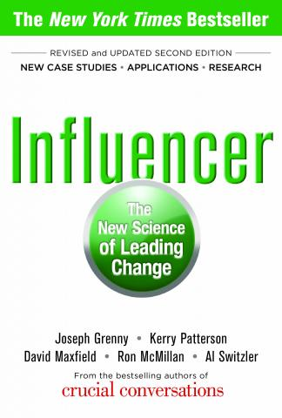
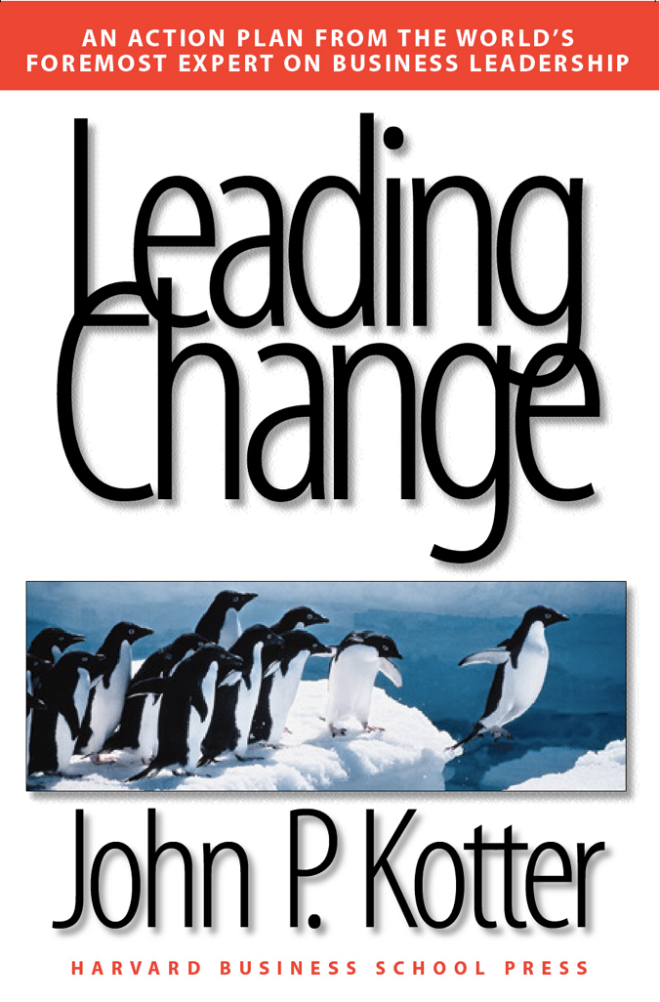

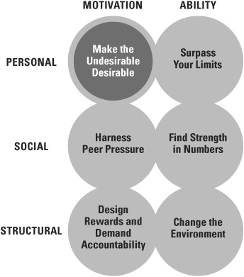
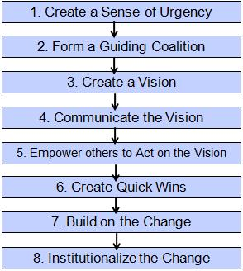
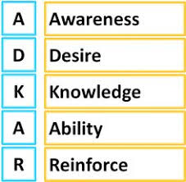
But if you want a method – the classic sources
4/6 = 10x

Slide 116
Seven ways to build support for change
1 – The power of venting –
let them be heard
2 – What first, who & how later – abstraction to the essence
3 – Don't start with why? – the problem with problem statements
4 – Clarify what you need to be great at – your differentiator
5 – Identify the organisation's beliefs, and their impact
6 – Describe organisational culture, and its impacts
7 – Build a feature-based, holistic view of the future state

Slide 117
1) Venting
1) The essence of the technique:
Early in the session, “venting” / “what's on your mind?”
questions
concerns
great ideas
what I'd change if I could
…
related to today's topic
Discussion:
Why is “venting” an effective technique?
What concerns do you have about “venting?”
How would you mitigate those concerns?
Notes:
DON”T do anything with venting outcomes during the session. Move on with the plan!

Slide 118
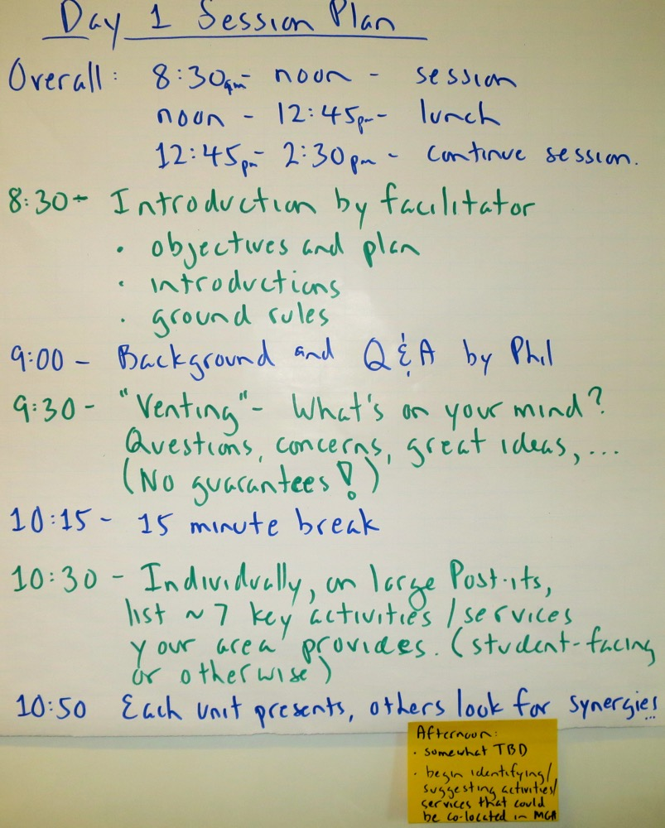
A typical first session agenda
Note – establish context before venting

Slide 119
Build “venting” into the session plan
Typical opening agenda…
Quick presentation by the sponsor on scope and overall project goals (5 minutes)
Introductions (10 minutes)
    Facilitator
    Participants
Brief presentation by the facilitator (10 minutes)
    What do we mean by “end-to-end” and what issues does this raise?
    Key elements in defining an end-to-end view
    Objectives for the series of sessions, objectives for today's session,
    and today's session plan and ground rules (5 minutes)
“Venting” / What's on your mind? (45 minutes)
    Key issues, specific expectations, concerns, burning questions,
    great ideas, cautionary tales, etc.
    No guarantee they'll be addressed in this session.
Clarify terminology (90 minutes)
Identify significant activities (30 minutes) etc.
No guarantees,
strictly time-boxed

Slide 120

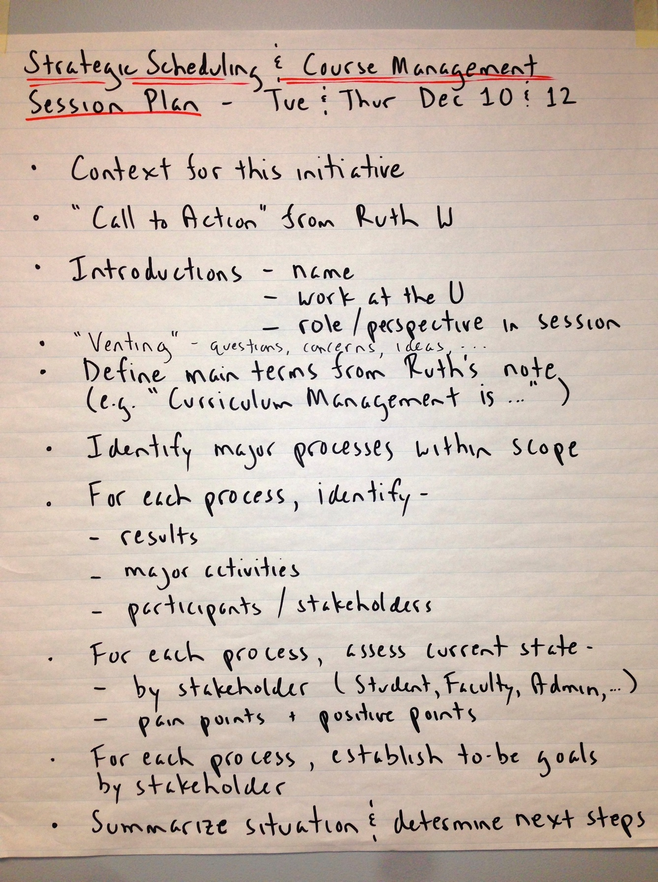
Venting example
Topic –
“Strategic Scheduling / Course Management”
(what that meant… not exactly clear)
Senior university personnel –
Department Chairs, Deans, …
45 minutes for venting –
it was well used!

Slide 121
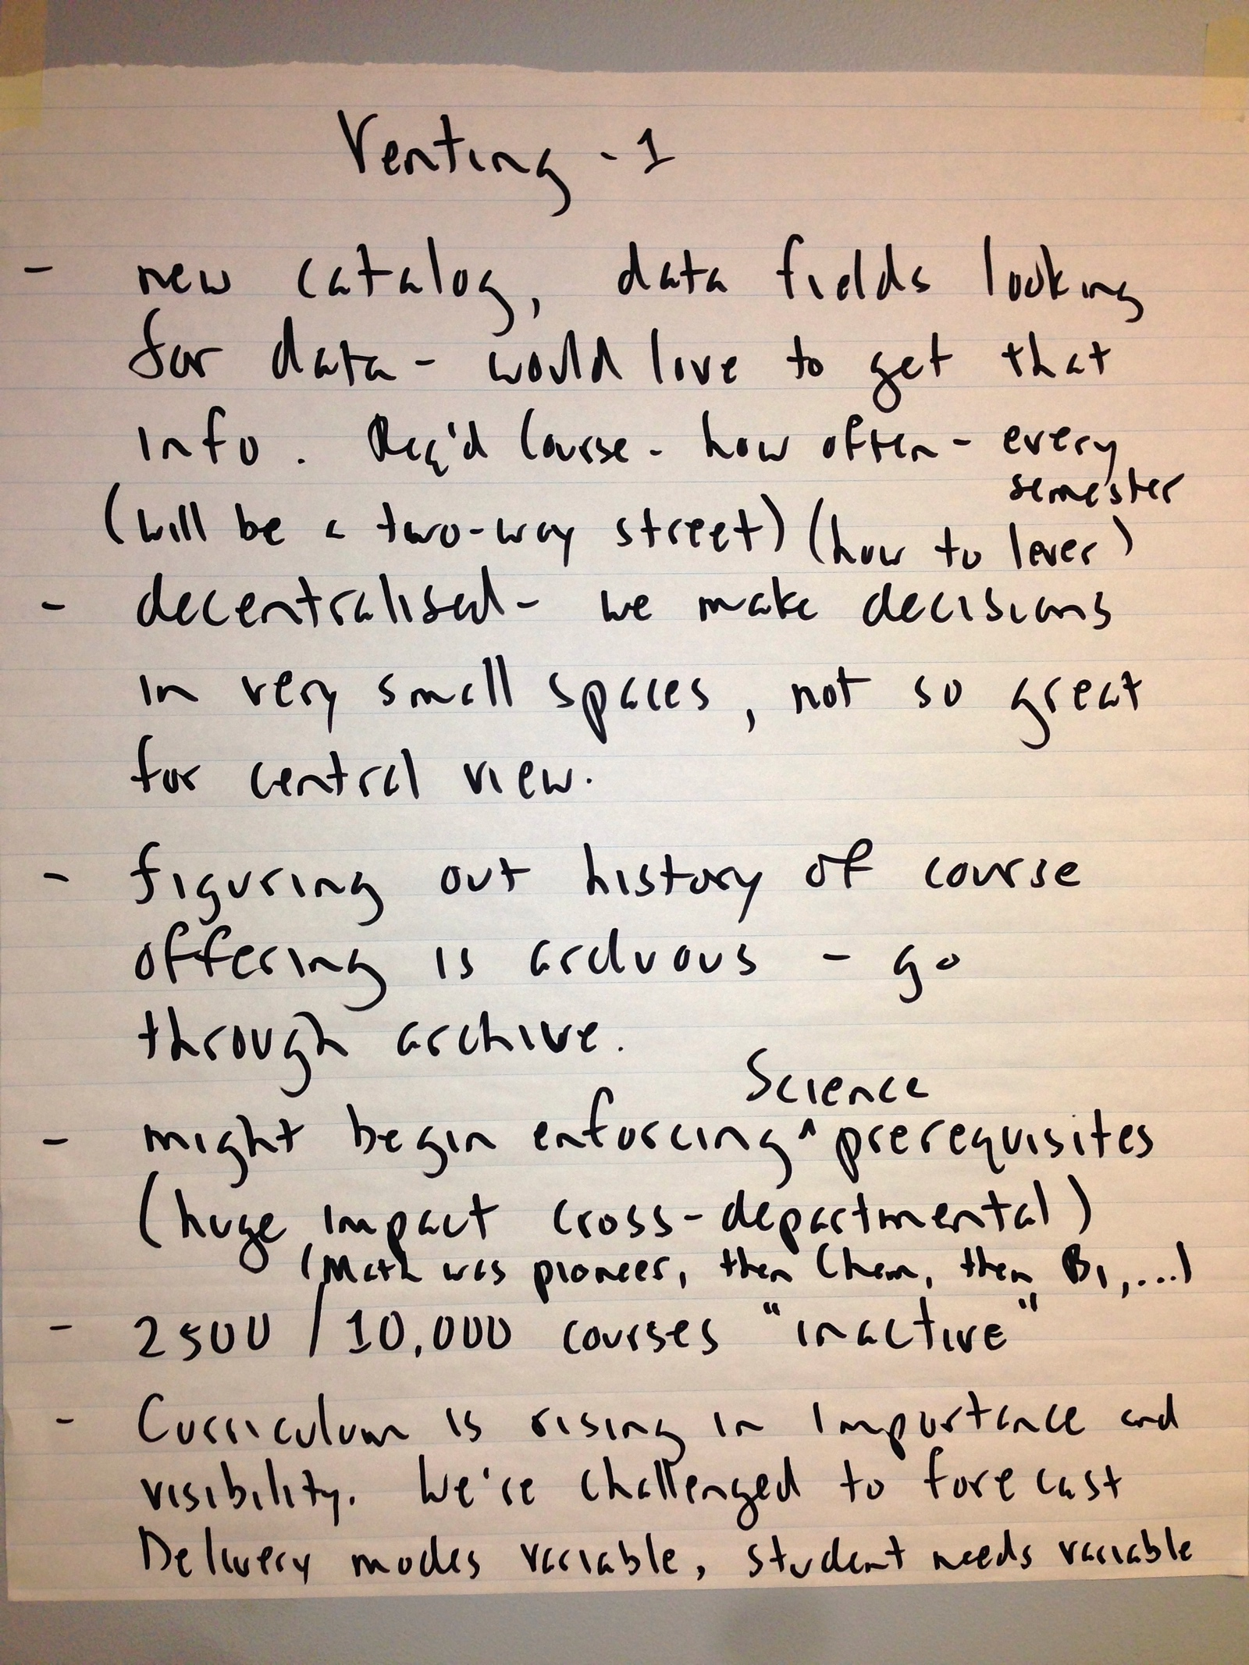

“Venting” 1 & 2

Slide 122


“Venting” 3 & 4

Slide 123


“Venting” 5 & 6

Slide 124



Two “Venting” topics raised a LOT of angst

Slide 125

Two “Venting” topics raised a LOT of angst
“Now what???!!!”

Slide 126








Overnight, team synthesises 8 key themes
Fell behind during good times!
Differentiator!
Inattention to integrated data!
Priorities!
Feature-based approach!
No “end-to-end” view!
Architecture!
Motivation, measurement, and perverse incentives!
The central issue - uncovered!

Slide 127

Next day, small groups expand on themes
Reaction: “Wow, we've never seen anyone actually do anything between sessions with our notes!”

Slide 128




They loved it!

Slide 129


The result – a gold mine!
Active participation
led to buy-in
Uncovered the
real issues
before we “structured”
things into a future state

Slide 130


A cyclical business architecture
Eventually, led to a very different Business Process Architecture and prioritisation than initially expected
Not sure we'd have got there so quickly without “venting”

Slide 131

2) What first, who & how later
“All models are wrong, but some are useful.”
Two especially useful models
Business Process Scope Model
Business Concept Model
(a.k.a Conceptual Data Model)
Both are “essential” –
they show the essence – the “what” – of a subject with no reference to who, how, why, etc.
See samples on the
next two slides
George E. P. Box
1919–2013

Slide 132
Samples – Process Scope Model
Communicate System Outage
Confirm Outage
triage & route notification
perform system diagnostics
Determine
scope
impact
audience
Communicate Situation
(as appropriate)
Communicate Resolution
Assess Communication Process
(lessons learned)
Identify and Communicate Next Steps / Follow Up
Triggering
Event:
Notification of degradation or lack of Service
internal system
external provider
calls to Service Desk
Cases:
new
recurring
Other factors:
severity
key operations periods / areas
(registration, summer, course evaluation season)
time of year
time of day
Results:
Communications about the Outage and the progress on resolving it are delivered:
internally and externally
informally and formally
Final Results:
Service is restored and root cause is known (or is determined to be unknowable) and resolution is communicated:
Externally (“good news”)
Internally (“cause & resolution)
Process Scope Model using “TRAC” -
what is the Trigger, what are the Results,
what are the main Activities
(7 ± 2 milestones, phases, or subprocesses,)
and what are the main cases or variations?
Why 7± 2?
Notes:
May incorporate many, even hundreds of services

Slide 133
Samples – Concept Model
A description of a business in terms of
things it needs to maintain records of – entities
facts about those things –
relationships & attributes
policies & rules –
definitions, constraints, and assertions governing those things and facts

Slide 134
“What” first, “who and how” later
Note – this won't always be appropriate, but for process- or data-focused initiatives, it's essential!
The essence of the technique, for process or data or both:
Describe what the process is,
with no reference to who (organisation or job role)
or how (artifacts or implementation technology)
Describe what the required data is without reference to how (existing systems, database/file design, forms, spreadsheets, or other implementation artifacts)
Discussion
Why are “essential” models useful in supporting change?
Are there any specific contributions made by
Scope Models or Concept Models?

Slide 135
Example – evaluating S/W with data models & events
Selection of new Financials app is hopelessly bogged down
Considerable effort in building a BDM*
Two problems:
  1 matrix points to the app no one likes
  2 want vendor demos with focus and control
BDM issues
time consuming
most apps meet most criteria
still can't tell if an app will work well in your environment
* Big Dumb Matrix
Notes:
Selecting in a hurry!!!
BDM actually more complex
each requirements had a weight
Y/N included factor (how well)
What we had here was a classic case of over-analysis

Slide 136
Selecting an application
The problem:
understand business to decide on package configuration options
a list of 100s of requirements wasn't helping
The approach:
small team builds “thing model”
(concept model, ~60 entities total, 15 “core”)
for each core entity,
identify 3 to 5 life cycle events
for each event, develop scenario
turn over to app vendors - show us
  “How do you support the data model?”
  “How do you handle scenarios?”
“Things we track” -
Project, Work Order
Plant, Plant Equipment
Product Type, Product Lot
Product Inventory
Sale, Transfer
Location, Ledger Entity
Financial Category
Responsibility Center
Account, Sub-Account
Fixed Asset
“Events that happens to them”
Fixed Asset is
Acquired or Constructed
Depreciated
Transferred
Disposed Of
The key points:
initiated by the business
it worked! – saw how an app would support the business
didn't initially call it “data modelling”
left vendor some room - “Here's how we'd do it.”
Notes:
The world's simplest requirements definition approach. It gets to the essential requirements– what the application knows, and what it does
knows
Data Model (or Concept Model)
Information presented (reports and queries)
does
What it will do (Business Services)
How you'll communicate it (Use Cases)
Don't minimize the value of this – when time is tight, this is what you'll need to fall back on. Many experienced analysts start with an approach like this as their default.
Key points:
Without the controlled “show me” aspect, it's too easy for the vendor to say “Yes - we meet that requirement.”
We didn't call it “data modelling” until late in the game
The data model revealed a lot of about business policies and assumptions – this is surprising to anyone who might assume that only a process model would do that
The conceptual model delivers high value, detailed models aren't necessary yet

Slide 137
Using a Scope Model to overcome resistance
A regional telecommunications provider (the "Telco") thought they had
three main Business Processes, and efforts to improve them were failing:
Sell
Offering
Implement
Offering
Collect
Payment for
Offering
Engineering
The outcome…
conflict between functional areas!
Sales
Finance

Slide 138

Process Scope Model showed ONE process not THREE
TRAC
Sell & Implement Offering (from need/opportunity to configuration, installation, & collection)
Describe
Need or Opportunity
Develop & Negotiate
Proposal
(iterative!)
Establish
Contract
Initiate
Service
Order
Complete
Installation and/or
Configuration
Preparation
Install
Product
and/or
Cutover
Service
Collect
One-time
Fees
main Activities
Triggering Event:
Prospect / Customer expresses need
Telco (Inside Sales, Marketing, Sales Rep, …)
recognizes opportunity
Cases:
BU with or without
Telco Internet, no cabling (our focus)
initial installation
service only
product only
mixed
Other factors:
TBD
Results:
Customer:
Product / Service is installed and operational per original or amended contract terms
Telco:
Ongoing source of revenue
in place
One-time fees collected
Employee:
Commission or referral credit
Agent:
Commission
The "token," a Service Order, is changing state from need/opportunity to
configured, installed, & collected.
The Business Process could be named
"Fulfill Service Order" but the client wanted to name it "Sell & Implement Offering."
President reports culture change.
"We're all in this together!"
An end-to-end, cross-functional Business Process is a great lens to view organisation conflict and disfunction!

Slide 139
Process Summary Chart – my favourite diagram!
Customer
Sales & Marketing
Finance (including Customer
Support)
Carriers
&
Vendors
Network
Engineering
Network
Services
Operations
Outside Plant
Sell & Implement Offering (from need/opportunity to installation/configuration & collection)
Describe
Need or Opportunity
Develop & Negotiate
Proposal
(iterative!)
Establish
Contract
Initiate
Service
Order
Complete
Installation and/or
Configuration
Preparation
Install
Product
and/or
Cutover
Service
Collect
One-time
Fees
Process Summary Chart (a.k.a. ”Process vs. Function Chart”)
adds “who” at the organisational unit or functional level.
Nothing else clarifies "Process" vs. "Function/Organisation" as well.
Great for putting details of Activities or Functions in context, e.g. …
Notes:
Next we typically identify:
individual roles or actors, and their responsibilities
supporting mechanisms (systems, tools, job aids, etc.)

Slide 140
Multiple roles by organisation for “Sell & Implement Offering”
Customer
Sales & Marketing
Finance (includingCustomer
Support)
Carriers
&
Vendors
Network
Engineering
Network
Services
Operations
Outside Plant
Roles:
Office manager or Owner
(Smaller)
IT (Larger)
C-level (CIO, COO, CFO…)
Third party IT vendor or agent
Customer Project Coord.
Roles:
Senior. Account Execs
Strategic Rel’nship Managers
Account Rep 1
Inside Sales Rep
Roles:
Sales Admin
Order Writer
Billing Rep.
Customer Support Rep.
Director of Customer Support
Receivingand Posting Payments (what role does this?)
Roles:
Port Out Specialist
(for CS Record)
CSR/LSR
IT Person
Local government
“Call before you dig”
Customer Project Co-ord (int/ext consultants or phone vendors)
Roles:
System Admins (assign IP)
Roles:
BU Tech
(survey)
Switching Specialist
(NS Spec)
Network Services Coord / Provisioner
Roles:
Sales Engineer
CLEC Technician
Material Manager
Materials Specialist
Project Manager
Customer Training & Support
Install Supervisor
Roles:
Drop Crew
Lineman
(not usually)
Engineering Supervisor
Outside Records Specialist
It was a shock to senior leadership to see how many roles were involved, often overlapping or unnecessarily

Slide 141
Many benefits to starting with a Process Scope Model
Why start with a Process Scope Model?
Then a Process Summary Chart?
People see themselves as part of something larger
and more important than their own job, department, systems, …
Without this, issues and objectives will be seen in functional (organisational) terms
Actual client comments – The focus on what…
  adds clarity and critical thinking.
  highlights how far removed the “as-is”
  is from “what” we’re trying to do.
  avoids the tension that comes with “who and how,”
  which is personal (it depersonalises in a good way
Function 1
Function 2
Function 3
Function 4

Slide 142
3) Don't start with “why?”
The essence of the technique:
After venting and establishing the essential what of the process or area being studied, conduct a three-part, stakeholder-based assessment of the as-is situation.
The three Cs:
Concerns – each stakeholder group's issues with as-is
Context – why these concerns are arising now
Consequence of inaction – if we don't change, what…?
Notes:
DON”T do anything with venting outcomes during the session. Move on with the plan!

Slide 143
Our methodology – three responses to three common difficulties
1
2
3
Establish
Process Scope and Objectives
Understand
the As-Is Process
Design
the To-Be Process
Identify & scope
the process with a Scope Model
& a Process Summary Chart;
Optional - build a Concept Model
Complete initial
as-is process assessment, and to-be objective setting, by stakeholder
Perform more
detailed as-is modelling:
an Augmented Scope Model & optionally, Workflow Models
Complete final as-is process assessment by enabler, and generate to-be improvement ideas
Refine to-be improvement ideas and determine 5-10 key features of the to-be process
Assess each
to-be feature
by enabler to ensure the new process is implementable and sustainable
Design the to-be process:
1 - essential activities first
2 - "who & how" next
3 – transport & protocol last
Some
goal or issue,
not rigorously
specified
Big picture first
Don’t start here!
Flow first, detail later
1 – Premature diagnosis
of the situation
Don’t start with a problem statement!
There will be some goal or issue, but don’t formalise it yet.
And remember… it may not be a “process” issue.
My hardest assignments
2 – Failure to identify true end-to-end processes
Rigorous techniques to identify real business processes –
a Process Scope Model and a Process Summary Chart
make scope and context visible.
.
3 – A rapid descent into unhelpful detail
Clarify the big picture, then take a controlled descent
with well-defined levels of detail.

Slide 144
Perform initial as-is assessment, determine to-be objectives
Process Scope Model
Why does this process need to change?
But for a process…
What first
Who & How next
Process Summary Chart
Function 1
Function 2
Function 3
Function 4
Only then Why?
Cross-functional Business Process
“People don’t buy what you do, they buy why you do it.”
Why does this process need to change?
We’ll answer that with a Case for Action
(a nuanced form of problem statement)
Supporting Mechanisms
Now we have an end-to-end,
cross-functional perspective.
Notes:
What first:
What is the process or process area?
Process Scope Model using TRAC
Trigger, Results, Activities, Cases
Who and how next:
Who is involved, internally and externally?
Process Summary Chart
Organisations, Roles, Responsibilities
How the process is supported?
Systems, Mechanisms, Methods, etc.
Only then why?
Why does the process need to change?
We'll answer with a Case for Action
A nuanced form of problem statement

Slide 145
My version of Michael Hammer's "Case for Action"
Simplified, re-sequenced, more stakeholder-focussed
1) Stakeholder assessment – makes it real
What are the concerns of each stakeholder group?
Customer
Performers
Owner/manager (the enterprise itself)
Others (regulator, partners, …) as needed
2) Context – makes it blame-free
What changes in the environment since the process
was “designed” have caused these issues to surface?
3) Consequences of inaction – makes it compelling
What will happen if the process is left as-is?
!
😔
We're not
that bad!
😀
Yay – It's not our fault!
😲
We'd better get on with it!
Notes:
Case for Action characteristics
a “wedge” or "prybar"; where we are, why we can't stay
factual, not exaggerated
concise, clear, compelling
Hammer's original framework:
Business context – what's happening?
Business problem – essence of concern?
Marketplace demands – requirements we can't meet?
Diagnostics – why we can't meet them?
Costs of inaction – what if we do nothing?
I simplified it, re-sequenced it,
and made it more stakeholder-focused (internal and external)

Slide 146
1. Stakeholder concerns
“You must communicate in a clear and compelling way why the process has to change by completing the initial assessment for the as-is process.”
Initial assessment – 3 components
Initial assessment – typical questions
Stakeholder assessment – makes it real
Customer
Performers
(what's in it for me?)
Owner/manager
(the enterprise itself)
Others, as needed
Customer:
Are there too many interactions?
Are rules, requirements, protocol reasonable?
Can your work be located within the process?
Are you the process integrator –
the human glue that connects the process steps?
Performer:
What are your major sources of frustration?
Do you have the necessary tools and support?
Are there redundant steps or steps that serve no purpose?
Are problems caused upstream? Does the workload vary wildly?
What would you change if you could?
Is there a documented process?
Owner/manager:
Does the process use resources you would rather re-allocate?
Is it a net contributor or a source of problems?
Does the process constrain innovation, growth, or opportunities?
Is it a source of customer or media criticism?

Slide 147
2. Context – assessing changes in the environment
Areas to consider:
Regulatory change
Workforce changes (e.g., “recruiting and retaining” vs. “retiring”)
Emergent technology (e.g. AI, robotics, drones, BP Automation,
SMAC ("Social, Mobile, Analytics, Cloud,")
or current technology is EOL ("End Of Life"))
Changing customer expectations
Competition, especially new or emerging
Economic conditions
Change in business volume (growth or contraction)
Change in business model (e.g., customised or standarised)
Change in business ownership (public, private,) M&A, divestiture
Change in business leadership / executives
Change in government (post-election fallout)
Changes in business operating locations
Socio-political change
Environmental (“green”) concerns
Context – makes it blame-free
What changes in the environment since the process was first “designed” have caused these issues to surface?
Consider external and internal influences.
Current "Top Five"
And many others
(see “PESTLE”)

Slide 148


3. Consequences of inaction
Consequences of inaction – makes it compelling
What will happen if the process is left as-is,
and the status quo is maintained?
For the individual:
Unsatisfying work environment?
Diminished opportunities?
Reduced employment
or loss of employment?
For the organisation:
Reduced performance?
Reduced stature or reputation?
Withdrawal from the market?

Slide 149

“Case for Change” example
Situation:
Manufacturing firm redesigns core Financial Reporting processes prior to COTS selection
No progress! – Project has descended into “the blame game”
Stakeholder assessment –
Customer – financial markets / fund managers cannot get
the info they need for investment decisions
Performers – Finance staff spend all their time on assembling
“the numbers” with no time for value-added analysis
Owner/manager – CFO is under constant pressure and criticism
from the financial markets and other executives
Context –
Firm recently divested from a huge conglomerate
Financial reporting was formerly to Head Office,
but now is to financial markets which the processes were never designed to do
Consequences of inaction –
Planned acquisition of competitor will not go ahead due to
lack of financial market support for new bond issue;
Firm likely to be acquired by the competitor. Uh oh… Finance staff quickly realised their employment was threatened and got on board!
Client was very happy!
Alec, I'm so happy I could just kiss you!
That's not
in my contract

Slide 150

Then, establish process goals / improvement targets
“You must also provide a sense of direction by
defining to-be process goals and objectives.”
Subjective goals
Measurable objectives
Give people a “feel” for direction:
“Customers will love this process because…”
“Performers will love this process because…”
“The process owner will love this process because…”
Provide specific targets
Establish baseline to prove success
Format:
Topic
(what will be improved?)
Target
(what is the measurable objective?)
Timeframe
(when will these results be realised?)
It may now be appropriate to introduce new process measures, metrics,
and key performance indicators (KPIs) to establish baseline performance
Notes:
“Measures” includes things like volume, % of different cases, number of actors, timing, etc.
KPIs should include metrics important to each stakeholder, e.g. process cycle time, error or reject rate, number of customer contacts per process execution, etc.
Key points –
don't simply carry yesterday's metrics into the to-be process or the process improvement effort will almost certainly fail
establish current values for the metrics and KPIs so you can prove that improvements have been made

Slide 151


Example from in-person workshop – assessment to goals

Slide 152
Case for Action summary
Stakeholder
assessment
Context
Consequences
of inaction
All stakeholders have real issues with the
as-is process –
it needs attention!
These issues have surfaced because of changes beyond our control in the wider environment.
If we don’t fix this process, there are serious consequences – individually and for the enterprise.
Factual and unexaggerated
Blame-free and
non-threatening
Urgent!
Operational
Excellence
The Case for Action is also a great starting point for
specifying to-be objectives,
and clarifying the process' Differentiator.
Product
Leadership
Customer
Intimacy

Slide 153
4) Clarify the “differentiator” – how will you excel? (a reminder)
Great at one,
good at the other two.
(Not awful at the other two.)
Operational
Excellence
Consistent, predictable, error-free, and efficient – focus on low cost
(or safety, in some industries.)
More efficient, but less flexible in changing direction or meeting needs of individual customers.
Good
Continuous and rapid introduction of new products and services,
or changes to the mix
More flexible for adapting to needs of new offerings,
but less efficient.
Great
Good
Product
Leadership
Customer
Intimacy
Tailors product or service delivery to the processes
of individual customers.
More flexible for adapting
to needs of individual customers, but less efficient.
Key points -
Concept developed for the entire enterprise, but we find it more useful for
individual processes / process areas – a “signpost” for decisions on process changes.
Processes in an enterprise do not all have the same differentiator.
The Process Differentiator can change over time – slowly!

Slide 154
Understanding through differentiators
The first time I used this framework on a consulting engagement
At a leading U.S. Health Maintenance Organization
major reengineering of “Provide Clinical Care” is stalled:
  I'm brought in to get it moving
  Quickly determine there are no overall objectives
Key finding when determining program objectives:
  50% thought Op Ex
  50% thought C.I.
The immediate and ultimate outcomes…
Conflicting differentiators or no differentiator are very common problems, so establishing the differentiator is part of every Project Recovery job
With no differentiator,
you're stuck in the
Bermuda Triangle
Operational
Excellence
50%
their history
50%
Product
Leadership
Customer
Intimacy
154

Slide 155
Another common differentiator problem
Conflicting differentiators within functions of a process leads to lower performance
An aerospace machine shop, once the leader at custom "design and build"
was beginning to struggle and fall behind.
Each of the three main functional areas had a natural affinity for
a different differentiator
Sales and Finance were doing what they thought was best but causing grief for the Engineering function the company's reputation was based on
Sales
Engineering
Finance
End-to-end business process –
“Engineer and Fabricate to Order”
Customer Intimacy
Product Leadership
Operational Excellence
Notes:
See also
“The Myth of Excellence:
Why Great Companies Never Try to Be the Best at Everything”
by Fred Crawford and Ryan Mathew

Slide 156
Another example – different differentiators
Client: a financial services organisation offering the management of tax-advantaged savings for higher education was a recent assignment.
We'll call them “EdSave.”
Terrific growth, now things “fraying around the edges,”
M.D. requested an “organisational review.”
Outline of our findings:
Background, approach, observations, quick wins
Mission and differentiator
The organisation overall:
Leadership and management, high-level structure, recruiting and retention
The organisation's culture:
Communication, management style, writing & review
Cross-functional work and projects
Organizational role refinement – Operations and Finance
IT: Custom system (The “Windows app”,) outsourced development,
IT role refinement
Business Intelligence / Analytics
Later, in the section on organisational culture

Slide 157
EdSave differentiators
“EdSave” is a classic example of an enterprise in which two different business areas – development and execution – each have their own differentiator
In developing new offerings, the differentiator is clearly Product Leadership
EdSave known as the innovator
New product development partly contracted out to external financial consultants
“We must constantly innovate, because if the ratings fall, money moves.”
In serving the Account Owners (opening, contributions, withdrawals, …)
EdSave's differentiator must be Operational Excellence
To drive the cost structure down, EdSave must continue to drive Account Owners to an easy-to-use web experience and minimize person-to-person interaction
“The Boglehead mentality focuses on fees, fees, fees.”
“<EdSave offers> a simple plan for simple people to engage in a solid plan.”
“We must make a concerted effort to minimize complexity”

Slide 158
Vision – what is EdSave's “differentiator?”
EdSave's differentiator is not Customer Intimacy, and should not be distracted by it
The most common error organizations make is trying to excel at Op Ex and CI
“Do we really need to respond to that one cranky customer?”
“One comment from an Account Holder has us trying to turn on a dime.”
2) Operationally, EdSave must “execute like crazy”
- low costs lead to low fees
- understandable offerings and processes
Operational
Excellence
Efficiency
and low cost
Industry-leading
offerings
Product
Leadership
Customer
Intimacy
Tailored for
individual
customers.
1) EdSave creates leading products
- consistently first with new options
- partially subcontracted out
Don't get distracted by tailoring for individual customer needs

Slide 159


5 – Identify the organisation's beliefs, and their impact
The essence of the technique is to identify the underlying (and often unstated) beliefs that drive the behaviour of the organisation – the paradigms.
E.g.,
Belief –
"Our Customers expect a high-touch experience
with personal contact."
Reality –
"Our younger Customers want a low-touch experience
via an app."
Then, are these beliefs preventing
the organisation from moving
in the direction it needs to go?

Slide 160
Case study – belief systems as barriers
The Problem:
Leading high-tech manufacturer hits limits to growth –
they can build, but can't seem to ship complete systems
Demand
Systems shipped
Capacity to Fulfill Order
Already a gap
2014
2017
2020
What works for a $100M company doesn't work for a $1B company!

Slide 161
Hitting the wall of beliefs
Fulfill Customer Order
Book Order
…related processes
Pick and Pack Order
Ship
Order
Collect
Payment
  Determined root causes and suggested process changes.
  But, for every suggested change: “We can't do that!”
  The Third Law of Process Design: “For every suggestion,
  there is an equal and opposite reason it can't be done.”
  Team visibly dispirited: “This is the point we always get to!”
  Me: “Always…?” Team: "This is the fifth time we've tried!"
  Classic symptom of having “hit the limit” with underlying beliefs
To achieve more than incremental improvement,
a new platform of beliefs and principles is needed.

Slide 162
Formulate value statements – new beliefs
First, identify barriers, the underlying beliefs causing them, then new beliefs
“We value this…” | “We value this more…"
Adapting schedules and dates to meet customer requests. | Providing a firm Promise Date to the customer, and sticking to it
Capacity utilisation of a cell or a person. | Smooth, non-disrupted flow of the overall process and the well-being of associates.
Responsive teams. | Recognizing that teams have a real lead time and capacity.
Teams value their data | One visible source of the truth
Filling Consumable Orders within 24 hours and minimising finished goods inventory. (This was the core issue!) | Shipping complete system orders according to Promise Date and not “cannibalising” them.
Borrowing from
The Agile Manifesto
This simple but cohesive set of value statements enabled us to describe a new process.

Slide 163

Collect ideas. Lots of ideas…

Slide 164
Identify 5 to 10 key features of to-be process
Tightly linked WO - SO
Produce Order, not parts
Hybrid ATO & statistical inventory
Single visible source of the truth
Measure true order fulfill
Single piece, fulfillment pull
Locked-in schedule
Staging space for OF
Process owner
Separate production and ship dates
True capacity-based planning
To be continued…

Slide 165
Fulfillment-pull model
Power Supplies
Consoles
Cables
Leads
Kits
Torches
Consumables
Customer
Order
Desired
Delivery
Date
ERP generates signals
Material
lead
time
Build
time
Pick &
pack
time
Ship
time

Slide 166
Reporting it out to the CxOs
Function
owner
Function
owner
Function
owner
Function
owner
Customer Service
Production
Order
Fulfillment
Accounts Receivable
Who owns the process? A process owner/steward/officer must be appointed
- clarify goals and metrics for the process
- ensure and monitor alignment among all the moving parts/
Business process: Fulfill Order
Business Process
enables
enables
enables
enables
enables
enables
Motivation & Measurement
Human Resources
Policies & Rules
Facilities
(or other)
Workflow
Design
Information Systems
*
*
*
End-to-end business process
Lean initiative
Lean initiative
Lean initiative
Six sigma
Notes:
We also positioned this change as a major step in our Lean evolution:
Reduce the Seven Wastes, reduce cost per order :
Defects
Overproduction
Transportation
Waiting
Inventory
Motion
Overprocessing
Essential for sustained, profitable growth

Slide 167

6 – Describe organisational culture, and its impacts
Culture: behavioural norms that are reinforced because they are seen as “good.”
Amplified by the behaviours of leaders
Embedded in a network of organisational practices
Evident in the behaviours of individuals and groups
Shared beliefs, values, and assumptions held by members of an organisation
Visible in the
“way that work gets done” on a day-to-day basis
Summary image from http://www.nhorizons.ca/

Slide 168
Note – "What is good?" may vary across functions
OEM
Team
Product
Team
Actuarial
Customer
Service
IT
Sales
Develop Insurance Product
Request Product
Approve Product
Design
Product
Develop
Product
Prepare
Product
Launch
The misalignment might not be in explicit measures, but in different groups' perceptions of “what is good”
  OEM – deadline driven
  Product – number of products / features introduced
  Customer Service – simpler products
  IT – bug-free product launches

Slide 169
Organisational Culture
Assess “organisational culture,” formally or informally, using one of the available frameworks –
we'll use the Organisational Culture Assessment Instrument (OCAI.)
All organisations have a culture, recognised or not.
Impacts process design and ability to change e.g.,
an organisation characterised by
centralised, top-down control and decision making
will not successfully implement a change requiring
front line accountability and decision making
What is a best practice for one culture can be a worst practice for another
Considerations
  A quick, informal assessment is probably adequate
  You might keep your assessment to yourself…

Slide 170

Organisational culture
OCAI – Organisational Culture Assessment Instrument
Professors Kim Cameron and Robert Quinn found two dimensions of culture were vital in understanding effectiveness:
Internal focus and integration
vs.
External focus and differentiation
Stability and control
vs.
Flexibility and discretion
A survey-based assessment determines
current dominant organisational or team culture
desired organisational or team culture
Rather than formal surveys, it can be effective to just observe and ask.
Notes:
From http://ocai.wordpress.com –
To the left in the graph, the organization is internally centered (what is important for us, and how do we want to work?)
To the right the organization is externally focused (what is valuable for the outside world, the clients, and the market?)
At the top of the graph, the organization desires flexibility and discretion
At the bottom the organization values the opposite: stability and control.

Slide 171
OCAI – Organizational Culture Assessment Instrument
Flexibility and Discretion
The Family / Clan Culture
Friendly, sociable, “one big happy family”
Leaders: mentor, facilitator, team builder.
Values: loyalty, tradition, involvement, communication, personal development
Focus: needs of the client, caring for people
Style: teamwork, participation, and consensus.
The Adhocracy Culture
Energetic, creative, entrepreneurial, dynamic
Leaders: innovators, risk takers, visionaries.
Values: innovation, agility, risk-taking, change
Focus: growth and creation of new/unique products, services, resources
Style: experimental, individual ingenuity, freedom
Internal Focus
and Integration
External Focus
and Differentiation
The Hierarchy Culture
Formal, structured, efficient, predictable
Leaders: coordinator, organiser, monitor.
Values: efficiency, stability, uniformity, timeliness, low cost
Focus: control, coordination, policies, rules, processes, procedures
Style: rule-driven, efficient, smooth-running
The Market Culture
Results-oriented, hard-driving, competitive
Leaders: hard driver, producer, and competitor.
Values: winning, reputation, hitting targets
Focus: goals, customer/market, market share and penetration,
Style: aggressively competitive, get things done, high expectations
Stability and Control

Slide 172


OCAI method
Test takers assess corporate culture, splitting 100 points over descriptions of the four culture types with respect to six aspects of the organisation –
dominant characteristics, organisational leadership, management, etc.
Done twice – current state and desired state
The culture profile illustrates:
  Current blend of cultures and the dominant culture
  Relative strength of the dominant culture
  Discrepancy between present and preferred culture
Can also show “competing values”:
tobyelwin.com/competing-values-drives-your-organization-out-of-business
As noted before, you should always be observing and asking.
Notes:
What are some obvious questions you could ask , or observations you could make,
in order to get a quick read on culture:

Slide 173

An example – 2
The “organisational review” at EdSave included an informal OCAI assessment:
  Off the scale in “Market culture”, essentially 'zero' in “Family / clan culture”
  This shaped the planning and design of the desired future state.
  We didn't actually draw the chart – didn't have the data to back it up.
  These often are drawn to show differences between two groups, or “current” and “desired.”

Slide 174
National culture
Modeling culture with Hofstede's cultural dimensions:
Understanding this has many implications for matching future state design to the organisation
Small vs. large
power distance
How less powerful members of groups perceive (and accept) that power is distributed unequally.
Individualism vs. collectivism
How an individual identifies with self or with group, how performance is seen as a group or individual function, …
Masculinity vs. femininity
Value of competitiveness, aggressiveness, assertiveness, etc. vs. relationships, quality of life, etc.
DISC-
red vs green
Low vs. High uncertainty avoidance
Extent to which uncertainty and ambiguity are avoided; “strong avoidance” values standardization, structure, rules, ritual, etc.
Long vs. short term orientation
“Future leaning” attitudes, e.g. thrift and persistence vs. “past/present leaning” e.g. benefit now, respect for tradition, and reciprocity.
Notes:
An update to the framework includes “Restraint vs. Indulgence”
Ind vs. Collect manifests itself in terms of centralization, # of org. levels, # of supervisors, wage difference, value of white vs. blue collar work
We'll describe a situation in which a US multinational offshored financial processes (especially payments to vendors/suppliers) that were designed in the US to a southeast Asian nation with a very different national culture.
The cultural profile of each nation will be described.
At tables, groups will discuss and prepare to share with the entire group:
What was the predictable outcome of this offshoring initiative,
and what specifically could be expected to go right or wrong?

Slide 175


Closing thought – procedure driving culture change
“The Checklist”
The New Yorker
Dec. 10, 2007 +
2011 Commencement Address,
Harvard Medical School
The point – fantastic statistical improvements in surgical outcomes from utilising a pre-surgery checklist.
Amazingly, this also drove cultural change!

Slide 176


7) A feature-based approach to process design
The essence of the technique is to identify each key feature of the to-be process, and determine what will be required (enabler by enabler) to make it work.
The alternative is to treat the entire to-be process as a “big bang,” implemented all or nothing.
Supports implementing change, feature by feature. Highlights need to
understand the six enablers. More in the upcoming section on design

Slide 177
Making process modelling relevant
Five things you need to know about Business Processes
Identifying true, end-to-end, cross-functional
Business Processes
Developing a Process Architecture
Seven ways to help people embrace Process Change
Human-oriented process modelling
A feature-based Process Design method –
transitioning from as-is to to-be

Slide 178

Complete additional as-is modelling
The goal is to understand the as-is process, not document it in excruciating detail!
Admit and Onboard a Student
Recruit
Prospect
Complete
Application
Assess
Applicant
Admit
Student
Award
Financial
Aid
Grant
Housing
Complete
Pre-
Enrollment
Requirements
Register
Student
in
Classes
Identify
Suspects
Qualify
Prospects
Engage
Prospect
etc.
Collect
App Fee
Initiate
Application
Submit
Application
etc.
Confirm
Application
Evaluate
Application
Verify
Req'ts
etc.
Make
admit /
deny /
assess
decision
Notify
Student
etc.
Optionally,
model initial Workflow –
Simplicity – minimal symbols and detail
“Flow first, detail later!”
Receive
FAFSA
Assess
Need
Determine
Aid
etc.
Provide
Housing
Req'ts
Assess
Application
Provide
Alternatives
etc.
Confirm
Other
Requirements
(visa, shots,
writing, …)
Register
Orientation
etc.
Identify
Courses
Create
Class
Schedule
Register
Classes
etc.
Who: Registration Assistant
What: Register Classes
How: via Workday SRS
I always build an Augmented Scope Model –
What the detailed activities are, e.g. “Register Class” (verb + noun)
Add who and how, e,g,
“Advisor Register Class via SIS”
This is often good enough! – no need for an
as-is swimlane diagram / workflow model
www.lucidchart.com

Slide 179
Simple Swimlane Diagrams – maximise their strengths
Who – the actors
What – the steps
When – the flow
Handoff:
A flow from one
actor to another.
Flow:
A sequential dependency between steps.
Other tools are better for capturing detail –
how the steps are done:
step-by-step procedures
checklists
decision trees
use cases
etc.
Actor:
A participant in the process – could be a person, organisation, job, system, tool, or anything else that “holds the work.”
Shows sequence and dependency, left to right
Simple – anyone can read
Shows all actors and therefore all handoffs
The entire, e2e process
What, but not how
Step:
An activity or step carried out by one or more actors.
Why did simple Swimlane Diagrams become popular?
Notes:
Various names:
Swimlane Diagram
Workflow Diagram
Cross-Functional Flowchart (Visio)
Process Map
Process Responsibility Diagram
Functional Deployment Chart
Line Of Visibility (LOV) chart
People-Process Chart

Slide 180

A quick Google Images search on "swimlane diagram" reveals…
… lots of diagrams I might draw differently.

Slide 181

One example… "Chaos With Colours"
Probably accurate,
not too many symbols, but…
do unexplained colours help?
significance of multiple flows?
  two separate flows inbound to a step
  two joined flows
  inbound to a step
  one outbound flow splitting
but most of all…
flows in all directions!:
  left to right
  right to left
  top down
  bottom up
Why???
Both or One?
Both or One?
Both or One?
Forcing it into a "one-pager" defeats
the graphic power of the diagram.

Slide 182
If you need a one-pager draw an Augmented Scope Model
Admit and Onboard a Student
Recruit
Prospect
Complete
Application
Assess
Applicant
Admit
Student
Award
Financial
Aid
Grant
Housing
Complete
Pre-
Enrollment
Requirements
Register
Student
in
Classes
Add 5 – 10 Activities per
Major Activity
Identify
Suspects
Qualify
Prospects
Engage
Prospect
etc.
Collect
App Fee
Initiate
Application
Submit
Application
etc.
Confirm
Application
Evaluate
Application
Verify
Req'ts
etc.
Make
admit /
deny /
assess
decision
Notify
Student
Complete
Integrated
Assessment
etc.
Receive
FAFSA
Assess
Need
Determine
Aid
etc.
Provide
Housing
Req'ts
Assess
Application
Provide
Alternatives
etc.
Confirm
Other
Requirements
(visa, shots,
insurance, …)
Register
Orientation
Complete
Orientation
etc.
Identify
Courses
Create
Class
Schedule
Register
Classes
etc.
Later add
who & how to
each Activity
Who: Registration Assistant
What: Register Classes
How: via Workday SRS
Before "swimlaning"…
We're almost at swimlane level!
Always!
Process Scope Model (TRAC)
Always!
Process Summary Chart
Almost always!
Augmented Scope Model
Function 1
Function 2
Function 3
Function 4
Cross-functional Business Process
……
……
……
……
……
……
……
……
……
……
……
……
……
……
……
……
……
……
……

Slide 183
Another fast Augmented Scope Model example
Cases:
$5000 - $25000 Goods
$25000 - $50000 Goods
$5000 - $25000 Services
$25000 - $50000 Services
Assume everything <$5000 is purchased with a PCard
Triggering Event:
Customer needs
Good / Service
Source Good/Service
Prepare
Requisition
Evaluate
Requisition
Solicit
Quotes
Evaluate
Quotes
Award /
Issue
P.O.
Receive &
Approve
Invoice
Issue
Payment
Final Results:
Customer has received Good/Service:
Vendor has been paid
  via A/P
  via PCard
Develop scope of work / specs
Investigate potential vendors (and price?)
Solicit vendor quotes
(just to get an idea)
Obtain approval (Department)
Verify Item and Account
(General Accounting)
Submit requisition (visible to all)
Confirm completeness – get clarification this is actionable (scope sufficient)
Assign (or re-assign Buyer as necessary)
Identify MBE/SB opportunity
(competitive)
(co-op)
* sole source or co-op, vendor(s) known
Determine methodology
sole source
co-operative (piggyback on contract)
competitive
emergency
Determine (additional) potential vendors
Solicit quote (including Bid Due Date)
Post quote (solicitation documents) in “the binder”
Resolve vendor queries
* Up to $200K, we control who gets solicitations; above, no control – it’s “publicly advertised.”
Over $200K there would be 20 more activities, and could be multiple award.
Receive quote (mail, fax, e-mail, …)
Confirm completeness
Verify suitable price, terms, and conditions
(generally, low bid for equivalent)
Clarify (not negotiate) with vendor
Optional:
Evaluate equivalency (for alternate)
Confirm equivalency w. Customer
Identify vendor
Generate Purchase Order
Notify Requestor
“Transmit / deliver” P.O.
* Pain point – we aren’t sure when the vendor receives the P.O.
Receive
Good/Service
* Invoice could be attached
Accept
Good/Service
Issue invoice
(vendor)
Receive invoice:
from vendor
from the department the vendor sent it to
* Vendor complains invoice is “lost”
If >$5000,
match
invoice
PO
receiver
If <$5000,
match
invoice
PO
* Could invoice $4K on $40K PO
Batch invoices for GAD
Receive payment
Issue Payment
(Magic Happens Here)
* If multiple line items, different line items could go to different vendors;
* If multiple vendors, line items are not split.

Slide 184
Core principles – "Flow first, detail later" and "Simplicity!"
Swimlane Diagram
Workflow Model
Process Map
Cross-Functional Flowchart
People-Process Chart
Functional Deployment Diagram
Process Responsibility Diagram
LOVEM Diagram
…
The purpose of a Workflow Model is to show the Flow of Work
Whatever you call them,
they are a great tool for showing flow –
sequence and dependency of steps
Left-to-right flow
Simple… but not simplistic
Symbols were just boxes and lines

Slide 185


The Cognitive Psychology of diagramming
What do people first perceive on a diagram?
relative size
relative X-Y position
an
important
step
a less
important
step
Make all the steps the same size,
unless you're trying to make a point
Actors
Y
X
Flow (time)
Notes:
It could be a deployment diagram, a concept model, an organisation chart, or a workflow model – the principles are the same.

Slide 186

Don't conceal sequence and dependency
Steps perceived as happening in parallel,
even though flow lines indicate sequential.
Critical in analysing a process:
sequential vs. parallel
dependent vs. independent
A simple guideline:
flow lines only leave
the right edge
and only enter
the left edge – never the top or bottom.

Slide 187
"I think I know why our business partners don't want to review this…"
Probably a good DFD (Data Flow Diagram) useful to a technical audience
Not a good
Process Flow Diagram, useful to business professionals, because...
no obvious flow
too many symbols
cryptic acronyms
lanes aren't actors
…
What's wrong with this diagram as a means of communicating with a business audience?
Notes:
By the way – IT's NOT A REAL ESTATE ISSUE!!! Don't try to compress a diagram onto a single page if it would mean hiding the fact that some activities are sequential and others are parallel.

Slide 188

Boxes alone are a great start
Remember – you can build an initial flow model with Post-its, real or virtual

Slide 189
Minimal symbols
Later, redrew it with Lucidchart (www.lucidchart.com) –
add rigour, but still focus on flow and simplicity.

Slide 190

Full BPMN* – not useful for business purposes
If you choose to use BPMN, use extreme restraint! Only use a few symbols
such as Lanes, Tasks, Flows, simple Events, and optionally Gateways
*Business Process Model and Notation, a standard by the OMG. BPMN was created to be a visual programming language for automating workflow, not for business modelling.

Slide 191

The full BPMN symbol set (why we use a subset)
4 kinds of Activities (plus
Markers & Task Types)
63 kinds of Events
6 ways to represent Data
7 kinds of Gateways

Slide 192


Minimal symbols for an approachable workflow model
mutually
exclusive
(decision)
parallel
Decide…
I don't use the BPMN Gateways:
I do use BPMN event symbols
interaction
exclusive (XOR –
exactly one flow, in or out)
parallel (AND –
(all flows,
in or out)
one or more
(inclusive OR)
inclusive (OR –
one or more flows, in or out)

Slide 193

Three questions to develop your initial workflow model
Emphasis:
keep you out of the details – focus on flow
ensure the involvement of every actor is shown –
it doesn't matter how much or how little they do,
or whether they add value
Three simple questions:
“Who gets the work next?”
“How does it get there?”
– Often uncovers "transport" actors or systems
“Who really gets the work next?”
– Often uncovers additional actors
?
Guideline for the initial Handoff Diagram:
Whenever an actor holds the work,
whether they do a lot or a little,
draw one box (or post one sticky)
and move on!
(And no value judgements – include every actor that holds the work!)

Slide 194

1 – "Who gets it next?" traces overall flow
Process: Issue Building Permit
Case: Single Family Dwelling (SFD)
My mantra –
“Flow first, detail later”
Etc. – In some cases it will carry on to Schools, Parks and Recreation, Legal, …
How would you describe this process?
Be factual, not judgmental
What questions do you have for the Building Permit experts? Focus on why it works the way it does,
not "Couldn't we do it this way instead…?"
Two key concepts:
– sequential vs. parallel
– dependent vs. independent
In scoping, you identified the trigger, the result, and the main actors. Now, starting at the
triggering event, keep asking question 1 –
“Who gets the work next?”
- trace the flow of work through to the Customer's result, following one path only!
- at a decision or parallel flows, follow the main path, mark the other with a cloud, and return later
- DO NOT ask “What do you do?”

Slide 195
2 – "How does it get there?" uncovers more actors
Process: Issue Building Permit
Case: Single Family Dwelling (SFD)
?
Admin Services and
the Mailroom move the work
Next, at every handoff, ask question 2 –
“How does it get there?”
- uncovers additional actors, and therefore more handoffs
- a handoff is a potential source of delay, error, or expense

Slide 196

2 – "How does it get there?" uncovers more actors
?
etc.
Who really gets it in Zoning?
Admin Services and
the Mailroom move the work
Pick Up
Deliver
Sort
Now, consider each handoff and ask question 3 -
“Who really gets it next?” Does it really go directly to the actor you first identified?

Slide 197

3 – "Who really gets it next?" uncovers specific roles
Log
Forward
THREE actors
within Zoning
Review
If you stick to the 3 questions, this is fast –trace one overall flow through the process without bogging down in detail.
Assess
We found FOUR
actors within
Fire Safety
Only when we got to the level of individual actors did we see where the delays were

Slide 198
We have started a "Handoff Diagram"
a little
Log
Forward
Guideline:
Whenever an actor holds the work,
whether they do a lot or a little,
draw one box (or post one sticky)
and move on!
Review
a lot
Assess
  Emphasises who is involved when.
  Shows handoffs and pattern of involvements –
  the overall flow, not the individual tasks.

Slide 199
Now develop a "Service Diagram"
Prepare
App'n
Accept
App'n & Fee
Steps within an actor's involvement that complete a service,
e.g., one handoff-level step could become four service-level steps:
Accept
App'n & Fee
Route
App'n
First, name steps in the handoff diagram, draw flow lines, check for alternate or parallel flows, etc.
Log
App'n
Assess
Zoning Compliance
Review
App'n
becomes…
Assess
Zoning Compliance
Etc.
Confirm Fit in OCP
Assess Site Coverage
Compliance
Assess Height & Enclosure
Compliance
Assess Easement & Encumbrance Impacts
  Puts the emphasis on what is achieved by showing the significant intermediate results or milestones –
  no procedural level “how.”
  Key point!
  The model grows left-to-right but not up-and-down – no new actors appear in the Service Diagram. If they do, go back and revise the Handoff Diagram.
Pick Up App'n
Deliver
App'n
Sort
App'ns

Slide 200
Two levels of swimlane diagrams
Level
Definition
Emphasis
Notes
1
Draw one step (box) every time an actor continuously “holds the work,” no matter how much or little they do
“Who”and “When” - pattern of involvement
Sometimes this level of detail is enough to understand As-Is process behaviour
Hand-off
2
Decompose handoff-level steps into discrete services, as necessary:
one step each time actor achieves a significant result or state change
“What” is actually achieved
Usually, we don't go any further than this for the As-Is process
Also called a “Milestone” diagram
Service
The handoff-level diagram is critical – ensures we discover the overall flow before diving into detail.
Notes:
The solution to the problem of managing detail is to work with two, well-defined levels of detail, as depicted above.
The basic philosophy is to start simple, add detail in layers – we want to ensure that we understand the entire scope of the process, and the involvement of all the players, before we start capturing any detail
The definition of a Handoff (Level 1) diagram is relatively precise, while the definitions of Service (or Milestone) (Level 2) and Task (Level 3) diagrams require that we apply some judgment. Note that we almost never produce a task level diagram, except perhaps for a piece of a process.
Generally, you'll go to more detail on the to-be than in the as-is. The goal of as-is modelling is to understand the process, while the goal of to-be is to ensure that the new process can be implemented.

Slide 201

What stands out on this minimalist Handoff Diagram?
“Order and simplification are the first steps to mastery of a subject.”
Thomas Mann

Slide 202
We learned a LOT in a short period of time
HR Enabler
Caused by recategorising
the Submissions Clerk job.
Facilities Enabler
Poor layout so Customer Services moves sample in and out of storage.
!
!
The Case was "No Search Involvement."
Policy & Rules Enabler
Policy requires constant non-value-added checking by DNA Manager.
!
!
Quality Manager (who drew the diagram) was very surprised they were not part of the process!
!
Business
Process
Design
(Workflow)
Technology & Information Systems
Motivation & Measurement
Human Resources & Organisation
Policies & Rules
Facilities
(or, Knowledge / Info / Data, Communications, Documents, …)
Notes:
This model shows ONLY the “flow of work” – no detail whatsoever about what any actor does. Yet, it revealed interesting aspects of the process much better than a complex model.
Note also that to fix the problems requires adjustment of various enablers (HR, Policies & Rules, Facilities)
This example worked in part because it “showed every actor that holds the work.”
Insight – A model that stresses the “flow of work” can be produced fairly quickly yet reveal more than a complex model does.

Slide 203
The Service level workflow
- Purpose -
Understand the actual contribution of
each actor to the process
Ensure feasibility and effectiveness of process
(can each actor actually perform their steps?)
Show relationship to systems - steps involving automated support correspond strongly to use cases and services
  Key points:
  Steps within an actor's involvement that complete a service
  E.g., one handoff-level step could become five service-level steps:
  Puts the emphasis on what is achieved during the process by showing the significant intermediate results or milestones –
  “the achievements, not the individual tasks”
Initiate
Vehicle Insurance
Claim
Identify
Claimant
Describe Incident
Describe Loss
Confirm
Coverage
Schedule
Inspection
One handoff-level step
One or more service-level steps
Notes:
Think of a service as an indivisible activity that yields a significant business event – it's not something you would want to leave half-done. In the examples above…
Either the “Claimant is identified” or not;
Either the “Incident is described” or not;
Either the “Loss is described” or not

Slide 204
Reminder: the service level ties in Use Cases and Services
3) …by interacting with
1) This Actor (or Role)…
2) …completes this Activity…
4) … this Service offered by a System
(which collectively is a Use Case)
Notes:
This shows how this style of diagram pulls together process workflow, use cases, and services.
“Actor – Service (verb-noun) – Platform” forms a Use Case – “Customer Service Rep Idles Units via S-MAN”

Slide 205
Stop diagramming before you get into “how”
Stop workflow modelling when work isn't flowing.
Do not use a workflow model to describe how an activity is done – that belongs in the activity description or in a linked document.
No
Validate Application Completeness
Determine Credit Limit
Set Up Account
Yes
Checklist
All contact info complete?
Tax registration number provided?
Net income
<= gross income?
etc.
Procedure
Use Case
Determine gross annual income
Subtract annual tax
Subtract child support
Etc.
When credit rep enters…
Then system displays…
When credit rep selects…
Then system calculates…
etc.
Notes:
Checklists, procedures, use cases, etc. should be on separate artifacts (job aids,) possibly linked to the corresponding steps on the swimlane diagram

Slide 206

Knowing when you've gone too far
Do not use a workflow model to describe how an activity is done – that belongs in the activity description or in a linked document.
Handle TEO
(Telecom Equipment Order)
Submit
TEO
(web/fax/print)
Receive
TEO
Print
TEO
Login to OSS
Create Pre-Order
Assign Input Service Coordinator
Input Org ID, Contact Info, Order Type
Input Customer Request from TEO
Print Order from OSS
Print
Labels
Distribute Papers & Orders to Assigned CSR
Login to CDC
You've gone too far if:
- there are multiple steps in sequence by the same actor
- the steps include "how-to" instructions (procedural level detail)

Slide 207

Getting out of the weeds if you've gone too far
Client struggling with process redesign, mired in detail
One of 17 flow models for variations of the same process
Excellent models, but detail without context is the enemy!
Step One – Establish context with a Process Scope Model

Slide 208

Step one – build a Process Scope Model then a Summary Chart
The process was actually "Acquire Information Asset"
and the Case was
"One-off Print Publication"
Only took ~20 minutes
Cleaner version using our “TRAC” framework –
Trigger, Results, Activities, Cases:
Then add
participating functions:
Trigger:
User or Librarian requests Print Publication
User
(Requestor)
Library
Accounting
Agent
Supplier
Customer result:
User (requestor) has publication on loan
Acquire “one-off” Print Publication
Cases TBD:
(triage criteria)
Validate Request
Place Order
Receive
Publication
Generate Publication Metadata
Make Publication Available
Library result:
Publication is available (shelved)
Notes:
A Process Summary Chart

Slide 209

Process Scope Model puts the detail into context
One of the clients had a great idea –
overlay the phases from the Process Scope Model on the Workflow Model.
90+ % of the process is activities the customer dislikes or doesn't care about!
Validate
Publication Request
Place Publication Order
Generate Publication Metadata
Make Publication Available
Receive
Publication
No need to do this before making publication available…
In most cases,
far too much time and effort on validation...
…so Make Publication Available earlier
…so reduce it greatly
during redesign.
Client comments:
The steps we went through and starting at the high level “opened up our minds.”
Pulling back to the high level (Scope Model) enabled us to make the progress we did.
Without high level, it’s easy to get into the weeds.

Slide 210
Summary – where we've been, where we're going
Why they work
The most common errors
Principles
Flow (sequence & dependency) is clearly visible, left to right
Concealing flow by drawing a convoluted diagram, usually in an attempt to make it a "one-pager"
The purpose of a Workflow Model is to show the Flow of Work
Simple to read – the symbols are mostly boxes and lines
Using a lot of symbols that regular folks don't understand
Simplicity is a virtue
Shows all actors and their steps, and therefore all interactions and handoffs
Omitting actors just because they play a minor part – everyone has an impact
Always do a Scope Model and a Summary Chart before flow modelling
Shows the entire, end-to-end process, from trigger to results
Cutting the diagram into one-page segments – the initial flow model should be continuous
Shows "what" the steps are without diving into "how"
Using a Workflow Model to document procedural level detail

Slide 211
Business Process assessment (as-is) and design (to-be)
Five things you need to know about Business Processes
Identifying true, end-to-end, cross-functional
Business Processes
Developing a Process Architecture
Seven ways to help people embrace Process Change
Human-oriented process modelling
A feature-based Process Design method –
transitioning from as-is to to-be

Slide 212

Before we do a "formal" as-is assessment…
Record first impressions, and identify obvious problems
and NVA (non-value added) work
Identify leverage points –
A point in a process that has a
disproportionate impact on
overall performance.
  Often early in the process
  Most “bang for the buck” – fix first!
Leverage point examples:
Sales reps dislike returning to the office to submit orders,
so, they submit in bulk at the last minute, causing a surge in workload
Forensics lab accepts all items submitted,
in the mistaken belief they are legally obligated to accept all of it,
even though much of it is redundant or useless
Notes:
There is no fixed process for Process Design/Redesign, any more than there is a process for Paint Masterpiece. Actually, in most published material on Process Design, the section on designing the new process is very thin; in practice, it's a mix of “perspiration and inspiration”. It is also iterative and non-linear. However, we can introduce a few techniques that really help!
In looking for NVA work, keep the acronym “RAMMPP” in mind. It was developed at GE during the Jack Welch / “Work Out” era, and reminds us of those factors that can easily become non-value adding over time: “Reports, Approvals, Meetings, Measures, Policies and Procedures.” Based on our experience, we would add “Notifications,” and “Record-Keeping” / “Data Duplication” (especially in “shadow systems”) to the list.
You can also uncover ideas for change by walking through the as-is process and challenging the assumptions it represents:
Does this step yield a useful result? Is it even necessary? (See “NVA” above.)
Does it have to be done by the actor currently doing it?
Does it have to be done in its current sequence?
Does it have to be done where it is being done?
Does it have to be completed or supported as it is now?

Slide 213
…then apply structured, enabler-based techniques
Two critical techniques address common problems:
  Problem: focusing excessively on workflow and IT.
  Solution: conduct a final assessment that holistically addresses
  all enablers and generates potential improvements
  Problem: implementing process “improvements” that have unforeseen consequences (negative and/or expensive)
  Solution: assess each significant improvement ("feature")
  by specifically considering each of the six enablers
Result: a set of to-be process characteristics (“features”) that:
  impact specific issues
  are consistent with one another and the differentiator
  are feasible with respect to culture, resources, …
Key point – don't jump into workflow design too soon!!!

Slide 214

Our methodology – two points highlighted by clients
1
2
3
Establish
Process Scope and Objectives
Understand
the As-Is Process
Design
the To-Be Process
Identify & scope
the process with a Scope Model
& a Process Summary Chart;
Optional - build a Concept Model
Complete initial
as-is process assessment, and to-be objective setting, by stakeholder
Perform more
detailed as-is modelling:
an Augmented Scope Model & optionally, Workflow Models
Complete final as-is process assessment by enabler, and generate to-be improvement ideas
Refine to-be improvement ideas and determine 5-10 key features of the to-be process
Assess each
to-be feature
by enabler to ensure the new process is implementable and sustainable
Design the to-be process:
1 - essential activities first
2 - "who & how" next
3 – transport & protocol last
Some
goal or issue,
not rigorously
specified
Start with what
Inclusive assessment
Based on reality
Awareness of all factors
Addresses our goals
We can do it!
Feature-based approach
1 – Builds support
for change
2 – Not a “big bang” –
an effective, implementable, sustainable business process
"We like the way support for change is built in throughout your approach, not bolted on at the end."
Feature-based approach makes it Agile / iterative.
And fast! – up-front work avoids endless rehashing later

Slide 215
The link between the As-is Process and the To-be Process
1
2
3
Establish
Process Scope and Objectives
Understand
the As-Is Process
Design
the To-Be Process
Identify & scope
the process with a Scope Model
& a Process Summary Chart;
Optional - build a Concept Model
Complete initial
as-is process assessment, and to-be objective setting, by stakeholder
Perform more
detailed as-is modelling:
an Augmented Scope Model & optionally, Workflow Models
Complete final as-is process assessment by enabler, and generate to-be improvement ideas
Refine to-be improvement ideas and determine 5-10 key features of the to-be process
Assess each
to-be feature
by enabler to ensure the new process is implementable and sustainable
Design the to-be process:
1 - essential activities first
2 - "who & how" next
3 – transport & protocol last
Some
goal or issue,
not rigorously
specified
This activity ( ) marks the pivot from as-is to to-be:
we capture what we learned while studying the as-is
we use this to generate ideas for the to-be
three more activities ( ) lead us to a new design
Key point!
Much of what we learn comes from discussions along the way,
not from studying the swimlane diagram.

Slide 216
Complete final as-is assessment, generate to-be ideas
Considering all six enablers is at the heart of this methodology
Business Process
enables
enables
Business
Process
Design
(Workflow)
Technology & Information Systems
Motivation & Measurement
Human Resources & Organisation
Policies & Rules
Facilities
(or, Knowledge / Info / Data, Communications, Documents, …)
This always uncovers issues
that would have been missed otherwise and
always generates ideas
(potential features) for the
to-be process
Too many actors
Non-value -added steps
Duplicate steps
Delays and bottlenecks
Excessively sequential
Unavailable information
Data re-entry
Missing functionality
Awkward interfaces
Lack of
support for workflow
Inappropriate performer or process measures
Internal rather than customer focus
Measures of tasks vs. outcomes
Mismatches between task value and performer
Too little empowerment
Fragmented jobs / roles
Inappropriate recruiting and placement
Out-of-date policies or numerical limits
Excessive review or approval steps
“Anecdotal” or inconsistent policies
Misinterpreted regulations
Mismatch of work needs and facility
No support for team work
Layout that impedes flow of people or material
Notes:
Also in Workflow and IT - watch for “batching” (e.g., overnight jobs) when individual transactions could instead be handled by “STP” (straight through processing)
Under “Policies and Rules,” “overly complex coding” is mentioned – this refers to policies that, for instance, require timesheets to be filled out to such a granular level that the data can't be relied upon.
This assessment may indicate one of five courses of action for the process:
Drop it - this process is not necessary
Outsource it - it will be a more effective use of resources if a supplier does this
Leave it as is - the process is fine; the issues were elsewhere (e.g., no one follows the process)
Improve it - the basic structure of the process is okay, but specific improvements are possible
Totally redesign it - the process doesn't make sense anymore, if it ever did, and must be redesigned from the ground up
Note – there is a continuum between improvement and full redesign.

Slide 217
A few examples…
Business
Process
Design
(Workflow)
Technology & Information Systems
Motivation & Measurement
Human Resources & Organisation
Policies & Rules
Facilities
(or, Knowledge / Info / Data, Communications, Documents, …)
Workflow AND Technology
Failing to rethink process design to take advantage of new technology…
The new "Settle Claim" process was still completely sequential after implementing a Workflow system because they copied the old paper-based workflow
Human Resources
Depressingly common…
Clerical, administrative, and
support staff made redundant,
so highly-paid professional staff
do the work instead (and poorly)
  Policies & Rules
  Micromanagement…
  Laboratory technicians:
  work had to be checked by a
  senior manager after every step,
  so the process was bogged down in pointless reviews
Motivation and Measurement
What you measure is what you get…
Customer Service Representatives:
measured on not exceeding
2 minute call time, so they hung up on Customers at 1:58 or 1:59
Notes:
Discussion question:
We'll continue to focus on the two enablers for which there is often the largest gap between importance and attention – “Motivation and Measurement” and “Human Resources”
Can you think of a change that was successful, in part, because careful attention was paid to M&M and HR?
Can you think of a change (or attempted change) that was unsuccessful because not enough attention was paid to M&M and HR?

Slide 218
Assessment by enabler – Business Process Design
Slides 218 – 226 are
for reference – I won't go through each of them except 225.
(But some are very interesting!)
Business
Process
Design
(Workflow)
Technology & Information Systems
Motivation
&
Measurement
Human Resources
&
Organisation
Policies
&
Rules
Facilities
(or other, e.g.
Data / Info / Knowledge)
Assessment points:
Too many actors
or excessively granular activities?
Non-value-adding or
duplicated steps?
Unnecessary intermediaries
Steps excessively sequential or not performed in natural sequence?
Confusing "inform" with "approve," leading to unnecessary delay?
Example:
The paper-based Settle Claim process was highly sequential, involving many roles and many tracking and checking steps. The to-be process perfectly duplicated the as-is flow using a workflow engine!
A quote:
"We have customised the process to meet every possible variation and need. Every instance is unique. Can we develop a baseline process that would meet most needs?"

Slide 219
Technology & Information Systems
Business
Process
Design
(Workflow)
Technology & Information Systems
Motivation
&
Measurement
Human Resources
&
Organisation
Policies
&
Rules
Facilities
(or other, e.g.
Data / Info / Knowledge)
Assessment points:
Unavailable information or redundant data re-entry?
Missing functionality?
Awkward interfaces?
Lack of support for workflow?
Not leveraging new technologies?
(Robotics, drones, AI, BPA…)
Purchased software that is more complex than necessary
Example:
Nurses in a Regional Dialysis Program were “supported” by multiple, dis-integrated applications, most externally hosted. They spent >50% of their work hours manually copying or “cut and pasting” data between applications.
A quote:
"We are so 'last-century' – printing, scanning, sending, and emailing inaccessible information. The result – we have local 'information factories' of shadow systems and Excel nightmares."

Slide 220

Motivation & Measurement
Business
Process
Design
(Workflow)
Technology & Information Systems
Motivation
&
Measurement
Human Resources
&
Organisation
Policies
&
Rules
Facilities
(or other, e.g.
Data / Info / Knowledge)
Assessment points:
Inappropriate performer or process measures?
Internal rather than customer focus?
Measures of tasks vs. outcomes?
(e.g., piecework)
Simple measures that are easy to game vs. metrics (algorithms) that are hard to game?
Rewards that work against the process? ("Perverse incentives")
Example:
A major telephone company invested hugely in reengineering Customer Service “processes” to enable CSRs to up-sell and cross-sell, but left performance measures based on call time in place. The result – total failure.
A quote:
"We reward our Quality Assurance people on the number of defects they discover. Naturally, they find a LOT of defects, and in some cases actually introduce them!"

Slide 221
Human Resources & Organisation
Business
Process
Design
(Workflow)
Technology & Information Systems
Motivation
&
Measurement
Human Resources
&
Organisation
Policies
&
Rules
Facilities
(or other, e.g.
Data / Info / Knowledge)
Assessment points:
Mismatches between
task value and performer?
Too little empowerment?
Fragmented jobs / roles?
Recruiting for past needs?
Roles needed to hold the process together – Expediter, Co-ordinator, Traffic Manager, …
Example:
A laboratory underwent major cost cutting and laid off many administrative and clerical support workers. Highly paid, scarce scientists then spent ~55% of their time on administrative tasks –
and they were not very good at them!
A quote:
"Our complex, decentralised, granular organisation structure and role definitions lead to a fractured process where no one feels responsible for the whole."

Slide 222
Policies & Rules
Business
Process
Design
(Workflow)
Technology & Information Systems
Motivation
&
Measurement
Human Resources
&
Organisation
Policies
&
Rules
Facilities
(or other, e.g.
Data / Info / Knowledge)
Assessment points:
Out-of-date policies or numerical limits?
Excessive review, inform, or approval steps?
Inconsistent or conflicting policies
“Anecdotal” policies
Misinterpreted regulations
Example:
For any policy change, a Property and Casualty Insurer required a document be signed at a broker's office and sent to their centralised Signature Verification Unit. This was of dubious value and is now a major bottleneck for a global company.
A quote:
"All these 'wet signatures' may be a cultural need, not a legal need."

Slide 223
Facilities (or other)
Business
Process
Design
(Workflow)
Technology & Information Systems
Motivation
&
Measurement
Human Resources
&
Organisation
Policies
&
Rules
Facilities
(or other, e.g.
Data / Info / Knowledge)
Assessment points:
Mismatch of work needs and facility?
No support for teamwork?
Layout that impedes flow of work, people, or materials?
Process design that optimises a facility, not the process?
"Facilities flow" that bears no relation to the "workflow?"
Example:
In a hospital, the location of units (Imaging, Toxicology, Cath Lab, …) dictated a bizarre (and risky!) patient flow that took them through every floor and area of the hospital.
A quote:
"Our in-person Customer Service area has two separated counter areas – essentially "Payments" and "Returns" – requiring two people to staff them, even in slow times. It's not so great when we're busy, either."

Slide 224
Conflict within an enabler
Business
Process
Design
(Workflow)
Technology & Information Systems
Motivation
&
Measurement
Human Resources
&
Organisation
Policies
&
Rules
Facilities
(or other, e.g.
Data / Info / Knowledge)
Contradictory policies, or "gaps and laps"
E.g., at a manufacturer of high-tech manufacturing equipment, the #1 problem was inability to ship complete systems on time
Policy: Virtually no finished goods inventory of spare parts and consumables – "overly Lean"
Policy: All orders for spare parts or consumables must be shipped within 24 hours
Outcome – complete systems awaiting shipping were cannibalised for spare parts and consumables

Slide 225
Conflict between enablers
Business
Process
Design
(Workflow)
Technology & Information Systems
Motivation
&
Measurement
Human Resources
&
Organisation
Policies
&
Rules
Facilities
(or other, e.g.
Data / Info / Knowledge)
E.g., at a gas utility a staffing decision (HR), a policy, and a
performance reward (punishment) collectively harmed the process
HR – Outsourced Level 1 Customer Service Reps to BPO provider
Policies and Rules – Level 1 CSRs must escalate certain cases (e.g., disconnection) to Level 2 CSRs employed at the utility
Motivation and Measurement – Outsourcer is hit with a
financial penalty for every escalation!
Outcome – Discuss with your colleagues the likely outcome

Slide 226
A problem in one enabler surfacing in another
Business
Process
Design
(Workflow)
Technology & Information Systems
Motivation
&
Measurement
Human Resources
&
Organisation
Policies
&
Rules
Facilities
(or other, e.g.
Data / Info / Knowledge)
E.g., at a national Forensics Lab, a reclassified job definition led to fractured workflow:
Police Officer submitting an Item met with Submissions Clerk
Police Officer then had to go elsewhere meet with Customer Services to complete submission.
Why? Submissions Clerk role improperly reclassified, now lacks legal authority to accept evidence (the Item) – Police Officer sent to Customer Services who have legal authority to accept the Item even though it's not their job!

Slide 227
Assessment by Enabler generates potential features for the To-Be
Workflow:
- Resource not available to Requestor until after all classification and tagging is complete, even though classification and tagging is unnecessary in many/most cases because the US Library of Congress and British Library do it and make it freely available to other libraries.
To-Be potential feature (an idea) – make Resource available immediately, then do classification and tagging only if necessary, first checking if other libraries have done it
IT:
- Three separate core systems lead to manual copying of data from system to system, often through "shadow systems."
To-Be potential feature – automated data replication
- Functional richness of core systems leads to overcomplexity
To-Be potential feature – identify the subset of features are really needed,
and only use those

Slide 228
Assessment by Enabler generates ideas for the To-Be
Motivation & Measurement:
- Because work is so granular, no one is motivated by the performance of the whole, which is not even measured.
To-Be potential feature – develop relevant end-to-end metrics, and develop role and workgroup metrics to assess our impact on professional staff
Human Resources:
- Acquisition tasks don't require a skilled, higher cost Records Manager – Agency staff could do much more, RMs could do higher value work.
To-Be potential feature – Assign authority for higher-value work to Agency staff
Policies & Rules:
Three (3!) approvals required for low-value (€20 - €50) cases
To-Be potential feature – revise policy to reduce approvals,
eliminate them entirely for low-value cases

Slide 229



The value of a framework,
Give people a framework, go through it point-by-point,
and they will quickly identify factors that would have been missed.
This took ~45 minutes

Slide 230
Assess by enabler, establish 5-10 to-be features, assess each feature by enabler
A feature is a significant change or improvement to the process,
or a significant factor in the design of an all-new process.
Assessment:
Features:
Enabler-based
assessment of
the
as-is process
generates
ideas for the to-be process.
Sales Reps motivated entirely by commission, with no motivation to return and submit Service Orders
Increase Rep's commission for early submission
New Sales Assistant role to enter Service Orders
Rejected by execs.
Motivation & Measurement
A feature.
Human
Resources
Order Capture and Order Submission are not effective uses of a Sales Rep's time
Service Order entry directly by Customer
New Sales Assistant role to enter Service Orders
Another feature.
Same feature
again.
Then, assess each Feature – what changes are needed, enabler by enabler, to make this feature work?
Avoids unanticipated
consequences!

Slide 231
Determine to-be process key features – consensus approach
Use "brainwriting" and "big wheel, little wheel" facilitation
Proven to generate more ideas / more diverse ideas
Easier for everyone to contribute
3. Small groups synthesise ideas into a “team effort” (again, ~5 to 7) then present to entire group.
2. Each participant “brainwrites” ideas,
each on a separate Post-it
or Lucidchart "Sticky Note".
4. Entire group synthesises ideas into a group effort,
~5 to 7 features
(rarely more than 10)
1. Facilitator gives question or instruction to entire group
(11 participants, in this case.)
"Let's each identify ~5 to 7 key features of the new process."

Slide 232


Example – determining features of the to-be process
Synthesis of features from group suggestions…
Five of seven features determined by the team
Data digital by default, validated and captured at source, and suitable for all downstream use.
Visibility into the current state of each instance of the process (each faculty search) by anyone with a need to know.
Separate the “need to approve” from the “need to be informed.”
Each search will follow a defined and visible workflow.
The process will be designed for digital signatures only – no fallback!
Ideas from the smaller groups…
Lucidchart / Lucidspark, Miro, or even Google Jamboard are perfect for a brainwriting session like this.
Ideas from the smaller groups…

Slide 233
Another example – assessing each to-be feature, enabler by enabler
Intent:
Ensure each feature is implementable and sustainable
Avoid unanticipated consequences through a holistic assessment
For each feature, ask…
"What needs to change in this specific enabler to make this feature work?"
***Changes in multiple enablers are usually needed for each feature.
This feature required change in all six enablers, especially M&M and P&R!

Slide 234
A richer example – first, describe the feature (page 1 of 2)
A surprise benefit – invaluable during training and roll-out.
Feature name (A feature is a particular characteristic or improvement in the to-be process)
Forensic strategy (“applying science at the front end”)
Description
A Senior Scientist, typically the Case Manager, will meet with the Submitting Officer and develop a case strategy specifying which avenues of investigation, and which items and tests are most likely to yield the needed results in the least time with the least effort. The goal is to do this for as high a percentage of cases as possible. This is the first decision point in another characteristic, multiple decision points. Visually, this is the first stage in a funnel, in which the work being performed on a case is continually reduced as new facts arise.
Issues addressed
There is a tendency for the Customer (the police) to submit all possible items, and request all possible tests, or at least submit more items for more tests than are necessary or justified. This is known as “forensicating” a case and is ironically a primary cause of the delay and expense that the customer is unhappy with. Currently, Forensics accepts all items and performs all requested tests through to completion. In some cases, the suspect has become the accused and then the defendant, and has been convicted and incarcerated, yet testing continues.
Anticipated outcomes / benefits
For the Customer – deliver a positive result in less time, at less cost. For Forensics – free up resources by reducing submissions, and performing fewer tests on fewer items, thereby providing better throughput for all cases. In the future, Forensics will only perform those tests that will help, and which will stand up in court because we can say “we chose these tests for these reasons.” On an ongoing basis the customer will become more aware of the avenues that are most effective.

Slide 235
Then identify requirements to implement each feature (page 2 of 2)
Eight features assessed in a single five-hour session!
Enablers
Process Design | Performers (“actors”), tasks, sequence, dependency Senior scientist “meets with” appropriate scientist, not necessarily in person Assessment and agreement and recording of requirement which is not contracted yet. The requirement must be made available to the Process Manager, who will assess it with respect to current capacity. The Case Manager and Process Manager will then negotiate and refine the requirement. They will then agree on “what and when” and commit capacity, which might involve another provider.
Information Systems & Technology | Systems, automated support, data and Information, comm. Capture requirement Real-time view into work-in-progress and committed capacity (Forensics' and subcontractors)
Motivation and Measurement | Measurement, assessment, consequences The Process Manager will be measured on accurately estimating capacity and throughput. The Process Manager makes a commitment for Forensics, and will be measured on having done the least to get the necessary result. (“lean consumption”)
Human Resources | Recruitment, placement, education, roles, matching task to role New front-end role for scientists Process Manager role Provide service 24x7 will impact some staff. Recruitment, recognition, and reward are fundamental to making this work
Policies and Rules | Internal: policies & guidelines. External: laws and regulations The overall submissions policy must be revised to reflect forensic strategy vs. “take it all.” Investigate legal consequences of forensic strategy. Mechanism to protect the individual scientist from pressure. (“Forensics, not the individual scientist” – this is a corporate decision, not a personal decision) Scientists can't make commitment without the Process Manager. A 10 minute phone call and a 4 hour conference both constitute delivery of a service. A request to confer with a Case Manager constitutes contract initiation.
Facilities and Equipment | Physical accommodations, layout, equipment, furnishings Some place to meet – in person, teleconference, …

Slide 236

4 – Design to-be process – overview
Key points:
As with the as-is process –
"What first, who and how later"
Design around essential steps,
not administrative steps
Use an Augmented Scope Model to determine what the
essential activities are
Next, factor in who will perform each activity, then how
    a person as a manual activity
    a person interacting with a system, e.g. a use case
    a system, e.g., RPA (Robotic Process Automation)
Link essential activities by dependency – a PERT chart
Adjust – e.g., verify activity is assigned to the correct role
Only then redraw as a swimlane diagram
Finally, add non-value-added but necessary activities:
    transport, record keeping, notification, etc.
    ensure any approval steps are really necessary
    ("Don't confuse notification with approval.")
Who: Safety Officer
What: Confirm Application Completeness
How: S-MAN (system)

Slide 237



4 – Design to-be process – the details – identify essential activities
Recruit, Hire, and Onboard Employee
Lucidchart version
Prepare to Recruit
Recruit Applicants
Evaluate Applicants & Select Finalist
Negotiate Terms of Employment
Finalise
Terms of Employment
Onboard Employee
1 – Two groups brainwrite essential activities.
They are "augmenting" the Scope Model.
2 – The full group
synthesises a list of essential activities.

Slide 238


For each essential Activity, add "Who," "How,” and lots of “Notes”
We have the core of the
to-be process design
Going immediately to a
Swimlane Diagram would be overwhelming!
But now, developing the to-be
flow model (swimlane diagram)
is straightforward – We Can Do It!
We have:
  actors (swimlanes)
  steps
  how the steps will be done
  sequence
  (approximate, but OK for now)

Slide 239


Final observations from session retrospective, 12 people

Slide 240
Final thoughts from session retrospective
The steps we went through and starting at the high level “opened up minds.”
Use of visible flipcharts helped, and could be
helpful / interesting to other staff.
Pulling back to the high level (Scope Model) enabled us to make the progress we did.
Having enabler assessments (e.g., Policy) addressed and visible enabled us to “let it go” and lay out new workflow.
Without the high level, it's easy to get into the weeds.
Specifically addressing the perspective of each stakeholder was beneficial because it changed our thinking.
Helpful to have a facilitator – “ignorance is golden.”

Slide 241
Every phase contributes to the goal – don't skip any!
1
2
3
Establish
Process Scope and Objectives
Understand
the As-Is Process
Design
the To-Be Process
Identify & scope
the process with a Scope Model
& a Process Summary Chart;
Optional - build a Concept Model
Complete initial
as-is process assessment, and to-be objective setting, by stakeholder
Perform more
detailed as-is modelling:
an Augmented Scope Model & optionally, Workflow Models
Complete final as-is process assessment by enabler, and generate to-be improvement ideas
Refine to-be improvement ideas and determine 5-10 key features of the to-be process
Assess each
to-be feature
by enabler to ensure the new process is implementable and sustainable
Design the to-be process:
1 - essential activities first
2 - "who & how" next
3 – transport & protocol last
Discover the real process and participants
Complete holistic as-is assessment & generate to-be ideas
Design to-be process flow
Ensure features are implementable
with no unforeseen consequences
Identify issues for all stakeholders
Pivot from
as-is to to-be
Understand activities and flow
Determine key process features

Slide 242
Remember – "It's a process!"
1
2
3
Establish
Process Scope and Objectives
Understand
the As-Is Process
Design
the To-Be Process
Identify & scope
the process with a Scope Model
& a Process Summary Chart;
Optional - build a Concept Model
Complete initial
as-is process assessment, and to-be objective setting, by stakeholder
Perform more
detailed as-is modelling:
an Augmented Scope Model & optionally, Workflow Models
Complete final as-is process assessment by enabler, and generate to-be improvement ideas
Refine to-be improvement ideas and determine 5-10 key features of the to-be process
Assess each
to-be feature
by enabler to ensure the new process is implementable and sustainable
Design the to-be process:
1 - essential activities first
2 - "who & how" next
3 – transport & protocol last
Some
goal or issue,
not rigorously
specified
Transparency and involvement are core principles –Brad Wheeler – “You can’t skip the therapy” and
"We are legitimising what comes next."
You can’t start here with “best practices”
Making the new process sustainable:
Alignment of all enablers, especially Motivation & Measurement,
Human Resources & Organisation, and Policies & Rules
Visibility of the process – the whole process, right down to job aids
Training in the new process for current and new staff
Time for each feature of the new process to take hold before more change –
continuous change should mean regular but not constant change

Slide 243
Phase 1 summary – Discover processes, “frame” the target process
– 2 –
Understand the
“as-is” process
– 3 –
Characterise and
design the
“to-be” process
– 1 –
Identify, scope, and assess the target process
Phase 1 – Identify processes & “frame” the target process (scope, issues, goals)
Identify a set
of related processes
Select target process and define “what”
(essential scope)
Define
as-is process “who and how”
Determine
why process must change – “Case for Action”
Specify to-be process goals – “Process Goals” and Differentiator
Specify to-be process performance metrics
ID common terms
Select core nouns (things)
ID activities acting on things
Link activities into processes
Draw Process Landscape
What – TRAC:
Triggering
event
Final Results
by stakeholder
~5 +/- 2 main Activities
Cases / variations
Draw Process Scope Model
Who – Functions / Organisations / each Actor
(optionally main responsibilities)
How – supporting Mechanisms
Draw Process Summary Chart
Stakeholder issues and concerns
Business context (changes in the environment)
Consequences of inaction
Record
Case for Action
Establish subjective goals
by stakeholder
Establish objective (measurable) goals
Clarify differentiator
Record Process Goals
Determine basic measures
Craft process metrics:
  strategically aligned
  outcome-based
  customer-focused.

Slide 244
Phase 2 summary – Model and understand the as-is process
– 1 –
Identify, scope,
and assess the target process
– 3 –
Characterise and
design the
“to-be” process
– 2 –
Understand the
“as-is” process
Phase 2 – Model and understand the as-is process, and impact of all enablers
Organise and initiate a modelling session
Augment Process Scope Model with more detailed steps
Optional:
Develop handoff-level
as-is Swimlane Diagram
Validate completeness using “the five questions” for each step
Model other cases of the same process
Develop
service-level Swimlane Diagram, if necessary
Workers, managers,
external stakeholders
Review Process Landscape, Process Scope Model, and Process Summary Chart
Review ground rules
Identify ~5 – 7 essential steps per main Activity
Determine
“who and how” for each key step
Add supporting activities (e.g., transport, review, inform) as necessary
From trigger,
trace one flow to result – “flow first, detail later”
Three questions:
1 - “Who next?”
2 - “How?”
3 - “Who really?”
Add details –
names, labels, alternate flows
1) “How does it
get there?”
- system?
- external process?
2) “Good name?”
3) “All inbound flows shown?”
4) “All actors / systems shown?”
5) “All outbound flows shown?”
Use initial diagram (case) as starting point.
If unwieldy, it's normal to create a separate diagram
Develop service level diagrams (one per case)
Document procedures etc. as needed (not usually done)
Optional, if you choose to develop as-is Swimlane Diagrams (Workflow Models.)

Slide 245
Phase 3 summary – Define to-be process characteristics and design
– 1 –
Identify, scope, and assess the target process
– 2 –
Understand the
“as-is” process
– 3 –
Characterise and
design the
“to-be” process
Phase 3 – Assess as-is process, develop to-be characteristics, design to-be
Conduct final assessment of as-is and generate ideas for the to-be
Decide on overall
approach
Conduct a challenge session to
generate more to-be ideas
Select
5-10 key features for
the to-be
Assess each feature by enabler
(to avoid unanticipated consequences)
Design
to-be
process
Collect first impressions
and ideas
Identify
leverage points and ideas
Assess process (and optionally each step) by enabler, and record ideas
Abandon
Outsource
Leave as-is
Improve or redesign
Totally new design
Optional
State
underlying assumption in each step
Overstate! and challenge
Record alternative ideas, or keep statement
Team and management review
Select 5 – 10 key ideas that:
- meet goals
- are significant
- are feasible
These are the to-be features
Describe what must be done, one enabler at a time,
to make the feature work
Result:
Characterised To-Be Process, Process Requirements
Identify essential activities (what), then who & how
Link activities by dependency and adjust
Draw initial Swimlane Diagram
Add non-essential activities
Annotate!

Slide 246
Three phases – summary
Phase 1
Identify, scope, and assess the target process
Phase 2
Understand the as-is process
Phase 3
Characterise and design the to-be process
Identify related processes
  identify and link activities
  1:1 links are in same process
  draw Process Landscape
Use TRAC to clarify target process' scope
  Triggering event
  Result for each stakeholder
  ~5+/- 2 main Activities
  Cases (main variations)
  draw Process Scope Model
Clarify as-is process elements
  functional areas
  actors and responsibilities
  systems and mechanisms
  draw Process Summary Chart
Assess as-is process
by stakeholder (initial assessment)
  also specify context and
  consequences of inaction
Specify to-be process goals
  subjective and objective
Specify performance metrics
  customer-focused outcomes,
  not internal task efficiency
Organise and initiate session
  staff and management plus external stakeholders
  review scope, issues, goals
  review ground rules
Build Augmented Scope Model
  Identify main steps by Activity
  Identify who & how per step
Build as-is swimlane diagram
  Optional
  one case and path at a time
  Three questions:
  “Who next?,” “How does it get there?,” “Who really gets it?”
Check each step - 5 questions
  Verify all flows in and out
  Confirm active, accurate name
  Confirm all actors / systems
Model other process cases
  create new diagram, or use original case as a starting point
Add additional levels of detail
  only if necessary
Assess as-is process
by enabler (final assessment)
  using as-is models as a guide
  record ideas for to-be
Decide on approach
(abandon, outsource, leave as-is, improve or redesign)
Conduct challenge session
  challenge hidden assumptions
  record ideas for to-be
Eliminate infeasible ideas
(cost, legal, resources, impact, …)
Select 5 – 10 key ideas –
these are the to-be “features”
Assess each feature by enabler
  helps us avoid unanticipated consequences
  builds Process Requirements
Identify & sequence essential activities
Lay out to-be workflow
  handoff then service
  only then add non-essential steps
Notes:
Phase 4) will move into specific requirements and development for IT and other enablers
Phase 5) Implementation

Slide 247
Other courses for analysts by Alec Sharp

Slide 248
Thank you!
Alec Sharp, West Vancouver, BC, Canada
If you have questions or comments…
don't be shy, get in touch!
e: asharp@clariteq.com
ig: @alecsharp01
m: +1 604 418-3352
Notes:
Bio:
Alec Sharp, a senior consultant with Clariteq Systems Consulting, has deep expertise in a rare combination of fields – process modelling, analysis, and redesign; business analysis and requirements specification; and business-oriented data modelling. Increasingly, his work involves facilitation and organisational change. His 40 years of hands-on consulting experience, practical approaches, and global reputation in model-driven methods have made him a sought-after resource in locations as diverse as Ireland, Illinois, and India.
He is also a popular conference speaker, mixing content and insight with irreverence and humour. Among his many top-rated presentations are “Crossing the Chasm - From Process Model to IT Requirements,” “Getting Traction for Process – What the Experts Forget,” “The Multi-Skilled Influencer – Becoming a T-Shaped Professional,” “Integrating Change Into Your Business Process Approach – Timing is Everything,” and “Days not Weeks or Months – Process Change in Agile Timeframes.” His 90-minute briefing “Five Things You Need To Know About Business Processes” has been delivered to senior executives at major organisations around the globe.
Alec literally wrote the book on business process modelling, “Workflow Modelling: Tools for Process Improvement and Application Development.” Popular with process improvement specialists, business analysts, consultants, and business professionals, it is consistently a top-selling title on business process modelling, analysis, and design, and is widely used as an MBA textbook. He was awarded DAMA's Professional Achievement Award, a global award given to one professional a year for contributions to the Data Management profession.
Alec's popular workshops “Working With Business Processes,” “Advanced Business Process Techniques,” “Business-Oriented Data Modelling,” “Business-Oriented Data Modelling MasterClass,” and “Requirements Modelling” are conducted on four or five continents each year (pre-COVID!), at many of the world's best-known organisations. His classes are practical, energetic, and fun, consistently earning “excellent” ratings.
Contact Alec – asharp@clariteq.com

